Slide 1
WELCOME TO MY PRESENTATION
PROJECT TOPIC:
Optimizing Prepaid Recharge System for Internet Usage

Slide 2
PRESENTED BY:
NAME :MD.EMON
DEPARTMENT : COMPUTER SCIENCE & ENGINEERING
COURSE TITLE : DATABASE MANAGEMENT SYSTEM LAB
COURSE CODE :CSE-2102
ROLL :21CSE07
YEAR :2nd
SEMESTER :1st
DATE :24-03-2024

Slide 3
PRESENTED TO:
MD.SAMSUD-DOHA
ASSISTANT PROFESSOR
DEPARTMENT OF COMPUTER SCIENCE & ENGINEERING
UNIVERSITY OF BARISHAL

Slide 4
Abstract
The project aims to address inefficiencies in prepaid recharge systems for internet usage by introducing a solution that allows users to sell their unused resources (money, minutes, MBs) to others. This approach optimizes resource utilization, saves money for sellers, and provides resources to buyers in a mutually beneficial manner.

Slide 5
INTRODUCTION
The project aims to develop a comprehensive prepaid recharge system for internet usage that optimizes the utilization of resources such as money, minutes, and MBs. Users will have the ability to sell their unused resources to others in need, creating a marketplace within the system. Key components include user management, resource balance tracking, transaction handling, feedback collection, and administration functionalities. The system will facilitate seamless transactions between users, ensuring fair exchanges and efficient resource allocation.

Slide 6
Problem Statement
The current prepaid recharge systems lead to inefficient resource utilization as users often fail to fully utilize their balances within the specified time frame. This results in wasted money, minutes, and MBs, causing financial losses for users and service providers alike.

Slide 7
Background Study
Previous research has explored various approaches to optimize resource utilization in prepaid systems, including dynamic pricing models, rollover balances, and resource sharing schemes. However, these solutions often have limitations in terms of implementation complexity, user acceptance, and regulatory constraints.

Slide 8
Comparative Analysis
A comparative analysis will be conducted to evaluate the proposed solution against existing approaches. This analysis will consider factors such as effectiveness in reducing resource wastage, user satisfaction, scalability, and regulatory compliance.

Slide 9
Proposed Methodology
The proposed methodology involves implementing a platform that facilitates the buying and selling of unused resources among users. This platform will utilize data structures such as linked lists and hash tables for efficient resource tracking and transaction processing.

Slide 10

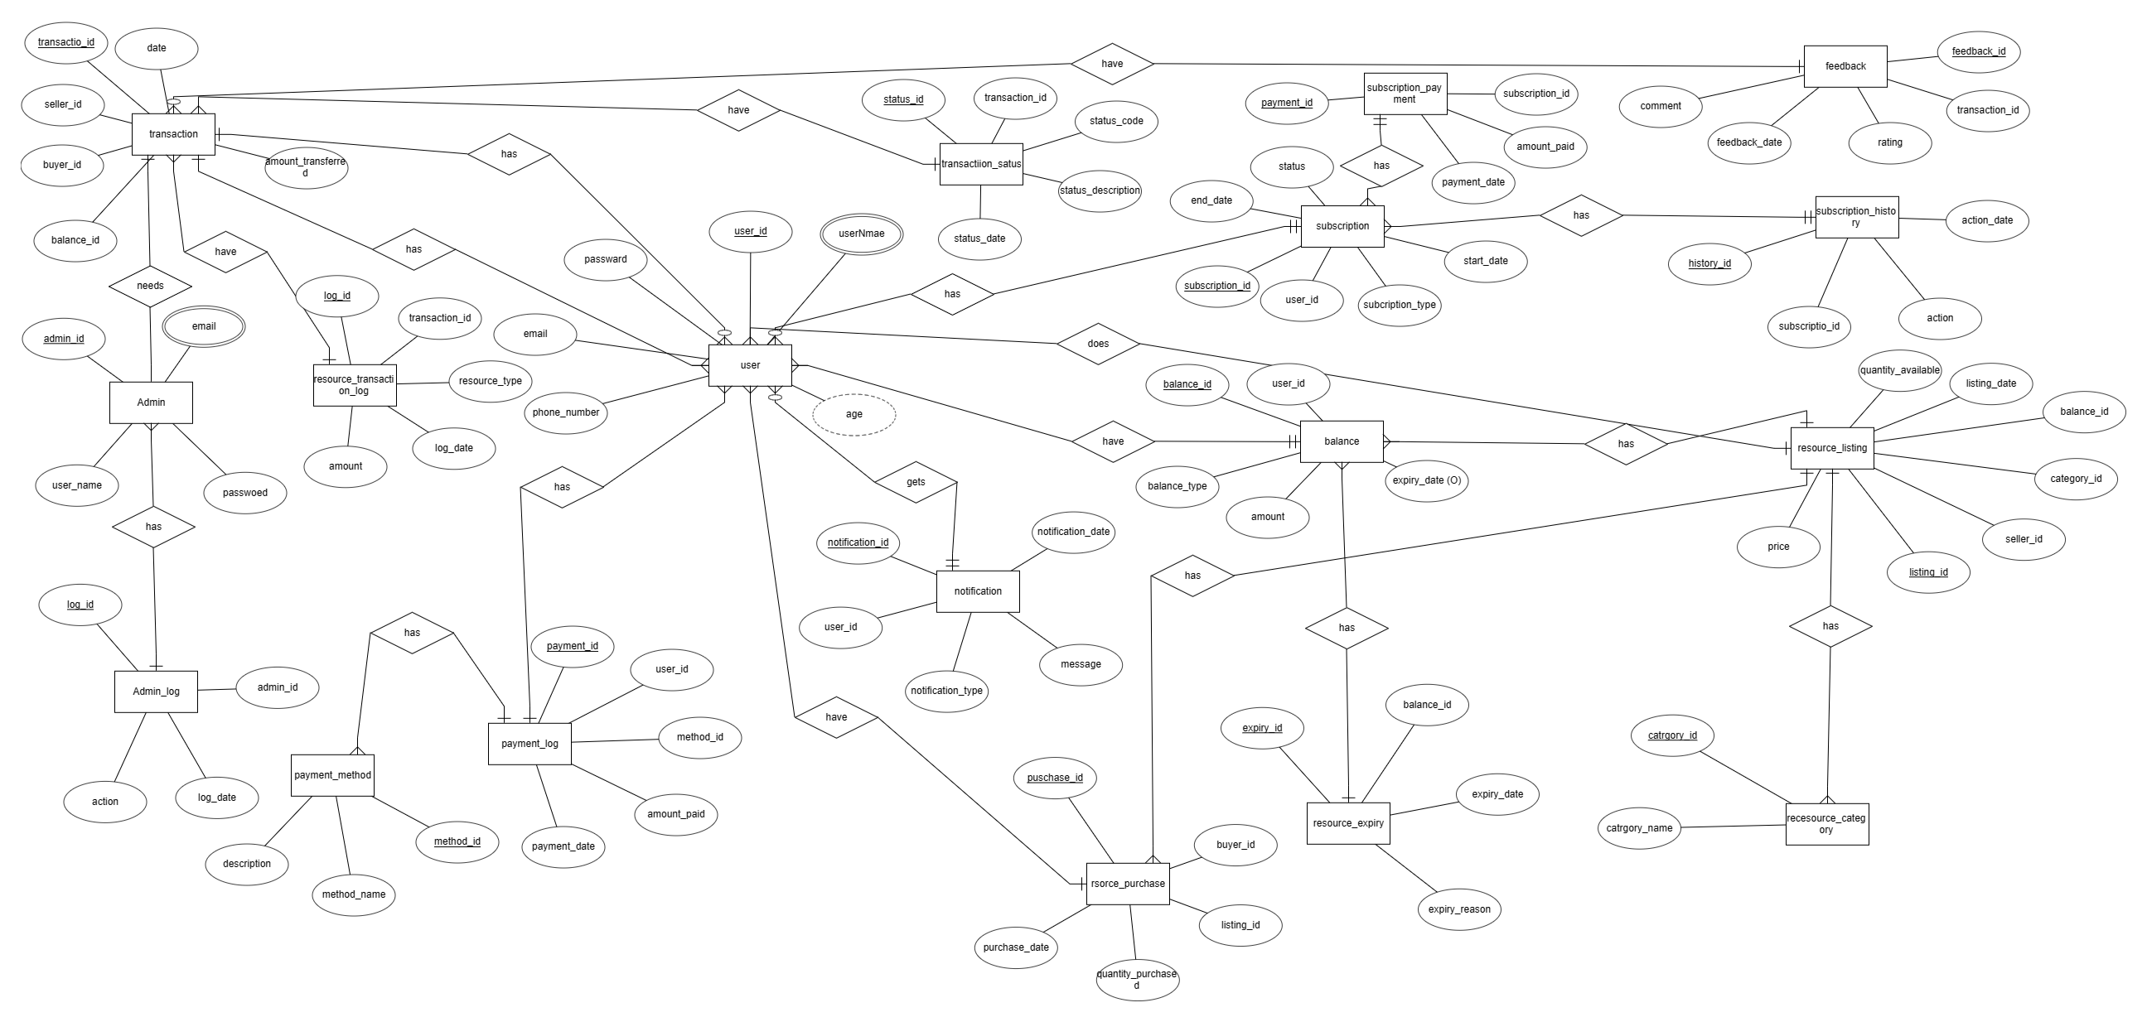

Slide 11
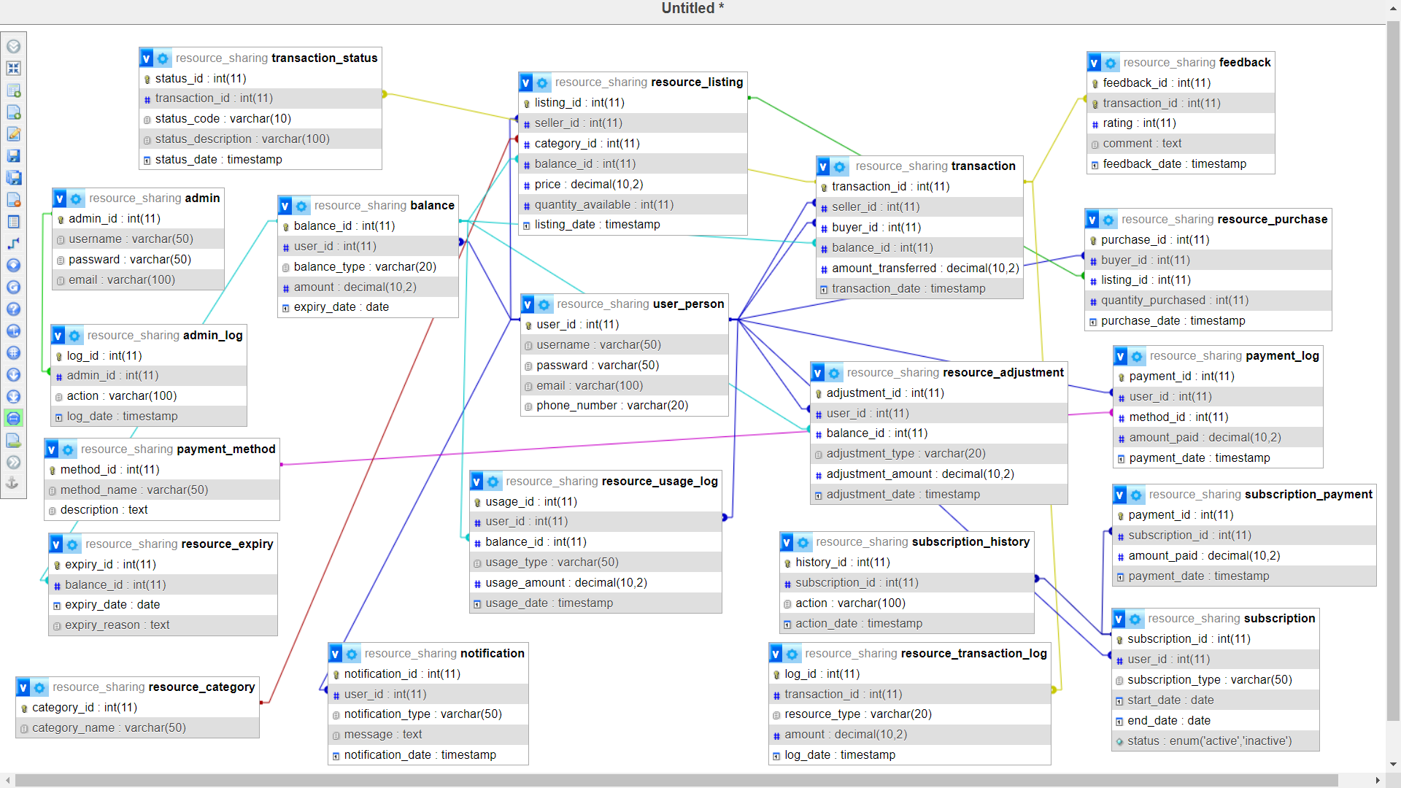

Slide 12
Objectives:
To optimize resource utilization in prepaid recharge systems for internet usage.
To reduce wastage of money, minutes, and MBs.
To provide a platform for users to buy and sell unused resources.

Slide 13
Key Traits
From the perspective of Bangladesh, where prepaid recharge systems are widely used, the proposed solution offers significant benefits in terms of cost savings and improved resource utilization. By allowing users to sell their unused resources, the solution empowers individuals to maximize the value of their prepaid balances.

Slide 14
Conclusion and Future Plan
In conclusion, this project offers a robust solution to optimize resource utilization in prepaid internet services. By providing a platform for resource trading, we address the issue of resource wastage and create value for users. Future plans include expanding the platform to support additional services and enhancing user experience through feedback-driven improvements. Overall, this project has the potential to revolutionize the way prepaid services are managed and utilized in the digital age.

Slide 15
THANK YOU

