Slide 1
Power Electric Switching and Current Ripple
Presented
By
MD ZAKIR HOSSEN (20CSE037)
1

Slide 2
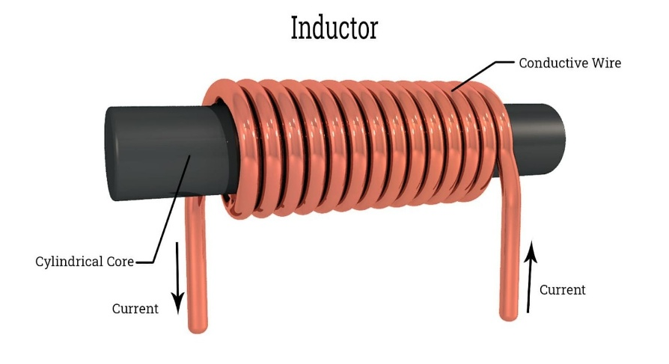
What is Inductor
Two-terminal passive components in electrical or electronic circuits
Consists of a coil that is formed by twisting wire into circles wrapped around a core
Store energy magnetically
Resist rapid changes in current
2

Slide 3
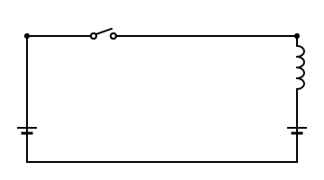
What will happen if you close the switch?
switch
Here,
La = Armature inductance
Eb = Induced emf
When you close the switch in the given circuit:
The voltage source Vg​ is applied across the series combination of the armature inductance La​ and the induced emf Eb.
La
Vg
Eb
2

Slide 4
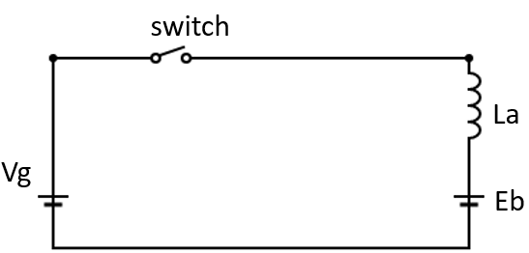
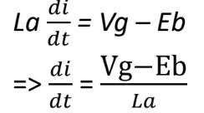
How much current will flow?
L a​ : Armature inductance
𝑑𝑖/𝑑𝑡: Rate of change of current
𝑉𝑔 : Supply voltage
𝐸𝑏: Induced EMF (back emf)
i
The armature inductance 𝐿𝑎 will initially oppose the sudden change in current due to its property of self-inductance.
Therefore, the current will start from zero and gradually increase according to the equation
i
3

Slide 5
What will happen to current I, if you switch it off?
Interrupt the circuit
The current will go to 0.
The moment you switch of the circuit, there will be no route for the current to flow.
But it is not a good idea for the circuit.
Half La will be dissipated and it will result in a spark, if it’s a mechanical switch.But we will use a electrical switch and the switch will burn.
i
The current through an inductor is suddenly interrupted, the inductor tries to maintain the current flow due to the energy stored in its magnetic field. This can lead to a large induced voltage across the switch contacts as the magnetic field collapses rapidly.
4

Slide 6

What is the solution of the problem?
We will add a diode in between the circuit.
Adding a diode in parallel with the inductor, oriented to be reverse-biased during normal operation.
When the switch opens, the inductor's reversed polarity forward-biases the diode, creating a path for the current to circulate.
This prevents the large voltage spike across the switch
This type of diode is often called a flyback diode or freewheeling diode.
5

Slide 7

What is the solution of the problem?
Now It will shorten the circuit.
The current will have a negative slope, which means the current will fall.
Then instead of current of falling to 0.
The graph shows:
A positive slope (current increasing) when switch is closed and 𝑉𝑔 is applied.
A negative slope (current decreasing) after the switch opens and only 𝐸𝑏​ is present.
6

Slide 8
Free wheeling Diode
The semiconductor diode that is used here is called free wheeling diode. Because it allows the inductor current to freely circulate when the main is off.
Switching circuit need free wheeling diode.
9

Slide 9
How will current flow will look like now?
i
After some time, turn the switch on the current will increase and then switch off the current will fall and so on
7

Slide 10
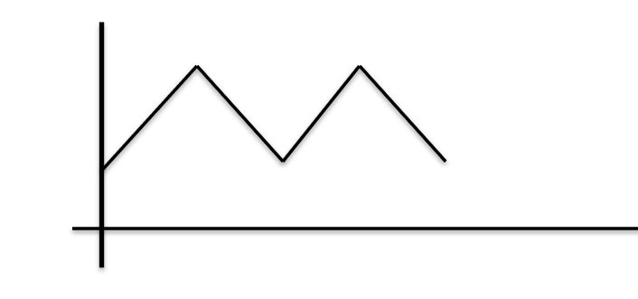
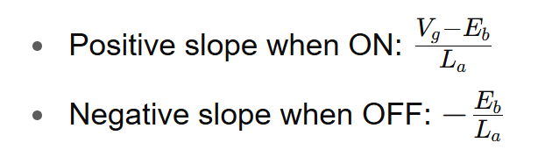
Ripple
Ripple current is a periodic non-sinusoidal waveform derived from AC power source characterized by high amplitude narrow bandwidth pulses.
ib​ : Minimum current
i𝑎 : Maximum current
Δ𝑖=𝑖𝑎−𝑖𝑏 : Peak-to-peak current ripple
𝑡𝑜𝑛​ : Time the switch is ON — current rises.
𝑡𝑜𝑓𝑓: Time the switch is OFF — current falls.
ia
Δi
ib
𝑡𝑜𝑛
𝑡𝑜𝑓𝑓
8

Slide 11
Electronic switches
There are 2 type electronic
switch :
MOSFET
IGBT
10

Slide 12
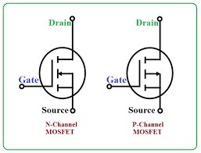
MOSFET
MOSFET = Metal-Oxide-Semiconductor Field-Effect Transistor.
Has three terminals: Gate (G), Drain (D), and Source (S).
Types of MOSFETs:
N-channel: Turns ON when gate voltage is positive
P-channel: Turns ON when gate voltage is negative .
OFF State (Switch Open):Gate voltage is below threshold → No current flows from Drain to Source. High resistance → acts like an open switch.
ON State (Switch Closed):Gate voltage exceeds threshold → Channel forms → Current flows. Low resistance → acts like a closed switch
11

Slide 13
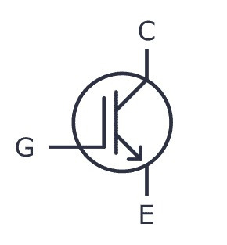
IGBT
IGBT = Insulated Gate Bipolar Transistor
Terminals: Gate (G), Collector (C), Emitter (E).
Gate voltage > threshold → channel forms → device conducts.
Gate voltage = 0V → channel disappears → no current flow.
12

Slide 14
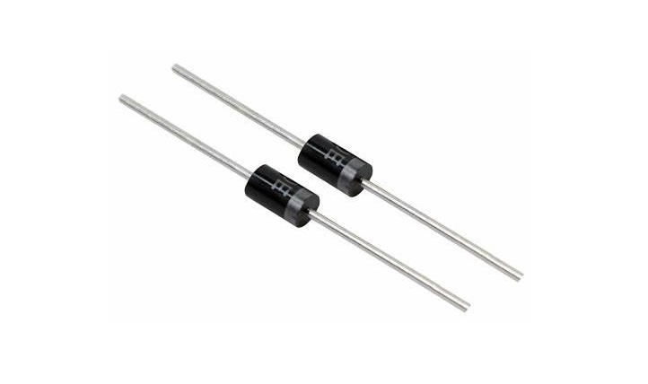
Diode
A diode is a two-terminal semiconductor device.
Allows current to flow in one direction only.
Terminals: Anode (+) and Cathode (−).
Forward-biased → conducts current.
Reverse-biased → blocks current.
13

Slide 15
End
Thank You All
14

