Slide 1

Principles of DC Motor Operation
Course title: Robotics & automation
Course code: cse-4101
md. Asad Mondall
20cse006

Slide 2
Actuators & Operation Requirements
Electric Actuators: Electric actuator or electric motors are responsible for the creation of movement in different parts of a robot.
Electric motor generates two types of motions:
Rotational (common) : Movement around a central axis (e.g., spinning wheels)
Linear (Rare) : Movement in a straight line (e.g., sliding doors).

Slide 3
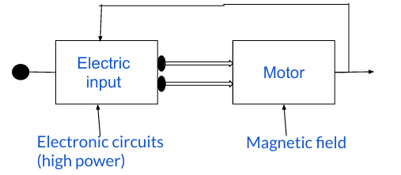
An Overview of Electric Motors Working Procedure
Two types of Electric input can be provided:
AC Input : If a robot doesn’t move, it can use AC power.
DC Input : If it moves, DC power is better since batteries (DC) are portable.
High power Electronic circuits are used to receive Electric Input.
Output flow back
Desirable Mechanical Output

Slide 4
An Overview of Electric Motors Working Procedure (Cont.)
Output flow back
Magnetic field is used inside the motor to convert electrical signal into kinetic motion.
In a feedback controlled system , output information flow back to the input and adjust itself to get Desirable Mechanical Output
Desirable Mechanical Output

Slide 5
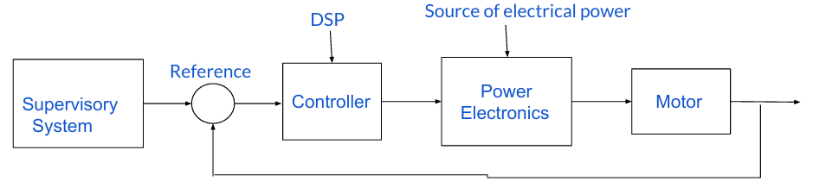
An Overview of Electric Motors in a Supervisory System
Supervisory system that handles big-picture decisions (like avoiding obstacles).
Components:
Sensors – Collect real-time data (e.g., position, obstacle, speed).
Processor (Microcontroller/Computer) – Analyzes sensor data.
Reference Input – Desired goal or behavior (e.g., move forward).
Decision Logic – Compares real-time data with the reference.
Controller Interface – Sends commands to motor/controller.
DSP (Digital Signal Processing) – It works with the coordination of Sensors & Microcontroller.

Slide 6
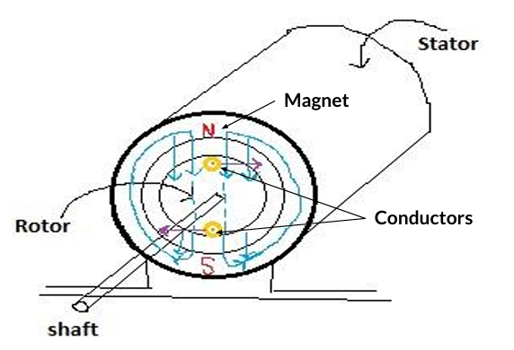
Basic Operational Behavior of Electric Motor
Motor Components
1. Rotor: Rotor is the rotating part of Motor.
2. Stator: Stator is the non-moving, fixed counterpart.
Together, they make the motor run.
Figure: Rotor & Stator
A magnetic field interacts with an electric current in a wire.
This causes a force on the wire, which is the basic working principle of a motor.
When current flows in a wire inside a magnetic field:
Force = Current × Length × Magnetic field strength (F = i × l × B)

Slide 7
Rotation & Torque
Torque is the rotational force that makes the motor shaft turn.
To rotate the motor:
Torque = Force × Radius
Total torque depends on the number of conductors.
Using physics laws:
Torque = k × Current ; where k is Motor Constant
EMF (voltage generated) = k × Speed
Figure: Rotor & Stator

Slide 8
Thank you all! Have a Good Day!
Team Members: Md. Asad Mondall [20CSE006]
Tanvir Ahmed [20CSE004]
Soheb Hossen [20CSE019]

