Slide 1

Overview of Electric Actuators &
Operational Needs
Presented by
20CSE019 – Md Soheb Hossen

Slide 2
Introduction
Actuation is the process of conversion of energy to mechanical form. A
device that accomplishes this conversion is called actuator.
Actuator plays a very important role while implementing control. The controller provides command signal to the actuator for actuation.
The control codes aims at "deriving the actuator when an event has
occurred"

Slide 3
Actuators for Robots
Actuators are used in order to produce mechanical movement in
robots.
Actuators are the muscles of robots. There are many types of actuators available depending on the load involved. The term load is associated with many factors including force, torque, speed of operation, accuracy, precision and power consumption.
Provide autonomous ability
Allows remotely supervision
Able to movement(except some robots like industrial robot)

Slide 4
Characteristics of actuators
Weight
Power-to-weight ratio
Operating pressure
Stiffness
Compliance

Slide 5
Factors to be considered while choosing the drive system for robots
Accuracy
Repeatability
Degree of freedom
Mobility
Coordinate systems
Gravitational and acceleration force
Backlash, friction and thermal effects
Weight
Power-to-weight ratio
Operating pressure

Slide 6
Types of Actuators
Electrical: stepper motors, DC servo motors
Pneumatic: air pressure
Hydraulic fluid pressure (oil pressure).
Advanced actuators: ultrasonic motors, molecular motors.
artificial
muscles,

Slide 7
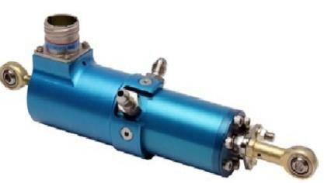
Hydraulic Actuators
A device that is used to change the fluid’s pressure energy into mechanical is
known as a hydraulic actuator.
Advantages:
Offer best among all varieties
Smallest for its output load capability
Disadvantages:
Difficult to maintain
May cause leakages of oil

Slide 8
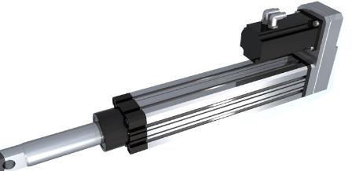
Electric Actuators
An electric actuator is a mechanical device used to convert electricity into
kinetic energy
in either a single linear or rotary motion.
Have AC/ DC motors
Advantages:
- Easy to maintain & operate

Slide 9
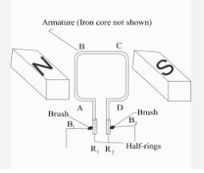
Motors
An electric motor is an electrical machine that converts electrical energy into mechanical energy.
Types of motors:
DC motor
AC motor
-

Slide 10
Types of electric motor
Types of motors:
DC motor
AC motor
  Induction motor
  Synchronous motor
-Brushless DC motor
-Permanent Magnet Synchronous motor

Slide 11
Variable reluctant machine
Stepper motor
Switch reluctance motor
Synchronous reluctance motor

Slide 12
Some terminology
Operational need, simply defined as torque capability.
Any sort of movement requires due to generating a force which in
again a rotating system is the mechanical torque.

Slide 13
Thank you All

