Slide 1
Lecture -13
Inverse Kinematics-Example
Presented By
Saraban Tahura (20CSE029)

Slide 2
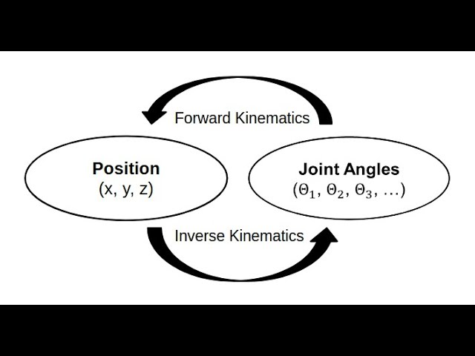
Inverse Kinematics
Definition: Inverse Kinematics is the process of calculating the joint variables (angles or displacements) of a robotic arm given a desired position and orientation of its end-effector (the tool or hand of the robot).
Used for: Motion planning, path following.
Often more complex than forward kinematics due to multiple solutions.

Slide 3
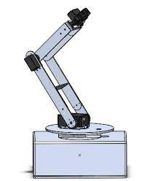
Purpose:
Imagine a robot arm (like a human arm):
It has joints (like shoulder, elbow, wrist).
And links (like upper arm, forearm).
Problem:
We want the robot’s hand (end effector) to reach a specific position and angle in space.
Goal of IK:
Figure out what angle each joint must rotate to get the end-effector to that position.

Slide 4
Solving Approach For Inverse Kinematics
Determine Home Position
Assign Axis / Coordinate Frame
Find out DH Parameter
Find out Forward relation of the Arm Matrix
Write down the Equation
Solve it

Slide 5
Example: Rhino XR-3 , 5 axis articulated arm
Step 1: Determine Home Position:
The default or zero position of the robot.
All joint angles are set to θ = 0
It’s used as a reference for other movements.
Step 2: Assign Coordinate Axes / Frames
For each joint and link, assign a local coordinate frame following the DH convention.
Use the Right-Hand Rule:
Z-axis is the axis of rotation for revolute joints.
X-axis points along the link length.

Slide 6
Step 3: Find DH Parameters
Axis | θ | d | a | α
1
2
3
4
5
θ (theta) = joint angle
d = offset along previous z to the common normal
a = length of the common normal
α (alpha) = angle between z-axes

Slide 7
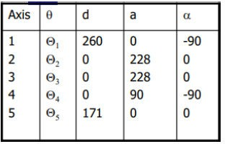
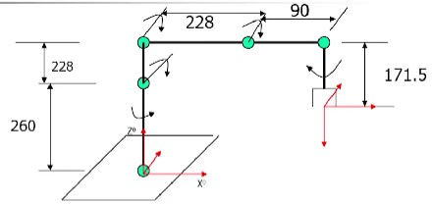

Slide 8
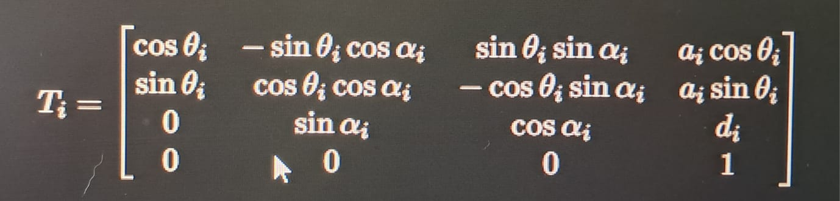
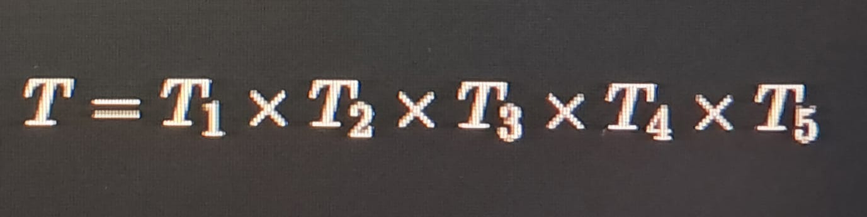
Step 4: Find Forward Kinematics
For each joint, create a transformation matrix T_{i} using DH parameters:
Multiply the matrices from base to end- effector:
This gives the full forward equation.

Slide 9
Step 5: Write the Inverse Kinematics Equation
Now a desired end-effector pose is given:
Position → (p_{x}, p_{y}, p_{z})
Orientation → (Rotation matrix R)
Write:
T_{desired}​=T_{1​}(θ₁)×T₂​(θ₂)×T_{3​}(θ₃)×T₄​(θ₄)×T₅​(θ₅)
Now compare:
Each element of this calculated matrix (on the right)
With the given desired transformation matrix
This gives a system of non-linear equations.

Slide 10
Step 6: Solve the Joint Angles
This step involves:
Using trigonometric identities (sin, cos, atan2)
Often you start by solving θ1 using position equations (e.g., p_{x} and p_{y})
Then solve for θ2 and θ3 using the rest of the position equations
Finally solve for θ4 and θ5 using orientation (rotation matrix)

Slide 11
Robotic Work Cell
Definition: A robotic work cell is a complete setup where a robot performs specific tasks in an organized working environment.
Main Components:
Robot:
The core part — usually a robotic arm like Rhino XR-3.
Performs actions like moving, picking, placing, welding, etc.
Sensors:
Detect the presence, position, or quality of objects.
Example: Proximity sensors to check if an object is present.
Camera (Vision System):
Helps the robot "see."
Captures images to determine an object’s position and orientation.
Used in vision-guided robotics.

Slide 12
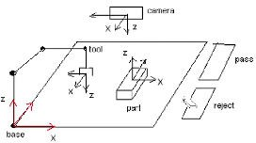
Conveyor or Transfer Mechanism:
Brings items to the robot and takes them away.
Automates the flow of work (input → robot → output).
Controller:
The robot's brain — processes sensor input and sends commands to the robot.
Pass/Reject System:
If the robot detects a good object, it puts it in the pass area.
If the object is defective, it places it in the reject bin.

Slide 13
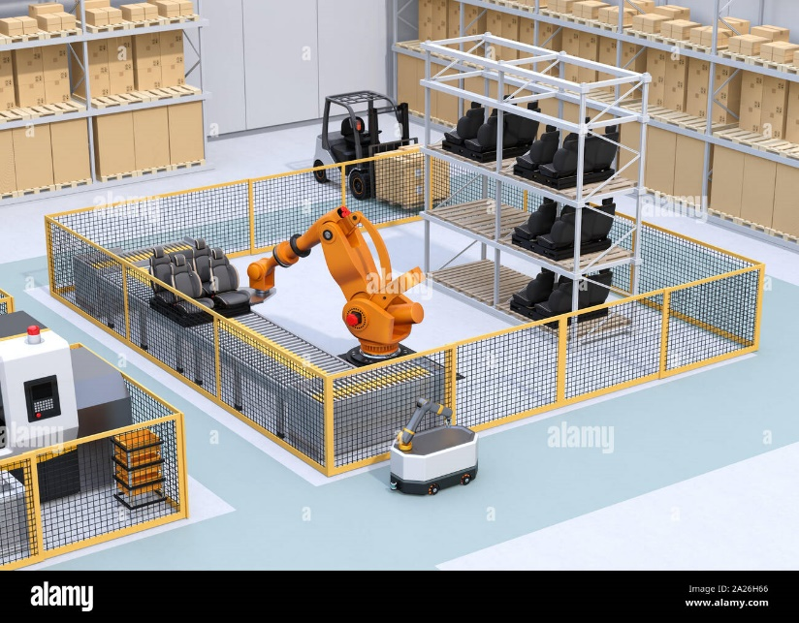
How It Works – Step-by-Step Example
Let’s say the robot needs to sort fruits:
Sensor detects a fruit has arrived on the conveyor.
Camera takes an image and sends it to the robot controller.
Robot calculates the exact position of the fruit using inverse kinematics.
Robot arm moves to pick up the fruit.
Based on size/color/shape, it decides:
Place in "Pass" box if it’s good.
Place in "Reject" box if it’s bad.

Slide 14
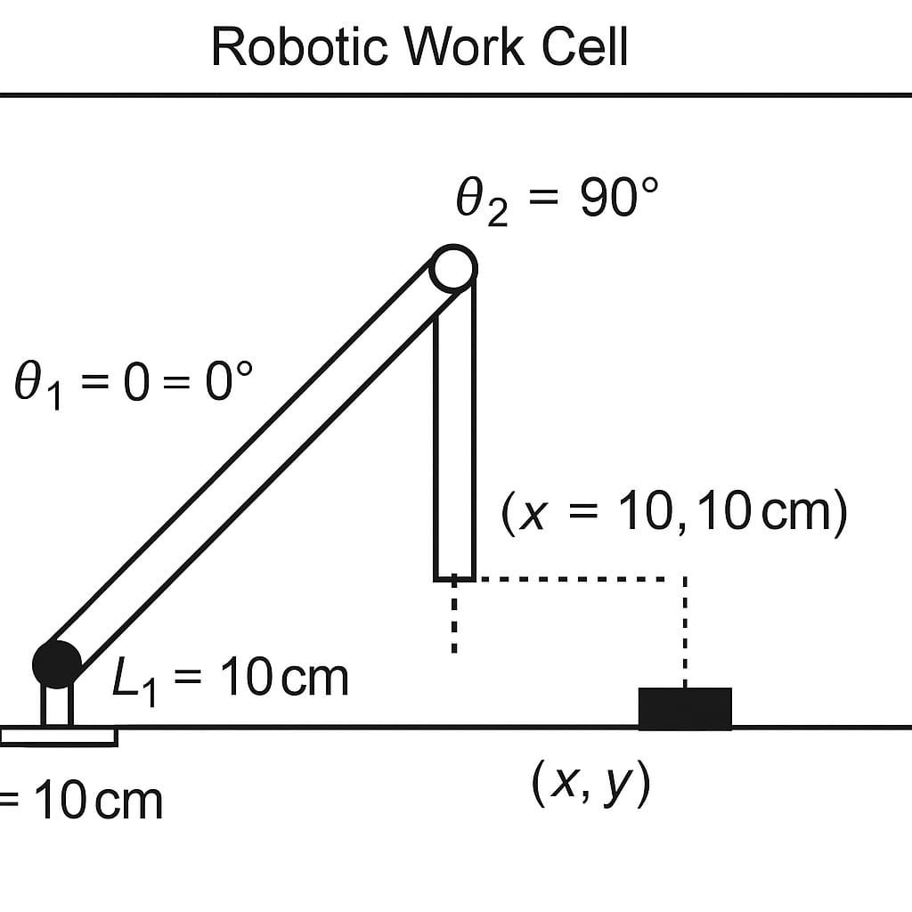
Scenario:
In a robotic work cell, a 2-joint robot arm is used to pick up an object at position (x, y) on a flat table and place it in a pass/reject bin.
Robot Arm Structure:
2 revolute joints
Link 1 length = L₁ = 10 cm
Link 2 length = L₂ = 10 cm
Object is located at position (x, y) = (10 cm, 10 cm)
We want to calculate the joint angles θ₁ and θ₂ so the robot’s hand (end effector) can reach the object.

Slide 15
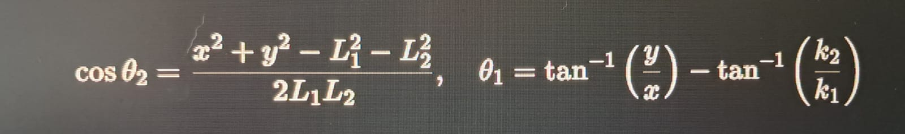
Formula:
We find θ₁ = 0° and θ₂ = 90°. The robot then moves to pick the object using these angles.

Slide 16
Why Robotic Work Cells Are Important
Increases efficiency and speed
Ensures precision and accuracy
Works in hazardous environments (e.g., welding, chemical handling)
Can run 24/7 with minimal human interaction
Relation to Kinematics:
A robotic work cell relies on:
Forward kinematics to know where the robot's hand is.
Inverse kinematics to calculate how to move to a new position.
Transformation matrices to understand and navigate 3D space.

Slide 17
Thank You

