Slide 1
Example of Forward Kinematics
Presented By: Sarna Das(20CSE001)

Slide 2
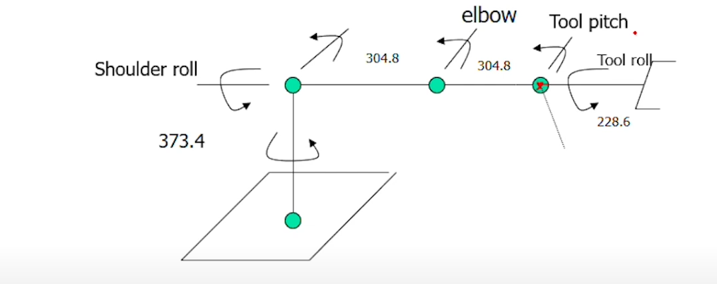
Forward Kinematics of Six-axis Articulated Robot
Find the position and orientation of the tool at the soft home position shown below for six axis articulated arm, Intelledex 660T

Slide 3
Steps
Assign coordinate frame
Get DH parameters
Arm matrix

Slide 4
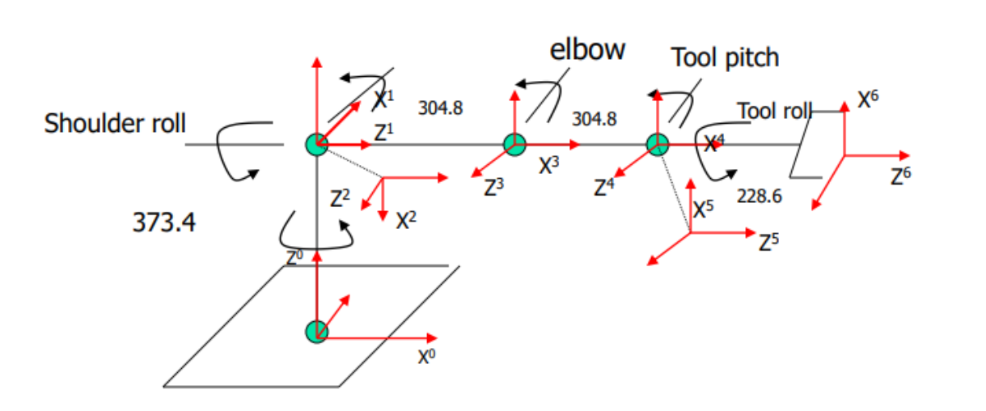
Assign coordinate frame

Slide 5
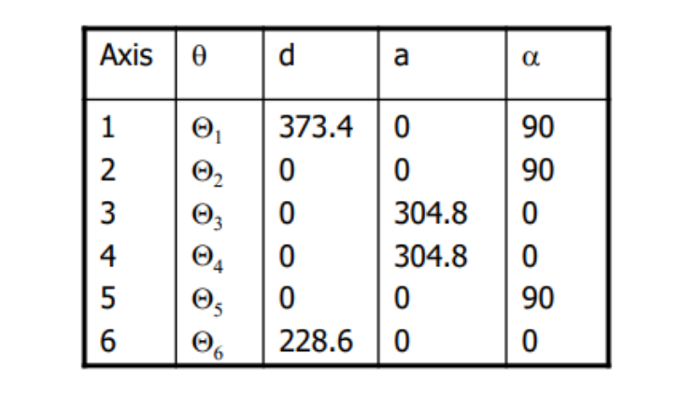
Get DH parameters

Slide 6
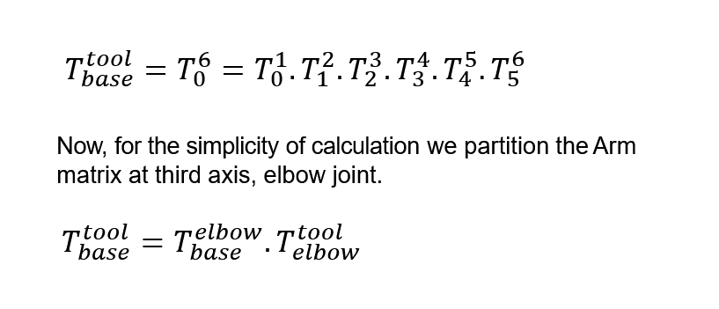
Transformation Matrix

Slide 7
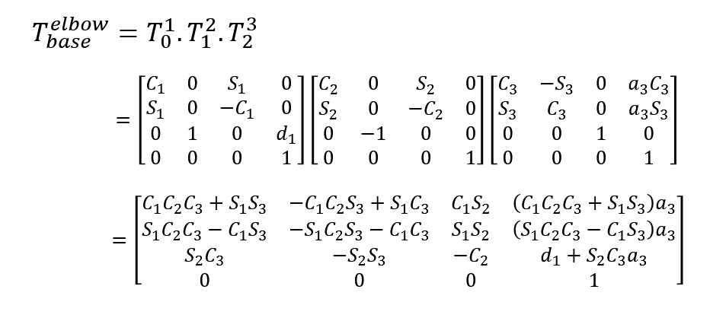
Transformation Matrix

Slide 8
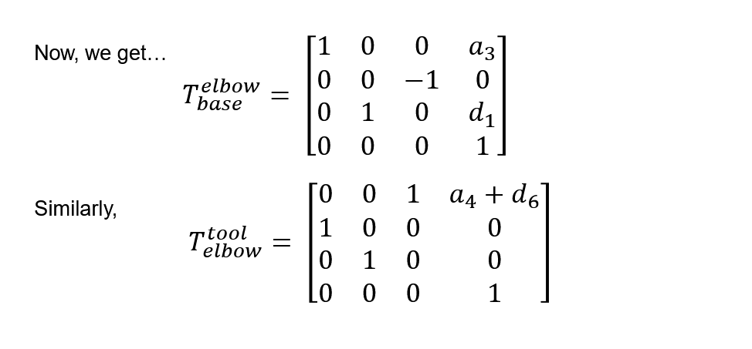
Transformation Matrix

Slide 9
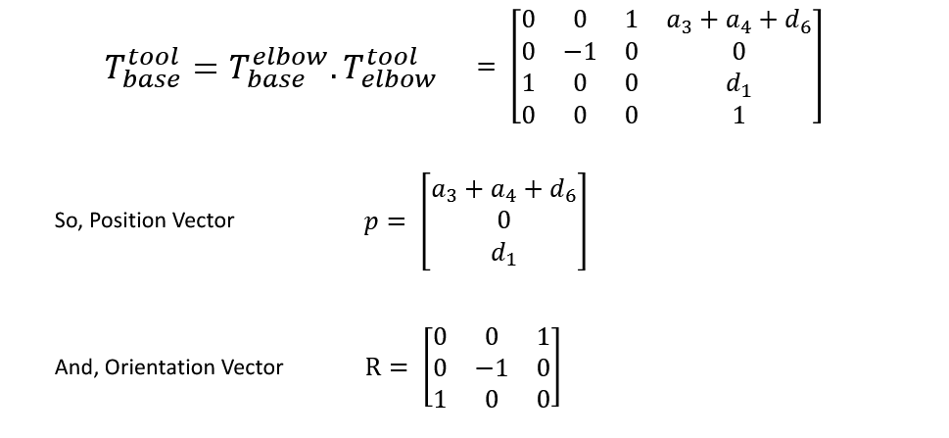
Transformation Matrix

Slide 10
Thank You

