Slide 1
Robot Architectures
Presented By
Deepanwita Roy(20CSE024)

Slide 2
Robot Architecture is the combination and disposition of the different kind of joints
that configure the robot kinematical chain.
Five common body-and-arm configurations:
Polar coordinate body-and-arm assembly.
Cylindrical body-and-arm assembly.
3. coordinate body-and-arm assembly.
Cartesian
4. body-and-arm assembly.
Joined-arm
5. Selective Compliance Assembly Robot Arm (SCARA).

Slide 3
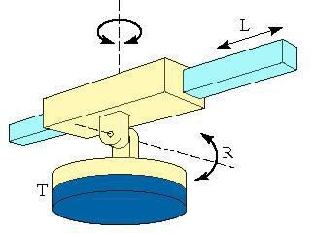
Polar coordinate body-and-arm assembly
Notation RRP
Consist of sliding arm (P joint) actuated related
to the body, which can about
a
(R
rotate
both
vertical axis (R joint) and
horizontal axis
joint)

Slide 4
Work Envelope
The gross work envelope of a robot is defined as the locus of points in three
dimensional space that can be reached by the wrist.
Positioning axes (Major axes)
N. B. Work space is basically subset of work envelope.

Slide 5
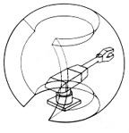
Polar Work Space

Slide 6
Polar robot characteristics
Advantages:
Joints:
●
It can bend to reach objects on the floor
Motor 1 and 2 close to the base
Rotation θ
Rotation φ
Linear ρ
Large reach
from a central support
Drawbacks:
Complex kinematics model
Difficult to visualize

Slide 7
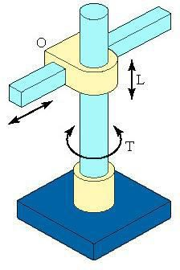
Cylindrical body-and-arm assembly
Notation RPP
Consists of a vertical column, relative to
which an assembly is
arm
moved up or
down.
The arm can be moved in or out relative to
the column.

Slide 8
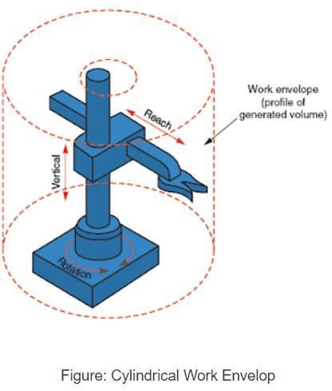
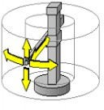
Cylindrical Work Space

Slide 9
Cylindrical Robot Characteristics
Advantages:
●
●
●
Simple kinematical model
Easy to display
Joints:
Good accessibility to
cavities an d open
Rotation θ
Linear Z
Linear ρ
machines
Large forces when using hydraulic actuators
Drawbacks:
Restricted working volume
Requires guides protection (linear)

Slide 10
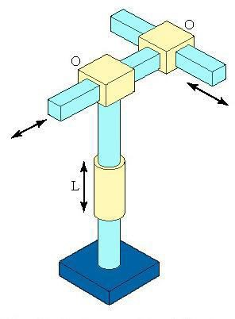
Cartesian coordinate body-and-arm assembly
Notation
Consists of three sliding joints
Other names include rectilinear robot and
PPP
X-Y-Z
robot

Slide 11
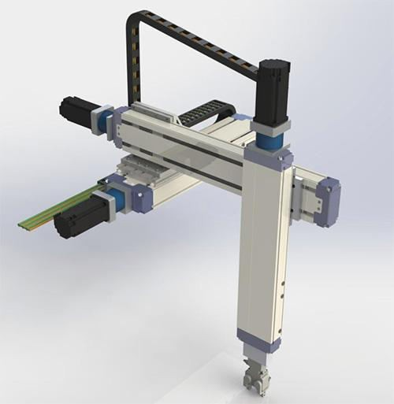
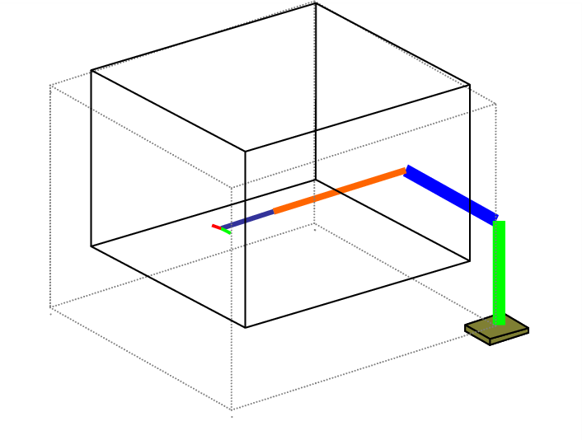
Cartesian Work Space

Slide 12
Cartesian Robot Characteristics
Advantages:
Joints:
●
●
●
●
Possibility of using cheap pneumatic actuators in pick and place operations
Linear X
Linear Y
Linear Z
Linear movement in three dimensions
Si | mple kinemati |  | cal model
Rigid structure
Easy to display
Drawbacks:
Requires a large robot volume which is greater than working
volume
Guides protection

Slide 13
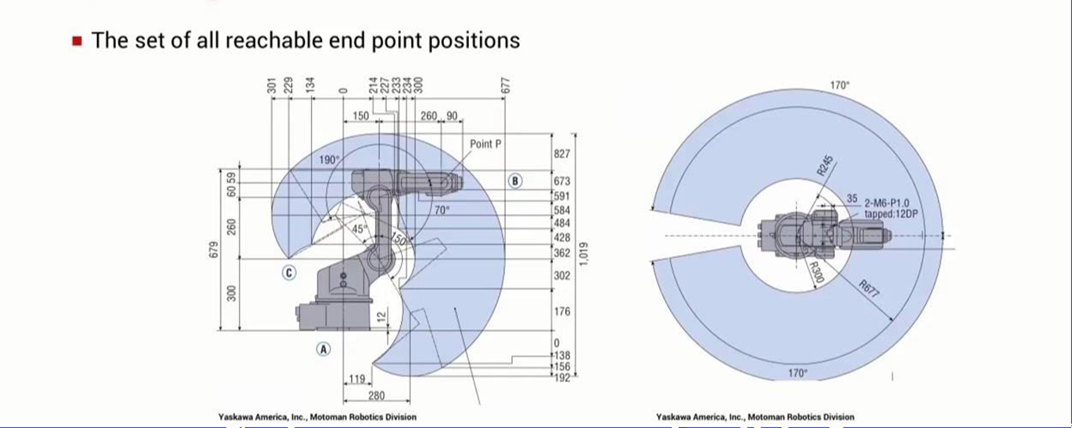
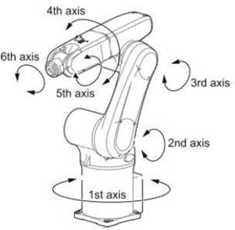
Joint-Arm body-and-arm assembly
Notation is RRR
3D rotation
General configuration of human arm
Basic angular work space

Slide 14
Observation
Joint Angles
Drawbacks
First rotation θ1
Second rotation θ2
Third rotation θ3
complex kinematical model
linear movements are difficult
no rigid structure when stretched
Advantages:
maximum flexibility
large working volume |  | with respect to the robot s (angular)
joints easy to protect
can reach the upper and lower side of an object

Slide 15
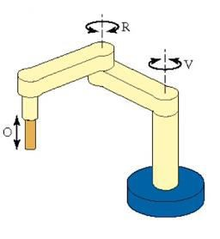
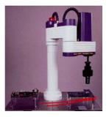
SCARA Robot
Notation RRP
SCARA stands for Selective Compliance Assembly Robot Arm
Similar to jointed-arm robot except that vertical axes are used
for shoulder and elbow joints to be compliant in horizontal
direction for vertical insertion tasks

Slide 16
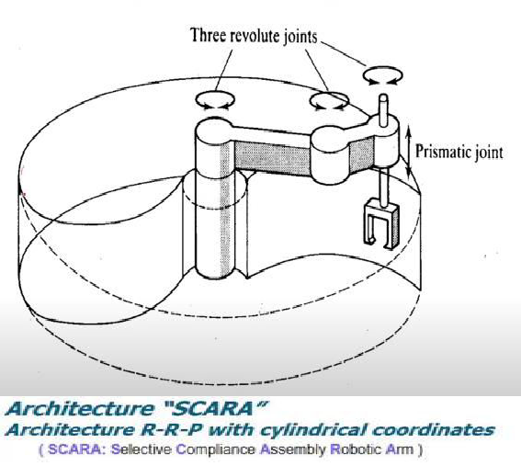
SCARA Robot
.

Slide 17
SCARA Robot Characteristics
.
Robot | Joints | Observations
SCARA | rotation θ1 rotation θ2 rotation θ3 | Advantages: -high speed and precision Drawbacks: -only vertical axes

Slide 18
Thanks
.

