Slide 1
Simulation and Modeling
CSE-3209

Slide 2
INTRODUCTION
Today we will explore different distribution functions. We will then use statistical models for problem-solving and conclude by discussing the key characteristics and performance measures of a queueing system.

Slide 3
Table of Contents
01
Lecture-9
02
Lecture-10
03
Lecture-11
04
Lecture-12
Continuous Distribution Functions
and Empirical Distribution Functions
Problem Solving on Statistical Models in Simulation
Characteristics of a Queueing System
Performance Measures of Queueing System

Slide 4
01
Lecture-9
Distribution Functions

Slide 5
Weibull distribution Function​

Slide 6
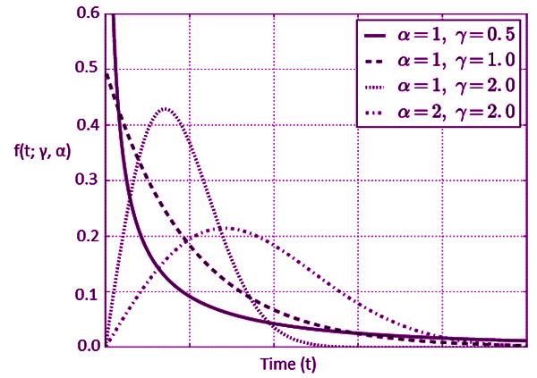
What is the Weibull Distribution?
The Weibull distribution is a probability distribution used to model the time until an event happens like the lifespan of a machine part, a bulb burning out, or the time to failure in reliability engineering.
It’s very flexible because it can model different types of failure rates:
Constant rate → like an exponential distribution.
Decreasing rate → items fail less often as time goes on.
Increasing rate → items wear out over time and fail more often later.
So, it’s often used in survival analysis, reliability engineering, and risk assessment.

Slide 7
Parameters
The Weibull distribution has two main parameters:
Shape parameter (k or β)
  Controls the shape of the distribution.
  If:
    β=1 → exponential distribution (constant failure rate).
    β<1 → failure rate decreases over time (infant mortality).
    β>1 → failure rate increases over time (wear-out failures).
Scale parameter (λ or η)
  Stretches or compresses the distribution along the x-axis.
  Think of it as the "characteristic life" (around the point where 63.2% of items have failed).

Slide 8

Weibull Distribution Formulas​
Probability Density Function (PDF)​
Here,
x: The time (or lifetime) at which we measure failure.​
β(shape): Decides if failures happen early, randomly, or late.​
η (scale): Sets the time scale — bigger means longer life.​

Slide 9

Weibull Distribution Formulas​
Cumulative Distribution Formula​
Here,
x: The time (or lifetime) at which we measure failure.​
β(shape): Decides if failures happen early, randomly, or late.​
η (scale): Sets the time scale — bigger means longer life.​
​

Slide 10
Example Problem-1
Problem-1 : A machine’s lifetime follows a Weibull distribution with:​
Shape parameter β = 2 (failures increase with time → old/used-item failures).
Scale parameter λ = 1000 hours​
Question: Find the probability density at x = 800 hours.​
​
​

Slide 11
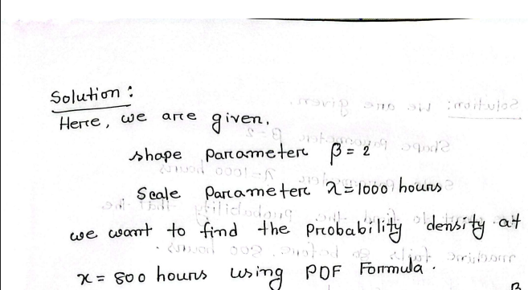
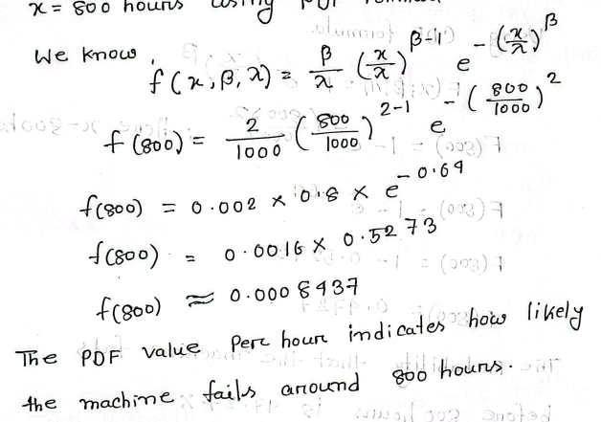
Solution

Slide 12
Example problem-2
Problem-2:
A machine’s lifetime follows a Weibull distribution with:​
Shape parameter β = 2 (failures increase with time → old/used-item failures)​
Scale parameter λ = 1000 hours​
Question: What is the probability that the machine fails before 800 hours?​
​

Slide 13
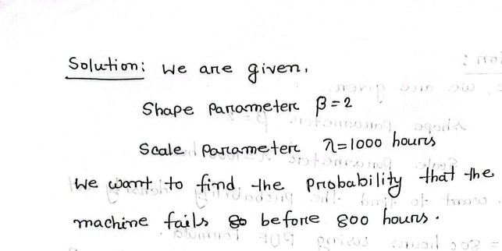
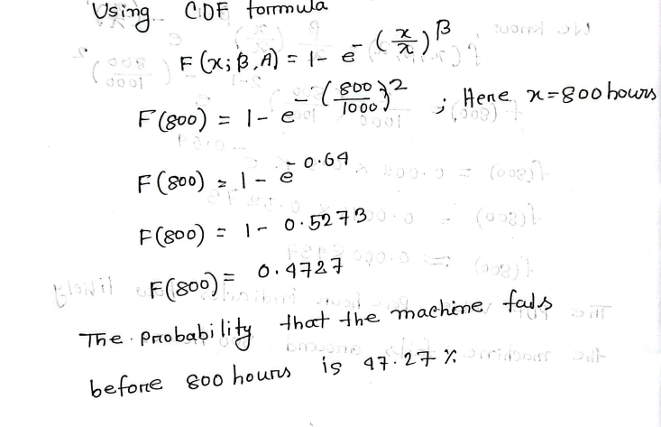
Solution

Slide 14
Application
Reliability Engineering​: Modeling time to failure of machines, components, or electronic devices.​
Survival Analysis (Medical Studies)​: Estimating survival times of patients or lifetimes of biological organisms.​
Weather and Environmental Studies​: Modeling wind speeds, flood events, or hurricanes.​
Risk Assessment / Safety Engineering​: Estimating likelihood of equipment or system failures over time.​
Quality Control / Manufacturing​: Evaluating failure rates of products during production.​​

Slide 15
Cumulative Distribution Function​
​

Slide 16
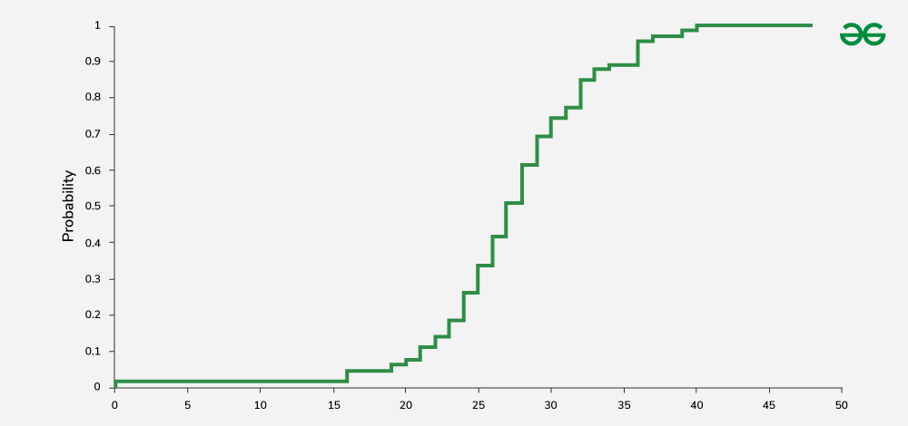
What is a CDF?
The Cumulative Distribution Function (CDF) of a random variable tells us the probability that the variable takes a value less than or equal to x.
In simple words: it adds up (cumulates) probabilities up to a point.
For any random variable X:
F(x) = P(X ≤ x)
Where,
F(x) is always between 0 and 1.
F(x) is non-decreasing (never goes down).
lim⁡ x_{→−∞} F(x) = 0
lim⁡ x_{→+∞} F(x) = 1

Slide 17

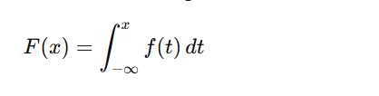
Formula of Cumulative Distribution
For a discrete random variable (like rolling a die):
For a continuous random variable,

Slide 18
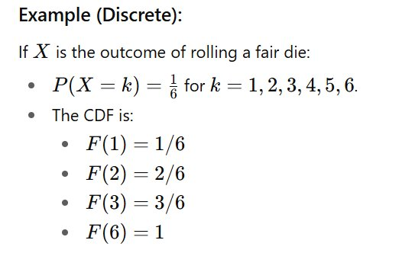
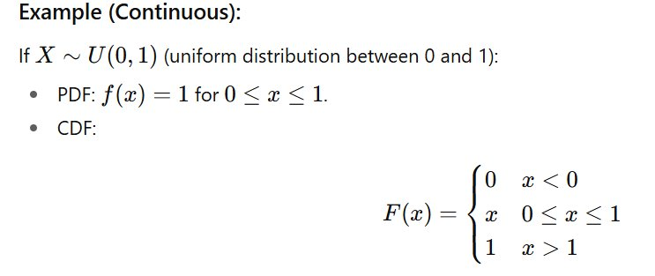
Example Problem

Slide 19
Applications
Probability Calculation – Used to find the probability that a random variable lies within a range:​
Statistical Inference – Helps in hypothesis testing, goodness-of-fit tests
Reliability Engineering – CDF gives the probability that a system fails before a certain time.​
Simulation & Random Sampling – Used in inverse transform sampling to generate random variables from distributions.​

Slide 20
02
Lecture-10
Distribution Formulas

Slide 21
Log normal Distribution Function​

Slide 22

What is Log normal distribution
A log-normal distribution is a probability distribution of a random variable whose logarithm is normally distributed.
In other words:
If a random variable Y is normally distributed,
Then X= e^{Y} follows a log-normal distribution.
A random variable X is said to follow a log-normal distribution if:

Slide 23
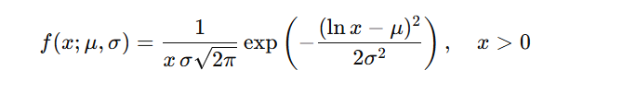

Formulas of Log Normal Distribution
Probability Density Function (PDF)
where:
μ = mean of the logarithm of X
σ² = variance of the logarithm of X
Cumulative Distribution Function (CDF)

Slide 24
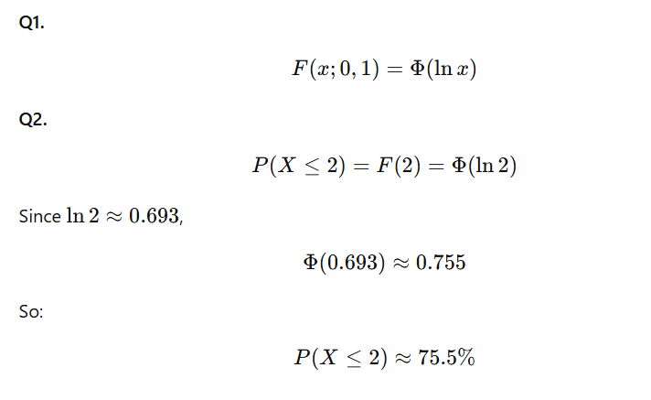
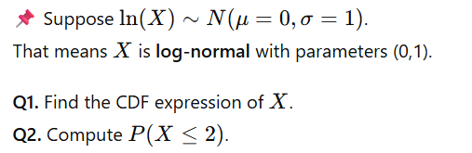
Example Problem

Slide 25
Applications
Finance – Stock prices follow a log-normal model (since prices can’t be negative and often grow multiplicatively).
Biology – Growth rates, survival times, size of organisms.
Engineering – Reliability analysis, material fatigue life.
Environmental science – Rainfall amounts, river discharges.

Slide 26
Poisson Distribution Function​

Slide 27
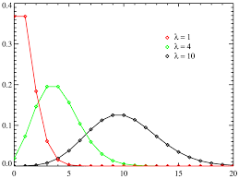
What is a Poisson Distribution?
The Poisson distribution models the number of times an event occurs in a fixed interval of time or space.
Events occur independently.​
The average rate (λ) of occurrence is constant.​
Two events cannot occur exactly at the same instant.​
Examples:
Number of emails received per hour.
Number of cars passing a checkpoint per minute.
Number of mutations in a DNA sequence per unit length.

Slide 28

Poisson Distribution Formula​
Poisson Probability Mass Function (PMF) ​​
Where:​
k= number of events​
λ>0= expected number of events in the interval​
e= base of natural logarithm (~2.718)​
P(R=r) gives the probability of exactly r events occurring in the interval

Slide 29
Example problem-1
Problem Statement:​
A call center receives an average of 3 calls per hour. Find the probability that it receives exactly 5 calls in an hour.​

Slide 30
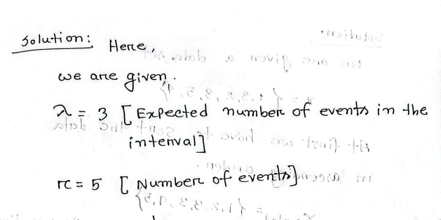
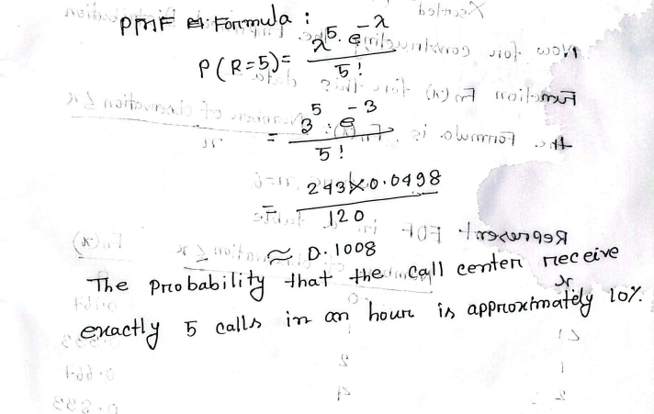
Solution

Slide 31
Applications
Call Centers / Service Systems​: Modeling the number of calls received in a call center per hour.​
Traffic Flow / Transportation​: Counting the number of cars passing through a toll booth in a fixed time interval.​
Natural Events / Rare Events​: Modeling rare occurrences like earthquakes, floods, or accidents.​
Telecommunications / Networks​: Modeling packet arrivals in network systems or errors in data transmission.​
Health / Biology​: Modeling disease occurrences, e.g., number of patients arriving at a hospital per day.​

Slide 32
03
Lecture-10
Distribution Formulas

Slide 33
Exponential Distribution Function​

Slide 34
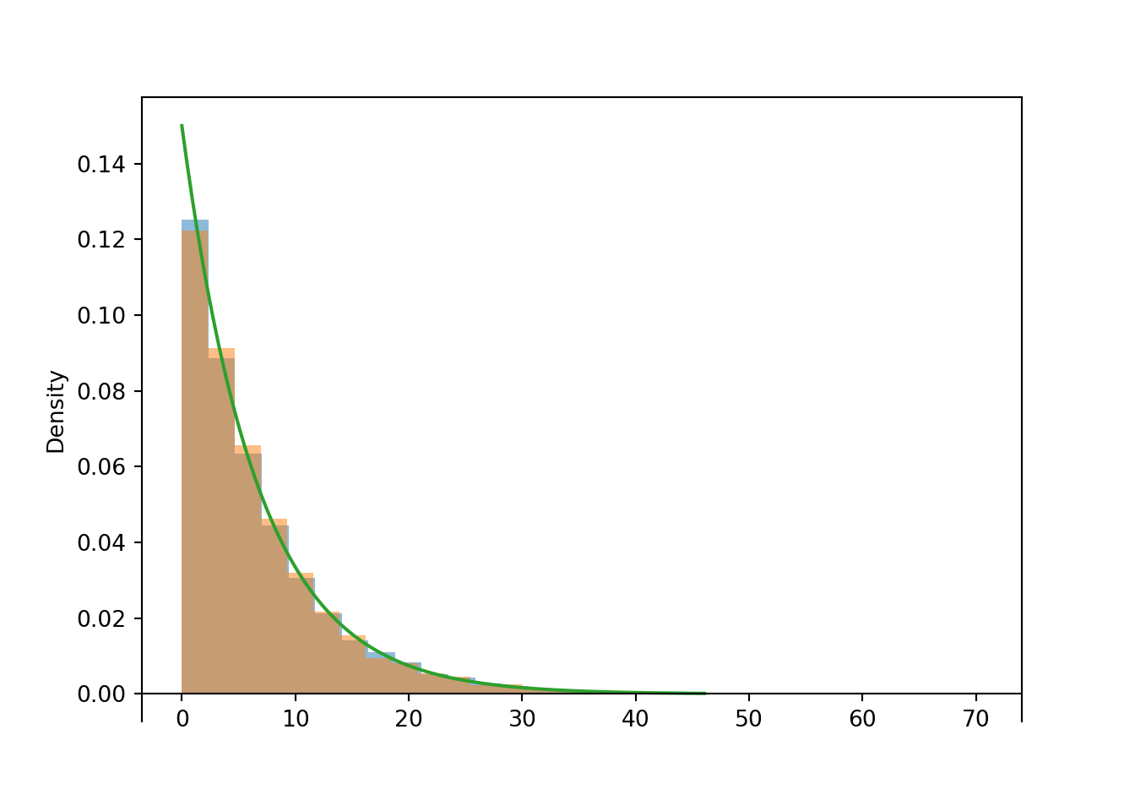
What is the Exponential Distribution?
The exponential distribution models the time between events in a Poisson process (events that occur randomly at a constant average rate).
In simple terms, it describes how long you have to wait before something happens, like a bus arriving or a customer calling a help center.
Examples:
Time between arrivals of buses at a station.
Time until a machine fails.
Time between phone calls at a call center.

Slide 35
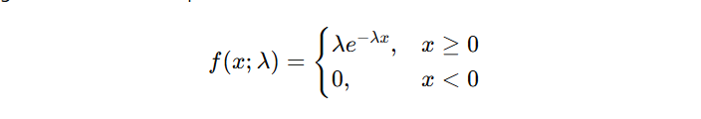

Exponential Function Formulas​
Probability Density Function (PDF)​
Where:​
x = the random variable (time until the event occurs)​
λ>0= rate parameter (average number of events per unit time)​
e = base of natural logarithm (~2.718)​
​​Cumulative Distribution Function (CDF)​​

Slide 36
Example Problem-1
Problem Statement:​
A light bulb has an average lifetime of 10 hours. Assume the lifetime follows an exponential distribution.​
A . What is the probability density that the bulb fails at exactly 5 hours?​
B . What is the probability that the bulb fails within 5 hours?​

Slide 37
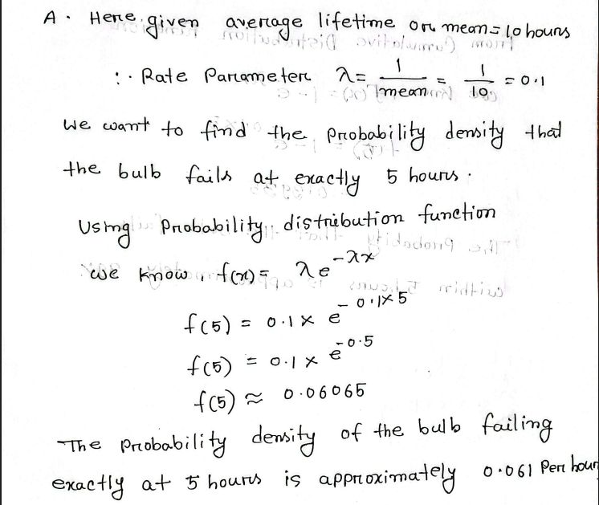
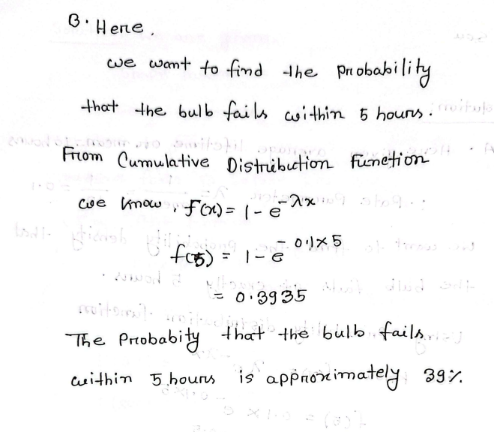
Solution

Slide 38
Applications
Reliability Analysis: Models the time until failure of electronic components or systems.​
Queueing Theory: Represents waiting times between arrivals in queues (e.g., customers, calls).​
Survival Analysis: Estimates the time until occurrence of an event like death or disease relapse.​
Telecommunications: Models the time between packet arrivals in a network.​
Inventory Management: Predicts time until stock depletion or demand for an item.​

Slide 39
Empirical Distribution Function​

Slide 40
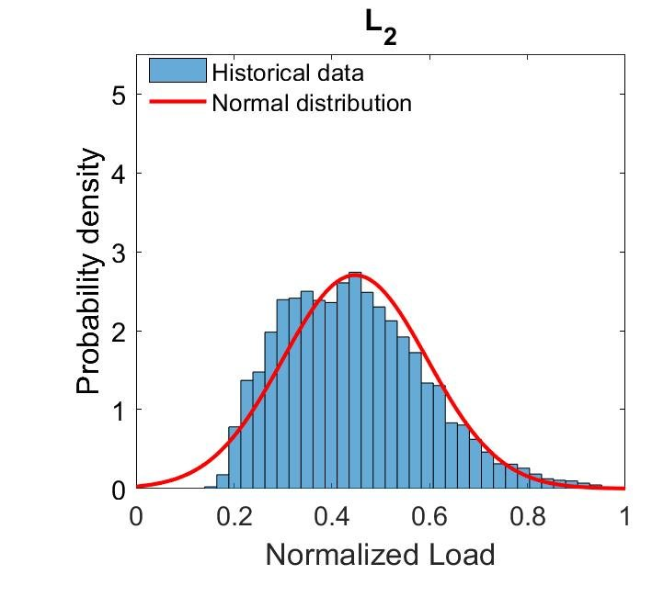
What is an Empirical Distribution?
The Empirical Distribution Function (EDF) (also called ECDF) is a way to estimate a probability distribution directly from data
It provides an estimate of the proportion of data points in the sample that are less than or equal to a particular value.

Slide 41
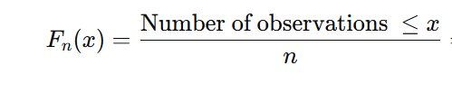
Formula of Empirical Function ​
Suppose we have a sample of size n:​ X_{1,} X_{2,} X₃, … X_{n}​
The Empirical Distribution Function F_{n} (x)is defined as:​
​

Slide 42
Example Problem-1
Problem Statement:​
Suppose we have the following sample of observed data representing the number of books read by 6 students in a month:​
X={1,3,2,3,5,4}​
We want to construct the Empirical Distribution Function F_{n}(x)for this data.​
​

Slide 43
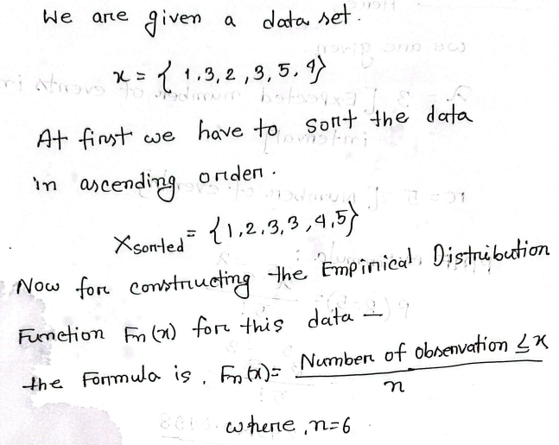
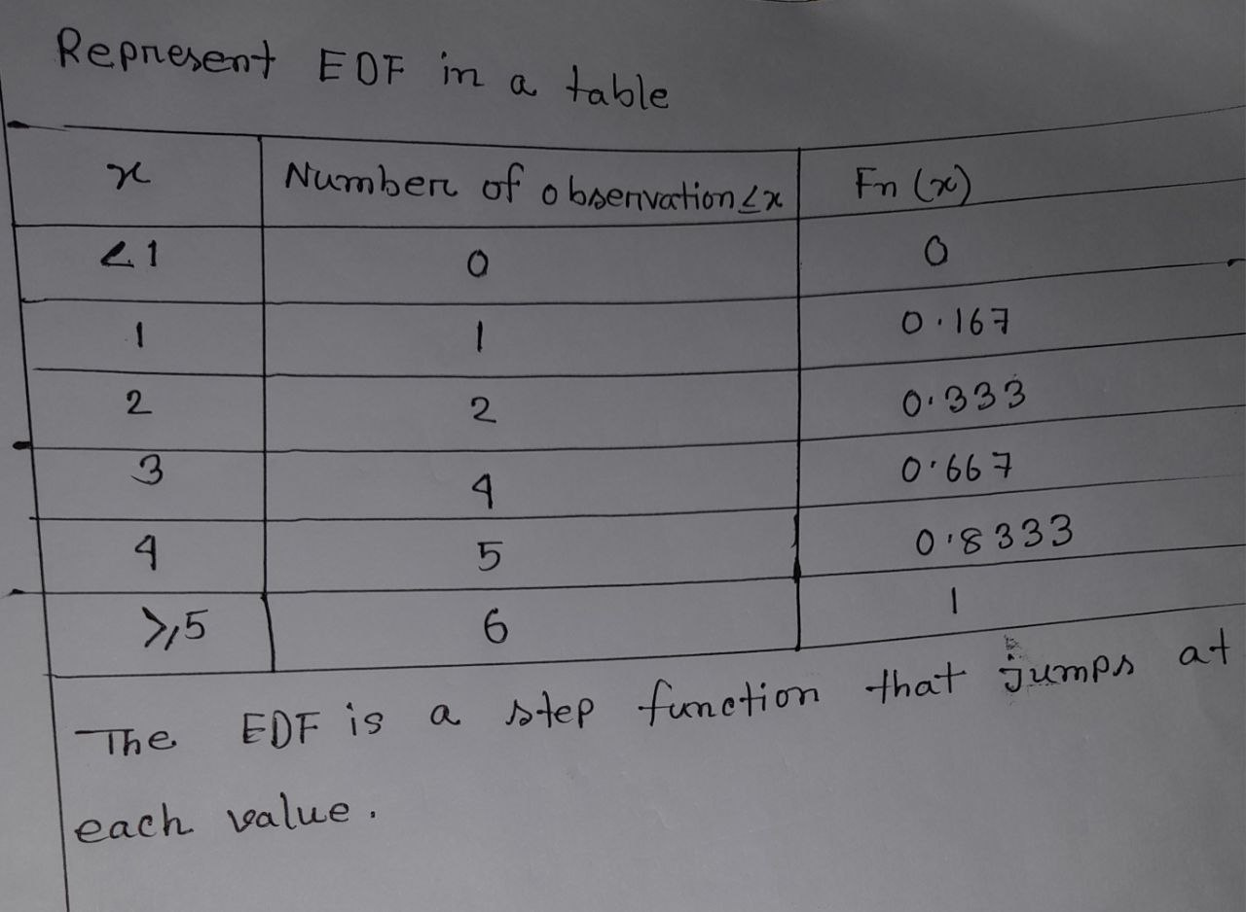
Solution

Slide 44
Applications
Non-Parametric Estimation: Estimates the cumulative distribution function without assuming a specific distribution.​
Goodness-of-Fit Tests: Compares the EDF with a theoretical CDF to check how well data fit a distribution.​
Statistical Inference: Estimates probabilities, quantiles, or medians directly from sample data.​
Data Visualization: Step plots of EDF show the cumulative behavior of data for easy interpretation.​
Survival Analysis / Reliability: Estimates survival probabilities or time-to-failure in reliability studies.​

Slide 45
04
Lecture-11
Characteristics of a Queueing System

Slide 46
Introduction
A Queueing System is defined as a system where customers arrive for service at a facility, forming a queue when the facility is busy.
Application: Banks, hospitals, computers networks, airports
Goal: Balance customer satisfaction & server efficiency.
Key Element of queue system
1. Customer
2. Server

Slide 47
Queue Formation and Service Cycle
Service
Customer Arrival
Customers receive
service when their turn
comes.
Customers arrive at the
service point.
Waiting Line
Server Check
Customers wait if the
server is busy.
Check if the server is
available.

Slide 48
Why Queue Analysis is Important
Organization’s Perspective:
The server (like a cashier, machine, or service provider) should not remain idle.
Full utilization of resources is important to increase profit and efficiency.
Customer’s Perspective:
Customers want to wait as little as possible.
Long waiting times reduce customer satisfaction.
Trade-off:
If we only focus on the organization, customers may wait too long.
If we only focus on customers, resources may stay idle.
Queue analysis helps find a balance between server utilization and customer waiting time.

Slide 49
Typical Performance Measures
Customers in System
Server Utilization
The average number of
customers in the
system.
Measures how busy the
server is. High utilization
indicates efficiency.
Average Delay
Line Length
The average time a
customer waits for
service.
The average number of
customers waiting in
line.

Slide 50
The main components of queue system
Description
Example
Customer arrival
method
Scheduled
appointments, bus
arrivals
Arrival Pattern
Service Pattern
Service time
variability
ATM fixed, doctor
random
Queue Discipline
Customer serving
order
FIFO, LIFO, SIRO

Slide 51
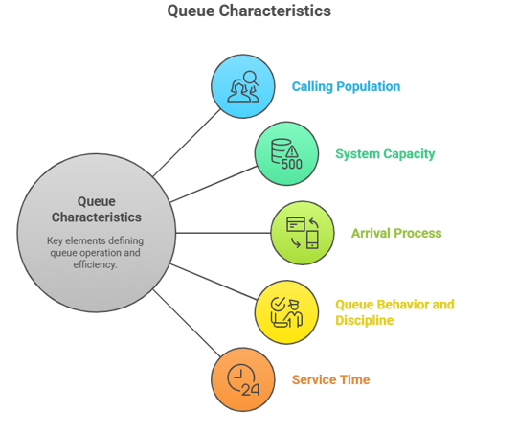
Characteristics of Queue
Key element of queue
Customer: One who requires service is called customer.
Example: Human, machine, etc.
Server: One who provides service is called server.
Example: Bank counter, repairman runway

Slide 52
Calling Population
Finite Population | Infinite Population
There is a limited number of customers. | There is an unlimited number of customers.
The arrival rate depends on how many customers are already in the system. | The arrival rate is constant, no matter how many are in the system (e.g., bank customers).

Slide 53
System Capacity
Unlimited
Capacity
Limited
Capacity
Manages queue size,
may reject customers
Accommodates all
customers, no
rejection

Slide 54
Queue behaviors
Jockeying
Balking
Customer switches to a
faster queue if multiple
queues exist.
Customer leaves due to
long queue before
service. Example:
Customer leaves bank
queue.
Reneging
Customer leaves after
waiting too long in the
queue. Impatience is
the reason.

Slide 55
Queue discipline
FIFO
LIFO
First customer is
served first.
Common in banks
and ticket
counters.
Last customer is
served first.
Similar to a stack
of plates.
1
2
SIRO
3
4
SPT
Customers are
chosen randomly.
Like a lottery
system.
Customer with less
work is served
first. Used in
production jobs.

Slide 56
Service Time Cycle
Customer
Arrival
Plan Resources
Service Begins
Predict Queue
Behavior
Service Time
Varies
Probability
Distribution

Slide 57
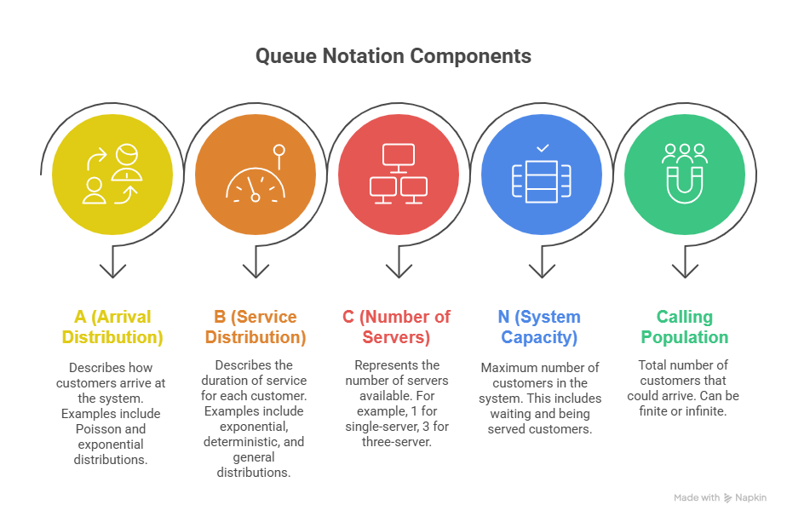
Queue Notation (ABCNK Format)

Slide 58
05
Lecture-12
Performance Measures of Queueing System

Slide 59
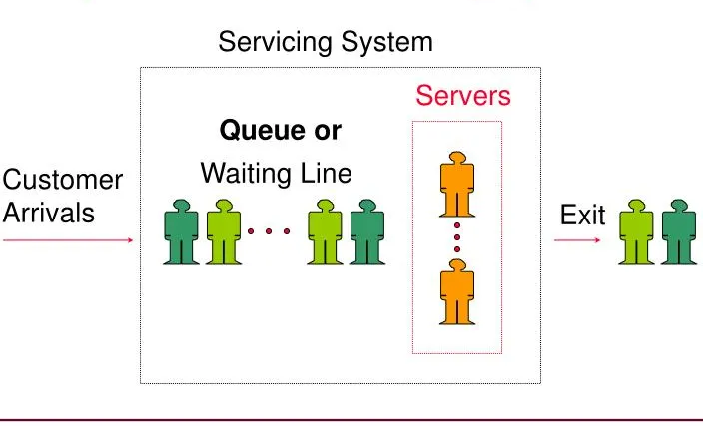
What is Queuing System?
Queueing system is a model for analyzing situations where customers wait in a line for a service.
The lecture discusses key performance measures and notations used to describe these systems.

Slide 60
QUEUING MODELS
A queuing model is a mathematical representation of a queuing system that includes certain presumptions on-
The discipline and organization of the queue
The number and type of servers
The arrival and service procedures
Their probabilistic character.

Slide 61
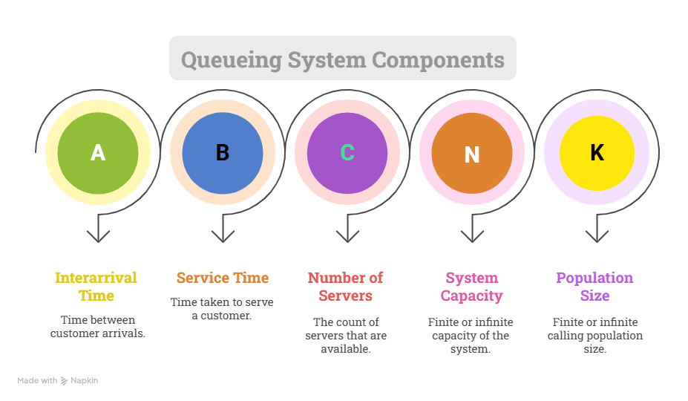

Slide 62
Denotation of arrival and service time Distribution
Markovian
Deterministic
Erlang
Suitable for systems
with variable arrival and
service times.
Ideal for systems with
fixed and predictable
times.
Useful for systems with
moderate variability and
specific order.
For an example
M/M/1 queueing system has a Markovian arrival rate, a Markovian service rate, and one server.

Slide 63
Queueing Performance Measures
Probability and Rates
P_{n}​: The steady-state probability of having n customers in the system.
P_{n}​(t): The probability of having n customers in the system at a specific time, t.
λ: The arrival rate, or the number of arrivals per unit of time.
μ: The service rate.
ρ: The server utilization, which is the fraction of time the server is busy.
Time-based and Count-based Averages
L_{s}​: Time-averaged number of customers in the system.
L_{q}​: Time-averaged number of customers in the queue.
W_{s}​: The average time a customer spends in the system (including waiting and service time).
W_{q}​: The average time a customer waits in the queue before being served.

Slide 64
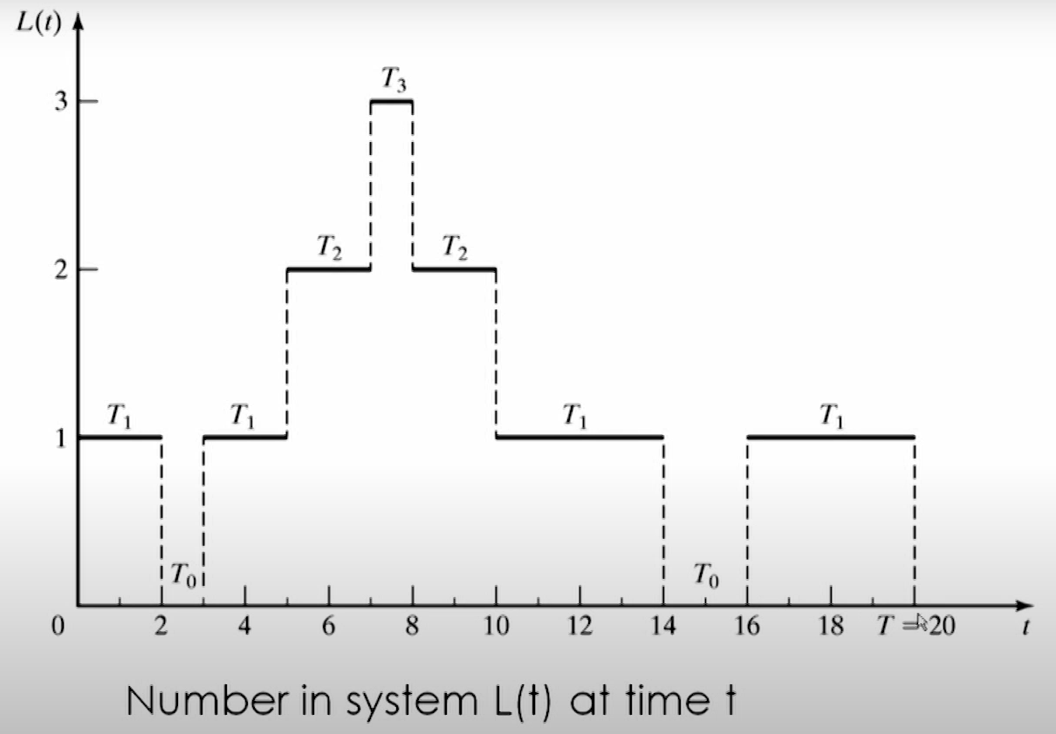
Typical Performance Measures
Time average no of customers in system > L_{s}
(In queue) > L_{q}
Average time spent in system > W_{s}
(in queue) > W_{q}(per customer)
Server Utilization

Slide 65


Time-Weighted Average Number of Customers in System (L_{s​})
The formula is:
T is the total time period.
i is the number of customers in the system.
T_{i}​ is the total duration during which there were exactly i customers in the system.
The graph shows:
0 customers for a total of 3 minutes (from time 2 to 3 and 14 to 16).
1 customer for 12 minutes (from 0 to 2, 3 to 5, 12 to 14, and 16 to 20).
2 customers for 4 minutes (from 5 to 7 and 10 to 12).
3 customers for 1 minute (from 7 to 8).
The total time is 20 minutes

Slide 66
Customer Presence Over 20 Minutes
Duration (minutes)
12
4
3
1
Number of
Customers
0 Customers
1 Customer
2 Customers
3 Customers

Slide 67

Average Number of Customers in Queue (L_{q}​)
The number of customers in the queue is typically one less than the number in the system, as the person being served is not considered to be in the queue.
L_{q}​ calculation is:
The graph shows:
1 customer in the queue for a total of 4 minutes (from time 5 to 7 and 10 to 12).
2 customers in the queue for 1 minute (from 7 to 8).
The total time is 20 minutes.

Slide 68

Server Utilization
Server utilization is calculated by finding the total time the server was busy and dividing it by the total observation time. From the graph, the server was idle for 3 minutes (from time 2 to 3 and 14 to 16)
This means the server was busy 85% of the time

Slide 69
Pizza Shop Example
Imagine a small pizza shop with a single oven that can cook one pizza at a time. Customers arrive to place an order, wait for their pizza to be made, and then leave. We'll analyze this system over a one-hour period (T = 60 minutes) to understand its performance.
Here's the data we've collected:
Arrivals
Service Times (time to cook and package)
Customer 1 | 0 minutes
Customer 2 | 10 minutes
Customer 3 | 15 minutes
Customer 4 | 25 minutes
Customer 5 | 40 minutes
Customer 1 | 15 minutes
Customer 2 | 20 minutes
Customer 3 | 10 minutes
Customer 4 | 15 minutes
Customer 5 | 10 minutes

Slide 70
Track the System and Queue Over Time
Time (min) | Event Description | Customers in System L(t) | Customers in Queue L_{q}(t)
0–10 | Customer 1 arrives. Being served. | 1 | 0
10–15 | Customer 2 arrives (waiting). Customer 1 still in service. | 2 | 1
15–25 | Customer 1 done. Customer 2 starts service. Customer 3 arrives (waiting). | 2 | 1
25–35 | Customer 4 arrives (waiting). Customer 2 still in service. | 3 | 2
35–40 | Customer 2 done. Customer 3 starts service. Customer 4 waiting. | 2 | 1
40–45 | Customer 5 arrives (waiting). Customer 3 still in service. | 3 | 2
45–55 | Customer 3 done. Customer 4 starts service. Customer 5 waiting. | 2 | 1
55–60 | Customer 4 done. Customer 5 starts service. | 1 | 0

Slide 71
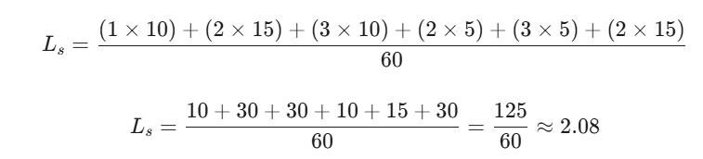
Time-Averaged Number of Customers in System (L_{s}​)
This is a time-weighted average of the number of customers in the system over the 60-minute period.
1 customer: from 0-10 min (10 min duration)
2 customers: from 10-25 min (15 min duration)
3 customers: from 25-35 min (10 min duration)
2 customers: from 35-40 min (5 min duration)
3 customers: from 40-45 min (5 min duration)
2 customers: from 45-60 min (15 min duration)

Slide 72
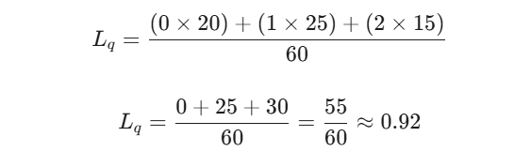
Time-Averaged Number of Customers in Queue (L_{q}​)
This is a time-weighted average of the number of customers in the queue.
0 customers: from 0-10 min, 35-40 min, 55-60 min (20 min total)
1 customer: from 10-15 min, 15-25 min, 45-55 min (25 min total)
2 customers: from 25-35 min, 40-45 min (15 min total)

Slide 73
Server Utilization (ρ)
The server (the oven) is busy whenever there is at least one customer in the system. From our timeline, the server is busy from 0-60 minutes.
Total busy time = 60 minutes
Total time = 60 minutes
Server Utilization = 60 / 60 = 1, or 100%.

Slide 74
THANKS!
Do you have any questions?
Presented by
21CSE005 Maria Islam
21CSE011 Sabiha Akter Tanny
21CSE026 Md. Sadekur Rahman Sahad
21CSE027 Md. Emon
21CSE051 Sadia Amrin Laaj

