Slide 1
8085 Architecture &
Its Assembly language programming
Dr A Sahu
Dept of Computer Science & Engineering
IIT Guwahati

Slide 2
Outline
8085
  Block diagram (Data Path)
  Instruction Set of 8085
Sample program of 8085
Counter & Time Delay
Stack and Sub Routine
Assignment on 8085
Introduction to 8086 and 30x86 architecture

Slide 3
8085 Microprocessor Architecture
INTR
INTA
ReSeT6.5
TRAP
RST5.5
RST7.5
SID
SOD
Interrupt Control
Serial I/O Control
Bus 8 Bit
ACC
tmp R
IR
MUX
W
Z
Flag
B
C
I Decode
&
M/C
Encoding
D
E
ALU
H
L
SP
PC
Inc/Dec. ter
Add latch
Timing and Control
Add Buff
Data/Add Buff
8085
MPU
A₁₅
Address Bus (16bit)
A₀
Memory
I/P
O/P
_{D7}
Data Bus (8bit)
_{D0}
Control Bus (8bit)

Slide 4
Assumption
RAM Memory is interfaced
Instructions are stored in memory
One I/O display port is interfaced to display data of ACC

Slide 5
Simple Assembly Program
MVI A, 24H // load Reg ACC with 24H
MVI B , 56H // load Reg B with 56H
ADD B // ACC= ACC+B
OUT 01H // Display ACC contents on port 01H
HALT // End the program
Result: 7A (All are in Hex)
DAA operation for Decimal Adjust A+6=10H

Slide 6
Flowchart to multiply two number
Start
LDA 2000 // Load multiplicant to accumulator
MOV B,A // Move multiplicant from A(acc) to B register
LDA 2001 // Load multiplier to accumulator
MOV C,A // Move multiplier from A to C
MOV C,A // Move multiplier from A to C
MVI A,00 // Load immediate value 00 to ACC
ADD B // Add B(multiplier) with A
DCR C // Decrement C, it act as a counter
JNZ L // Jump to L if C!=0
STA 2010 // Store result in to memory
HLT // End

Slide 7
Code to multiply two number
LDA 2000 // Load multiplicant to accumulator
MOV B,A // Move multiplicant from A(acc) to B register
LDA 2001 // Load multiplier to accumulator
MOV C,A // Move multiplier from A to C
MVI A,00 // Load immediate value 00 to a
L: ADD B // Add B(multiplier) with A
DCR C // Decrement C, it act as a counter
JNZ L // Jump to L if C reaches 0
STA 2010 // Store result in to memory
HLT // End

Slide 8
Delay of Instructions
Performance/delay of each instruction
  MVI C, FFH 7 T-State
  LOOP: DCR C 4 T-State
  JNZ LOOP 7/10 T-State
Performance of other INS
ADD R 4 T-State
ADD M 7 T-State
CALL addr 18 T-State
F=Fetch with 4 State, S=Fetch with 6 State, R=Memory Read, W=Memory Write
F
R
F
F
R
R
F
F
R
S
R
R
W
W

Slide 9
Time Delay Loop
Performance/delay of each instruction
  MVI C, FFH 7 T-State
  LOOP: DCR C 4 T-State
  JNZ LOOP 7/10 T-State
Time delay in loop
  T_{L}= T x Loop T-States x N₁₀
  where T=System clock period
  N₁₀= Equiv. decimal value of count loaded to C
  T_{L}= 0.5x10⁻⁶ x (14 x 255)=1.8ms (ignore 10 T-State)
F
R
F
F
R
R

Slide 10
Time Delay: Nested Loop
Performance/delay of each instruction
  MVI C, FFH 7 T-State
  MVI D, FFH 7 T-State
  LOOP1: DCR C 4 T-State
  LOOP2: DCR D 4 T-State
  JNZ LOOP2 7/10 T-State
  JNZ LOOP1 7/10 T-State
Time delay in Nested loop
  T_{NL}= N1₁₀ x T x ( L1_TStates+ L2_TStates x N2₁₀ )
F
R
F
R
F
F
F
R
R
F
R
R

Slide 11
Traffic Light Control: Counter & Delay
Turn Signal to Red
LOOP: MVI A 01H
OUT 01H
LD B DELAY_RED
CALL DELAY
Load DelayRed
Time Delay
Turn Signal to Yellow
MVI A 02H
OUT 01H
LD B DELAY_YELLOW
CALL DELAY
Load DelayYellow
Time Delay
MVI A 03H
OUT 01H
LD B DELAY_GREEN
CALL DELAY
Turn Signal to Green
Load DelayGreen
Time Delay
JMP LOOP

Slide 12
Stack Pointer (SP) & Stack Memory
The stack is an area of memory identified by the programmer for temporary storage of information.
The stack is a LIFO structure.
The stack normally grows backwards into memory.
  Programmer can defines the
  bottom of the stack (SP)
  and the stack grows up into
  reducing address range.
Memory
The Stack
grows
backwards
into memory
Bottom
of the
Stack

Slide 13
Stack Memory
Grows backwards into memory
Better to place the bottom of the stack at the end of memory
To keep it as far away from user programs as possible.
Stack is defined by setting the SP (Stack Pointer) register.
LXI SP, FFFFH
This sets SP to location FFFFH (end of memory for 8085).

Slide 14
Saving Information on the Stack
Save information by PUSHing onto STACK
Retrieved from STACK by POPing it off.
PUSH and POP work with register pairs only.
Example “PUSH B”
  Decrement SP, Copy B to 0(SP)
  Decrement SP, Copy C tp 0(SP)
Example “POP B”
  Copy 0(SP) to C, Increment SP
  Copy 0(SP) to B, Increment SP
B
C
12
F3
FFFB
FFFC
FFFD
F3
FFFE
12
FFFF
SP

Slide 15
Stack/LIFO use in CALL/RET
Retrieve information back into its original location
  The order of PUSHs and POPs must be opposite
8085 recognizes one additional register pair
  PSW (Prog Status word) = ACC and Flag
Before any routine CALL do this
PUSH B
PUSH D
PUSH PSW
After RETURN from call do this
POP PSW
POP D
POP B

Slide 16
Subroutines
A subroutine is a group of instructions
  That is used repeatedly in different places of the program.
  Rather than repeat the same instructions several times
  It can be grouped into a subroutine and call from the different locations.
Instructions for dealing with subroutines.
  The CALL instruction is used to redirect program execution to the subroutine.
  The RET instruction is used to return the execution to the calling routine.

Slide 17
CALL/RET Instruction
  You must set the SP correctly before using CALL
CALL 5000H
  Push the PC value onto the stack
  Load PC with 16-bit address supplied CALL ins.
RET : Load PC with stack top; POP PC
PC
2 0 0 3
2000 CALL 5000
2003
FFFB
FFFC
FFFD
03
FFFE
20
FFFF
SP

Slide 18
Call by References
If SR performs operations on the contents of the registers
These modifications will be transferred back to the calling program upon returning from a subroutine.
If this is not desired, the SR should PUSH registers and POP on return.

Slide 19
Stack/LIFO use in CALL/RET
Retrieve information back into its original location
  The order of PUSHs and POPs must be opposite
8085 recognizes one additional register pair
  PSW (Prog Status word) = ACC and Flag
Before any routine CALL do this
PUSH B
PUSH D
PUSH PSW
After RETURN from call do this
POP PWD
POP D
POP B

Slide 20
Factorial of a number
LXI SP, 27FFH // Initialize stack pointer
LDA 2200H // Get the number
CPI 02H // Check if number is greater than 1
JC LAST
MVI D, 00H // Load number as a result
MOV E, A
DCR A
MOV C,A // Load counter one less than number
CALL FACTO // Call subroutine FACTO
XCHG // Get the result in HL // HL with DE
SHLD 2201H // Store result // store HL at 0(16bit)
JMP END
LAST: LXI H, 000lH // Store result = 01
END: SHLD 2201H
HLT

Slide 21
Sub Routine for FACTORIAL
FACTO:LXI H, 0000H
MOV B, C // Load counter
BACK: DAD D // double add ; HL=HL+DE
DCR B
JNZ BACK //Multiply by successive addition
XCHG // Store result in DE // HL with DE
DCR C // Decrement counter
CNZ FACTO // Call subroutine FACTO
RET // Return to main program

Slide 22
Assignment I
Write and execute 8085 assembly language program to find value of N_{th} Fibonacci number (Recursive version: using recursive subroutine call)
16 bit can support up to 65356 > F₂₄
Deadline: 12th Aug 2010, 11.55Mid night
After deadline grading: Max 5 out of 10
Send TXT version of program with file name RollNo.txt to asahu@iitg.ernet.in with Assignment one as subject of email
Don’t submit copied one: will get Negative marks

Slide 23
Introduction to
8086 & i386 processor
16 bit Microprocessor
All internal registers as well as internal and external data buses were 16 bits wide
4 Main Register, 4 Index Register, 4 Segment Register, Status Reg, Instr Ptr.
Not compatible with 8085, but with successors
Two Unit works in parallel:
  Bus Interface Unit (BIU)
  Execution Unit (EI)

Slide 24
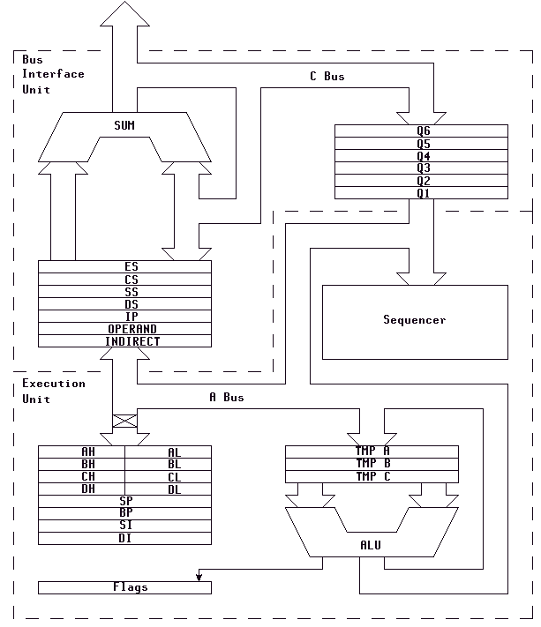
8086 Architecture
Bus Interface Unit
C BUS
SUM
Q6
Q5
Q4
Q3
Q2
Q1
CS (Code Seg Reg)
DS (Data Seg Reg )
ES (Extra Seg Reg )
Sequencer
SS (Stack Seg Reg)
IP (Intr Ptr)
Operand
InDirect
Execution
Unit
A BUS
AH
AL
Temp A
BH
BL
Temp B
CH
CL
Temp C
DH
DL
SI (Source Idx )
DI (Dest. Idx)
BP (Base Ptr )
ALU
SP (Stack Ptr)
Z (Flag Reg)

Slide 25
8086 Registers
AX - the accumulator register (divided into AH / AL)
BX - the base address register (divided into BH / BL)
CX - the count register (divided into CH / CL)
DX - the data register (divided into DH / DL)
SI - source index register.
DI - destination index register.
BP - base pointer.
SP - stack pointer.
AH
AL
BH
BL
CH
CL
DH
DL
SI (Source Idx )
DI (Dest. Idx)
BP (Base Ptr )
SP (Stack Ptr)
Z (Flag Reg)
CS (Code Seg Reg)
DS (Data Seg Reg )
ES (Extra Seg Reg )
SS (Stack Seg Reg)
IP (Intr Ptr)

Slide 26
8086 Architecture
Execution Unit :
  ALU may be loaded from three temp registers (TMPA, TMPB, TMPC)
  Execute operations on bytes or 16-bit words.
  The result stored into temp reg or registers connected to the internal data bus.
Bus Interface Unit
  BIU is intended to compute the addresses.
  Two temporary registers
  indirect addressing
  four segment registers (DS, CS, SS and ES),
  Program counter (IP - Instruction Pointer),
  A 6-byte Queue Buffer to store the pre-fetched opcodes and data.
  This Prefetch Queue optimize the bus usage.
  To execute a jump instruction the queue has to be flushed since the pre-fetched instructions do not have to be executed.

Slide 27
Next Class Agenda
Detail of 8086 Architecture
Advanced 32 bit architecture (i386, Pentium, p4)
  I know a little bit of this
  My expertise area of work
Programming model for x86 architecture
8086 Assembly language programming
MASM / TASM /NASM (x86 assembler)
If you miss the next class, will miss a lot

Slide 28
Thanks

