Slide 1
Computer Peripheral & Interfaces
(Introduction )
A Sahu
Deptt. of Comp. Sc. & Engg.
IIT Guwahati

Slide 2
Outline
Introduction
Motivation
Course structure & Reference Books
Class timing
Rules & Examination
Lab part (CS422)

Slide 3

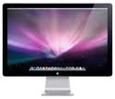
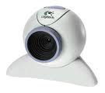
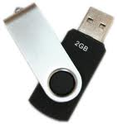

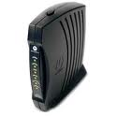

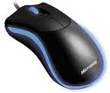
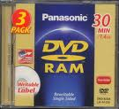
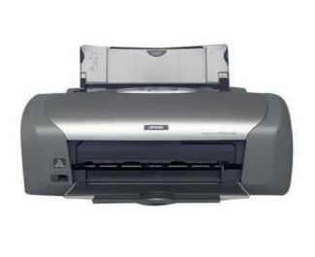
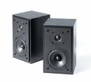
Introduction
R
A
M
Processor
Computer Systems
  Internal (processor + memory (RAM) )
  Peripheral (Disk, Display, Audio, Eth,..)

Slide 4
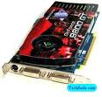
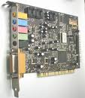

Introduction
R
A
M
Processor
Peripherals : HD monitor, 5.1 speaker
Interfaces : Intermediate Hardware
  Nvidia GPU card, Creative Sound Blaster card
Interfaces : Intermediate Software/Program
  Nvidia GPU driver , Sound Blaster Driver software

Slide 5
Introduction
Interfaces
  Intermediate Hardware
    Timer, Counter, DMA, USB, UART,
    Peripheral Controller
  Intermediate Software/Program
    Device driver (Linux)/ Assembly Code
Peripheral Component Interconnect(PCI)
  Audio card, VGA card, Ethernet card
Low level signal + high level C code

Slide 6
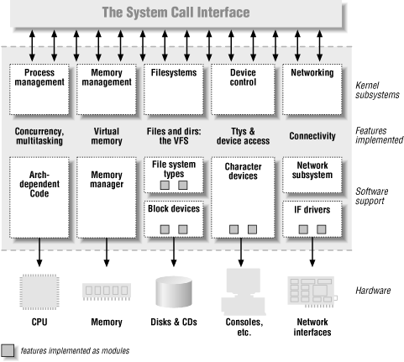
Linux Kernel Split View
Linux Device Driver by Jonhantan Corbet

Slide 7
Motivation
Knowledge: both hardware & software
Exact interface: Architecture & OS
Used in many places (Computer +ES )
  All embedded system (mobile, laptop, ..)
Highly paid job in industries
  Intel (BIOS, driver), Sony, Motorola, ..
Low level signal + Device drivers

Slide 8
Motivation Contd..
Knowledge of simple peripherals
(Display, Audio, Disk drives, Ethernet)
  In connection with 8085/8086
Peripheral are powerful than main computing, knowledge of advance peripherals
  Linux/Window device drivers
  Dolby Digital Stereo, HD Cinema
  Most influential technology of 2010
    USB 3.0, Bluetooth 4
    Graphics cards (Nvidia with 480 core)

Slide 9
Motivation Contd..
Use of old technology in newer devices
  Intel Atom processor (PII technology with modification)
  Use of winXP in mobile; may be obsolete for PC
Combining peripheral controller in main computing for low power
  Intel Centrino have wireless controller functionality inside processor chip
  Intel atom 45x have DDR2 memory controller + Graphics controller in inside processor chip

Slide 10
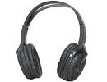
Dolby Digital
Stereo: Moving origin of sound in a line
  Stereo Ear Phone:
  Stereo Image: to calculate Depth : why two eye in human face?
Dolby Lab: 5.1 (5 normal + 1 subwoofer)
  5 normal : 20-20Khz, 1 low freq (20-120K)
  RFront,Centre,LFrnt, RSorround, Lsorrnd
  Max bit rate: 560 bit/s
Dolby HD : 7.1, Max bit rate:18MBs

Slide 11
HD Cinema
Video : 30 frame/ Sec
1 Hr Video size with out compression
  (Resolution).(3 color).(2byte).(30F/S).60M.60S
  VGA:640x480: 199GB , Comp: 450 Mb
  720p:1280x720: 597GB, Comp:1.2Gb
  1080p/i:1920x1080: 1.35TB, Comp:2.4G
MP2, MP4, MKV matryoshka (nested doll)
Cinema:Old-2K(2048×1080),New- 4K(4096×2160 )
TI- Digital Light Processing, Sony: SXRD (Silicon X-tal Reflective Display), LCOS ( liquid crystal on silicon)

Slide 12
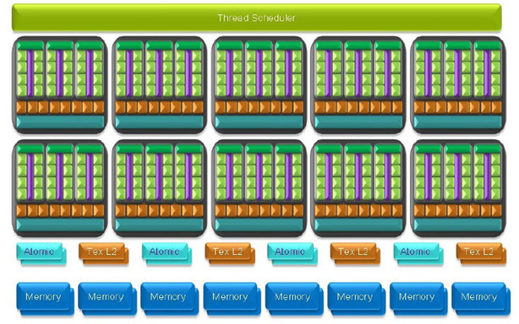

MI Tech 2010 :Nvidia GPUs
Nvidia GTX295, 480 Cuda core
VGA upto Res: 2048x1536, Dual monitor
HD Cinema, Play MKV File

Slide 13
MI Tech 2010 : USB 3.0
SuperSpeed" bus
Enhanced Host Controller Interface (EHCI)
  Register-level interface: Host Controller for the Universal Serial Bus (USB2.0)
  SATA HDD: Serial Adv. Tech. Attachment.
USB3.0: Transfer mode at 5.0 Gbit/s =400MB/s
It uses
  8B/10B encoding, LinearFBshftReg (LFSR) scrambling for data, Spread Spectrum.
  Receivers: low freq periodic signaling, dynamic equalization & training sequences

Slide 14
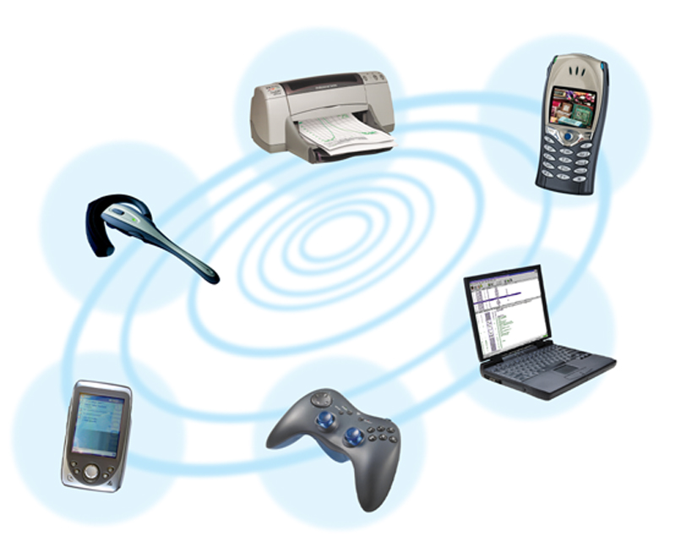

MI Tech 2010: Bluetooth 4.0
Classic Bluetooth
  Radio: Freq Hop Spread Spectrum,2.4Ghz
  1Meters, 3MB/s
  Bluetooth high speed (based on WiFi )
  Bluetooth low energy (Added 4.0 Spec)

Slide 15
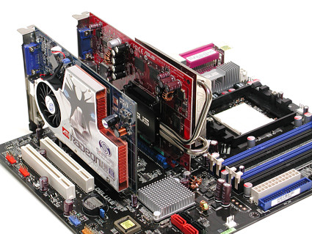
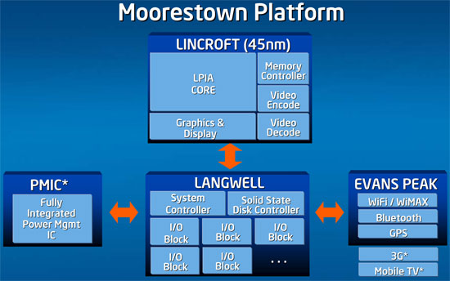
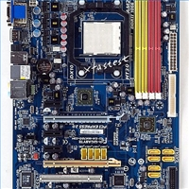
Peripherals Controller Migration
Cards on Mother board
Onboard: graphics, modem, audio, Wireless
Inside processor: graphics, memory cont.

Slide 16
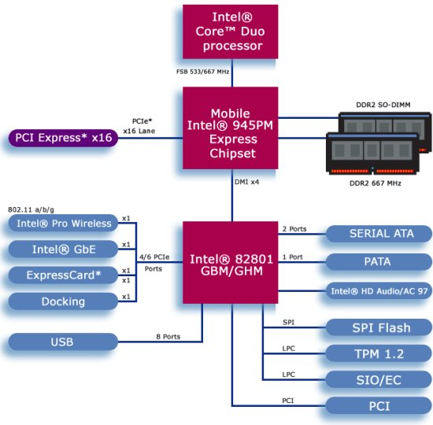
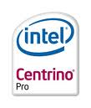
Intel Centrino Processor
5X better wireless performance with Proactive Security (Added Instruction to support this)
Longer Battery Life (Low power instr & FUs)

Slide 17


Intel Atom Processor
Old Pentium architecture with modification (Low power addition) : 10Watt
Default: MMX, SSE (Streaming SIMD)
Inside processor chip
  Graphics processor, Memory controller
  Wireless controller (Centrino Atom)

Slide 18
Course Structure: CCS421
  Intro to 8/16/32 bit microP and its programming.
    (2 Prog Assignments - one in 8085 & other in 8086 simulator)
  Interfacing devices such as
    displays Kbd, DAC/ADC.
  Using programmable chips like
    I/O ports, timer/counter, kbd/display cont.,
    DMA cont., Interrupt cont. etc.
    Familiarization with MDS other Bus standards
      IEEE 488, VME, MULTIBUS, SCSI, ISA/EISA, PCI.
  Selected peripheral devices and their characteristics.
    Dolby Stereo, HD Cinema, Gigabit Ethernet
    Device &driver for HD Audio, Nvidia Graphics card
    Linux device driver (2 Programming Assignments)

Slide 19
Rules & timing
Timing Slot A
  Monday 8 AM – 9 AM (Skipping)
  Tuesday (9 AM - 10 AM), Wednesday (10 AM - 11AM), Thursday (11AM -12 AM)
Venue: 1201
Rules
  75% attendance mandatory
  10% Assignment + 40% mid term+ 50% end term
  Copy cases lead to negative marks (-ve Max mark)
  For AA Grade: marks in all parts should be positive

Slide 20
Lab part
CS422 Lab
8085 Microprocessor Kit
Will be taken by Prof SB Nair
Hardware laboratory
Microprocessor Development System
  Timer, sensor, DMA, peripheral controller

Slide 21
Book
Text
  R S Gaonkar, “Microprocessor Architecture, Programming and Application with the 8085”, 5th edition, Penram India
  J. Corbet, A Rubini, “Linux Device Driver” 3rd Edition,O’relly publisher
References
  D V Hall, Microprocessors and Interfacing, TMH, 1995
  M B Cook and H White Neil, Computer Peripherals, 3/e. London: Edward Arnold, 1995.
  L F Doyle, Computer Peripherals, Prentice Hall, 19

Slide 22
Course Website
http://jatinga.iitg.ernet.in/~asahu/cs421/

Slide 23
Thanks

