Slide 1
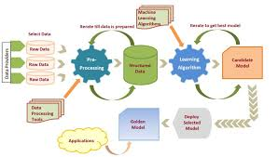
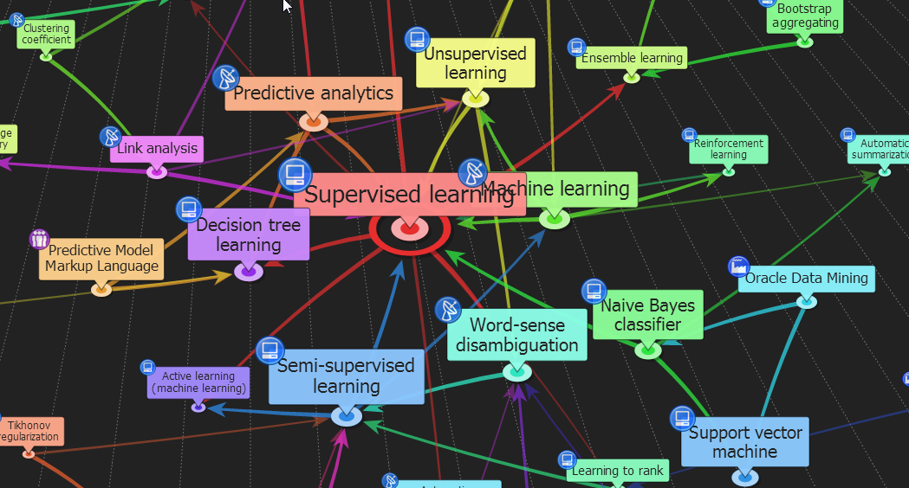

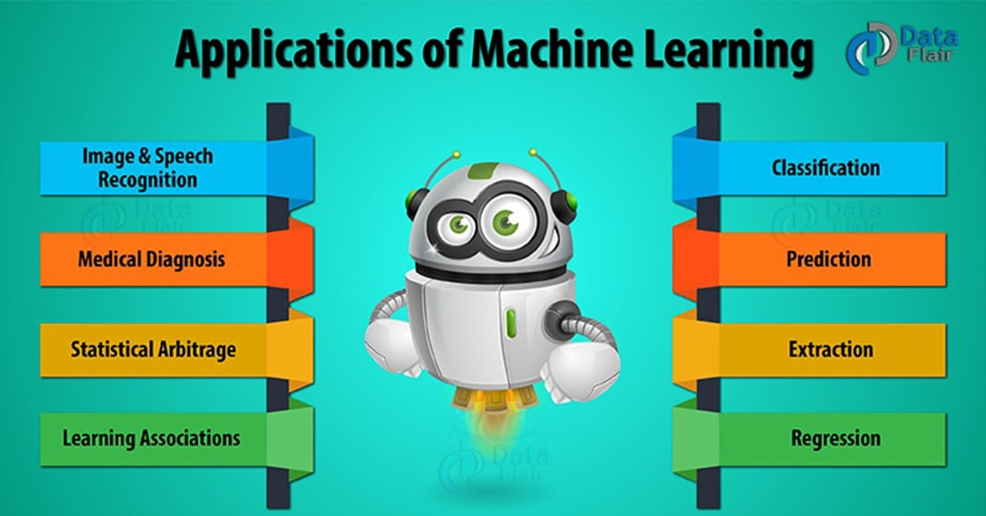

ENG6500: Intro to Machine Learning Ensemble Learning “Part I: Introduction”
S. Areibi
School of Engineering
University of Guelph
Notes:
In this lecture we will introduce the concept of “Ensemble Learning” or mixture of experts which is a powerful Machine Learning technique

Slide 2
Introduction
Notes:
In this course, we have covered several concepts related to ML (data preparation, evaluation, ..) but most importantly we learned about algorithms.

Slide 3
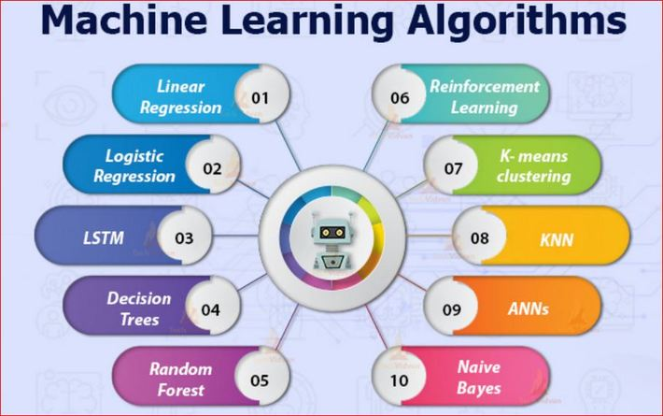
Machine Learning Algorithms
Supervised Learning Regression:
Simple Linear, Multiple, Polynomial Regression
Supervised Learning Classification:
Logistic Regression, KNN, DTs, NB, SVM, ANNs ..
Unsupervised Learning Algorithms:
Clustering (KNN), PCA, Apriori algorithm
Each algorithm had its pros and cons
Why is it important to learn about
Different ML Algorithms?
Notes:
So far we have covered the following algorithms
Regression → Simple Linear Regression, Multiple Regression, Polynomial Regression
Classification → Logistic Regression, KNN, Decision Trees, Naïve Bais, SVM, ANNs
In practice, experience with a broad range of techniques is the best insurance for solving arbitrary new classification problems
Pros/Cons
Each technique had its advantages and disadvantages
Each algorithm performed well on some problems and lacked performance on others

Slide 4
Bias and Variance
No “best classifier” in general
Necessity for exploring a variety of methods
Bias: measures the quality of the match
High-bias implies poor match
Algorithm too simple
Variance: measures the specificity of the match
High-variance implies a weak match
Algorithm too complex
Bias and variance are not independent of each other
The correct balance of bias and variance is vital to building machine learning algorithms that create accurate results from their models.
How to evaluate if the learning algorithm “matches” the classification problem?
Notes:
The main causes of error in learning are due to noise, bias and variance.
Models with high bias make a lot of assumptions about the training data.
This leads to over-simplification of the model and may cause a high error on both the training and testing sets.
Models with high variance are too complex:
Variance is the amount a model's prediction will change if the training data is changed.
Ensemble may help to minimize these factors.
By using ensemble methods, we’re able to increase the stability of the final model and reduce the errors mentioned previously.
Open Research Problem
How can we find a “best match” of algorithm and problem at hand??

Slide 5
No Free Lunch Theorem
No Free Lunch Theorem:
There is no one algorithm that is always the most accurate
There is no “one size fits all”
It is the assumptions about the learning algorithm that are important
Even popular algorithms will perform poorly on some problems, why?
One possible reason is that the learning algorithm and data distribution do not match well
What is the solution?
Combine or hybridize approaches.
Build on top of their advantages and avoid their weaknesses.
Make a wise decision on when to use the suitable algorithm given the problem.
Notes:
In many disciplines in Engineering, Statistics, Computer Science and even Machine Learning:
We can never find a single technique (Algorithm) that can solve all types of problems
Some ML techniques have high Bias and low Variance
Some ML techniques have high Variance and Low Bias
Using hybrid approaches have proven to be an excellent approach .. Why?
Hybrids tend to build on top of the advantages of algorithms while avoiding their disadvantages

Slide 6
Different Classifiers
Performance
No one existing classifier is perfect
No need to create yet another complex approach
Complementary Approach
Examples which are not correctly classified by one classifier may be correctly classified by the other classifiers
Simple “weak” techniques may be combined to produce “strong” effective frameworks
Potential Improvements?
Performance can be improved if complementary “different” classifiers and approaches were used to solve difficult problems
6
Notes:
Simple techniques may perform well on some problems and poorly on others (Perceptron)
Combining several simple techniques may be beneficial since we can build on their strengths and avoid their drawbacks.
Performance can be improved if complementary (different) classifiers were used to solve problems
The complementary approaches collaborate to solve the problem efficiently

Slide 7
Ensemble-based Systems in Decision Making
We consider decisions of multiple experts in our daily lives
For many tasks, we often seek second opinion before making a decision, sometimes many more
Consulting different doctors before a major surgery
Reading reviews before buying a product
Requesting references before hiring someone
Why not follow the same strategy in automated decision making?
Ensemble Based Systems:
Multiple classifier systems, committee of classifiers, mixture of experts, ensemble based systems …
Polikar R., “Ensemble Based Systems in Decision Making,” IEEE Circuits and Systems Magazine, vol.6, no. 3, pp. 21-45, 2006
Polikar R., “Bootstrap Inspired Techniques in Computational Intelligence,” IEEE Signal Processing Magazine, vol.24, no. 4, pp. 56-72, 2007
Polikar R., “Ensemble Learning,” Scholarpedia, 2008.
Notes:
Seeking opinions from several experts (Medical Doctors, Researchers, Bankers) “Second Opinions”:
Helps people to take a correct decision and action
Why not follow same strategy in ML?
In statistics and machine learning, ensemble methods use multiple learning algorithms to obtain better predictive performance than could be obtained from any of the constituent learning algorithms alone.

Slide 8
Ensemble Learning
So far – we covered learning methods that learn a single hypothesis, chosen from a hypothesis space that is used to make predictions.
Ensemble learning → select a collection (ensemble) of hypotheses and combine their predictions.
Example 1 - generate 100 different decision trees from the same or different training set and have them vote on the best classification for a new example.
Key motivation: reduce the error rate. Hope is that it will become much more unlikely that the ensemble of will misclassify an example.
8
Notes:
A single ML algorithm may produce good results for some problems and produce poor results for others
Ensembles tend to overcome the short coming of single ML algorithms
For example, combining several decision trees each with different structures (roots) may produce better results
DT is subject to overfitting training data
A small change in the data can cause a large change in the structure of the DT causing instability

Slide 9
Ensemble Based Systems

Slide 10
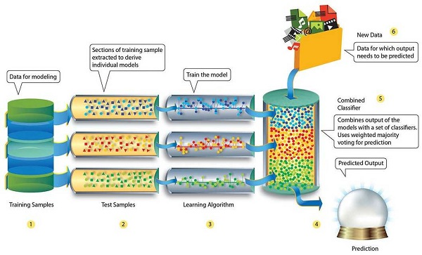
Ensembles
Ensemble machine learning methods use multiple learning algorithms to obtain better predictive performance than could be obtained from any of the constituent learning algorithms.
Many of the popular modern machine learning algorithms are actually ensembles. For example, Random Forest (RF) and Gradient Boosting Machine (GBM) are both ensemble learners.
Both bagging (e.g. Random Forest) and boosting (e.g. GBM) are methods for ensembling that take a collection of weak learners (e.g. decision tree) and form a single, strong learner.
10

Slide 11
Ensembles of Classifiers
Idea
Combine similar/different classifiers to improve the performance and accuracy of results
Multiple Classifiers
If we utilize multiple independent and diverse decisions (classifiers) each of which is at least more accurate than random guessing, random errors cancel each other out, correct decisions are reinforced.
Ensembles of Classifiers
Combine the classification results from different classifiers to produce the final output. How?
Unweighted voting
Weighted voting
Majority voting
11
Notes:
Voting:
Vote provides a baseline method for combining classifiers.
The default scheme is to average their probability estimates or numeric predictions, for classification and regression, respectively.
Other combination schemes are available—for example, using majority voting for classification.
MultiScheme selects the best classifier from a set of candidates using cross-validation of percentage accuracy or mean-squared error for classification and regression, respectively. The number of folds is a parameter. Performance on training data can be used instead.

Slide 12
Ensemble Learning
Definition: A Method to select and combine an ensemble of hypotheses into a hopefully better hypothesis
Can enlarge hypothesis space to create complex decision boundary:
Perceptron
Linear separators (limited)
Ensemble of perceptron
Polytype (more rich separator)
Classifier #1
Classifier #2
Classifier #3
Notes:
We learnt from our studies of Perceptrons that a single perceptron may be limited (underfit) in terms of its capability of classifying linearly separable problems.
However, multiple Perceptrons can be used to solve more complex problems

Slide 13
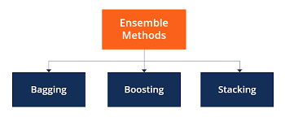
Different types of Ensembles
How can we design/create ML Ensembles?
Different learning algorithms (Collaborate)
Similar algorithms with different choice for parameters
Data set with different features (e.g. random subspace)
Data set = different subsets (e.g. bagging, boosting, stacking)
Bagging helps decrease variance.
Boosting helps to decrease the model’s bias.
13
Notes:
Ensembles can be created in different ways
Different Algorithms (DT, SVM, KNN, NB, …)
Same Algorithm but different choices of hyperparamters
ANN with 2 hidden layer, ANN with 3 hidden layer, ANNs with different weight initialization strategies
Using different features for different Algorithms
Using different subsets of data

Slide 14
Ensemble Learning
Learn multiple alternative definitions of a concept using different training data or different learning algorithms.
Combine decisions of multiple definitions, e.g. using weighted voting.
Training Data
⋅ ⋅ ⋅ ⋅ ⋅ ⋅ ⋅ ⋅
Data1
Data2
Data m
Learner1
Learner2
⋅ ⋅ ⋅ ⋅ ⋅ ⋅ ⋅ ⋅
Learner m
⋅ ⋅ ⋅ ⋅ ⋅ ⋅ ⋅ ⋅
Model1
Model2
Model m
Model Combiner
Final Model
14
Notes:
The idea behind “Ensemble Methods” is based on combining several base models in order to produce one optimal predictive model.
One idea for creating an ensemble would be to
Partition the data
Feed different partitions to multiple classifiers
Use the learnt classifiers and combine their results

Slide 15
Ensemble Learning
Combine all results
Same Data
model 1
Ensemble model
Data
model 2
……
Combine multiple models into one!
model k
Applications: classification, clustering, collaborative filtering, anomaly detection……
Notes:
Another idea for creating an ensemble would be to
Feed the same data to all the models
Use same model or use different models
If same model then use different hyperparamter tuning
Use the learnt classifiers and combine their results

Slide 16
Ensemble-based Classifiers
In Ensemble Learning, individual models come together and bring forth a model that is more accurate.
Ensemble based systems provide favorable results compared to single-expert systems for a broad range of applications & under a variety of scenarios
How to (i) generate individual components of the ensemble systems (base classifiers), and (ii) combine the outputs of individual classifiers?
Popular ensemble based algorithms
Bagging, boosting, stacked generalization, and hierarchical mixture of experts
Commonly used combination rules
Algebraic combination of outputs, voting methods, behavior knowledge space & decision templates
Notes:
Issues with Ensemble Based Methods
Advantages/Pros of Ensemble methods
How to generate and create ensembles?
What are the popular ensemble based methods? Why they are popular?
How do we combine results?

Slide 17
Why does it Work?
Suppose there are 25 base classifiers
Each classifier has error rate, ε = 0.35
Assume classifiers are independent
Probability that the ensemble classifier makes a wrong prediction:
When combing multiple independent and diverse decisions each of which is at least more accurate than random guessing, random errors cancel each other out, correct decisions are reinforced.
Notes:
A motivation of using ensembles is to:
Increase accuracy and reduce error rate

Slide 18
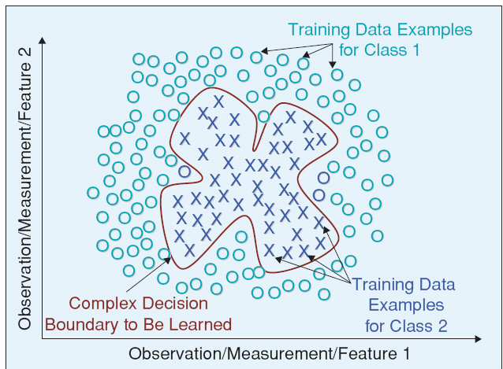
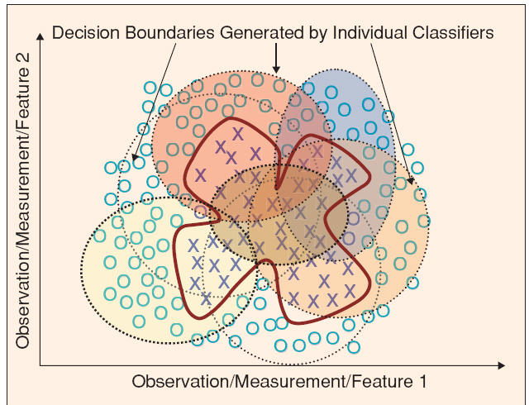
Why Ensemble Based Systems?
Divide and Conquer
Divide data space into smaller & easier-to-learn partitions; each classifier learns only one of the simpler partitions
Complex decision boundary that cannot be
Learnt by linear or circular classifiers
Ensemble of classifiers spanning
the decision space
Notes:
Motivation:
(Left Image) Some complex decision boundaries CANNOT be learnt by certain classifiers
(Right Image) Using an ensemble may simplify the process

Slide 19



Success Stories
Million-dollar prize
Improve the baseline movie recommendation approach of Netflix by 10% in accuracy
The top submissions all combine several teams and algorithms as an ensemble
Data mining competitions
Classification problems
Winning teams employ an ensemble of classifiers

Slide 20
Ensemble Learning: Approaches

Slide 21
Key Ensemble Questions
Which components to combine?
Different learning algorithms
Same learning algorithm trained in different ways
Same learning algorithm trained the same way
How to combine classifications?
Majority vote
Weighted (confidence of classifier) vote
Weighted (confidence in classifier) vote
Learned combiner
What makes a good (accurate) ensemble?
Produce better results than single traditional ML
Utilize similar CPU time as regular ML algorithms
Notes:
Questions related to the design of an ensemble learner ..
Similar vs different algorithms
How to combine results
What qualifies an ensemble to be a good model?

Slide 22
Brief History of Ensemble Systems
One of the earliest work on ensemble systems is Dasarathy and Sheela (1979 paper) which proposed using an ensemble system in a divide and conquer fashion
Several research directions:
Classifier selection
Each classifier is trained to become an expert in some local area of the feature space; one or more local experts can be nominated to make the decision
Classifier fusion
All classifiers are trained over the entire feature space; fusion involves merging the individual (weaker) classifiers to obtain a single (stronger) expert of superior performance
Classifier diversification
Notes:
Research Directions for Ensemble Learning
Train each classifier on a certain local area of the solution space (expert only in one area)
Train all weak classifiers on all the data but combine their solutions
Diversify the capability of each classifier (Heterogenous vs Homogenous)

Slide 23
Diversity of Ensemble
Objective: create many classifiers, and combine their outputs to improve the performance of a single classifier
Intuition: if each classifier makes different errors, then their strategic combination can reduce the total error!
Need base classifiers whose decision boundaries are adequately different from those of others
Such a set of classifiers is said to be diverse
How to achieve classifier diversity?
Use different training sets to train individual classifiers
Use different features with each classifier
Use Heterogenous vs Homogenous classifiers
How to obtain different training sets?
Resampling techniques: bootstrapping or bagging, training subsets are drawn randomly, usually with replacement, from the entire training set
Notes:
Criteria for assembling ensembles
Reduce error by using several classifiers (How many?)
Diverse Classifiers that produce different decision boundaries. (How to guarantee that)

Slide 24
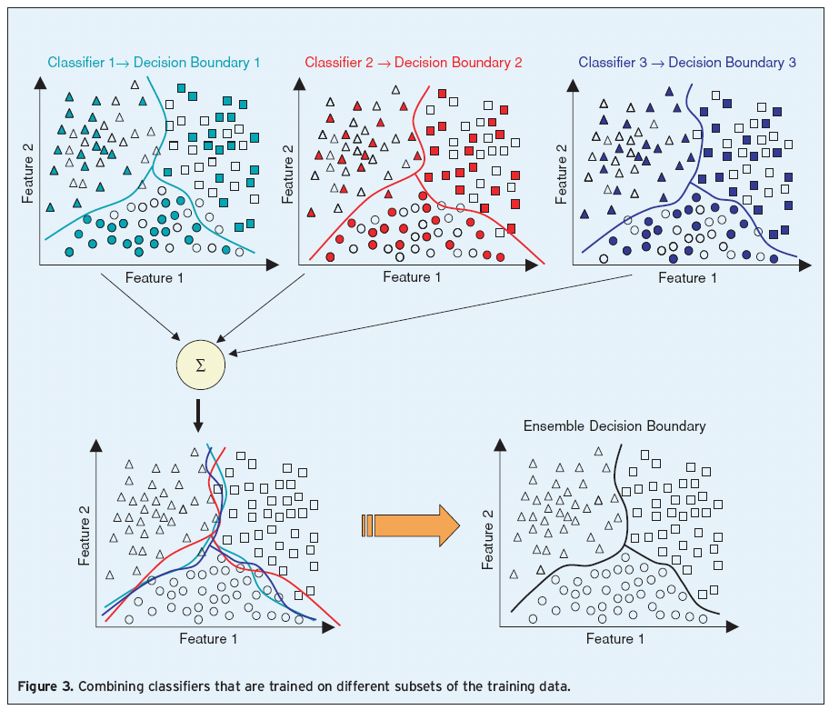
Sampling with Replacement
Random & overlapping training sets to train three classifiers; they are combined to obtain a more accurate classification
Notes:
In this example we see three different classifiers that use different and overlapping datasets …
Each classifier produces a different decision boundary
Combining the decision boundaries of the 3 classifier leads to good and reasonable solutions

Slide 25
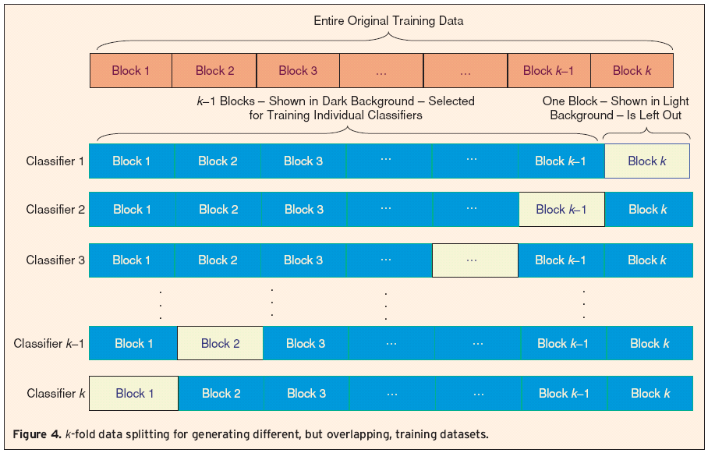
Sampling without Replacement
Jackknife or k-fold data split:
Entire data is split into k blocks; each classifier is trained only on different subset of (k-1) blocks
K-fold data splitting for generating different, but overlapping, training datasets
How else can we diversify our proposed Classifiers?
Notes:
A different approach is to split the data like we did for K-Fold cross validation and train Classifier x on all different subsets by excluding a block from the training set

Slide 26
Other Approaches to Achieve Diversity
Use different training parameters for a classifier
A series of MLP can be trained using different weight initializations, number of layers/nodes, etc.
Adjusting these parameters controls the instability of such classifiers (local minima)
Similar strategy can be used to generate different decision trees for the same problem
Different types of classifiers (MLPs, decision trees, NN classifiers, SVM) can be combined for added diversity
Diversity can also be achieved by using random feature subsets, called random subspace method
Notes:
Other approaches for achieving diversity:
Using different parameters may help diversify the classifiers
Using different classifiers
Using different features (a form of feature selection)

Slide 27
Ensemble Algorithms
Notes:
Bagging and Boosting are two types of Ensemble Learning. These two decrease the variance of a single estimate as they combine several estimates from different models. So the result may be a model with higher stability.

Slide 28
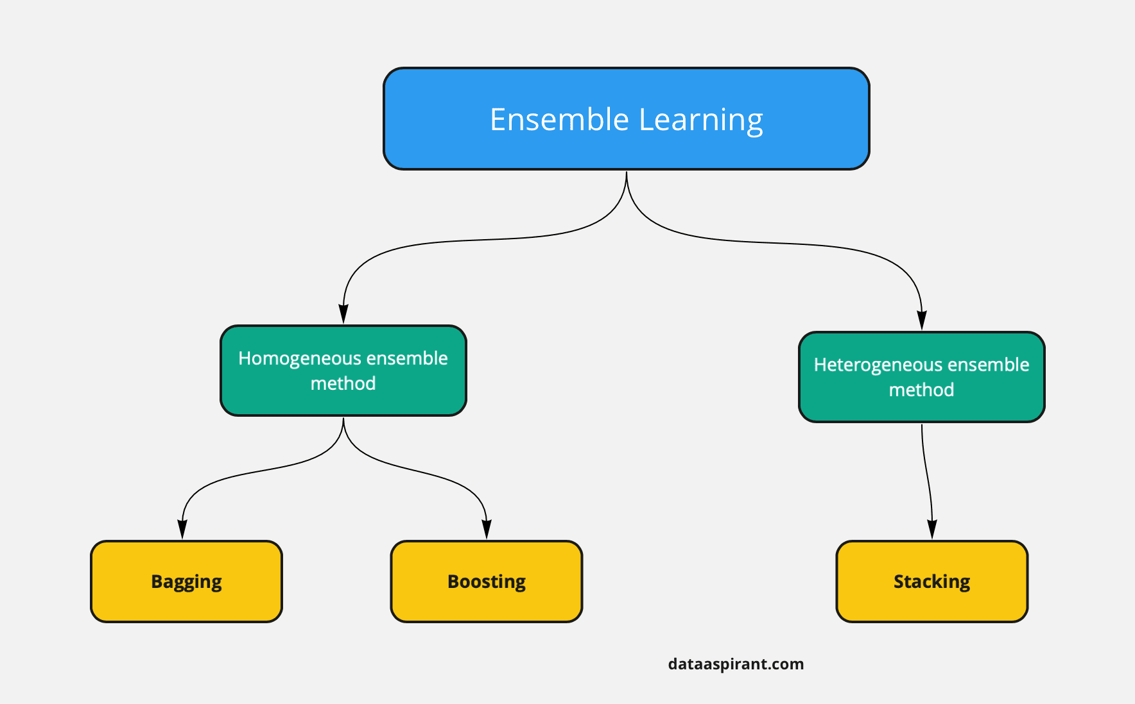
Types of Ensemble Learning
Concurrent
Sequential
Ensemble learning is a machine learning paradigm where multiple models are trained to solve the same problem and combined to get better results.
Homogenous vs. Heterogenous
Sequential vs. Concurrent
Same data vs. different data .
Notes:
The main hypothesis is that when weak models are correctly combined we can obtain more accurate and/or robust models.
Bagging and Boosting are two types of Ensemble Learning.
These two decrease the variance of a single estimate as they combine several estimates from different models.
So, the result may be a model with higher stability.
https://towardsdatascience.com/ensemble-methods-bagging-boosting-and-stacking-c9214a10a205

Slide 29
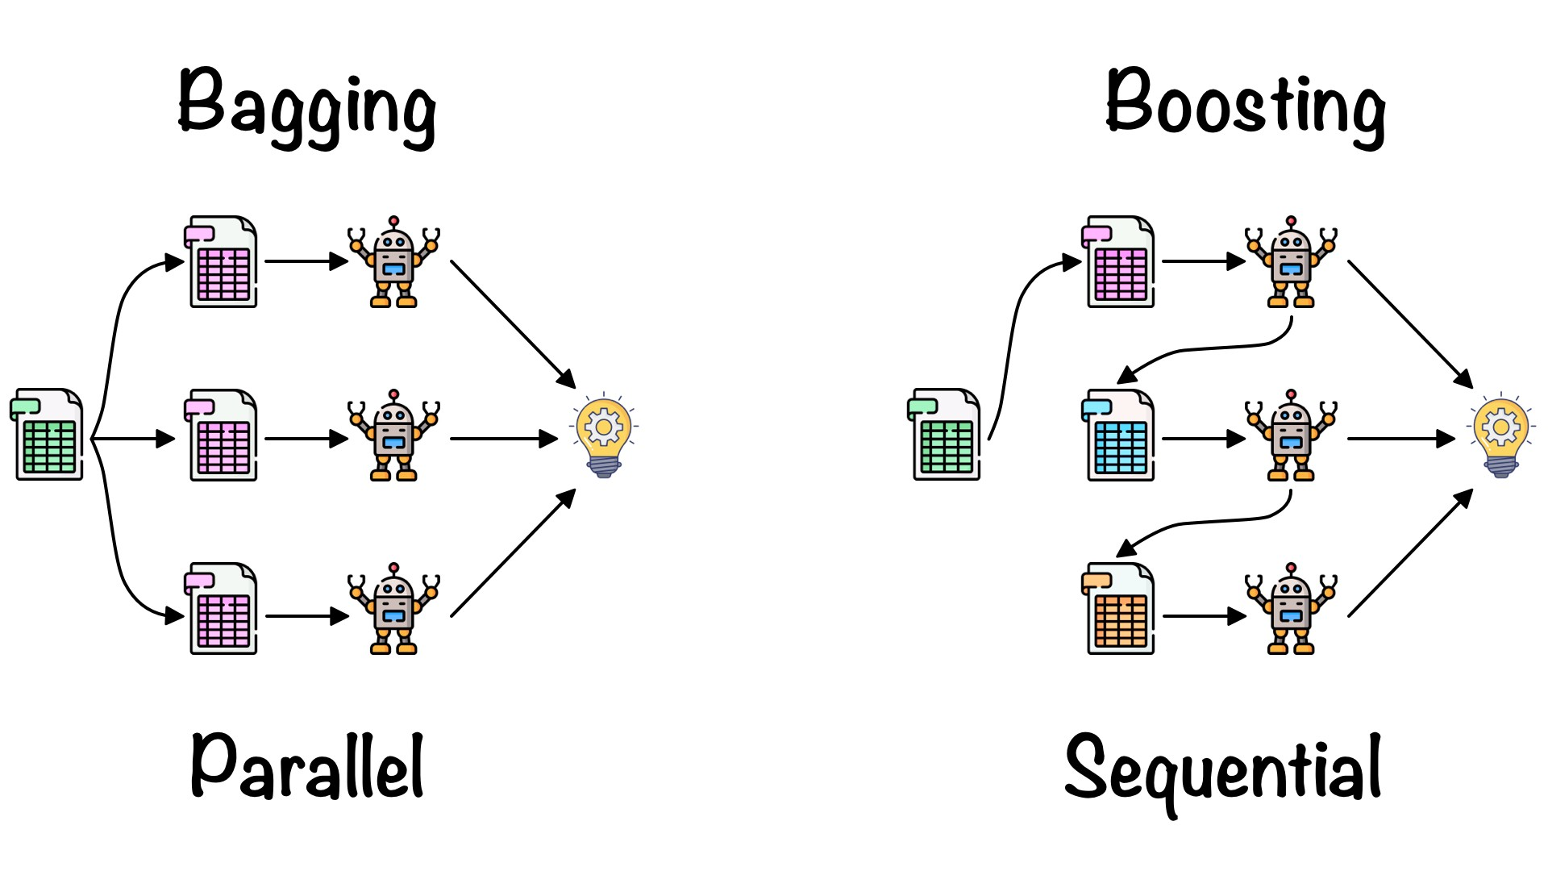
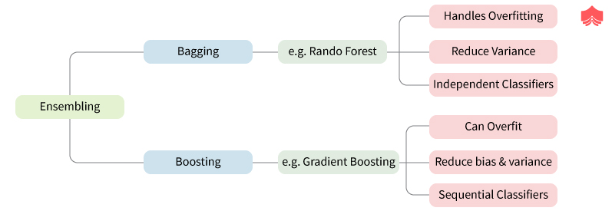
Ensembles
Ensemble methods use multiple learning algorithms to obtain better predictive performance than could be obtained from any of the constituent learning algorithms
Bagging
Boosting
Random
Forests
Gradient
Boosting
Learn different parts of the concept with different models and combine
29
Notes:
Bagging and Boosting are the most popular Ensemble based techniques
Bagging is a way to decrease the variance in the prediction by generating additional data for training from dataset using combinations with repetitions to produce multi-sets of the original data.
Boosting is an iterative technique (Sequential) which adjusts the weight of an observation based on the last classification.

Slide 30
(1) Bagging
Bagging, short for Bootstrap aggregating, is one of the earliest ensemble based algorithms.
It is also one of the most intuitive and simplest to implement, with a surprisingly good performance
Use bootstrapped replicas of the training data; large number of (say 200) training subsets are randomly drawn - with replacement - from the entire training data
Each resampled training set is used to train a different classifier of the same type (Homogenous)
Individual classifiers are combined by taking a majority vote of their decisions
Random Forest is one of the most popular and most powerful machine learning bagging techniques.
Notes:
Bagging, often considers homogeneous weak learners,
Learns them independently from each other in parallel and
Combines them following some kind of deterministic averaging process

Slide 31
(1) Bagging
Individual classifiers are combined by taking a majority vote of their decisions
Instance
X
Classification
h₂
h₁
Majority(h₁(x), h₂(x), h₃(x), h₄(x), h₅(x))
h₃
h₄
For the classification to be wrong, at least 3 out
Of the 5 hypotheses have to be wrong!
h₅
The class that gets the most votes, majority class
Ensemble of hypotheses
Notes:
In this example we have 5 classifiers of the same type
The idea of bagging is simple:
We want to fit several independent models and “average” their predictions in order to obtain a model with a lower variance.
However, we can’t, in practice, fit fully independent models because it would require too much data.
So, we rely on the good “approximate properties” of bootstrap samples (representativity and independence) to fit models that are almost independent.

Slide 32
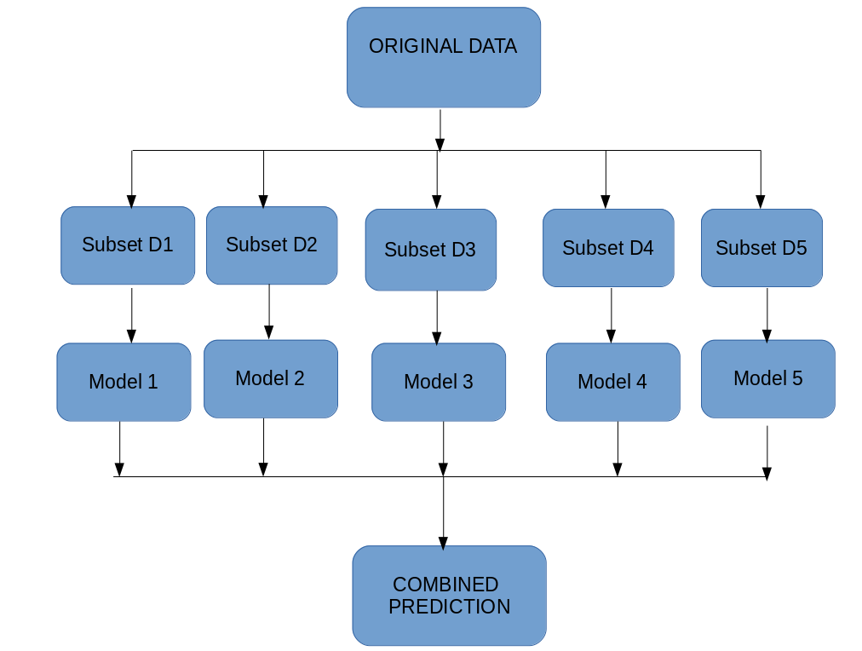
(1) Bagging: Bootstrapping
Multiple subsets are created from the original dataset, selecting observations with replacement.
A base model (weak model) is created on each of these subsets.
The models run in parallel and are independent of each other.
The final predictions are determined by combining the predictions from all the models.
run in parallel
Notes:
Unlike Boosting which is sequential, bagging is parallel in nature

Slide 33
(2) Boosting
Boost the performance of a weak learner to the level of a strong one
Boosting creates an ensemble of classifiers (models run sequentially) by resampling the data; classifiers combined by majority voting
resampling is strategically geared to provide the most informative training data for each consecutive classifier
Example → Boosting creates three weak classifiers:
First classifier C₁ is trained with a random subset of the available training data
Second classifier C₂ is trained on instances on which C₁ misclassifies.
Third classifier C₃ is trained on instances on which both C₁ & C₂ disagree
Notes:
Boosting, often considers homogeneous weak learners,
Learns them sequentially in a very adaptative way (a base model depends on the previous ones)
Combines them following a deterministic strategy

Slide 34
Boosting Illustration
Weak
Classifier 1
Notes:
The term Boosting refers to a family of algorithms which converts weak learner to strong learners.
Boosting is an ensemble method for improving the model predictions of any given learning algorithm.
The idea of boosting is to train weak learners sequentially, each trying to correct its predecessor.

Slide 35
Boosting Illustration
Weights
Increased
Notes:
This process slowly learns from data and tries to improve its prediction in subsequent iterations

Slide 36
Boosting Illustration
Weak
Classifier 2

Slide 37
Boosting Illustration
Weights
Increased

Slide 38
Boosting Illustration
Weak
Classifier 3

Slide 39
Boosting Illustration
Final classifier is
a combination of weak classifiers

Slide 40
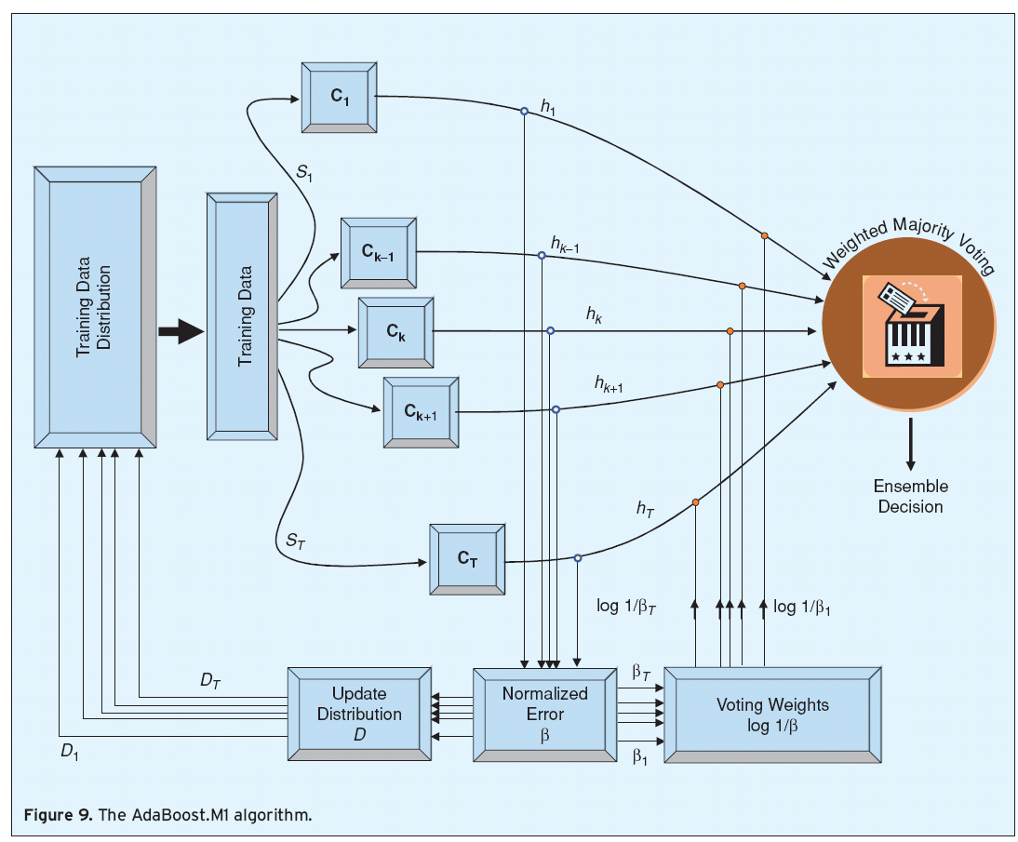
(2) AdaBoost.M1
AdaBoost algorithm is sequential; classifier (CK-1) is created before classifier CK
Notes:
Boosting mainly aims at reducing variance.
Boosting is a technique that consists in fitting sequentially multiple weak learners in a very adaptative way:
Each model in the sequence is fitted giving more importance to observations in the dataset that were badly handled by the previous models in the sequence.

Slide 41
(3) Stacking
Stacking mainly differ from bagging and boosting on two points.
First stacking often considers heterogeneous weak learners (different learning algorithms are combined) whereas bagging and boosting consider mainly homogeneous weak learners.
Second, stacking learns to combine the base models using a meta-model whereas bagging and boosting combine weak learners following deterministic algorithms.
For example, for a classification problem, we can choose as weak learners a:
(a) KNN classifier, (b) A logistic regression (c) An SVM,
And decide to learn a neural network as meta-model.
Then, the neural network will take as inputs the outputs of our three weak learners and will learn to return final predictions based on it.
Notes:
https://www.youtube.com/watch?v=xtTyEoJ31Vg
Stacking mainly differ from bagging and boosting on two points.
First stacking often considers heterogeneous weak learners (different learning algorithms are combined) whereas bagging and boosting consider mainly homogeneous weak learners.
Second, stacking learns to combine the base models using a meta-model whereas bagging and boosting combine weak learners following deterministic algorithms.
For example, for a classification problem, we can choose as weak learners a:
KNN classifier,
A logistic regression and
An SVM,
And decide to learn a neural network as meta-model.
Then, the neural network will take as inputs the outputs of our three weak learners and will learn to return final predictions based on it.

Slide 42
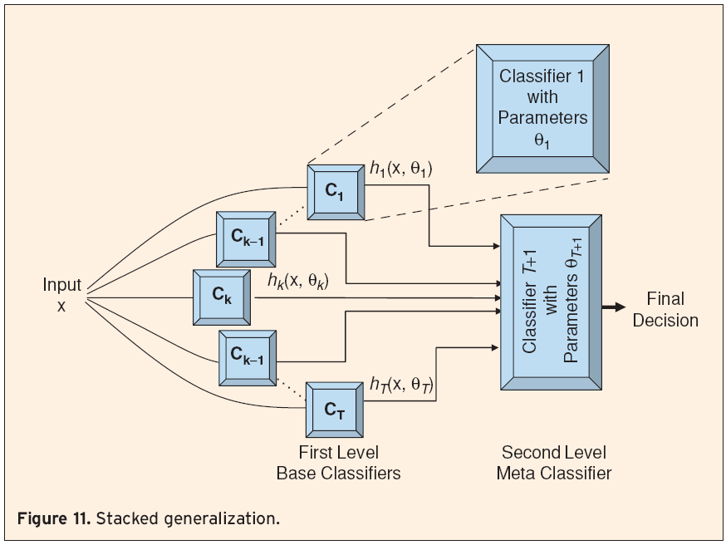
(3) Stacked Generalization
An ensemble of classifiers is first created, whose outputs are used as inputs to a second level meta-classifier to learn the mapping between the ensemble outputs and the actual correct classes
C₁, …,C_{T} are trained using training parameters θ₁ through θ_{T} to output hypotheses h₁ through h_{T}
The outputs of these classifiers and the corresponding true classes are then used as input/output training pairs for the second level classifier, C_{T+1}
Notes:
https://www.youtube.com/watch?v=xtTyEoJ31Vg
https://drive.google.com/drive/folders/1XdPbyAc9iWml0fPPNX91Yq3BRwkZAG2M
Assume we have 100 records → split data into 75 (Training Set) and 25 (Testing Set)
From the Training Set use 80% for training the 1st level classifiers, and 20% to validate these classifiers
After training the 1st level classifiers using the 80% of the training data we validate them using a record with 3 features
X1, X2, X3 and the label Y = 0
Assume we are using Log. Regression, SVM, NN and their prediction is 1, 0, 1 → use the combination 1, 0, 1 with Y=0 as a training set for the Meta Classifier.

Slide 43
(4) Mixture-of-Experts
A conceptually similar technique is the mixture-of-experts model, where a set of classifiers C₁, …,C_{T} constitute the ensemble, followed by a second-level classifier C_{T+1} used for assigning weights for the consecutive combiner
The combiner itself is usually not a classifier, but rather a simple combination rule, such as random selection (from a weight distribution), weighted majority, or weighted winner-takes-all
the weight distribution used for the combiner is determined by a second level classifier, usually a neural network, called the gating network
The inputs to the gating network are the actual training data instances themselves (unlike outputs of first level classifiers for stacked generalization)
Mixture-of-experts can, therefore, be seen as a classifier selection algorithm
Individual classifiers are experts in some portion of the feature space, and the combination rule selects the most appropriate classifier, or classifiers weighted with respect to their expertise, for each instance x
Notes:
https://machinelearningmastery.com/mixture-of-experts/
https://mkai.org/a-gentle-introduction-to-mixture-of-experts-ensembles/
Mixtures of experts shows a strong similarity to stacked generalization
Belongs to the class of ensemble learning methods referred to as meta-learning.
Mixture of experts is an ensemble learning technique developed in the field of neural networks.
It involves decomposing predictive modeling tasks into sub-tasks, training an expert model on each, developing a gating model that learns which expert to trust based on the input to be predicted, and combines the predictions.

Slide 44
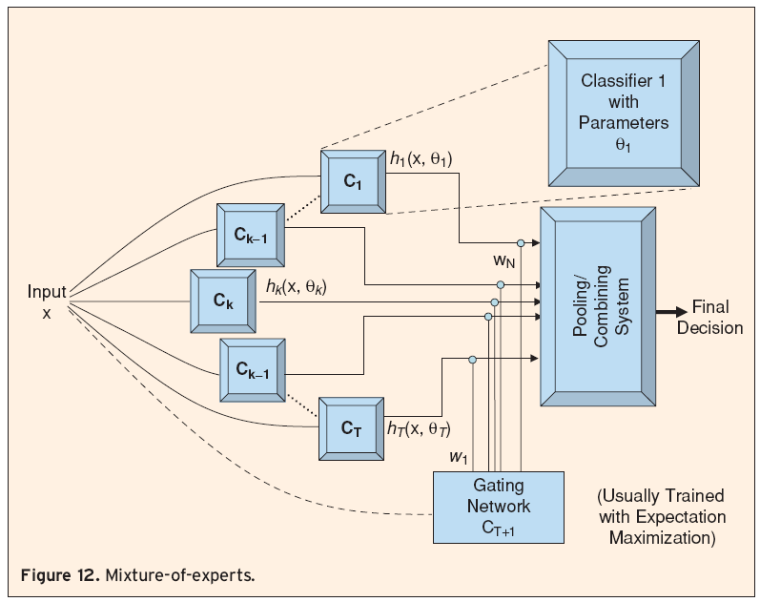
(4) Mixture of Experts
There are four elements to the approach, they are:
Division of a task into subtasks.
Develop an expert for each subtask.
Use a gating model to decide which expert to use.
Pool predictions/gating model output to make a prediction
Notes:
The pooling system may use weights in different ways.
It may choose a single classifier with the highest weight, or calculate a weighted sum of the classifier outputs for each class, and pick the class that receives the highest weighted sum.

Slide 45
(4) Mixture of Experts
Subtasks: Divide the predictive modeling problem into subtasks. This often involves using domain knowledge. For example, an image could be divided into separate elements such as background, foreground, objects, colors, lines, and so on.
Expert Models: An expert is designed for each subtask. The mixture of experts approach was initially developed and explored within the field of artificial neural networks, so traditionally, experts themselves are neural network models.
Gating Model: A model is used to interpret the predictions made by each expert and to aid in deciding which expert to trust for a given input. This is called the gating model, or the gating network, given that it is traditionally an ANN model.
Pooling Method: Finally, the mixture of expert models must make a prediction, and this is achieved using a pooling or aggregation mechanism. This might be as simple as selecting the expert with the largest output or confidence provided by the gating network.
Notes:
Dividing the prediction modeling problem into subtasks (divide & Conquer) can take different approaches for different problems:
Image processing
Natural Language processing …
Consider a decision boundary that has a complex shape like an S in two dimensions.
We could divide up the problem into three parts:
The curve at the top,
The curve at the bottom and
The line connecting the curves.
Assigning an expert model to each task mask may take different approaches
Homogenous
Heterogenous
A model can be trained on each subspace of the problem, being in effect an expert on the specific subproblem.
A model then learns which expert to call upon to predict new examples in the future.
Gating model/network (interprets predictions made) can be simple or complex
Learns which expert to trust based on the input to be predicted, and combines the predictions.
Pooling method:
How to aggregate results and make final decision
https://machinelearningmastery.com/mixture-of-experts/

Slide 46
Combining Classifiers

Slide 47
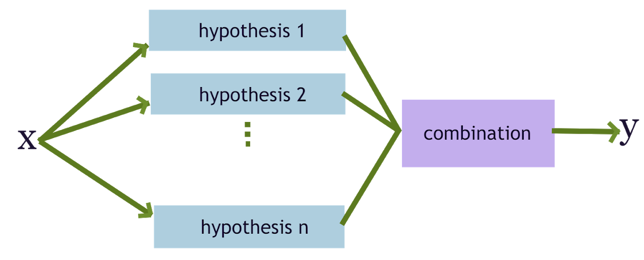
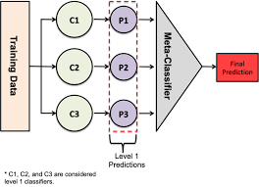
Combining Classifiers
How to combine classifiers?
The combination of the predictions is a central part of the ensemble method and depends heavily on:
The types of models that contribute to the ensemble,
Homogenous
Heterogenous
The type of prediction problem that being modeled,
Classification
Regression.
Notes:
https://machinelearningmastery.com/combine-predictions-for-ensemble-learning/
The combination of the predictions is a central part of the ensemble method and depends heavily on:
The types of models that contribute to the ensemble and
The type of prediction problem that is being modeled, such as a classification or regression.
Current research on ensembles centers on:
More efficient and complex ways to combine models,

Slide 48
Combining Outputs
Algebraic combiners
Mean Rule:
Weighted Average:
Minimum/Maximum/Median Rule:
Product Rule:
Generalized Mean:
Many of the above rules are in fact special cases of the generalized mean
: minimum rule; :maximum rule; :
: mean rule
Notes:
Here are a few algebraic combination rules

Slide 49
Combining Class Labels
Majority Voting :
Weighted Majority Voting –
Borda Count –
Each voter (classifier) rank orders the candidates (classes).
If there are N candidates, the first-place candidate receives N − 1 votes, the second-place candidate receives N − 2, with the candidate in i^{th} place receiving N − i votes.
The votes are added up across all classifiers, and the class with the most votes is chosen as the ensemble decision
Notes:
Here are a few Majority rules:
Simple voting, called plurality voting, selects the class label with the most votes.
Given ties, it is common to have an odd number of ensemble members in an attempt to automatically break ties, as opposed to an even number of ensemble members where ties may be more likely.
Majority voting selects the class label that has more than half the votes.
If no class has more than half the votes, then a “no prediction” is made.
Interestingly, majority voting can be proven to be an optimal method for combining classifiers, if they are independent.
Weighted voting weighs the prediction made by each model in some way.
One example would be to weigh predictions based on the average performance of the model, such as classification accuracy.
The weight of each classifier can be set proportional to its accuracy performance on a validation set.
Assigning weights to classifiers can become a project in and of itself and could involve using an optimization algorithm and a holdout dataset, a linear model, or even another machine learning model entirely.
The idea of weighted voting is that some classifiers are more likely to be accurate than others and we should reward them by giving them a larger share of the votes.

Slide 50
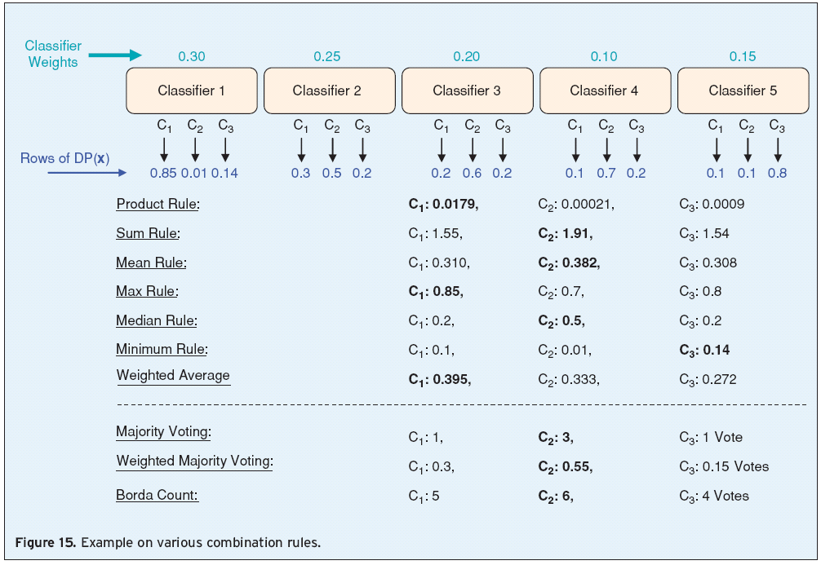
Combining Classifier Outputs
Various Combination Rules
Notes:
This is an example of how classifier outputs can be combined effectively using
Majority voting
Weighted Majority voting
Borda Count

Slide 51
Summary

Slide 52
Summary
Ensemble systems are useful in practice
Diversity of the base classifiers is important
Ensemble generation techniques include bagging, boosting, mixture of experts
Classifier combination strategies: algebraic combiners, voting methods, and decision templates.
No single ensemble generation algorithm or combination rule is universally better than others
Effectiveness on real world data depends on the classifier diversity and characteristics of the data

Slide 53
Summary Ensemble Learning
Ensemble approaches use multiple models in their decision making. They frequently accomplish high accuracies, are less likely to over-fit and exhibit a low variance. They have been successfully used in the Netflix contest and for other tasks. However, some research suggest that they are sensitive to noise (http://www.phillong.info/publications/LS10_potential.pdf ).
The key of designing ensembles is diversity and not necessarily high accuracy of the base classifiers: Members of the ensemble should vary in the examples they misclassify. Therefore, most ensemble approaches, such as AdaBoost, seek to promote diversity among the models they combine.
The trained ensemble represents a single hypothesis. This hypothesis, however, is not necessarily contained within the hypothesis space of the models from which it is built. Thus, ensembles can be shown to have more flexibility in the functions they can represent. Example: http://www.scholarpedia.org/article/Ensemble_learning
Current research on ensembles centers on: more complex ways to combine models, understanding the convergence behavior of ensemble learning algorithms, parameter learning, understanding over-fitting in ensemble learning, characterization of ensemble models, sensitivity to noise.
Notes:
Summary:
Ensemble Techniques use a diversity of models
The diverse models produce different decision boundaries that can be combined and more effective

Slide 54
Resources

Slide 55
Ensemble Learning: Misc. Resources
YouTube
https://www.youtube.com/watch?v=gTUigPt8fVo
https://www.youtube.com/watch?v=sfVms30Ulxw&t=0s
https://www.youtube.com/watch?v=SZbEZcdyOWU
https://www.youtube.com/watch?v=m-S9Hojj1as
https://www.youtube.com/watch?v=LsK-xG1cLYA
https://www.youtube.com/watch?v=Yvn3--rIdZg
https://www.youtube.com/watch?v=FxrTtRvYQWk
55

Slide 56
Ensemble Learning: Misc. Resources
Tutorials:
https://www.analyticsvidhya.com/blog/2018/06/comprehensive-guide-for-ensemble-models/
https://sefiks.com/2018/10/04/a-step-by-step-gradient-boosting-decision-tree-example/
https://machinelearningmastery.com/boosting-and-adaboost-for-machine-learning/
https://machinelearningmastery.com/gentle-introduction-gradient-boosting-algorithm-machine-learning/
https://machinelearningmastery.com/mixture-of-experts/
https://mkai.org/a-gentle-introduction-to-mixture-of-experts-ensembles/
Documents:
https://www.kaggle.com/code/prashant111/bagging-vs-boosting/notebook
https://towardsdatascience.com/ensemble-methods-bagging-boosting-and-stacking-c9214a10a205
https://medium.com/@rrfd/boosting-bagging-and-stacking-ensemble-methods-with-sklearn-and-mlens-a455c0c982de
56

Slide 57
End Slides

