Slide 1
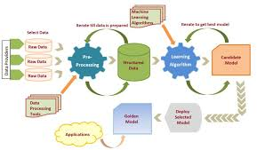
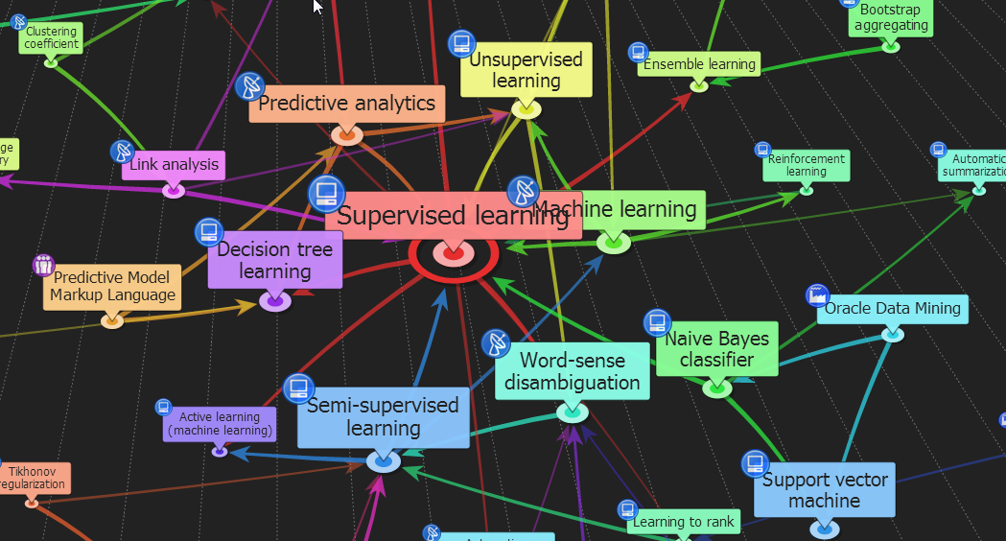



ENG6500: Intro to Machine Learning Ensemble Learning “Part II: Boosting”
S. Areibi
School of Engineering
University of Guelph
Notes:
The first ensemble based technique that we will cover in details is Boosting

Slide 2
Introduction
Notes:
Boosting is based on a simple concept that enables it to achieve good results

Slide 3
Boosting
Definition of Boosting:
Boosting refers to a general method of producing a very accurate prediction rule by combining rough and moderately inaccurate weak learners “rules-of-thumb”.
Intuition:
No learner is always the best;
Construct a set of base “weak” learners which when combined achieves higher accuracy
A weak learner is “rough and moderately inaccurate” predictor but one that can predict better than chance.
Different learners may:
--- Be trained by different algorithms
--- Use different modalities (features)
--- Focus on different subproblem
3
Notes:
Boosting is an ensemble based approach that attempts to produce a classifier with high accuracy by using simple weak classifiers
Weak classifiers can come in different flavors
Perceptrons
Stumps (decision trees that can use only a single variable to produce a result)

Slide 4
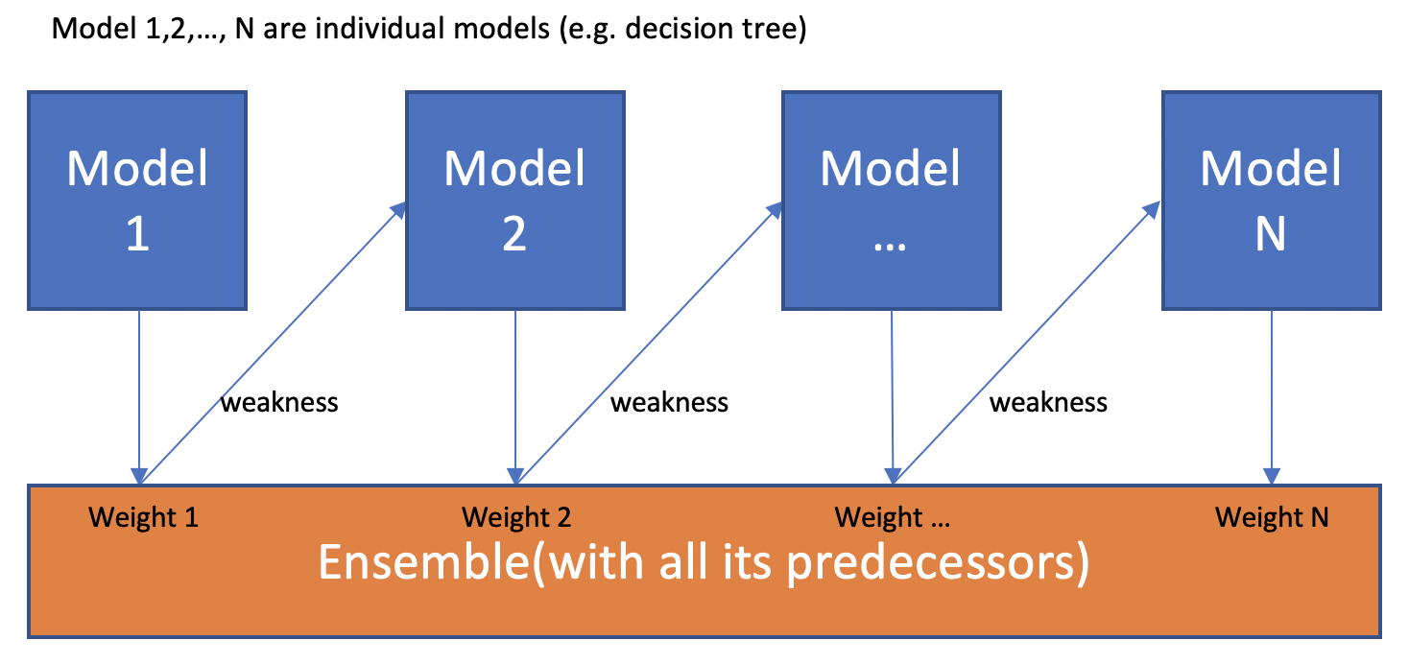
Boosting
Boosting algorithms convert weak learners into strong learners.
Boosting is a sequential process; i.e., trees are grown using the information from a previously grown tree, one after the other.
This process slowly learns from data and tries to improve its prediction in subsequent iterations.
Each classifier has a voting weight by which we can combine all results to produce a strong learner
Notes:
The idea of boosting is to create good solutions by using mediocre classifiers and improve the accuracy sequentially
Unlike Boosting, other ensemble based techniques are parallel
Order in Boosting is important:
Errors made by the first classifier (Stump or perceptron) influence how the second classifier is made

Slide 5
Boosting
Weak learner: produces a hypotheses at least as good as a random classifier.
What can we boost?
Examples of weak learners:
Rules of thumb
Decision “Tree” stumps (decision trees of one parent node)
Perceptron
Naïve Bayes Models
….
Notes:
Boosting tends to create solutions form weak learners ..
Weak learners are models that perform slightly better than random guessing.
Strong learners are models that have arbitrarily good accuracy.
Weak and strong learners are tools from computational learning theory and provide the basis for the development of the boosting class of ensemble methods

Slide 6
Boosting Paradigm
Advantages?
No need to learn a perfect hypothesis
Can boost any weak learning algorithm
Boosting is very simple to program
Boosting provides good generalization
Paradigm Shift
Don’t try to learn a perfect hypothesis
Just learn simple rules of thumbs and boost them
Notes:
Pros of using a sequential learning technique such as Boosting?
Simple yet effective technique that produces good results and generalizes
Iterative in nature thus builds on top of previous classifier
Learns from previous mistakes
Puts more weights on errors

Slide 7
Boosting Framework
Assume we have 4 data points to be classified
√
√
√
√
√
√
√
√
√
√
h₁
h₂
h₃
h₄
Increase weight of misclassified points
Create a weighted combination of the previous models used
h
Let us feed these points to a base learner (simple decision tree algorithm)
Notes:
This example shows the sequential nature of the Boosting algorithm
In every iteration we produce a hypothesis that is different than the previous approach
What is the advantage of choosing h₁, h₂, h₄??

Slide 8
Boosting Algorithm
Set all instance weights W_{x} to some value either
Set to 1
Or set to W/n where n is the number of instances
Repeat
h_{i} ← learn (dataset, weights)
Rank classifiers based on performnace
Increase W_{x} of misclassified instances X
Until sufficient number of hypotheses
Ensemble hypothesis is the weighted majority of h_{i}’s with weights W_{i} proportional to the accuracy of h_{i}
Notes:
The overall algorithm for Boosting can be described in a few phases
Assign Weights to instances
Learn a Hypothesis i
Modify weights of misclassified instances
Use next Learner to produce a hypothesis on newly modified weights

Slide 9
Boosting: Objectives
Boost the performance of a weak learner to the level of a strong one
Boosting creates an ensemble of classifiers by resampling the data; classifiers combined by majority voting
resampling is strategically geared to provide the most informative training data for each consecutive classifier
Example → Boosting creates three weak classifiers:
First classifier C₁ is trained with a random subset of the available training data
Training set for second classifier C₂ is chosen as the most informative subset, given C₁; half of the training data for C₂ is correctly classified by C₁, other half is misclassified by C₁
Third classifier C₃ is trained on instances on which both C₁ & C₂ disagree
Notes:
Since Boosting tends to boost the performance of weak learner its main objective is:
Decrease bias, not variance.
Concentrates on misclassified samples by reweighting them

Slide 10
Boosting: Simple Example
D₁
The first classifier creates a vertical line (split) at D₁.
It says anything to the left of D₁ is “+” and anything to the right of D₁ is “-”.
However, this classifier misclassifies three “+” points.
How does Boosting help in this case?
It creates a new weak classifier to try to fix the problem.
+
-
+
+
+
-
-
+
-
-
Classifier #1
Assume we have 10 data points to be classified
Notes:
Here is an example with 10 samples (data points)
The first classifier creates a decision boundary (hypothesis)
Some points will be classified correct while others are wrongly classified

Slide 11
Boosting: Simple Example
D₂
The next classifier says I will correct the mistake committed by the previous classifier.
It gives more weight to the three “+” misclassified points and,
Creates a vertical line at D₂.
However, with this classifier, we will have three “-” points being misclassified.
Boosting again will attempt to give more weights to the misclassified “-” points.
+
-
+
+
+
-
-
+
-
-
Classifier #2
Notes:
Classifier #2 produces a different hypothesis and creates a new decision boundary

Slide 12
Boosting: Simple Example
D₃
The next classifier continues to bestow support.
Again, it gives more weight to the three – misclassified points and,
Creates a horizontal line at D₃.
Again, we will have two “+” points that are misclassified and a “-” at the top that is also misclassified.
+
-
+
+
+
-
-
+
-
-
Classifier #3
Notes:
Classifier #3 will also create a new hypothesis and decision boundary

Slide 13
Boosting: Simple Example
D₁
D₂
+
+
-
+
-
D₃
-
+
+
+
+
+
+
+
-
-
+
-
-
+
-
-
+
-
-
+
-
-
+
-
-
+
-
+
+
+
-
-
+
-
-
The aggregation of the solutions of the weak classifiers D₁, D₂, D₃ will create the final strong and more accurate classification of the points.
Notes:
At this point if we aggregate the solutions of all classifiers we may be able to get a combined new decision boundary
This decision boundary is capable of accurately classifying the points
What is missing from this example?
Who has the highest say (highest vote)?
Why does it work?
We will answer these questions in the next example.

Slide 14
AdaBoost
Notes:
AdaBoost is one form of Boosting

Slide 15
Adaptive Boosting: AdaBoost
AdaBoost (1997) is a more general version of the boosting algorithm; AdaBoost.M1 can handle multiclass problems
AdaBoost generates a set of hypotheses (classifiers), and combines them through weighted majority voting of the classes predicted by the individual hypotheses
Hypotheses are generated by training a weak classifier; samples are drawn from an iteratively updated distribution of the training set
This distribution update ensures that instances misclassified by the previous classifier are more likely to be included in the training data of the next classifier
Consecutive classifiers are trained on increasingly hard-to-classify samples
Notes:
AdaBoost, short for Adaptive Boosting, is a statistical classification meta-algorithm.
It was formulated by Yoav Freund and Robert Schapire in 1995, who won the 2003 Gödel Prize for their work.
It can be used in conjunction with many other types of learning algorithms to improve performance.
https://machinelearningmastery.com/boosting-and-adaboost-for-machine-learning

Slide 16
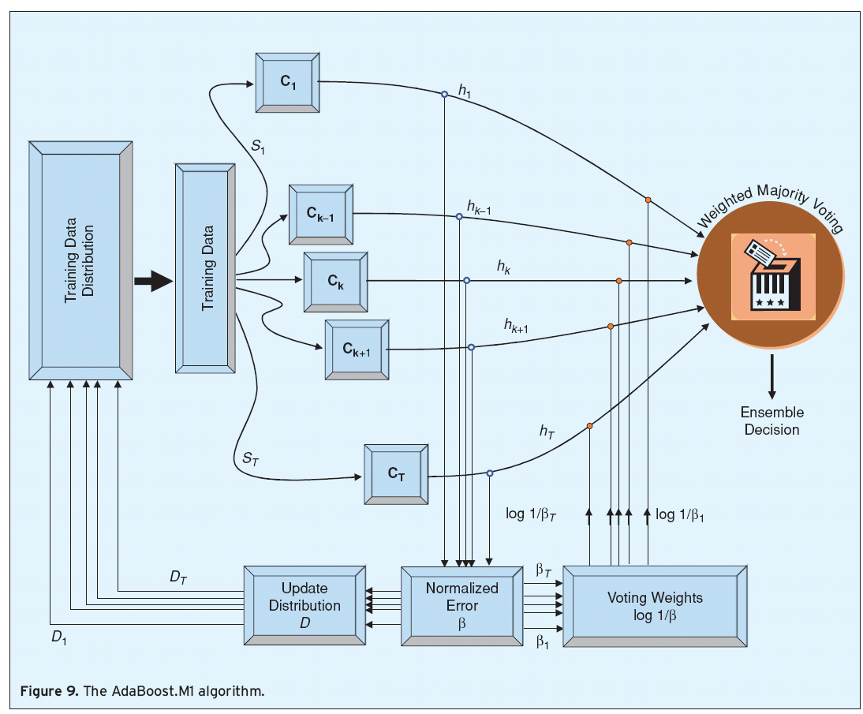
AdaBoost.M1
A weight distribution D_{t}(i) on training instances x_{i} , i=1,…,N from which training data subsets S_{t} are chosen for each consecutive classifier (hypothesis) h_{t}
AdaBoost raises the weights of instanced misclassified by h_{t} , and lowers the weights of correctly classified instances
AdaBoost is ready for classifying unlabeled test instances. Unlike bagging AdaBoost uses the weighted majority voting
Notes:
The adaboost algorithm is sequential in nature
Classifier C_{k+1} is built following classifier C_{k}
AdaBoost uses an iterative approach to learn from the mistakes of weak classifiers, and turn them into strong ones.

Slide 17
AdaBoost: Pseudocode
Initialization: W_{j} ← 1/N for all instances
For m=1 to M do
h_{m} ← learn (dataset, W)
err ← 0
For each (x_{j} , y_{j}) in dataset do
if h_{m}(x_{j}) != y_{j} then err ← err + w_{j} /* Increase error of classifier */
For each (x_{j} , y_{j}) in dataset do
if h_{m}(x_{j}) = y_{j} then w_{j} ← w_{j} * err/(1-err) /* Increase weight of instance */
W ← normalize (W)
Z_{m} ← log [(1-err)/err] /* Update classifier weights */
Return weighted-majority (h,Z)
W: vector of N instance weights
Z: vector of M hypothesis. weights
17
Notes:
The algorithm consists of several steps.
Weight Initialization
Calculating the error of classifiers
Ranking classifiers “Computing the voting power” based on their errors
Reweighting the sample points based on errors committed by classifiers

Slide 18
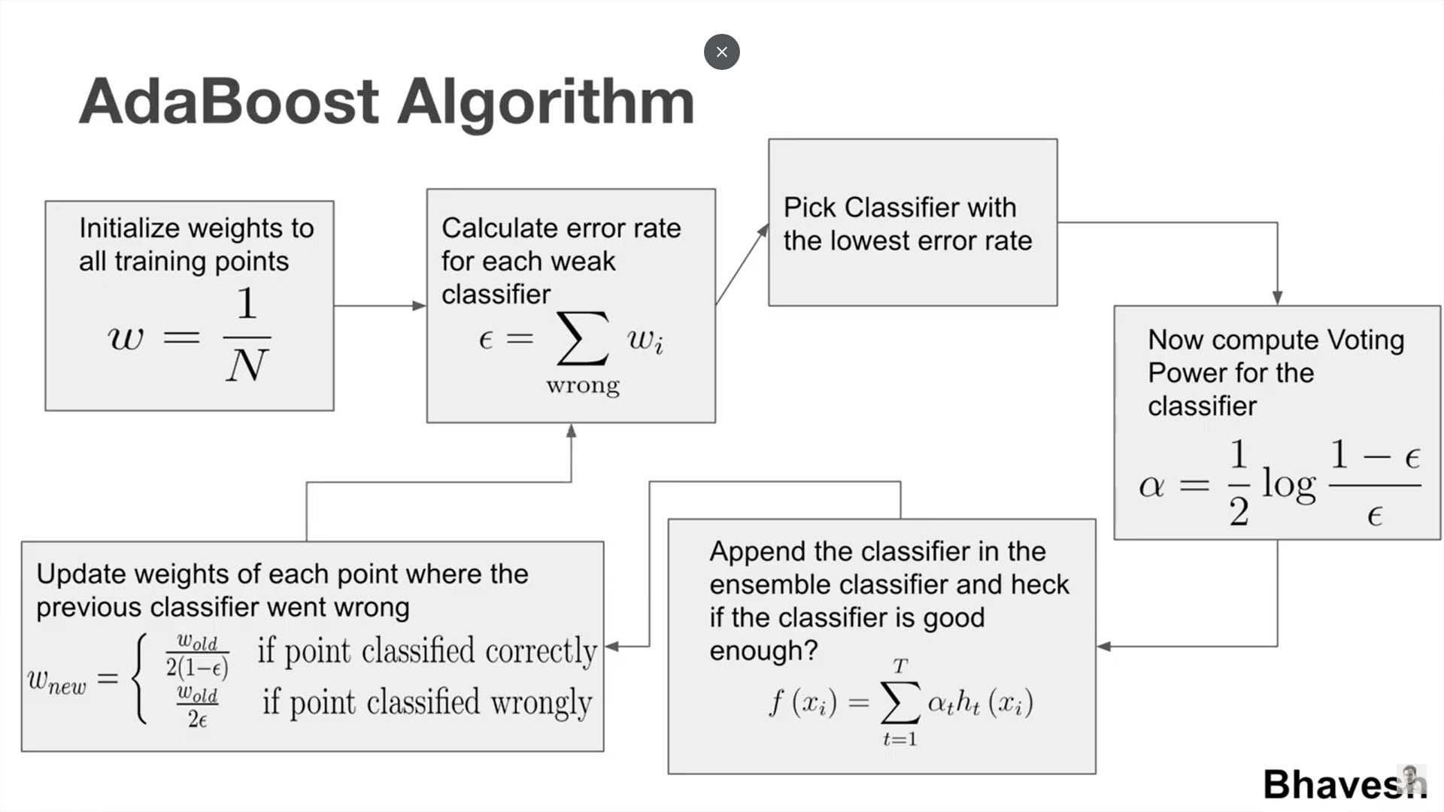
AdaBoost: Flowchart
check
Exit
The algorithm consists of several steps/Iterations.
We will demonstrate the algorithm via an example
18
Notes:
The overall algorithm of AdaBoost is shown in this figure.
The algorithm consists of several steps.
Step #1: Weight Initialization
Step #2: Perform classification by the weak classifiers and calculating the error of each
Step #3: Choosing the classifier(s) who committed the least error
Step #4: Computing the voting power (amount of say) for classifiers
Step #5: Adding the Classifier wit least errors to the Hypothesis of the ensemble
Step #6: Update the weights of each sample and point .. We can use different formulas than the one showed
If wrongly classified → W_{new} = W_{old} x e^{amount of say}
If correctly classified → W_{new} = W_{old} x e^{-amount of say}
We will demonstrate the algorithm via an example

Slide 19
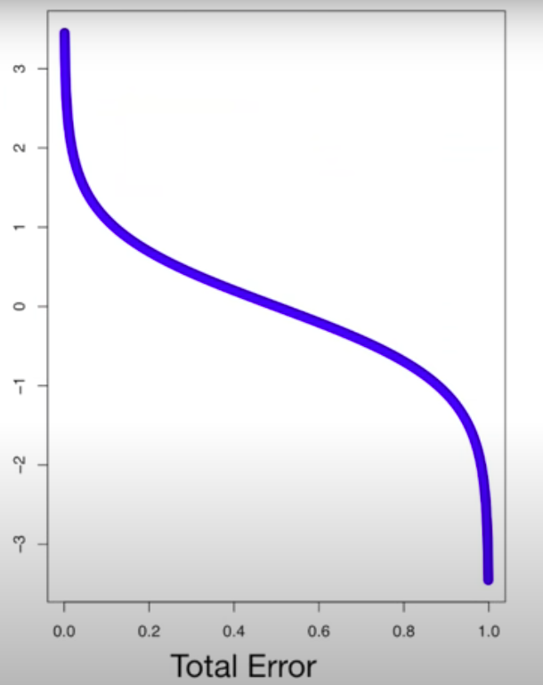
AdaBoost: Voting Power
0.368
19
Notes:
The voting power (alpha) of each weak classifier will be a function of the number of errors committed
If say a classifier makes 3 mistakes out of 8 predictions then the total error would be say 3/8
And based on the formula, alpha will be 0.368
If say a classifier makes 7 mistakes out of 8 predictions then the total error would be 7/8
And based on the formula, alpha would be NEGATIVE 3 or 4

Slide 20
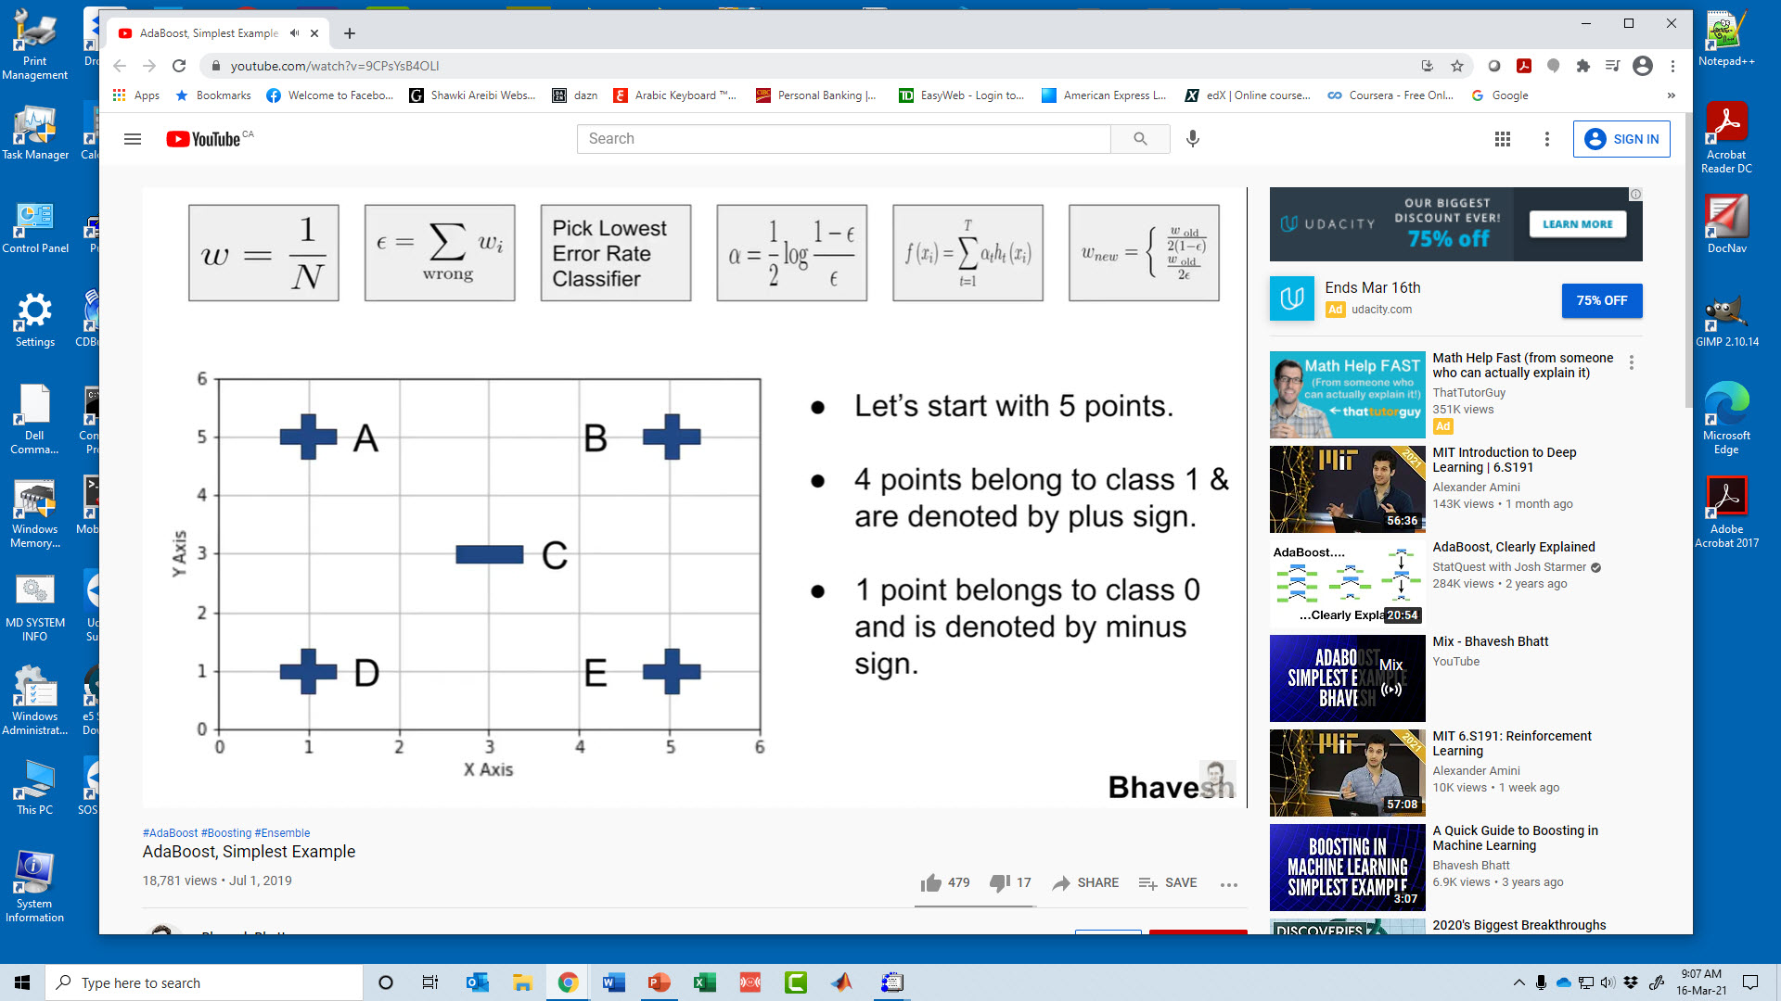
AdaBoost Algorithm: Example
If we assume we have only 5 points (A, B, C, D, E)
“+” points belong to class 1
“-” points belong to class 2
The next step is to give a weight to each point
20
Notes:
Points or samples are assigned a weight

Slide 21
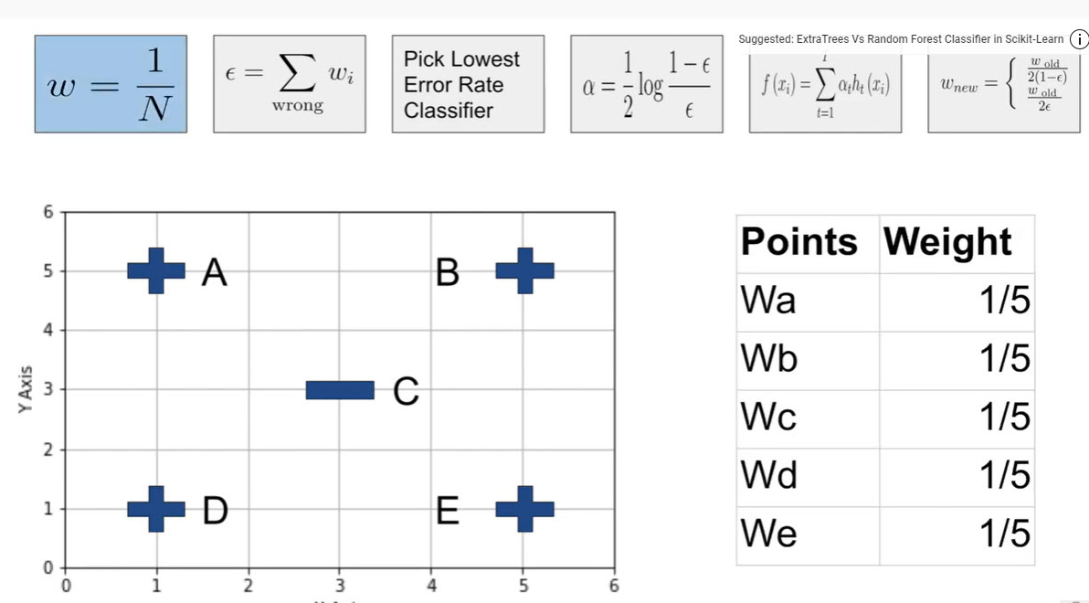
AdaBoost Algorithm: Example
Since there are 5 points each will get a weight of 1/5
The next step is to choose several weak classifiers to perform the classification task
21
Notes:
The initial assigned weight depends on the number of points in the training set
This makes the samples all equally important
However, after we create the 1st classifier .. The weights will tend to change

Slide 22
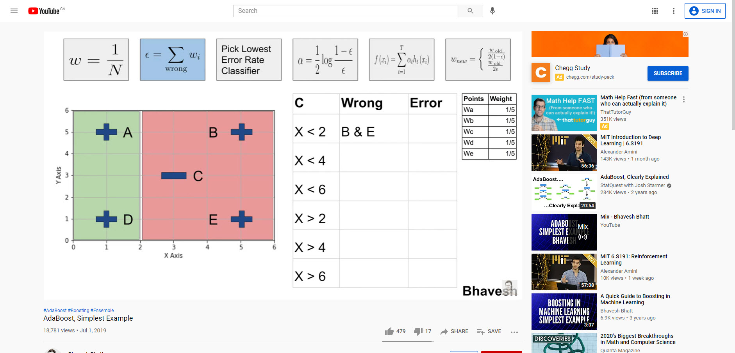
AdaBoost Algorithm: Example
The first classifier (X < 2) is responsible to classify all “+” points left of 2 and classify all “-” points to the right of 2
This classifier tends to miss classify two points “E” and “B”
We will need to calculate the error “e” of this classifier
22
Notes:
Six classifiers will be created in this example .. Each with a simple rule
The first classifier produces a hypothesis that classifies 3 points correctly and misclassifies 2 points

Slide 23
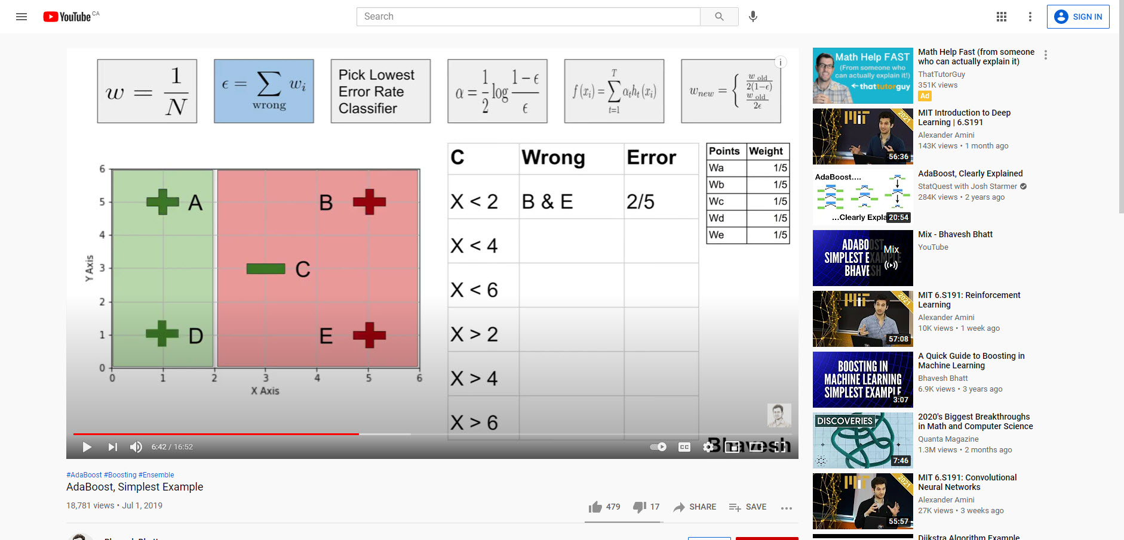
AdaBoost Algorithm: Example
This classifier made an error to classify points “E” and “B”
Since the weight of each point is 1/5
Therefore, the error for this classifier is updated to be 2/5
23
Notes:
The first classifier will be labeled with an error of 2/5

Slide 24
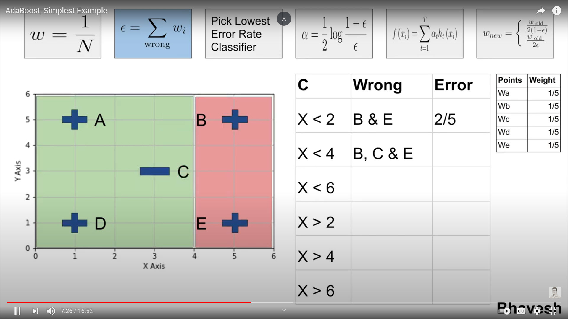
AdaBoost Algorithm: Example
The next classifier (X < 4) is applied, all “+” points should be on the left of 4 and all “-” points should be to the right of 4
This classifier made an error in three points “B”, “C” and “E”
Therefore, the error for this classifier should be updated accordingly.
24
Notes:
The next classifier produces a hypothesis that correctly classifies 2 points and misclassifies 3 points
The error of the second classifier will be updated accordingly to be 3/5

Slide 25

AdaBoost Algorithm: Example
Since three errors were committed by classifier (X < 4) the error is updated to be 3/5
The AdaBoost algorithm will continue to use all remaining classifiers and update their error accordingly.
25
Notes:
The error table will be updated for each classifier based on the mistakes and correct decisions made

Slide 26
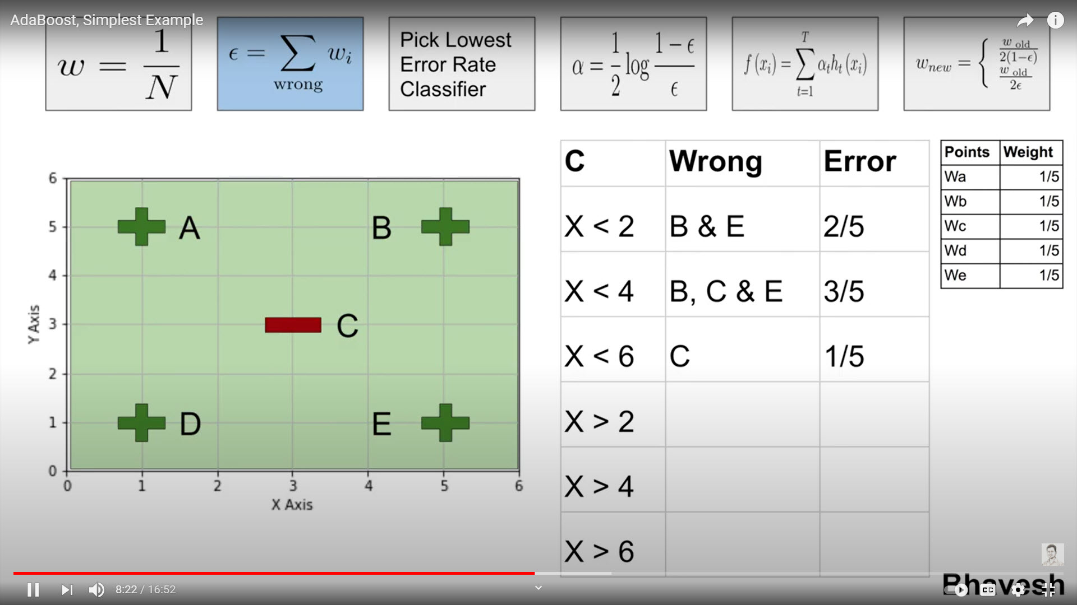
AdaBoost Algorithm: Example
The next classifier (X < 6) is applied.
All “+” points should be on the left of 6 and all “-” points should be to the right of 6.
The classifier had a single error classifying point “C”
Therefore, its error has been updated to 1/5
26
Notes:
The next classifier has an error of 1/5 (lowest so far)

Slide 27
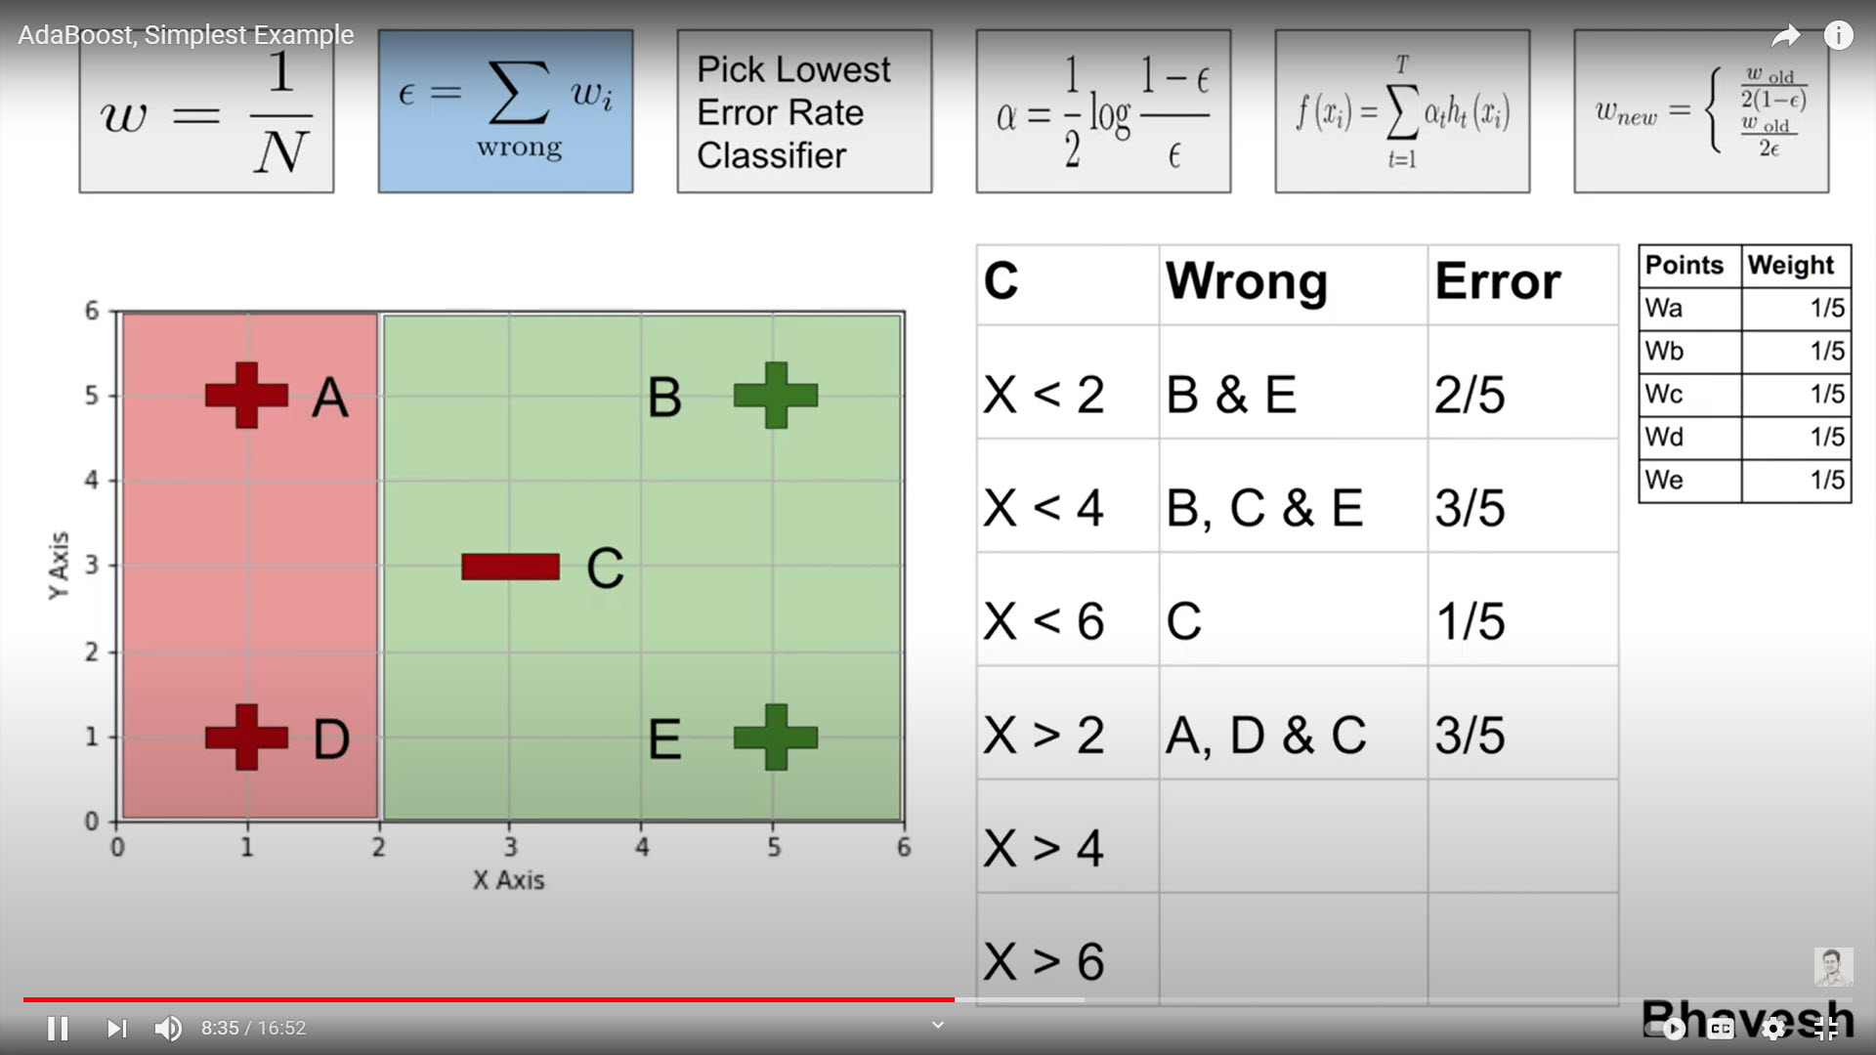
AdaBoost Algorithm: Example
The next classifier (X > 2) is applied. In this case all “+” points should be on the right of 2 and all “-” points should be to the left of 2.
The classifier had three classification errors “A”, “D”, “C”
Therefore, its error is calculated to be 3/5
27
Notes:
Next classifier has an error of 3/5

Slide 28
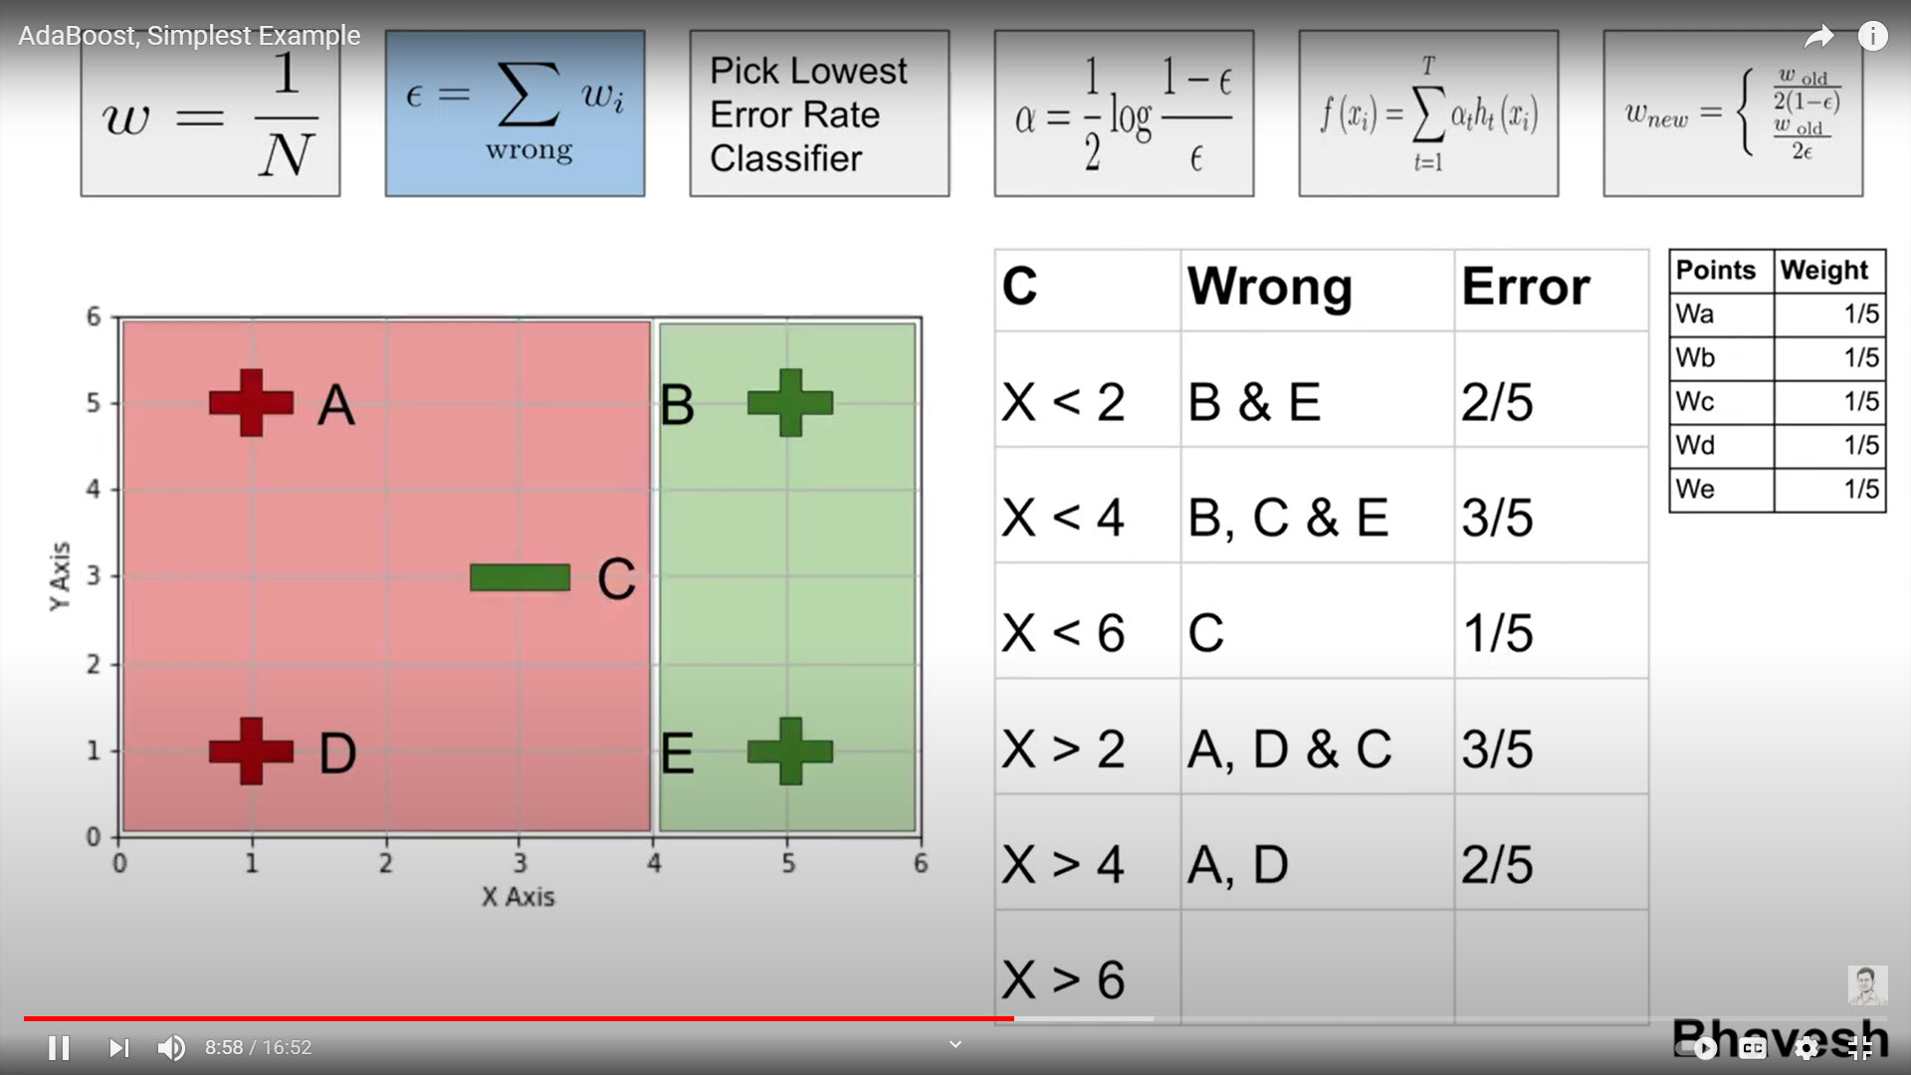
AdaBoost Algorithm: Example
The classifier (X > 4) is applied next.
In this case all “+” points should be on the right of 4 and all “-” points should be to the left of 4.
The classifier has two misclassification errors “A”, and “D”
Therefore, its error is calculated to be 2/5
28
Notes:
Next classifier made two mistakes and its error is set to 2/5

Slide 29
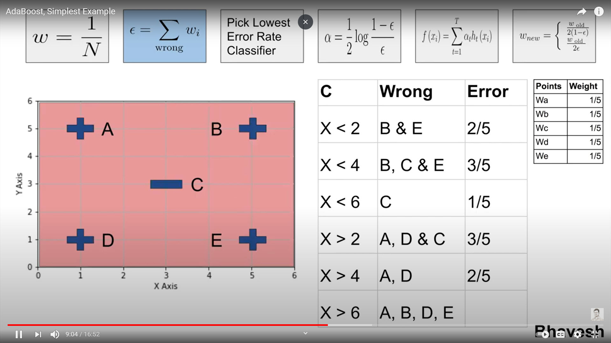
AdaBoost Algorithm: Example
4/5
The final classifier (X > 6) is applied.
All “+” points should be to the right of 6 and all “-” points should be to the left of 6
The classifier misclassified points “A”, “B”, “D”, “E”
The error committed by this classifier is 4/5
29
Notes:
The final classifier has the largest error of 4/5

Slide 30
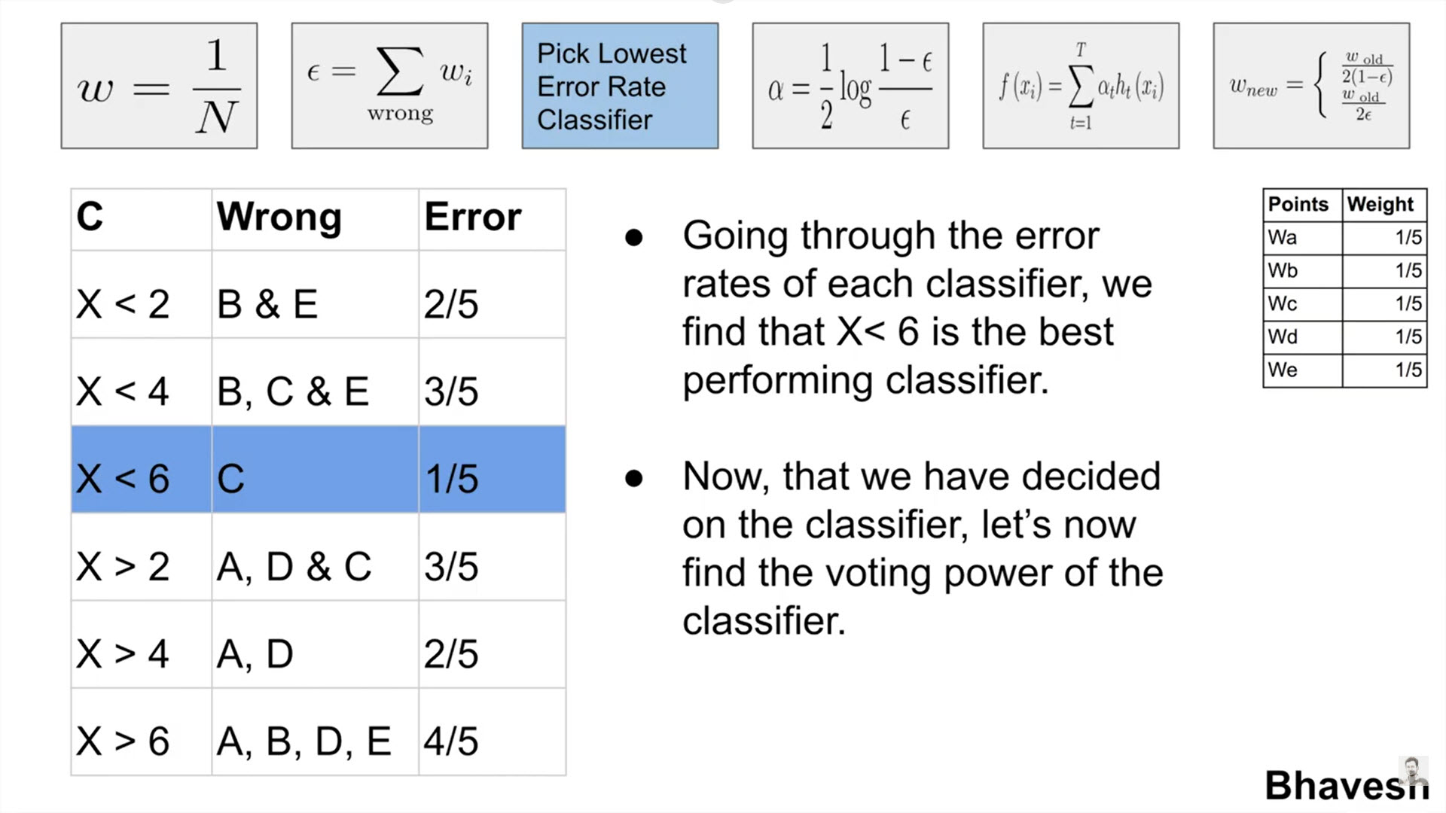
AdaBoost Algorithm: Example
We will need to determine and pick the lowest error rate classifier
Going through the error rate of each classifier, we find that weak classifier (X <6) is the best performing classifier
The error committed by (X < 6): 1/5
Next, we will need to determine the voting power of the classifier
30
Notes:
At this stage the voting power of each classifier is determined based on the errors committed

Slide 31
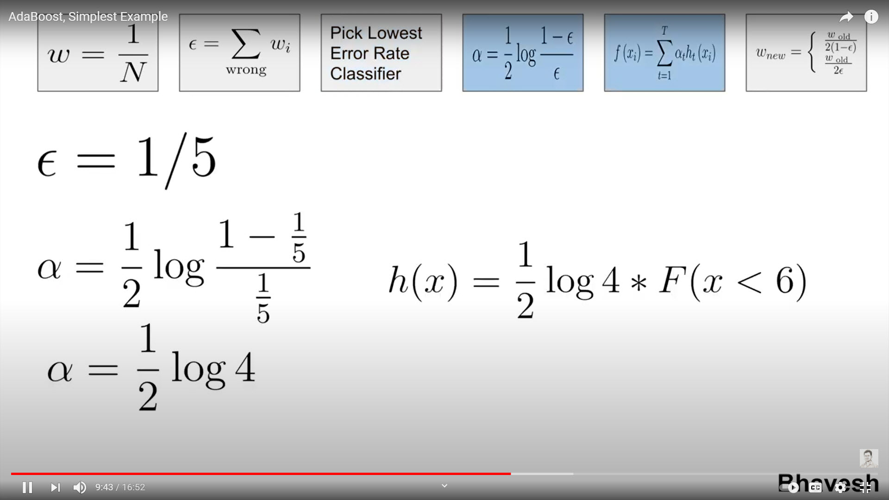
AdaBoost Algorithm: Example
Given the error rate of classifier (X < 6) is 1/5
Alpha “Voting Power” is determined to be ½ log 4
The Ensemble Hypothesis → ½ Log 4 * F( X < 6)
31
Notes:
We determine “how much say” a classifier has in the final classification based on how well it classified sample
Classifier #3 has the highest voting power since it committed the least errors
Log to be the base e
We ask our self the following question:
Is my h(x) good enough?
Have I had enough rounds?
If not satisfied, we go on to update the weights and start round 2

Slide 32
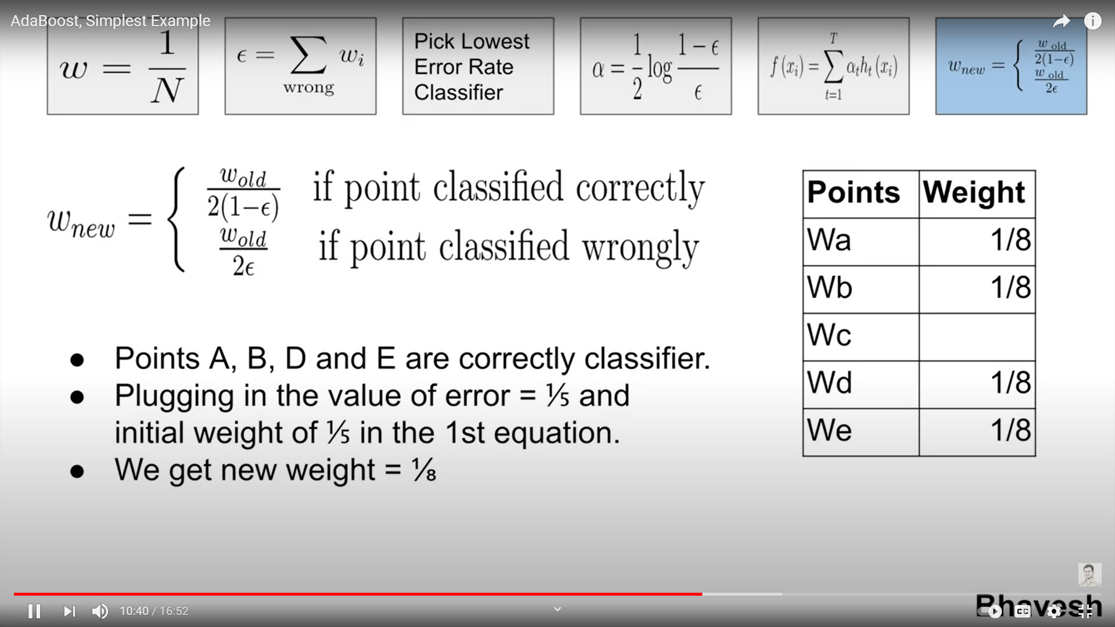
AdaBoost Algorithm: Example
All the weights of points need to be updated.
Points A, B, D, E are correctly classified by the best classifier and therefore the W_{new} of these weights are updated accordingly
Plugging in the values of W_{old} and epsilon
W_{new} = (1/5)/(2 x (1 – 1/5) → (1/5)/(2 x 4/5) → (1/5)/(8/5) → 1/8
32
Notes:
The weights of the points will be updated according to the formula (all points were classified correctly)
Epsilon in the formula above is the error of my best classifier → (X < 6) = 1/5

Slide 33
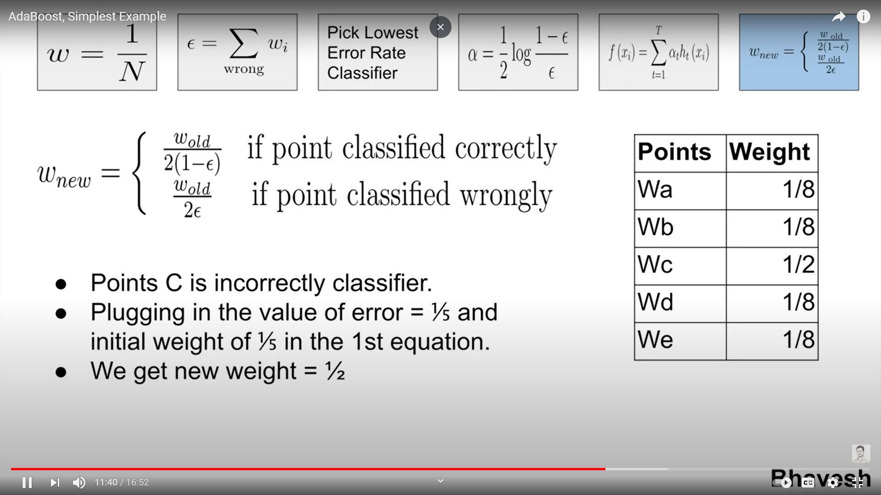
AdaBoost Algorithm: Example
Point C is incorrectly classified and therefore the W_{new} of this weight is updated accordingly
Plugging in the values of W_{old} and classifier error (epsilon)
W_{new(c)} = (1/5)/(2 x 1/5) → (1/5)/(2/5) → 1/2
33
Notes:
Since point C was incorrectly classified, its weight will be different than other points
The weight of point C will be modified from 1/5 to 4/8 or 1/2

Slide 34
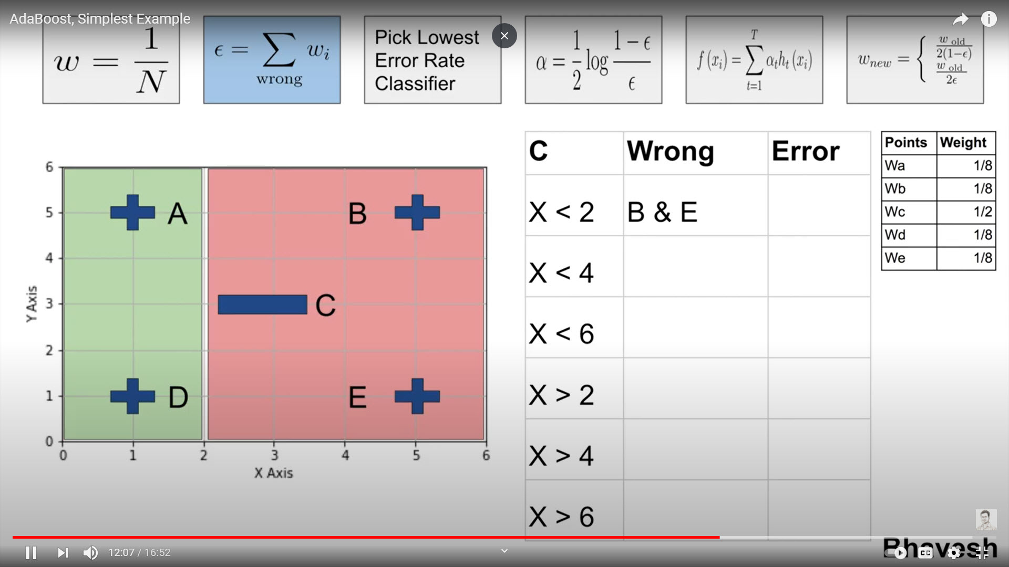
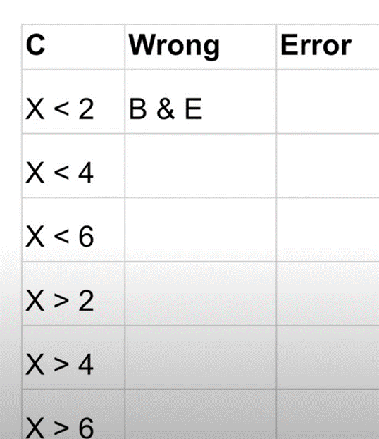
AdaBoost Algorithm: Example
Classifier #1 → B, E
Error Classifier #1 = 1/8 + 1/8 = 2/8
34
Notes:
We repeat the application of the weak classifiers on the data
Classifier #1 commits two errors (points B &E) which translates to 2/8
We iterate over all the classifiers available and record the error of each

Slide 35
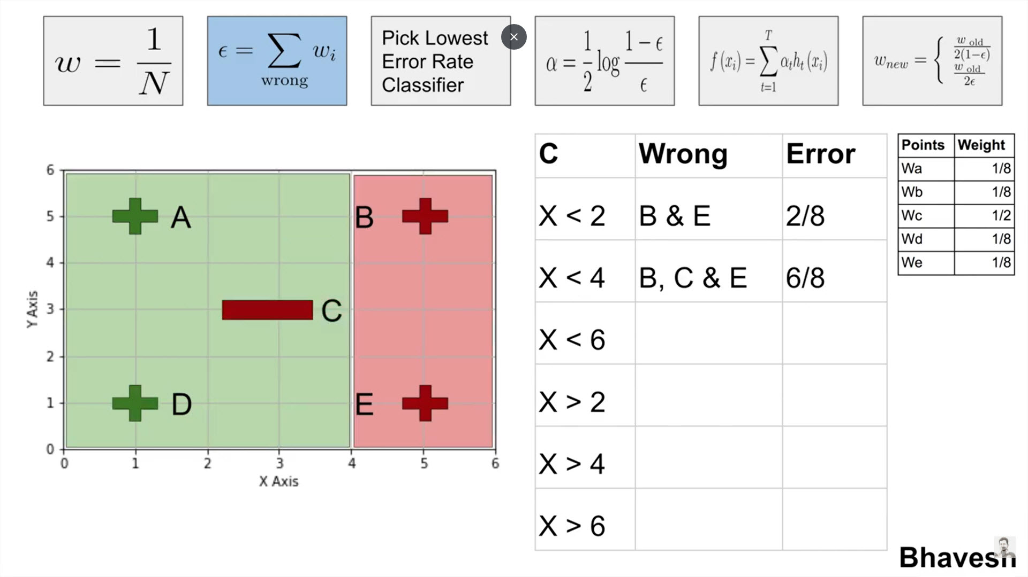
AdaBoost Algorithm: Example
Classifier #2 → B, C, E
Error Classifier #2 = 1/8 + 4/8 + 1/8 = 6/8
35
Notes:
Three errors committed by Classifier #2 → B, C, E

Slide 36
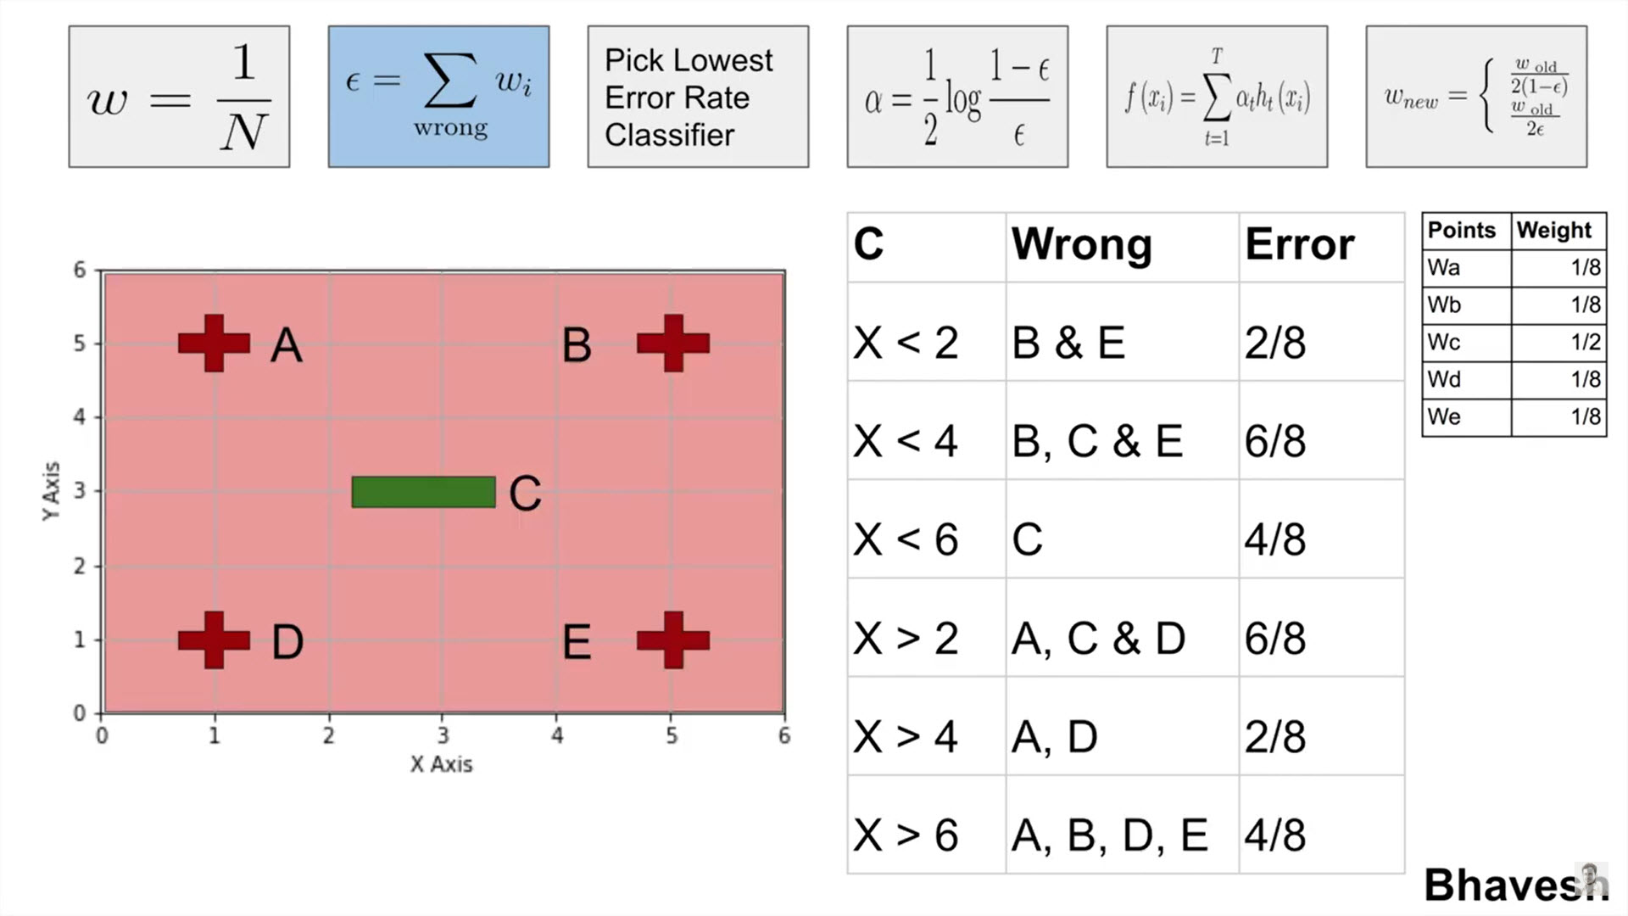
AdaBoost Algorithm: Example
Errors commiteed by all classifiers updated
36
Notes:
We perform the same for all the remaining classifiers
Classifier #3 committed 4 errors
Classifier #4 committed 6 errors
Classifier #5 committed 2 errors
Classifier #6 committed Four errors

Slide 37
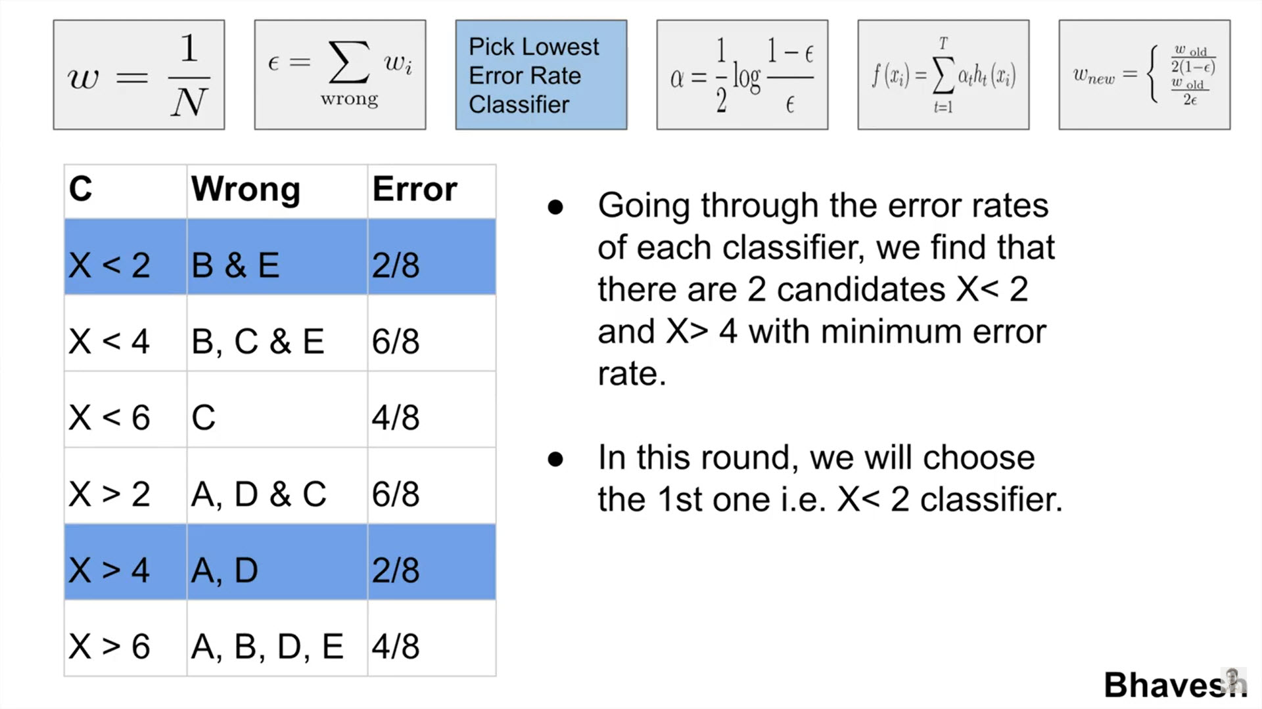
AdaBoost Algorithm: Example
Going through the error rates of each classifier, we find that there are two candidates:
Classifier #1 → X < 2
Classifier #5 → X > 4
In this round we will choose Classifier #1 → X < 2
37
Notes:
Classifier #1 and Classifier #5 committed the least number of errors .. (2 errors each)
We pick the lowest error rate classifier
We Pick classifier #1

Slide 38
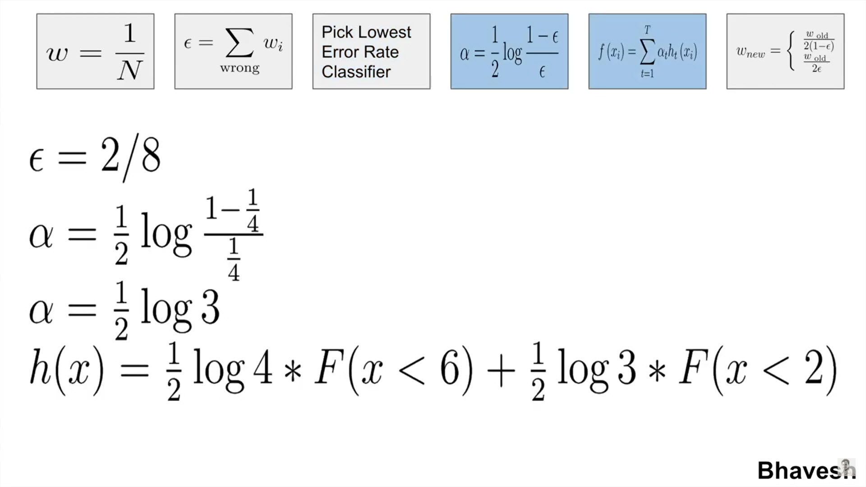
AdaBoost Algorithm: Example
38
Notes:
We calculate the voting power of classifier #1
Update the Hypothesis of the ensemble accordingly
We ask our self the following question:
Is my h(x) good enough?
Have I had enough rounds?
If not satisfied, we go on to update the weights and start round 3

Slide 39
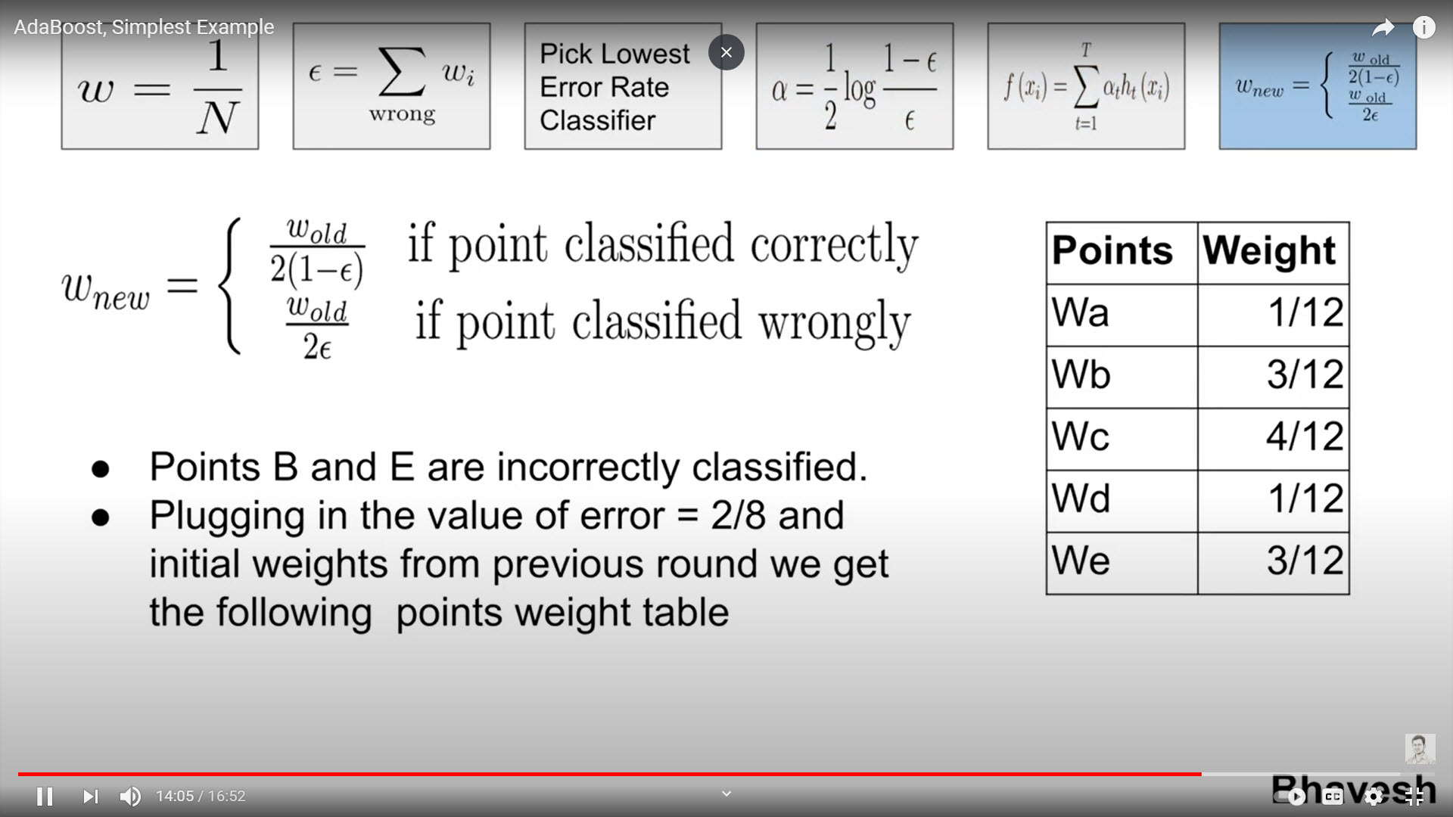
AdaBoost Algorithm: Example
Points B and E are incorrectly classified
Plugging in the value of C_{error} = 2/8 and initial weights from previous round we
Update points classified correctly
Update points classified wrongly
Finally, we get the following weight table
39
Notes:
Since two points (B &E) are incorrectly classified by Classifier #1
We update the weights of all the points based on the formula
W_{a} → (1/8)/(2 * (1- 2/8) → 1/12
W_{b}→ (1/8)/(2 * 2/8 ) → 3/12
W_{c} → (1/2)/(2 * (1-2/8 ) → 4/12
W_{d} → (1/8)/(2 * (1- 2/8) → 1/12
W_{e} → (1/8)/(2 * 2/8 ) → 3/12

Slide 40
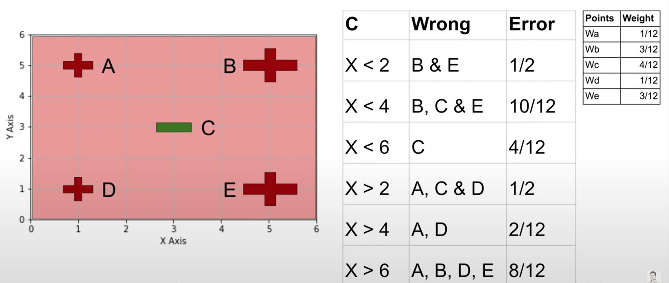
AdaBoost Algorithm: Example
Perform yet another round and updating the errors of all classifiers
40
Notes:
Updating the errors of all classifiers after another round indicates that Classifier #5 is least
The errors were committed on Points A, D
The weights of these sample points will be updated according to the formula

Slide 41
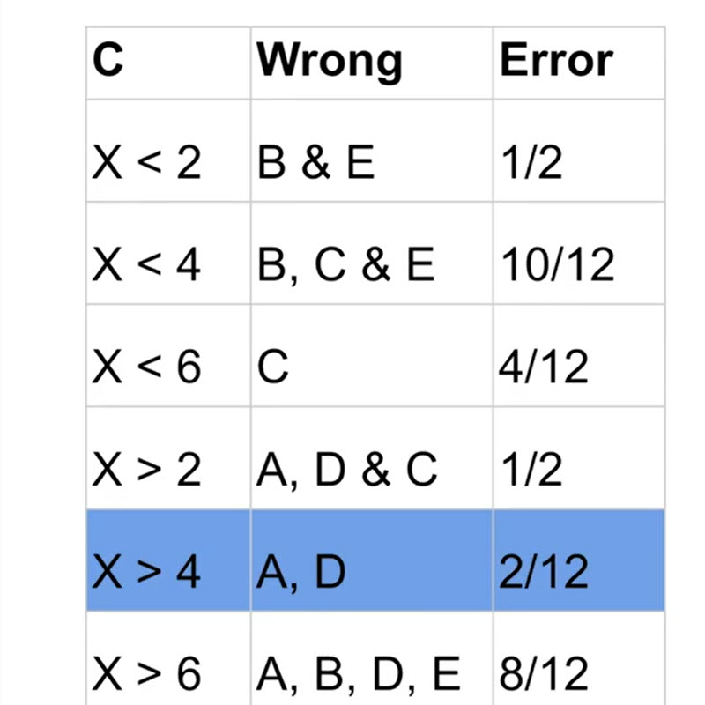
AdaBoost Algorithm: Example
Going through the error rates of each classifier, we find that X > 4 is the classifier with minimum error rate (2/12)
In this round we will choose X > 4 classifier
41
Notes:
Since classifier X > 4 has the least errors it will have the highest vote ..
Find the voting power and append the hypothesis

Slide 42
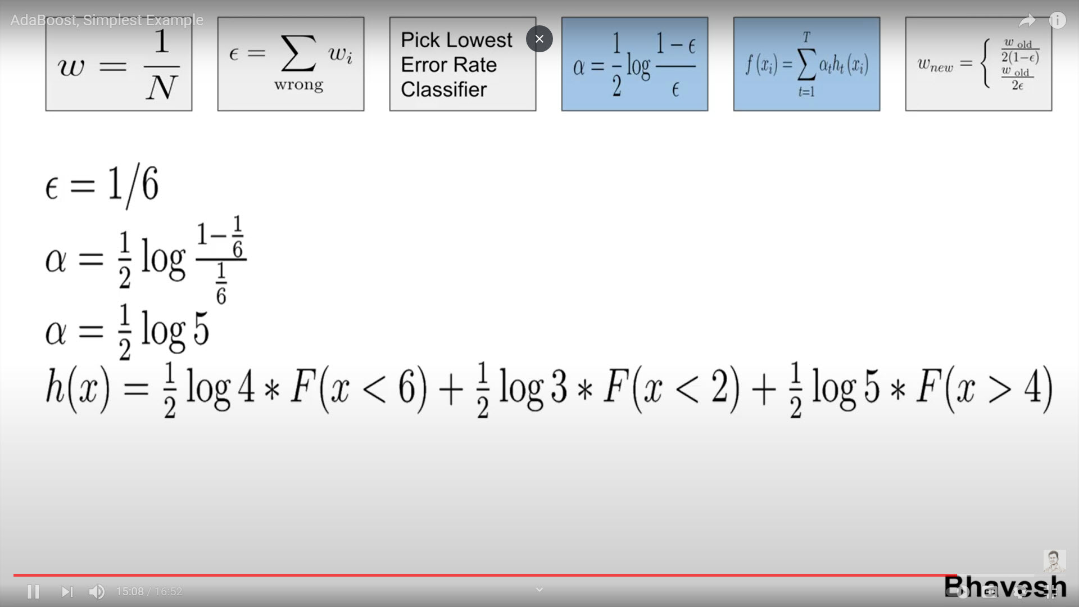
AdaBoost Algorithm: Example
What have we achieved?
Now we have a combination of 3 classifiers
42
Notes:
The latest update of the hypothesis is given in the formula above
Now we have a combination of 3 classifiers
What have we achieved?

Slide 43
AdaBoost Algorithm: Example
OK
OK
OK
Majority Rule
We can stop
43
Notes:
What have we achieved?
The first classifier X < 6 made a mistake on Point C ..
But both X < 2 nor X >4 had it right
The second classifier X < 2 made a mistake on Pont B & E
But both X < 6 and X >4 had it right
This is a good place to STOP!!

Slide 44
Summary

Slide 45
Summary
Ensemble systems are useful and powerful in practice
Boosting is a general ensemble method that creates a strong classifier from a number of weak classifiers. This is done by building a model from the training data, then creating a second model that attempts to correct the errors from the first model.
Boosting is a sequential process; i.e., trees are grown using the information from a previously grown tree, one after the other.
AdaBoost (1997) is a more general version of the boosting algorithm; AdaBoost.M1 can handle multiclass problems
AdaBoost generates a set of hypotheses (classifiers), and combines them through weighted majority voting of the classes predicted by the individual hypotheses
Notes:
XGBoost is a popular and efficient open-source implementation of the gradient boosted trees algorithm. Gradient boosting is a supervised learning algorithm, which attempts to accurately predict a target variable by combining the estimates of a set of simpler, weaker models.
XGBoost generally can't predict the future very well, but it is well suited for tasks such as the following: Classification problems, especially those related to real-world business problems such as fraud detection or customer churn prediction.

Slide 46
Resources

Slide 47
Misc. Resources
YouTube
https://www.youtube.com/watch?v=sfVms30Ulxw&t=0s
https://www.youtube.com/watch?v=LsK-xG1cLYA
https://www.youtube.com/watch?v=9CPsYsB4OLI
Tutorials:
https://machinelearningmastery.com/boosting-and-adaboost-for-machine-learning/
https://mccormickml.com/2013/12/13/adaboost-tutorial/
https://blog.paperspace.com/adaboost-optimizer/
Software:
https://www.datacamp.com/community/tutorials/adaboost-classifier-python
https://www.kdnuggets.com/2020/12/implementing-adaboost-algorithm-from-scratch.html
https://towardsdatascience.com/machine-learning-part-17-boosting-algorithms-adaboost-in-python-d00faac6c464
Books:
https://doc.lagout.org/science/0_Computer%20Science/2_Algorithms/Boosting_%20Foundations%20and%20Algorithms%20%5BSchapire%20%26%20Freund%202012-05-18%5D.pdf
http://www.cs.toronto.edu/~mbrubake/teaching/C11/Handouts/AdaBoost.pdf
47

Slide 48
Misc. Resources: GB
YouTube
https://www.youtube.com/watch?v=sfVms30Ulxw&t=0s
Tutorials:
https://www.analyticsvidhya.com/blog/2016/02/complete-guide-parameter-tuning-gradient-boosting-gbm-python/
https://www.analyticsvidhya.com/blog/2015/11/quick-introduction-boosting-algorithms-machine-learning/
https://www.analyticsvidhya.com/blog/2015/05/boosting-algorithms-simplified/
Courses:
https://courses.analyticsvidhya.com/courses/ensemble-learning-and-ensemble-learning-techniques?utm_source=blog&utm_medium=complete-guide-parameter-tuning-gradient-boosting-gbm-python
48

Slide 49
End Slides

