Slide 1
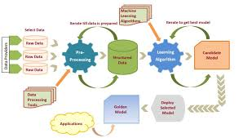
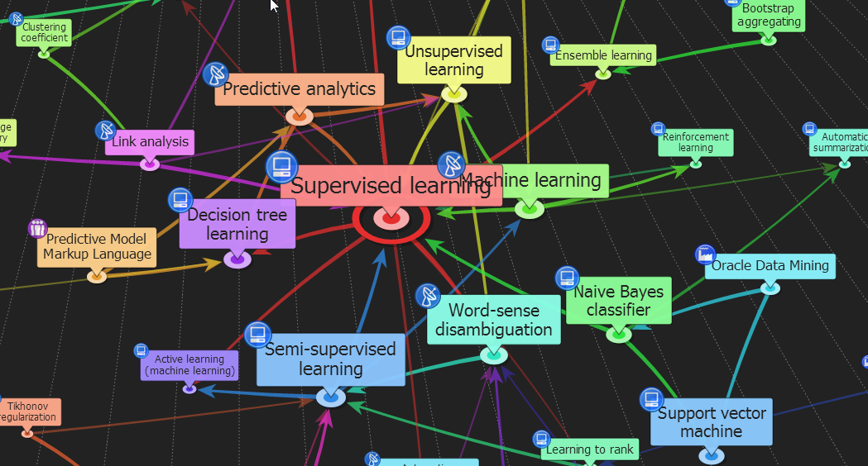

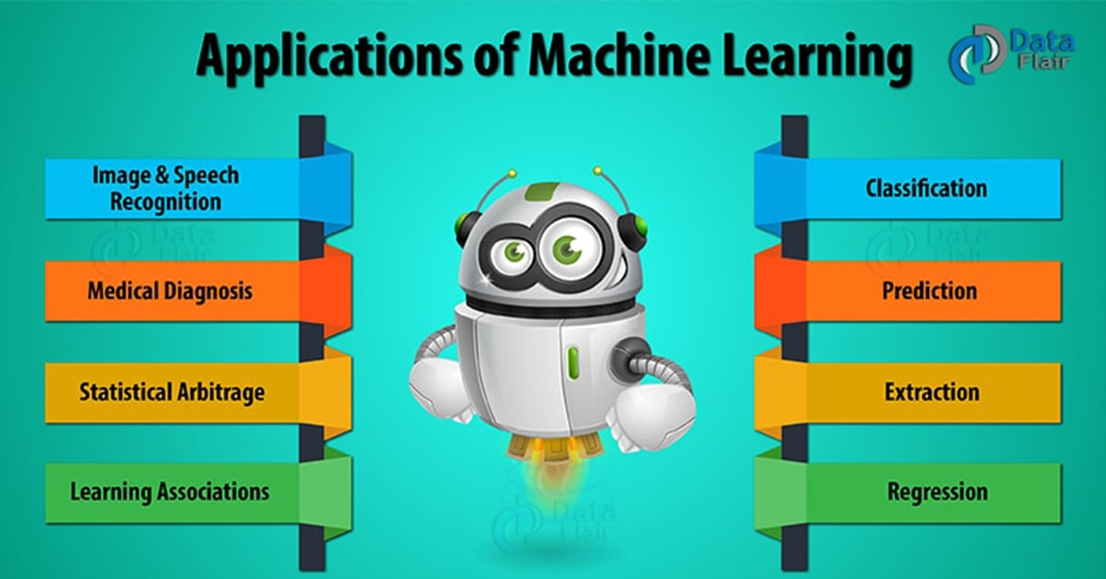

ENG6500: Intro to Machine Learning Ensemble Learning “Part III: Bagging”
S. Areibi
School of Engineering
University of Guelph
Notes:
In this lecture we will cover the second type of Ensemble Learning namely “Bagging”

Slide 2
Introduction
Notes:
Ensemble learning helps to improve machine learning model performance by combining several “weak” models.
This approach allows the production of better predictive performance compared to a single “base” model.

Slide 3
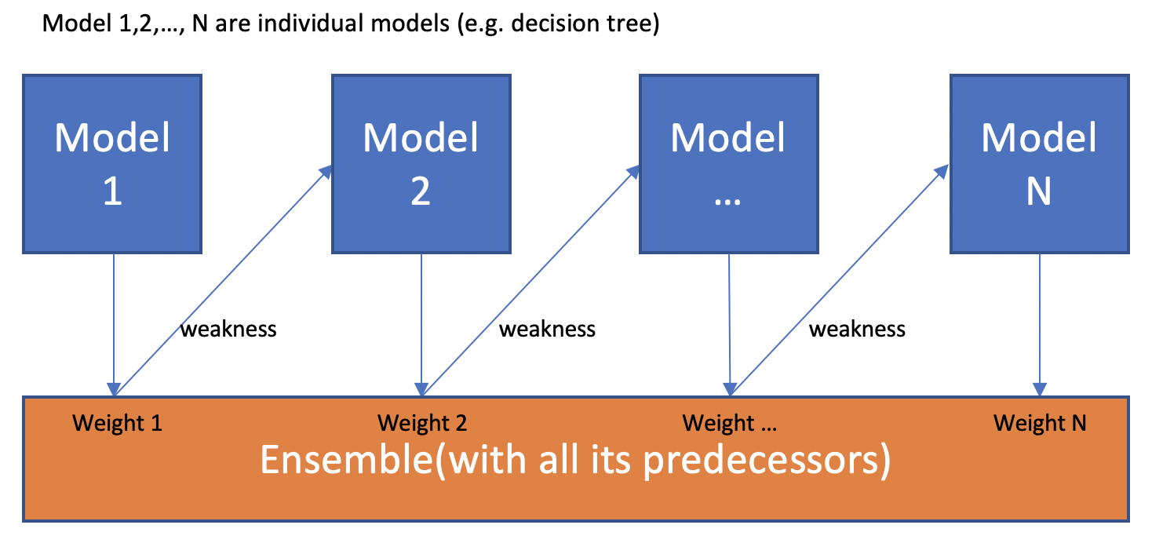
Recall Boosting
Boosting algorithms convert weak learners into strong learners.
Boosting is a sequential process; i.e., trees are grown using the information from a previously grown tree, one after the other.
This process slowly learns from data and tries to improve its prediction in subsequent iterations.
Notes:
The idea of boosting is to create good solutions by using mediocre classifiers and improve the accuracy sequentially
Unlike Boosting, other ensemble based techniques are parallel
Order in Boosting is important:
Errors made by the first classifier (Stump or perceptron) influence how the second classifier is made

Slide 4
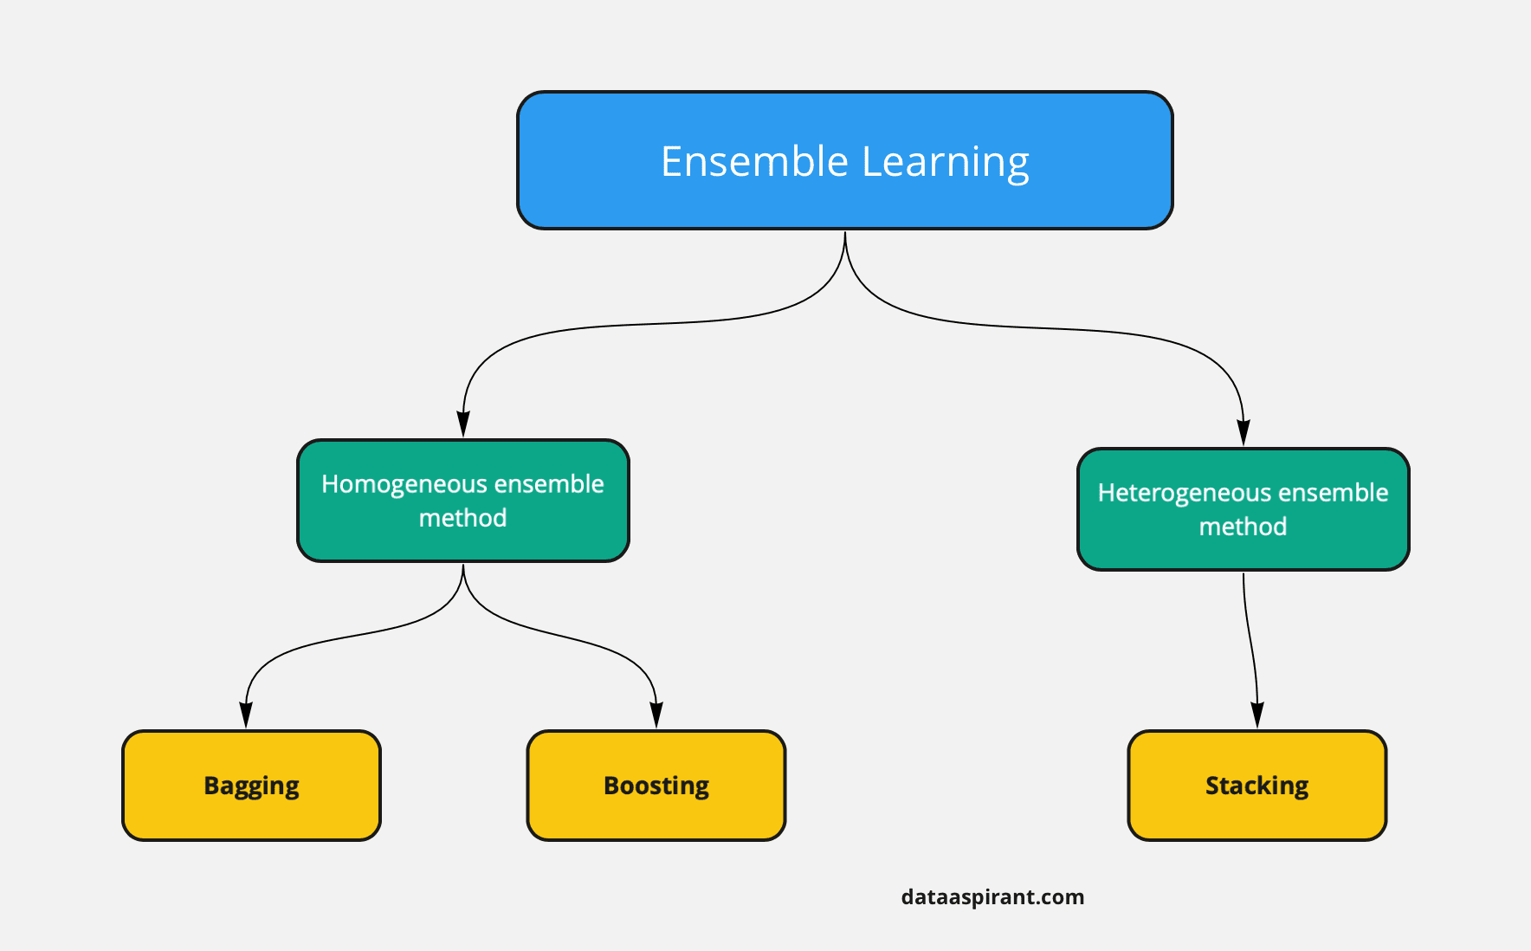
Types of Ensemble Learning
Concurrent
Sequential
Ensemble learning can be classified into different approaches based on the type of machine learning techniques used, concurrency and distribution of data ...
Bagging is based on Homogenous Classifiers
Bagging is a concurrent technique.
In Bagging data is created using bootstrapping
Notes:
The main hypothesis is that when weak models are correctly combined we can obtain more accurate and/or robust models.
Bagging and Boosting are two types of Ensemble Learning.
These two decrease the variance of a single estimate as they combine several estimates from different models.
So the result may be a model with higher stability.
https://towardsdatascience.com/ensemble-methods-bagging-boosting-and-stacking-c9214a10a205

Slide 5
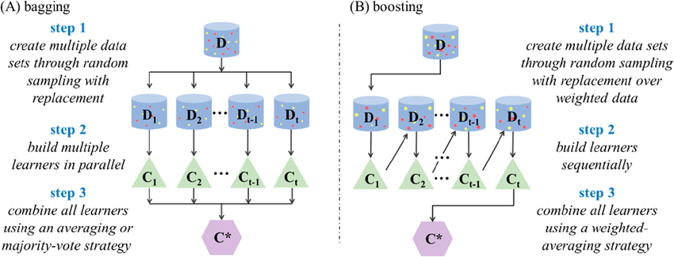
Bagging vs. Boosting
Bagging and boosting are both ensemble learning methods in machine learning.
Bagging: Bootstrap aggregating.
Bagging/Boosting Similarities: Weak Homogenous Classifiers/Voting
Bagging vs Boosting Differences:
While boosting is sequential, bagging is parallel
Bagging creates data sets using Bootstrapping (no data weighting)
5
Notes:
What is the difference between bootstrapping bagging and boosting?
In boosting each model will build on top of the previous model (framework is sequential)
In the bagging method all the individual models will take the bootstrap samples and create the models in parallel.
.

Slide 6
Bagging

Slide 7
Bagging
Bagging, short for Bootstrap aggregating, is one of the earliest ensemble based algorithms.
It is also one of the most intuitive and simplest to implement, with a surprisingly good performance
Use bootstrapped replicas of the training data; large number of (say 200) training subsets are randomly drawn - with replacement - from the entire training data
Each resampled training set is used to train a different classifier of the same type
Individual classifiers are combined by taking a majority vote of their decisions
Notes:
Bagging, often considers homogeneous weak learners,
Learns them independently from each other in parallel and
Combines them following some kind of deterministic averaging process
Bagging is appealing for small training set;
Relatively large portion of the samples is included in each subset

Slide 8
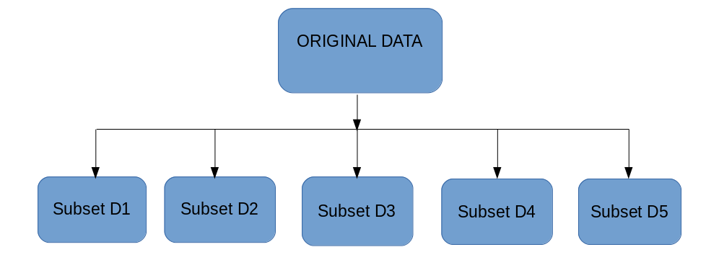
Bootstrapping
The idea behind bagging is combining the results of multiple models (for instance, all decision trees) to get a generalized result.
Bootstrapping is a sampling technique in which we create subsets of observations from the original dataset, with replacement.
The size of the subsets is the same as the size of the original set.
Notes:
Bagging leverages a bootstrapping sampling technique to create diverse samples.
This resampling method generates different subsets of the training dataset by selecting data points at random and with replacement.
If our sample has 1000 cases, we will randomly draw 1000 cases form our sample, with replacement … HOW?

Slide 9
Bootstrapping
Sampling with replacement
Most bootstrap samples contain duplicates from the original
Some samples may be missing from the original set
Bagging (Round 1) → Missing 1, 3, 4, 6
Build classifier on each bootstrap sample
Each sample has probability (1 – 1/n)^{n} of being selected
9
Notes:
Here is an example that demonstrates bootstrapping
Starting with the original data
Bagging round #1 creates a dataset with several duplicates
Bagging round #2 creates a different dataset again with duplicates while missing some samples from the original set
The goal of bootstrapping is to understand/take advantage of sampling variation

Slide 10
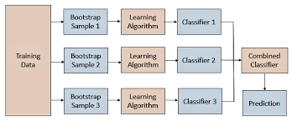
Bagging
Reduces overfitting (variance)
Normally uses one type of classifier (weak)
Decision trees are popular (fast, easy to implement)
Easy to parallelize (independent)
10
Notes:
Bagging has many advantages
It tends to reduce variance thus overfitting
It uses a single type of classifier such as Decision Trees
Unlike boosting, all the classifiers work in parallel

Slide 11
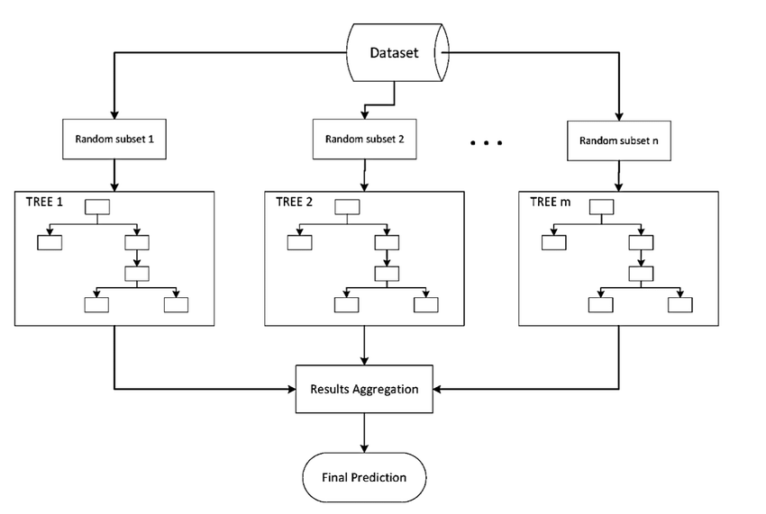
Bagging: Bootstrap/Aggregating
BAGGing, or Bootstrap AGGregating:
Combines Bootstrapping and Aggregation to form on ensemble model.
Given a sample data, multiple bootstrapped subsamples are pulled.
A decision tree is formed on each of the bootstrapped subsamples.
After each subsample Decision Tree has been formed, an algorithm is used to aggregate over the Decision Trees to form the most efficient predictor
Advantages
Bootstrap sampling accentuates variance between individual models.
Each model learns the concept a different way
Voting tends to reduce the variance without increasing bias.
Notes:
Multiple subsets are created from the original dataset, selecting observations with replacement.
A base model (weak model) is created on each of these subsets.
The models run in parallel and are independent of each other.
The final predictions are determined by combining the predictions from all the models.

Slide 12
Decision Boundaries
Bagging: Constructs hundreds of trees
Learn a classifier for each bootstrap sample and average them
Creates different decision boundaries
Very effective: achieves good results
12
Notes:
Bootstrapping helps in creating different trees with different decision boundaries.
This helps introduce diversification in the framework
This should help in improving accuracy and achieving good results

Slide 13
Bagging
Notes:
Bagging Algorithm:
Initialization
Set number of iterations T
Choose an appropriate WeakLearner (Tree)
Determine how to create data
Main Algorithm:
For a certain number of iterations
Provide each WeakLearn with sub-data
For each resample, grow a large (low bias, high variance) tree
Get Hypothesis h
Add to Ensemble
Majority Voting:
Average/aggregate predictions from all of the WeakLearners (Trees)
Regression: take the mean of the B predictions
Classification: take the majority vote of the B predictions

Slide 14
Decision Trees

Slide 15
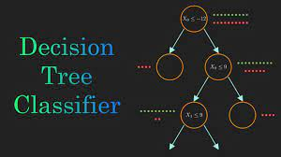
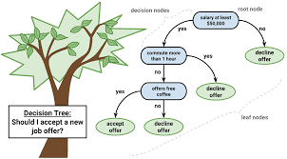
Decision trees
Decision Trees are individual learners.
Decision Trees are one of the most popular learning methods commonly used for data exploration.
Decision trees can be used for both regression and classification problems.
Decision Trees create different decision boundaries based on how it was designed and created
Decision trees are easy to understand and interpret
Popular type of DTs: CART Classification And Regression Tree.
Notes:
Decision trees can be used for both regression and classification problems.
Decision trees are easy to understand and interpret
Decision Trees follow a similar pattern to other Machine Learning Algorithms in terms of Training, validation and Testing
Decision Trees tend to create simple decision rules that can be followed (by using Training Data) to predict and classify unseen data.

Slide 16
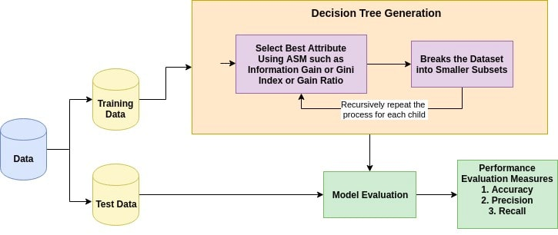
Building the Tree (ASM)
Attribute Selection Measure (ASM) is a heuristic for selecting the splitting criterion that partition data into the best possible manner.
It is also known as splitting rules because it helps us to determine breakpoints for tuples on a given node.
The basic idea behind any decision tree algorithm is as follows:
Select the best attribute using Attribute Selection Measures(ASM) to split the records.
Recursively repeat the process for each child
16
Notes:
If the dataset consists of N attributes then deciding which attribute to place at the root or at different levels of the tree as internal nodes is a complicated step.
By just randomly selecting any node to be the root can’t solve the issue.
If we follow a random approach, it may give us bad results with low accuracy.

Slide 17
The Key Idea
Recursive Partitioning
Take all of your data.
Consider all possible values of all variables.
Select the variable/value (X=t₁) that produces the greatest “separation” in the target.
(X=t₁) is called a “split”.
If X< t₁ then send the data to the “left”; otherwise, send data point to the “right”.
Now repeat same process on these two “nodes”
You get a “tree”
17
Notes:
The main and key idea of decision trees is to build the tree based on a specific criteria ..
At each node a variable is evaluated to decide which path to follow
Choose the independent variable (predictor) that produces the highest information gain ..
The predictor that may split either the root node or decision nodes to classify the most points

Slide 18
Attribute Selection Measure
Attribute Selection Measure (ASM) provides rank to each feature by explaining the given dataset.
Best score attribute will be selected as a splitting attribute (Source).
In the case of a continuous-valued attribute, split points for branches also need to be defined.
Most popular selection measures are
Entropy
Information Gain,
Gain Ratio,
Reduction in Variance,
Chi-Square,
Gini Index
18
Notes:
For solving this attribute selection problem, researchers worked and devised some solutions.
They suggested using some criteria like :
These criteria will calculate values for every attribute.
Entropy,
Information gain,
Gini index,
Gain Ratio,
Reduction in Variance
Chi-Square
Which feature should I consider first to split the tree?
The one that produces the greatest separation in the target.

Slide 19
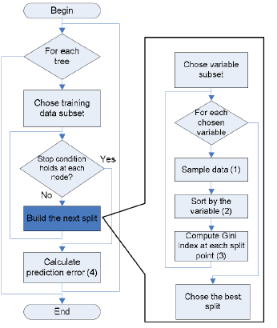
Multiple Trees
How can we create many trees (diversified)?
Selection Measures
Entropy
Information Gain,
Gain Ratio,
Reduction in Variance,
Chi-Square,
Gini Index
Selection
Measure
19
Notes:
We can use any of the attribute selection measures to create different trees.

Slide 20
Decision Trees → Forests
Decision Trees are easy to build, easy to use and easy to interpret, but in practice they are not robust!!
Decision Trees have one aspect that prevents them from being the ideal tool for predictive learning, namely inaccuracy.
In other words, they work great with the data used to create them, but they are not flexible when it comes to classifying new samples.
Bagging in the form of Random Forests combines the simplicity of decision trees with flexibility resulting in a vast improvement in accuracy.
Random Forests employs several weak learners (simple Trees) and combines them to achieve excellent results for both classification and regression.
Notes:
Decision trees are effective Machine Learning algorithms but have limitations
They are not robust nor accurate for complex problems
Bagging in the form of Random Forests overcomes several limitations of DT
However, we will need to fine tune more hyper parameters

Slide 21
Random Forests

Slide 22
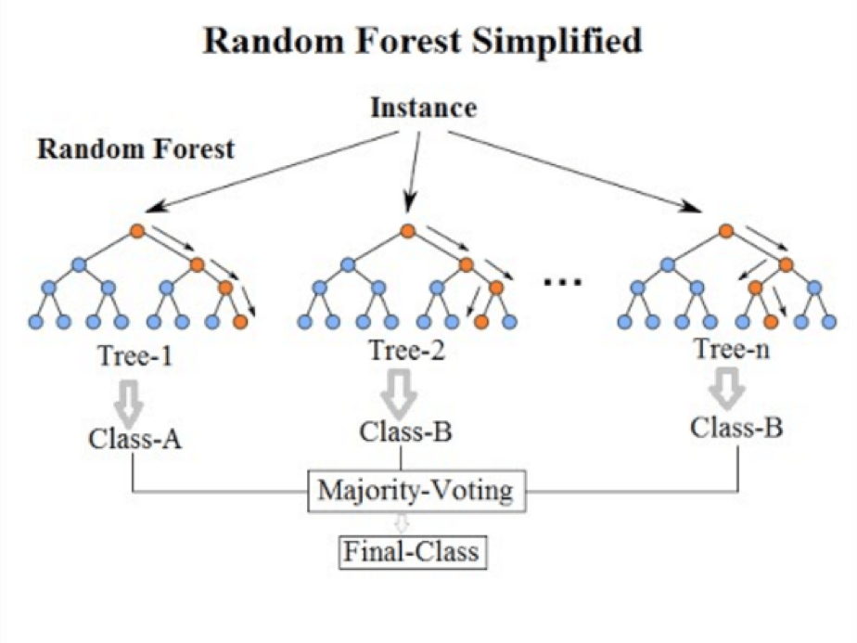
Random Forest
Below is a random forest consisting of multiple decision trees trained on different subsets of the training data.
In order to improve the reliability of the decisions made, random forests involve many decision trees, effectively crowdsourcing the answer by averaging or combining the results of the different trees.
Results of each tree are combined or averaged.

Slide 23
Random Forests
Random Forests:
Instead of building a single large decision tree and use it to make predictions, build many slightly different trees and combine their predictions
We have a single data set, so how do we obtain slightly different trees?
1. Bagging (Bootstrap Aggregating):
Take random subsets of data points from the training set to create N smaller data sets
Fit a decision tree on each subset
2. Random Subspace Method (also known as Feature Bagging):
Fit N different decision trees by constraining each one to operate on a random subset of features
23
Notes:
The first step moving from Decision Trees to Random Forests is to come up with a strategy of creating many different trees:
Bootstrapping: similar to bagging
Random Subspace: divide the feature subset randomly

Slide 24
Tuning Random Forests
Random forest models have multiple hyperparameters to tune:
The sampling scheme: number of predictors to randomly select at each split : max_features {“auto”, “sqrt”, “log2”}, int or float, default=”auto”.
The total number of trees in the forest: n_estimators, int, default=100
The complexity of each tree:
stop when a leaf has <= min_samples_leaf samples or when we reach a certain max_depth.
In theory, each tree in the random forest is full, but in practice this can be computationally expensive (and added redundancies in the model), thus, imposing a minimum node size is not unusual.
Notes:
Several hyperparameters to tune when using Random Forests in our ML pipeline

Slide 25
Random Forest: Example

Slide 26


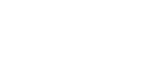




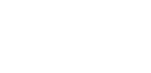

Bagging at Training Time
N subsets (with replacement)
Training set
26

Slide 27





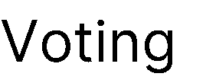



Bagging at Inference Time
A test sample
75% confidence
27

Slide 28
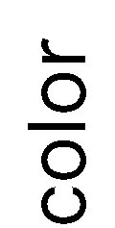


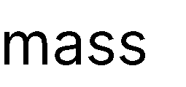










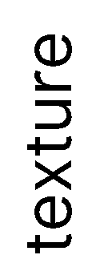
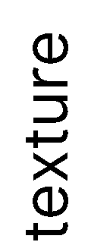















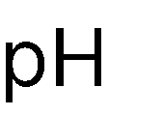





Random Subspace: Training Time
Training data
28
Notes:
A subset of the features is used to create different trees

Slide 29






Random Subspace: Inference Time
A test sample
66% confidence
29

Slide 30

















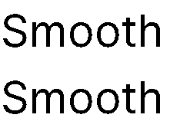








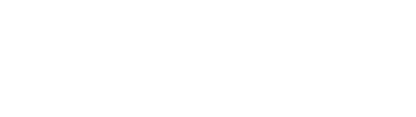
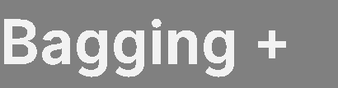
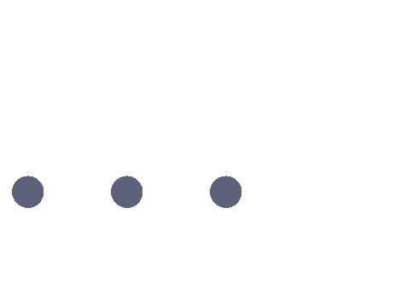






Random Forests
Tree 1
Tree 2
Random Forest
Tree N
30

Slide 31
Random Forests: Pros/Cons

Slide 32
RF Features/Advantages
The advantages of random forest are:
It is one of the most accurate learning algorithms available. For many data sets, it produces a highly accurate classifier.
It runs efficiently on large databases.
It can handle thousands of input variables without variable deletion.
It gives estimates of what variables are important in the classification.
It generates an internal unbiased estimate of the generalization error as the forest building progresses.
It has an effective method for estimating missing data and maintains accuracy when a large proportion of the data are missing.
Notes:
The advantages of Random Forests include
Accuracy
Robustness

Slide 33
RF: Disadvantages
Random forests have been observed to overfit for some datasets with noisy classification/regression tasks.
For data including categorical variables with different number of levels, random forests are biased in favor of those attributes with more levels. Therefore, the variable importance scores from random forest are not reliable for this type of data.
Notes:
The main disadvantages of Random Forests include
1) Possibility of Overfitting

Slide 34
SK-Learn

Slide 35
SK-Learn Steps ..
# Import all necessary libraries
from sklearn.datasets import make_classification
from sklearn.model_selection import train_test_split
from sklearn.ensemble import RandomForestClassifier
from sklearn.metrics import accuracy_score
print('all libraries have been imported')
#generate the dataset
X,y=make_classification(n_samples=1000,n_features=20,n_informative=15,n_classes=2)
#split data into train and test sets
X_train,X_test,y_train,y_test=train_test_split(X,y,test_size=0.2)
X_train.shape
(800, 20)
y_train.shape
(800,)
35

Slide 36
SK-Learn Steps ..
#build the random forest classifier
clf=RandomForestClassifier()
clf.fit(X_train,y_train)
RandomForestClassifier(bootstrap=True, ccp_alpha=0.0, class_weight=None,
criterion='gini', max_depth=None, max_features='auto',
max_leaf_nodes=None, max_samples=None,
min_impurity_decrease=0.0, min_impurity_split=None,
min_samples_leaf=1, min_samples_split=2,
min_weight_fraction_leaf=0.0, n_estimators=100,
n_jobs=None, oob_score=False, random_state=None,
verbose=0, warm_start=False)
36

Slide 37
SK-Learn Steps ..
y_pred=clf.predict(X_test)
y_pred[0:5]
array([1, 1, 1, 0, 0])
y_test[0:5]
array([1, 1, 1, 0, 0])
#model evaulation using accuracy_score
accuracy=accuracy_score(y_test,y_pred)
print('accuracy:',accuracy)
accuracy: 0.88
37

Slide 38
Summary

Slide 39
Summary
Ensemble methods use multiple learning algorithms to obtain better predictive performance than could be obtained from any of the constituent learning algorithms
Ensemble systems are useful in practice
Bagging, short for bootstrap aggregating, is one of the earliest ensemble based algorithms.
A decision tree is a simple tree where, at each node, a decision is made, and inference travels down the path according to that decision.
Random forests take decision trees one step further. In order to improve the reliability of the decisions made, random forests involve many decision trees, effectively crowdsourcing the answer by averaging or combining the results of the different trees.

Slide 40
Resources

Slide 41
Bagging: Misc. Resources
YouTube
https://www.youtube.com/watch?v=uhjeVdLjVFI&list=PLrQmbzbRJ5mwDinvDEJ5B-KDZlPM-sCYO&index=15
https://www.youtube.com/watch?v=J4Wdy0Wc_xQ
https://www.youtube.com/watch?v=sQ870aTKqiM
https://www.youtube.com/watch?v=841I7-imlVo
https://www.youtube.com/watch?v=f2S4hVs-ESw
https://www.youtube.com/watch?v=3R0AW-vrPEw
https://www.youtube.com/watch?v=4EOCQJgqAOY
41

Slide 42
Bagging: Misc. Resources
Documents:
https://sebastianraschka.com/faq/docs/bagging-boosting-rf.html
https://www.stat.berkeley.edu/~breiman/RandomForests/
https://web.csulb.edu/~tebert/teaching/lectures/551/random_forest.pdf
https://math.usu.edu/adele/RandomForests/Ovronnaz.pdf
https://machinelearningmastery.com/bagging-and-random-forest-ensemble-algorithms-for-machine-learning/
https://www.analyticsvidhya.com/blog/2018/06/comprehensive-guide-for-ensemble-models/
Software:
https://www.knowledgehut.com/blog/data-science/bagging-and-random-forest-in-machine-learning
https://github.com/vappiah/Machine-Learning-Tutorials/blob/main/random_forest_classifier.ipynb
Books:
https://www.researchgate.net/publication/236952762_Random_Forests
42

Slide 43
End Slides

