Slide 1
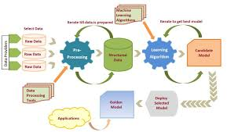
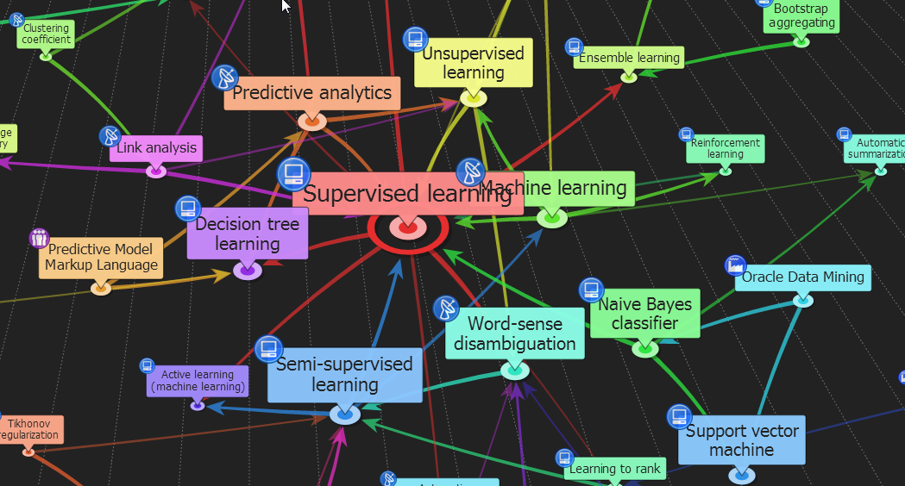
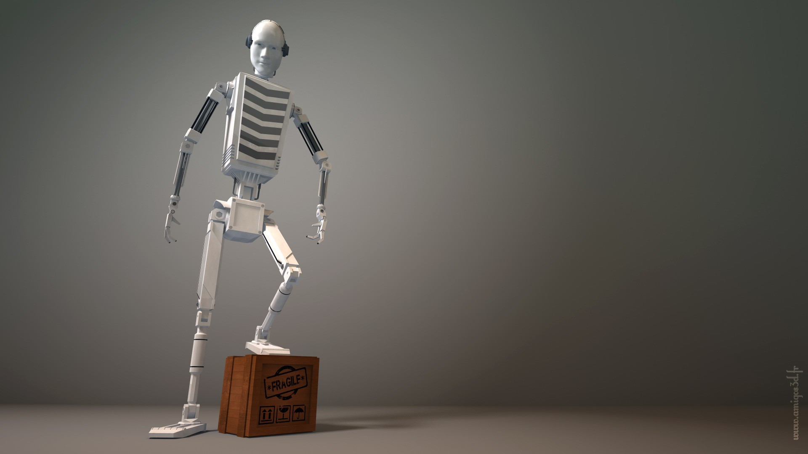
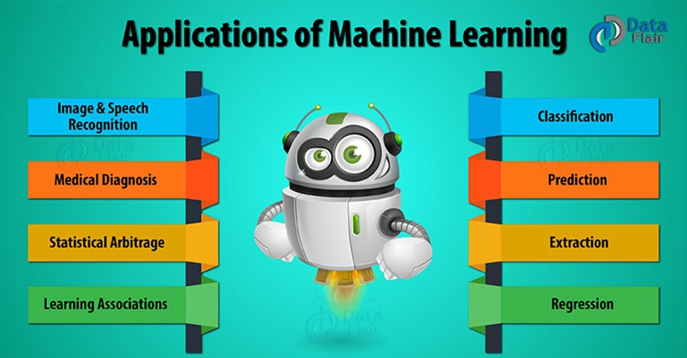
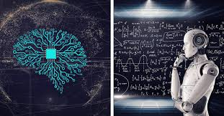
ENG6600: Advanced Machine Learning
“Classification: K Nearest Neighbor”
S. Areibi
School of Engineering
University of Guelph
Notes:
In this lecture we will cover the KNN Classification Algorithm which is considered to be
one of the easiest Machine Learning techniques to understand..
Yet very effective in solving classification problems

Slide 2
Introduction
Notes:
We introduce the main concepts of the KNN algorithm …

Slide 3
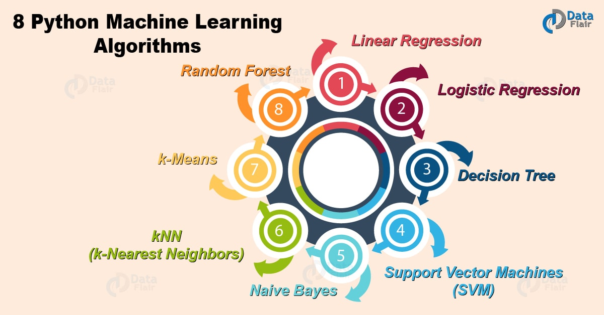
Classification Algorithms
Among the simplest and easiest supervised learning algorithms to understand.
Developed by Fix & Hodges in 1951, later expanded by Thomas Cover.
It is used for both Classification and Regression.
It is a non-parametric and lazy supervised learning algorithms.
Typical Algorithms:
Decision trees
Rule-based induction
Neural networks
K-Nearest Neighbor
Random Forests
Bayesian networks
Support Vector Machines
3
Notes:
Among the simplest and easiest supervised learning algorithms to understand is the KNN algorithm.
The k-nearest neighbors algorithm is a non-parametric supervised learning method first developed by Evelyn Fix and Joseph Hodges in 1951, and later expanded by Thomas Cover.
It is used for both classification and regression.

Slide 4
Instance-Based Learning
Idea:
  Similar examples have similar label.
  What is meant by Similar?
    Similar means “close” and similar feature values.
  Classify new examples like similar existing training examples.
Algorithm:
  Given new example x for which we need to predict its class y
  Find most similar training examples (closest)
  Classify x “like” these most similar examples
Questions:
  How to determine similarity?
  What are similarity measures to be used?
  How does the KNN learn?
  How many similar training examples to consider?
  How to resolve inconsistencies among training examples?
4
Notes:
Similar inputs map to similar outputs
If not true => learning is impossible
If true => learning reduces to defining “similar”
KNN classifies the new data points based on the similarity measure of the earlier stored data points.

Slide 5
1-Nearest Neighbor
One of the simplest of all machine learning classifiers
Simple idea: label a new point the same as the majority closest known point(s)
Label it red
5
Notes:
Assume we have a dataset of tomatoes and bananas.
KNN will store similar measures like shape and color → these are features
When a new object comes it will check its similarity with the color (red or yellow) and shape.
KNN algorithm is one of the simplest classification algorithm.
Even with such simplicity, it can give highly competitive results.

Slide 6
KNN Algorithm: General Information
Machine Learning
Supervised
ANN, SVM, NB,
….
Unsupervised
Semi-supervised
Reinforcement
Referred to as a Lazy Learner … Why?
Does not use training points to construct a model
No parameters to be learned to create a model.
Training set is delayed to classification phase
Training set is used to compute the distance between the testing point and all points in training set.
K-NN
6
Notes:
Why is the k-nearest neighbors algorithm called “lazy”?
Because it does no training at all when you supply the training data.
At training time, all it is doing is storing the complete data set but it does not do any calculations at this point.

Slide 7
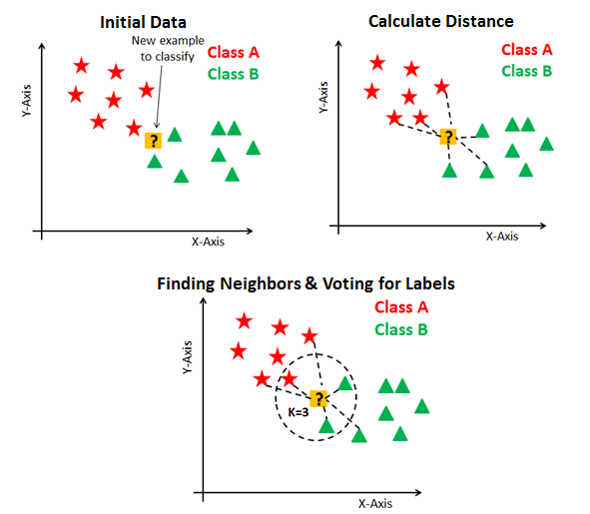
KNN Algorithm: General Information
KNN has the following basic steps:
Prepare data (split to training/testing)
Get first test data point
Calculate distance
Find closest neighbors
Vote for labels (majority rule)
7
Notes:
Basic Steps:
Download the dataset
Split data into Training and Testing
Download the Training Dataset into memory (do nothing)
Show me the example that you want me to classify
Measure the distance from the NEW POINT to all the training set data points
Based on the value of K (the closest neighbors) make a decision and find the appropriate class.

Slide 8
The KNN Algorithm
Notes:
We will introduce the pseudo code of the KNN algorithm and understand the complexity of the algorithm

Slide 9
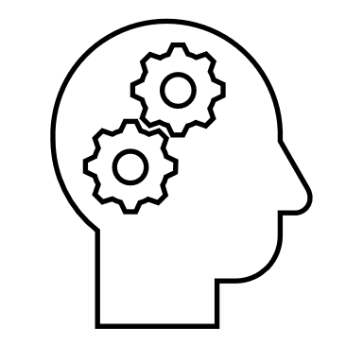
The KNN Algorithm
KNN – K Nearest Neighbors, is one of the simplest Supervised
Machine Learning Algorithms used for
Advantages of Simple?
Classification
It classifies a data point based on how its neighbors are
classified
Simple: (a) Easy to implement, (b) Can be developed even in hardware without much issues.
9
Notes:
The KNN is simple since we do not adjust any parameters to fit the data or classify the data.
The KNN simply measure and calculates the distance.
It classifies a NEW DATA POINT based on how the closest neighbors are classified.
Closest here means how close the features (independent variables) are w.r.t to the NEW TESTING POINT
What are the advantages of Simple?
Can be developed even in hardware without much issues.

Slide 10
Nearest Neighbor Models
Key Idea: Properties of an input x (features) are likely to be similar to those of points in the neighborhood of x.
Basic Idea: Find (k) nearest neighbor(s) of x and infer target attribute value(s) of x based on corresponding attribute value(s).
Form of non-parametric learning where hypothesis complexity grows with data (learned model ≈ all examples seen so far)
  Non-parametric (e.g., KNN, DT, GB) may produce different models based on the amount and type of data you feed them.
Parametric ML models: (e.g., Log. R, LR, ANN)
    Have a fixed number of parameters that determine their complexity and behavior.
    No matter how much data you throw at a parametric model it won’t change its mind about how many parameters it needs.
    Their complexity does not increase (does not get affected) as we increase the size of the data set.
Notes:
We say KNN is non-parametric and lazy learning algorithm …
Non-parametric means there is no assumption for distribution of underlying data
A learning model that summarizes data with a set of parameters of fixed size (independent of the number of training examples) is called a parametric model.
No matter how much data you throw at a parametric model, it won’t change its mind about how many parameters it needs.
Some examples of parametric machine learning algorithms include (fast & simple, require less data, have certain assumptions about the data)
Logistic Regression
Linear Discriminant Analysis
Perceptron
Some examples of popular nonparametric machine learning algorithms (no assumption about data, complexity increases with data)
k-Nearest Neighbors (KNN)
Naïve Bayes
Decision Trees like CART and C4.5
Support Vector Machines

Slide 11

K-Nearest Neighbor
Compute the Euclidian Distance between the test point “t” and Training point X_{i} to determine the nearest neighbor
Compute the set of K closest points to “t”
Compute the label using majority rule
m training points
Record | X1,1 | X1,2 | Label
Rec #1 | 2 | 3 | A
Rec #2 | 4 | 4 | B
Rec #3 | 5 | 3 | A
Rec #4 | 6 | 4 | A
Rec #5 | 7 | 1 | B
Rec #6 | 8 | 5 | B
…. … …
Algorithm 1 The K-NN Classification Algorithm
Let $k$be the number of nearest neighbors
Let $t$ be the test point to classify
$Let X be the set of m training points each with n features$
Let $Y$be the class labels of $X$
$for i=1 to m do$
$Compute d(t,Xi)$– $distance between t and training point$ $i∈X$
$end for$
$Compute W – the set of k closest training points to t$
$Compute the majority class label from Yi where i∈W, assign to t$
t→ Test Point
NEW | 4 | 5 | ??
11
Notes:
The algorithm in action:
Set k (the number of nearest neighbors to be used)
Use the test point t to be classified
Pick m points to represent the “training points”
As the number of data points increase the number of calculations increase
The KNN algorithm does not adjust any parameters like ANN or SVM
We do not get rid of the training dataset as we usually do with other ML algorithms

Slide 12
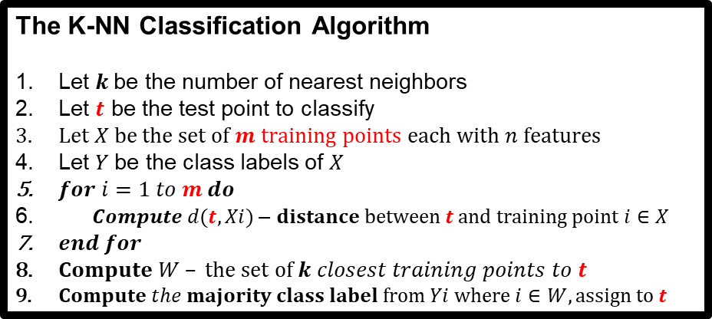
KNN Complexity
Suppose there are m instances and n features in the dataset
Nearest neighbor algorithm requires computing m distances
Each distance computation involves scanning through each feature value (n features)
Running time complexity is O(m.n)
The K-NN Classification Algorithm
Let $k$be the number of nearest neighbors
Let $t$ be the test point to classify
$Let X be the set of m training points each with n features$
Let $Y$be the class labels of $X$
$for i=1 to m do$
$Compute d(t,Xi)$– $distance between t and training point$ $i∈X$
$end for$
$Compute W – the set of k closest training points to t$
$Compute the majority class label from Yi where i∈W, assign to t$
12
Notes:
The complexity of the KNN algorithm is Big O(mn)

Slide 13
Nearest Neighbor Models
Idea:
  Identify K records in the training data set that are similar to a new record that we wish to classify
  Result depends on the value of “k”
Class A
Class B
Belongs to Class B
Belongs to Class A
X1.1
K=3
K=6
X1.2
13
Notes:
Depending on the value K, the class of the test point may change

Slide 14
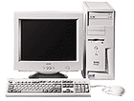
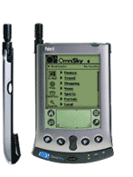

Learning Method
Instance-based Learning
  Learning=storing all training instances
  Classification=assigning target function to a new instance
  Referred to as “Lazy” learning
Its very similar to a
Desktop!!
Test Point
14
Notes:
An issue that arises with KNN is that we need to keep all our data stored in memory
(we always need the training data)
Lazy → No training nor adjusting of weights or parameters

Slide 15
K-Nearest Neighbor
Training method:
  Save the training examples → Save all samples in memory
  No parameters to adjust!! → Always keep training set!!
At prediction time:
  Find the k training examples (x₁,y₁),…(x_{k},y_{k}) that are closest to the test example x
  Predict the most frequent class among those y_{i}’s.
Performance Improvements?
  Reduce complexity of the algorithm ..
  Implement the algorithm in hardware
  Scaling the features ..
  Measuring “closeness” ..
  Finding “close” examples in a large training set quickly
  Find the most suitable value “k” for the problem
15
Notes:
Since the training examples are saved:
We will need a large memory → the requirement to a high storage
We do not get rid of the training dataset as we usually do with other ML algorithms
It does not learn anything in the training period. It does not derive any discriminative function from the training data.
At Prediction time:
Depending on the value of k different solutions are obtained for the class
Improvement to KNN:
The improved method is to sample the training data around the test data,
This should reduce the number of distance calculation of the test data to each training data, and reduces the time complexity of the algorithm.

Slide 16
Curse-of-Dimensionality
Prediction accuracy can quickly degrade when number of attributes grows.
  Irrelevant attributes easily “swamp” information from relevant attributes
  When many irrelevant attributes, similarity/distance measure becomes less reliable
Remedy:
  Try to remove irrelevant attributes in pre-processing step
  Weight attributes differently
  Increase k (but not too much)
16
Notes:
Prediction accuracy can quickly degrade when number of attributes grows.
Pick and select only relevant features to reduce computations

Slide 17
KNN: Advantages/Disadvantages
K Nearest Neighbors
  Advantage:
    Nonparametric architecture
    Simple method and easy to understand
    Powerful … performs quite well on many datasets
    Requires no training time
    Requires little tuning.
  Disadvantage:
    Memory intensive
    Classification/estimation is slow
    Prediction accuracy can quickly degrade when number of attributes grows.
17
Notes:
Advantages:
Simple, easy to understand, performs well in most cases
Disadvantages:
Does not work well with large dataset as calculating distances between each data instance would be very costly.
Does not work well with high dimensionality as this will complicate the distance calculating process to calculate distance for each dimension.
Sensitive to noisy and missing data.
Parametric algorithms are best suited for problems where the input data is well-defined and predictable,
while nonparametric algorithms are best suited for problems where the input data is not well-defined but there are a lot more data we can use to train it.

Slide 18
K Nearest Neighbors
Key issues involved in training model includes setting:
  The variable K
    Validation techniques (ex. Cross validation)
  The type of distant metric
    Euclidean measure
Any other distance measures?
18
Notes:
Different datasets may require different values of K
The Euclidean distance may be expensive to calculate.

Slide 19
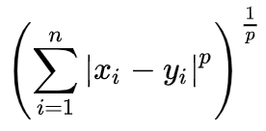

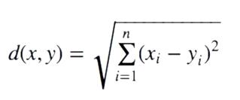
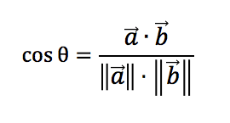
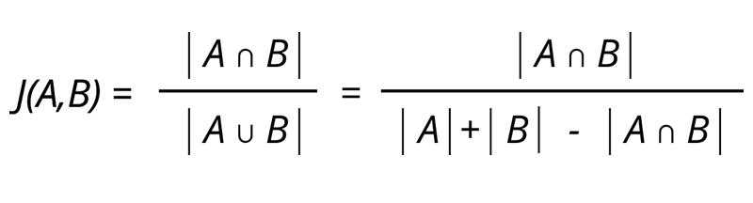
Distance Measures
Minkowski Distance:
P = 1 → Manhattan Distance
P = 2 → Euclidean Distance
Cosine Distance:
determines whether two vectors are pointing in the same direction
Jaccard Distance:
Ratio of overlapping items to Total Items
19
Notes:
https://www.kdnuggets.com/2020/11/most-popular-distance-metrics-knn.html
Specifically, four different distance functions, which are:
Minkowsky, -- Manhattan, Euclidean
cosine similarity measure,
correlation, and Chi square, are used in the k-NN classifier respectively.
Cosine Distance – This distance metric is used mainly to calculate similarity between two vectors.
It is measured by the cosine of the angle between two vectors and determines whether two vectors are pointing in the same direction.
It is often used to measure document similarity in text analysis. When used with KNN this distance gives us a new perspective to a business problem and lets us find some hidden information in the data which we didn’t see using the above two distance matrices.
It is also used in text analytics to find similarities between two documents by the number of times a particular set of words appear in it.
Jaccard Similarity – Measures the overlap between two sets of items → Ratio of overlapping items to Total Items

Slide 20
How to choose K?
Notes:
In KNN, finding the value of k is not easy.
A small value of k means that noise will have a higher influence on the result
A large value make it computationally expensive.

Slide 21
The K Factor
KNN Algorithm is based on feature similarity: Choosing the right value of K is a process called parameter tuning and is important for better accuracy.
K=7
K=3
?
New variable
At k = 3, we classify’?’ as
But at k = 7, we classify’?’ as
21
Notes:
We need to use Cross-validation to find a suitable value for k.

Slide 22
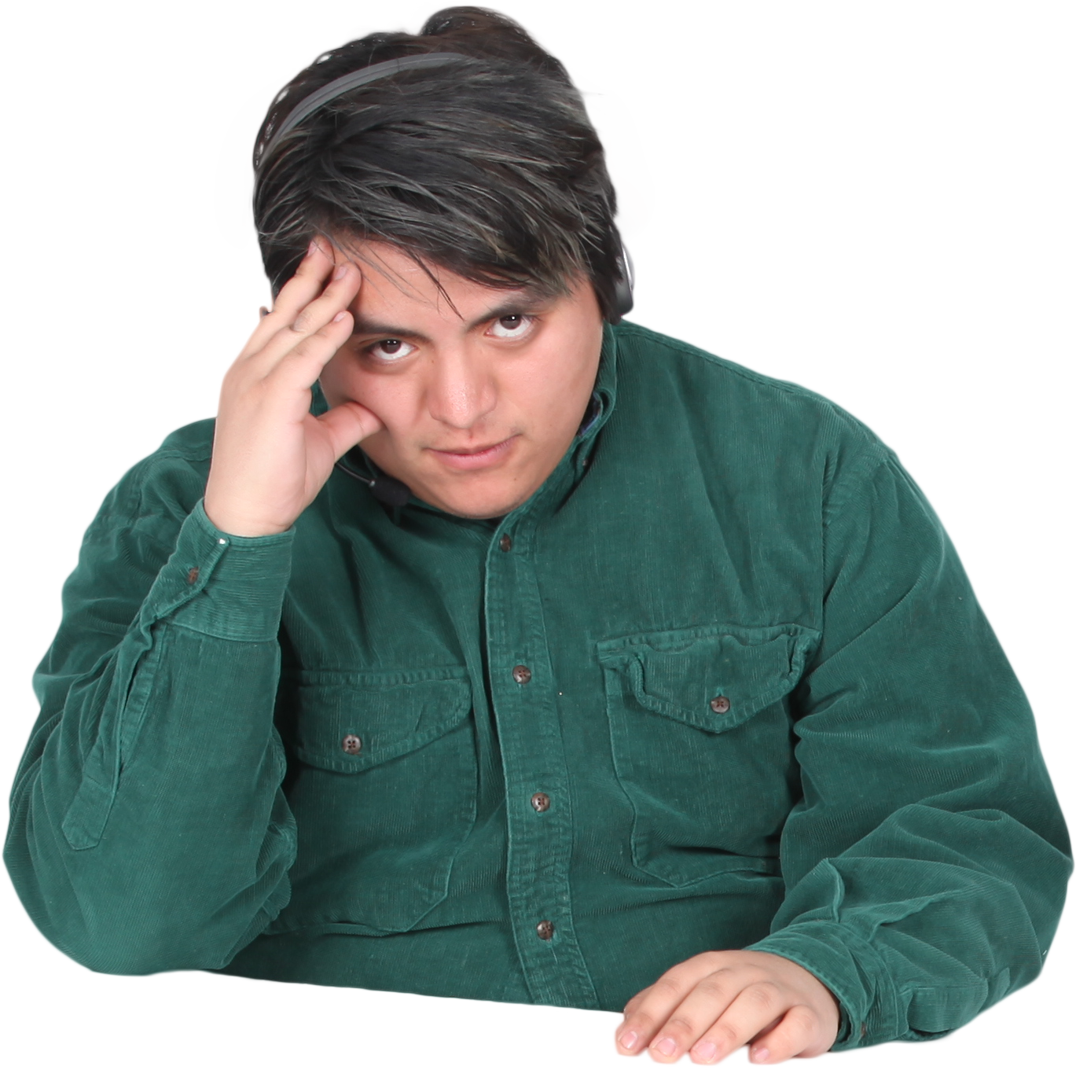
How do we choose ‘k’?
The class of unknown data
Point was at k=3 but changed at k=7, so which k
Should we choose?
If ‘k’ is too low vs. ‘k’ is too big?
22
Notes:
Depending on the value of K we may get different results
The smaller values for k , not only makes our classifier so sensitive to noise but also may lead to the overfitting problem.
Large values for k also may lead to underfitting.

Slide 23
Selecting the Number of Neighbors
K is a hyperparameter that is important to the KNN algorithm performance
Increase k:
  Makes KNN less sensitive to noise
Decrease k:
  Allows capturing finer structure of space
➔Pick k not too large, but not too small (depends on data)
When we increase K, the training error will increase (increase bias), but the test error may decrease at the same time (decrease variance).
The bias will be 0 (but variance will be high) when K is small (K=1)
23
Notes:
K is a hyperparameter that is important to the KNN algorithm performance
The bias will be 0 when K=1,
However, when it comes to new data (in test set), it has higher chance to be an error, which causes high variance.
When we increase K, the training error will increase (increase bias), but the test error may decrease at the same time (decrease variance).

Slide 24
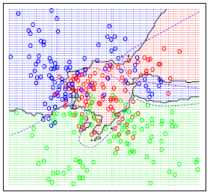
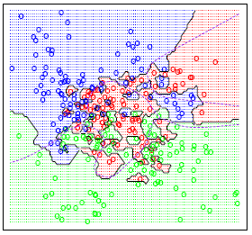
Selecting the Number of Neighbors
The classification boundaries generated by a given training data set and 15 Nearest Neighbors are shown below.
As a comparison, we show the classification boundaries generated for the same training data but with 1 Nearest Neighbor.
We can see that the classification boundaries induced by 1 NN are much more complicated than 15 NN.
K = 15
Low Variance
K = 1
High Variance
24
Notes:
The only parameter that can adjust the complexity of KNN is the number of neighbors k.
The larger k is, the smoother the classification boundary. Or we can think of the complexity of KNN as lower when k increases.

Slide 25
Training Parameters/Typical Settings
Number of nearest neighbors?
  The numbers of nearest neighbors (K) should be based on cross validation over a number of K setting.
  When k=1 is a good baseline model to benchmark against.
  A good rule-of-thumb is: k should be less than the square root of the total number of training patterns.
  Choose an odd “K” value for a Binary Classification problem.
  “K” must not be a multiple of the number of classes for a Multi-class Classification problem.
To choose a value of k:
Sqrt(n), where n is the total number of data points
Odd value of k is selected to avoid confusion between two classes of data
25
Notes:
let's talk about the effect of small k, and large k.
A small value of k will increase the effect of noise,
A large value makes it computationally expensive.
Data scientists usually choose as an odd number if the number of classes is 2 and another simple approach to select k to be the SQRT(n)

Slide 26
When do we use KNN?
Notes:
The KNN algorithm has several advantages and we will learn why and when to use the KNN

Slide 27


When to use KNN?
When data is labeled.
When data is noise free
When dataset is small (since KNN is a lazy learner i.e., doesn’t learn a discriminative function from the training set.)
weight | height | class
51 | 167 | underweight
62 | 182 | 23
65 | 172 | normal
Does our data have to be scaled? Why?
Since this algorithm relies on distance for classification, if the features represent different physical units or come in vastly different scales then normalizing the training data can improve its accuracy dramatically.
27
Notes:
Our data has to be labeled, noise free, small and also scaled why?
Distance based classifiers as we have covered in this course are sensitive to scaling and therefore our data has to be standardized.
Since this algorithm relies on distance for classification, if the features represent different physical units or come in vastly different scales then normalizing the training data can improve its accuracy dramatically.

Slide 28
When to use KNN?
Imbalanced datasets is an issue for most if not all Machine Learning Models.
  On average KNN is considered to be a better performing algorithm compared to other traditional classifiers on imbalanced datasets.
The KNN does not require any “Training Time”, therefore if you do not wish to waste any time training a Machine Learning Model then the KNN would be a preferable algorithm.
The KNN does not need intensive Hyper-parameter tuning .. Therefore if the user does not wish to spend too much time on parameter tuning the KNN would be an ideal algorithm.
Compared to other simplistic classification algorithms such as Logistic Regression, the KNN on average performs better.
KNN can learn non-linear decision boundaries when used for classification and regression.
28
Notes:
In principal, unbalanced classes are not a problem at all for the k-nearest neighbor algorithm. Why?
Because the algorithm is not influenced in any way by the size of the class, it will not favor any on the basis of size.
Try to run k-means with an obvious outlier and k+1 and you will see that most of the time the outlier will get its own class.
The most important parameter that needs to be tuned is the value “K” ..
Other parameters may include the metric = ‘Euclidean’ or ‘Manhattan’ or other measure

Slide 29
KNN Example
Notes:
Lets look at a simple example of a dataset and how we can employ KNN to classify new points

Slide 30
How does the KNN Alg. Work?
Consider a dataset having two variables: height (cm) & weight (kg) and each point is classified as Normal or Underweight
Weight (x2) | Height (y2) | Class
51 | 167 | Underweight
62 | 182 | Normal
69 | 176 | Normal
64 | 173 | Normal
65 | 172 | Normal
56 | 174 | Underweight
58 | 169 | Normal
57 | 173 | Normal
55 | 170 | Normal
On the basis of the given data we have to classify the below set as Normal or Underweight using KNN
57 kg | 170 cm | ?
30
Notes:
In this dataset, we have 9 records and two features (a) Weight, (b) Height and a label (Binary Classification)
Our objective is to classify a new data point to be either “Normal” or “Underweight”

Slide 31
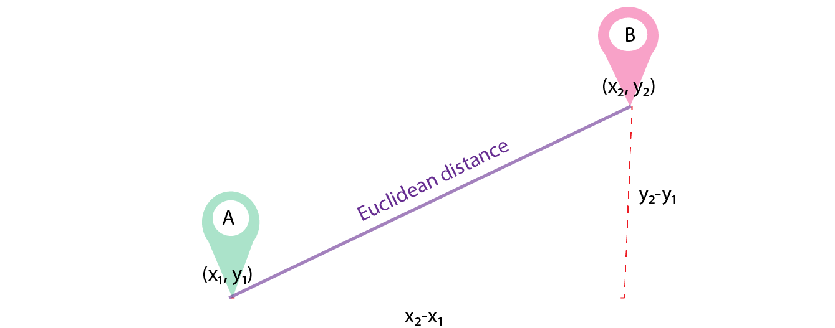
How does the KNN Alg. Work?
To find the nearest neighbors, we will calculate the Euclidean Distance
Euclidean Distance (d) = sqrt ( (x₂-x₁)² + (y₂-y₁)² )
31
Notes:
We will use the Euclidean distance to find the nearest neighbors .. We could use any other measure ofcourse
Notice that with he Euclidean Distance we will have to perform
Subtractions, Additions
Multiplications
SQRT
For a large dataset this would be quite expensive for each test point

Slide 32
How does the KNN Alg. Work?
dist(d₁) = 6.7
dist(d₂) = 13
dist(d₃) = 13.4
180
175
170
Similarly, we will calculate the Euclidean distance of unknown data points from all the points in the dataset
Height
165
160
50.0
52.5
55.0
57.5
60.0
62.5
65.0
67.5
Weight
Unknown data point
57 kg | 170 cm | ?
32
Notes:
Notice here that:
Yellow points indicate “Normal” class
Black points indicate “Underweight” class
Distances are calculated from the new test point or “Unknown data point” to all points
The Nearest points to the “Unknown data point” will determine the class of the point → Most probably “Normal”

Slide 33
How does the KNN Alg. Work?
Weight (x2) | Height (y2) | Class | Euclidean Distance
51 | 167 | Underweight | 6.7
62 | 182 | Normal | 13
69 | 176 | Normal | 13.4
64 | 173 | Normal | 7.6
65 | 172 | Normal | 8.2
56 | 174 | Underweight | 4.1
58 | 169 | Normal | 1.4
57 | 173 | Normal | 3
55 | 170 | Normal | 2
57 kg | 170 cm | ?
Unknown data point
33
Notes:
The 4th column in the table now shows the distances of the “Unknown data point” to all the training set

Slide 34
How does the KNN Alg. Work?
Recap of KNN
A positive integer k is specified, along with a new sample.
We select the k entries in our database which are closest to the new sample.
We find the most common classification of these entries.
This is the classification we give to the new sample.
Now, lets calculate the nearest neighbor at k=3
Weight (x2) | Height (y2) | Class | Euclidean Distance
51 | 167 | Underweight | 6.7
62 | 182 | Normal | 13
69 | 176 | Normal | 13.4
64 | 173 | Normal | 7.6
65 | 172 | Normal | 8.2
56 | 174 | Underweight | 4.1
58 | 169 | Normal | 1.4
57 | 173 | Normal | 3
55 | 170 | Normal | 2
K=3
Unknown data point
57 kg | 170 cm | ?
34
Notes:
Given the value of k=3 (the three nearest neighbors) that the “Unknown data point” should be classified as Normal

Slide 35
SKLearn
Notes:
We will look at a simple classification problem based on the iris dataset

Slide 36
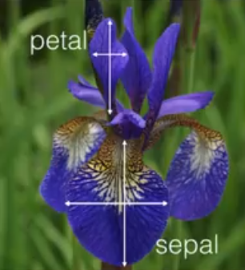
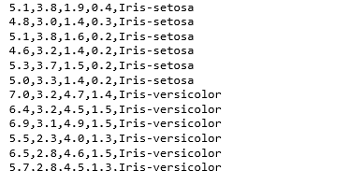
The KNN Alg.: SKLearn
In this exercise we show an implementation of KNN on iris dataset using scikit-learn library.
Iris dataset has 50 samples for each different species of Iris flower (total of 150).
For each sample we have sepal length, width and petal length and width and a species name(class/label).
Notes:
The Iris dataset has 150 samples, 4 features, and 3 classes → 'setosa' 'versicolor' 'virginica']

Slide 37
The KNN Alg.: SKLearn
Our task is to build a KNN model which classifies the new species based on the sepal and petal measurements. Iris dataset is available in scikit-learn and we can make use of it build our KNN.
# Import the load_iris function from datasets module
import sklearn
import sklearn.datasets
from sklearn.datasets import load_iris
# import the KNN Classifier from sklearn
from sklearn.neighbors import KNeighborsClassifier
#import metrics model to check the accuracy
from sklearn import metrics
# import plotting library
import matplotlib.pyplot as plt
Notes:
Import necessary libraries .. In this case the KNN classifier

Slide 38
The KNN Alg.: SKLearn
# Create bunch object containing iris dataset and its attributes
iris = load_iris()
type(iris)
iris.data
array([[5.1, 3.5, 1.4, 0.2],
[4.9, 3. , 1.4, 0.2],
[4.7, 3.2, 1.3, 0.2],
[4.6, 3.1, 1.5, 0.2],
[5. , 3.6, 1.4, 0.2],
[5.4, 3.9, 1.7, 0.4],
[4.6, 3.4, 1.4, 0.3],
[5. , 3.4, 1.5, 0.2],
iris.target
array([0, 0, 0, 0, 0, 0, 0, 0, 0, 0, 0, 0, 0, 0, 0, 0, 0, 0, 0, 0, 0, 0,
0, 0, 0, 0, 0, 0, 0, 0, 0, 0, 0, 0, 0, 0, 0, 0, 0, 0, 0, 0, 0, 0,
0, 0, 0, 0, 0, 0, 1, 1, 1, 1, 1, 1, 1, 1, 1, 1, 1, 1, 1, 1, 1, 1,
1, 1, 1, 1, 1, 1, 1, 1, 1, 1, 1, 1, 1, 1, 1, 1, 1, 1, 1, 1, 1, 1,
1, 1, 1, 1, 1, 1, 1, 1, 1, 1, 1, 1, 2, 2, 2, 2, 2, 2, 2, 2, 2, 2,
2, 2, 2, 2, 2, 2, 2, 2, 2, 2, 2, 2, 2, 2, 2, 2, 2, 2, 2, 2, 2, 2,
2, 2, 2, 2, 2, 2, 2, 2, 2, 2, 2, 2, 2, 2, 2, 2, 2, 2])
Notes:
Explore the data as much as you can to further understand the dataset

Slide 39
The KNN Alg.: SKLearn
# print the names of the features, names of the labels, # observations e.t.c
# Names of 4 features (column names)
print(iris.feature_names)
['sepal length (cm)', 'sepal width (cm)', 'petal length (cm)', 'petal width (cm)']
# 3 classes of target
print(iris.target_names)
['setosa' 'versicolor' 'virginica']
# we have a total of 150 observations and 4 features
print(iris.data.shape)
(150, 4)
Notes:
Check if any values are missing

Slide 40
The KNN Alg.: SKLearn
# Load the iris datasets in a different way by returning the Features and labels
X, y = sklearn.datasets.load_iris(return_X_y=True)
# Splitting the data into training and test sets (80:20)
X_train, X_test, y_train, y_test = train_test_split(X,y,test_size=0.2,random_state=4)
# Try running from k=1 through 25 and record testing accuracy
k_range = range(1,26)
scores = {}
scores_list = []
for k in k_range:
knn = KNeighborsClassifier(n_neighbors=k)
knn.fit(X_train, y_train)
y_pred = knn.predict(X_test)
scores[k] = metrics.accuracy_score(y_test,y_pred)
scores_list.append(metrics.accuracy_score(y_test,y_pred))
Notes:
Split the data into training and testing
It is interesting to know the affect of K on the training data

Slide 41
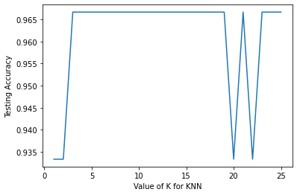
The KNN Alg.: SKLearn
# Plot the relationship between the values of K and testing accuracies
plt.plot(k_range, scores_list)
plt.xlabel('Value of K for KNN')
plt.ylabel('Testing Accuracy')
Notes:
By plotting the testing accuracy and the different values of K we see that we achieve excellent accuracies for values of k> 3 and k < 18

Slide 42
The KNN Alg.: SKLearn
# For our final model we can choose an optimal value of K=5 and retrain the model
# with all available data
# This will be our final model which is ready to make predictions
knn = KNeighborsClassifier(n_neighbors=5)
knn.fit(X,y)
# Classes or labels in the data set .. 0 = setosa, 1 = vesicolor, 2 = virginica
classes = {0:'setosa', 1:'versicolor', 2:'virginica'}
# Let us make predictions on some unseen data
# Predict for the below two random observations
x_new = [[3,4,5,2],
[5,4,2,2]]
y_predict = knn.predict(x_new)
print(classes[y_predict[0]])
print(classes[y_predict[1]])
versicolor
setosa
Notes:
Our final KNN model is based on K=5 in this example
When we present new testing points the KNN is able to predict the samples correctly

Slide 43
Summary

Slide 44
Summary
The K-Nearest Neighbor (KNN) is a non-parametric supervised learning method first developed by Evelyn Fix and Joseph Hodges in 1951and later expanded by Thomas Cover.
KNN is a type of classification where the function is only approximated locally and all computation is deferred until function evaluation.
Since this algorithm relies on distance for classification, if the features represent different physical units or come in vastly different scales then normalizing the training data can improve its accuracy dramatically.
KNN can be used for both classification and regression.
In both cases, the input consists of the k closest training examples in a data set. The output depends on whether KNN is used for classification or regression.
K is the only parameter that needs to be tuned .. Therefore, less time is spent on hyperparameter tuning ..
44

Slide 45
Resources

Slide 46
KNN: Misc. Resources
YouTube (Intro to KNN)
  https://www.youtube.com/watch?v=NNuXuJFaJl4&feature=youtu.be
  https://www.youtube.com/watch?v=4HKqjENq9OU
  https://www.youtube.com/watch?v=HVXime0nQeI
  https://www.youtube.com/watch?v=v5CcxPiYSlA
YouTube (Parametric vs Non-Parametric ML):
  https://www.youtube.com/watch?v=qY-dzPR4Al8
  https://www.youtube.com/watch?v=OXcV0EXSRb4
  https://www.youtube.com/watch?v=UgwUi8fu0CY
  https://www.youtube.com/watch?v=5cXyiCI189M
46

Slide 47
KNN: Misc. Resources
Tutorials:
  KNN Algorithm
    https://www.tutorialspoint.com/machine_learning_with_python/machine_learning_with_python_knn_algorithm_finding_nearest_neighbors.htm
    https://www.listendata.com/2017/12/k-nearest-neighbor-step-by-step-tutorial.html
    https://www.datacamp.com/community/tutorials/k-nearest-neighbor-classification-scikit-learn
    https://towardsdatascience.com/knn-algorithm-what-when-why-how-41405c16c36f
  Non Parametric Classifiers:
    https://machinelearningmastery.com/parametric-and-nonparametric-machine-learning-algorithms/
Code:
  https://www.kaggle.com/omkarsabnis/diabetes-prediction-using-ml-pima-dataset/notebook
  https://www.tutorialspoint.com/scikit_learn/scikit_learn_knn_learning.htm
Dataset:
  https://www.kaggle.com/saurabh00007/diabetescsv/data?select=diabetes.csv
47

Slide 48
End Slides

