Slide 1
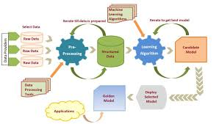
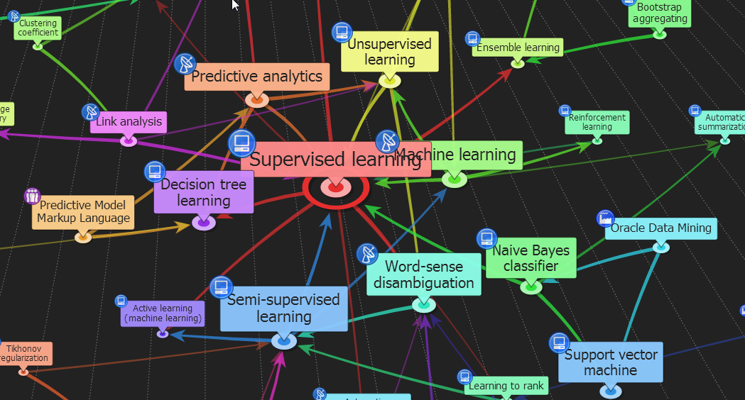




ENG6500: Intro to Machine Learning “Naïve Bayes”
Notes:
In this lecture we will cover yet another Machine Learning classification Algorithm: Naïve Bayes

Slide 2
Introduction
Notes:
At this point we covered 3-4 Classification Algorithms and understood how they operate and their advantages and disadvantages,
KNN,
Decision Trees
Logistic Regression
In todays lecture we will learn about how Naïve Bayes differ from the previous two approaches and why we should use.

Slide 3
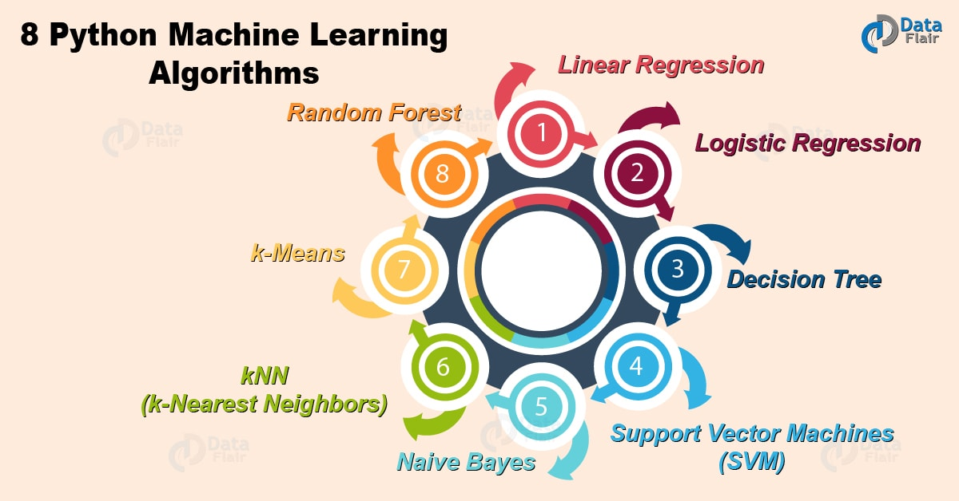
Classification Algorithms
Proposed by Thomas Bayes in the 1760’s
NB is used for classification
It is easy to understand and implement
Typical Algorithms:
Decision Trees
Rule-based induction
Neural networks
K-Nearest Neighbor
Random Forests
Naïve Bayes
Support Vector Machines
3
Notes:
The Naïve Bayes’ Algorithm is named after the Reverend Thomas Bayes (1702–61),
Bayes studied how to compute a distribution for the probability parameter of a binomial distribution.
After Bayes' death, his friend Richard Price edited and presented this work in 1763, as An Essay towards solving a Problem in the Doctrine of Chances
Naïve Bayes is simple, easy to understand yet powerful to classify objects

Slide 4
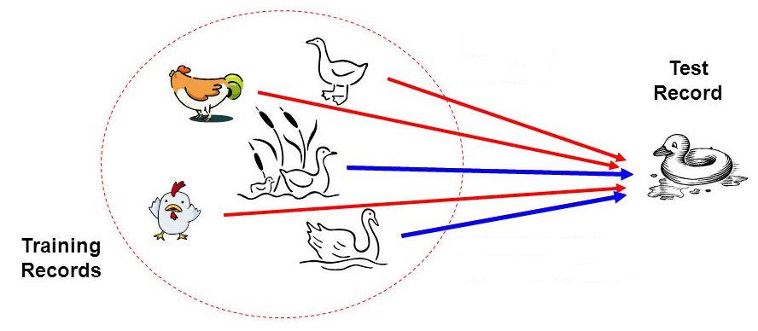
Bayesian Classifier
Principle
If it walks like a duck, quacks like a duck, then it is probably a duck
Naïve Bayes Classifier is one of the simple and most effective Classification algorithms
It is a probabilistic classifier, which means it predicts on the basis of the probability of an object.
4
Notes:
Based on a simple principle of probability … it is an effective technique that can be used as a baseline for classification
Naïve bayes is simple but effective in producing good results ..
Comparing NB with the previous approaches we studied such as DT, KNN, we can say that NB uses probability to classify objects

Slide 5
Bayesian Classifier
In many applications, the relationship between the attributes set and the class variable is non-deterministic.
In other words, a test cannot be classified to a class label with certainty.
In such a situation, the classification can be achieved probabilistically.
The Bayesian classifier is an approach for modelling probabilistic relationships between the attribute set and the class variable.
More precisely, Bayesian classifier uses Bayes’ Theorem of Probability for classification.
Before discussing the Bayesian classifier, we should have a quick look at the Theory of Probability and then Bayes’ Theorem.
5
Notes:
In some situations non-deterministic relationship exists between features and label
Neither rules nor distances may be convenient
Therefore, we may resort to probability
In statistics, naive Bayes classifiers are:
A family of simple "probabilistic classifiers" based on applying Bayes' theorem with strong independence assumptions between the features.

Slide 6
Probability
Notes:
We will review the concept of probability quickly before introducing the Naïve Bayes Classifier

Slide 7
Sample Space & Events
The sample space, S, for a random phenomena is the set of all possible outcomes.
The event, E, is any subset of the sample space, S. i.e. any set of outcomes (not necessarily all outcomes) of the random phenomena
S
E
Events
Flipping a coin,
Rolling a dice
…
7
Notes:
The sample space, S, for a random phenomena is the set of all possible outcomes.
Actual events, the compliment event, intersection, union e.t.c
Events are random outcomes in the Sample Space such as:
Flipping a coin,
Rolling a dice
….

Slide 8
Special Events
The Null Event, The empty event - φ
φ = { } = the event that contains no outcomes
The Entire Event, The Sample Space - S
S = the event that contains all outcomes
The empty event, φ , never occurs.
The entire event, S, always occurs.
8
Notes:
The Null event Phi has no outcomes
The entire Sample Space contains all outcomes

Slide 9
Set operations on Events
Union
Let A and B be two events, then the union of A and B is the event (denoted by A∪B) defined by:
A ∪ B = {e| e belongs to A or e belongs to B}
A ∪ B
A
B
9
Notes:
The Union Probability should exclude the intersection of A and B (i.e the Joint Probability)
The Union Probability → P(A) + P(B) – Joint Probability

Slide 10
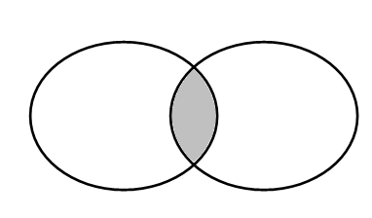
Intersection
Let A and B be two events, then the intersection of A and B is the event (denoted by A∩B) defined by:
A ∩ B = {e| e belongs to A and e belongs to B}
A ∩ B
A
B
The event A ∩ B occurs if the event A occurs and the event B occurs .
10
Notes:
The Joint Probability → Intersection → Probability of A AND B

Slide 11
Definition:
Mutually Exclusive
Two events A and B are called mutually exclusive if:
A
B
They have no outcomes in common.
They can’t occur at the same time.
The outcome of the random experiment can not belong to both A and B.
11
Notes:
Events are mutually exclusive if the intersection or joint probability is Phi

Slide 12
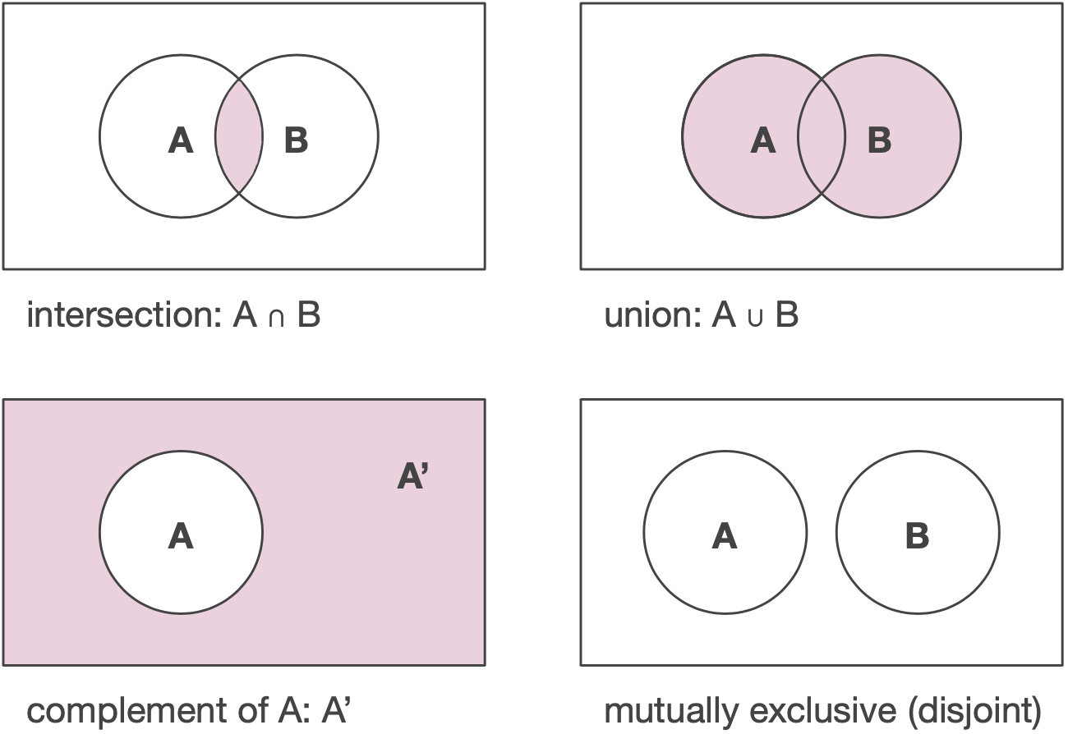

Mutually Exclusive
Suppose, A and B are any two events and P(A), P(B) denote the probabilities that the events A and B will occur, respectively.
Mutually Exclusive Events:
Two events are mutually exclusive, if the occurrence of one precludes the occurrence of the other.
Example:
Tossing a coin (two events)
Heads and Tails cannot occur together ..
Tossing a ludo cube (Six events)
Can you give an example, so that two events are not mutually exclusive?
Hint: Tossing two identical coins, Rolling a Die
12
Notes:
Mutually exclusive is a statistical term describing two or more events that cannot happen simultaneously.
Example of Mutually Exclusive Events:
For example, war and peace cannot coexist at the same time.
Flipping a coin, occurrence of a head and occurrence of a tail are mutually exclusive
Mutually Non Exclusive Events →
Driving and listening to the radio
in the case of rolling a die the event of getting an ‘odd-face’ and the event of getting ‘less than 4’ are not mutually exclusive and they are also known as compatible event.

Slide 13
Independent Events
Independent events: Two events are independent if occurrences of one does not alter the occurrence of other.
Example: Tossing both coin and rolling a Die together.
(How many events are here?)
Can you give an example, where an event is dependent on one or more other events(s)?
Hint: Receiving a message (A) through a communication channel (B)
over a computer (C), rain and dating.
13
Notes:
Independent events are those events whose occurrence is not dependent on any other event.
For example, if we flip a coin in the air and get the outcome as Head, then again if we flip the coin but this time we get the outcome as Tail.
In both cases, the occurrence of both events is independent of each other.
Dependent events:
Events are dependent if the outcome of one event affects the outcome of another.
Failing a course and graduating ..
Robbing a bank and going to jail.
Not paying your power bill on time and having your power cut off.

Slide 14
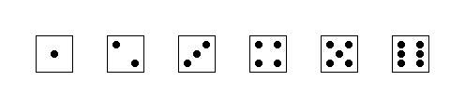
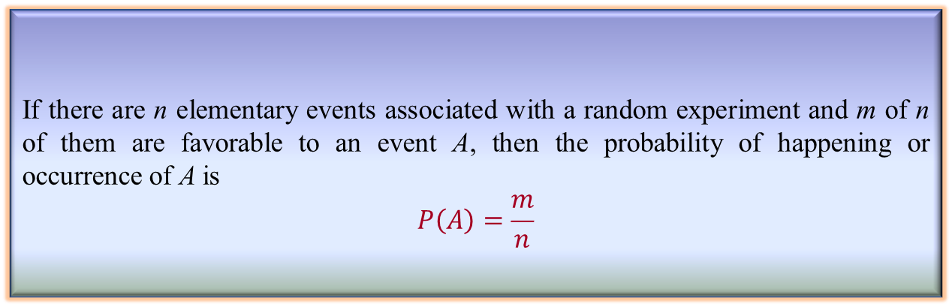
Simple Probability
If there are n elementary events associated with a random experiment and m of n of them are favorable to an event A, then the probability of happening or occurrence of A is
$$P\left(A\right)=\frac{m}{n}$$
Definition : Simple Probability
Examples
Tossing a coin – outcomes S ={Head, Tail}
Rolling a die – outcomes
S ={ }
={1, 2, 3, 4, 5, 6}
14
Notes:
We start reviewing simple probability concepts that we will use to understand Naïve Bayes Classifier
Examples of elementary events include (a) tossing a coin, (b) rolling a die
The probability of tossing a coin and getting a head = ½
The probability of rolling a die and getting an even number = 3/6

Slide 15
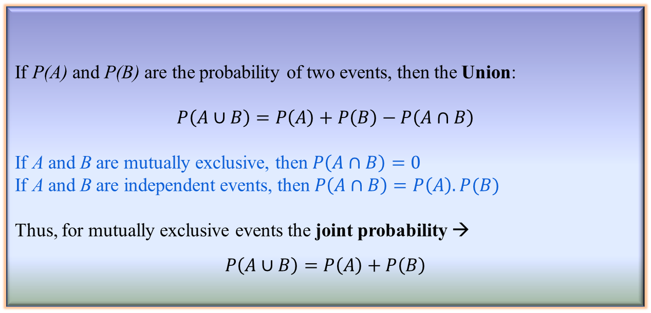
Union & Joint Probability
Definition: Union and Joint Probability
If P(A) and P(B) are the probability of two events, then the Union:
$$P\left(A∪B\right)=P\left(A\right)+P\left(B\right)−P\left(A∩B\right)$$
If A and B are mutually exclusive, then $P\left(A∩B\right)=0$
If A and B are independent events, then $P\left(A∩B\right)=P\left(A\right).P(B)$
Thus, for mutually exclusive events the joint probability →
$$P\left(A∪B\right)=P\left(A\right)+P\left(B\right)$$
15
Notes:
The Union Probability → P(A) + P(B) – Joint Probability
The Joint Probability → Intersection → Probability of A AND B

Slide 16
Example
Example: Saskatoon and Moncton are two of the cities competing for the World University Games. The organizers are narrowing the competition to the final 5 cities.
There is a 20% chance that Saskatoon will be amongst the final 5.
There is a 35% chance that Moncton will be amongst the final 5
There is an 8% chance that both Saskatoon and Moncton will be amongst the final 5.
What is the probability that Saskatoon or Moncton will be amongst the final 5.?
16
Notes:
In this example we will attempt to apply the Joint Probability to solve a simple problem.

Slide 17
Example: Solution
Solution: Let A = the event that Saskatoon is amongst the final 5. Let B = the event that Moncton is amongst the final 5. Given P[A] = 0.20, P[B] = 0.35, and P[A ∩ B] = 0.08 What is P[A ∪ B]? Note: “and” ≡ ∩, “or” ≡ ∪ .
17
Notes:
The joint probability seems to be higher than the P(A) and P(B)

Slide 18
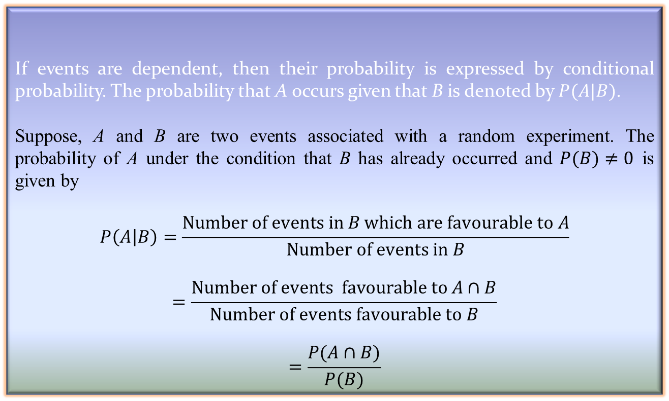
Conditional Probability
Definition: Conditional Probability
If events are dependent, then their probability is expressed by conditional probability. The probability that A occurs given that B is denoted by $P(A|B)$.
Suppose, A and B are two events associated with a random experiment. The probability of A under the condition that B has already occurred and $P(B)≠0$ is given by
$$P\left(A | B\right)=\frac{Number of events in B which are favourable to A}{Number of events in B}$$
$$=\frac{Number of events favourable to A∩B}{Number of events favourable to B}$$
$$=\frac{P(A∩B)}{P(B)}$$
18
Notes:
Conditional probability is a measure of the probability of an event occurring, given that another event has already occurred.
Deck of Cards (52 Cards) → There are 26 red cards and 26 black cards in a standard deck.
For example, given that you drew a red card from a deck of cards, what's the probability that it's a four (p(four|red))=2/26=1/13.
So out of the 26 red cards (given a red card), there are two fours so 2/26=1/13.
Conditional probability is known as the possibility of an event or outcome happening, based on the existence of a previous event or outcome.

Slide 19

Conditional Probability
Corollary: Conditional Probability
$P\left(A∩B\right)=P\left(A\right).P\left(B | A\right), if P\left(A\right)≠0$
or $P\left(A∩B\right)=P\left(B\right).P\left(A | B\right), if P(B)≠0$
For three events A, B and C
$$P\left(A∩B∩C\right)=P\left(A\right).P\left(B\right).P\left(C | A∩B\right)$$
For n events A₁, A₂, …, A_{n} and if all events are mutually independent to each other
$$P\left(A_{1}∩A_{2}∩ …………∩A_{n}\right)=P\left(A_{1}\right).P\left(A_{2}\right)…………P\left(A_{n}\right)$$
Note:
$P\left(A | B\right)=0$ if events are mutually exclusive
$P\left(A | B\right)=P\left(A\right)$ if A and B are independent
$P\left(A | B\right)⋅P\left(B\right)=P\left(B | A\right)⋅P(A)$ otherwise,
$P\left(A∩B\right)=P(B∩A)$
19
Notes:
We can rewrite the Conditional Probability in different ways
P(A|B) = P(A AND B)/P(B)
P(A AND B) = P(A) x P(B|A)
P(A AND B) = P(B) x P(A|B)
Pay attention to the special cases
P(A|B) = 0 → Events are mutually exclusive

Slide 20
Cond. Probability: Example
The academy awards is soon to be shown.
For a specific married couple the probability that the husband watches the show is 80%, the probability that his wife watches the show is 65%, while the probability that they both watch the show is 60%.
If the husband is watching the show, what is the probability that his wife is also watching the show?
20
Notes:
Here is an example to demo Conditional Probability

Slide 21
Solution:
The academy awards is soon to be shown.
Let B = the event that the husband watches the show
P[B]= 0.80
Let A = the event that his wife watches the show
P[A]= 0.65 and P[A ∩ B]= 0.60
21
Notes:
The probability that the wife will watch the show given that the husband will watch the show is higher than the probability of the wife watching the show without any condition.

Slide 22
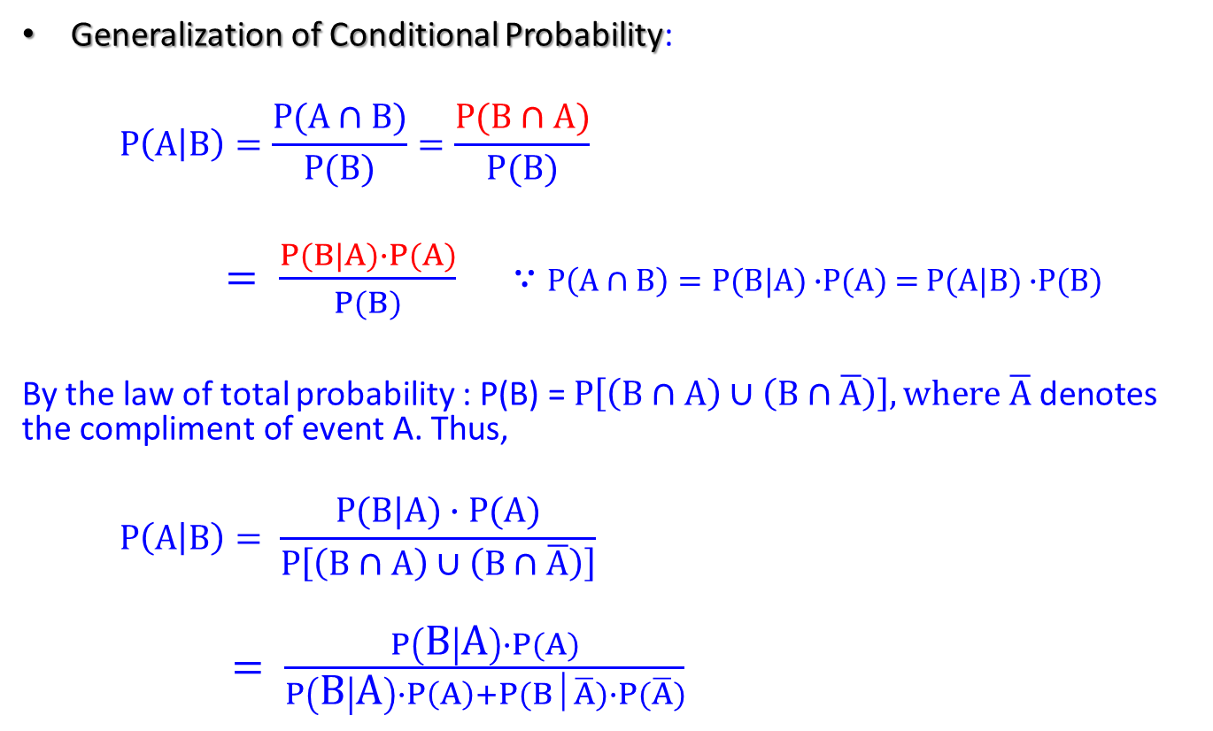
Conditional Probability
Generalization of Conditional Probability:
$$P\left(A | B\right)=\frac{P(A∩B)}{P(B)}=\frac{P(B∩A)}{P(B)}$$
$= \frac{P(B|A)∙P(A)}{P(B)}$ ∵ $P\left(A∩B\right)=P(B|A)$ $∙$P(A) = $P(A|B)$ $∙$P(B)
By the law of total probability : P(B) = $P\left[\left(B∩A\right)∪\left(B∩\overline{A}\right)\right],\text{where} \overline{A} \text{denotes} \text{the} \text{compliment} \text{of} \text{event} \text{A}\text{. }\text{Thus}\text{, }$
$$P\left(A | B\right)= \frac{P(B|A)∙P(A)}{P\left[\left(B∩A\right)∪\left(B∩\overline{A}\right)\right]}$$
$= \frac{P\left(B | A\right)∙P(A)}{P\left(B | A\right)∙P\left(A\right)+P(B│\overline{A})∙P(\overline{A})}$
22
Notes:
It is interesting to see how the Conditional Probability can be written in different expressions .

Slide 23
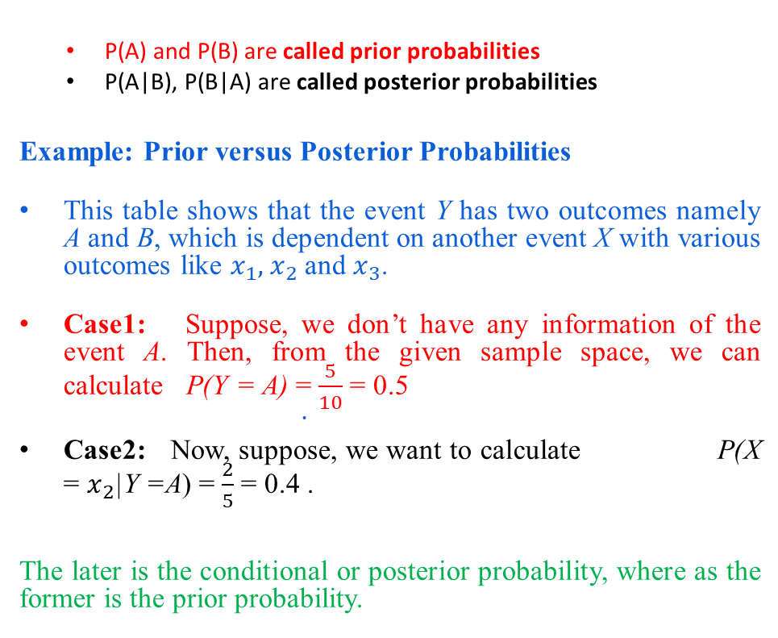
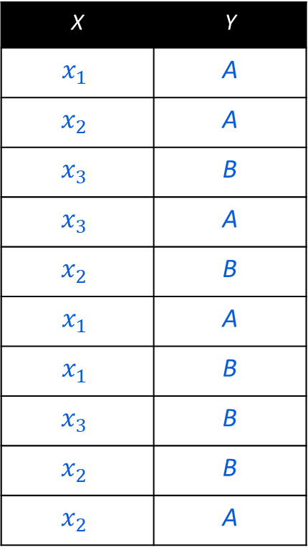
Prior and Posterior Probabilities
X | Y
$$x_{1}$$ | A
$$x_{2}$$ | A
$$x_{3}$$ | B
$$x_{3}$$ | A
$$x_{2}$$ | B
$$x_{1}$$ | A
$$x_{1}$$ | B
$$x_{3}$$ | B
$$x_{2}$$ | B
$$x_{2}$$ | A
P(A) and P(B) are called prior probabilities
P(A|B), P(B|A) are called posterior probabilities
Example: Prior versus Posterior Probabilities
This table shows that the event Y has two outcomes namely A and B, which is dependent on another event X with various outcomes like $x_{1},{ x}_{2}$ and $x_{3}$.
Case1: Suppose, we don’t have any information of the event A. Then, from the given sample space, we can calculate P(Y = A) =$\frac{5}{10}$ = 0.5
Case2: Now, suppose, we want to calculate P(X = $x_{2}$|Y =A) =$\frac{2}{5}$ = 0.4 .
The later is the conditional or posterior probability, where as the former is the prior probability.
23
Notes:
Prior Probability:
a probability as assessed before making reference to certain relevant observations, especially subjectively or on the assumption that all possible outcomes be given the same probability.
Represents what is originally believed before new evidence is introduced,
the probability of an event before new data is collected.
Posterior Probability:

Slide 24
Independent Events
Two events A and B are called independent if
Thus in the case of independence the conditional probability of an event is not affected by the knowledge of the other event
Notes:
Events are independent if the intersection probability is given by the product of the two probabilities

Slide 25
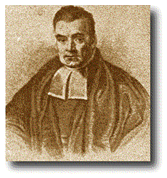
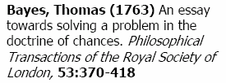
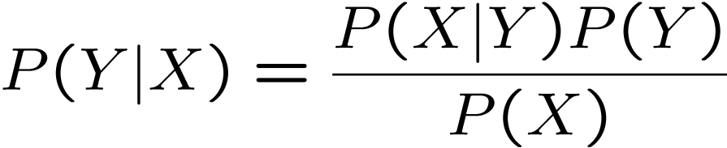
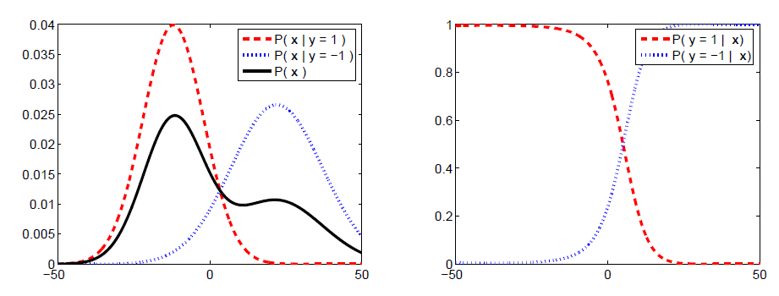
Bayes Formula
25
Notes:
This is the famous Bayes Formula that Naïve Bayes algorithm utilizes for classification

Slide 26

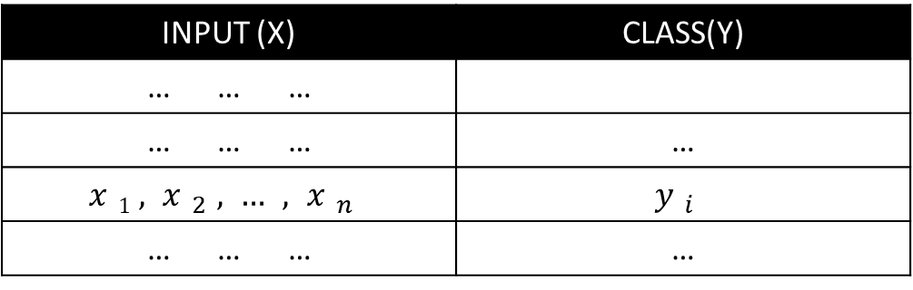
Naïve Bayesian Classifier
Suppose, Y is a class variable and X = $\left\{X1,X_{2},…..,X_{n}\right\}$ is a set of attributes, with instance of Y.
The classification problem, then can be expressed as the class-conditional probability
$$P\left(Y=yi|\left(X_{1}=x_{1}\right) AND \left(X_{2}=x_{2}\right) AND …..\left(X_{n}=x_{n}\right)\right)$$
INPUT (X) | CLASS(Y)
… … …
… … … | …
$$x1,x_{2},…,x_{n}$$ | $$y_{i}$$
… … … | …
26
Notes:
This slide summarizes the Naïve Bayes Approach in terms of classification

Slide 27
Naïve Bayes

Slide 28
What is it ?
Naive Bayes is a statistical classification technique based on Bayes Theorem.
It is one of the simplest supervised learning algorithms and uses Bayes theorem of probability for predicting unknown classes.
Naive Bayes classifier is successfully used in various applications such as spam filtering, text classification, sentiment analysis, and recommender systems.
Naive Bayes classifier assumes that the effect of a particular feature in a class is independent of other features.
For example, a loan applicant is desirable or not depending on his/her income, previous loan and transaction history, age, and location.
This assumption simplifies computation, and that's why it is considered as naive.
This assumption is called class conditional independence
28
Notes:
Naive Bayes is a supervised learning algorithm that is based on applying Bayes’ theorem with the “naive” assumption. The Bayes Rule gives the formula for the probability of Y given X. It is called Naive because of the naive assumption that the X’s are independent of each other.

Slide 29
Naïve Bayesian: Types
There are three types of Naive Bayes models:
Gaussian: is a variant of Naive Bayes used in classification and it assumes that features follow a normal distribution.
Gaussian Naive Bayes supports continuous data.
Multinomial: It is used for discrete counts. ...
Multinomial Naive bayes is good at handling discrete values
The multinomial Naive Bayes classifier is suitable for classification with discrete features (e.g., word counts for text classification).
Bernoulli: The binomial model is useful if your feature vectors are binary (i.e. zeros and ones).
It accepts only binary values, i.e., 0 or 1.
If the features of the dataset are binary, then we can assume that Bernoulli Naive Bayes is the algorithm to be used.
29
Notes:
https://iq.opengenus.org/gaussian-naive-bayes/
https://www.mygreatlearning.com/blog/multinomial-naive-bayes-explained/

Slide 30
Naïve Bayesian Classifier
Pros and Cons
The Naïve Bayes’ approach is a very popular one, which often works well.
Simple and easy to implement.
It doesn’t require much training data.
It is fast and highly scalable with the number of predictors.
It works well with high-dimensional data such as text classification, email spam detection.
However, it has a number of potential problems
It relies on all attributes being categorical.
If the data is less, then it estimates poorly.
30
Notes:
Pros:
It is simple and easy to implement.
It doesn't require as much training data.
It handles both continuous and discrete data.
It is highly scalable with the number of predictors and data points.
It is fast and can be used to make real-time predictions.

Slide 31
Example 1 (Single Feature)

Slide 32
Naïve Bayes Algorithm (Steps)
Naive Bayes classifier calculates the probability of an event (in case of a single feature) in the following steps:
Step 1: Calculate the prior probability for given class labels
Step 2: Find Likelihood probability with the attribute for each class
Step 3: Put value in Bayes Formula & calculate posterior prob.
Step 4: See which class has a higher probability, given the input belongs to the higher probability class.
32
Notes:
Summarizing the Naïve Bayes Algorithm, we can use the following steps

Slide 33
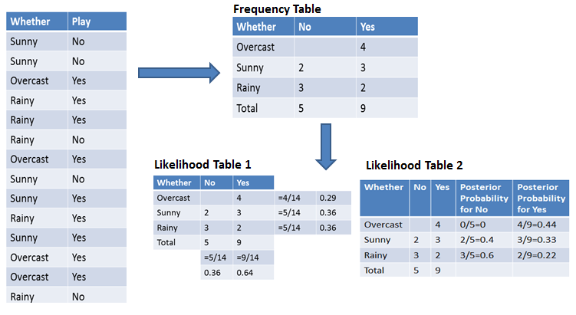
NB Algorithm (Single Feature)
The Frequency table contains the occurrence of labels for all features.
There are two likelihood tables.
Likelihood Table 1 is showing prior probabilities of labels and
Likelihood Table 2 is showing the posterior probability.
14 Records, 1 Feature
Weather
Weather
Weather
Weather
33
Notes:
In this example we have a dataset with 14 records, and a single feature
We create the Frequency Table and Likelihood Tables (both prior and Posterior Probabilities)

Slide 34
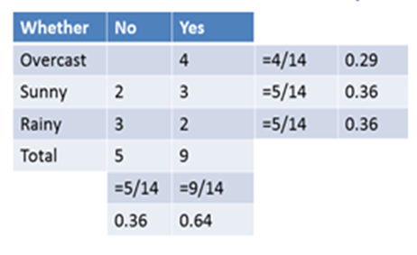
NB Algorithm (Single Feature)
Now suppose you want to calculate the probability of playing when the weather is overcast.
Probability of playing:
P(Yes | Overcast) = P(Overcast | Yes) * P(Yes) / P(Overcast) .....................(1)
Calculate and use Prior Probabilities:
P(Overcast) = 4/14 = 0.29
P(Yes)= 9/14 = 0.64
Calculate and use Posterior Probabilities:
P(Overcast |Yes) = 4/9 = 0.44
Substitute Prior and Posterior probabilities in equation (1)
P (Yes | Overcast) = 0.44 * 0.64 / 0.29 = 0.98 (High!!)
Likelihood Table 1
Likelihood Table 2
Weather
Weather
34
Notes:
We use the prior and posterior probabilities to calculate the probability of playing
The result indicates that based on Overcast the probability of playing is HIGH

Slide 35
NB Algorithm (Single Feature)
Now calculate the probability of not playing when the weather is overcast.
Probability of not playing:
P(No | Overcast) = P(Overcast | No) * P(No) / P(Overcast) .....................(1)
Calculate Prior Probabilities:
P(Overcast) = 4/14 = 0.29
P(No)= 9/14 = 0.36
Calculate Posterior Probabilities:
P(Overcast |No) = 0/5 = 0
Put Prior and Posterior probabilities in equation (1)
P (No | Overcast) = 0 * 0.36 / 0.29 = 0
Likelihood Table 1
Likelihood Table 2
Weather
Weather
35
Notes:
Now we can calculate the probability of NOT playing
From the two results the probability of playing given Overcast is YES

Slide 36
Example 2 (Multi Features)

Slide 37
Naïve Bayes Algorithm (Steps)
Naive Bayes classifier calculates the probability of an event (in case of multiple features) in the following steps:
Step 1: Calculate the Prior Probability for given Class Labels
Step 2: Calculate Cond. Prob. with each Attribute for each Class.
Step 3: Multiply Same Class Conditional Probability.
Step 4: Multiply Prior Probability with Step 3 Probability.
Step 5: See which Class has Higher Probability, Higher Probability Class belongs to given input Step.
37

Slide 38
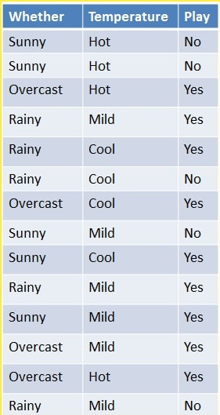
NB Algorithm (Multiple Features)
14 Records, 2 Feature
Weather
Step 1: Calculate the Prior Probability for given Class Labels
Step 2: Calculate Conditional Probability with each Attribute for each Class.
Step 3: Multiply Same Class Conditional Probability.
Step 4: Multiply Prior Probability with Step 3 Probability.
Step 5: See which Class has Higher Probability, Higher Probability Class belongs to given input Step.
38

Slide 39
NB Algorithm (Multiple Features)
Calculate the probability of playing when (a) weather is overcast and (b) temperature is mild
Probability of playing:
P(Play=Yes | W=Overcast, T=Mild) = P(W=Overcast, T=Mild | Play=Yes) * (Play=Yes) …(1)
P(W=Overcast, T=Mild | Play= Yes)= P(W=Overcast |Play=Yes) * P(T=Mild |Play=Yes) …(2)
Calculate Prior Probabilities:
P(Play=Yes) = 9/14 = 0.64
Calculate Posterior Probabilities:
P(W=Overcast |Yes) = 4/9 = 0.44
P(T=Mild | Yes) = 4/9 = 0.44
Put Posterior Probabilities in Equation (2)
P(W=Overcast, T=Mild | Play= Yes) = 0.44 * 0.44 = 0.1936
Put Prior and Posterior probabilities in Equation (1)
P (Play=Yes | W=Overcast, T=Mild) = 0.1936 * 0.64 = 0.124
Step 1: Calculate the Prior Probability for given Class Labels
Step 2: Calculate Conditional Probability with each Attribute for each Class.
Step 3: Multiply Same Class Conditional Probability.
Step 4: Multiply Prior Probability with Step 3 Probability.
Step 5: See which Class has Higher Probability, Higher Probability Class belongs to given input Step.
Probability of not playing: 0
The probability of a 'Yes' class is higher.
So, you can say here that if the weather is overcast than players will play the sport.
39

Slide 40
Example 3 (Multi Features)

Slide 41
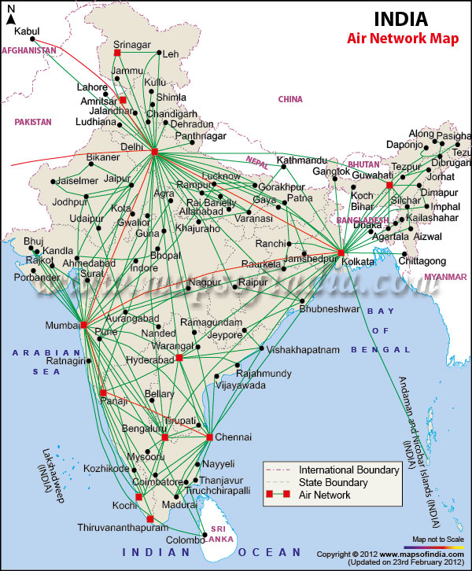
Example: Bayesian Classification
Example: Air Traffic Data
Let us consider a set observation recorded in a database
Regarding the arrival of airplanes in the routes from any airport to New Delhi under certain conditions.
41
Notes:
Here is another example where we can apply Naïve Bayes
We want to classify if a flight will be one of FOUR CLASSES
On time → 14 times
Late → 2 times
Very Late → 3 times
Cancelled → 1 time
Based on the following features: (a) Day, (b) Season, (c) Fog, (d) Rain

Slide 42
Air-Traffic Data
Days | Season | Fog | Rain | Class
Weekday | Spring | None | None | On Time
Weekday | Winter | None | Slight | On Time
Weekday | Winter | None | None | On Time
Holiday | Winter | High | Slight | Late
Saturday | Summer | Normal | None | On Time
Weekday | Autumn | Normal | None | Very Late
Holiday | Summer | High | Slight | On Time
Sunday | Summer | Normal | None | On Time
Weekday | Winter | High | Heavy | Very Late
Weekday | Summer | None | Slight | On Time
42
Notes:
This is the data with four features.
There are 20 records in total and 4 features
Feature #1: Day: has 4 possible values (a) Weekday, (b) Holiday, (c) Saturday (d) Sunday
Weekday → 13 instances (9 On Time …. 3 Very Late ….. 1 Late ….
Feature #2: Season: has 4 possible values (a) Autumn, (b) Winter, (c) Spring, (d) Summer
Feature #3: Fog: has 3 possible values (a) None, (b) High, (c) Normal
Feature #4: Rain: has 3 possible values (a) None, (b) Slight, (c) Heavy

Slide 43
Air-Traffic Data
Remainder of the dataset …
Days | Season | Fog | Rain | Class
Saturday | Spring | High | Heavy | Cancelled
Weekday | Summer | High | Slight | On Time
Weekday | Winter | Normal | None | Late
Weekday | Summer | High | None | On Time
Weekday | Winter | Normal | Heavy | Very Late
Saturday | Autumn | High | Slight | On Time
Weekday | Autumn | None | Heavy | On Time
Holiday | Spring | Normal | Slight | On Time
Weekday | Spring | Normal | None | On Time
Weekday | Spring | Normal | Heavy | On Time
43
Notes:
This is the remainder of the dataset

Slide 44
Air-Traffic Data
In this database, there are four attributes with 20 tuples
A = [ Day, Season, Fog, Rain]
The categories of classes are:
C= [On Time, Late, Very Late, Cancelled]
Given this is the knowledge of data and classes, we are to find most likely classification for any other unseen instance, for example:
Classification technique eventually to map this tuple into an accurate class.
Week Day | Winter | High | None | ???
44
Notes:
We need to use NB to classify unknown and unseen instances given the training data.

Slide 45
Air-Traffic Example
let us tabulate all the posterior and prior probabilities as shown below.
 |  | Class
Attribute |  | On Time | Late | Very Late | Cancelled
Day | Weekday | 9/14 = 0.64 | ½ = 0.5 | 3/3 = 1 | 0/1 = 0
 | Saturday | 2/14 = 0.14 | ½ = 0.5 | 0/3 = 0 | 1/1 = 1
 | Sunday | 1/14 = 0.07 | 0/2 = 0 | 0/3 = 0 | 0/1 = 0
 | Holiday | 2/14 = 0.14 | 0/2 = 0 | 0/3 = 0 | 0/1 = 0
Season | Spring | 4/14 = 0.29 | 0/2 = 0 | 0/3 = 0 | 0/1 = 0
 | Summer | 6/14 = 0.43 | 0/2 = 0 | 0/3 = 0 | 0/1 = 0
 | Autumn | 2/14 = 0.14 | 0/2 = 0 | 1/3= 0.33 | 0/1 = 0
 | Winter | 2/14 = 0.14 | 2/2 = 1 | 2/3 = 0.67 | 0/1 = 0
45
Notes:
Classes → 14 On Time, 2 Late, 3 Very Late, 1 Cancelled
Feature #1: Day: has 4 possible values (a) Weekday, (b) Holiday, (c) Saturday (d) Sunday
Weekday → 13 instances (9 On Time …. 3 Very Late ….. 1 Late ….

Slide 46
Air-Traffic Example
 |  | Class
Attribute |  | On Time | Late | Very Late | Cancelled
Fog | None | 5/14 = 0.36 | 0/2 = 0 | 0/3 = 0 | 0/1 = 0
 | High | 4/14 = 0.29 | 1/2 = 0.5 | 1/3 = 0.33 | 1/1 = 1
 | Normal | 5/14 = 0.36 | 1/2 = 0.5 | 2/3 = 0.67 | 0/1 = 0
Rain | None | 5/14 = 0.36 | 1/2 = 0.5 | 1/3 = 0.33 | 0/1 = 0
 | Slight | 8/14 = 0.57 | 0/2 = 0 | 0/3 = 0 | 0/1 = 0
 | Heavy | 1/14 = 0.07 | 1/2 = 0.5 | 2/3 = 0.67 | 1/1 = 1
Prior Probability |  | 14/20 = 0.70 | 2/20 = 0.10 | 3/20 = 0.15 | 1/20 = 0.05
46
Notes:
We will tabulate all the posterior and prior probabilities for Attribute “Fog” and “Rain”

Slide 47
Air-Traffic Example
Instance:
Case1: Class = On Time : 0.70 × 0.64 × 0.14 × 0.29 × 0.07 = 0.0013
Case2: Class = Late : 0.10 × 0.50 × 1.0 × 0.50 × 0.50 = 0.0125
Case3: Class = Very Late : 0.15 × 1.0 × 0.67 × 0.33 × 0.67 = 0.0222
Case4: Class = Cancelled : 0.05 × 0.0 × 0.0 × 1.0 × 1.0 = 0.0000
Week Day | Winter | High | Heavy | ???
Case3 is the strongest; Hence correct classification is Very Late
47
Notes:
We calculate all the necessary probabilities for each Class.
We find that the probability of “Very Late” is the highest thus the Class for the test data

Slide 48
Example 4 (Multi Features)
Notes:
Here is yet another example

Slide 49
Naïve Bayesian Classifier: Training Dataset
4 Features
Class:
C₁:buys_computer = ‘yes’
C₂:buys_computer = ‘no’
Test Data Sample
X =
(age <=30,
Income = medium,
Student = yes
Credit_rating = Fair)
Total Records = 14
Class #1: 9
Class #2: 5
49
Notes:
In this example we have a dataset with 14 records (9 YES, 5 NO)
The dataset comes with 4 features (Age, Income, Student, Credit-Rating)
We want to classify the test point given.

Slide 50
Naïve Bayesian Classifier: An Example
P(C_{i}): P(buys_computer = “yes”) = 9/14 = 0.643
P(buys_computer = “no”) = 5/14= 0.357
Compute P(X|C_{i}) for each class
P(age = “<=30” | buys_computer = “yes”) = 2/9 = 0.222
P(age = “<= 30” | buys_computer = “no”) = 3/5 = 0.6
P(income = “medium” | buys_computer = “yes”) = 4/9 = 0.444
P(income = “medium” | buys_computer = “no”) = 2/5 = 0.4
P(student = “yes” | buys_computer = “yes) = 6/9 = 0.667
P(student = “yes” | buys_computer = “no”) = 1/5 = 0.2
P(credit_rating = “fair” | buys_computer = “yes”) = 6/9 = 0.667
P(credit_rating = “fair” | buys_computer = “no”) = 2/5 = 0.4
X = (age <= 30 , income = medium, student = yes, credit_rating = fair)
P(X|C_{i}) : P(X | buys_computer = “yes”) = 0.222 x 0.444 x 0.667 x 0.667 = 0.044
P(X | buys_computer = “no”) = 0.6 x 0.4 x 0.2 x 0.4 = 0.019
P(X|C_{i})*P(C_{i}) : P(X | buys_computer = “yes”) * P(buys_computer = “yes”) = 0.028
P(X | buys_computer = “no”) * P(buys_computer = “no”) = 0.007
Therefore, X belongs to class (“buys_computer = yes”)
50
Notes:
By calculating the (a) Prior, (b) Posterior Probabilities we can classify the test point

Slide 51
Avoiding the 0-Probability Problem
Naïve Bayesian prediction requires each conditional prob. be non-zero. Otherwise, the predicted prob. will be zero
Ex. Suppose a dataset with 1000 tuples, income=low (0), income= medium (990), and income = high (10),
Use Laplacian correction (or Laplacian estimator)
Adding 1 to each case
Prob(income = low) = 1/1003
Prob(income = medium) = 991/1003
Prob(income = high) = 11/1003
The “corrected” prob. estimates are close to their “uncorrected” counterparts
51

Slide 52
Bayesian Belief Networks

Slide 53
Naïve Bayesian Classifier: Comments
Advantages
Easy to implement
Good results obtained in most of the cases
Disadvantages
Assumption: class conditional independence, therefore loss of accuracy
Practically, dependencies exist among variables
E.g., hospitals: patients: Profile: age, family history, etc.
Symptoms: fever, cough etc., Disease: lung cancer, diabetes, etc.
Dependencies among these cannot be modeled by Naïve Bayesian Classifier
How to deal with these dependencies?
Bayesian Belief Networks
53
Notes:
One of the main disadvantages of Naïve Bayes is the assumption that attributes are independent!
In cases where attributes indeed are dependent we will not be able to use Naïve Bayes and resort to something different

Slide 54
Bayesian Belief Networks
Bayesian belief network allows a subset of the variables conditionally independent
BBNs are graphical representations of the probabilities
A graphical model of causal relationships
Represents dependency among the variables
Gives a specification of joint probability distribution
Nodes: random variables
Links: dependency
X and Y are the parents of Z, and Y is the parent of P
No dependency between Z and P
Has no loops or cycles
X
Y
Z
P
54

Slide 55
A Bayesian Network
A Bayesian network is made up of:
1. A Directed Acyclic Graph
A
B
C
D
2. A set of tables for each node in the graph
A | P(A)
false | 0.6
true | 0.4
A | B | P(B|A)
false | false | 0.01
false | true | 0.99
true | false | 0.7
true | true | 0.3
B | D | P(D|B)
false | false | 0.02
false | true | 0.98
true | false | 0.05
true | true | 0.95
B | C | P(C|B)
false | false | 0.4
false | true | 0.6
true | false | 0.9
true | true | 0.1
55

Slide 56
A Directed Acyclic Graph
Each node in the graph is a random variable
A node X is a parent of another node Y if there is an arrow from node X to node Y eg. A is a parent of B
A
B
C
D
Informally, an arrow from node X to node Y means X has a direct influence on Y
56

Slide 57
A Set of Tables for Each Node
A | P(A)
false | 0.6
true | 0.4
A | B | P(B|A)
false | false | 0.01
false | true | 0.99
true | false | 0.7
true | true | 0.3
Each node X_{i} has a conditional probability distribution P(X_{i} | Parents(X_{i})) that quantifies the effect of the parents on the node
The parameters are the probabilities in these conditional probability tables (CPTs)
B | C | P(C|B)
false | false | 0.4
false | true | 0.6
true | false | 0.9
true | true | 0.1
A
B
B | D | P(D|B)
false | false | 0.02
false | true | 0.98
true | false | 0.05
true | true | 0.95
C
D
57

Slide 58
Using a Bayesian Network Example
Using the network in the example, suppose you want to calculate:
P(A = true, B = true, C = true, D = true)
= P(A = true) * P(B = true | A = true) *
P(C = true | B = true) P( D = true | B = true)
= (0.4)*(0.3)*(0.1)*(0.95)
A
B
C
D
58

Slide 59
Using a Bayesian Network Example
Using the network in the example, suppose you want to calculate:
P(A = true, B = true, C = true, D = true)
= P(A = true) * P(B = true | A = true) *
P(C = true | B = true) P( D = true | B = true)
= (0.4)*(0.3)*(0.1)*(0.95)
This is from the graph structure
A
B
These numbers are from the conditional probability tables
C
D
59

Slide 60
SKLearn
Notes:
Here is an example of how to use NB for classification

Slide 61
SKLearn: Naïve Bayes
# Naive Bayes with Multiple Labels
# Multinomial Naive Bayes classification
# https://www.datacamp.com/community/tutorials/naive-bayes-scikit-learn
# Will use wine data set that consists of 13 features with three classes
# The dataset is available in the scikit-learn library
# Import necessary libraries
from sklearn import datasets
import numpy as np
#Import Gaussian Naive Bayes model
from sklearn.naive_bayes import GaussianNB
# Import train_test_split function
from sklearn.model_selection import train_test_split
#Import scikit-learn metrics module for accuracy calculation
from sklearn import metrics
61
Notes:
Important libraries are imported

Slide 62
SKLearn: Naïve Bayes
# Dataset comprises of 13 features
# (alcohol, malic_acid, ash, alcalinity_of_ash, magnesium, total_phenols, # flavanoids, nonflavanoid_phenols,
# proanthocyanins, color_intensity, hue, od280/od315_of_diluted_wines, proline)
# It consists of 3 type of classes Class_0, Class_1, Class_2
# Load dataset
wine = datasets.load_wine()
# Exploring Data
# print the names of the 13 features
print ("Features: ", wine.feature_names)
# print the label type of wine(class_0, class_1, class_2)
print ("Labels: ", wine.target_names)
Features: ['alcohol', 'malic_acid', 'ash', 'alcalinity_of_ash', 'magnesium', 'total_phenols', 'flavanoids', 'nonflavanoid_phenols', 'proanthocyanins', 'color_intensity', 'hue', 'od280/od315_of_diluted_wines', 'proline’]
Labels: ['class_0' 'class_1' 'class_2']
62
Notes:
Load the dataset
Perform some exploration

Slide 63
SKLearn: Naïve Bayes
# good idea to always explore your data a bit, so you know what you're working with.
# Here, you can see the first five rows of the dataset are printed,
# as well as the target variable for the whole dataset.
# print data(feature)shape
wine.data.shape
(178, 13)
# print the wine data features (top 3 records)
print(wine.data[0:3])
[[1.423e+01 1.710e+00 2.430e+00 1.560e+01 1.270e+02 2.800e+00 3.060e+00
2.800e-01 2.290e+00 5.640e+00 1.040e+00 3.920e+00 1.065e+03]
[1.320e+01 1.780e+00 2.140e+00 1.120e+01 1.000e+02 2.650e+00 2.760e+00
2.600e-01 1.280e+00 4.380e+00 1.050e+00 3.400e+00 1.050e+03]
[1.316e+01 2.360e+00 2.670e+00 1.860e+01 1.010e+02 2.800e+00 3.240e+00
3.000e-01 2.810e+00 5.680e+00 1.030e+00 3.170e+00 1.185e+03]
# print the wine labels (0:Class_0, 1:class_1, 2:class_2)
print(wine.target)
[0 0 0 0 0 0 0 0 0 0 0 0 0 0 0 0 0 0 0 0 0 0 0 0 0 0 0 0 0 0 0 0 0 0 0 0 0
0 0 0 0 0 0 0 0 0 0 0 0 0 0 0 0 0 0 0 0 0 0 1 1 1 1 1 1 1 1 1 1 1 1 1 1 1
1 1 1 1 1 1 1 1 1 1 1 1 1 1 1 1 1 1 1 1 1 1 1 1 1 1 1 1 1 1 1 1 1 1 1 1 1
1 1 1 1 1 1 1 1 1 1 1 1 1 1 1 1 1 1 1 2 2 2 2 2 2 2 2 2 2 2 2 2 2 2 2 2 2
2 2 2 2 2 2 2 2 2 2 2 2 2 2 2 2 2 2 2 2 2 2 2 2 2 2 2 2 2 2]
63
Notes:
Display the data if needed

Slide 64
SKLearn: Naïve Bayes
# Split dataset into training set and test set
# 70% training records, 30% testing records
X_train, X_test, y_train, y_test = train_test_split(wine.data, wine.target,test_size=0.3, ,random_state=109)
# Model Generation
#Create a Gaussian Classifier
gnb = GaussianNB()
#Train the model using the training sets
gnb.fit(X_train, y_train)
#Predict the response for test dataset
y_pred = gnb.predict(X_test)
# Model Accuracy, how often is the classifier correct?
print("Accuracy:",metrics.accuracy_score(y_test, y_pred))
Accuracy: 0.9074074074074074
64
Notes:
Use Gaussian NB Classifier and display the accuracy

Slide 65
Summary

Slide 66
Summary
Naive Bayes is a classification algorithm for binary and multiclass classification problems.
It is called Naive Bayes or idiot Bayes because the calculations of the probabilities for each class are simplified to make their calculations tractable.
Rather than attempting to calculate the probabilities of each attribute value, they are assumed to be conditionally independent given the class value.
Naïve Bayes is Simple and easy to implement, doesn’t require much training data, it is fast, and it is highly scalable with the number of predictors.
66

Slide 67
Why Bayesian ?
Provides practical learning algorithms
E.g. Naïve Bayes
Prior knowledge and observed data can be combined
Calculate explicit probabilities for hypothesis
Provides a useful perspective for understanding many learning algorithms
Provides a gold standard for evaluating other learning algorithms
Robust to Noise in input data
67

Slide 68
Resources

Slide 69
Naïve Bayes: Misc. Resources
YouTube:
Tutorial on Naïve Bayes (intro by Simplilearn)
https://www.youtube.com/watch?v=l3dZ6ZNFjo0
NB a Friendly Approach
https://www.youtube.com/watch?v=Q8l0Vip5YUw
Naïve Bayes, StatQuest!!
https://www.youtube.com/watch?v=O2L2Uv9pdDA
Math Behind NB
https://www.youtube.com/watch?v=lFJbZ6LVxN8
BNNS
https://www.youtube.com/watch?v=ibKIrRGUxG4
Documents:
https://www.cs.ucr.edu/~eamonn/CE/Bayesian%20Classification%20withInsect_examples.pdf
https://web.stanford.edu/class/archive/cs/cs109/cs109.1176/lectures/22-NaiveBayes.pdf
http://www.cs.cmu.edu/~10601b/slides/NBayes.pdf
69

Slide 70
Naïve Bayes: Misc. Resources
Tutorials:
https://towardsdatascience.com/a-short-tutorial-on-naive-bayes-classification-with-implementation-2f69183d8ce1
https://www.machinelearningplus.com/predictive-modeling/how-naive-bayes-algorithm-works-with-example-and-full-code/
https://www.springboard.com/blog/data-analytics/naive-bayes-classification/
https://jakevdp.github.io/PythonDataScienceHandbook/05.05-naive-bayes.html
Code:
https://machinelearningmastery.com/naive-bayes-classifier-scratch-python/
https://scikit-learn.org/stable/modules/naive_bayes.html
https://www.datacamp.com/community/tutorials/naive-bayes-scikit-learn
70

Slide 71
End Slides

