Slide 1
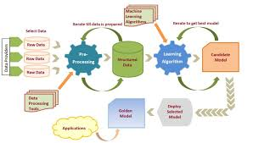
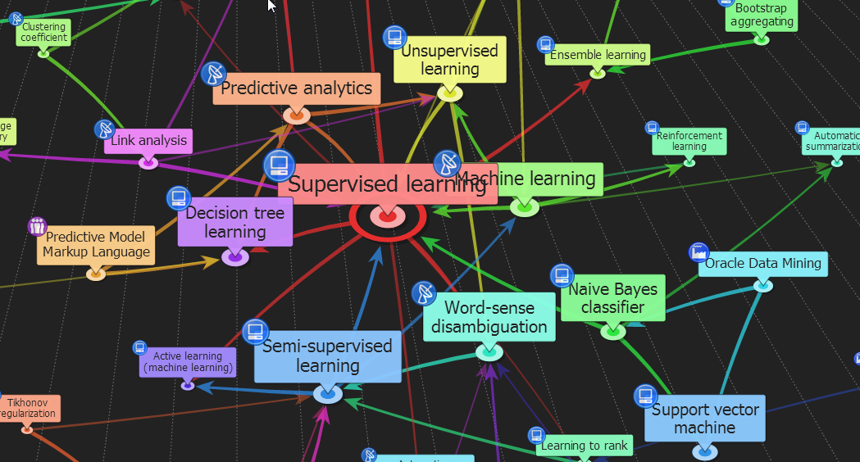

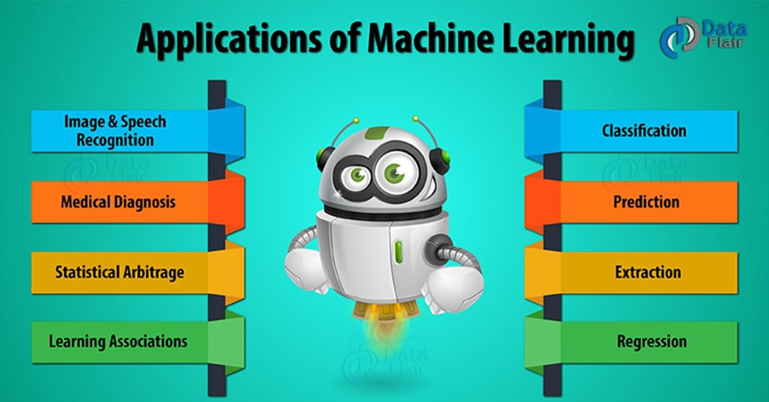

ENG6500: Intro to Machine Learning
“Decision Trees”
S. Areibi
School of Engineering
University of Guelph
Notes:
In this lecture we will cover the concept of Decision Trees as a Supervised Machine Learning Algorithm

Slide 2
Introduction
Notes:
Decision trees are one of the most popular predictive modelling approaches used in statistics, data mining and machine learning.

Slide 3
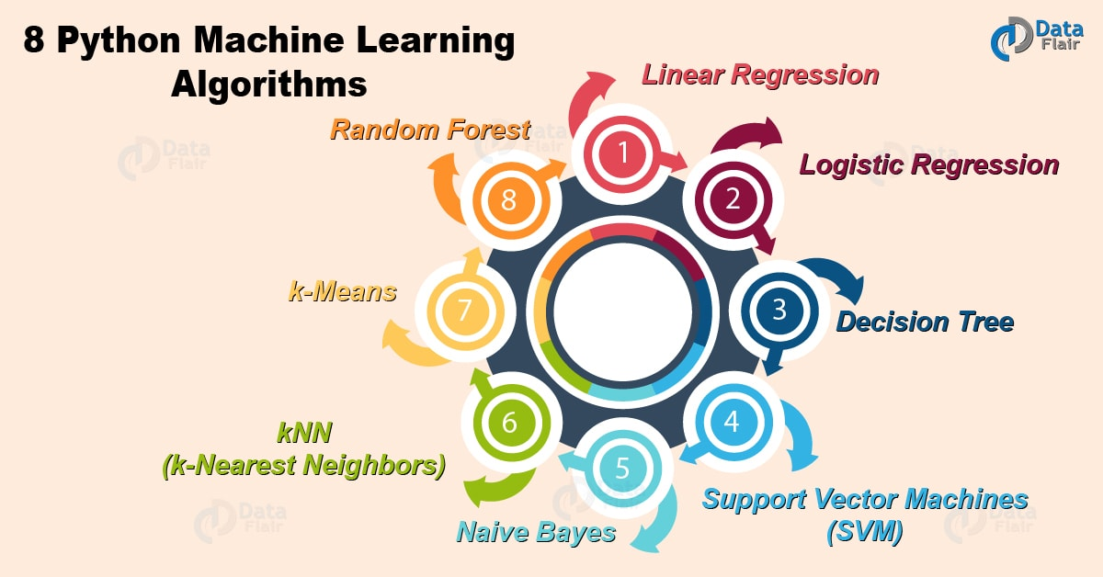
Classification Algorithms
Introduced in the early 60’s by Morgan & Sonquist
DTs can be used for both classification and regression
Easy to understand and interpret
Typical Algorithms:
Decision Trees
Rule-based induction
Neural networks
K-Nearest Neighbor
Random Forests
Bayesian networks
Support Vector Machines
3
Notes:
Decision trees can be used for both regression and classification problems.
Decision trees are easy to understand and interpret
The Department of Statistics at the University of Wisconsin–Madison writes:
that the first decision tree regression was invented in 1963 (AID project, Morgan and Sonquist).

Slide 4
Classification Learning
Dataset: (a) Training Set, (b) Validation Set, (c) Test Set
  Each record contains a set of attributes, one of the attributes is the class
Given the (Training set)
  Use Training Set to build the model
    Find a model for the class attribute as a function of the values of the other attributes
Use the Validation Set to:
  Tune (Optimize) the parameters of the model
  Evaluate how well the model makes predictions
Use Test Set to estimate the accuracy of the model
  Goals:
    Previously unseen records should be assigned a class as accurately as possible
    Model should be able to generalize
    Deploy the model
4
Notes:
Decision Trees follow a similar pattern to other Machine Learning Algorithms in terms of Training, validation and Testing
Decision Trees tend to create simple decision rules that can be followed (by using Training Data) to predict and classify unseen data.
Unlike KNN, decision trees learn from the model attributes .. In other words we can throw the Training Data once we fit the model

Slide 5
Terminology
Notes:
Before proceeding with how Decision Trees are constructed we will introduce “Terminology”

Slide 6
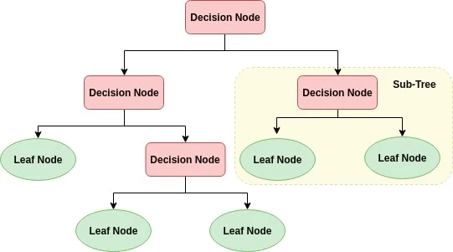
Decision Trees
A decision tree is a flowchart-like tree structure where an internal node represents feature (or attribute), the branch represents a decision rule, and each leaf node represents the outcome.
This flowchart-like structure helps you in decision making.
It's visualization like a flowchart diagram which easily mimics the human level thinking.
That is why decision trees are easy to understand and interpret.
6
Notes:
Decision trees are easy to follow and easy to construct since they follow and mimic how we humans think (logical)
The flowchart structure helps the designer:
Understand the different decisions taken by the ML algorithm.
Interpret the results obtained ..
The tree has different types of nodes and a certain depth

Slide 7
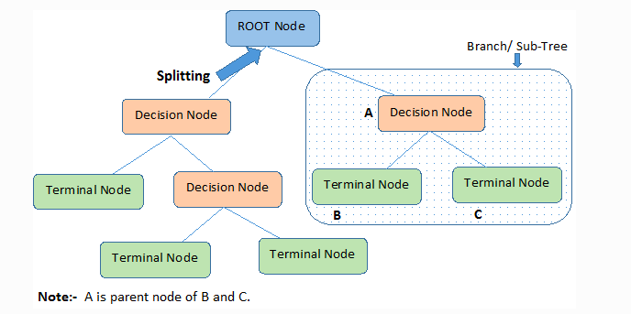
Tree Structure: Root Node
The topmost node in a decision tree is known as the root node.
It learns to partition on the basis of the attribute value.
Different Tree Structures will be formed if different “Features” are used to split the tree at the root.
7
Notes:
The very top node in the tree is the “Root Node”
It is a very important Node since splitting the tree optimally at this stage makes the tree a better ML algorithm
This is part of the learning that occurs in the Tree

Slide 8
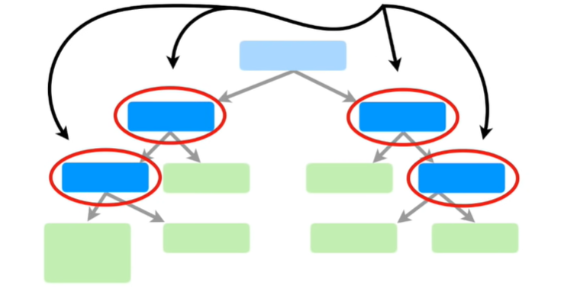
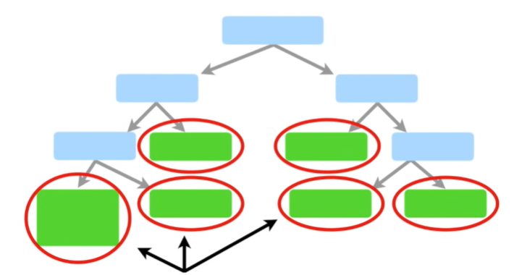
Internal & Leaf Nodes
These are called internal nodes or decision nodes
These are called Leaf Nodes or Terminal Nodes
8
Notes:
Internal Nodes are the Decision Nodes that further split the tree
The terminal nodes are called Leaf Nodes and these nodes have the class answer of the records

Slide 9
Decision Trees: Examples
Notes:
We will look at several examples where decision trees may be handy to predict or classify

Slide 10
Example 1: Decision?
What would you do tonight?
Decide amongst the following:
  Finish homework
  Go to a party
  Read a book
  Hang out with friends
10
Notes:
In this first example, the decision is “What to do Tonight?”
The decision will be based on the following factors
If Homework needs to be finished,
If we are invited to a party then go to a party
If we have friends then hang out with friends

Slide 11
Example 1: Decision?
Homework Deadline tonight?
Yes
No
Do homework
Party invitation?
Yes
No
Do I have friends
Go to the party
Yes
No
Read a book
Hang out with friends
11
Notes:
Example #1, shows how a tree is built based on the features available

Slide 12
Example 2: Cheat (Yes/No)
Refund
Yes
No
NO
MarSt
Single, Divorced
Married
TaxInc
NO
< 80K
> 80K
NO
YES
Training Data
Model: Decision Tree
12
Notes:
In the second example we show how to classify a person to be a honest or a cheat using the following features
If he/she received a refund
Marital Status
The income that is taxable

Slide 13
Apply Model to Test Data
Test Data
Start at the root of tree
Refund
Yes
No
NO
MarSt
Single, Divorced
Married
TaxInc
NO
< 80K
> 80K
NO
YES
13
Notes:
Once the tree is built we will check a “Test Data” by going through the tree

Slide 14
Apply Model to Test Data
Test Data
Refund
Yes
No
NO
MarSt
Single, Divorced
Married
TaxInc
NO
< 80K
> 80K
NO
YES
14
Notes:
Since there is No Refund we need to check another feature

Slide 15
Apply Model to Test Data
Test Data
Refund
Yes
No
NO
MarSt
Single, Divorced
Married
TaxInc
NO
< 80K
> 80K
NO
YES
15
Notes:
We will then use the Martial Status, it indicates Married=True

Slide 16
Apply Model to Test Data
Test Data
Refund
Yes
No
NO
MarSt
Single, Divorced
Married
TaxInc
NO
< 80K
> 80K
NO
YES
16
Notes:
By using Martial Status we can reach a leaf node that indicates NO CHEAT

Slide 17
Apply Model to Test Data
Test Data
Refund
Yes
No
NO
MarSt
Single, Divorced
Married
TaxInc
NO
< 80K
> 80K
NO
YES
17

Slide 18
Apply Model to Test Data
Test Data
Refund
Yes
No
NO
MarSt
Single, Divorced
Married
Assign Cheat to “No”
TaxInc
NO
< 80K
> 80K
NO
YES
18

Slide 19
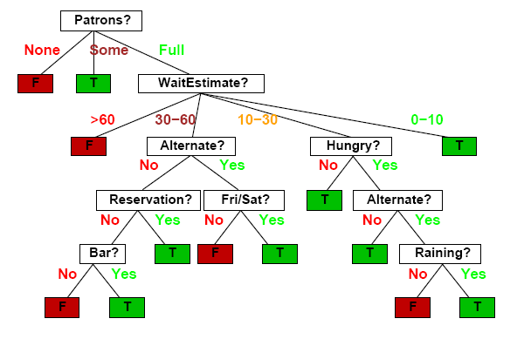
Example 3: Waiting
Should I wait at this restaurant?
Notes:
In this example a person wants to make a decision to wait at a restaurant or not.
This will depend on many factors
Patrons
Time to wait
If he/she are Hungry
If it is raining
Depends on the day (Fri/Sat) or weekday

Slide 20
Building Trees
Notes:
How are Trees built for classification and regression?

Slide 21
Weather data: Play or not to Play?
Label
4 Features
ID code | Outlook | Temperature | Humidity | Windy | Play
a b c d e f g h i j k l m n | Sunny Sunny Overcast Rainy Rainy Rainy Overcast Sunny Sunny Rainy Sunny Overcast Overcast Rainy | Hot Hot Hot Mild Cool Cool Cool Mild Cool Mild Mild Mild Hot Mild | High High High High Normal Normal Normal High Normal Normal Normal High Normal High | False True False False False True True False False False True True False True | No No Yes Yes Yes No Yes No Yes Yes Yes Yes Yes No
Decision
Tree?
14 Records → Training Data
Feature
At the
Root?
Notes:
This is a dataset consisting of
14 records
4 features and a label
If we want to create a decision tree, we have to make a decision on which feature to use first as the Root Node?
This is part of the learning that Decision Trees encounters while building the tree

Slide 22
Internal vs. Leaf Nodes
ID code | Outlook | Temp | Humidity | Windy | Play
a b c d e f g h i j k l m n | Sunny Sunny Overcast Rainy Rainy Rainy Overcast Sunny Sunny Rainy Sunny Overcast Overcast Rainy | Hot Hot Hot Mild Cool Cool Cool Mild Cool Mild Mild Mild Hot Mild | High High High High Normal Normal Normal High Normal Normal Normal High Normal High | False True False False False True True False False False True True False True | No No Yes Yes Yes No Yes No Yes Yes Yes Yes Yes No
Outlook
Sunny
Overcast
Rain
Humidity
Each internal node tests an attribute
High
Normal
Each branch corresponds to an
attribute value node
No
Yes
Each leaf node assigns a classification
22
Notes:
This is one way of constructing the tree (choosing Outlook feature to split the Tree at the Root)
Internal Nodes are Decision Nodes (to test the attributes)
Notice that Leaf nodes in blue boxes are the terminal nodes that assign the final class for the records

Slide 23
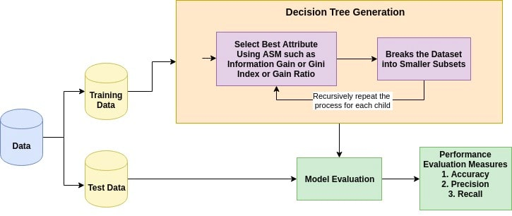
Building the Tree
The basic idea behind any decision tree algorithm is as follows:
Split Data into Training and Testing records.
Start tree building (select an attribute at a root node and decision node)
Evaluate the Tree using all performance measures
Pick the best tree that solves the problem at hand.
Building the Tree: Learning
23
Notes:
As with any ML algorithm, split the data into training and testing
Use the training data to create the DT model
Follow the procedure listed above
Once the Tree is created use on the test data and evaluate the model in terms of Accuracy, Precision, Recall …

Slide 24
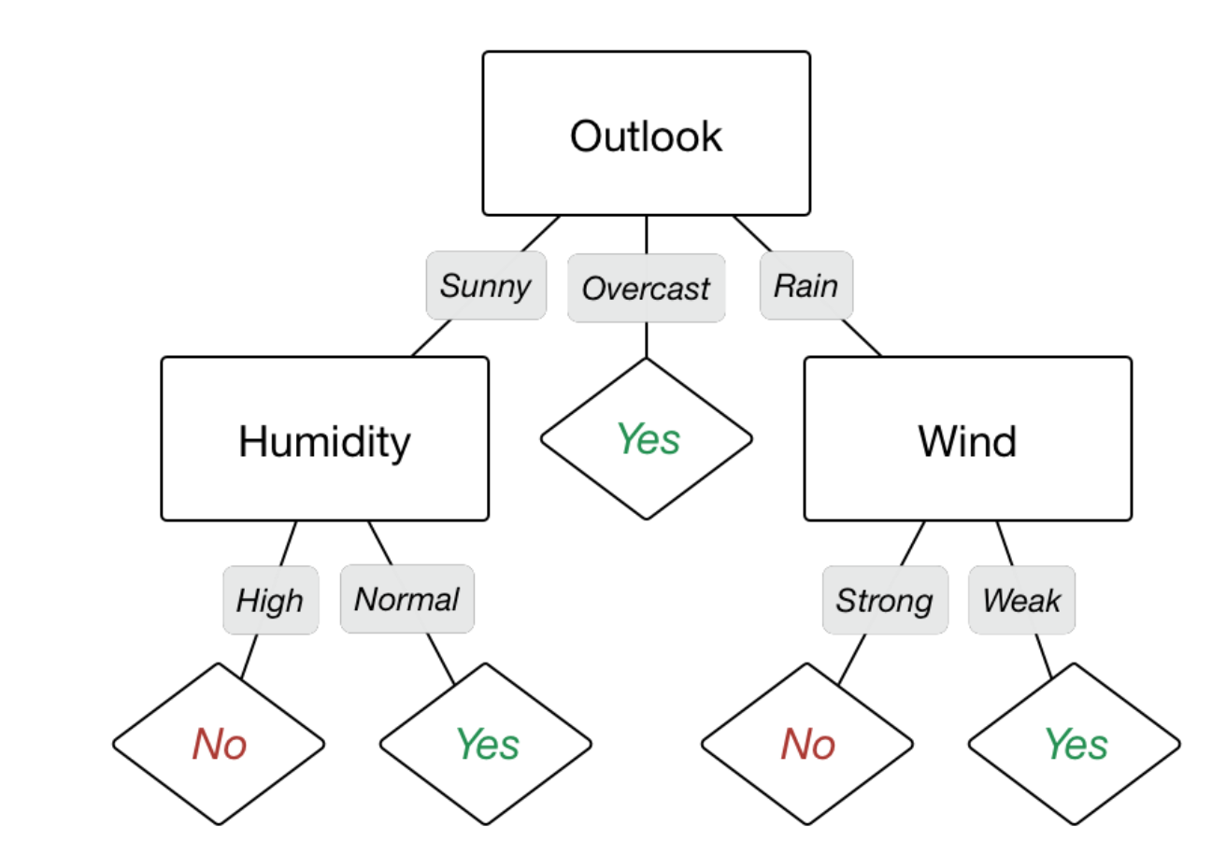
A Tree from Data
ID code | Outlook | Temperature | Humidity | Windy | Play
a b c d e f g h i j k l m n | Sunny Sunny Overcast Rainy Rainy Rainy Overcast Sunny Sunny Rainy Sunny Overcast Overcast Rainy | Hot Hot Hot Mild Cool Cool Cool Mild Cool Mild Mild Mild Hot Mild | High High High High Normal Normal Normal High Normal Normal Normal High Normal High | False True False False False True True False False False True True False True | No No Yes Yes Yes No Yes No Yes Yes Yes Yes Yes No
24
Notes:
A Complete tree constructed from the data
Start with the Feature that gives best split (best solution)
Next with another feature “Humidity”
And recursively build the tree

Slide 25
The Key Idea
Recursive Partitioning
Take all of your data.
Consider all possible values of all variables.
Select the variable/value (X=t₁) that produces the greatest “separation” in the target.
    (X=t₁) is called a “split”.
If X< t₁ then send the data to the “left”; otherwise, send data point to the “right”.
Now repeat same process on these two “nodes”
    You get a “tree”
25
Notes:
The main and key idea of decision trees is to build the tree based on a specific criteria ..
At each node a variable is evaluated to decide which path to follow
Choose the independent variable (predictor) that produces the highest information gain ..
The predictor that may split either the root node or decision nodes to classify the most points

Slide 26
DT: Algorithm
Start with a training data set which we’ll call S. It should have attributes and classification.
Determine the best attribute in the dataset. (We will cover the definition of best attribute)
Split S into subset that contains the possible values for the best attribute.
Make decision tree node that contains the best attribute.
Recursively generate new decision trees by using the subset of data created from step 3 until a stage is reached where you cannot classify the data further. Represent the class as leaf node.
ID code | Outlook | Temperature | Humidity | Windy | Play
a b c d e f g h i j k l m n | Sunny Sunny Overcast Rainy Rainy Rainy Overcast Sunny Sunny Rainy Sunny Overcast Overcast Rainy | Hot Hot Hot Mild Cool Cool Cool Mild Cool Mild Mild Mild Hot Mild | High High High High Normal Normal Normal High Normal Normal Normal High Normal High | False True False False False True True False False False True True False True | No No Yes Yes Yes No Yes No Yes Yes Yes Yes Yes No
26
Notes:
We start to build the tree by checking all the features and how well they split the tree
By looking at one of the measures used to split trees we find that “Outlook” is the best feature to use at the Root.
In some cases we end up with a leaf (such as Overcast) since there is always a single outcome
The next feature chosen on the left hand side is “Humidity” since it gives the best split
A Complete tree constructed from the data

Slide 27
Decision Boundaries

Slide 28
Decision Boundaries
x₂
Region2
Region1
Two Features
X₁
X₂
x₂ª
Region3
x₁ª
x₁
28
Notes:
This example shows how Decision Trees define boundaries as the Tree is being built
Assume we have three classes for our problem
We can start with a vertical cut (anything > X₁ª) is a region and anything less is another region
We can then introduce a horizontal cut (anything < X₂ª) is Region 3 and anything greater is another region
We end up with three distinct regions and boundaries that classify the points correctly

Slide 29
Creating the Tree
Vertical Cut
Region2
X₁<x₁ª
X₁>x₁ª
Region1
Region3
Horizontal Cut
Region3
X₂<x₂ª
X₂>x₂ª
Region2
Region2
X₂>x₂ª
Region1
Region3
X₁>x₁ª
29
Notes:
This is how the tree is being built and how the boundaries and regions are defined
The Vertical Cut corresponds to taking Feature #1 “X₁” and using it to build the tree and boundaries
The Horizontal Cut corresponds to taking Feature #2 “X₂” and also using to further create necessary boundaries

Slide 30
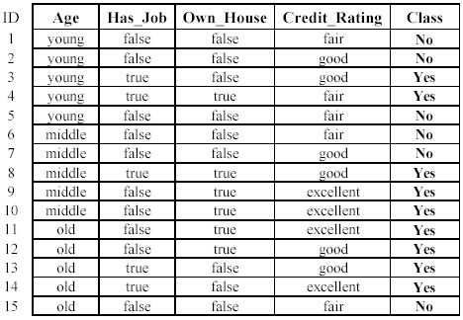
Example: data (Loan Application)
Approve: Yes/No
Notes:
A Binary Classification Loan application dataset with four features and label (two classes)
Notice that some features are Categorical and even Ordinal ..
Decision Trees have no problem with non-numerical data

Slide 31
Loan Application: The learning task
Learn a classification model from the data
Use the model to classify future loan applications into
  Yes (approved) and
  No (not approved)
What is the class for following case/instance?
Notes:
Learn a classification model from the data means: Build the tree
Once the tree is built then we can use it to decide if the new record is approved or not

Slide 32
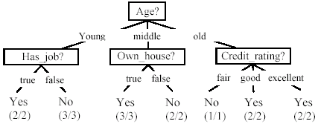
A Decision Tree: Loan Data Example
Decision nodes and leaf nodes (classes)
Notes:
The first step is to choose one of the 4 features to be at the root of the tree.
What is the criteria that we will need to use to select the correct feature?
The criteria is called “Attribute Selection Measure”:
Entropy
Information Gain
Gini Index ..

Slide 33
A Decision Tree: Loan Data Example
No
Is this the only tree we can create?
Notes:
Once the model is created we can test the DT on a new unseen record
We simply use the Tree to direct us from one branch to another based on the features of the record
In this example, the record will be rejected for a loan since the customer will not qualify

Slide 34
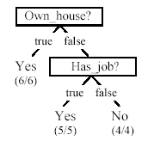
Is the Decision Tree Unique?
No. Here is a simpler tree.
We want smaller and accurate trees.
  Easy to understand and perform better.
Finding the best tree is NP-hard.
All current tree building algorithms are heuristic algorithms
Notes:
There can be many ways for constructing Decision Trees ..
In this example the heuristic chose the two most important features
Owning a house
Having a Job
The most effective is the one that can generalize of course and be simple

Slide 35
Attribute Selection Measure
Notes:
Attribute Selection is the most important part within Decision Trees Classifiers

Slide 36
Building the Tree (ASM)
Attribute Selection Measure (ASM) is a heuristic for selecting the splitting criterion that partition data into the best possible manner.
It is also known as splitting rules because it helps us to determine breakpoints for tuples on a given node.
The basic idea behind any decision tree algorithm is as follows:
  Select the best attribute using Attribute Selection Measures(ASM) to split the records.
  Recursively repeat the process for each child
36
Notes:
If the dataset consists of N attributes then deciding which attribute to place at the root or at different levels of the tree as internal nodes is a complicated step.
By just randomly selecting any node to be the root can’t solve the issue.
If we follow a random approach, it may give us bad results with low accuracy.

Slide 37
Example: Feature Selection
Suppose that your goal is to predict whether some unknown user will enjoy some unknown course.
To the right is a Course rating data set.
20 course rating examples, with course ratings and answers to questions that you might ask about this pair.
Label
5 Features
Like
How useful is each feature in Building
a tree that can help us guess
whether a student will enjoy
this course or hate it?
Hate
How can we build the Tree?
Which feature should we consider first to split the tree?
37
Notes:
In this example we have a dataset with 20 courses (20 records)
Five Features
A Label that gives the Rating of the Course
We need to build a tree that can assist a student to choose a course based on its features
What is a possible answer to the above question?
Choose a feature to split the tree so that we can reach a classification answer quickly ..
Reduce depth of the tree ..
Make tree generalize

Slide 38
Example: Feature Selection
Build a histogram of labels for:
  The entire data set
  The feature Easy
  The feature AI
  The feature Systems
  The feature Theory
  The feature Morning
The entire data set:
Total Records = 20
  “Like” Records = 12/20
  “Dislike” Records = 8/20
  % Like → 60%
  % Dislike → 40%
38
Notes:
We need to pick a feature that acts as a decider and splits the tree at the root
We can get some statistics on the features and use this stats to decide on the best feature

Slide 39
Example: Feature Selection
12 like
Useful
8 hate
You want to find a feature that is most
Useful in helping you guess whether this
Student will enjoy this course
39
Notes:
Looking at the histogram of % of features and the information they provide
Easy, not enough information, since since 6/10 → 60% indicate Enjoy … while 4/10 → 40% indicate Not Enjoy
AI, Is useful
The best Feature to give good information is Systems and therefore we can use it at the root.

Slide 40
Attribute Selection Measure
Attribute Selection Measure (ASM) provides rank to each feature by explaining the given dataset.
Best score attribute will be selected as a splitting attribute (Source).
In the case of a continuous-valued attribute, split points for branches also need to be defined.
Most popular selection measures are
  Entropy
  Information Gain,
  Gain Ratio,
  Reduction in Variance
  Chi-Square
  Gini Index,
40
Notes:
For solving this attribute selection problem, researchers worked and devised some solutions. They suggested using some criteria like :
Entropy,
Information gain,
Gini index,
Gain Ratio,
Reduction in Variance
Chi-Square
Which feature should I consider first to split the tree?
These criteria will calculate values for every attribute.
The values are sorted, and attributes are placed in the tree by following the order i.e, the attribute with a high value( in case of information gain) is placed at the root.
While using Information Gain as a criterion, we assume attributes to be categorical, and for the Gini index, attributes are assumed to be continuous.

Slide 41
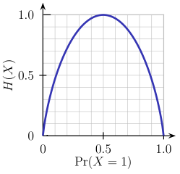
ASM “Entropy”
Entropy is a measure of the randomness in the information being processed.
The higher the entropy, the harder it is to draw any conclusions from that information.
Flipping a coin is an example of an action that provides information that is random.
From the graph, it is quite evident that the entropy H(X) is zero when the probability is either 0 or 1.
The Entropy is maximum when the probability is 0.5 because it projects perfect randomness in the data and there is no chance if perfectly determining the outcome.
The lower the value the better!!
41
Notes:
Entropy is defined as the measurement of degree of randomness or in other words, it is the increase in the disorganization within a system.
The lower the value the better!!

Slide 42
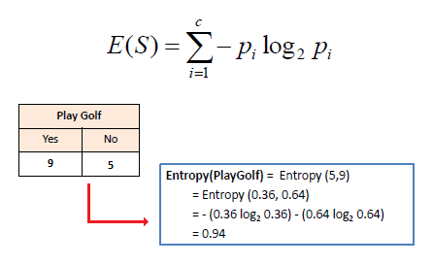
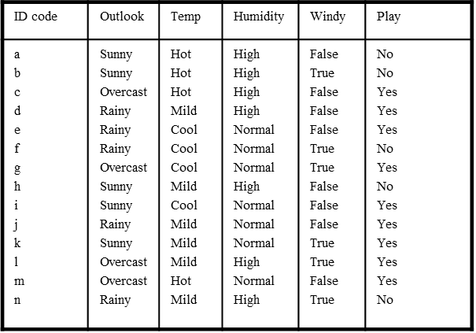
“Entropy”: One Attribute
Entropy helps in finding the purity of a feature
  Better distinction of classes (more yes or no in one branch)
Mathematically Entropy for ONE attribute is represented as:
P(Play Golf=Yes) = 9/14 = 0.642
P(Play Golf=No) = 5/14 = 0.3571
14 Records In Total
42
Notes:
How does entropy assist us in zooming down on most effective feature?
By calculating the entropy measure (purity) of a feature or a split
Highest entropy is when + Class and – Class are equal
In statistical mechanics, entropy is a measure of the number of ways a system can be arranged, often taken to be a measure of "disorder" (the higher the entropy, the higher the disorder).
Entropy can be calculated with the formula above
Assume a set R = {a,a,a,b,b,b,b,b}
Entropy = -[ (3/8) Log₂ (3/8) + (5/8)Log₂ (5/8) ]

Slide 43
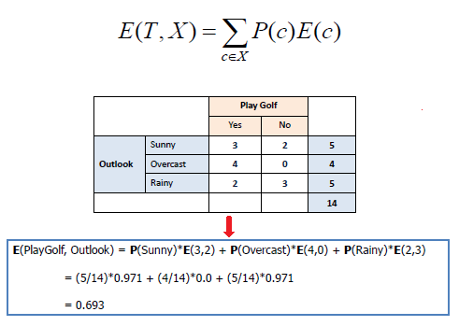
“Entropy”: Multiple Attribute
Mathematically Entropy for Multiple attributes is represented as:
43
Notes:
Note that:
Entropy can range from 0-1
With Entropy we are getting if the split is pure or not
If the calculated Entropy is 0 .. Then we can stop splitting and we have reached to a LEAF

Slide 44
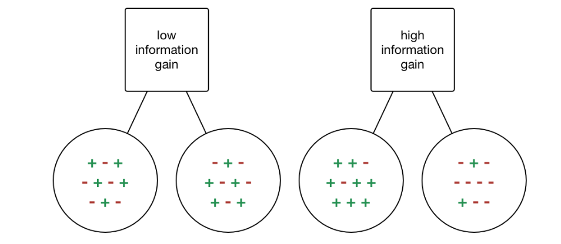
Information Gain
Information gain or IG is a statistical property that measures how well a given attribute separates the training examples according to their target classification.
Constructing a decision tree is all about finding an attribute that returns the highest information gain and the smallest entropy.
we require more information here to make a decision
Pos = 5/10
Neg = 5/10
Pos = 8/10
Neg = 8/10
44
Notes:
The information gained in the decision tree can be defined as the amount of information improved in the nodes before splitting them for making further decisions.
If a node is containing only one class in it or formally says the node of the tree is pure the entropy for data in such node will be zero
According to the information gain formula the information gained for such node will we higher and purity is higher
If the entropy is higher the information gain will be less and the node can be considered as the less pure.

Slide 45
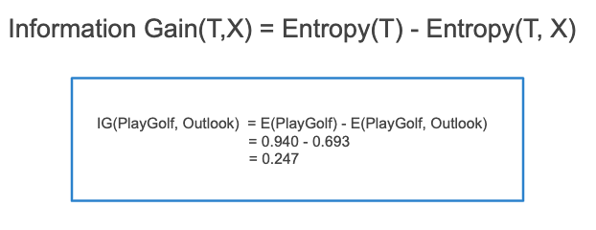

Information Gain
Information gain is a decrease in entropy. It computes the difference between entropy before split and average entropy after split of the dataset based on given attribute values.
The ID3 decision tree algorithm uses information gain.
Mathematically, IG is represented as:
Entropy(T)
Entropy(T,X)
45
Notes:
In a much simpler way, we can conclude that information gain can be given with the expression below, where
(before) is the dataset before the split,
K is the number of subsects generated by the split,
(j, after) is subset after the split
Check this example to compute Gain:
https://machinewithdata.com/2020/06/17/deriving-decision-tree-using-entropy-id3-approach/

Slide 46
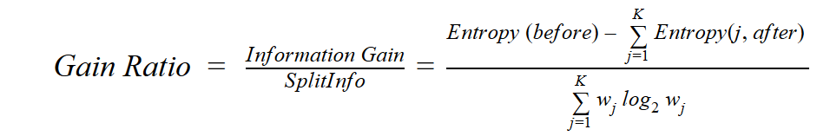
Gain Ratio
Information Gain (IG) is biased towards choosing attributes with a large number of values as root nodes.
IG prefers the attribute with a large number of distinct values.
C4.5, an improvement of ID3, uses Gain ratio which is a modification of Information gain that reduces its bias and is usually the best option.
Gain ratio overcomes the problem with information gain by taking into account the number of branches that would result before making the split.
It corrects information gain by taking the intrinsic information of a split into account.
46
Notes:
Gain Ratio is modification of information gain that reduces its bias.
Gain ratio overcomes the problem with information gain by taking into account the number of branches that would result before making the split.
It corrects information gain by taking the intrinsic information of a split into account.We can also say Gain Ratio will add penalty to information gain.
Let us consider if we have a dataset that has users and their movie genre preferences based on variables like gender, group of age, rating, …...
With the help of information gain, you split at ‘Gender’ (assuming it has the highest information gain) and now the variables ‘Group of Age’ and ‘Rating’ could be equally important and with the help of gain ratio, it will penalize a variable with more distinct values which will help us decide the split at the next level.

Slide 47
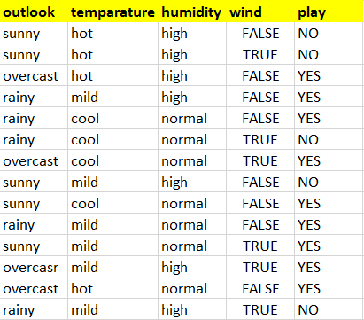
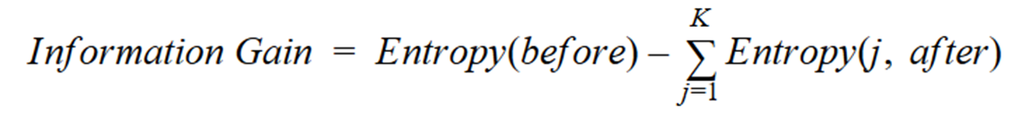
Gain Ratio: Example
47
Notes:
https://machinewithdata.com/2018/07/10/how-to-calculate-gain-ratio/

Slide 48
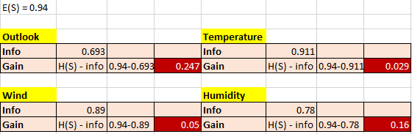
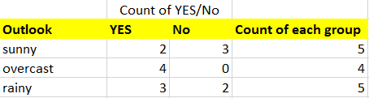
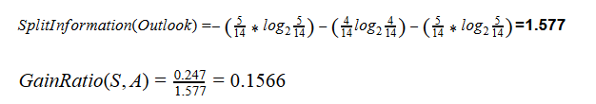
Gain Ratio: Example
3
3
2
2
48

Slide 49
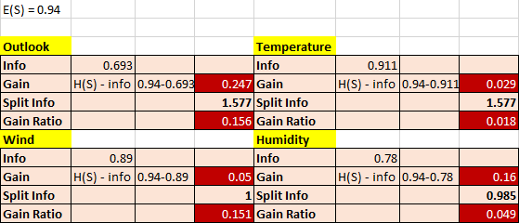
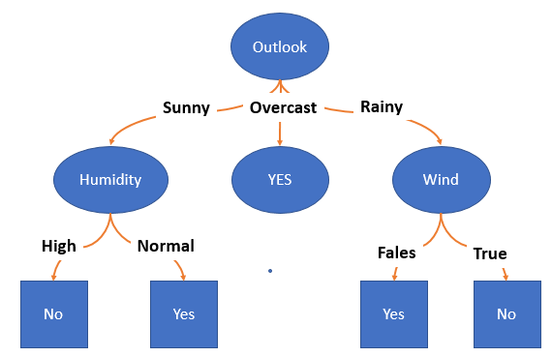
Gain Ratio: Example
The attribute with the maximum gain ratio is selected as the splitting attribute
49
Notes:
Once we calculate the gain ratio for all features then we can make a final decision which feature should be at the root ….

Slide 50
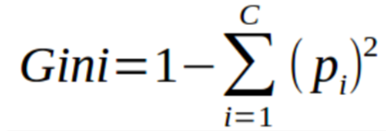
Gini Index
The Gini index is a cost function that is also used to evaluate splits in the dataset.
It is calculated by subtracting the sum of the squared probabilities of each class from one.
It favors larger partitions and easy to implement whereas information gain favors smaller partitions with distinct values.
50
Notes:
The value of Gini Coefficient is used in decision trees to split the population into two equal halves.
The value of Gini Coefficient at which the population is exactly split is always greater than or equal to 0.50.

Slide 51
Gini Index
Gini Index works with the categorical target variable “Success” or “Failure”. It performs only Binary splits.
  Higher value of Gini index implies higher inequality, higher heterogeneity.
Steps to Calculate Gini index for a split
  Calculate Gini for sub-nodes, using the formula below for success(p) and failure(q) (p²+q²).
  Calculate the Gini index for split using the weighted Gini score of each node of that split.
CART (Classification and Regression Tree) uses the Gini index method to create split points.
51
Notes:
A feature with a lower Gini index (Gini Impurity) is chosen for a split
https://www.analyticsvidhya.com/blog/2021/03/how-to-select-best-split-in-decision-trees-gini-impurity/

Slide 52
Building Trees: Gini Index
Notes:
Decision Trees using Gini Index (Solved Example)
https://www.google.com/search?q=Gini+index+and+decision+trees&rlz=1C1GCEB_enCA888CA888&oq=Gini+index+and+decision+trees&aqs=chrome..69i57j0i22i30l9.5569j0j7&sourceid=chrome&ie=UTF-8#kpvalbx=_-emxYtfgN7iB9PwPnOeTyAs19

Slide 53
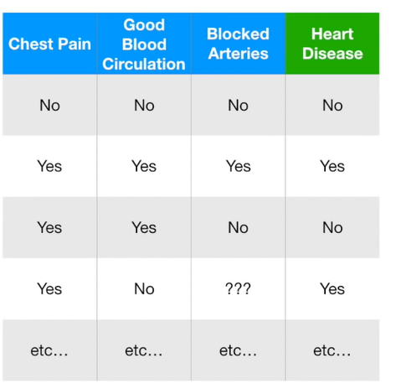
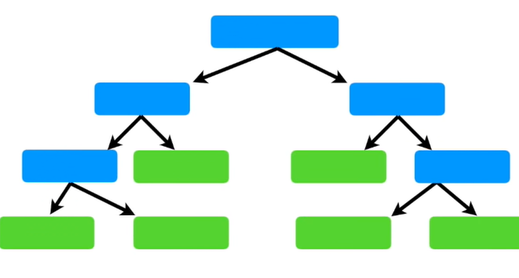
Which Predictor at Root?
The first thig we want to know is whether
Chest Pain, Good Blood Circulation or
Blocked Arteries should be at the root of
The tree
How to go from Raw Data in a table
To a tree?
???
Gini Index
53
Notes:
This simple dataset shows a classification of patients with and without Heart Disease based on several markers (features):
Chest Pain
Good Blood Circulation
Blocked Arteries
Our objective is to build a tree to help us classify future patients
We need to know which feature would act as the best root node to split the tree
The attribute with the minimum Gini Index will have the maximum information

Slide 54
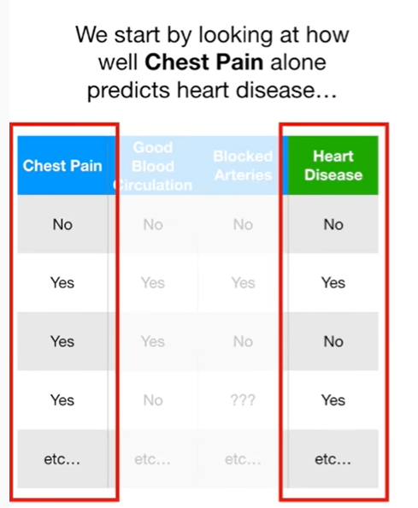
Which Predictor at Root?
54
Notes:
We start by looking at every feature on its own

Slide 55
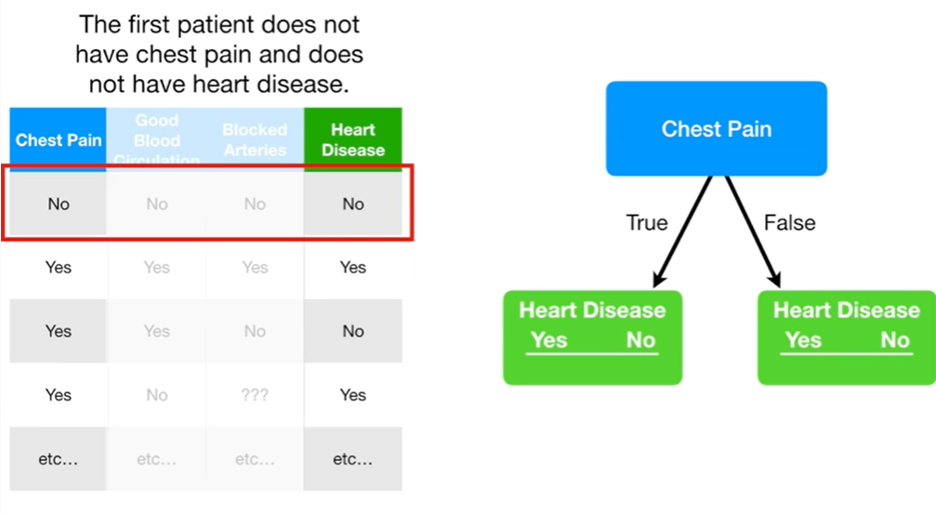
Which Predictor at Root?
55
Notes:
We start counting the following
Number of Patients who have Chest Pain and
Diagnosed to have Heart Disease
Diagnosed to Not have Heart Disease
Number of Patients who do not have Chest Pain and
Diagnosed to have Heart Disease
Diagnosed to Not have Heart Disease

Slide 56
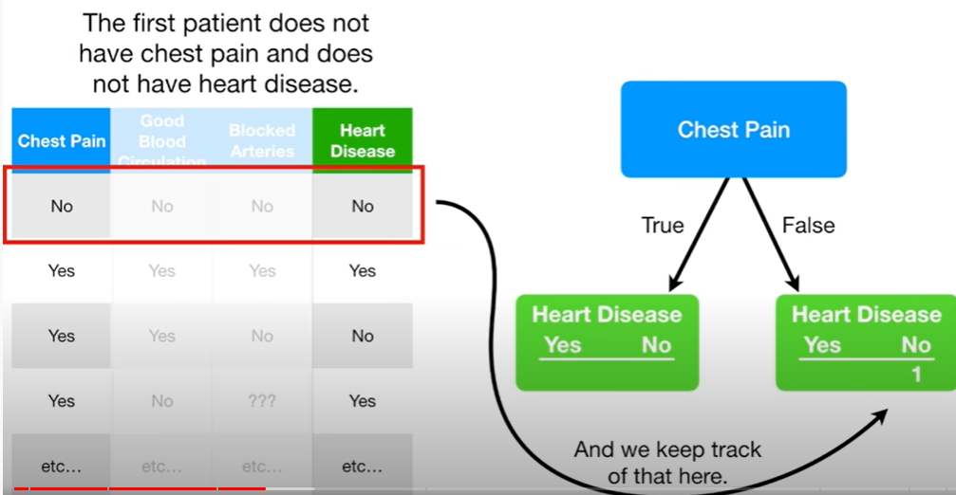
Which Predictor at Root?
56
Notes:
We keep track of every record

Slide 57
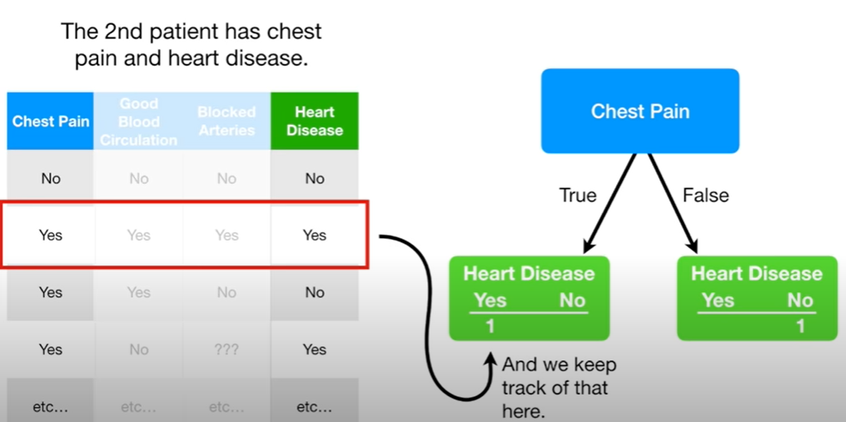
Which Predictor at Root?
57
Notes:
We continue to keep track of all records

Slide 58
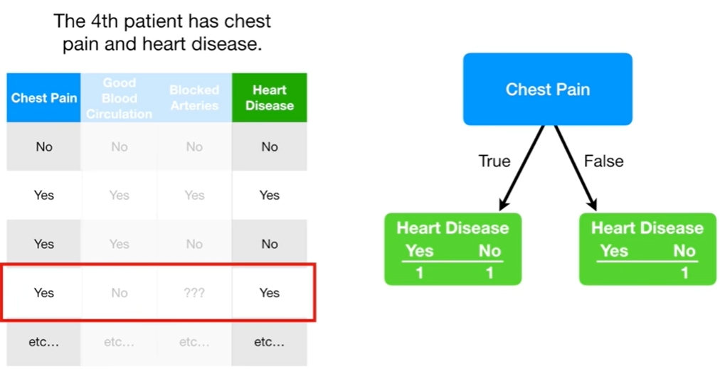
Which Predictor at Root?
58

Slide 59
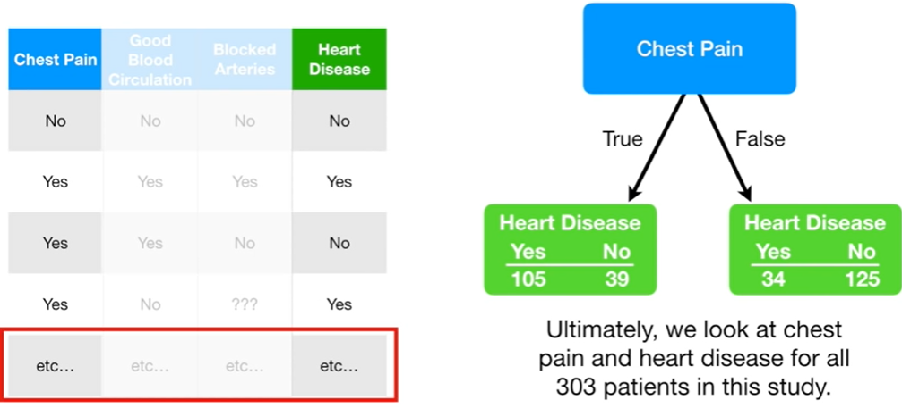
Which Predictor at Root?
144
159
59
Notes:
Out of the 144 patients who had Chest Pain:
105 have Heart Disease
39 Do not have Heart Disease
Out of the 159 patients who did not have Chest Pain
34 have Heart Disease
125 do not have Heart Disease

Slide 60
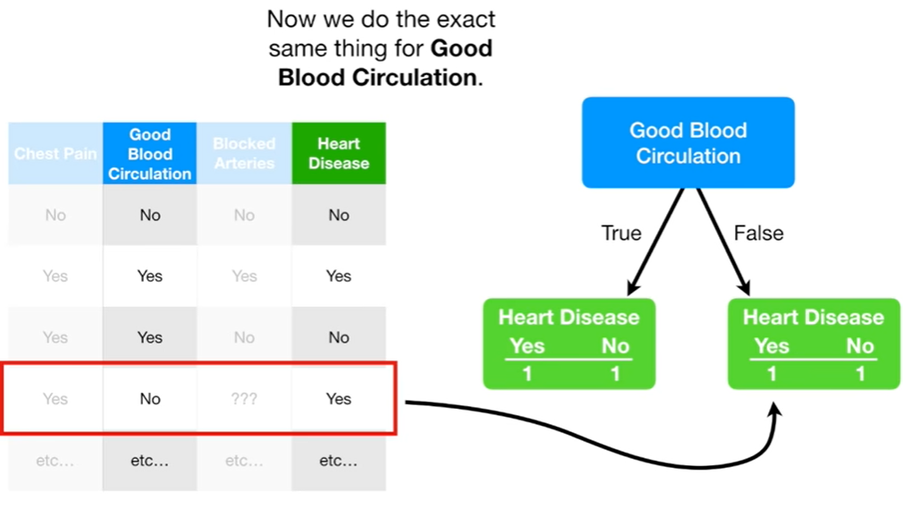
Which Predictor at Root?
60
Notes:
We do the same thing for patients whose blood circulation was measured (i.e 2nd feature)

Slide 61
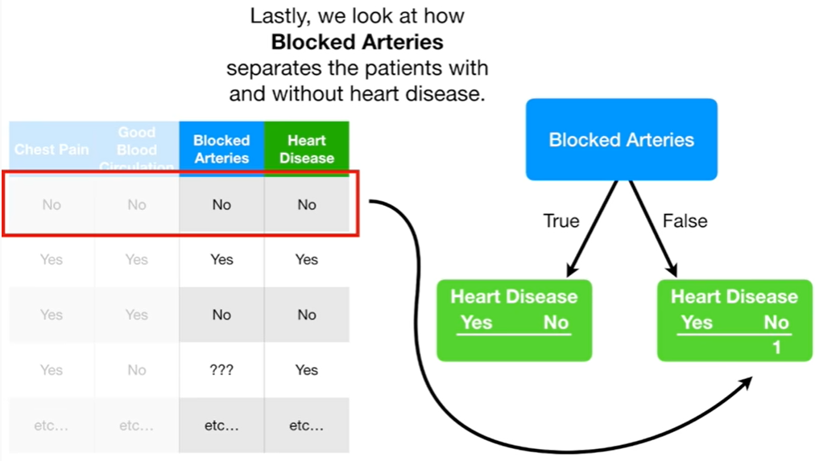
Which Predictor at Root?
61
Notes:
The same applies to patients who were checked for Blocked Arteries → 3rd Feature

Slide 62
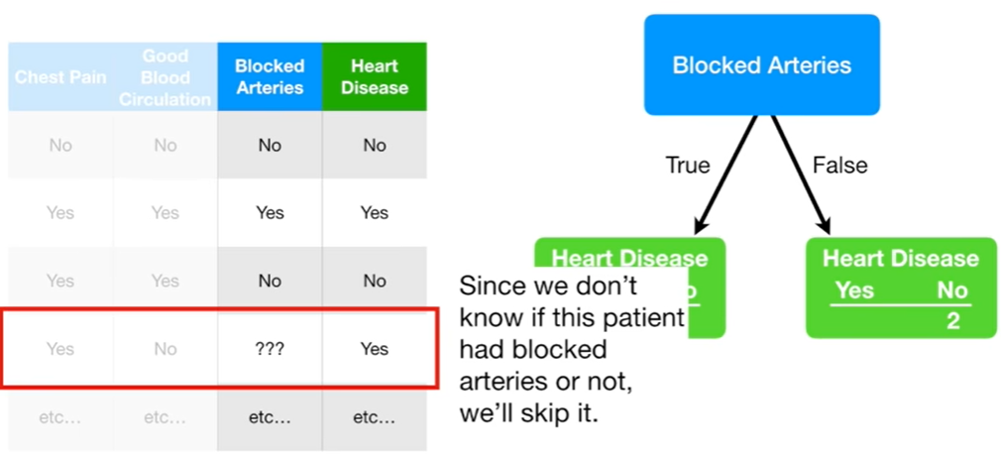
Which Predictor at Root?
62
Notes:
Some records may be skipped if it is incomplete

Slide 63
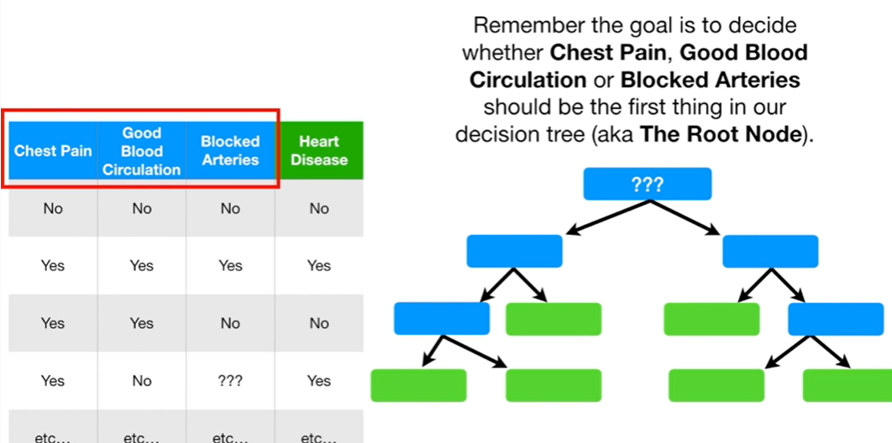
Which Predictor at Root?
63
Notes:
The idea behind this exercise is measure the gini index to decide which feature can act as the Root Node

Slide 64
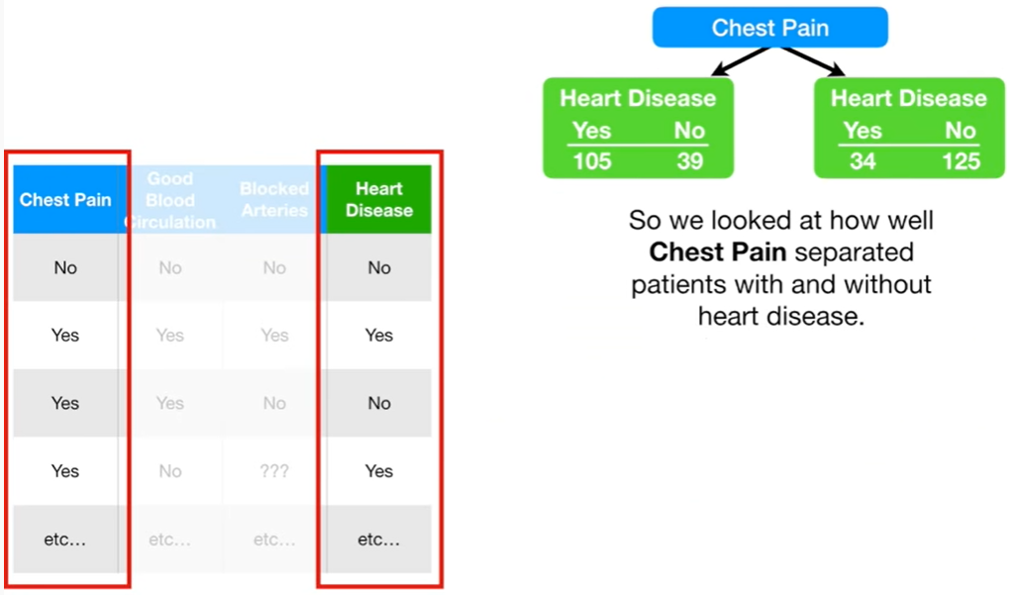
Which Predictor at Root?
64
Notes:
If we analyze the data at this point (Chest Pain)
Can it do a good job to separate patients with and without Heart Disease?

Slide 65
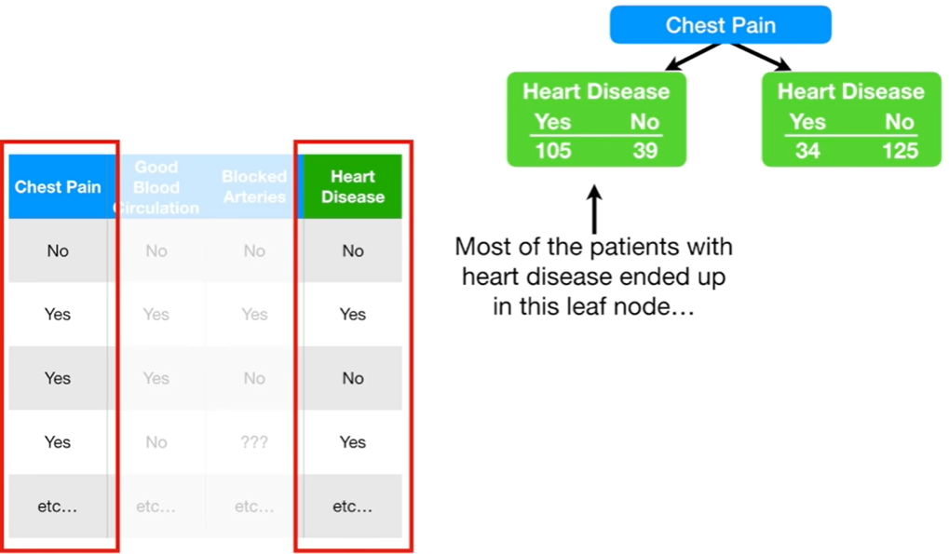
Which Predictor at Root?
105/144 = 73%
65
Notes:
The majority of patients (73%) who have Chest Pain seem to be diagnosed with Heart Disease

Slide 66
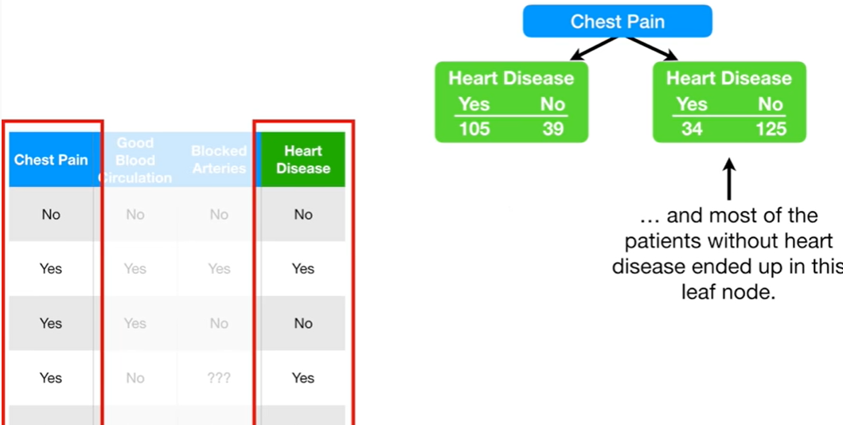
Which Predictor at Root?
125/159 = 78.5%
66
Notes:
The majority of patients (78.5%) who do no have Chest Pain seem to be diagnosed with No Heart Disease

Slide 67
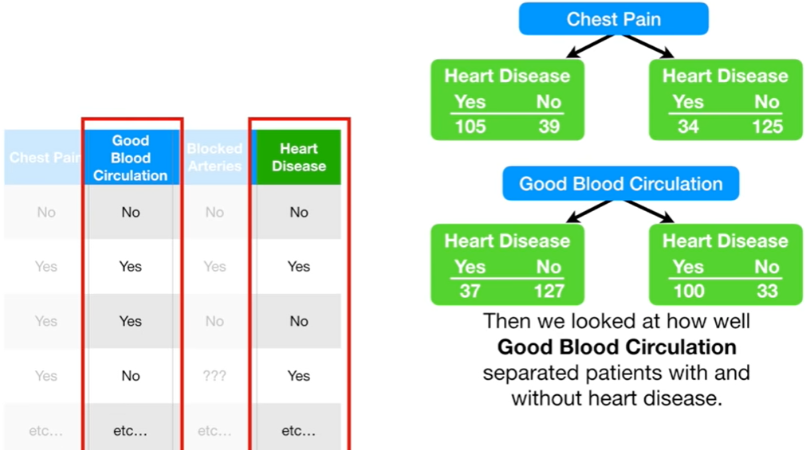
Which Predictor at Root?
127/164= 77.5%
100/133= 75.1%
67
Notes:
We analyze the Good Blood Circulation Feature
77.5% who have good Circulation are confirmed not to have Heart Disease
75.1% who do not have good Circulation are considered to have Heart Disease

Slide 68
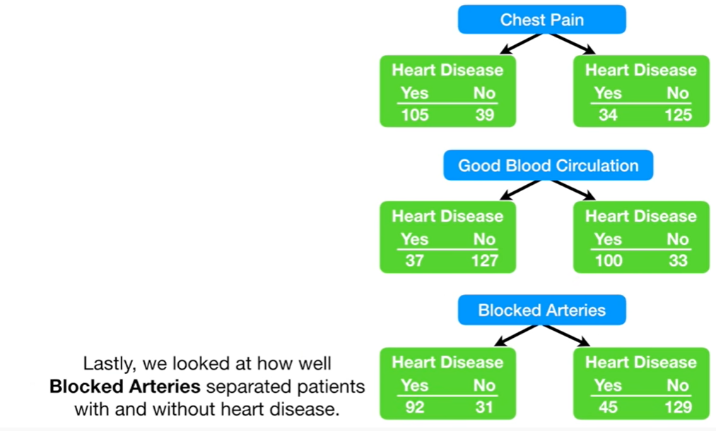
Which Predictor at Root?
92/123= 74.8%
129/174= 74.1%
68
Notes:
We analyze the Blocked Arteries Feature
74.8% who have Blocked Arteries are confirmed to have Heart Disease
74.1% who do not have Blocked Arteries are considered to not have Heart Disease

Slide 69
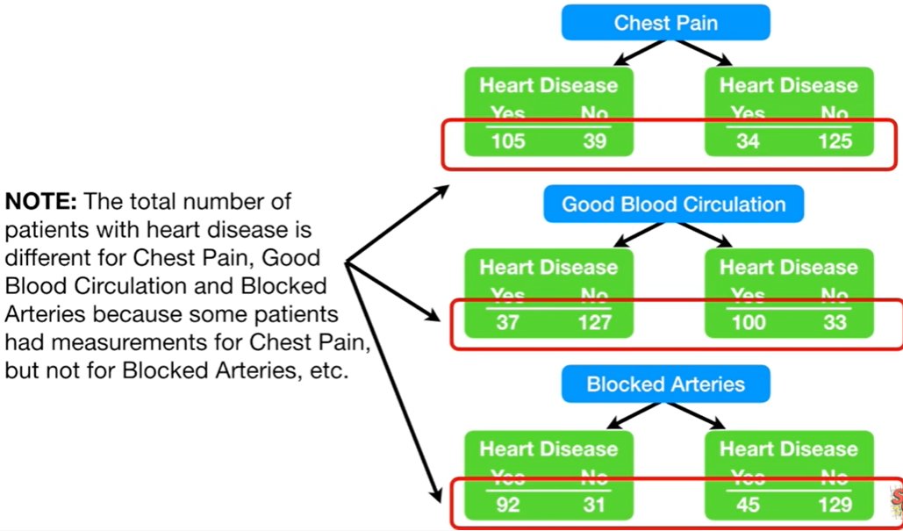
Which Predictor at Root?
303
297
297
69

Slide 70
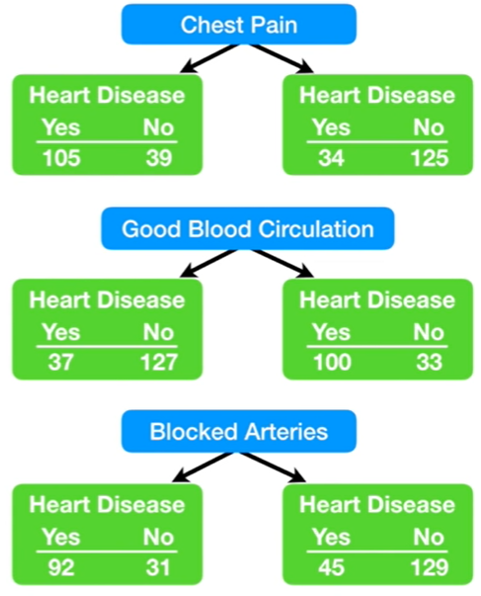
Which Predictor at Root?
Because none of the leaf nodes are 100 %
  YES HEART Disease, nor
  NO HEART Disease
They are all considered “impure”
To determine which separation is best, we need a way to measure and compare “impurity”
70
Notes:
We measure impurity based on the equation we introduced earlier

Slide 71
Which Predictor at Root?
There are a bunch of ways to measure impurity, but we will just focus on a very popular method called “Gini”
71

Slide 72
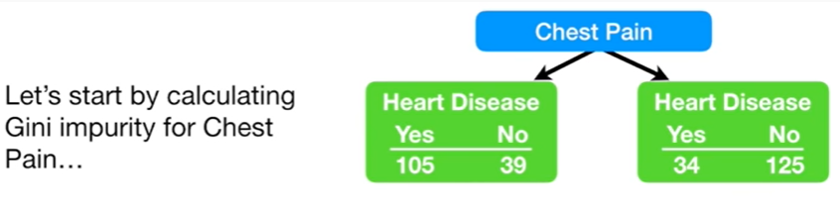
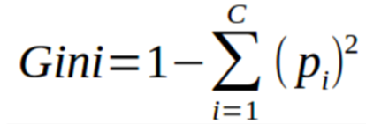
Which Predictor at Root?
Recall:
72

Slide 73

Which Predictor at Root?
73

Slide 74

Which Predictor at Root?
74

Slide 75

Which Predictor at Root?
75

Slide 76

Which Predictor at Root?
76

Slide 77

Which Predictor at Root?
77

Slide 78

Which Predictor at Root?
78

Slide 79

Which Predictor at Root?
79

Slide 80

Which Predictor at Root?
80

Slide 81

Which Predictor at Root?
81

Slide 82

Which Predictor at Root?
82

Slide 83

Which Predictor at Root?
83

Slide 84

Which Predictor at Root?
84

Slide 85

Which Predictor at Root?
85

Slide 86

Which Predictor at Root?
86

Slide 87

Which Predictor at Root?
164
133
87

Slide 88

Which Predictor at Root?
164
111
53
88

Slide 89

Which Predictor at Root?
164
111
53
164
49
115
89

Slide 90

Which Predictor at Root?
164
111
53
164
49
115
90

Slide 91

Which Predictor at Root?
49
20
29
49
115
91

Slide 92

Which Predictor at Root?
49
20
29
92

Slide 93

Which Predictor at Root?
115
33
82
93

Slide 94

Which Predictor at Root?
94
Notes:
If the node has lower gini score than using a feature → treat this node as leaf node

Slide 95

Which Predictor at Root?
95

Slide 96

From Start to End
HD
HD
HD
96

Slide 97
From Start to End
HD
HD
HD
97

Slide 98
Decision Trees: Pros/Cons

Slide 99
Advantages
Compared to other algorithms decision trees requires less effort for data preparation during pre-processing.
A decision tree does not require normalization of data.
A decision tree does not require scaling of data as well.
Missing values in the data also do NOT affect the process of building a decision tree to any considerable extent.
A Decision tree model is very intuitive and easy to explain to technical teams as well as stakeholders.
99

Slide 100
Disadvantages
Overfitting can become a problem if a decision tree’s design is too complex.
They are not well-suited to continuous variables (i.e. variables which can have more than one value, or a spectrum of values.)
They are unstable, meaning that a small change in the data can lead to a large change in the structure of the optimal decision tree.
They are often relatively inaccurate.
Decision trees often involves higher time to train the model.
100

Slide 101
When to consider Decision Trees?
Instances describable by attribute-value pairs
Target function is discrete valued
Disjunctive hypothesis may be required
Possibly noisy training data
Missing attribute values
Examples:
  Medical diagnosis
  Credit risk analysis
  Object classification for robot manipulator (Tan 1993)
101

Slide 102
SKLearn

Slide 103
SKLearn Decision Trees Example
# This example is from the following link
# https://scikit-learn.org/stable/modules/tree.html
from sklearn.datasets import load_iris
from sklearn import tree
import graphviz
# Load iris data
iris = load_iris()
# X will contain the features, y will contain the label
X, y = iris.data, iris.target
print('The classification target:\n',iris['target'])
print('The names of the dataset columns:\n',iris['feature_names'])
print('The names of target classes:\n',iris['target_names'])
The classification target:
[0 0 0 0 0 0 0 0 0 0 0 0 0 0 0 0 0 0 0 0 0 0 0 0 0 0 0 0 0 0 0 0 0 0 0 0 0
0 0 0 0 0 0 0 0 0 0 0 0 0 1 1 1 1 1 1 1 1 1 1 1 1 1 1 1 1 1 1 1 1 1 1 1 1
1 1 1 1 1 1 1 1 1 1 1 1 1 1 1 1 1 1 1 1 1 1 1 1 1 1 2 2 2 2 2 2 2 2 2 2 2
2 2 2 2 2 2 2 2 2 2 2 2 2 2 2 2 2 2 2 2 2 2 2 2 2 2 2 2 2 2 2 2 2 2 2 2 2
2 2]
The names of the dataset columns:
['sepal length (cm)', 'sepal width (cm)', 'petal length (cm)', 'petal width (cm)']
The names of target classes:
['setosa' 'versicolor' 'virginica']
103

Slide 104
SKLearn Decision Trees Example
print('The full description of the dataset:\n',iris['DESCR'])
print('The path to the location of the data:\n',iris['filename'])
**Data Set Characteristics:**
:Number of Instances: 150 (50 in each of three classes)
:Number of Attributes: 4 numeric, predictive attributes and the class
:Attribute Information:
- sepal length in cm
- sepal width in cm
- petal length in cm
- petal width in cm
- class:
- Iris-Setosa
- Iris-Versicolour
- Iris-Virginica
:Summary Statistics:
============== ==== ==== ======= ===== ====================
Min Max Mean SD Class Correlation
============== ==== ==== ======= ===== ====================
sepal length: 4.3 7.9 5.84 0.83 0.7826
sepal width: 2.0 4.4 3.05 0.43 -0.4194
petal length: 1.0 6.9 3.76 1.76 0.9490 (high!)
petal width: 0.1 2.5 1.20 0.76 0.9565 (high!)
============== ==== ==== ======= ===== ====================
104

Slide 105

SKLearn Decision Trees Example
# Use Decision Trees Classifier to fit the data
clf = tree.DecisionTreeClassifier()
clf = clf.fit(X, y)
# Plot the tree
tree.plot_tree(clf)
105

Slide 106
Summary

Slide 107
Summary
A Decision Tree is a flowchart like structure in which:
  Each internal node represents a “test” on an attribute, an
  Each branch represents the outcome of the test, and
  Each leaf node represents a class label (decision taken after computing all attributes).
  The paths from root to leaf represent classification rules.
Advantages:
  Are simple to understand and interpret
  Have value even with little hard data
  Help determine worst, best and expected values for different scenarios
Disadvantages:
  They are unstable, meaning that a small change in the data can lead to a large change in the structure of the optimal decision tree.
  They are often relatively inaccurate.
They can be remedied by replacing a single decision tree with a random forest (Ensemble)
107

Slide 108
Resources

Slide 109
Misc. Resources
YouTube:
  Introduction:
    https://www.youtube.com/watch?v=7VeUPuFGJHk
    https://www.youtube.com/watch?v=_L39rN6gz7Y
  Building Trees:
    https://www.youtube.com/watch?v=ZVR2Way4nwQ
  Feature Selection (Missing Data)
    https://www.youtube.com/watch?v=wpNl-JwwplA
  Tutorial (Decision Trees in Python)
    https://www.youtube.com/watch?v=RmajweUFKvM
  The Decision Tree Classifier:
    https://www.youtube.com/watch?v=ZVR2Way4nwQ
  Decision Tree Regression:
    https://www.youtube.com/watch?v=UhY5vPfQIrA
  Attribute Selection Method (ASM)
    https://www.youtube.com/watch?v=5aIFgrrTqOw
    https://www.youtube.com/watch?v=-W0DnxQK1Eo
109

Slide 110
Misc. Resources
Tutorials:
  Attribute Selection Measures:
    https://www.kdnuggets.com/2020/01/decision-tree-algorithm-explained.html
    https://becominghuman.ai/decision-trees-in-machine-learning-f362b296594a
  https://www.datacamp.com/community/tutorials/decision-tree-classification-python
  https://stackabuse.com/decision-trees-in-python-with-scikit-learn/
  https://www.hackerearth.com/practice/machine-learning/machine-learning-algorithms/ml-decision-tree/tutorial/
  https://towardsdatascience.com/understanding-decision-trees-for-classification-python-9663d683c952
Documents:
  https://en.wikipedia.org/wiki/Decision_tree_learning
  https://scikit-learn.org/stable/modules/tree.html
110

Slide 111
End Slides

