Slide 1
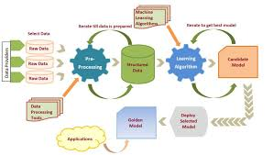
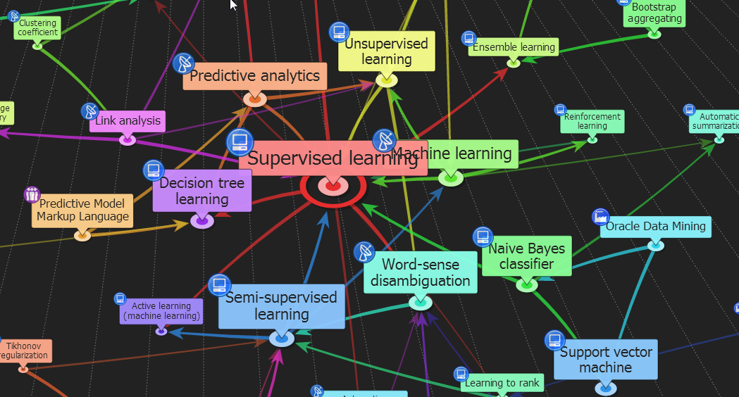

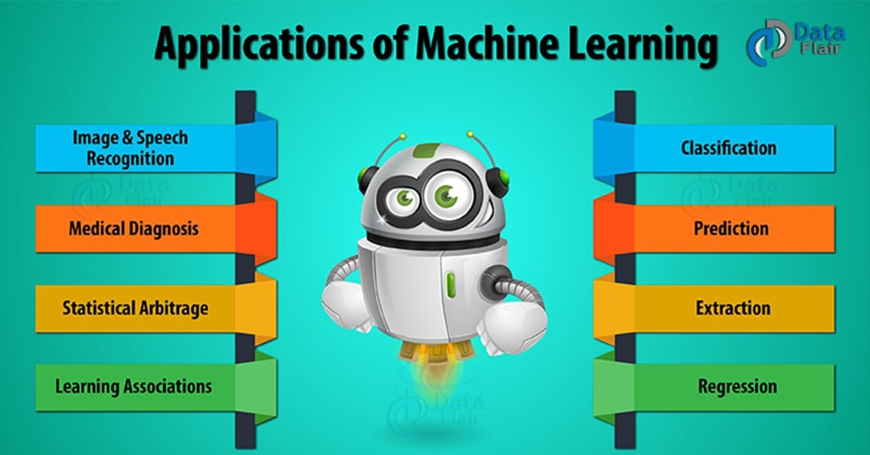

ENG6500: Intro to Machine Learning “Evaluation Techniques (Part 2)”
S. Areibi
School of Engineering
University of Guelph
Notes:
Regression predictive modeling are those problems that involve predicting a numeric value.
It is different from classification that involves predicting a class label.
Unlike classification, you cannot use classification accuracy to evaluate the predictions made by a regression model.
Metrics for regression involve calculating an error score to summarize the predictive skill of a model.

Slide 2
Introduction
Notes:
Why evaluate ML models?

Slide 3
Evaluating Machine Learning
The primary aim of the Machine Learning model is to learn from the given data and generate predictions based on the pattern observed during the learning process.
We need to continuously make improvements to the models, based on the kind of results it generates.
We also quantify the model’s performance using metrics like Accuracy, Mean Squared Error (MSE), F1-Score e.t.c and try to improve these metrics.
A supervised Machine Learning model aims to train itself on the input variables (X) in such a way that the predicted values (Y) are as close to the actual values as possible.
The difference between the actual values and predicted values is the error and it is used to evaluate the model.
3
Notes:
Why evaluate the performance of ML?
Performance evaluation is an important aspect of the machine learning process.
However, it is a complex task.
It, therefore, needs to be conducted carefully in order for the application of machine learning to radiation oncology or other domains to be reliable.
We therefore need to understand the different evaluation metrics

Slide 4
Regression Evaluation Metrics
Notes:
We will discuss the best metrics for regression including MAE, MSE, RMSE and R^2

Slide 5
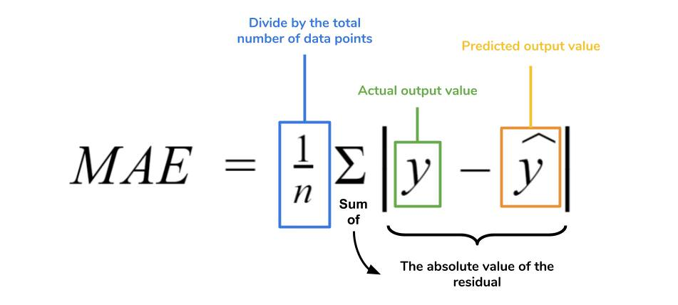
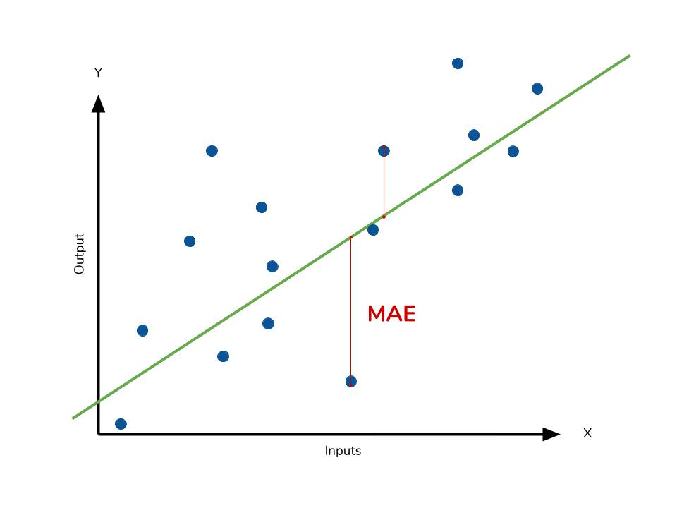
Regression Evaluation “MAE”
The Mean Absolute Error (MAE) is the simplest regression error metric to understand.
The absolute value of the residual is taken so that negative and positive residuals do not cancel out.
The average of all residuals is then taken only the absolute value of each
A small MAE suggests the model is great at prediction
A MAE of 0 means that your model is a perfect predictor
5
Notes:
Mean absolute error (MAE) is a loss function used for regression.
MAE does not penalize larger errors more than smaller ones! (this is different than MSE and RMSE introduced next)
The MAE takes the absolute value (WHY?):
This avoids errors to cancel each other out when calculating the MAE.
We are not interested in the direction in which the estimated and actual target values differ (estimated > actual or vice-versa) but on the absolute distance.
Use MAE when you are doing regression and don't want outliers to play a big role.
The loss is the mean over the absolute differences between true and predicted values, deviations in either direction from the true value are treated the same way.

Slide 6
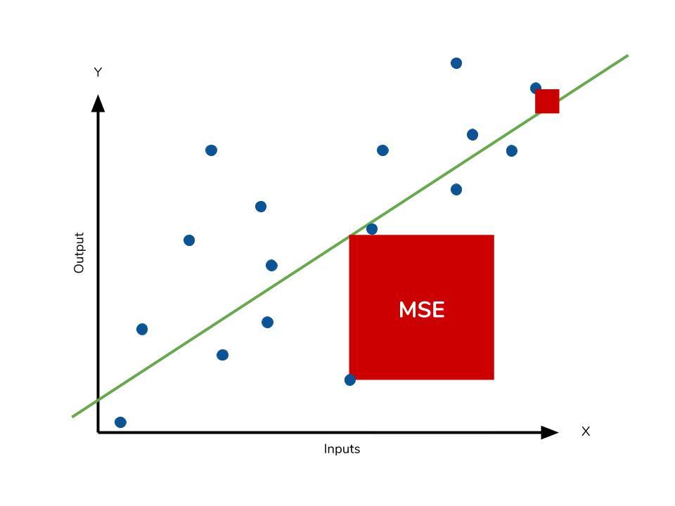
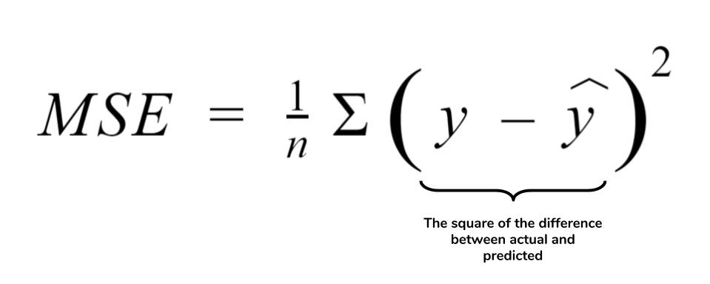
Regression Evaluation “MSE”
The Mean Square Error (MSE) is just like the MAE, but squares the difference before summing them all instead of using the absolute value.
Because we are squaring the difference, the MSE will almost be bigger than the MAE.
It is preferred more in some cases because the errors are first squared before averaging which poses a high penalty on large errors.
The effect of the square term in the MSE equation is most apparent with the presence of outliers in our data.
Our model will be penalized more for making predictions that differ greatly from the corresponding actual value.
The large differences between actual and predicted are punished more in MSE than in MAE.
6
Notes:
The mean squared error (MSE) tells you how close a regression line is to a set of points.
It does this by taking the distances from the points to the regression line (these distances are the “errors”) and squaring them.
The squaring is necessary to remove any negative signs.

Slide 7
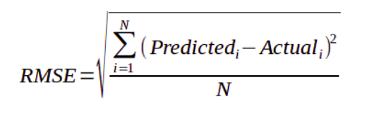
Regression Evaluation “RMSE”
The Root Mean Square Error (RMSE) is the most widely used metric for regression tasks and is the square root of the averaged squared difference between the target value and the value predicted by the model
It is preferred more in some cases because the errors are first squared before averaging which poses a high penalty on large errors.
The RMSE is useful when large errors are undesired.
However, the range of the dataset you're working with is important in determining whether or not a given RMSE value is “low” or not.
7
Notes:
The most common metric for evaluating linear regression performance is: root mean squared error, RMSE.
RMSE is the square root of MSE → measured in the same units as the target variable
The basic idea is to measure how bad/erroneous the model's predictions are when compared to actual observed values.
So a high RMSE is “bad” and a low RMSE is “good”
Based on a rule of thumb, it can be said that RMSE values between 0.2 and 0.5 shows that the model can relatively predict the data accurately
The lower the RMSE, the better a given model is able to “fit” a dataset. However, the range of the dataset you're working with is important in determining whether or not a given RMSE value is “low” or not.

Slide 8
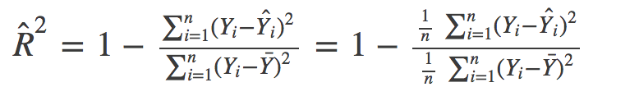
Regression Evaluation “R²”
The R² Error (also called Coefficient of Determination) is another metric used for evaluating the performance of a regression model.
The most common interpretation of the coefficient of determination is how well the regression model fits the observed data.
R² will always be less than or equal to 1.
R² is used to explain how much variability of one factor can be caused by its relationship to another factor.
If the R² of a model is 0.75, then approximately 75% of the observed variation can be explained by the model’s features.
8
Notes:
The coefficient of determination effectively compares the variance in the data to the variance in the residual.
The residual is the difference between the predicted and observed value and its variance is the sum of squares of this difference.
If the prediction is perfect, the variance of the residual is zero.
Hence, the coefficient of determination is one.
If the prediction is not perfect some of the residuals are non-zero and the variance of the residuals is positive.
Hence, the coefficient of determination is lower than one.
Negative R2 in scikit learn means that your model is worse than the average of the observed train data.
Negative R2 happens especially in test data because they do not participate in the fit modeling.
When you have a negative R2 value in scikit learn, you are going to have an R2 close to zero
using R2 of the linear regression between True and Pred values.

Slide 9
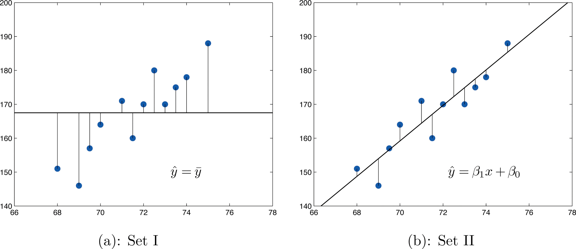
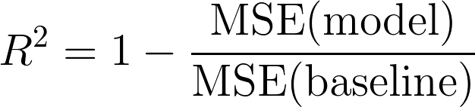
Regression Evaluation “R²”
The constant baseline is chosen by taking the mean of the data and drawing a line at the mean.
MSE (Baseline)
MSE (Model)
9
Notes:
The metric helps us to compare our current model with a constant baseline and tells us how much our model is better.

Slide 10
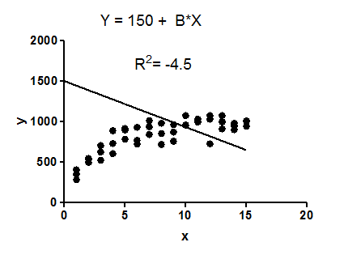
Negative “R²” !!
R² compares the fit of the chosen model with that of a horizontal straight line (the null hypothesis).
If the chosen model fits worse than a horizontal line, then R² is negative.
R² is negative only when the chosen model does not follow the trend of the data, so fits worse than a horizontal line.
One of the drawbacks of R² is that the more features are added to a model, the more the R² increases. This happens even though the features added to the model are not intrinsically predictive.
10
Notes:
Why is R² Negative?
After giving you a brief overview of the various regression metrics, let us finally talk about why R² is negative.
There is a misconception among people that R² score ranges from 0 to 1 but actually it ranges from -∞ to 1.
Due to this misconception, they are sometimes scared why the R² is negative which is not a possibility according to them.
The main reasons for R² to be negative are the following:
One of the main reason for R² to be negative is that the chosen model does not follow the trend of the data causing the R² to be negative.
This causes the mse of the chosen model (numerator) to be more than the mse for constant baseline (denominator) resulting in negative R².

Slide 11
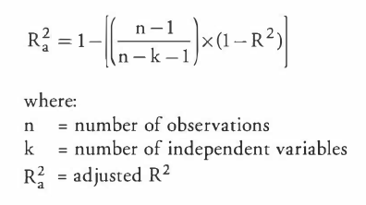
Regression Evaluation “Adj. R²”
The R² Error (also called Coefficient of Determination) suffers from the problem that the scores improve on increasing terms even though the model is not improving which may mislead the researcher.
Adjusted R² depicts the same meaning as R² but is an improvement of it.
Adjusted R² is always lower than R² as it adjusts for the increasing predictors and only shows improvement if there is a real improvement.
11
Notes:
Using adjusted R-squared over R-squared may be favored because of its ability to make a more accurate view of the correlation between one variable and another.
Adjusted R-Squared takes into account the features used in the predictive model.
Doing so, the more predictive features are added to the model, the higher the Adjusted R².
However, the more “useless” features are added to the model, the lower the Adjusted R² value, differently from what would happen with R².
Adjusted R-squared identifies the percentage of variance in the target field that is explained by the input or inputs.
Adjusted R-squared does this by taking into account how many independent variables are added to a particular model against which the stock index is measured

Slide 12
Bias & Variance
Notes:
In week #1 we briefly discussed the issue of bias and variance

Slide 13
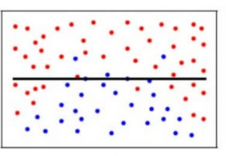
What is Bias?
Bias is the difference between the Predicted Value and Expected Value.
The model makes certain assumptions when it trains on the data provided.
When the model is introduced to the testing/validation data, these assumptions may not always be correct.
In a nutshell,
The model used is simple (i.e., predicting a simple relationship when the data points indicate a more complex relationship).
The model does not consider the variations very well and does not learn the training data very well
The bias is a measure of how close the model can capture the mapping function between inputs and outputs.
13
Notes:
The bias is a measure of how close the model can capture the mapping function between inputs and outputs.
Intuitively, underfitting occurs when the model or the algorithm does not fit the data well enough.
Specifically, underfitting occurs if the model or algorithm shows low variance but high bias.
Underfitting is often a result of an excessively simple model.

Slide 14
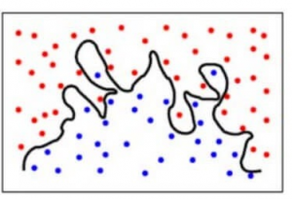
What is Variance?
The variance is when the model takes into account the fluctuations in the data i.e. the noise as well
When a model has a high variance it learns too much from the training data, (it memorizes rather than learns), so much, so that when it is confronted with new (testing) data, it is unable to predict accurately based on it.
The ML Model used is too complex for the task.
The model predicts very complex relationships between the outcome and the input features when for example a quadratic equation would have sufficed.
14
Notes:
Specifically, overfitting occurs if the model or algorithm shows low bias but high variance.
Overfitting is often a result of an excessively over complicated model
It can be prevented by:
Fitting multiple models and using validation or cross-validation to compare their predictive accuracies on test data.
Use more data
Early Stopping
Use Ensemble Learning
Regularization: L1 or L2 regularization (maybe reduce number of features)

Slide 15
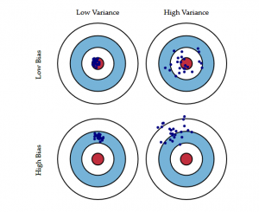
Bias-Variance Tradeoff
The following bulls-eye diagram explains the tradeoff:
Ideally, we would prefer a model with low bias and low variance (challenging!!)
A model with low bias and high variance predicts points that are around the center generally, but pretty far away from each other.
A model with high bias and low variance is pretty far away from the bull’s eye, but since the variance is low, the predicted points are closer to each other (it is more consistent).
Overfitting
Underfitting
15
Notes:
There will always be a tradeoff between Bias and Variance

Slide 16
Bias-Variance Tradeoff
Reducing the bias can be easily achieved by increasing the variance. Conversely, reducing the variance can easily be achieved by increasing the bias.
This is referred to as a trade-off because it is easy to obtain a method with extremely low bias but high variance […] or a method with very low variance but high bias …
We can choose a model based on its bias or variance.
Simple models, such as linear regression and logistic regression, generally have a high bias and a low variance.
Complex models, such as random forest, generally have a low bias but a high variance.
We may also choose model configurations based on their effect on the bias and variance of the model.
The k hyperparameter in k-nearest neighbors controls the bias-variance trade-off.
Small values, such as k=1, result in a low bias and a high variance, whereas large k values, such as k=21, result in a high bias and a low variance.
We often must test a suite of different models and model configurations in order to discover what works best for a given dataset. A model with a large bias may be too rigid and underfit the problem. Conversely, a large variance may overfit the problem.
16

Slide 17
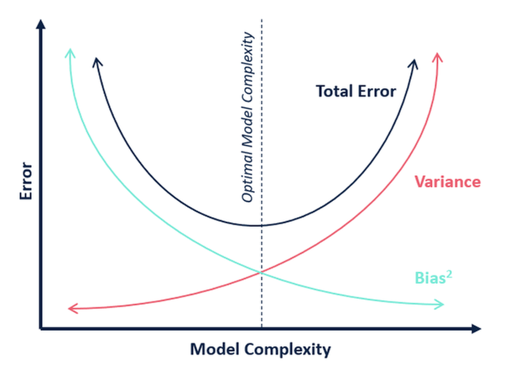
Model Complexity
In terms of model complexity, we can use the following diagram to decide on the optimal complexity of our model.
A “simple model” contributes to high bias.
A “complex model” contributes to high variance.
Simple
Complex
17

Slide 18
Bias Variance Trade-off: Example
Notes:
In this example we see how we tend to develop an ML regression framework and end up with an inappropriate ML model

Slide 19
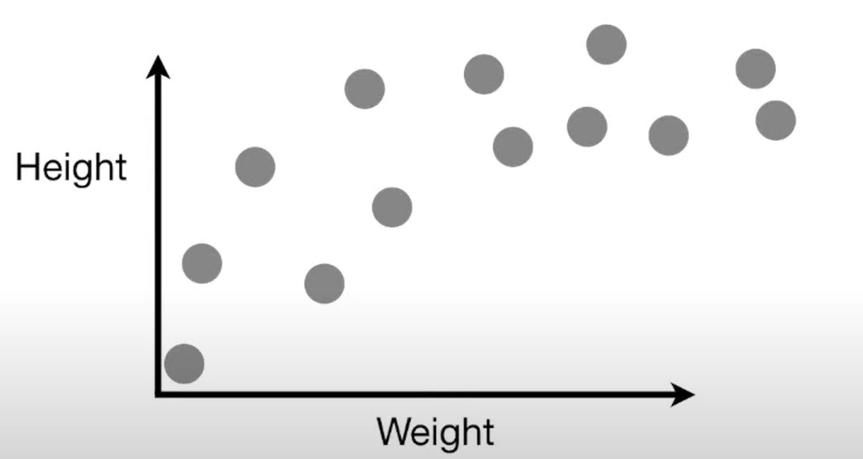
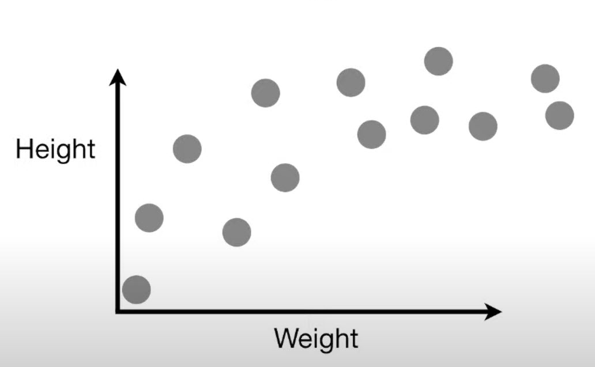
Bias/Variance Tradeoff
Imagine we measured the weight and
height of a bunch of mice and plotted
the data on a graph …
Given this data, we would like to predict mouse height given its weight
19

Slide 20
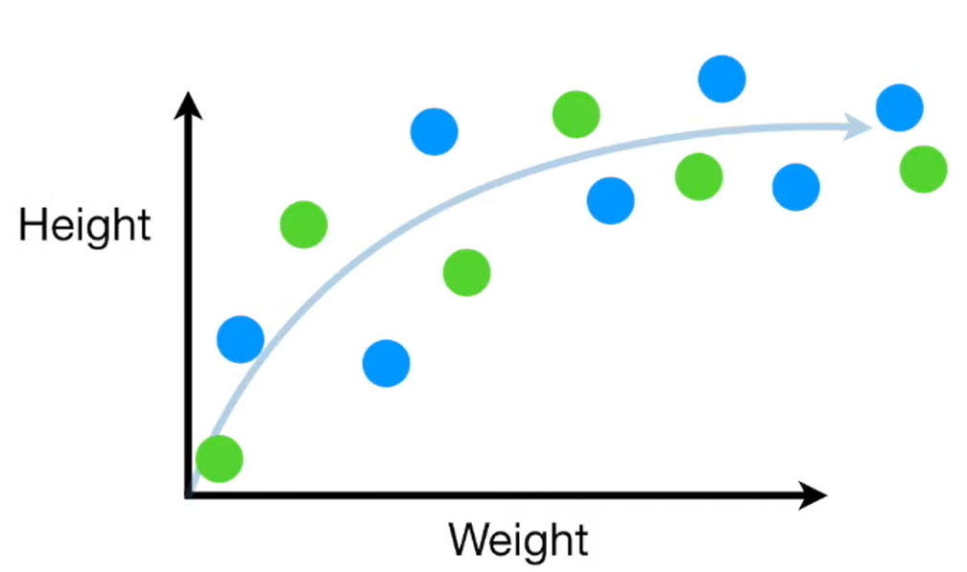
Bias/Variance Tradeoff
The first thing we do is split the data into two sets,
one for training the Machine Learning Algorithms
and another for testing them.
20

Slide 21
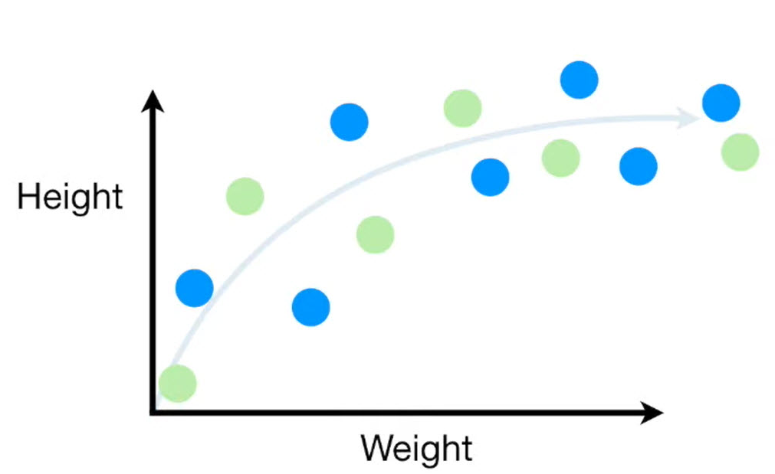
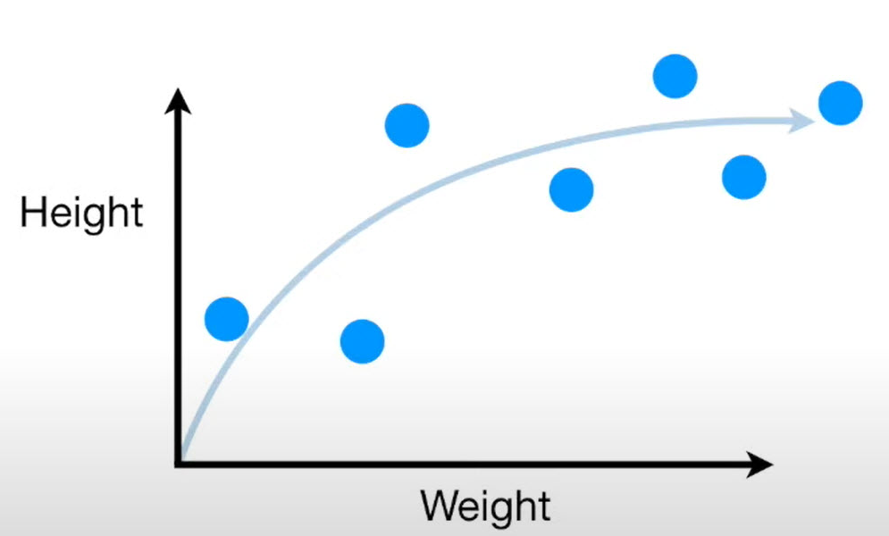
Bias/Variance Tradeoff
Blue dots are the training set
Green dots are the testing set
Here is just the ``training set”
21

Slide 22
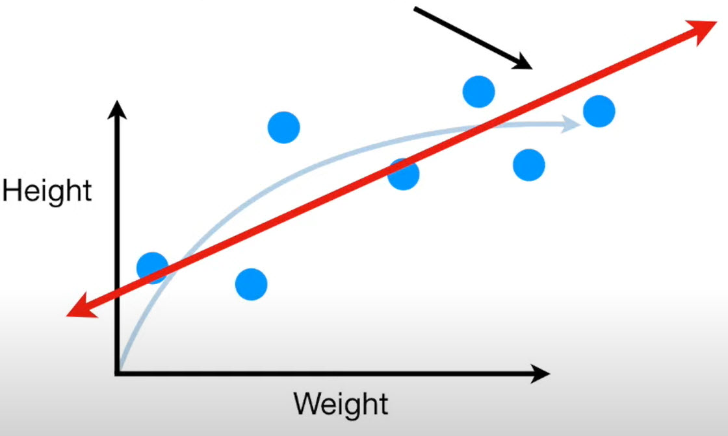
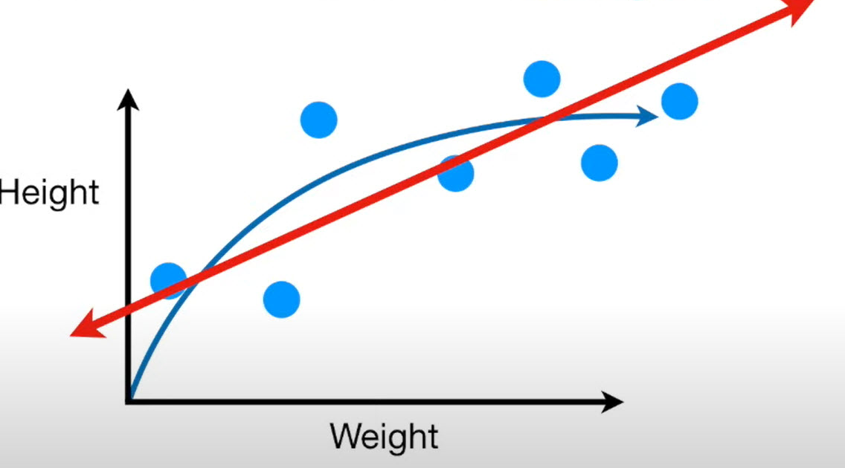
Bias/Variance Tradeoff
The First Machine Learning algorithm used
is the Linear Regression (Least Squares)
The Straight Line will never capture the true
relationship between weight and height, no
matter how well we fit it to the training set.
22

Slide 23
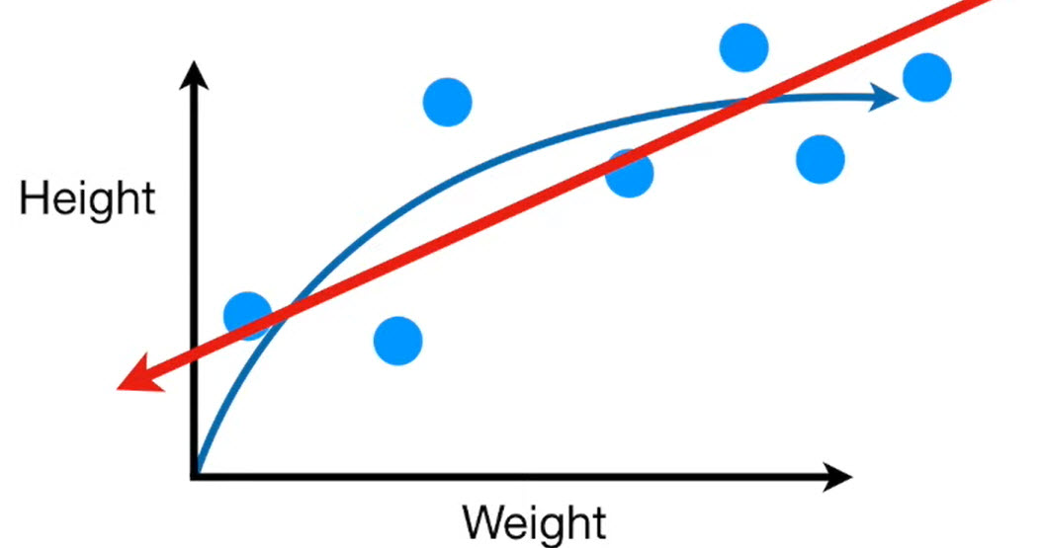
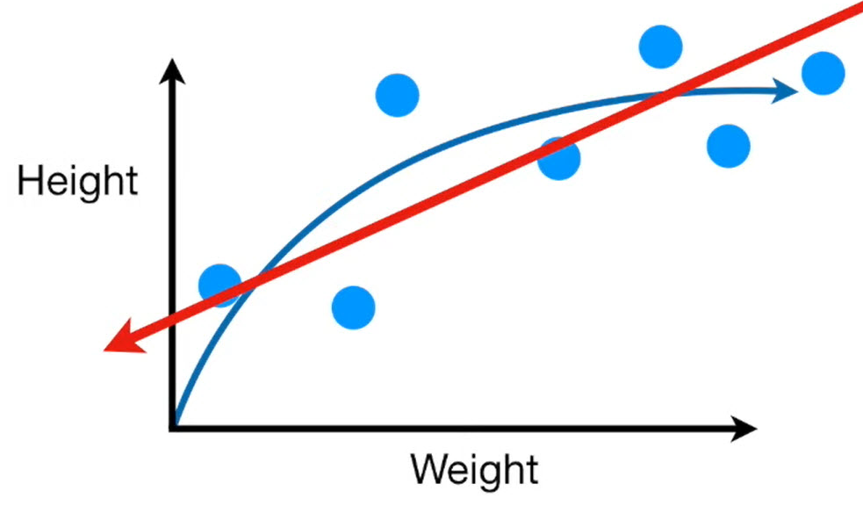
Bias/Variance Tradeoff
The inability for a machine learning method (like linear regression)
to capture the true relationship is called bias.
Because the Straight Line can’t be
Curved like the “true” relationship, it has a relatively large amount of bias.
23

Slide 24
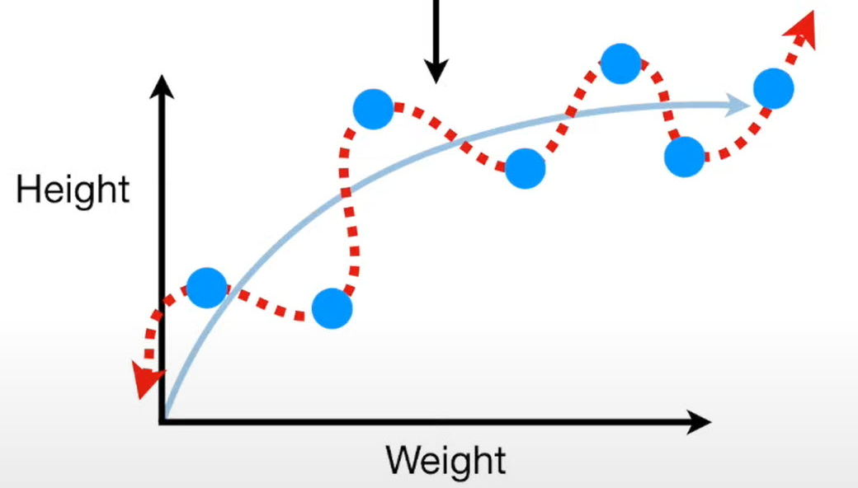
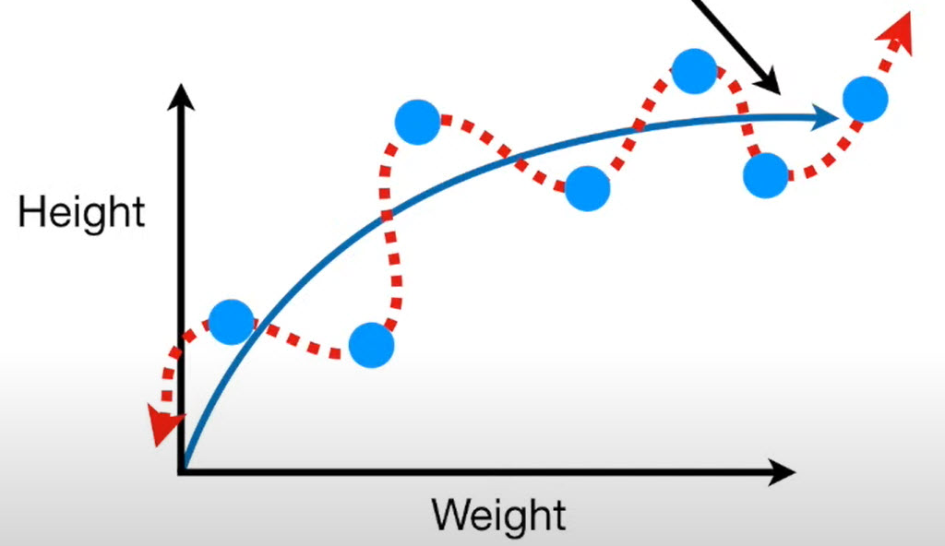
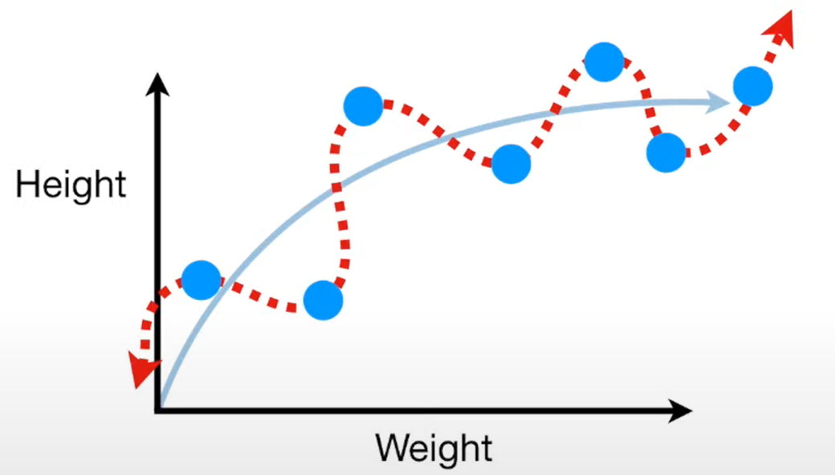
Bias/Variance Tradeoff
Another machine learning method might
Fit a “Squiggly Line” to the training set ..
The “Squiggly Line” is super flexible and
hugs the training set along the arc of the
true relationship.
Because the “Squiggly Line” can handle the arc in the true relationship
Between weight and height, it has very little bias.
24

Slide 25
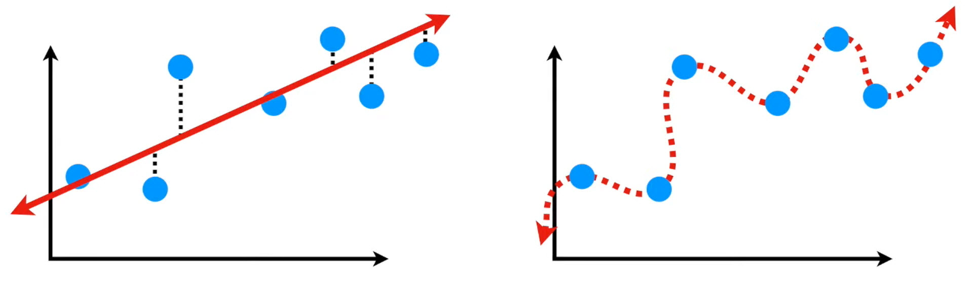
Bias/Variance Tradeoff
We can compare how well the Straight Line and the Squiggly Line
fit the training set by calculating their sums of squares
Has Low Bias
Since it is flexible
Notice how the “Squiggly Line” fits the
data so well that the distances between
the line and the data are all ZERO.
The “Squiggly Line” Wins!!
25

Slide 26
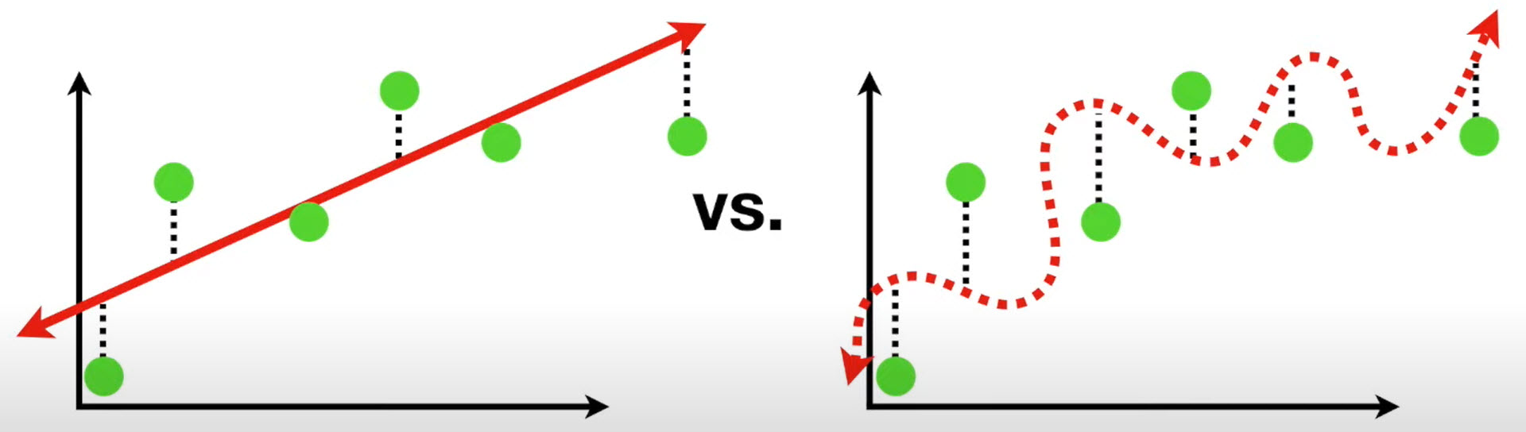


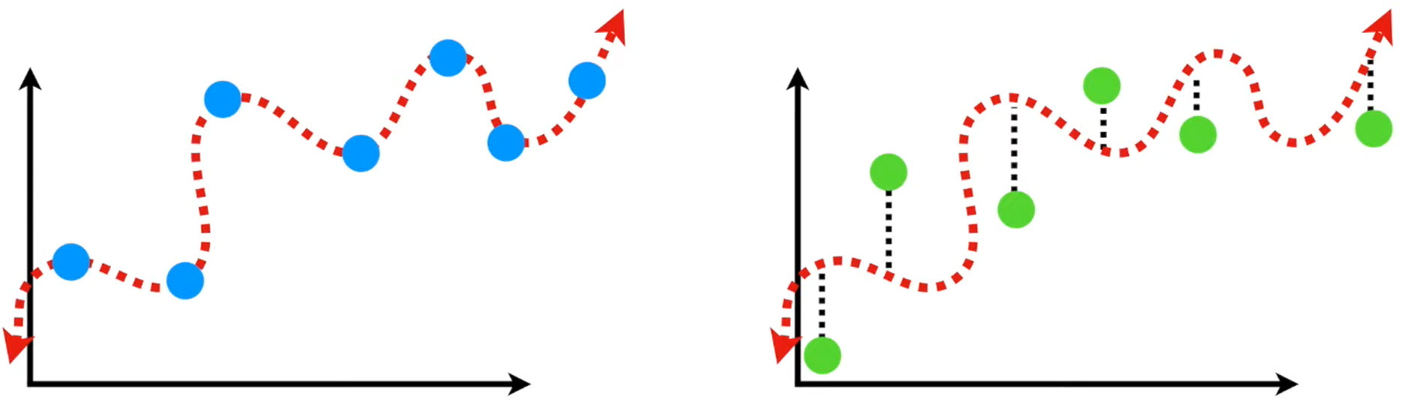
Bias/Variance Tradeoff
We now compare how well the Straight Line and the Squiggly Line
fit the testing set by calculating their sums of squares
Even though the ``Squiggly Line” did a
Great Job fitting the training set …
The ``Squiggly Line did not generalize
Well with the testing set !!!!
It is Overfitting!!
In Machine Learning, the difference in fits between data sets is called Variance
26

Slide 27
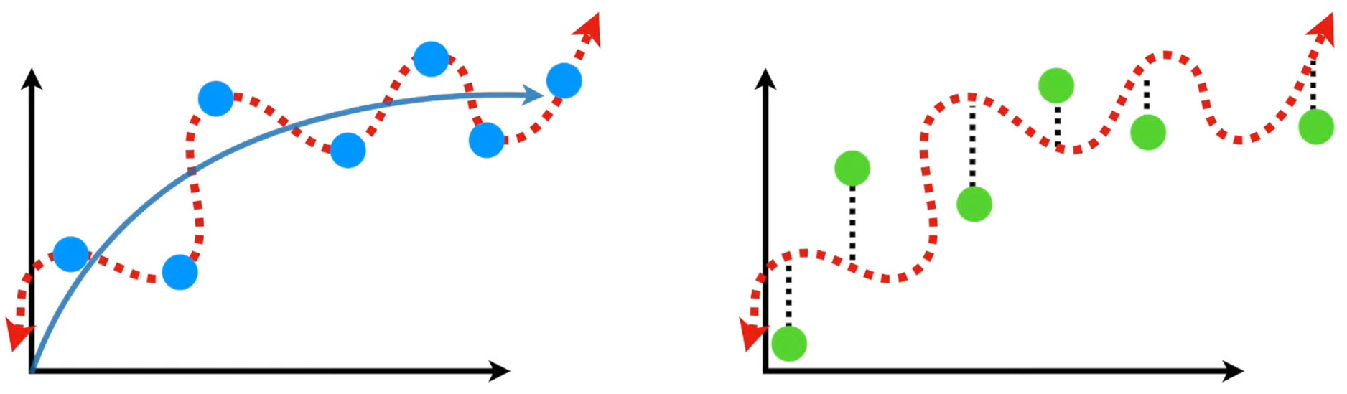
Bias/Variance Tradeoff
It is hard to predict how well the “Squiggly Line” will perform with
Future data sets.!!
It might do well sometimes, and other times it might do terribly.
27

Slide 28
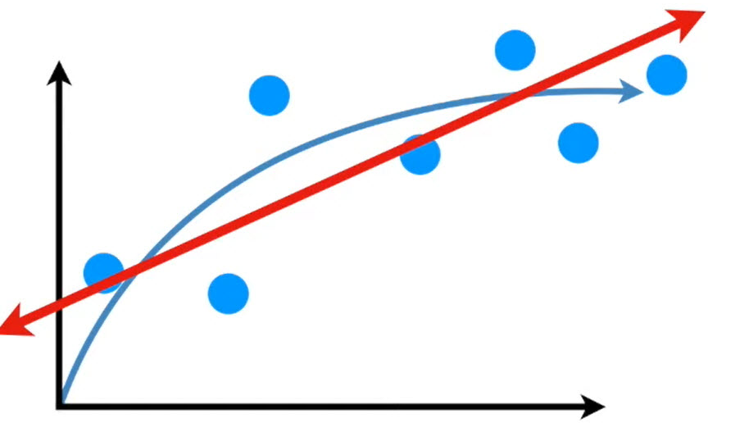
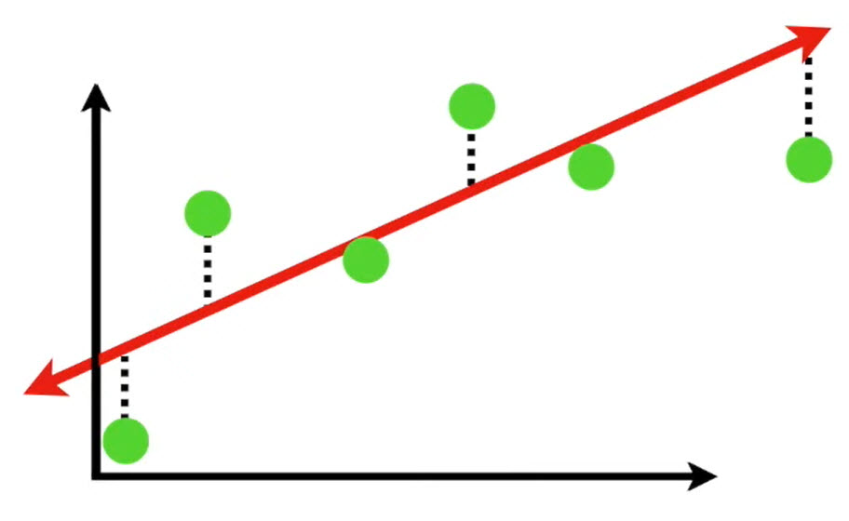
Bias/Variance Tradeoff
Underfitting!!
In contrast, the Straight Line has relatively high bias since it can not capture the curve in the relationship between weight and height …
… but the Straight Line has relatively low variance, because the Sums of Squares are very similar for different datasets.
In other words, the Straight Line might only give good predictions,
And not great predictions … But they will be consistently good predictions.
28

Slide 29
Overfitting and Underfitting

Slide 30
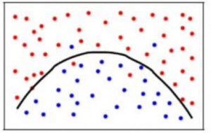
Overfit vs. Underfit
To achieve a balance between the Bias error and the Variance error, we need to use an appropriate model that neither
learns from the noise (memorize or overfit on data) nor
makes sweeping assumptions on the data (underfit on data).
A balanced model would look like the one in the figure below
Though some points are classified incorrectly, the model generally fits most of the datapoints accurately.
The balance between the Bias error and Variance error is the Bias-Variance Tradeoff.
Overfit
Just Right!!
Underfit
30
Notes:
This is a summary of the three possible scenarios as we develop ML models

Slide 31
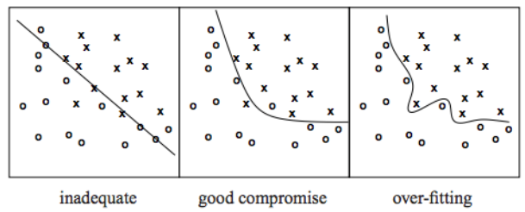
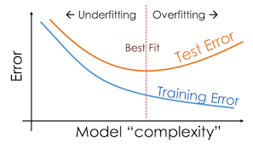
Underfitting
Underfitting refers to a model that can neither model the training data nor generalize to new data.
An underfit machine learning model is not a suitable model and will be obvious as it will have poor performance on the training data
Training and Testing
Accuracy are low!!
31
Notes:
In underfitting since the model is simple it is neither accurate on the training nor testing data

Slide 32
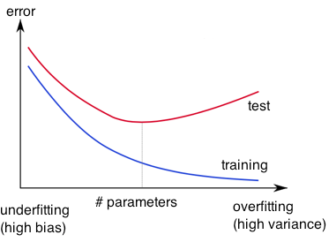
Overfitting
http://wiki.bethanycrane.com/overfitting-of-data
Learned hypothesis may fit the training data very well, even outliers (noise) but fail to generalize to new examples (test data)
https://www.neuraldesigner.com/images/learning/selection_error.svg
32
Notes:
In overfitting, the model is memorizing …
It does well in the training data (high accuracy)
However, it fails to generalize and therefore the accuracy of the testing data is low

Slide 33
Improving Learning
http://wiki.bethanycrane.com/overfitting-of-data
Model Selection
Hyper Parameter Tuning
Train with more Data
Data augmentation
Feature Selection
Early stopping
Regularization
https://www.neuraldesigner.com/images/learning/selection_error.svg
33
Notes:
Techniques to reduce Underfitting:
Increase model complexity.
Increase the number of features, performing feature engineering.
Remove noise from the data.
Increase the number of epochs or increase the duration of training to get better results.
Techniques to reduce overfitting
Cross-validation (data) ...
Data augmentation (data) ...
Feature selection (data) ...
L1 / L2 regularization (learning algorithm) ...
Regularization is a technique used to reduce the errors by fitting the function appropriately on the given training set and avoid overfitting.
Remove layers / number of units per layer (model) ...
Dropout (model)

Slide 34
Regularization
Notes:
Overfitting can be reduced using several techniques as we mentioned earlier
Simplify the model (Model Selection)
Hyper Parameter Tuning
Train with more Data
Data augmentation
Early stopping
Regularization

Slide 35
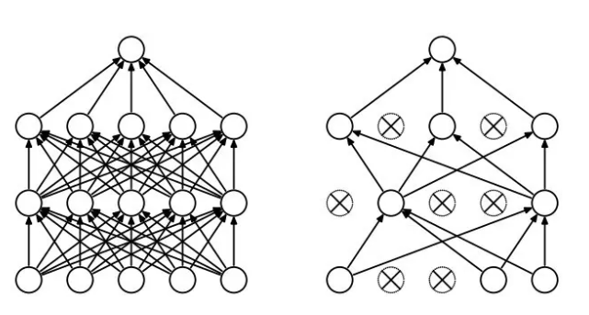
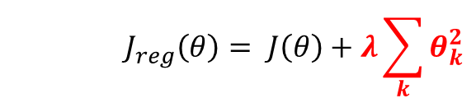
Regularization
Dropout
Randomly drop units (along with their connections) during training
Each unit retained with fixed probability p, independent of other units
Hyper-parameter p to be chosen (tuned)
Srivastava, Nitish, et al. "Dropout: a simple way to prevent neural networks from overfitting." Journal of machine learning research (2014)
L2 = weight decay
Regularization term that penalizes big weights, added to the objective
Weight decay value determines how dominant regularization is during gradient computation
Big weight decay coefficient → big penalty for big weights
$$J_{reg}\left(θ\right)= J\left(θ\right)+λ\sum_{k}{θ_{k}^{2}}$$
Early-stopping
Use validation error to decide when to stop training
Stop when monitored quantity has not improved after n subsequent epochs
n is called patience
35
Notes:
Dropout: is a technique used to prevent a model from overfitting.
Dropout works by randomly setting the outgoing edges of hidden units (neurons that make up hidden layers) to 0 at each update of the training phase.
Dropout is a technique where randomly selected neurons are ignored during training. They are “dropped-out” randomly. This means that their contribution to the activation of downstream neurons is temporally removed on the forward pass and any weight updates are not applied to the neuron on the backward pass.
L1, L2 Regularization: apply a penalty to some parameters to further simplify a model
Early Stopping: In machine learning, early stopping is a form of regularization used to avoid overfitting when training a learner with an iterative method, such as gradient descent.
Such methods update the learner so as to make it better fit the training data with each iteration.
Early stopping is a method that allows you to specify an arbitrary large number of training epochs and stop training once the model performance stops improving on a hold out validation dataset.

Slide 36
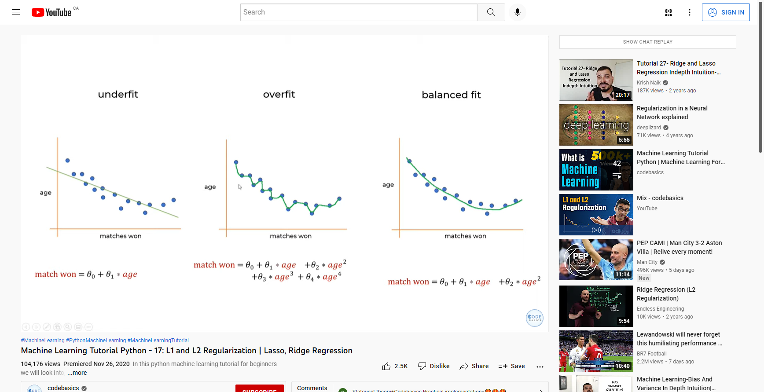
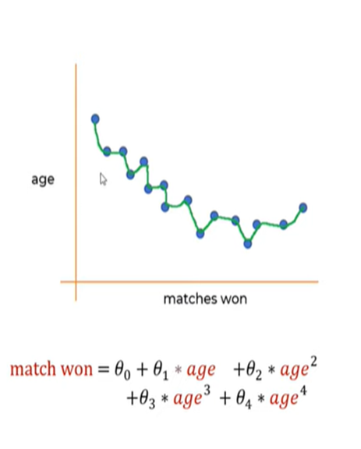
Regularization
Underfitting
Overfitting
Balanced Fit
Regularization in simple words is adding a penalty on say weights of the model to the objective function such that the model becomes simpler by making these weights smaller and thus reduce overfitting
Notes:
What is Regularization in Machine Learning?
Regularization in simple words is adding a penalty on say weights of the model to the objective function such that the model becomes simpler by making these weights smaller and thus reduce overfitting
For example
H(xi) = a0 + a1 x1 + a2 x22 + a3 x33 which may represent a squiggly line to be of order 2 instead of order 3

Slide 37
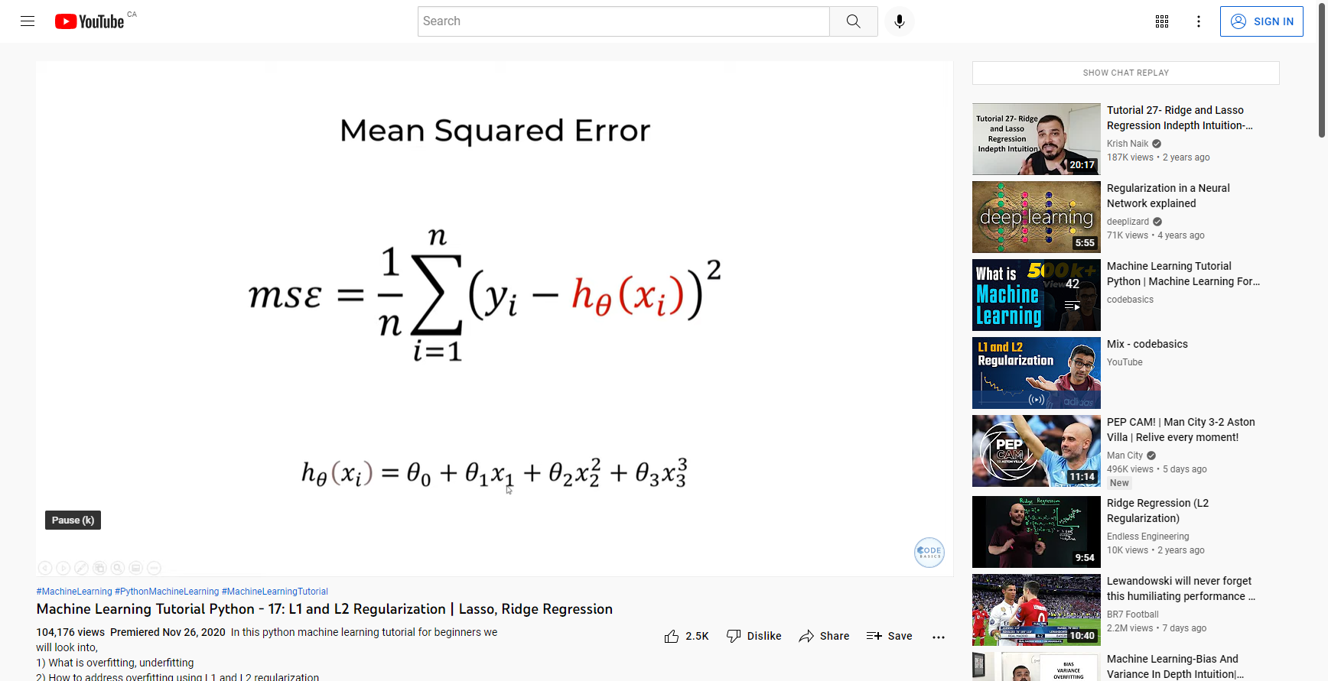
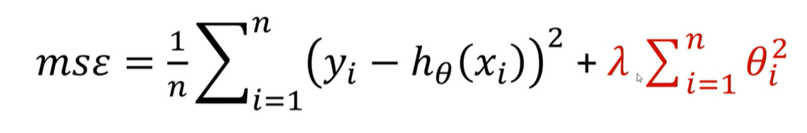
L₂ Regularization
Loss Function
L₂ Regularization
adds the “squared magnitude” of the coefficient
as a penalty term to the loss function
Notes:
L2 Regularization, also called a ridge regression,
adds the “squared magnitude” of the coefficient as the penalty term to the loss function.
We penalize the large weights and thus tend to make Theta₃ and Theta₂ smaller thus H_{theta} smaller

Slide 38
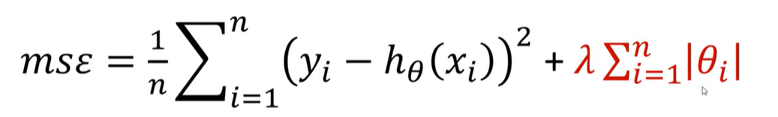
L₁ Regularization
Loss Function
L₁ Regularization:
adds the “absolute value of magnitude” of the coefficient
as a penalty term to the loss function
Notes:
L1 Regularization, also called a lasso regression,
adds the “absolute value of magnitude” of the coefficient as a penalty term to the loss function.

Slide 39
SKLearn
Notes:
This is a simple example where we estimate the bias and variance of the ML model to be used

Slide 40
Estimate Bias/Variance
# estimate the bias and variance for a regression model
from pandas import read_csv
from sklearn.model_selection import train_test_split
from sklearn.linear_model import LinearRegression
from mlxtend.evaluate import bias_variance_decomp
# load dataset
# Info about dataset can be found here
# https://github.com/jbrownlee/Datasets/blob/master/housing.names
# Has 506 instances with 13 attributes and a label (Median value of the home)
url = 'https://raw.githubusercontent.com/jbrownlee/Datasets/master/housing.csv'
dataframe = read_csv(url, header=None)
Dataframe.head()
0 1 2 3 4 5 6 7 8 9 10 11 12 13
0 0.00632 18.0 2.31 0 0.538 6.575 65.2 4.0900 1 296.0 15.3 396.90 4.98 24.0
1 0.02731 0.0 7.07 0 0.469 6.421 78.9 4.9671 2 242.0 17.8 396.90 9.14 21.6
2 0.02729 0.0 7.07 0 0.469 7.185 61.1 4.9671 2 242.0 17.8 392.83 4.03 34.7
3 0.03237 0.0 2.18 0 0.458 6.998 45.8 6.0622 3 222.0 18.7 394.63 2.94 33.4
4 0.06905 0.0 2.18 0 0.458 7.147 54.2 6.0622 3 222.0 18.7 396.90 5.33 36.2
40
Notes:
We will use a regression model on the housing dataset

Slide 41
Estimate Bias/Variance
# separate into inputs and outputs
data = dataframe.values
X, y = data[:, :-1], data[:, -1]
X.shape
(506, 13)
# split the data
# Training Data and Testing Data
X_train, X_test, y_train, y_test = train_test_split(X, y, test_size=0.33, random_state=1)
X_train.shape
(339, 13)
41
Notes:
The housing dataset has 506 instances and 13 features
We split the data into training and testing .. The size of the testing is almost 30% of the data

Slide 42
Estimate Bias/Variance
# define the model
model = LinearRegression()
# estimate bias and variance
mse, bias, var = bias_variance_decomp(model, X_train, y_train,
X_test, y_test,
loss='mse', num_rounds=200, random_seed=1)
# summarize results
print('MSE: %.3f' % mse)
print('Bias: %.3f' % bias)
print('Variance: %.3f' % var)
MSE: 22.418
Bias: 20.744
Variance: 1.674
In this case, we can see that the model has a high bias and a low variance.
This is to be expected given that we are using a linear regression model.
We can also see that the sum of the estimated mean and variance equals the estimated error of the model, e.g. 20.744 + 1.674 = 22.418.
42
Notes:
We calculate the MSE, Bias and Variance of the model using the dataset

Slide 43
Summary

Slide 44
Summary
Model error consists of model variance, model bias, and irreducible error.
The performance of any machine learning model can be characterized in terms of the bias and the variance of the model.
A model with high bias makes strong assumptions about the form of the unknown underlying function that maps inputs to outputs in the dataset, such as linear regression.
The bias-variance trade-off is a useful conceptualization for selecting and configuring models, although generally cannot be computed directly as it requires full knowledge of the problem domain, which we do not have
We seek models with low bias and variance, although typically reducing one results in a rise in the other.
44

Slide 45
Evaluation: Misc. Resources
YouTube (Evaluation Metrics)
https://www.youtube.com/watch?v=wpQiEHYkBys
https://www.youtube.com/watch?v=85dtiMz9tSo
https://www.youtube.com/watch?v=qQMAjsOihYc
https://www.youtube.com/watch?v=WQ652YORc54
https://www.youtube.com/watch?v=gGxaYk0Wiz4
YouTube (Cross Validation)
https://www.youtube.com/watch?v=fSytzGwwBVw&t=0s
YouTube (Bias and Variance)
https://www.youtube.com/watch?v=EuBBz3bI-aA&t=0s
YouTube (Regularization)
https://www.youtube.com/watch?v=4VKVGybyElM
https://www.youtube.com/watch?v=VqKq78PVO9g
45

Slide 46
Evaluation: Misc. Resources
Tutorials:
https://machinelearningmastery.com/regression-metrics-for-machine-learning/
https://scikit-learn.org/stable/modules/model_evaluation.html
https://towardsdatascience.com/8-simple-techniques-to-prevent-overfitting-4d443da2ef7d
Documents:
https://www.analyticsvidhya.com/blog/2020/08/bias-and-variance-tradeoff-machine-learning/
https://machinelearningmastery.com/calculate-the-bias-variance-trade-off/
https://machinelearningmastery.com/gentle-introduction-to-the-bias-variance-trade-off-in-machine-learning/
Software:
https://rasbt.github.io/mlxtend/
46

Slide 47
End Slides

