Slide 1
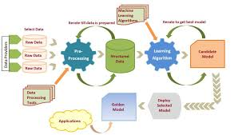
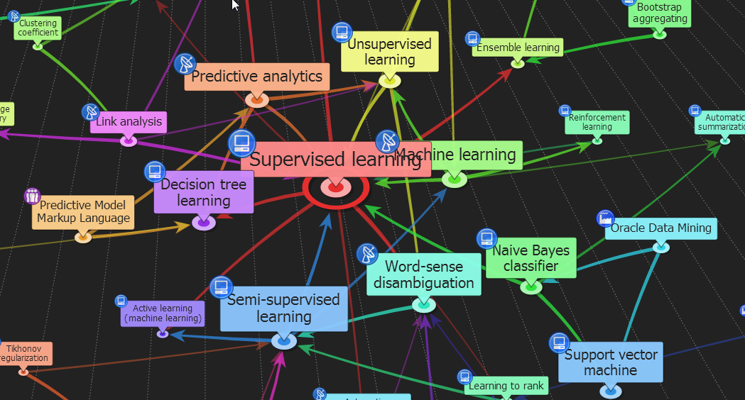



ENG6500: Intro to Machine Learning
“Evaluation Techniques (Part 1)”
S. Areibi
School of Engineering
University of Guelph
Notes:
In this lecture we cover evaluation techniques and metrics for supervised learning

Slide 2
Why Evaluate?
Multiple methods are available to classify or predict.
For each method, multiple choices are available for settings
To choose the best model, we need to assess each model’s performance.
Several metrics are available for:
  Regression Models
    R^2, MAE, MSE, RMSE
  Classification Models
    Accuracy, Precision, Sensitivity, Recall, ROC, F₁ Measure
Which metric should we use? Why? and When?
2
Notes:
Model Evaluation is the process through which we quantify the quality of a system's predictions.
To do this, we measure the newly trained model performance on a new and independent dataset.
This model will compare labeled data with it's own predictions.
We will cover several metrics for Regression and Classification ..
We will also learn how to answer this question posed ..

Slide 3
Evaluation Criteria
Predictive accuracy
Accuracy = Number of Correct Classifications
Total Number of Test Cases
Efficiency
  Time to construct the model … (Training Time)
  Time to use the model … (Inference Time)
Robustness: handling noise and missing values
Scalability: efficiency in disk-resident databases
Interpretability:
  understandable and insight provided by the model
Compactness of the model: size of the tree, or number of rules.
Other measures??
  Simplicity or Complexity of the technique …
  Hyper Parameter Tuning (# of parameters) …
3
Notes:
There are several evaluation metrics and criteria that can be used …
The most popular is Accuracy
Also .. Efficiency, robustness, scalability, compactness,
Other important measures include simplicity of model, easiness of tuning the model ….

Slide 4
How to Split Data?
Notes:
This is a topic that we covered and discussed … but is worth revisiting

Slide 5
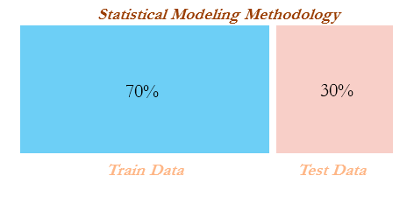
Train/Test Split
Learning the parameters of a prediction function and testing it on the same data is a methodological mistake!! Why?
A model that would just repeat the labels of the samples that it has just seen would have a perfect score but would fail to predict anything useful on yet-unseen data.
This situation is called overfitting (Memorizing).
To avoid it, it is common practice when performing a (supervised) machine learning experiment to hold out part of the available data as a test set
So, we should divide the dataset into say 70% training data, 30% test data.
  Use the training data to develop the model
  Use the test data to evaluate the model performance.
5
Notes:
We usually split our data into (a) training and (b) testing
Training is responsible to fit the model (e.g. adjusting the weights of an ANN) to learn a function
Testing is used to evaluate the goodness of the model

Slide 6
SKLearn: Train/Test Split
# Evaluating a Machine Learning Model by splitting the data
# https://scikit-learn.org/stable/modules/cross_validation.html
# Import necessary libraries
import numpy as np
from sklearn.model_selection import train_test_split
from sklearn import datasets
from sklearn import svm
# Load the data "iris", X will hold the features, while y will hold the label
X, y = datasets.load_iris(return_X_y=True)
X.shape, y.shape
((150, 4), (150,))
6
Notes:
Here is a simple example of how we use scikit learn to load a data set and split the data into training and testing

Slide 7
SKLearn: Train/Test Split
# Split the data into (a) Training data X, y (60%) and Testing data X, y (40%)
X_train, X_test, y_train, y_test = train_test_split(X, y, test_size=0.4, random_state=0)
# Check the size of the training data
X_train.shape, y_train.shape
((90, 4), (90,))
# check the size of the test data
X_test.shape, y_test.shape
((60, 4), (60,))
# Train an SVM model on the data and report the score (accuracy)
clf = svm.SVC(kernel='linear', C=1).fit(X_train, y_train)
clf.score(X_test, y_test)
0.9666666666666667
What are we missing??
7
Notes:
We can consider this to be a first step in developing a ML model
But however we are missing several things including
Splitting our data into (a) training, (b) validation, (c) testing
Hyper Parameter Tuning

Slide 8
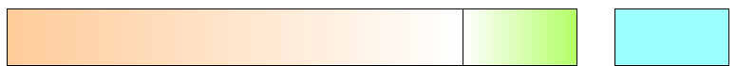
Train/Validation/Test Split
When evaluating different settings (“Hyperparameters”) for estimators such as the value “k” in K-Means clustering or K-Nearest Neighbors, there is risk of overfitting (i.e. memorizing) on the test set because the parameters can be tweaked until the estimator performs optimally.
To solve this problem, yet another part of the dataset can be held out as a so called “validation set”: training proceeds on the training set, after which evaluation is done on the validation set, and when the experiment seems to be successful, final evaluation can be done on the test set.
Divide the dataset into 70% training data, 15 % Validation, 15% test data.
  Use the training data to develop the model
  Use the validation data to tune the parameters of the model
  Use the test data to evaluate the model performance.
Training
Validation
Testing
8
Notes:
Validation split helps to improve the model performance by fine-tuning the model after each epoch.
The test set informs us about the final accuracy of the model after completing the training phase.
The training set should not be too small; else, the model will not have enough data to learn.

Slide 9
Validation
Validation Dataset: The sample of data used to provide an unbiased evaluation of a model fit on the training dataset while tuning model hyperparameters. The evaluation becomes more biased as skill on the validation dataset is incorporated into the model configuration.
The validation dataset may also play a role in other forms of model preparation, such as feature selection.
# split data
data = ...
train, validation, test = split(data)
# tune model hyperparameters
parameters = ...
for params in parameters:
model = fit(train, params)
skill = evaluate(model, validation)
# evaluate final model for comparison with other models
model = fit(train)
skill = evaluate(model, test)
9
Notes:
This is an example that shows how the data can be split from start to (a) Training, (b) Validation, (c) Testing
Notice that that final evaluation of the model is based on the testing set.

Slide 10
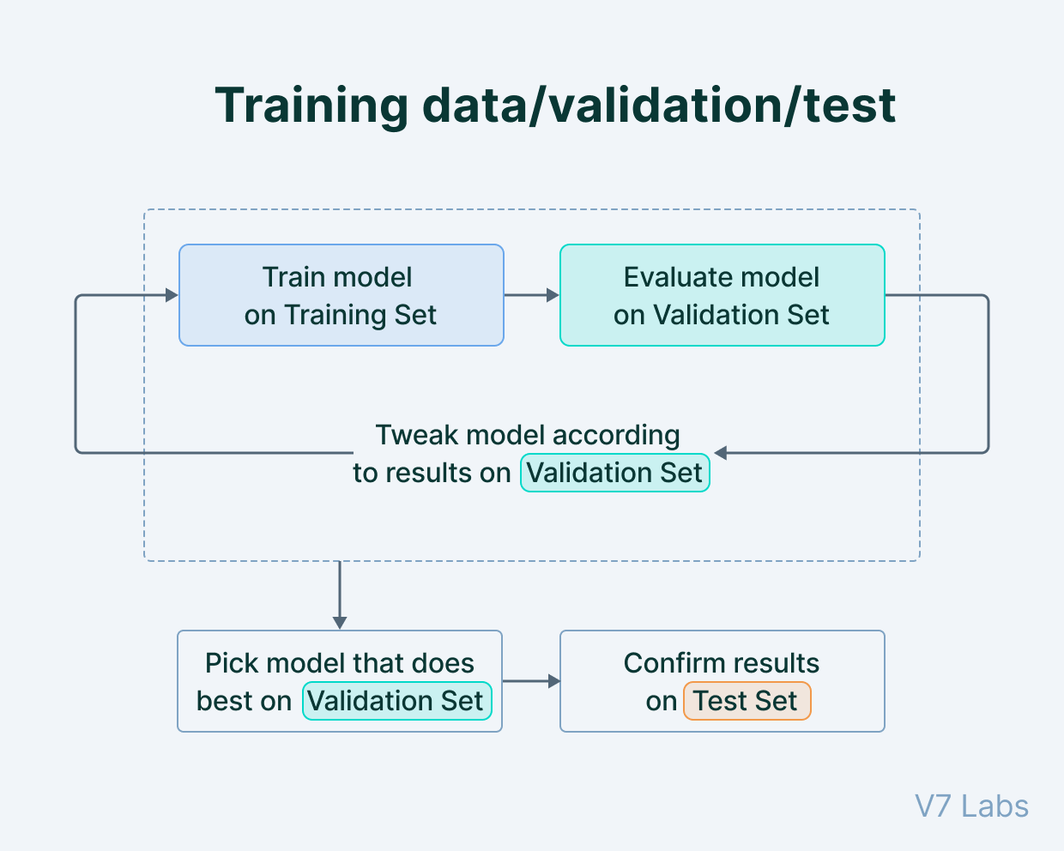
Train/Validation/Test Split
What is the disadvantage of Train/Validate/Test??
By partitioning the available data into three sets, we drastically reduce the number of samples which can be used for learning the model.
Also, the results can depend on a particular random choice for the pair of (train, validation) sets!
A solution to this problem is a procedure called Cross Validation.
10
Notes:
When we attempt to split our data into → Training, validation, testing we might hurt the development of the model since we reduce the # of instances that are used to fit the model

Slide 11
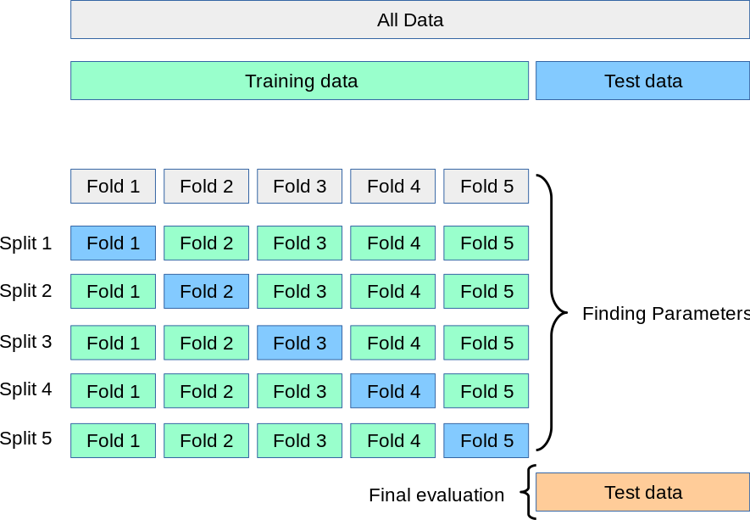
K-Fold Cross Validation
In K-fold cross validation, a test set should still be held out for final evaluation, but the validation set is no longer needed when doing Cross Validation.
The training set is split into k smaller sets.
The value of k could be 5, 10 …
The model is trained using k-1 of the folds as training data
The resulting model is validated on the remaining part (fold) of the data.
11
Notes:
To create the various testing and training data required to construct the supervised classification models, we employed k-fold cross validation.
With this method, the original dataset is first divided into K equal-size chunks or folds…
Aim of cross validation is to ensure that every example from the data set has an equal chance of appearing in the training and testing set.

Slide 12
K-Fold Cross Validation
Reference to a “validation dataset” disappears if the practitioner is choosing to tune model hyperparameters using k-fold cross-validation with the training dataset.
# split data
data = ...
train, test = split(data)
# tune model hyperparameters
parameters = ...
k = ...
for params in parameters:
skills = list()
for i in k:
fold_train, fold_val = cv_split(i, k, train)
model = fit(fold_train, params)
skill_estimate = evaluate(model, fold_val)
skills.append(skill_estimate)
skill = summarize(skills)
# evaluate final model for comparison with other models
model = fit(train)
skill = evaluate(model, test)
12
Notes:
Here is an example of a scikit learn example that uses cross validation based on k

Slide 13
SKLearn: K-fold CV
# Evaluating a Machine Learning Model by K-Fold CV
# https://scikit-learn.org/stable/modules/cross_validation.html
# Import necessary libraries
import numpy as np
from sklearn.model_selection import cross_val_score
from sklearn import datasets
from sklearn import svm
# Load the data "iris", X will hold the features, while y will hold the label
X, y = datasets.load_iris(return_X_y=True)
X.shape, y.shape
((150, 4), (150,))
13
Notes:
Again we can use a simple data set such as iris data set to evaluate the classification process using Cross Validation
Four Features (Length and Width of Sepals and Petals)
Total 150 samples (50 samples of each specie) → Balanced
Three Classess (three species
Iris Setosa
Iris Verginica
Iris Versicolor

Slide 14
SKLearn: K-fold CV
# Call SVM to fit the training data
clf = svm.SVC(kernel='linear', C=1, random_state=42)
scores = cross_val_score(clf, X, y, cv=5)
scores
array([0.96666667, 1., 0.96666667, 0.96666667, 1. ])
print("%0.2f accuracy with a standard deviation of %0.2f" % (scores.mean(), scores.std()))
0.98 accuracy with a standard deviation of 0.02
14
Notes:
The call to cross_val_score with the correct CV value will return the score based on the # of folds used
We can then find the mean

Slide 15
Classification Evaluation Metrics
Notes:
Several evaluation metrics can be used for classification problems
The most popular is the accuracy …

Slide 16
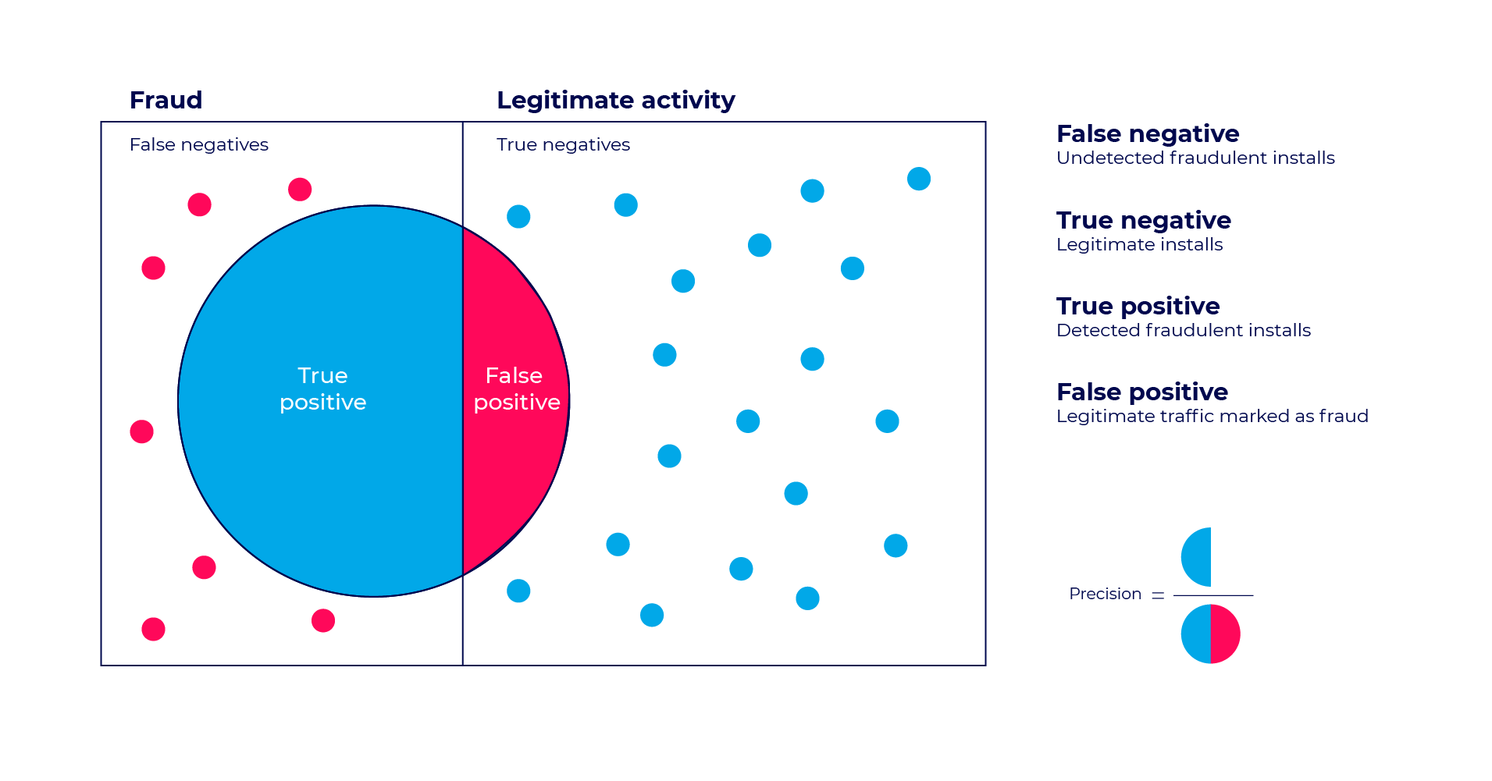
True/False Positive/Negative
The dataset is input to an algorithm that predicts each instance’s class association.
If an instance is correctly predicted as positive or negative, it is a True Positive (T_{P}) or True Negative (T_{N}), respectively.
If an instance is incorrectly labeled or predicted positive or negative, it is a False Positive (F_{P}) or False Negative (F_{N})
16
Notes:
True Positives (TP): The number of positive instances correctly classified as positive.
E.g., predicting an email as spam when it actually is spam.
True Negatives (TN): The number of negative instances correctly classified as negative.
E.g., predicting an email is not spam when it actually is not spam.
False Positives (FP): The number of negative instances incorrectly classified as positive.
E.g., predicting an email is spam when it actually is not spam.
False Negatives (FN): The number of positive instances incorrectly classified as negative.
E.g., predicting an email is not spam when it actually is spam.

Slide 17
Classification Evaluation Metrics
A confusion matrix is an N x N matrix, where N is the number of target labels (classes)
It shows the number of correct and incorrect predictions made by the classifier compared to the actual outcomes (target labels) in the actual data
E.g., binary classification problem (e.g., two classes 0|1 or T|F)
Model Prediction
Predicted T
Predicted F
Actually T
T_{P}
F_{N}
Accuracy: the proportion of the total number of predictions that are correct
T_{N} + T_{P} / (T_{N} + T_{P} +F_{P} + F_{N})
Target
Actually F
F_{P}
T_{N}
17
Notes:
The performance of a classifier is often evaluated using the information contained in a CONFUSION matrix.
The confusion matrix contains the number of correct and incorrect predictions made by the classification system compared to the actual outcomes or target labels.
Without loss of generality, let’s assume for the sake of simplicity that we have a binary classification problem.
So, there are two target labels or classes. We can refer to these as 0 or 1, true or false, yes or no, do we use the flow or do we not use the flow, etc.
Here is the simple 2 x 2 confusion matrix for our problem, where the two classes are TRUE and FALSE.
The rows of our table correspond to our target or the actual TRUE and FALSE classes, while the columns correspond to the TRUE and FALSE classes predicted by our model.
This entry (point to it) contains the number of instances where the target class was actually TRUE and the model predicted TRUE; this is the number of TRUE POSITIVES our model give us.
This entry (point to it) contains the number of instances where the target class is TRUE, but the model predicted FALSE; this is the number of FALSE NEGATIVES our model produces.
This entry (point to it) contains the number of instances where the target class is actually FALSE and the model predicts TRUE; this is the number of FALSE POSITVES our model gives.
Finally, this entry (point to it) gives the number of instances where the target class is FALSE and the model correctly predicts FALSE; this is the number of TRUE negatives that our model gives.
Note to self: Any multi-class problem, like ours, can be reduced to a series of binary classification problems, but we will not go into that. (E.g., one to many, pair-wise approach)

Slide 18
Confusion Matrix Example
201 1’s correctly classified as “1”
85 1’s incorrectly classified as “0”
25 0’s incorrectly classified as “1”
2689 0’s correctly classified as “0”
Accuracy = (201 + 2689)/(201+85+25+2689) = 96.33%
18
Notes:
An example to show how to use the confusion matrix to calculate the Accuracy from the TP, TN, FP, FN

Slide 19
Confusion Matrix Example
Total Samples = 3000
Accuracy = (201 + 2689)/3000 = 96.33%
Overall Error Rate = (25+85)/3000 = 3.67%
Accuracy = 1 – Overall Error Rate = 96.33%
What is the problem using the Accuracy measure here?
19
Notes:
Accuracy is also measured by subtracting the overall error rate from 1
Problem is we can estimate the TN with high accuracy but TP with less accuracy even though the overall accuracy is 96%

Slide 20
Be Careful of “Accuracy”
The simplest measure of performance would be the fraction of items that are correctly classified, or the “accuracy” which is:
But this measure is dominated by the larger set (of positives or negatives) and favors trivial classifiers.
e.g. if 5% of items are truly positive, then a classifier that always says “negative” is 95% accurate.
Tp + Tn
Tp + Tn + Fp + Fn
Class Imbalance is an issue during evaluation
20
Notes:
Accuracy is an easy measure to understand but may have issues !!
Class imbalance is just one issue we might consider when using the confusion matrix

Slide 21
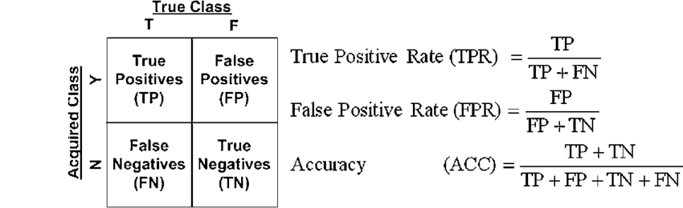
Recall Class Imbalance
For classification problems, we often use accuracy as evaluation metric.
It is easy to calculate and intuitive:
  Accuracy = # of correct predictions / # of total predictions
But, it is misleading for highly imbalanced datasets!!.
For example, in credit card fraud detection, we can set a model to always classify new transactions as legit. The accuracy could be high at 99.9% if 99.9% in the dataset is all legit.
The same applies for imbalance that may occur in cancer classification problems. The majority are cancer free and the minority are cancer positive. Again, our goal is to detect cancer, so such a model is useless.
That is why we need other metrics such as Precision, Recall, F1- Score, Sensitivity, Specificity and many others.
21
Notes:
Since accuracy may be misleading we will resort to other metrics such as:
Recall ..
Sensitivity ..
Specificity ..
F1-Score …

Slide 22
Precision, Sensitivity, Specificity
Notes:
Beside Accuracy, the user can use the following metrics (Precision, Recall, Sensitivity and Specificity) to evaluate models.
Each of the new measures we will introduce will have advantage and disadvantage …

Slide 23
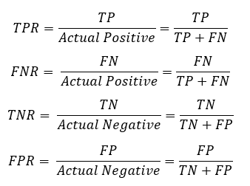
TPR and TNR
Predicted T
Predicted F
T_{P}
F_{N}
Actually T
Actually F
F_{P}
T_{N}
True Positive Rate (TPR) is the probability that an actual positive will test positive (Sensitivity/Recall).
True Negative Rate (TNR) is the probability that an actual negative will test negative (called Specificity).
FNR and FPR are two kind of errors that need to be minimized!
23
Notes:
The True Positive Rate (TPR, also called sensitivity/Recall) is calculated as TP/TP+FN.
TPR is the probability that an actual positive will test positive.
Indicates a test’s ability to detect the minority class (detect spam, detect disease …)
The True Negative Rate (TNR, also called specificity), is calculated as TN/TN+FP
TNR is the probability that an actual negative will test negative.
Both FNR and FPR are errors that need to be minimized

Slide 24
Sensitivity & Specificity
If “C₁” is the important class,
Sensitivity (TPR) = % of “C₁” class correctly classified
(or Recall) = n_{1,1} / (n_{1,0}+ n_{1,1} )
Specificity (TNR) = % of “C₀” class correctly classified
= n_{0,0} / (n_{0,0}+ n_{0,1} )
False Positive Rate = % of predicted “C₁’s” that were not “C₁’s” → F_{P} /(F_{P}+T_{N})
False Negative Rate = % of predicted “C₀’s” that were not “C₀’s” → F_{N}/(F_{N}+T_{P})
Predicted T
Predicted F
T_{P}
F_{N}
Actually T
n_{1,1}
n_{1,0}
n_{0,1}
n_{0,0}
Actually F
F_{P}
T_{N}
24
Notes:
Depending on the important class we seek
We either improve TPR or improve the TNR
In all cases we seek to reduce the FPR and FNR

Slide 25
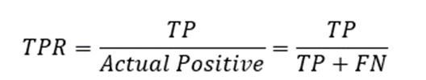
Sensitivity & Specificity
Total Samples = 3000
Accuracy = (201 + 2689)/3000 = 96.33%
Sensitivity (Recall) =
= (201 / (201 + 85) = 70.2%
Specificity =
= (2689 / (2689 + 25) = 99.0%
25
Notes:
If we make a comparison between Accuracy, Recall and Specificity we notice
The Negative class is the majority and therefore the Overall Accuracy leans towards the majority class

Slide 26
Sensitivity & Specificity
(A) – A model with perfect sensitivity and perfect specificity.
(B) – A model with perfect sensitivity and poor specificity.
(C) – A model with poor sensitivity and perfect specificity.
26
Notes:
Every model can have its advantages and disadvantages as we see in this example.
The developer should identify the most important case and class and act accordingly.
There will always be a tradeoff between Sensitivity and Specificity

Slide 27
Precision
We are also interested in the following performance measures:
Positive Predictive Value (PPV): Within a given set of positively-labeled results, the fraction that were true positives = T_{P}/(T_{P} + F_{P}) .. Also called Precision. It tells us how correct (precise) our model’s positive predictions.
Negative Predictive Value (NPV): the fraction that were true negatives = T_{N}/(T_{N} + F_{N})
Predicted T
Predicted F
T_{P}
F_{N}
Actually T
Actually F
F_{P}
T_{N}
https://en.wikipedia.org/wiki/Positive_and_negative_predictive_values
27
Notes:
Beside TPR and TNR we might be interested in the following measures and metrics
PPV (Positive Predictive Value) or “Precision” → out of all the records that were predicted to be Positive or Class “1” what is the fraction that were truly Positive
NPV (Negative Predictive Value) → i.e., the truly Negative records out of all the records that were predicted to be negative

Slide 28
Precision and Recall
Precision: is the ratio of correctly predicted positive examples divided by the tot.# of positive examples that were predicted (calculates the accuracy of minority class).
Recall (Sensitivity): is the ratio of correctly predicted positive classes to all items that are actually positive
Precision P = T_{P}/(T_{P} + F_{P})
Recall R = T_{P}/(T_{P} + F_{N})
Predicted T
Predicted F
T_{P}
F_{N}
Actually T
Actually F
F_{P}
T_{N}
28
Notes:
There is also a tradeoff between Precision and Recall …
There are cases you mostly care about the precision and in other context you mostly care about the recall.
Which one is more important depends on
Improving Precision → thus reducing False Positive
Or improving Recall → thus reducing False Negative

Slide 29
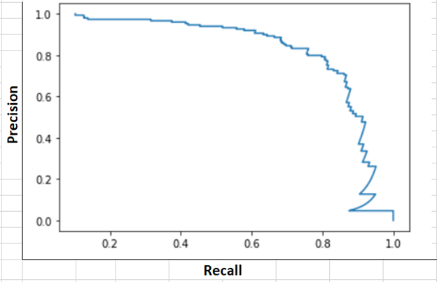
Precision and Recall
Search tools and classifiers normally assign scores to items.
Sorting by score gives us a precision-recall plot which shows what performance would be for different score thresholds.
Precision → “P” = T_{P}/(T_{P} + F_{P})
Recall → “R” = T_{P}/(T_{P} + F_{N})
29
Notes:
Unfortunately, you can’t have both precision and recall high.
If you increase precision, it will reduce recall, and vice versa.
This is called the precision/recall tradeoff.

Slide 30
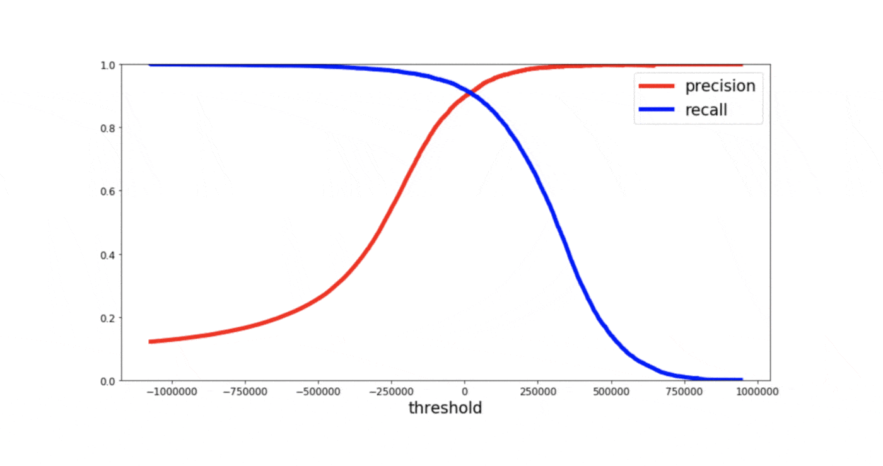
Precision/Recall Tradeoff
Sec. 8.3
So, in general for most classifiers, there is going to be a trade-off between recall and precision as you vary the probability threshold.
If you need to compare different models with different precision-recall value, It is often convenient to combine precision and recall into a single metric. Correct!!
We need a metric that considers both recall and precision to compute the performance.
30
Notes:
In most cases when precision increases .. Recalls decreases and vice versa
We need a single metric that may combine both Recall and Precision to give us a measure of goodness of an ML model
(F1 Measure)

Slide 31


The weighted “F” measure
A measure that naturally combines precision and recall is the β-weighted F-measure:
F =
Which is the weighted harmonic mean of precision and recall. Setting β = 1 gives us the F₁ – measure. It can also be computed as:
The F1-score is a great way to compare the performance of multiple classifiers. When choosing between multiple models, all with varying values of precision and/or recall, it may be used to determine the one that produces the 'best' results for the problem.
For this reason, it's often used in practice as a metric by which to rank models by performance.
31
Notes:
If you need to compare different models with different precision-recall value, it is often convenient to combine precision and recall into a single metric.
The highest value of an F1 Score is 1, indicating perfect Precision and Recall, and the lowest possible value is 0 if either the Precision or the Recall is zero.
Different Means:
The arithmetic mean is appropriate if the values have the same units,
The geometric mean is appropriate if the values have differing units.
The harmonic mean is appropriate if the data values are ratios of two variables with different measures, called rates.
Why Harmonic Mean?
Harmonic mean is a conservative average
Harmonic mean is not sensitive to extremely large values unlike simple averages.

Slide 32
AUC, ROC
Notes:
AUC stands for Area Under the Curve
ROC stands for Receiver Operating Characteristics
Both tell → how much the model is capable of distinguishing between classes
The higher the AUC, the better the model is at predicting ZERO Class as ZERO and “1” Class as “1”

Slide 33
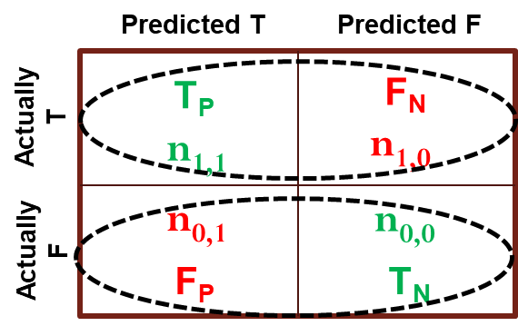
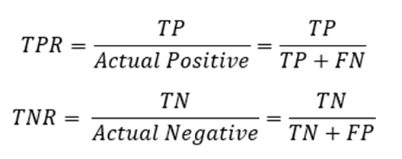
Introduction to ROC Curves
ROC = Receiver Operating Characteristic curves
The ROC is another common tool used for evaluation.
It plots out the sensitivity and specificity for every possible decision rule cutoff between 0 and 1 for a model.
Has become very popular in biomedical applications, particularly radiology and imaging
Also used in machine learning applications to assess classifiers
Can be used to compare tests/procedures
33
Notes:
The ROC curve shows the trade-off between sensitivity (or TPR) and specificity (1 – FPR).

Slide 34
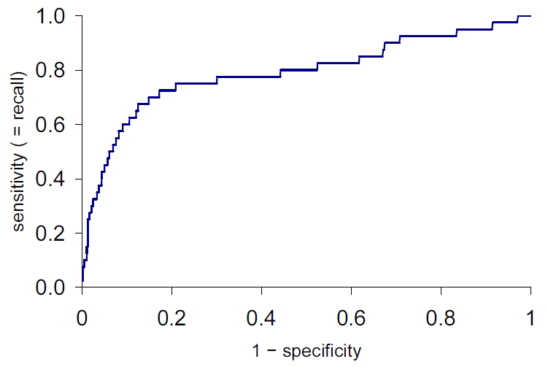
ROC Plots
ROC is Receiver-Operating Characteristic. ROC plots
Y-axis: True Positive Rate = T_{p}/(T_{p} + F_{n}), same as recall
X-axis: False Positive Rate = F_{p}/(F_{p} + T_{n}) = 1 - specificity
Score increasing
True Positive Rate: Fraction of positive instances that are correctly predicted as positive.
False Positive Rate: Fraction of negative instances that are incorrectly classified as positive.
34
Notes:
Classifiers that give curves closer to the top-left corner indicate a better performance.

Slide 35
ROC AUC
ROC AUC is the “Area Under the Curve” – a single number that captures the overall quality of the classifier. It should be between 0.5 (random classifier) and 1.0 (perfect).
Random ordering
area = 0.5
35
Notes:
Area under the curve (AUC) is a single number that tells us the goodness of the model being used
Anything close to 0.5 indicates a random classifier
Anything close to 1.0 indicates an excellent classifier

Slide 36
ROC Curve
ROC Plots
(Receiver Operating Characteristic)
Percent of 0s classified as 1
Perfect score:
0% of 1s called 0
0% of 0s called 1
This model’s distance
from perfect
Sweep threshold from 0 to 1
Threshold 0: ‘all’ classified as 1
Threshold 1: ‘all’ classified as 0
Percent of 1s classified as 0
36
Notes:
Another way of plotting the Receiver Operating Characteristics (ROC)

Slide 37
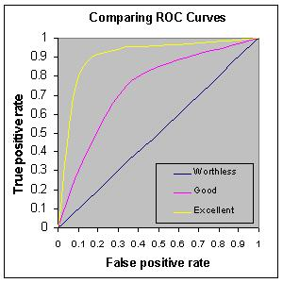
Receiver Operating Characteristic
Increase TPR
Decrease FPR
37
Notes:
As a baseline, a random classifier is expected to give points lying along the diagonal (FPR = TPR).

Slide 38
AUC for ROC curves
100%
100%
AUC = 100%
True Positive Rate
True Positive Rate
AUC = 50%
0%
0%
0%
100%
0%
False Positive Rate
100%
False Positive Rate
100%
100%
AUC = 90%
True Positive Rate
True Positive Rate
AUC = 65%
0%
0%
0%
False Positive Rate
100%
0%
100%
False Positive Rate
38
Notes:
Some of the properties that make ROC/AUC a preferred metric are:
Scale-Invariance. AUC measures how well predictions are ranked, instead of their absolute values.
Classification-Threshold-Invariance. AUC measures the quality of the model’s predictions regardless of what classification threshold is chosen.

Slide 39
Summary

Slide 40
Summary
Evaluation metrics are important for comparing across ML models, for choosing the right configuration of a specific ML model, and for comparing to the baseline.
Major metrics include accuracy, error rate, predictive error, Precision, Recall, F1-Score, Sensitivity, Specificity.
The F1-score is a great way to compare the performance of multiple classifiers. When choosing between multiple models, all with varying values of precision and/or recall, it may be used to determine which one produces the 'best' results for the problem at hand. For this reason, it's often used in practice as a metric by which to rank models by performance.
When developing and comparing several machine learning models use different evaluation metrics to further understand how each model differs from the other.
40

Slide 41
Resources

Slide 42
Evaluation: Misc. Resources
YouTube (Training)
  https://www.youtube.com/watch?v=fSytzGwwBVw
  https://www.youtube.com/watch?v=sFO2ff-gTh0
  https://www.youtube.com/watch?v=TIgfjmp-4BA
  https://www.youtube.com/watch?v=Kdsp6soqA7o
YouTube (Evaluation Metrics)
  https://www.youtube.com/watch?v=wpQiEHYkBys
  https://www.youtube.com/watch?v=85dtiMz9tSo
YouTube (Cross Validation)
  https://www.youtube.com/watch?v=fSytzGwwBVw&t=0s
YouTube (Bias and Variance)
  https://www.youtube.com/watch?v=EuBBz3bI-aA&t=0s
42

Slide 43
Evaluation: Misc. Resources
General Documents:
  https://towardsdatascience.com/performance-metrics-in-machine-learning-part-1-classification-6c6b8d8a8c92
  https://machinelearningmastery.com/classification-accuracy-is-not-enough-more-performance-measures-you-can-use/
  https://machinelearningmastery.com/how-to-choose-the-right-test-options-when-evaluating-machine-learning-algorithms/
  https://machinelearningmastery.com/confusion-matrix-machine-learning/
  https://mlu-explain.github.io/precision-recall/?utm_medium=email&utm_source=topic+optin&utm_campaign=awareness&utm_content=20220411+data+ai+nl&mkt_tok=MTA3LUZNUy0wNzAAAAGDuIw9G_D3dge_stBX9vUQIUNNI0IYd-H5l_HoFF_wYHAGaXoWONn2BwhdG2OFuOr7I2hM6JOaVOS9jSfgWSlCy9_rNbpQ978mm718E19F9JimKbdf
  https://www.analyticsvidhya.com/blog/2020/10/how-to-choose-evaluation-metrics-for-classification-model/
Tutorials:
  https://scikit-learn.org/stable/modules/model_evaluation.html
  https://scikit-learn.org/stable/modules/cross_validation.html
  https://towardsdatascience.com/understanding-confusion-matrix-a9ad42dcfd62
  https://medium.com/fintechexplained/part-3-regression-analysis-bcfe15a12866
  https://www.analyticsvidhya.com/blog/2020/08/bias-and-variance-tradeoff-machine-learning/
43

Slide 44
Splitting Data: Misc. Resources
Important Documents (Data Splitting)
  https://machinelearningmastery.com/difference-test-validation-datasets/
  https://machinelearningmastery.com/training-validation-test-split-and-cross-validation-done-right/
  https://gijopeter.medium.com/cross-validation-for-ml-feature-selection-ffdb71e5a68f
YouTube (Data Splitting)
  https://www.youtube.com/watch?v=_kp19PIVuXc
  https://www.youtube.com/watch?v=Zi-0rlM4RDs
  https://www.youtube.com/watch?v=ZHPwPHkrT4I
  https://raw.githubusercontent.com/EvidenceN/Insurance_premium_prediction/master/data/auto_insurance_data.csv
44

Slide 45
End Slides

