Slide 1
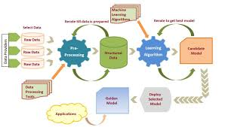
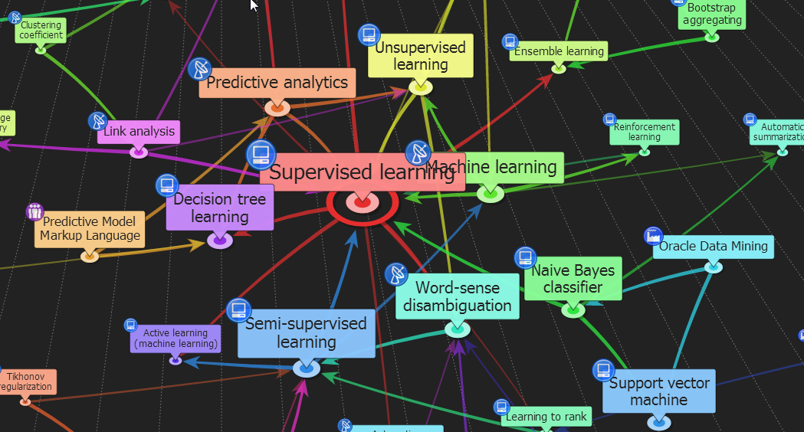

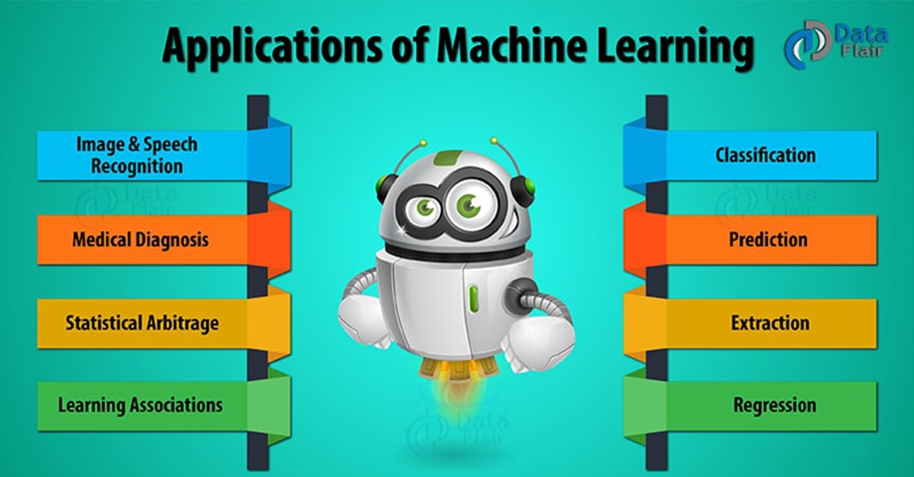
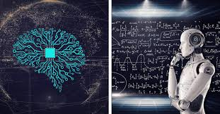
ENG6500: Intro to Machine Learning “ML: An Overview (Part 2)”
S. Areibi
School of Engineering
University of Guelph
Notes:
This is the second part of the lecture introduction to ML concepts

Slide 2
ML: Overall Methodology
Notes:
One of the most important concepts we will learn in this course (beside the ML Algorithms) is the Methodology of
Creating a Machine Learning Framework to perform a certain task

Slide 3
Machine Learning: Steps
Any step we missed!
3
Notes:
Here are the traditional ML steps that we discussed …
Anything within these 5 steps that we missed or ignored?
Collecting data requires
cleaning, preprocessing, feature selection …
Learning → you fit the model with the training model
but how do you evaluate it?
How do you know it will generalize?

Slide 4
Machine Learning: Steps
Garbage In Garbage out
Simple Model? Complex Model?
Fitting the model/minimizing the error!!
Is the model generalizing or memorizing?
What are the most important steps?
4
Notes:
The most important steps
The quality of data is the most important step.. If the data is dirty, garbage in → garbage out
Selecting the model is important since selecting a simple model may not fulfill the requirements (under fitting).

Slide 5
Machine Learning: Steps
5
Notes:
Again, we emphasize that data cleaning, data preprocessing, feature selection are very important withing the frame of Machine Learning.

Slide 6
Machine Learning: Overall Process
Are we using the correct ML
model suitable for the problem?
Are we using the correct
Evaluation criteria?
Phase 1) Learning
Preprocessing
Normalization
Dimension Reduction
Etc.
Learning
Supervised
Unsupervised
Semi-Supervised
Etc.
Error Analysis
Precision/Recall
Overfitting
Cross Validation
Etc.
MODEL
Training
Data
Phase 2) Testing
MODEL
Predicted Data
Prediction
New
Data
Underfitting or Overfitting?
6
Notes:
Developers of Machine Learning frameworks will always go through 2-3 steps
Fitting Phase (i.e., developing the Model) with Training Data
Performing Preprocessing of data
Using the appropriate model
Evaluating the model
Producing a learnt model
Prediction Phase (or deployment) using Testing data (unseen)
The Model trained in Phase 1 is used during deployment to perform new predictions

Slide 7
Supervised Learning Approach

Slide 8
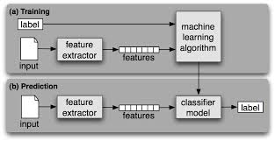
Supervised Machine Learning
y = f(x)
label
prediction function
example with features
Training data consists of examples (pairs of features and label.)
The task of Supervised Learning is to infer a function from labeled data.
Training: given a training set of labeled examples {(x1,y1), …, (xN,yN)}, estimate the prediction function f() by minimizing the prediction error on the training set
Testing & Deployment: Once the model has learnt it is capable of generalizing and predicting new unseen data
8
Notes:
Our main task in Supervised ML is build and design a function (straight line, or curved line, or ..) that is capable of say partitioning the solution space into different parts to classify objects into different classes
Notice that during Training, we have to supply both the features and labels .. The Optimization Algorithm will adjust the parameters of the Machine Learning Algorithm such that the error between the label and prediction is minimized
During the Testing and Deployment, only the features of the object are extracted and given to the learnt model.
The classifier is expected to produce the correct label for the object given the training that occurred in the Training Phase

Slide 9
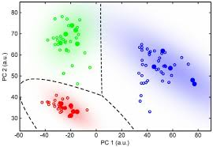
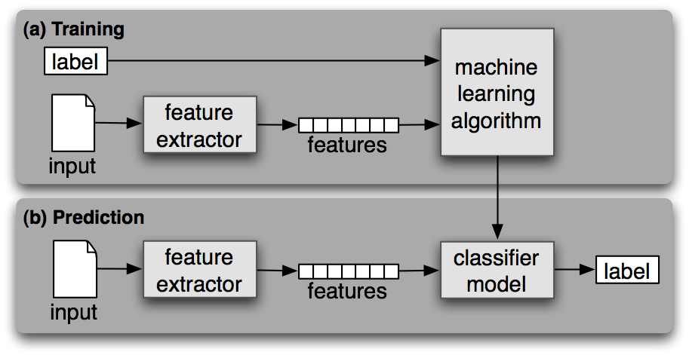
Supervised Learning
What has the ML Algorithm Learn?
9
Notes:
What do we expect the Machine Learning algorithm to have learnt in the Training Phase?
It learnt the function y = f(x) that performs the task of classifying the objects into green, red and blue classes.
Notice that some times the function y = f(x) is linear, in other times it is polynomial and so on
The most important task is to be able to generalize!!

Slide 10
Process (1): Model Construction
What is the rule that the Classifier Model Learnt from the data?
Classification
Algorithms
Training
Data
features
Classifier
(Model)
IF rank = ‘professor’
OR years > 6
THEN tenured = ‘yes’
Notes:
Here is an example of a classification algorithm that is developed at the University to predict if a faculty member would be tenured or not..
Notice that the data is balanced (the yes/no classes are balanced)
Given two features (rank and years in the system) we expect the Classifier model to learn a rule that can be used for classification
In some cases the rule to be learnt maybe simple as the one we propose here but in many cases the rule might be more complex
Also, the advantage of the data driven approach is that as long as we feed the Machine Learning Algorithm with the appropriate data it will be able to continue to learn and adjust

Slide 11
Process (2): Model Deployment
IF rank = ‘professor’
OR years > 6
THEN tenured = ‘yes’
Classifier
Testing
Data
Unseen Data
Unseen Data
(Jeff, Professor, 4)
Tenured?
Notes:
If we are happy with the performance of the Classification Model during Training, we should test it on unseen data and find out if it indeed generalizes or Unseen data
Recall that the classification technique will use the function and rule it learned earlier on the training data
In some cases, the rule or function learnt may not be sufficient to generalize thus the performance will suffer.

Slide 12
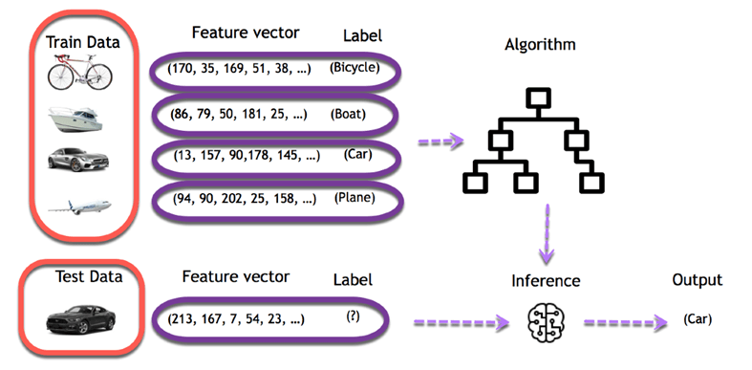
Training and Testing
Training objects or data can be images, pixels, feature vectors, speech
Features have to be informative and correlated to the label
Deep Neural Networks (CNNs) can extract the features automatically
12
Notes:
Training data for Supervised or Unsupervised Learning can be of different formats:
Speech,
Data from sensors
Images,
Heatmaps in case of designs mapped onto ICs
Feature vectors
If the features selected can distinguish different images then it will succeed in its task
The features have to be meaningful and informative to lead to an Algorithm that can classify and generalize
Deep Learning techniques in the form of Convolutional Neural Networks can extract the features

Slide 13
Training vs Testing
What do we want? – High accuracy on training data .. (is this enough?)
Yes, but more importantly high accuracy on unseen/new/test data! – Why is this tricky?
Training data – Features (x) and labels (y) used to learn mapping f()
Testing data – Features used to make a prediction – Labels only used to see how well we’ve learned f()!
Validation data
– Held-out set of the training data
– Can use both features and labels to tune parameters of the model we’re learning
Same
Distribution??
13
Notes:
We need to have a high accuracy on both Training Data and also on Testing Data
It could be tricky since the testing data could be a different distribution than the training data
Beside the (a) Training Data, (b) Testing data to evaluate the performance of the ML Model, we will need (c) Validation data to fine tune hyperparameters of the ML model

Slide 14
Classification Step 1: Split data into training and test sets
THE PAST
Results Known
+
Training set
+
-
-
Data
+
Testing set
14
Notes:
A Quick and fast approach could be to split the data into training and testing sets
The training set is used to create the model and the testing set to evaluate either one or several models.

Slide 15
Classification Step 2: Build a model on a training set
THE PAST
Results Known
Features
+
Training set
+
-
-
Data
+
Model Builder
Testing set
15
Notes:
The features have to be engineered correctly to be able to build a model that can generalize

Slide 16
Classification Step 3: Evaluate on test set (Re-train?)
Results Known
+
Training set
+
-
-
Data
+
Model Builder
Evaluate
Predictions
+
-
+
-
Y
N
Validation set
16
Notes:
A Better approach is to split the data into Training and Testing sets
Then split the Training set into a validation set and training set.
The training set is used to build the model and validation set to fine tune the parameters of the model

Slide 17
Classification: Train, Validation, Test split
Results Known
+
Model
Builder
+
Training set
-
-
Data
+
Evaluate
Model Builder
Predictions
+
-
+
-
Y
N
Validation set
Features
+
-
+
-
Final Evaluation
Final Test Set
Final Model
17
Notes:
Once the model is build and the hyper parameters tuned using the validation set
The final test set (unseen) is used to evaluate the final model that will be deployed for an application

Slide 18
Feature Selection (Reduction)
Notes:
We mentioned in the previous lecture the importance of data .. Both records and features
However, One of the most important practices in ML is identifying the importance of some features (i.e. Feature Selection)

Slide 19
Data Reduction Strategies
Data reduction: Obtain a reduced representation of the data set that is much smaller in volume but yet produces the same (or almost the same) analytical results
Why data reduction? — A database/data warehouse may store terabytes of data. Complex data analysis may take a very long time to run on the complete data set.
Data reduction strategies
Dimensionality Reduction, e.g., remove unimportant attributes (noise)
Principal Components Analysis (PCA)
Feature subset selection, feature creation
Notes:
Dimensionality reduction is the task of reducing the number of features in a dataset.
In machine learning tasks like regression or classification, there are often too many variables to work with.
These variables are also called features.
Extra redundant features can cause Noise and the ML technique performance will be affected

Slide 20
Dimensionality Reduction
Feature selection (i.e., attribute subset selection):
Select a minimum set of features such that the probability distribution of different classes given the values for those features is as close as possible to the original distribution given the values of all features
reduce # of patterns in the patterns, easier to understand
Wrapper Based Methods vs. Filter Based methods
Heuristic methods (due to exponential # of choices):
step-wise forward selection
step-wise backward elimination
combining forward selection and backward elimination
decision-tree induction
Meta Heuristic based feature selection (Genetic Algorithms)
20
Notes:
We will learn the difference between wrapper based vs. filter based approaches
Filter methods measure the relevance of features by their correlation with dependent variable
Wrapper methods measure the usefulness of a subset of feature by actually training a model on it.
Heuristic Methods: In this course we will learn about several heuristics that are used for Dimensionality Reduction (feature Selection) Including heuristic and meta heuristic based approaches

Slide 21
How to Split Data
Notes:
How do we split data for training and testing and why?

Slide 22
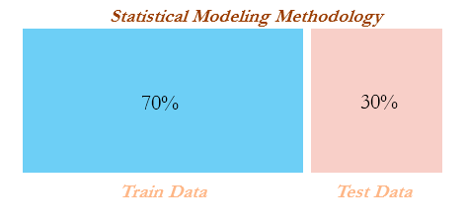
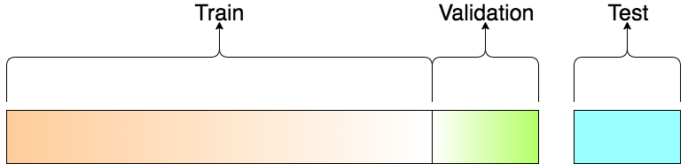
Train/Test Split
Divide the dataset into 70% training data, 30% test data.
Use the training data to develop and fit the model
Use the test data (unseen data) to evaluate the model performance.
The Training data is further divided to (Training and Validation).
Validation is used to fine tune the parameters of the algorithm.
Any issues with this approach?
Solution? Alternatives?
22
Notes:
What are the main drawbacks of splitting the data into Training, Validation, Testing data?
If we have a small dataset, splitting the data this way will:
reduce the training dataset that is used to create the model (i.e., for the model to learn an effective mapping of inputs to outputs) and
there will also not be enough data in the testing dataset to effectively evaluate the model performance!!

Slide 23
K-Fold Cross Validation
Divide the dataset into K chunks (i.e., folds) and train K times, using a different fold for each time.
E.g., Assume K=5
Advantages/Disadvantages?
Dataset
Fold 1
Fold 2
Fold 3
Fold 4
Fold 5
1
Test
Train
Train
Train
Train
2
Train
Test
Train
Train
Train
3
Train
Train
Test
Train
Train
4
Train
Train
Train
Test
Train
5
Train
Train
Train
Train
Test
Hence, you create 5 models and choose the best model based on its performance
23
Notes:
To create the various testing and training data required to construct the supervised classification models, we employed k-fold cross validation.
With this method, the original dataset is first divided into K equal-size chunks or folds…
Advantages: (Better use of data and validates performance on multiple folds)
Aim of cross validation is to ensure that every example from the data set has an equal chance of appearing in the training and testing set.
As the value of K increases the variance of the resulting estimate is reduced
K-fold CV often give more accurate estimate of the test error rate
Disadvantages: (CPU Time)
The training algorithm has to be rerun from scratch k times..
Which means it takes k times as much computation to make an evaluation

Slide 24
Machine Learning Evaluation Metrics
Notes:
Evaluating the performance of Machine Learning Algorithms is one of the most important steps in ML
We will introduce several evaluation metrics for both classification and regression
We will then understand when to use each and the advantages and disadvantages of each

Slide 25
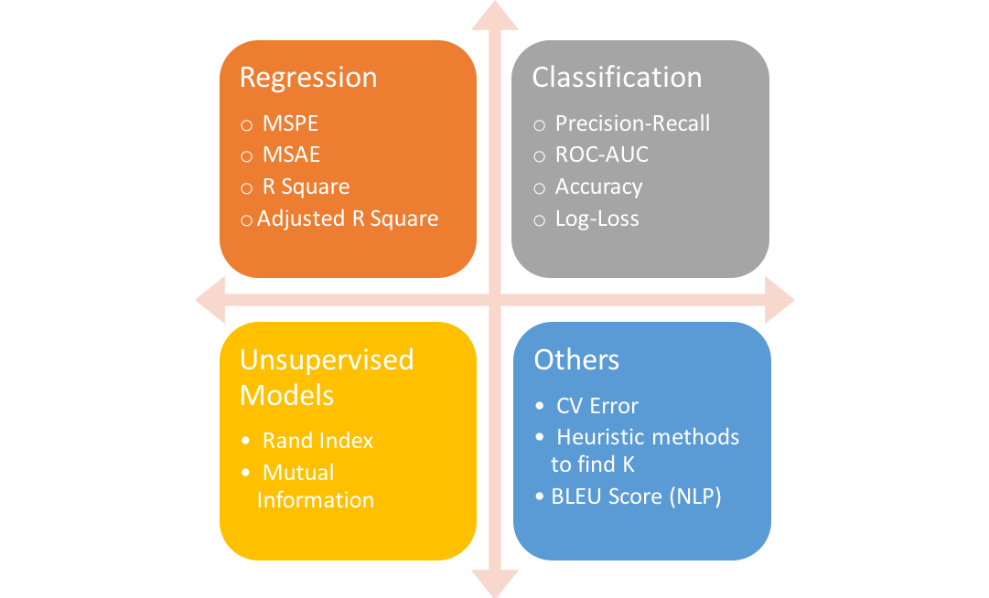
ML/DL Evaluation Metrics
Evaluation metrics are used to measure the quality of machine learning models.
Evaluating machine learning models or algorithms is essential for any project.
There are many different types of evaluation metrics available to test a model.
25
Notes:
Different evaluation metrics need to be used for Supervised Machine Learning (Regression, Classification) and Unsupervised Learning models such as Clustering
Evaluation metrics are used to measure the quality of the statistical or machine learning model.
Evaluating machine learning models or algorithms is essential for any project.
There are many different types of evaluation metrics available to test a model.

Slide 26
Classification Evaluation Metrics
Notes:
In this course you will develop and/or use many Machine Learning Algorithms for classification and therefore it is important to understand the advantages and disadvantages of the evaluation metrics

Slide 27
Evaluation Metrics
A confusion matrix is an N x N matrix, where N is the number of target labels (classes)
It shows the number of correct and incorrect predictions made by the classifier compared to the actual outcomes (target labels) in the actual data
E.g., binary classification problem (e.g., two classes 0|1 or T|F)
Predicted by Model
Predicted T
Predicted F
Actually T
T_{P}
F_{N}
Accuracy: the proportion of the total number of predictions that are correct
TN + TP / (TN + TP +FP + FN)
Target
Actually F
F_{P}
T_{N}
Disadvantages of Accuracy?
27
Notes:
The performance of a classifier is often evaluated using the information contained in a CONFUSION matrix.
This is just one evaluation metric to measure the goodness of classification …
The confusion matrix contains the number of correct and incorrect predictions made by the classification system compared to the actual outcomes or target labels.
TP → # instances where target class is TRUE and the model predicted TRUE; (TRUE POSITIVES).
FN → # instances where target class is TRUE, but the model predicted FALSE; (i.e. someone with cancer classified as healthy!!!)
TN → # instances where target class is FALSE and the model correctly predicts FALSE; (TRUE NEGATIVES).
FP → # instances where target class is FALSE and the model predicts TRUE; (i.e. someone healthy classified as sick)
Disadvantages of Accuracy and Confusion matrix is when we have unbalanced data ..
If the minority class T_{P} is not classified well the Accuracy will still be high → Misleading

Slide 28
Regression Evaluation Metrics
Notes:
Several metrics are also used for Regression ..

Slide 29
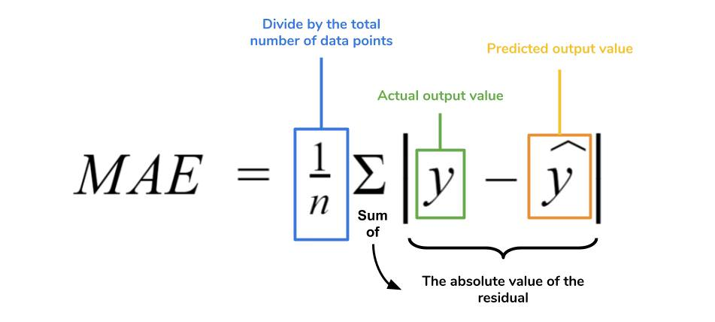
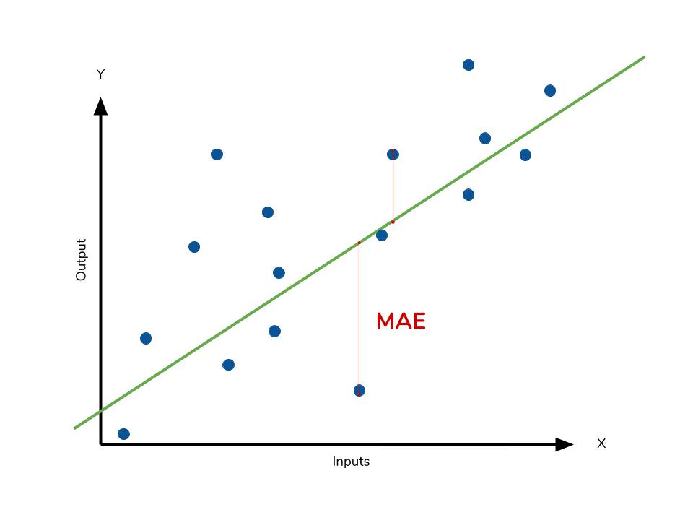
Regression Evaluation “MAE”
The Mean Absolute Error (MAE) is the simplest regression error metric to understand.
The absolute value of the residual is taken so that negative and positive residuals do not cancel out.
The average of all residuals is then taken only the absolute value of each
A small MAE suggests the model is great at prediction
A MAE of 0 means that your model is a perfect predictor
29
Notes:
One of the simplest evaluation metrics used in regression is MAE
Why absolute?
To prevent positive and negative values to cancel each other
Other measures include RMSE, MSE, R^2

Slide 30
Overfitting and Underfitting
Notes:
So far we discussed how to use Training data to fit a model and create a highly accurate ML model to predict either continuous or discrete values ..

Slide 31
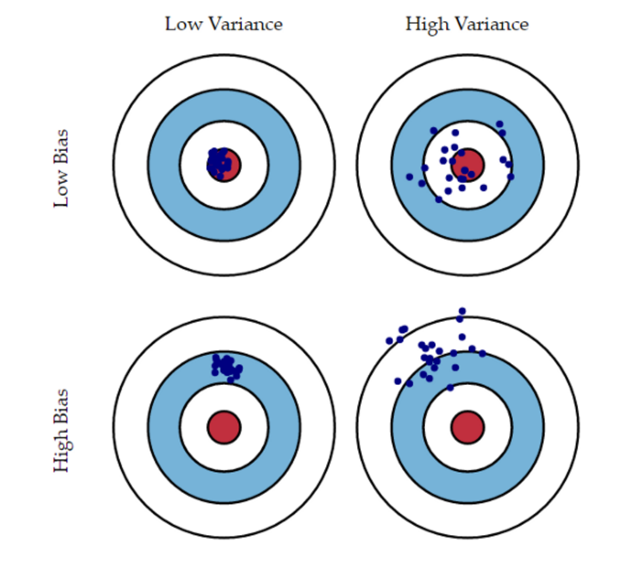
Generalization
Components of expected loss:
Noise in our observations: unavoidable
Bias: how much the average model over all training sets differ from the true model. Error due to inaccurate assumptions/simplifications made by the model.
Variance: how much models estimated from different training sets differ from each other. Error due to overcomplicated model.
Overfitting
Underfitting
31
Notes:
A model that we build is never perfect !!!
There will be several sources of errors .. Some that we can fix others that we can not address
Noise due to sensors output or means of gathering data
Bias: When the model is simple and you are trying to solve a complicated problem
This error can be avoided by using a more suitable model
Variance: When the model is over complicated
Use a simpler model
Generate more data

Slide 32
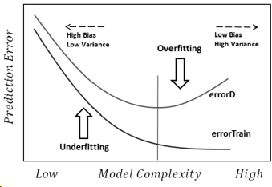
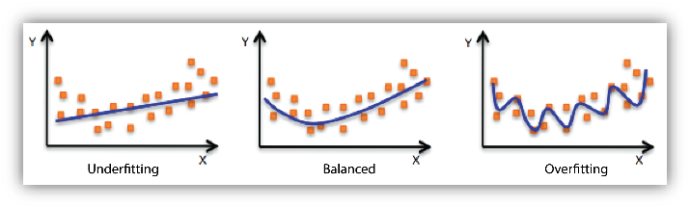
Overfitting & Underfitting
Underfitting: Poor performance on the training data and poor generalization to other (unseen) data
Overfitting: Good performance on training data but poor generalization to other (unseen) data (memorizing!!)
Simple model
Just Right
Complicated model
32
Notes:
Intuitively, underfitting occurs when the model or the algorithm does not fit the data well enough.
Specifically, underfitting occurs if the model or algorithm shows low variance but high bias.
Underfitting is often a result of an excessively simple model.
Specifically, overfitting occurs if the model or algorithm shows low bias but high variance.
Overfitting is often a result of an excessively over complicated model
It can be prevented by:
Fitting multiple models and using validation or cross-validation to compare their predictive accuracies on test data.
Use more data
Early Stopping
Use Ensemble Learning
Regularization L1 or L2 regularization (maybe reduce number of features)

Slide 33
ML Classification Algorithms
Notes:
The core topic in Machine Learning is the development of algorithms that can be used affectively to perform
Classification and regression on data ..

Slide 34
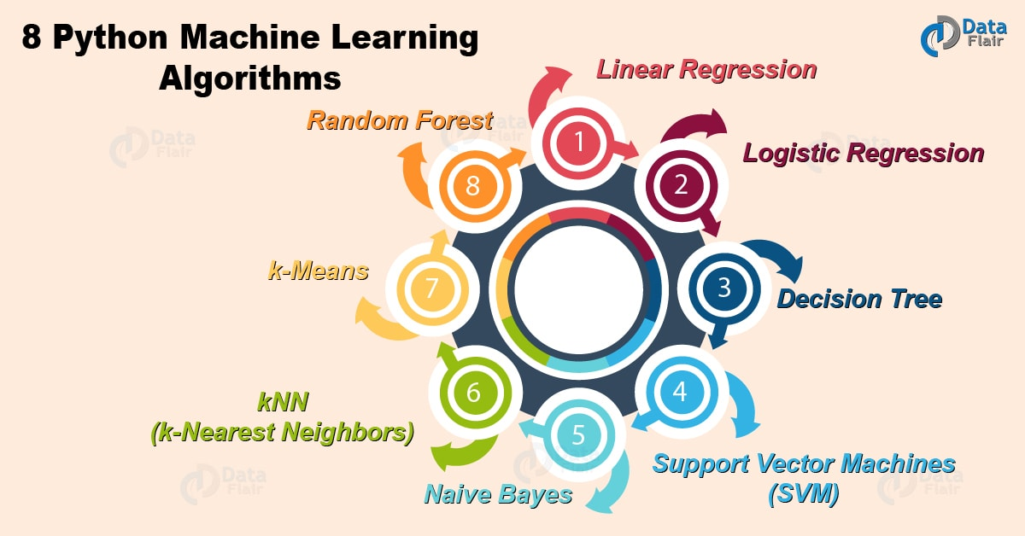
Classification Algorithms
Basic Principle (Inductive Learning Hypothesis): Any hypothesis found to approximate the target function well over a sufficiently large set of training examples will also approximate the target function well over other unobserved examples.
Typical Algorithms:
Decision trees
Rule-based induction
Neural networks
K-Nearest Neighbor
Random Forests
Bayesian networks
Support Vector Machines
34
Notes:
In this course will study many Machine Learning Algorithms including
Simple techniques such as Decision Trees, KNN, Naïve Bayes
More accurate techniques such ANNs, Support Vector Machines
Ensemble Methods such as Random Forests, Gradient Boost and Stacking

Slide 35
Decision Trees
Notes:
Decision Trees is considered to be one of the simplest approaches developed for classification and regression

Slide 36
Decision Tree for Play Tennis
Root Node
Outlook
Sunny
Overcast
Rain
Humidity
Each internal node tests an attribute
High
Normal
Each branch corresponds to an
attribute value node
No
Yes
Each leaf node assigns a classification
36
Notes:
A decision tree is a type of supervised machine learning used to categorize or make predictions based on how a previous set of questions were answered.
The model is a form of supervised learning, meaning that the model is trained and tested on a set of data that contains the desired categorization.
Decision tree uses the tree representation to solve the problem in which each leaf node corresponds to a class label and attributes are represented on the internal node of the tree.
We can represent any Boolean function on discrete attributes using the decision tree.

Slide 37
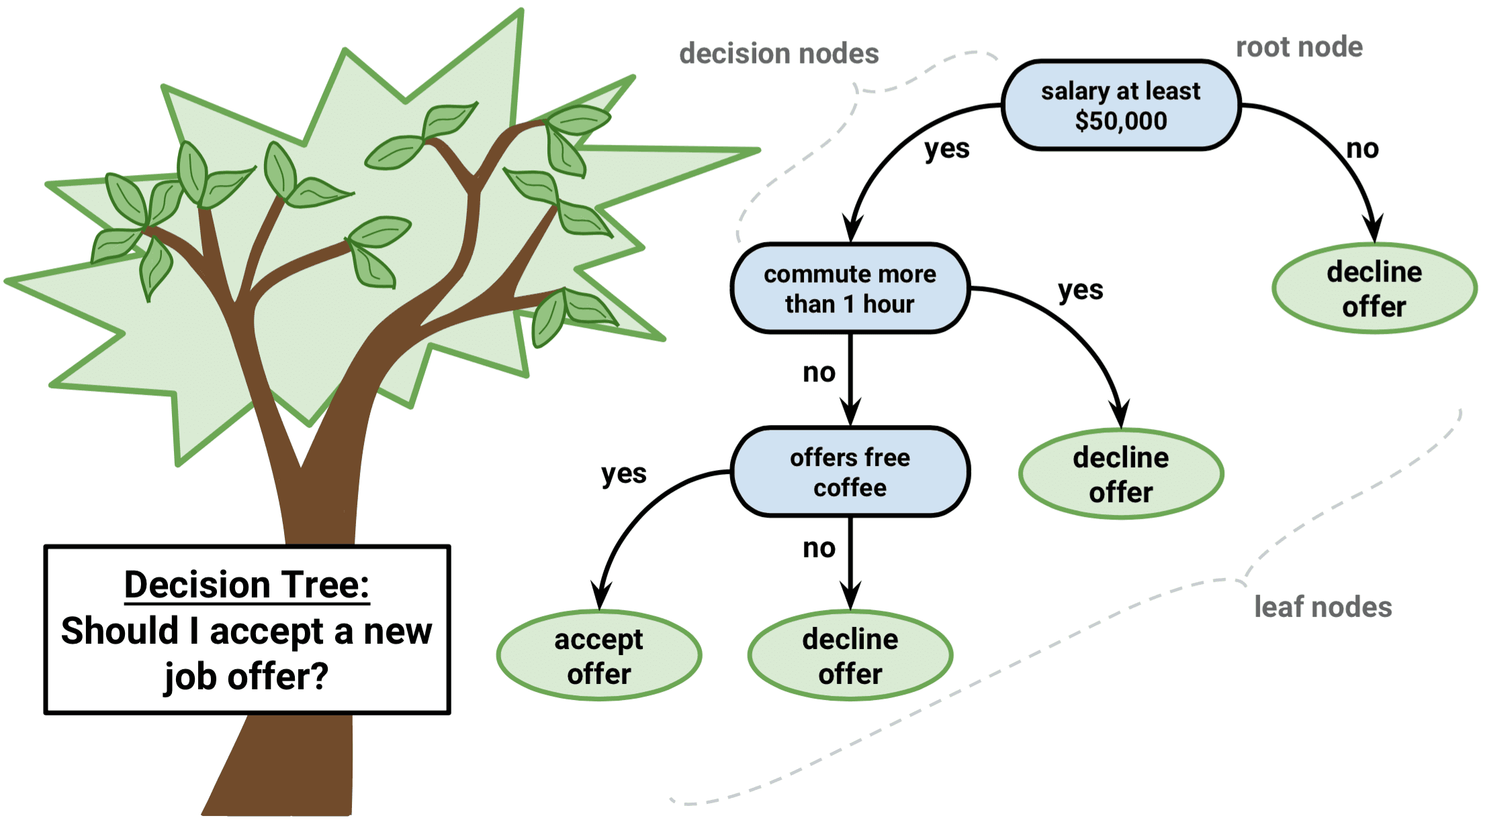
Decision Trees
37
Notes:
The question is should I accept an offer or refuse an offer ..
Based on several features
Salary
Commute Error
Coffee

Slide 38
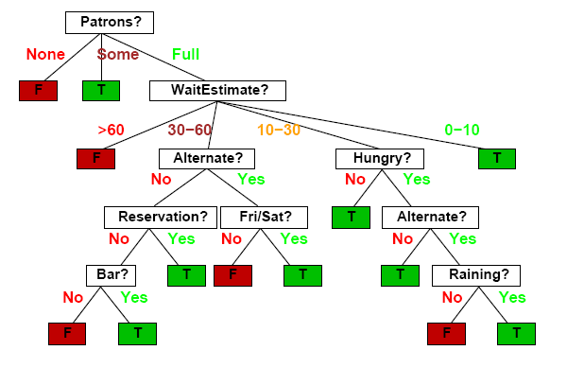
Decision Trees
Should I wait at this restaurant?
38
Notes:
The question is (is it worth waiting at a restaurant or should I go to yet another restaurant)
Based on different attributes
If customers are present
Time to wait
Being Hungry
Weather (Raining)

Slide 39
K Nearest Neighbor (KNN)
Notes:
Another simple approach is the KNN techniques that is considered to be an effective approach used in ML frameworks

Slide 40
K-Nearest Neighbor Model
Key Idea: Properties of an input x are likely to be similar to those of points in the neighborhood of x.
Basic Idea: Find (k) nearest neighbor(s) of x and infer target attribute value(s) of x based on corresponding attribute value(s).
Lazy?
It does no training at all when you supply the training data!!
[instance-based learning, case-based reasoning, analogical reasoning]
40
Notes:
The k-nearest neighbors (KNN) algorithm is a simple supervised machine learning algorithm that can be used to solve both classification and regression problems.
It's easy to implement and understand but has a major drawback of becoming significantly slows as the size of that data in use grows.
Algorithms that do not make strong assumptions about the form of the mapping function are called nonparametric machine learning algorithms.
By not making assumptions, they are free to learn any functional form from the training data.

Slide 41
K-Nearest Neighbor Models
Idea:
Identify K records in the training data set that are similar to a new record that we wish to classify
Class A
Class B
Belongs to Class B
Belongs to Class A
X1.1
K=3
K=6
X1.2
41
Notes:
Given a set of objects each plotted based on two features X1.1 and X1.2
Some are classified to be Square (Class A) … while others are Circles (Class B)
What and how do we classify a new object ??
Depending on the value of K (which is used in the algorithm) find the K nearest neighbors ..
Find the majority of objects in the vicinity .. Accordingly classify the new object with the majority rule

Slide 42
Artificial Neural Networks
Notes:
Artificial Neural Networks or ANNs is considered to be one of the most sophisticated Machine Learning Algorithms
Depending on the structure of the ANN it can be classified to be either as shallow or deep

Slide 43
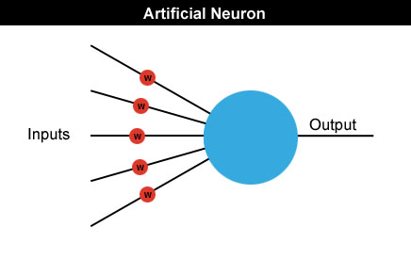
Artificial Neural Networks
Artificial Neural Networks tend to mimic the human brain.
Neural networks are made up of many artificial neurons.
Each input into the neuron has its own weight associated with it illustrated by the red circle.
A weight is simply a floating-point number and it's these we adjust when we eventually come to train the network.
43
Notes:
ANNs were initially developed to mimic the behavior of the human brain
The first artificial neural network was invented in 1958 by psychologist Frank Rosenblatt.
Each neuron has 1 or more input. Each input has a weight associated with it
A weight represent the strength of the connection between units.
If the weight from say node 1 to node 2 has a greater magnitude, it means that neuron 1 has greater influence over neuron 2.
A Weight brings down the importance of the input value.
Adjusting the weights of the ANN is what leads to training and fitting this Machine Learning algorithm

Slide 44
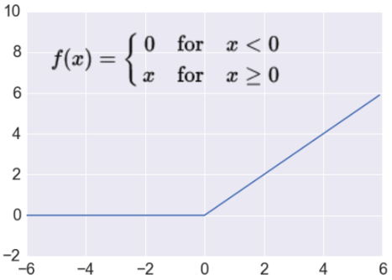
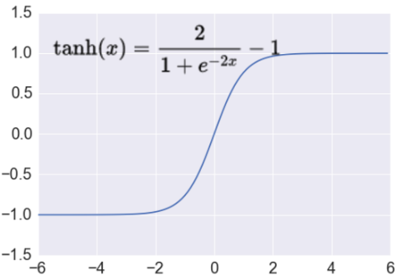
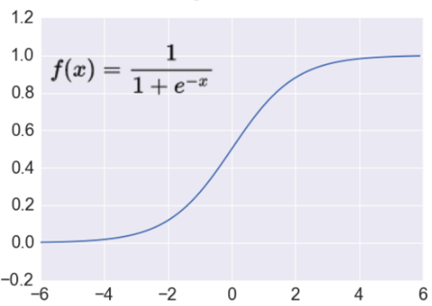
Threshold Logic Unit (TLU)
ReLU
tanh
Sigmoid
inputs
weights
x₁
w₁
output
w₂
activation
x₂
Σ
y
.
.
.
θ
a=Σ_{i=1}^{n} w_{i} x_{i}
w_{n}
x_{n}
1 if a ≥ θ
y=
0 if a < θ
{
44
Notes:
Besides the inputs and weights to a Neuron an Activation is also part of the architecture
The purpose of the activation function is to introduce non-linearity into the output of a neuron.
An activation function decides whether a neuron should fire or not (should be activated or not)
In other words, the activation function will determine if the neurons input to the network is important or not in the process of prediction.

Slide 45
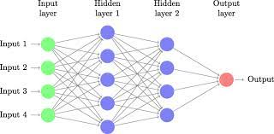
Multi Layer Perceptron (MLP)
A neural network is a method in artificial intelligence that teaches computers to process data in a way that is inspired by the human brain.
An MLP is a fully connected class of feedforward artificial neural network. MLP refers to networks composed of multiple layers of perceptrons.
It is a type of machine learning process, that uses interconnected nodes or neurons in a layered structure that resembles the human brain.
Backward propagation algorithm is used to teach the ANN how to classify.
45
Notes:
Multi layer perceptron (MLP) is a supplement of feed forward neural network.
It consists of three types of layers—the input layer, output layer and hidden layer, as shown in the figure.
The input layer receives the input signal to be processed.
Backpropagation, short for "backward propagation of errors," is an algorithm for supervised learning of artificial neural networks using gradient descent.
Given an artificial neural network and an error function, the method calculates the gradient of the error function with respect to the neural network's weights.

Slide 46
Ensemble Based Systems
Notes:
Ensemble methods are techniques that create multiple models and then combine them to produce improved results.
Ensemble methods usually produces more accurate solutions than a single model would.
This has been the case in a number of machine learning competitions, where the winning solutions used ensemble methods.

Slide 47
Ensemble-based Systems in Decision Making
For many tasks, we often seek second opinion before making a decision, sometimes many more
Consulting different doctors before a major surgery
Reading reviews before buying a product
Requesting references before hiring someone
We consider decisions of multiple experts in our daily lives
Why not follow the same strategy in automated decision making?
Multiple classifier systems, committee of classifiers, mixture of experts, ensemble based systems
Polikar R., “Ensemble Based Systems in Decision Making,” IEEE Circuits and Systems Magazine, vol.6, no. 3, pp. 21-45, 2006
Polikar R., “Bootstrap Inspired Techniques in Computational Intelligence,” IEEE Signal Processing Magazine, vol.24, no. 4, pp. 56-72, 2007
Polikar R., “Ensemble Learning,” Scholarpedia, 2008.
47
Notes:
Ensemble methods are machine learning technique that combines several base models in order to produce one optimal/Superior predictive model.
For example, the Decision Tree we briefly covered earlier is a simple model.
We can create many trees and improve the performance of the Decision Tree by developing a Random Forest ..
Each tree can in fact produce a solution and we can aggregate the solutions to a final excellent solution

Slide 48
Ensemble-based Classifiers
Ensemble based systems provide favorable results compared to single-expert systems for a broad range of applications & under a variety of scenarios
How to (i) generate individual components of the ensemble systems (base classifiers), and (ii) how to combine the outputs of individual classifiers?
Popular ensemble based algorithms
Bagging, Boosting, Stacking, and hierarchical mixture of experts
Commonly used combination rules
Algebraic combination of outputs, voting methods, behavior knowledge space & decision templates
48
Notes:
The three main classes of ensemble learning methods are bagging, stacking, and boosting, and it is important to both have a detailed understanding of each method and to consider them on your predictive modeling project.

Slide 49
Summary
Notes:
The two lectures we introduced on “Overview of Machine Learning” are eye openers to what ML is
We learnt the relationship between ML, AI and DL
We learnt the different classes of ML (Supervised, Unsupervised and RL)
We also learnt that ML is nothing but a set of algorithms that are data driven
Data is important and has to be explored and preprocessed .. Why? Because garbage in .. Garbage out
We briefly touched upon several issues including
Training, Validating and Testing the models
There exists different evaluation metrics that can be used in regression and classification
Beside training and testing some algorithms have many parameters to be tuned.
Most importantly once a model is chosen and trained we need to know if it underfits or overfits or is just the right model for our problem

Slide 50
Summary
Over the past decade, artificial intelligence (AI) has become a popular subject both within and outside of the scientific community.
Machine learning tasks are typically classified into three broad categories, depending on the nature of the learning "signal" or "feedback" available to a learning system. These are: (a) Supervised, (b) Unsupervised, (c) Reinforcement Learning
Machine Learning is a diverse field covering a wide territory and has impacted many verticals.
It is able to tackle tasks in language and image processing, anomaly detection, credit scoring sentiment analysis, forecasting alongside dozens of other downstream tasks.
Successful design of an ML framework requires knowledge of (i) Selection of Algorithms, (ii) Tuning these algorithms, (iii) Evaluation techniques, (iii) Data Preparation, (iv) Feature Selection, …..
50

Slide 51
Resources

Slide 52
Misc. Resources
YouTube (Short Intro)
https://www.youtube.com/watch?v=ukzFI9rgwfU
https://www.youtube.com/watch?v=KNAWp2S3w94
https://www.youtube.com/watch?v=bemDFpNooA8
https://www.youtube.com/watch?v=G7fPB4OHkys
YouTube (Complete Course):
https://www.youtube.com/watch?v=eq7KF7JTinU
Tutorials:
https://towardsdatascience.com/8-simple-techniques-to-prevent-overfitting-4d443da2ef7d
http://disp.ee.ntu.edu.tw/~pujols/Machine%20Learning%20Tutorial.pdf
https://machinelearningmastery.com/machine-learning-in-python-step-by-step/
Documents:
Intro to Machine Learning (Kaggle)
https://www.kaggle.com/learn/intro-to-machine-learning
Books:
https://alex.smola.org/drafts/thebook.pdf
52

Slide 53
End Slides

