Slide 1
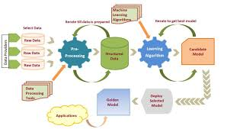
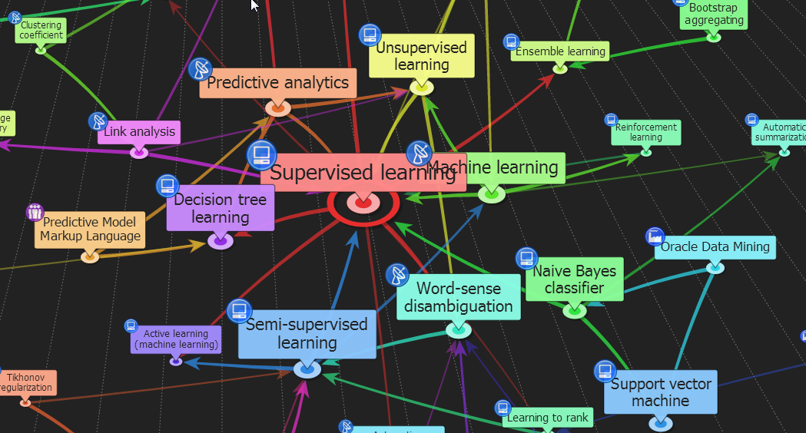

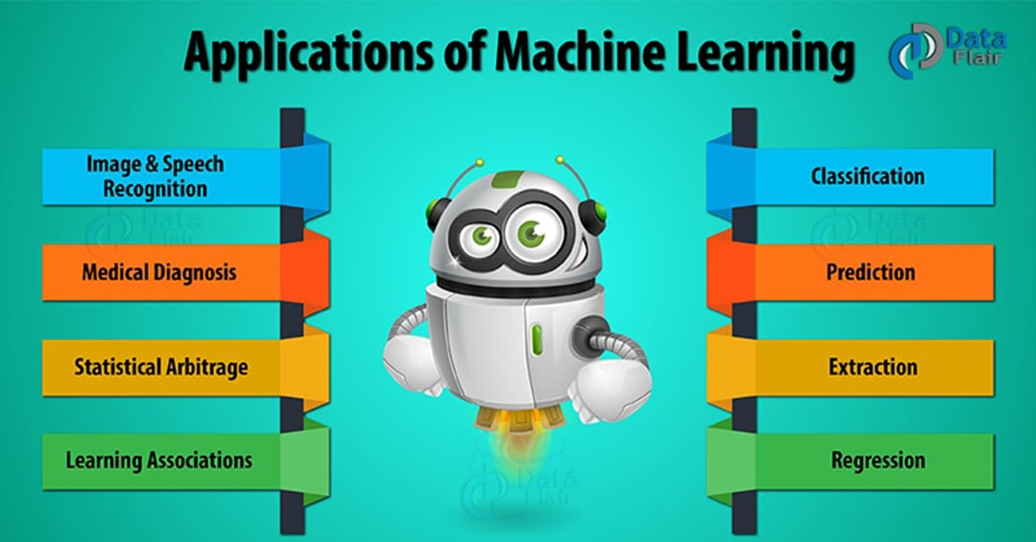
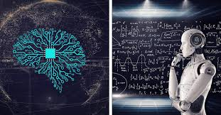
ENG6500: Intro to Machine Learning “ML: Overview (Part 1)”
Prof. S. Areibi
School of Engineering
University of Guelph
Notes:
The first topic we cover in this course is “An Intro and overview of ML”
It will be given in two parts.
This will be part 1
Through this Intro we will touch upon several issues that will be covered in this course
Definition of Machine Learning
History of AI and ML
Relationship between ML and AI
Why ML today and not 30-40 years ago
When to use ML, when to avoid using ML
The most important ingredients of ML (Data, Algorithms, Evaluation Criteria, …)
How do we evaluate ML techniques
How do we know if an ML technique is ready to be deployed ..

Slide 2
Learning
Notes:
Before we introduce the concept of Machine Learning, we will need to define the concept of Learning.
What is Learning?

Slide 3
What is Learning?
“The acquisition of knowledge or skills through experience, study, and the capability to generalize”
“Learning is the process of acquiring new understanding, knowledge, behavior, skills, attitudes, and preferences” – Wikipedia.
“Learning denotes changes in a system that ... enable a system to do the same task … more efficiently the next time.” - Herbert Simon
“Learning is constructing or modifying representations of what is being experienced.” - Ryszard Michalski
How do we learn?
3
Notes:
Different people have different definitions for the term Learning
Acquiring skills and knowledge through trial and error
Acquiring new knowledge and skills
Understanding a concept and improving upon that understanding
….
Next Question:
HOW DO WE LEARN?

Slide 4
How do we Learn?
By telling us exactly what to do
Writing steps to follow (i.e., a flowchart or program)
By showing us multiple examples
We are “forced” to learn (this becomes our knowledge)
By observation (real-world experience, trial and errors)
In case examples are not enough, not clear and/or there is no expert.
By being rewarded or punished to reinforce concepts.
What are the different techniques for learning?
4
Notes:
People learn in different ways
Follow instructions (observing) and maybe doing better next time
Monkey see Monkey do ☺ .. Show the learner examples and then they generalize
Let a learner wonder and observe and make mistakes and learn from his/her mistake
Getting rewards when performing a task correctly, getting punished otherwise??

Slide 5
Learning Techniques
Memorization
Accumulation of individual facts
Limited by:
Time to observe and preserve facts
Memory Capacity to store facts
Generalization:
Deduce new facts from old facts
Essentially a predictive activity
Assumes that the past predicts the future.
Limited by:
Accuracy of deduction process
Learning and memory are closely related concepts. Learning is the acquisition of skill or knowledge, while memory is the expression of what you've acquired.
5
Notes:
Memorization is a skill that we try to avoid during learning and during Machine Learning. Why?
People tend to rely on two concepts to Learn
Memorize and use that memory as a means to perform tasks
Generalize → avoid memorization and be able to generate new methods (facts) from old methods

Slide 6
AI: Machine/Deep Learning
Notes:
We all must have heard the terms AI, ML, DL in a movie or news or TV or a friend
So, what is the relationship between all these terms?

Slide 7
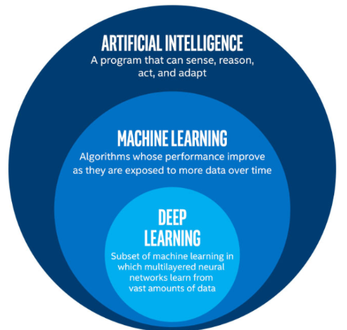
Artificial Intelligence
Artificial Intelligence means getting a computer to mimic human behavior in some way (Speech recognition, Image Classification, …) .. Rule Based
Machine learning is a subset of AI and pretty old field. It incorporates algorithms that have been around and new algorithms … Data Driven
Deep Learning is a very young field of AI that is powered by multi layered ANNs.
7
Notes:
AI broadly refers to any human-like behavior displayed by a machine or system
Most techniques in AI were rule based → certain rules coded by humans (based on expertise) .. Expert systems
Researchers wanted computers to mimic the human behavior (Vision, Speech Recognition, et.c)
ML deals with the algorithms used to enable AI to perform certain tasks … the machines produce the rules that are based on data fed to the machines ..
DL on the other hand is a subset of ML and it refers specifically to Artificial Neural Networks that have many hidden layers as opposed to the traditional ANN introduced in ML which has very few hidden layers (i.e shallow)

Slide 8
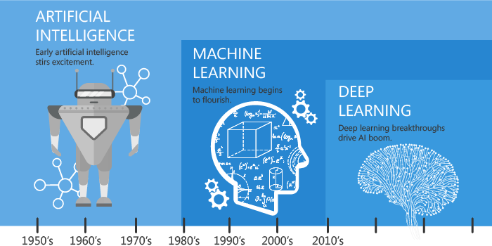
Artificial Intelligence: History
The field of AI was not formally founded until 1956, at a conference at Dartmouth College, in Hanover, New Hampshire, where the term “artificial intelligence” was coined. A group of computer scientists proposed that computers could be programmed to think ad reason
Machine learning started in the late 50’s early 60’s and began to flourish in the 80’s.
Deep Learning, is a subset of machine learning that came to life in 2010-2012 that enables computers to solve more complex problems.
8
Notes:
To be specific, it was in 1956 where the field of AI formally founded and started
ML and the development of algorithms related to AI started in early 60’s and flourished in the 80’s
While DL came to life in 2010-2012 by having more data, sophisticated computing systems (GPUs)
and better algorithms.
We have defined the term Learning .. But what is Machine Learning?

Slide 9
Tom Mitchell: ML Definition
Tom Mitchell (1988) well posed Learning Problem:
A computer program is said to learn from Experience (E) with respect to some Task (T) and some Performance measure (P), if its performance on T, as measured by P, improves with experience E.
A well-posed learning problem <P, T, E>
Improve performance P
at task T
with experience E
9
Notes:
Tom Mitchell is an American Computer scientist at Carnegie Mellon University and is considered to be well known researcher in AI/ML and is an author of several Textbooks on Machine Learning.
His definition of Machine Learning is interesting ..
This is very much like us describing students to have learnt from offering a course or courses if their performance improved over time ..

Slide 10
Defining the Learning Task
Categorizing Email Spam:
T: Categorize email messages as spam or legitimate
P: Percentage of email messages correctly classified
E: Database of emails, some with human-given labels
Recognizing Words:
T: Recognizing hand-written words
P: Percentage of words correctly classified
E: Database of human-labeled images of handwritten words
Checkers:
T: Playing Checkers
P: Percentage of games won against an arbitrary opponent
E: Playing practice games against itself
Driving:
T: Driving four-lane highways using vision sensors
P: Average distance traveled before a human-judged error
E: A sequence of images and steering commands recorded while observing a human
10
Notes:
There are many examples of Machine Learning (or machines learning to do tasks well as described by Tom Mitchel) including …

Slide 11
Related Fields
data
mining
control theory
statistics
machine
learning
decision theory
information theory
cognitive science
databases
psychological models
evolutionary
models
neuroscience
Machine learning is primarily concerned with the accuracy and effectiveness of the computer system.
Notes:
Machine Learning is usually connected with so many disciplines (borrow important concepts from different sciences) including
Statistics & Probability (Naïve Bayes Algorithm)
Decision Theory
Neuroscience (Artificial Neural Networks)
Cognitive Science
Information Theory
Many algorithms that we will cover in this course will be influenced by one or many of these fields

Slide 12
Machine Learning: Applications
Notes:
Machine Learning is used today in many applications including:
Social Media,
Product recommendation,
Image Recognition
Sentiment Analysis

Slide 13
Machine Learning Applications
Retail: Market basket analysis, Customer relationship management (CRM)
Finance: Credit scoring, fraud detection
Manufacturing: Control, robotics, troubleshooting
Medicine: Medical diagnosis, correct image classification
Telecommunications: Spam filters, intrusion detection
Web mining: Search engines
Autonomous Driving: Vehicles, Trucks, Drones, …
Electronic Design Automation: Synthesis, Placement, …
Chip Fabrication, … improving yield
IOT (Internet of Things) … Wireless Sensor Networks
13
Notes:
This is a short list of where Machine Learning is being used today
The list goes on and on

Slide 14
Web Page Search
It is Everywhere
Web Page Search
14
Notes:
When you use Google to search for information, Machine Learning is involved

Slide 15
Email Anti-Spam
It is Everywhere
Email Anti-Spam
15
Notes:
When you use outlook or any email application, email is classified to spam and ham by ML

Slide 16
Character Recognition
It is Everywhere
Character Recognition
16
Notes:
When bank drafts are being processed in banks or cameras at traffic lights are used to identify certain drivers Character recognition is used via Machine Learning

Slide 17
Voice Recognition
It is Everywhere
Voice Recognition
Google Voice Recognition Now Supports 119 Languages
17
Notes:
If you happen to use Siri or Alexa or Google Assistant then an LSTM Machine Learning network is involved to perform Voice Recognition

Slide 18
Face Recognition
It is Everywhere
Face Recognition and tagging
18
Notes:
When you are in far east or some European airports, face recognition is used.
Face recognition is processed via Machine Learning techniques (maybe a Convolutional Neural Network)

Slide 19
From Deep Blue to AlphaGo
1998
IBM Deep Blue
Now
2016
Alpha Go developed by DeepMind Technologies which was later acquired by Google
19
Notes:
Many games such as Chess, Go, StarCraft, Minecraft can be played by computers at the level of a master
Alpha Go developed by DeepMind Technologies which was later acquired by Google.
AlphaGo had three far more powerful successors, called AlphaGo Master, AlphaGo Zero and AlphaZero

Slide 20
Machine Learning
Notes:
Here we try to answer the following questions
What are the different types of Machine Learning?
How important is data for Machine Learning?
What are the necessary steps to develop a Machine Learning framework.

Slide 21

Machine Learning is…
Machine learning is a field of computer science that gives computers the ability to learn without being explicitly programmed
Machine learning, is a branch of Artificial Intelligence (AI), concerns the construction and study of systems that can learn from data.
Automatically detect patterns in data
Use the uncovered patterns to predict future data or other outcomes of interest
21
Notes:
The focus of this course is Machine Learning
One of the most important facts that you will learn in this course about ML is that it is Data Driven (i.e learns from Data)
The term Learn from data is equivalent to preparing a model to perform certain tasks
Once the learning happens or the model is developed then it can be deployed.

Slide 22
ML (PREDICTION)
Machine learning is about predicting the future based on the past.
-- Hal Daume III
past
future
predict
learn
Training
Data
model/
predictor
Testing
Data
model/
predictor
22
Notes:
Machine Learning is mainly about using DATA to create a model and using the model to predict something useful in the future.
For example, you may want to use DATA to create a model that is able to:
Predict if a patient has cancer or is cancer free
Predict if a student will pass a course or achieve his/her degree
Predict if an application for a loan will go through or get rejected ..

Slide 23
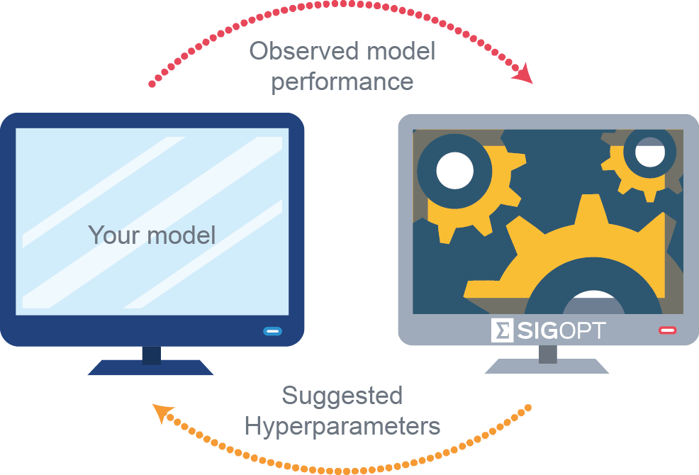
Machine Learning
Machine learning is a field of computer science that gives computers the ability to learn without being explicitly programmed
?
Labeled Data
Machine Learning algorithm
Training
Prediction
Labeled Data
Learned model
Prediction
Unseen Data
Hyper Parameter Tuning
Methods that can learn from and make predictions on data
23
Notes:
Notice here the term Labeled Data .. This could mean a picture of an animal and label that says CAT
This is one form of Machine Learning ..
So in the training phase, we need to show the Computer both the features of the animal (weight, height, color) and the label “name” of the animal .. We do this many times
Once the computer learns labeled data … we show it a new unseen image that does not have a label and ask it to predict the outcome (i.e. how it can classify the image)
An important phase within Machine Learning is Hyper Parameter Tuning that is invoked to further improve the performance of the Framework

Slide 24
Machine Learning
Machine Learning is a diverse field covering a wide territory and has impacted many verticals.
It is able to tackle tasks in language and image processing, anomaly detection, credit scoring sentiment analysis, forecasting alongside dozens of other downstream tasks.
A proficient developer, in this line of work; has to be able to draw, & borrow, from many adjacent fields such as mathematics, statistics, programming, and most importantly common sense.
It turns out that developing and training a model only takes a small fraction of the project duration.
The bulk of the time and resources are spent on data acquisition, preparation, hyperparameter tuning, optimization, using the correct evaluation criteria, and model deployment.
24
Notes:
So far our discussion about Machine Learning indicates the following
It is a subset of AI
It is related to many fields such as statistics, optimization …
It has many application
It needs to be trained to create a model that becomes useful for prediction
But most importantly, training a model may not be the most challenging part
The bulk of the time is spent on
Preparing the data, cleaning the data, transforming the data
Tuning the parameters of the ML algorithm
Optimizing the model and using different evaluation metrics to understand what we were able to accomplish ..
This is what we will learn in this course.

Slide 25

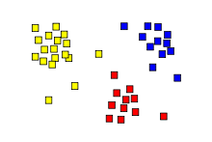
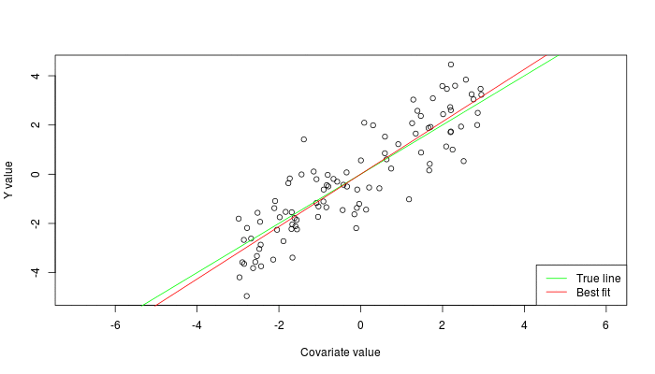
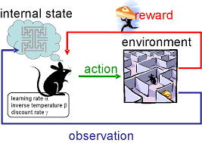
Types of ML Classes
Supervised: Learning with a labeled training set
Example: classify email to be either Spam or Ham
Unsupervised: Discover patterns in unlabeled data
Example: cluster similar documents based on text
Reinforcement learning: learn to act based on feedback/reward
Example: learn to play Go, or Chess, reward: win or lose
class B
Clustering
class A
Regression
Classification
Anomaly Detection
Sequence labeling
…
25
Notes:
In this course we will learn that Machine Learning can be classified into the following
Supervised Learning Algorithms (where data and the label are given to the model) .. Could be either classification or regression (discrete or continuous)
When the data is not labeled and it is expensive to label the data, we call this Unsupervised Learning Algorithms (clustering is just one type of Unsupervised Learning)
When creating or accumulating data is challenging and posses an issue we will resort to Reinforcement Learning .. Which we will not cover in this course
A Course on Reinforcement Learning is offered in the Fall 2022.

Slide 26
Data
Notes:
Data is an important ingredient in Machine Learning .. So what is the structure of Data in ML?

Slide 27
Data Objects
Data sets are made up of data objects.
A data object represents an entity.
Rows represent:
Medical records: patients, treatments
University records: students, professors, courses
Also called samples , examples, instances, data points, objects, tuples.
Data objects are described by attributes.
Data:
Rows -> data objects;
Columns ->attributes.
Features
Object #1
Object #2
Object …
Object #n
27
Notes:
We can think of Data as a matrix
Rows represent the records or samples or instances .. Each representing a patient or a course or animal e.t.c
Columns on the other hand represent the features or attributes that describe the object

Slide 28
Attributes (Features)
Whenever you perform classification, the first step is to understand the problem and identify potential features and label.
Features are those “characteristics” which affect the results obtained by the ML model.
Features are also known as “Attributes” which help the model during classification/regression/clustering.
For example, in the case of a loan distribution, bank manager's identify customer’s occupation, income, age, location, previous loan history, transaction history, and credit score.
28
Notes:
Features of data records are considered to be the secret sauce …
Features represent the attributes of the object by which:
A Machine Learning Algorithm will Learn and Generalize
A Machine Learning Algorithm will map inputs to outputs y = f(x)
If Features are not effective then the Model will not be able to Learn and not generalize

Slide 29
Records & Features
Label
Features
Weather data example: Play or not to Play?
ID code | Outlook | Temperature | Humidity | Windy | Play
a b c d e f g h i j k l m n | Sunny Sunny Overcast Rainy Rainy Rainy Overcast Sunny Sunny Rainy Sunny Overcast Overcast Rainy | Hot Hot Hot Mild Cool Cool Cool Mild Cool Mild Mild Mild Hot Mild | High High High High Normal Normal Normal High Normal Normal Normal High Normal High | False True False False False True True False False False True True False True | No No Yes Yes Yes No Yes No Yes Yes Yes Yes Yes No
Record
Training Data
Testing Data
29
Notes:
Here is an example of dataset that contains both Records (instances) and Features
Each row may represent a certain day of the month or year
The dataset has several features that describe the weather during a day
The features or columns are Outlook, Temp, Humidity, Windy or not
The final column represent the label (should we play tennis on this day or not)
The first part of the data (the majority) can be used for Training the model,
The remaining part (hidden/unseen) is used to test and evaluate the model.

Slide 30
Data Preprocessing

Slide 31

Why Data Preprocessing?
Data in the real world is dirty
incomplete: lacking attribute values, lacking certain attributes of interest, or containing only aggregate data
noisy: containing errors or outliers
inconsistent: containing discrepancies in codes or names
No quality data, no quality mining results!
Quality decisions must be based on quality data
Data warehouse needs consistent integration of quality data
Cleaning, preprocessing, preparing
Data is an important task to be able to
Develop effective ML frameworks
31
Notes:
Data may be either given to you or engineered by you.
Accumulating and Engineering features is an important task in Machine Learning
However, accumulated data might be dirty (missing values, outliers, incomplete…)
Therefore, one of the most important tasks is to make sure that your data is clean ..
Data scientists and engineers have to clean their data, transform their data and preprocess their data or else they will not be able to develop a Machine Learning Model that can accurately predict values with high accuracy.

Slide 32
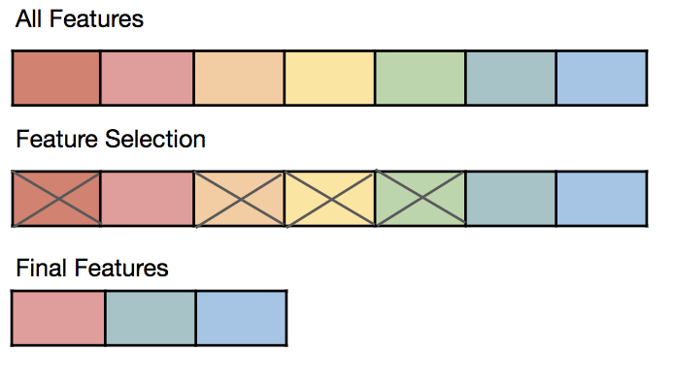
Data Reduction Strategies
Data reduction: Obtain a reduced representation of the data set that is much smaller in volume but yet produces the same (or almost the same) analytical results
Why data reduction? —
A database/data warehouse may store terabytes of data. Complex data analysis may take a very long time to run on the complete data set.
Data reduction strategies
Dimensionality reduction, e.g., remove unimportant attributes
Wavelet transforms
Principal Components Analysis (PCA)
Feature subset selection, feature creation
32
Notes:
Beside Data Cleaning and preprocessing, data scientists may need to reduce the following:
Records
Features
Why?
Some features may be redundant and may just add noise, and this will reduce the accuracy of the ML model.
Several techniques we will learn in this course deal with Dimensionality Reduction including:
Feature Selection (i.e reducing the number of features needed to develop a model)
PCA (Principle Component Analysis) which is a process of computing the principle components and using them to perform a change of basis on the data (in lame terms … simplify data, reduce noise)
PCA is a dimensionality-reduction method that is often used to reduce the dimensionality of large data sets, by transforming a large set of variables into a smaller one that still contains most of the information in the large set.

Slide 33
Why/When Machine Learning?
Notes:
This is an important question that you will know the answer to as we progress through the term.
Why should we use Machine Learning to solve a problem when an algorithmic approach is available ??…
For example, if we want to know the shortest path in a graph we can use several efficient algorithms such as Dijkstra Algorithm or Bellman-Ford Algorithm .. No need to use Machine Learning.
So, we will learn via application that will be covered in class why and when to use Machine Learning

Slide 34
Machine Learning vs. Traditional Programming
Machine learning teaches computers to do what comes naturally to humans: learn from given examples and experience.
Answer: Prediction
Label
34
Notes:
Here we see the difference between Traditional Programming where a developer creates a program and feeds data to the program and the program produces certain outputs
In Machine Learning on the other hand, the developer feeds the algorithm (or computer) with the input data and also the output data (labels) and the model or algorithms learns via the data the pattern and produces the answer or the program

Slide 35
Where ML works best?
Complex problems involving a large amount of data with lots of variables, but no existing formula or equation that describes the system.
Some common scenarios where machine learning applies
Systems are too complex for handwritten rules
Face and speech recognition
FPGA routability prediction.
ASIC congestion estimation.
Rules of a task are constantly changing
Fraud detection
Email Spam
Nature of the data itself keeps changing
Automated trading, predicting shopping trends,
Mutations in viruses
35
Notes:
Here are some scenarios where Machine Learning can excel and do wonderful job

Slide 36
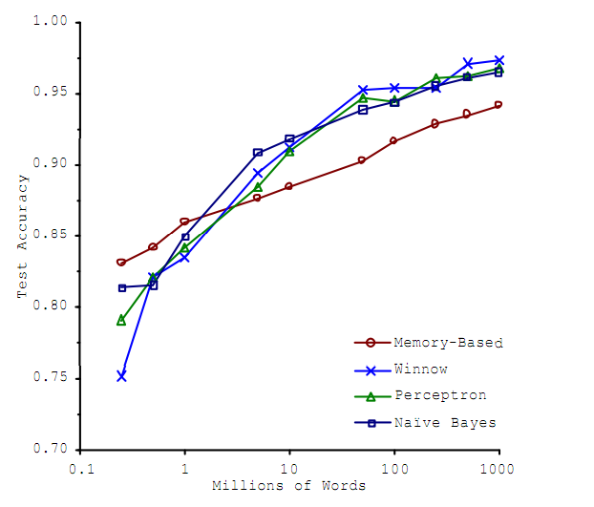
Why are things working today?
More compute power
More data
Better algorithms /models
Applications and Industry
Better
Accuracy
Amount of Training Data
36
Notes:
Beside data, computing power and algorithms, many industrial applications are finding Machine Learning useful to solve hard problems
lots of investment in ML by companies such as UBER, AMAZON, Face Book, Google, Block Chain companies, Robotics, Financial Institutions, Semi conductor Companies and the list goes on and on

Slide 37
Machine Learning Methods
Notes:
We mentioned earlier briefly the different types of Machine Learning Methods.
Here we clarify these methods by some examples.
Note: we will cover the algorithms in detail during the course.
You will learn more about the algorithms and methods via the assignments.

Slide 38
Machine Learning Approaches
Machine Learning
Supervised
Unsupervised
Semi-supervised
Reinforcement
Learning
.
.
Machine learning provides systems with the ability to learn without being explicitly programmed.
38
Notes:
Machine learning tasks are typically classified into four broad categories, depending on the feedback available to a learning system.
Supervised Learning where the model is presented with example inputs and their desired outputs (i.e., labels)
Unsupervised Learning, no labels are given to the learning algorithm, leaving it on its own to find structure in its input
Semi Supervised Learning where the model is given incomplete training signal (a training set with some (often many) of the target outputs missing.
Reinforcement Learning, where the model interacts with a dynamic environment in which it must perform a certain goal and it is provided feedback in terms of rewards and punishments as it performs certain tasks.

Slide 39
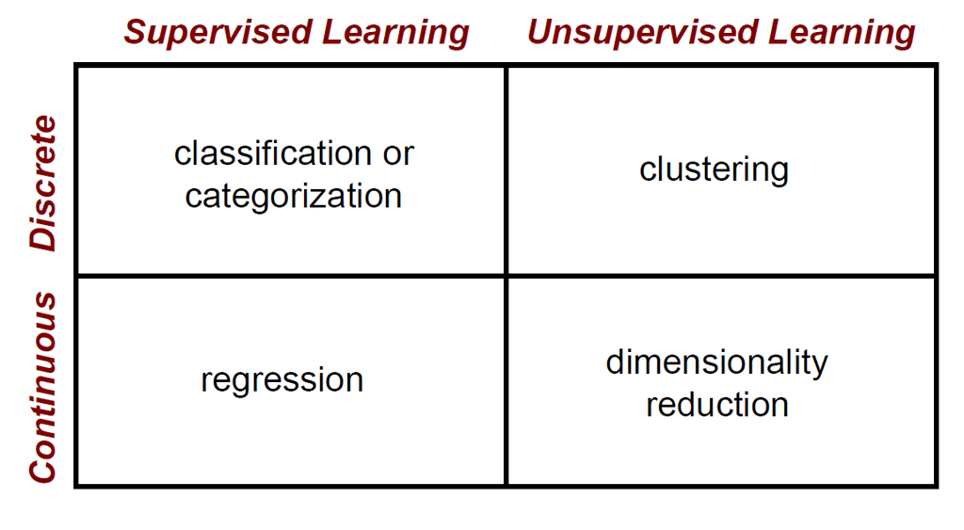
Machine Learning Approaches
39
Notes:
Depending on the existence of labels and type of labels we can have the following types:
When the label is discrete and we need to predict the value this is a Supervised classification problem (Mail Spam or Ham)
When the label is continuous and we need to predict the value this is a Supervised regression problem (for example we wish to estimate the price of a house given the number of bedrooms, location, e.t.c)
When we lack any labels and we have n observations that naturally belong to certain groups we call this Unsupervised Learning “clustering”
When we assign m features to p components with some weight or probability we call this unsupervised dimensionality reduction.

Slide 40
Regression
Notes:
Regression is a supervised machine learning technique which is used to predict continuous values.
Many examples in real life are considered to be of this type.

Slide 41
Regression
y
Y1
Regression analysis: A collective name for techniques for the modeling and analysis of numerical data consisting of values of a dependent variable (also called response variable or measurement) and of one or more independent variables (aka. explanatory variables or predictors)
The parameters are estimated so as to give a "best fit" of the data
Most commonly the best fit is evaluated by using the least squares method, but other criteria have also been used
Y1’
y = x + 1
X1
x
Used for prediction (including forecasting of time-series data), inference, hypothesis testing, and modeling of causal relationships
41
Notes:
Regression is a technique for investigating the relationship between independent variables or features and a dependent variable or outcome.
It's used as a method for predictive modelling in machine learning, in which an algorithm is used to predict continuous outcomes.
The ultimate goal of the regression algorithm is to plot a best-fit line or a curve to fit the data.
The three main metrics that are used for evaluating the trained regression model are
variance,
bias and
error.

Slide 42
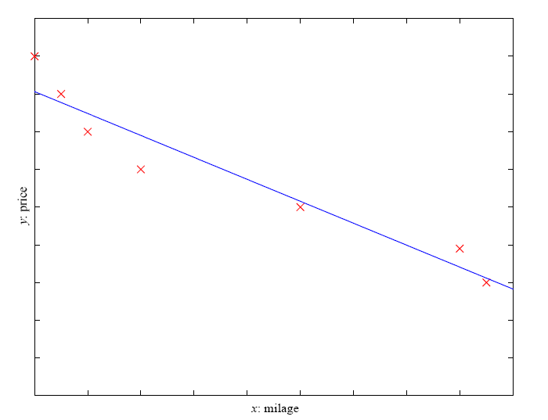
Regression Example
The best fit line is determined by varying the values of w and w0.
Price of a used car
x : car attributes (e.g. mileage)
y : price
y = wx+w₀
Other Applications?
The values of w and w0 get selected in such a way to produce the minimum predictor error.
Determining the slope, intercept of the line is an Optimization Problem (GD)
42
Notes:
The best fit line is determined by varying the values of w (slope) and w₀ (intersection).
The predictor error is the difference between the observed values and the predicted value.
The values of w and w₀ get selected in such a way to produce the minimum predictor error.
THIS IS AN OPTIMIZATION PROBLEM!! → we use the Gradient Descent approach
It is important to note that a simple linear regression model is susceptible to outliers.
Therefore, it should not be used in case of big size data.

Slide 43
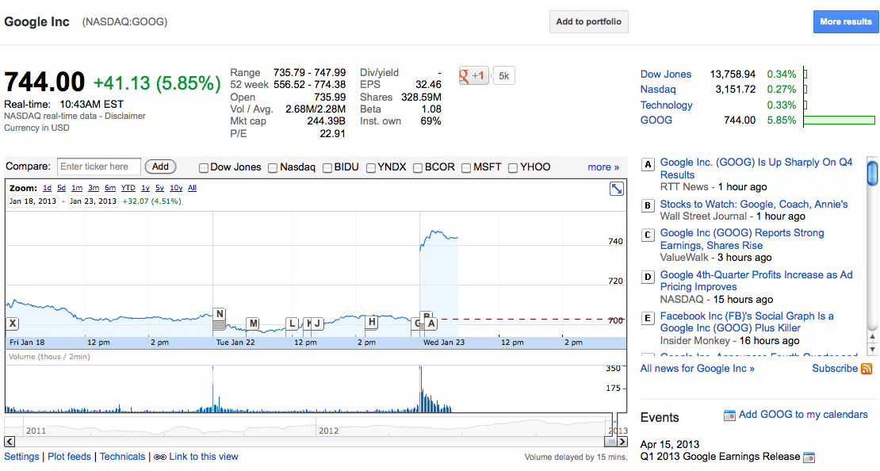
Stock Market
Predict the price of a stock given historical data
43
Notes:
Many important applications of regression including Stock Market (which is a continuous value)

Slide 44

Weather Prediction
Temperature
Predict the temperature given historical data
44
Notes:
Weather prediction (is a continuous value)

Slide 45
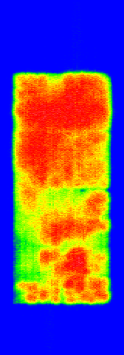


Estimating FPGA Congestion
Congestion occurs when the demand for routing resources exceeds the supply in some region of a design
3 connections
2 channels available
Excessive congestion causes subsequent routing stage to fail
45
Notes:
Estimating congestion in Integrated Circuits is a continuous problem which cannot be estimated easily using a computer program.

Slide 46
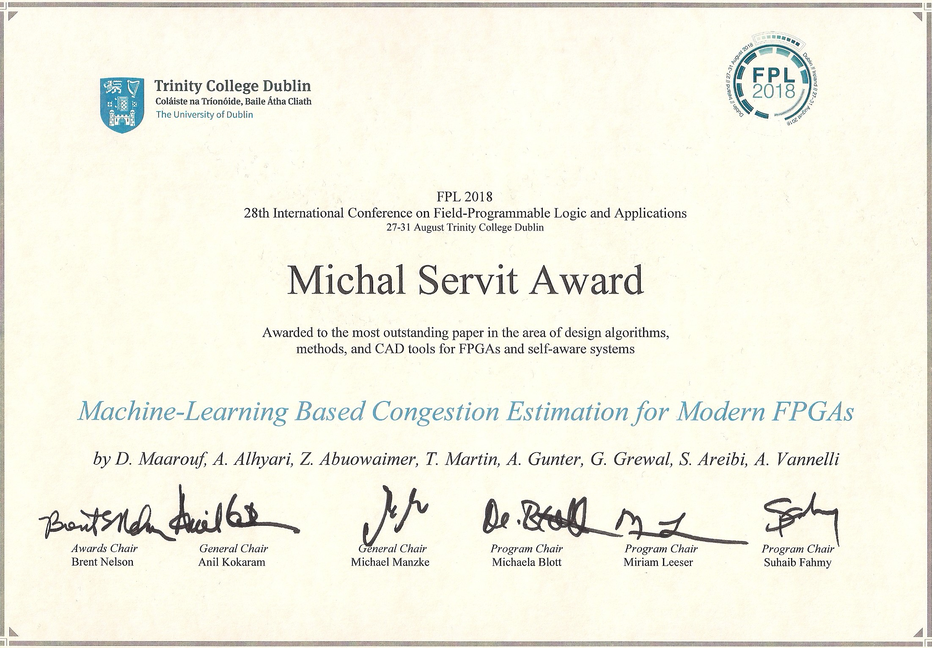
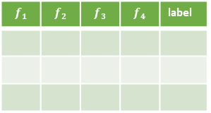
MLCong: FPGA Congestion
Training
Extract congestion map with TCL script
$$f_{1}$$ | $$f_{2}$$ | $$f_{3}$$ | $$f_{4}$$ | label
Xilinx Detailed Router
372 Ultrascale Benchmarks
FPGA placer
Placement file results
Congestion features
NCPR
WLPA
etc
Filtering
Training
Testing
New
Circuit
FPGA placer
Placement file results
Congestion features
NCPR
WLPA
etc
Prediction Model
Deployment
Predicted Congestion of New Circuit
D. Maarouf, A. Al-hyari, Z. Abouwaimer, T. Martin, A. Gunter, G. Grewal, S. Areibi, A. Vannelli
“A Machine Learning Based Congestion Estimation for Modern FPGAs”,
International Conference on Field Programmable Logic & Applications (FPL 2018), Ireland, pp. 427-434
46
Notes:
This is an example of how my research team used regression to accurately estimate congestion.
This work was published in 2018 and received the best paper award.

Slide 47
Classification
Notes:
Several examples will be given in this part of the lecture demonstrating the concept of Classification

Slide 48
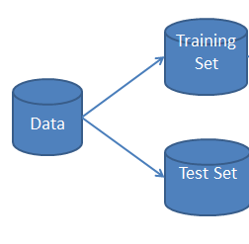
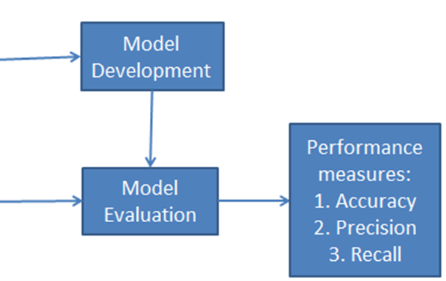
Supervised Learning: Classification
The classification has two phases, a training (learning) phase, and the testing (evaluation) phase.
In the training phase, classifier trains its model on a given dataset.
The model is developed during the training phase.
Development of the model means that several parameters are adjusted to predict a value (weights in ANN).
In the evaluation phase, it tests the classifier performance.
Performance is evaluated on the basis of various parameters such as accuracy, error, precision, and recall.
Training
Which metric should be used?
Testing
48
Notes:
We learned earlier that Classification has two phases (Training and Testing) ..
However, to be more accurate Classification in fact has even more than two phases
Training (adjusting the parameters of the model)
Evaluation (to fine tune parameters)
Testing on unseen data (deployment)
Evaluating the performance and choosing the most appropriate metrics is crucial.

Slide 49
Classification Example 1
Day Outlook Temperature Humidity Wind Play Tennis
1 Sunny Hot High Weak No
2 Sunny Hot High Strong No
3 Overcast Hot High Weak Yes
4 Rain Mild High Weak Yes
5 Rain Cool Normal Weak Yes
6 Rain Cool Normal Strong No
7 Overcast Cool Normal Strong Yes
8 Sunny Mild High Weak No
9 Sunny Cool Normal Weak Yes
10 Rain Mild Normal Weak Yes
11 Sunny Mild Normal Strong Yes
12 Overcast Mild High Strong Yes
13 Overcast Hot Normal Weak Yes
14 Rain Mild High Strong No
Outlook
Label
Sunny
Overcast
Rain
Humidity
Wind
Decision Tree Algorithm
Yes
High
Normal
Strong
Weak
No
Yes
No
Yes
49
Notes:
Here is an example of a dataset with values (numerical and categorical) along with a label (Play or not Play)
One algorithm that can be used in this case for classification is a Decision Tree.
Start from a feature at the root of the tree to split the tree into two.
The selection of this feature is based on several metrics we will cover in this course
The class (answer) of the unseen data can be found in the leafs of the Decision Tree

Slide 50
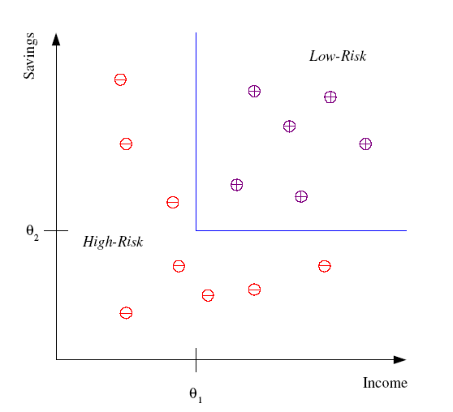
Classification Example 2
Machine Learning Algorithm
Should be able to create this
Partition or border to distinguish
Between low risk and high risk
Differentiate between low-risk and high-risk customers from their income and savings
Income and Savings are the features within the data used to train the ML Model
50
Notes:
In this examples we have a Binary Classification problem
The model will try differentiate and classify customers with high risk vs. those with low risk
This information should be useful to banks to lend customers
Two features are used in this case Income and Savings
Given the distribution of Data a ML model should be able to create a partition to differentiate between these two classes
Many other real life situations can be categorized as Binary Classification:
Classes of Patients with Cancer vs. those who are free
Students who will succeed a course vs. those who will fail

Slide 51
Classification Example 3
Classify a car to be either a family car or not!
Each car has two features to be used as input to the classifier:
Price
Engine power
X₂: Engine Power
+
+
+
+
+
+
+
These would be the labels for each car
+
X₁: Price
1 if x is family class: Positive Example
r=
0 if x is not a family class: Negative Example
51
Notes:
Another example of a binary classification problem is to distinguish between cars being classified as a family car or not based on two features (a) Price and (b) Engine Power

Slide 52
Unsupervised Learning
Notes:
Unsupervised Learning is usually used when the data scientist does not have labeled data
Or if labeling the data is very expensive

Slide 53
Unsupervised Learning
Draws inferences from datasets that don’t have labeled responses associated with the input data.
Clustering is the most common unsupervised learning technique. It puts data into different groups based on shared characteristics in the data.
Clustering is used to find hidden groupings in applications such as:
Gene Sequence Analysis,
Market Research, and
Electronic Design Automation
Object Recognition among many others.
53
Notes:
Many applications to Unsupervised Learning … but one of the most common techniques is Clustering
Based on the different features of the objects, clustering tends to put similar data objects in the same group (i.e cluster)

Slide 54

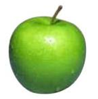


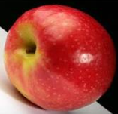
Unsupervised learning
Create Clusters (groups) of similar features
Unsupervised learning: given data, i.e. examples, but no labels
We seek to categorize a new object to a specific group
54

Slide 55
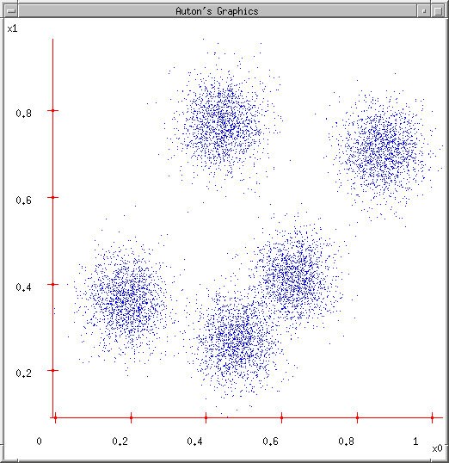
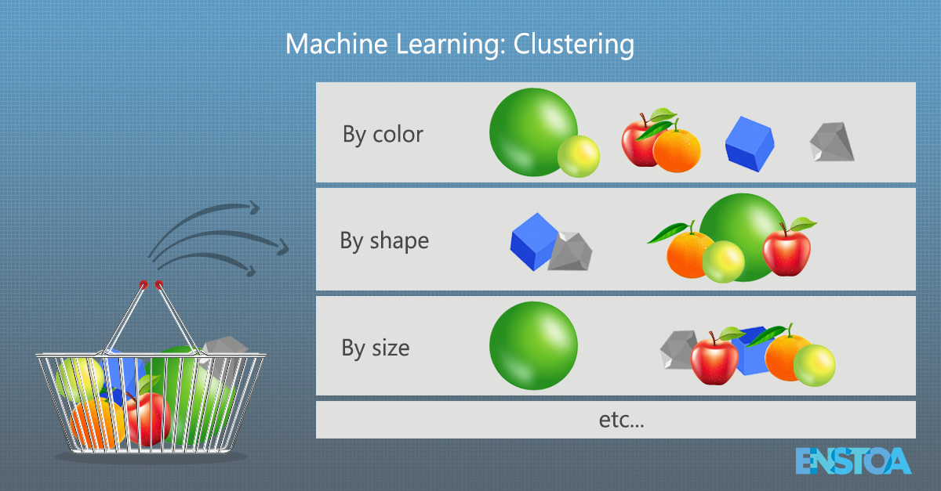
Clustering Data: Group similar things
55

Slide 56
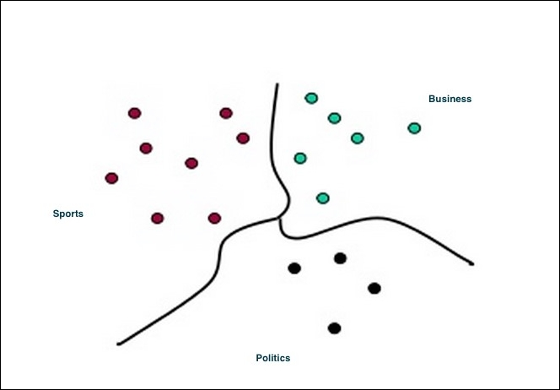
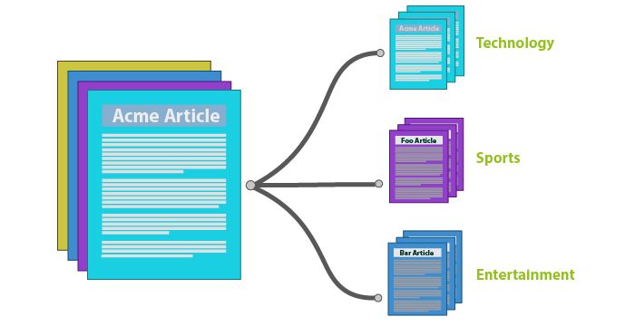
Article Clustering
Apply ML to classify documents (Clustering)
56

Slide 57
Reinforcement Learning

Slide 58
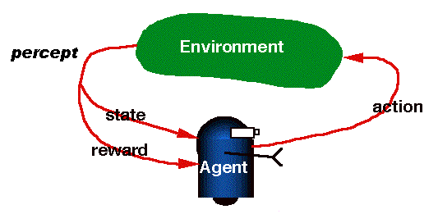
RL is Learning from Interaction
Reinforcement learning
An agent interacts with the environment:
Makes sensor observations
Must select action
Receives rewards
positive for “good” states
negative for “bad” states
Applications:
Robotics
Playing chess
Towel Folding
http://youtu.be/gy5g33S0Gzo
58
Notes:
Reinforcement learning is one of three basic machine learning paradigms, alongside supervised learning and unsupervised learning.
Reinforcement learning is an area of machine learning concerned with how intelligent agents ought to take actions in an environment in order to maximize the notion of cumulative reward.
Reinforcement learning is mainly used in scenarios where sequential decision making is required.

Slide 59
Summary

Slide 60
Summary
Over the past decade, artificial intelligence (AI) has become a popular subject both within and outside of the scientific community.
AI is a field focused on automating intellectual tasks normally performed by humans, and ML and DL are specific methods of achieving this goal.
Machine Learning is a diverse field covering a wide territory (stats, neuro science, …) and has impacted many verticals.
It is able to tackle tasks in language and image processing, anomaly detection, credit scoring sentiment analysis, forecasting alongside dozens of other downstream tasks.
Machine learning tasks are typically classified into three broad categories, depending on the nature of the learning "signal" or "feedback" available to a learning system. These are: (a) Supervised, (b) Unsupervised, (c) Reinforcement Learning
60

Slide 61
Resources

Slide 62
ML Intro: Misc. Resources
YouTube
https://www.youtube.com/watch?v=KNAWp2S3w94
https://www.youtube.com/watch?v=ukzFI9rgwfU
https://www.youtube.com/watch?v=XvZsiWj6VuU
https://www.youtube.com/watch?v=h0e2HAPTGF4
https://www.youtube.com/watch?v=Gv9_4yMHFhI
https://www.youtube.com/watch?v=IpGxLWOIZy4
https://www.youtube.com/watch?v=f_uwKZIAeM0
Courses and mini courses:
https://www.learndatasci.com/best-machine-learning-courses/
https://www.coursera.org/learn/machine-learning
https://www.edx.org/learn/machine-learning
https://developers.google.com/machine-learning/crash-course/
https://www.udemy.com/topic/machine-learning/
https://www.youtube.com/watch?v=9f-GarcDY58
https://www.youtube.com/watch?v=79ry4-FdrdM
https://www.tensorflow.org/resources/learn-ml?gclid=CjwKCAjw6dmSBhBkEiwA_W-EoOrWHh10oPeIdMF2LXISTAMxeZ7dWIqcdbp-Uka9Jw2FdoSS7Xh8TxoCnUsQAvD_BwE
62

Slide 63
ML Intro: Misc. Resources
Documents:
https://www.simplilearn.com/data-mining-vs-machine-learning-article#:~:text=Data%20mining%20is%20designed%20to,total%20of%20the%20gathered%20data.
https://www.seas.upenn.edu/~cis519/fall2017/lectures/01_introduction.pdf
Tutorials:
https://www.guru99.com/machine-learning-tutorial.html
https://www.toptal.com/machine-learning/machine-learning-theory-an-introductory-primer
https://www.geeksforgeeks.org/getting-started-machine-learning/?ref=leftbar-rightbar
https://intellipaat.com/blog/supervised-learning-vs-unsupervised-learning-vs-reinforcement-learning/
https://www.geeksforgeeks.org/what-is-reinforcement-learning/#:~:text=Reinforcement%20learning%20differs%20from%20supervised,to%20perform%20the%20given%20task.
Books:
A Course on Machine Learning → http://ciml.info/
Deep Learning → http://www.deeplearningbook.org
63

Slide 64
End Slides

