Slide 1
Image Segmentation
Presented By:
Afrin Hayat
Md.Kilab Hossain
Md Al-Amin
Zahid Hasan
Nabiha Taieba Nuha
19CSE001
19CSE002
19CSE016
19CSE037
19CSE025

Slide 2
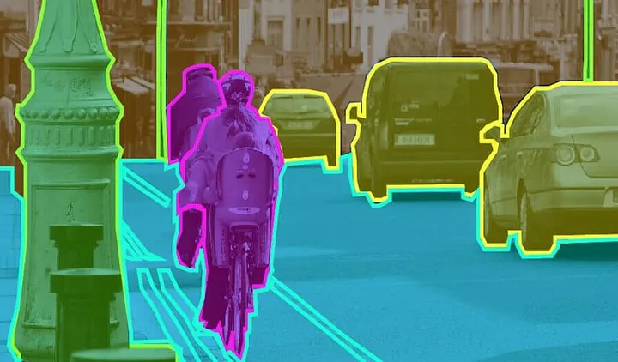
What is Image segmentation?
Image segmentation is dividing the image into groups of pixel based on some criteria
Or,
Image segmentation is the process of dividing an image into multiple segments (sets of pixels) to simplify its representation and make it more meaningful for analysis.

Slide 3
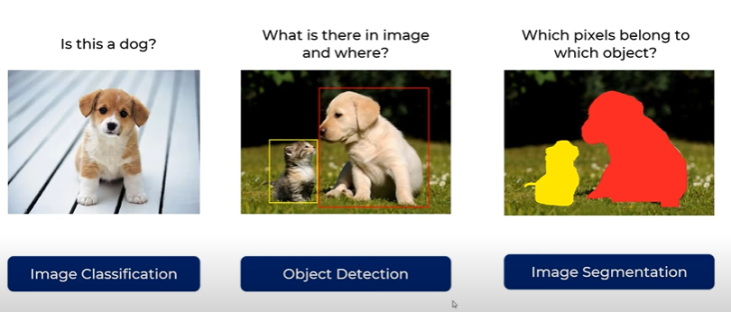
How Does Image Segmentation Work?
Object detection builds a bounding box corresponding to each class in the image. But it tells us nothing about the shape of the object. We only get the set of bounding box coordinates. We want to get more information – this is too vague for our purposes.
Image segmentation creates a pixel-wise mask for each object in the image. This technique gives us a far more granular understanding of the object(s) in the image.

Slide 4
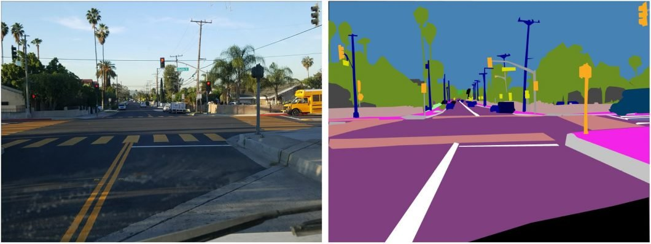
Another Example of Image Segmentation?
Q- Which photos are more meaningful?
It’s like breaking down an image into smaller pieces, like objects, groups of pixels with similar characteristics, or even individual pixels themselves.

Slide 5
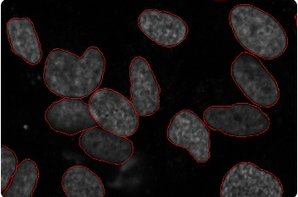
What Is Image Segmentation Used For?
Image segmentation is crucial for early cancer detection by precisely identifying the shape and severity of cancerous cells, thus improving diagnosis and treatment.
Traffic Control Systems: Enhances traffic monitoring and management.
Self-Driving Cars: Improves object detection and navigation.etc
Fig:Cancerous cells

Slide 6
Types of Image Segmentation
There are three types of segmentation:
Segmentation
Semantic
instance
Panoptic

Slide 7
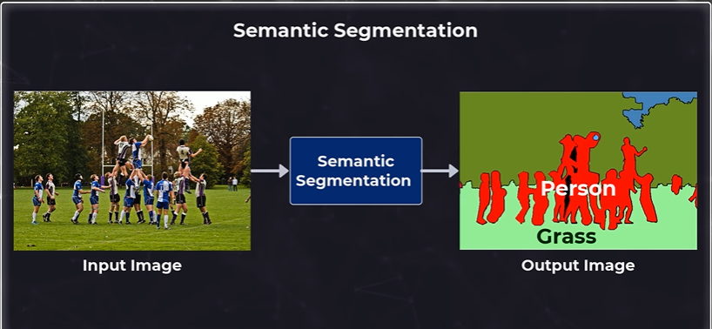
Semantic Segmentation
Semantic segmentation is simply the task of assigning a class label to every single pixel of an input image.

Slide 8
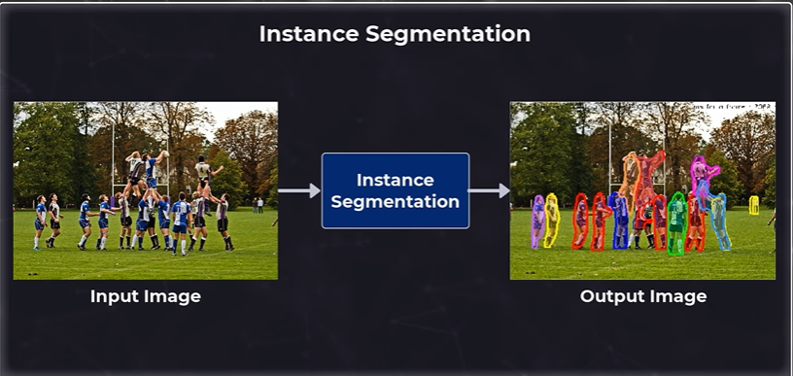
Instance segmentation
Instance Segmentation is a computer vision task that involves identifying and separating individual objects within an image, including detecting the boundaries of each object and assigning a unique label to each object.

Slide 9
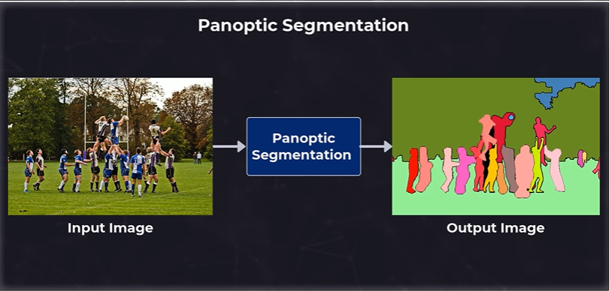
Panoptic Segmentation
Panoptic segmentation is a computer vision technique that combines semantic segmentation and instance segmentation to provide a detailed output of an image or video scene.

Slide 10
Quiz Part
Q-1. Which of the following best describes semantic instance segmentation?
a) Assigning a class label to each pixel in an image without distinguishing between different instances of the same class.
b) Assigning a class label to each pixel in an image and distinguishing between different instances of the same class.
c) Assigning a unique identifier to each object instance in an image.
d) Identifying the boundaries of objects in an image.
Q-2. What is the primary objective of panoptic segmentation in computer vision?
a) Segmenting objects based on their semantic categories.
b) Segmenting objects based on their instance identities.
c) Combining instance-aware and semantic segmentation into a unified framework.
d) Detecting objects in images and videos.

Slide 11
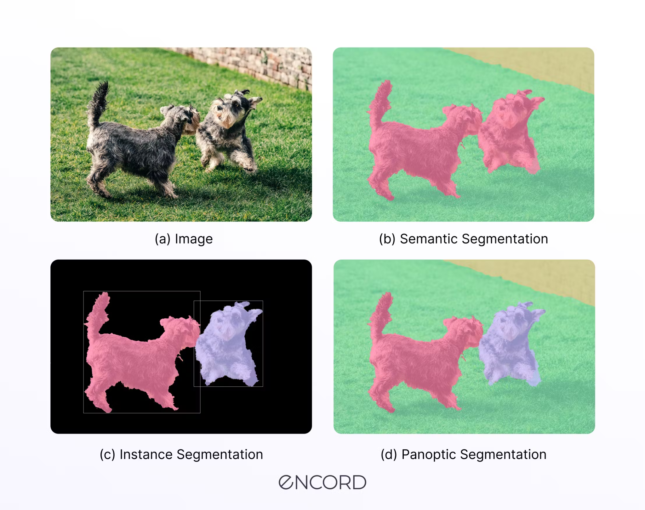
Relation Each Segmentation

Slide 12
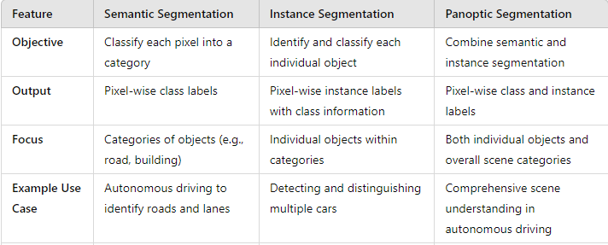
Semantic segmentation vs Instance segmentation vs Panoptic segmentation

Slide 13
Image Segmentation
Image Segmentation Techniques
Discontinuity
[Partitioning according to Abrupt changes]
Similarity
[Partitioning based on similar regions according to predefined criteria]
Edge Based
Clustering Based
Thresholding
Region Based
Edge Detection
Roberts Operator
Gaussian Based Edge Detection
Gradient Based Edge detection
Prewitt Operator
Sobel Operator

Slide 14
Traditional Image Segmentation Techniques
Traditional Techniques
Split-and-Merge Method
Clustering Methods
Watershed Methods

Slide 15
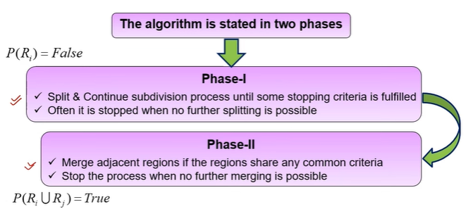
Split and Merge Method
lt is an alternative method of image segmentation
An image is subdivided into arbitrary disjoined region
Arbitrary regions can be split and merged in order to satisfy the condition

Slide 16
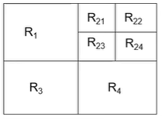
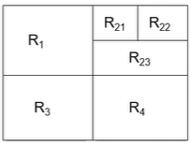
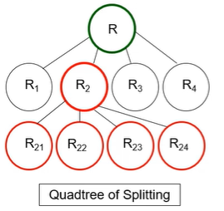
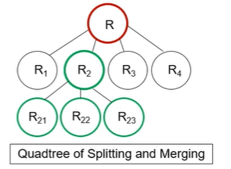
Split and Merge Method
It is known as Divide and Conquer approach

Slide 17
Clustering Methods
Clustering is the task of dividing the population (data points) into a number of groups, such that data points in the same groups are more similar to other data points in that same group than those in other groups. These groups are known as clusters.

Slide 18
K-means Clustering
One of the most commonly used clustering algorithms is k-means. Here, the k represents the number of clusters (not to be confused with k-nearest neighbor).

Slide 19
Working Principle:
First, randomly select k initial clusters
Randomly assign each data point to any one of the k clusters
Calculate the centers of these clusters
Calculate the distance of all the points from the center of each cluster
Depending on this distance, the points are reassigned to the nearest cluster
Calculate the center of the newly formed clusters

Slide 20
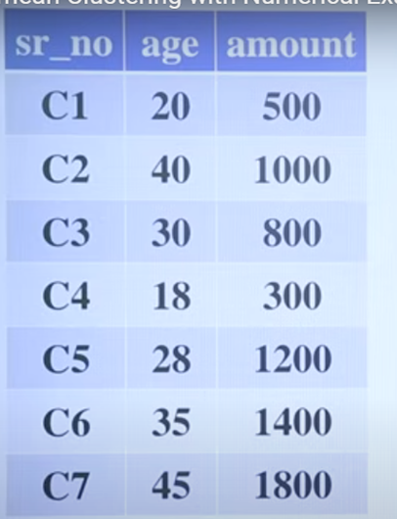
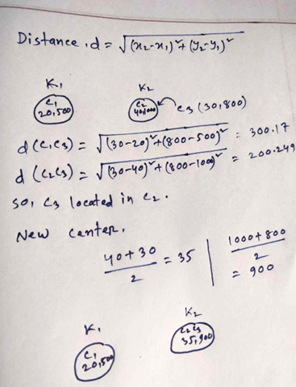
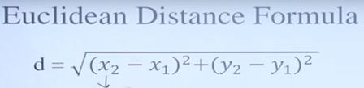
Mathematical Example :

Slide 21
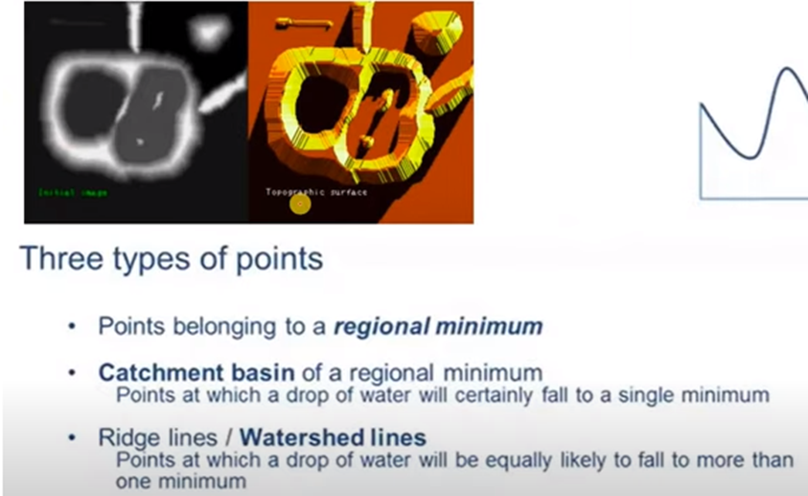
Watershed Segmentation Methods
Start with all pixels with lowest possible value.
--These from the basis for initial watersheds

Slide 22
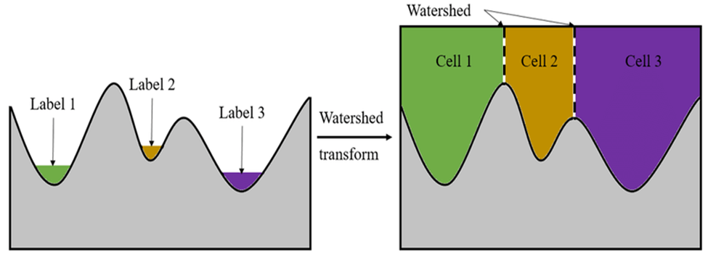
Watershed Segmentation Methods
1) Histogram shape-based methods: where, for example, the peaks, valleys and curvatures of the smoothed histogram are analyzed to calculate threshold value.
2) Clustering-based methods: where the gray-level samples are clustered in two parts as background and foreground (object), or alternately are modeled as a mixture of two Gaussians

Slide 23
Thresholding
Thresholding is a type of image segmentation. In this case, we can set a threshold value. The pixel values falling below or above that threshold can be classified accordingly (as an object or the background). This technique is known as Threshold Segmentation.

Slide 24
Category of thresholding
Global threshold : If we want to divide the image into two regions (object and background), we define a single threshold value. This is known as the global threshold.
Local threshold : If we have multiple objects along with the background, we must define multiple thresholds. These thresholds are collectively known as the local threshold.Also known as Adaptive threshold method…

Slide 25
Procedures Of Global Threshold :
1.Select an initial Value for ‘T’.
2.Segment the image using T into 2 groups .
3.Compute the average value for m1 and m2 for the pixel.
4. Compute the new threshold value from the average of m1 and m2 .

Slide 26
Mathematical Problem :
Here,
T = (5+3+9+2+1+7+8+4+2)/9 =4.55(5)
Segmenting the image using T , we would get ,
G1 = {9,8,7} G2={5,3,2,1,4,2}
Finding the average ,we get,
m1=(9+8+7)/3=8 m2=(5+3+2+1+4+2)/6=2.83(3)
Then find out the new T ,
T=(8+3)/2 = 5.5(5)
Pixels values
5 | 3 | 9
2 | 1 | 7
8 | 4 | 2

Slide 27
Assingment :
Segmenting the Image Using Global threshold method and find out the threshold value for the above image .
7 | 3 | 4
2 | 1 | 9
5 | 3 | 2

Slide 28
Quiz
What is the primary objective of clustering in image segmentation, and which algorithm is commonly employed for this task?
a) The objective is to identify the edges of objects in an image, and the commonly used algorithm is the Sobel operator.
b) The goal is to partition the image into regions with similar characteristics, and the commonly used algorithm is K-nearest neighbors.
c) The aim is to divide the population of pixels into distinct groups based on similarity, and the commonly used algorithm is K-means clustering.
d) The objective is to label each pixel in the image according to predefined classes, and the commonly used algorithm is Principal Component Analysis (PCA).

Slide 29
Code:
1.Clustering:( https://colab.research.google.com/drive/1EncWK1PR_-3JDcLNTlMohZsoS7eQvGt_#scrollTo=UcZTjcbCyImG)
2.Watershed:( https://colab.research.google.com/drive/1feDQ4QqSNK2j2AH2-bY7HwYnbhxxYVtH#scrollTo=WXV7-kx8rwXN)
3.Threshold:(https://colab.research.google.com/drive/1QhLvqpXBruR697REYi154j4XF0RkXSoE?authuser=0#scrollTo=4zxEcmX5n5WV)

Slide 30
Region-based Segmentation
Region-based segmentation is a technique in digital image processing (DIP) used to partition an image into regions that are homogeneous according to some criteria.
Region based segmentation is a technique for determining the region correctly.
The region-based segmentation method looks for similarities between adjacent pixels.
That is, pixels that possess similar attributes are grouped into unique regions.
Goal
To simplify the image representation into something that is more meaningful and easier to analyze.
Can we jump?

Slide 31
Region-based Segmentation
There are four types of region-based segmentation. Those are as follows:
Region growing segmentation
Region splitting segmentation
Region merging segmentation
Region splitting and merging segmentation

Slide 32
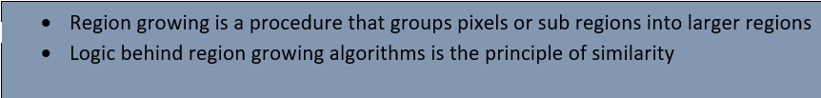


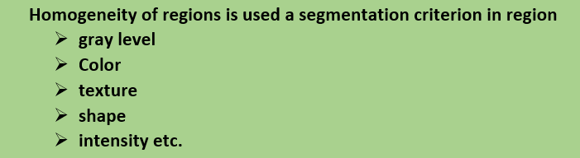
Region growing segmentation

Slide 33
Region growing segmentation
Major steps of the region growing algorithm are:
• Selection of the initial seed
• Seed growing criteria
• Termination of the segmentation process
5*5
End
Initial Regions
Iterations
Termination Condition
Groups pixels into larger
regions
Starts with a seed region
Grows region by merging
neighboring pixels
Iterative process
How to start?
How to iterate?
When to stop?

Slide 34
Region growing segmentation
1 | 0 | 7 | 8 | 8
0 | 1 | 8 | 9 | 8
0 | 0 | 7 | 9 | 8
0 | 1 | 8 | 8 | 9
1 | 2 | 8 | 8 | 9
Example: For the given image, show the results of region growing algorithm
Seed point : (9, 1)
Threshold : <= 4
For s=9,
f(x,y)-(x’,y’) <=4
f(x,y)-(9) <=2
f(x,y)={5,6,7,8,9}=A
For s=1,
f(x,y)-(1) <=4
f(x,y)={0,1,2,3,4,5}=B
B | B | A | A | A
B | B | A | A | A
B | B | A | A | A
B | B | A | A | A
B | B | A | A | A
Resultant Image

Slide 35
Region growing Region growing segmentation
HW: For the given image, show the results of region growing algorithm.Threshold,<=3.
4 | 5 | 4 | 5 | 3 | 5 | 5 | 4
6 | 6 | 4 | 4 | 5 | 3 | 4 | 3
6 | 7 | 7 | 6 | 6 | 3 | 5 | 3
5 | 6 | 4 | 7 | 3 | 6 | 4 | 5
2 | 0 | 1 | 1 | 5 | 7 | 4 | 3
1 | 2 | 0 | 2 | 4 | 4 | 5 | 5
0 | 2 | 1 | 1 | 3 | 5 | 6 | 4
1 | 0 | 1 | 0 | 4 | 5 | 3 | 7

Slide 36

Region splitting segmentation
Olt is an alternative method of image segmentation
An image is sub-divided into disjoint region
Major steps of the region splitting algorithm are:
Split & Continue subdivision process until some stopping criteria is fulfilled
Often it is stopped when no further splitting is possible

Slide 37
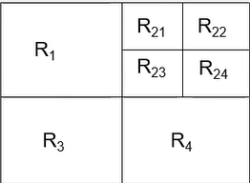
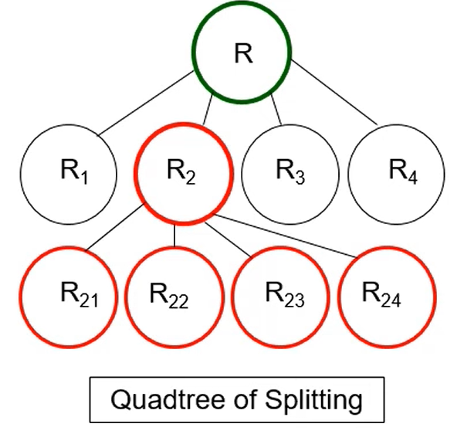
Region splitting segmentation

Slide 38
Region splitting segmentation
Region growing starts from a set of seed point.
An Alternative is to start with the whole image as a single region and subdivide the regions that do not satisfy a condition of homogeneity.
6 | 5 | 6 | 6 | 7 | 7 | 6 | 6
6 | 7 | 6 | 7 | 5 | 5 | 4 | 7
6 | 6 | 4 | 4 | 3 | 2 | 5 | 6
5 | 4 | 5 | 4 | 2 | 3 | 4 | 6
0 | 3 | 2 | 3 | 3 | 2 | 4 | 7
0 | 0 | 0 | 0 | 2 | 2 | 5 | 6
1 | 1 | 0 | 1 | 0 | 3 | 4 | 4
1 | 0 | 1 | 0 | 2 | 3 | 5 | 4
Example: For a given image, apply split and merge algorithm
Min value : 0
Max value: 7
If (Max – min) > threshold, we have to split the region.

Slide 39
Region splitting segmentation
Threshold: <= 3
6 | 5 | 6 | 6 | 7 | 7 | 6 | 6
6 | 7 | 6 | 7 | 5 | 5 | 4 | 7
6 | 6 | 4 | 4 | 3 | 2 | 5 | 6
5 | 4 | 5 | 4 | 2 | 3 | 4 | 6
0 | 3 | 2 | 3 | 3 | 2 | 4 | 7
0 | 0 | 0 | 0 | 2 | 2 | 5 | 6
1 | 1 | 0 | 1 | 0 | 3 | 4 | 4
1 | 0 | 1 | 0 | 2 | 3 | 5 | 4
If (Max – min) > threshold, we have to split the region.
Max-min=7-0=7>Threshold

Slide 40
Region splitting segmentation
6 | 5 | 6 | 6 | 7 | 7 | 6 | 6
6 | 7 | 6 | 7 | 5 | 5 | 4 | 7
6 | 6 | 4 | 4 | 3 | 2 | 5 | 6
5 | 4 | 5 | 4 | 2 | 3 | 4 | 6
0 | 3 | 2 | 3 | 3 | 2 | 4 | 7
0 | 0 | 0 | 0 | 2 | 2 | 5 | 6
1 | 1 | 0 | 1 | 0 | 3 | 4 | 4
1 | 0 | 1 | 0 | 2 | 3 | 5 | 4
6 | 5 | 6 | 6 | 7 | 7 | 6 | 6
6 | 7 | 6 | 7 | 5 | 5 | 4 | 7
6 | 6 | 4 | 4 | 3 | 2 | 5 | 6
5 | 4 | 5 | 4 | 2 | 3 | 4 | 6
0 | 3 | 2 | 3 | 3 | 2 | 4 | 7
0 | 0 | 0 | 0 | 2 | 2 | 5 | 6
1 | 1 | 0 | 1 | 0 | 3 | 4 | 4
1 | 0 | 1 | 0 | 2 | 3 | 5 | 4

Slide 41
Region Merging segmentation
Region merging is the opposite of region splitting.
Here we start from the pixel level and consider each of them as a homogeneous region.
At any level of merging, we check if the four adjacent regions satisfy the homogeneous property. If yes, they are merged to form a bigger region, otherwise the regions are left as they are.
This is repeated until no further region exists that requires merging.
For checking 2 regions to be merged following criteria should be fulfilled at the same time :
The difference between Maximum pixel value of 1st region and the Minimum value of 2nd region must no be greater than “Threshold” value.
The difference between Maximum pixel value of 2nd region and the Minimum value of 1st region must no be greater than “Threshold” value.
* Check adjacent regions, if they are falling within the threshold, then merge.

Slide 42
Region Merging segmentation Example
Apply merge algorithm ,considering the Threshold value as <= 3
R2
6 | 5 | 6 | 6 | 7 | 7 | 6 | 6
6 | 7 | 6 | 7 | 5 | 5 | 4 | 7
6 | 6 | 4 | 4 | 3 | 2 | 5 | 6
5 | 4 | 5 | 4 | 2 | 3 | 4 | 6
0 | 3 | 2 | 3 | 3 | 2 | 4 | 7
0 | 0 | 0 | 0 | 2 | 2 | 5 | 6
1 | 1 | 0 | 1 | 0 | 3 | 4 | 4
1 | 0 | 1 | 0 | 2 | 3 | 5 | 4
R22
R21
R1
R23
R24
R41
R42
R3
R43
R44
R4

Slide 43
Region Merging segmentation Example Cont.
R2
Step1 :
Check the adjacent of R1 region. Adjacent are R21,R23,R3.
Step 1.1: Check R1 and R21
Max of R1 = 7
Min of R21= 5
Since , 7- 5 = 2 < Threshold
Again,
Max of R21 = 7
Min of R1= 4
Since , 7- 4 = 3 == Threshold
So, the regions should be merged
6 | 5 | 6 | 6 | 7 | 7 | 6 | 6
6 | 7 | 6 | 7 | 5 | 5 | 4 | 7
6 | 6 | 4 | 4 | 3 | 2 | 5 | 6
5 | 4 | 5 | 4 | 2 | 3 | 4 | 6
0 | 3 | 2 | 3 | 3 | 2 | 4 | 7
0 | 0 | 0 | 0 | 2 | 2 | 5 | 6
1 | 1 | 0 | 1 | 0 | 3 | 4 | 4
1 | 0 | 1 | 0 | 2 | 3 | 5 | 4
R21
R22
R1
R23
R24
R41
R42
R3
R43
R44
R4

Slide 44
Region Merging segmentation Example Cont.
R2
Step1 :
Check the adjacent of R1 region. Adjacent are R21,R23,R3.
Step 1.2: Check R1 and R23
Max of R1 = 7
Min of R23= 2
Since , 7- 2 = 5 > Threshold
So, they remain separated
Step1.3: Check R1 and R3
Max of R1 = 7
Min of R3 = 0
Since , 7- 0 = 7 > Threshold
So,they remain separated
6 | 5 | 6 | 6 | 7 | 7 | 6 | 6
6 | 7 | 6 | 7 | 5 | 5 | 4 | 7
6 | 6 | 4 | 4 | 3 | 2 | 5 | 6
5 | 4 | 5 | 4 | 2 | 3 | 4 | 6
0 | 3 | 2 | 3 | 3 | 2 | 4 | 7
0 | 0 | 0 | 0 | 2 | 2 | 5 | 6
1 | 1 | 0 | 1 | 0 | 3 | 4 | 4
1 | 0 | 1 | 0 | 2 | 3 | 5 | 4
R21
R22
R1
R23
R24
R41
R42
R3
R43
R44
R4

Slide 45
Region Merging segmentation Example Cont.
R2
Step2 :
Check the adjacent of R21 region. Adjacent are R22,R23.
Step 2.1: Check R21 and R22
Max of R21 = 7
Min of R22= 4
Since , 7- 4 = 3 == Threshold
Again,
Max of R22 = 7
Min of R21= 5
Since , 7- 5 = 2 < Threshold
So, the regions should be merged
6 | 5 | 6 | 6 | 7 | 7 | 6 | 6
6 | 7 | 6 | 7 | 5 | 5 | 4 | 7
6 | 6 | 4 | 4 | 3 | 2 | 5 | 6
5 | 4 | 5 | 4 | 2 | 3 | 4 | 6
0 | 3 | 2 | 3 | 3 | 2 | 4 | 7
0 | 0 | 0 | 0 | 2 | 2 | 5 | 6
1 | 1 | 0 | 1 | 0 | 3 | 4 | 4
1 | 0 | 1 | 0 | 2 | 3 | 5 | 4
R21
R22
R1
R23
R24
R41
R42
R3
R43
R44
R4

Slide 46
Region Merging segmentation Example Cont.
R2
6 | 5 | 6 | 6 | 7 | 7 | 6 | 6
6 | 7 | 6 | 7 | 5 | 5 | 4 | 7
6 | 6 | 4 | 4 | 3 | 2 | 5 | 6
5 | 4 | 5 | 4 | 2 | 3 | 4 | 6
0 | 3 | 2 | 3 | 3 | 2 | 4 | 7
0 | 0 | 0 | 0 | 2 | 2 | 5 | 6
1 | 1 | 0 | 1 | 0 | 3 | 4 | 4
1 | 0 | 1 | 0 | 2 | 3 | 5 | 4
Step2 :
Check the adjacent of R21 region. Adjacent are R22,R23.
Step 2.2: Check R21 and R23
Max of R21 = 7
Min of R23= 2
Since , 7- 2 = 5 > Threshold
So, the regions remains splitted
R21
R22
R1
R23
R24
R41
R42
R3
R43
R44
R4

Slide 47
Region Merging segmentation Example Cont.
R2
Step3 :
Check the adjacent of R41 region. Adjacent are R3,R42,R43,R23
Step 3.1: Check R41 and R3
Max of R41 = 3
Min of R3 = 0
Since , 3- 0 = 3 == Threshold
Again,
Max of R3 = 3
Min of R41= 2
Since , 3 - 2 = 1 < Threshold
So, the regions should be merged
6 | 5 | 6 | 6 | 7 | 7 | 6 | 6
6 | 7 | 6 | 7 | 5 | 5 | 4 | 7
6 | 6 | 4 | 4 | 3 | 2 | 5 | 6
5 | 4 | 5 | 4 | 2 | 3 | 4 | 6
0 | 3 | 2 | 3 | 3 | 2 | 4 | 7
0 | 0 | 0 | 0 | 2 | 2 | 5 | 6
1 | 1 | 0 | 1 | 0 | 3 | 4 | 4
1 | 0 | 1 | 0 | 2 | 3 | 5 | 4
R21
R22
R1
R23
R24
R41
R42
R3
R43
R44
R4

Slide 48
Region Merging segmentation Example Cont.
R2
Step3 :
Check the adjacent of R41 region. Adjacent are R3,R42,R43,R23
Step 3.2: Check R41 and R42
Max of R42 = 7
Min of R41 = 2
Since , 7 - 2 = 5 > Threshold
So, region remain splitted.
Step 3.3: Check R41 and R43
Max of R41 = 3
Min of R43 = 2
Since , 3 - 2 = 1 < Threshold
So, the regions should be merged
6 | 5 | 6 | 6 | 7 | 7 | 6 | 6
6 | 7 | 6 | 7 | 5 | 5 | 4 | 7
6 | 6 | 4 | 4 | 3 | 2 | 5 | 6
5 | 4 | 5 | 4 | 2 | 3 | 4 | 6
0 | 3 | 2 | 3 | 3 | 2 | 4 | 7
0 | 0 | 0 | 0 | 2 | 2 | 5 | 6
1 | 1 | 0 | 1 | 0 | 3 | 4 | 4
1 | 0 | 1 | 0 | 2 | 3 | 5 | 4
R21
R22
R1
R23
R24
R41
R42
R3
R43
R44
R4

Slide 49
Region Merging segmentation Example Cont.
R2
Step3 :
Check the adjacent of R41 region. Adjacent are R3,R42,R43,R23
Step 3.4: Check R41 and R23
Max of R41 = 3
Min of R23 = 1
Since , 3 - 1 = 2 < Threshold
Again,
Max of R23 = 3
Min of R41 = 2
Since , 3 - 2 = 1 < Threshold
So, the regions should be merged
6 | 5 | 6 | 6 | 7 | 7 | 6 | 6
6 | 7 | 6 | 7 | 5 | 5 | 4 | 7
6 | 6 | 4 | 4 | 3 | 2 | 5 | 6
5 | 4 | 5 | 4 | 2 | 3 | 4 | 6
0 | 3 | 2 | 3 | 3 | 2 | 4 | 7
0 | 0 | 0 | 0 | 2 | 2 | 5 | 6
1 | 1 | 0 | 1 | 0 | 3 | 4 | 4
1 | 0 | 1 | 0 | 2 | 3 | 5 | 4
R21
R22
R1
R23
R24
R42
R41
R3
R43
R44
R4

Slide 50
Region Merging segmentation Example Cont.
R2
Step4 :
Check the adjacent of R43 region. Adjacent are R3,R44
Step 4.4: Check R43 and R3
Max of R43 = 3
Min of R3 = 0
Since , 3 - 0 = 3 == Threshold
Again,
Max of R3 = 3
Min of R43 =0
Since , 3 - 0 = 3 == Threshold
So, the regions should be merged
6 | 5 | 6 | 6 | 7 | 7 | 6 | 6
6 | 7 | 6 | 7 | 5 | 5 | 4 | 7
6 | 6 | 4 | 4 | 3 | 2 | 5 | 6
5 | 4 | 5 | 4 | 2 | 3 | 4 | 6
0 | 3 | 2 | 3 | 3 | 2 | 4 | 7
0 | 0 | 0 | 0 | 2 | 2 | 5 | 6
1 | 1 | 0 | 1 | 0 | 3 | 4 | 4
1 | 0 | 1 | 0 | 2 | 3 | 5 | 4
R21
R22
R1
R23
R24
R42
R41
R3
R43
R44
R4

Slide 51
Region Merging segmentation Example Cont.
R2
Step4 :
Check the adjacent of R43 region. Adjacent are R3,R44
Step 4.4: Check R43 and R44
Max of R44 = 5
Min of R43 = 0
Since , 5 - 0 = 5 > Threshold
Remain, splitted.
6 | 5 | 6 | 6 | 7 | 7 | 6 | 6
6 | 7 | 6 | 7 | 5 | 5 | 4 | 7
6 | 6 | 4 | 4 | 3 | 2 | 5 | 6
5 | 4 | 5 | 4 | 2 | 3 | 4 | 6
0 | 3 | 2 | 3 | 3 | 2 | 4 | 7
0 | 0 | 0 | 0 | 2 | 2 | 5 | 6
1 | 1 | 0 | 1 | 0 | 3 | 4 | 4
1 | 0 | 1 | 0 | 2 | 3 | 5 | 4
R21
R22
R1
R23
R24
R42
R41
R3
R43
R44
R4

Slide 52
Region Merging segmentation Example Cont.
R2
Step5 :
Check the adjacent of R24 region. Adjacent are R22,R23,R42
Step 5.1: Check R24 and R23
Max of R24 = 6
Min of R23 = 2
Since , 6 - 2 =4 > Threshold
Step 5.2: Check R24 and R22
Max of R24 = 6
Min of R22 = 6
Since , 6 - 6 = 0 = < Threshold
Again,
Max of R22 = 7
Min of R24 = 4
Since, 7 - 4 = 3 == Threshold
So, the regions should be merged
6 | 5 | 6 | 6 | 7 | 7 | 6 | 6
6 | 7 | 6 | 7 | 5 | 5 | 4 | 7
6 | 6 | 4 | 4 | 3 | 2 | 5 | 6
5 | 4 | 5 | 4 | 2 | 3 | 4 | 6
0 | 3 | 2 | 3 | 3 | 2 | 4 | 7
0 | 0 | 0 | 0 | 2 | 2 | 5 | 6
1 | 1 | 0 | 1 | 0 | 3 | 4 | 4
1 | 0 | 1 | 0 | 2 | 3 | 5 | 4
R21
R22
R1
R23
R24
R42
R41
R3
R43
R44
R4

Slide 53
Region Merging segmentation Example Cont.
R2
Step 5.3: Check R24 and R42
Max of R24 = 6
Min of R42 = 4
Since , 6 - 4 =2 < Threshold
Again,
Max of R42 = 7
Min of R24 = 4
Since, 7 - 4 = 3 == Threshold
So, the regions should be merged
6 | 5 | 6 | 6 | 7 | 7 | 6 | 6
6 | 7 | 6 | 7 | 5 | 5 | 4 | 7
6 | 6 | 4 | 4 | 3 | 2 | 5 | 6
5 | 4 | 5 | 4 | 2 | 3 | 4 | 6
0 | 3 | 2 | 3 | 3 | 2 | 4 | 7
0 | 0 | 0 | 0 | 2 | 2 | 5 | 6
1 | 1 | 0 | 1 | 0 | 3 | 4 | 4
1 | 0 | 1 | 0 | 2 | 3 | 5 | 4
R21
R22
R1
R23
R24
R42
R41
R3
R43
R44
R4

Slide 54
Region Merging segmentation Example Cont.
R2
Step 6 :
Check the adjacent of R42 region. Adjacent are R24,R41,R44
Step 6.1 : Check R24 and R42
Already checked and merged.
Step 6.2 :Check R42 and R41
Max of R42 = 7
Min of R41 = 2
Since , 7 - 2 = 5 > Threshold.
Remain splitted.
Step 6.3: Check R42 and R44
Max of R42 = 7
Min of R44 = 4
Since , 7 - 4 = 3 == Threshold.
Again,
Max of R44 = 5
Min of R42 = 4
Since, 5 - 4 = 1 < Threshold
So, the regions should be merged .
6 | 5 | 6 | 6 | 7 | 7 | 6 | 6
6 | 7 | 6 | 7 | 5 | 5 | 4 | 7
6 | 6 | 4 | 4 | 3 | 2 | 5 | 6
5 | 4 | 5 | 4 | 2 | 3 | 4 | 6
0 | 3 | 2 | 3 | 3 | 2 | 4 | 7
0 | 0 | 0 | 0 | 2 | 2 | 5 | 6
1 | 1 | 0 | 1 | 0 | 3 | 4 | 4
1 | 0 | 1 | 0 | 2 | 3 | 5 | 4
R21
R22
R1
R23
R24
R42
R41
R3
R43
R44
R4

Slide 55
Region Merging segmentation Example Cont.
R2
6 | 5 | 6 | 6 | 7 | 7 | 6 | 6
6 | 7 | 6 | 7 | 5 | 5 | 4 | 7
6 | 6 | 4 | 4 | 3 | 2 | 5 | 6
5 | 4 | 5 | 4 | 2 | 3 | 4 | 6
0 | 3 | 2 | 3 | 3 | 2 | 4 | 7
0 | 0 | 0 | 0 | 2 | 2 | 5 | 6
1 | 1 | 0 | 1 | 0 | 3 | 4 | 4
1 | 0 | 1 | 0 | 2 | 3 | 5 | 4
R21
R22
R1
R23
R24
R42
R41
R3
R43
R44
R4

Slide 56
Region Merging segmentation Example Cont.
Final Merged regions are depicted in the figure
6 | 5 | 6 | 6 | 7 | 7 | 6 | 6
6 | 7 | 6 | 7 | 5 | 5 | 4 | 7
6 | 6 | 4 | 4 | 3 | 2 | 5 | 6
5 | 4 | 5 | 4 | 2 | 3 | 4 | 6
0 | 3 | 2 | 3 | 3 | 2 | 4 | 7
0 | 0 | 0 | 0 | 2 | 2 | 5 | 6
1 | 1 | 0 | 1 | 0 | 3 | 4 | 4
1 | 0 | 1 | 0 | 2 | 3 | 5 | 4
R1
R2

Slide 57
Region splitting and Merging segmentation
Split based on given set of rules (threshold)
Then merge the splitted area according to given set of rules (threshold).

Slide 58
Mathematical problem
Apply region splitting and merging on the following image with threshold value as 3
5 | 6 | 6 | 6 | 7 | 7 | 6 | 6
6 | 7 | 6 | 7 | 5 | 5 | 4 | 7
6 | 6 | 4 | 4 | 3 | 2 | 5 | 6
5 | 4 | 5 | 4 | 2 | 3 | 4 | 6
0 | 3 | 2 | 3 | 3 | 2 | 4 | 7
0 | 0 | 0 | 0 | 2 | 2 | 5 | 6
1 | 1 | 0 | 1 | 0 | 3 | 4 | 4
1 | 0 | 1 | 0 | 2 | 3 | 5 | 4

Slide 59
5 | 6 | 6 | 6 | 7 | 7 | 6 | 6
6 | 7 | 6 | 7 | 5 | 5 | 4 | 7
6 | 6 | 4 | 4 | 3 | 2 | 5 | 6
5 | 4 | 5 | 4 | 2 | 3 | 4 | 6
0 | 3 | 2 | 3 | 3 | 2 | 4 | 7
0 | 0 | 0 | 0 | 2 | 2 | 5 | 6
1 | 1 | 0 | 1 | 0 | 3 | 4 | 4
1 | 0 | 1 | 0 | 2 | 3 | 5 | 4
Threshold : 3
Max value : 7
Min value : 0
Max-Min > 3, Therefore, we will split the region into 4 region.

Slide 60
Mathematical problem (cont..)
R2
For region 2,
Max value : 7
Min value : 2
Max-Min > 3, Therefore, we will split the region into 4 region.
R1
5 | 6 | 6 | 6 | 7 | 7 | 6 | 6
6 | 7 | 6 | 7 | 5 | 5 | 4 | 7
6 | 6 | 4 | 4 | 3 | 2 | 5 | 6
5 | 4 | 5 | 4 | 2 | 3 | 4 | 6
0 | 3 | 2 | 3 | 3 | 2 | 4 | 7
0 | 0 | 0 | 0 | 2 | 2 | 5 | 6
1 | 1 | 0 | 1 | 0 | 3 | 4 | 4
1 | 0 | 1 | 0 | 2 | 3 | 5 | 4
For region 4,
Max value : 7
Min value : 0
Max-Min > 3, Therefore, we will split the region into 4 region.
R3
R4

Slide 61
Mathematical problem 2 (cont..)
Step1 :
Check the adjacent of R1 region. Adjacent are R21,R23,R3.
Step 1.1: Check R1 and R21
Max of R1 = 7
Min of R21= 5
Since , 7- 5 = 2 < Threshold
Again,
Max of R21 = 7
Min of R1= 4
Since , 7- 4 = 3 == Threshold
So, the regions should be merged
R21
R22
R1
5 | 6 | 6 | 6 | 7 | 7 | 6 | 6
6 | 7 | 6 | 7 | 5 | 5 | 4 | 7
6 | 6 | 4 | 4 | 3 | 2 | 5 | 6
5 | 4 | 5 | 4 | 2 | 3 | 4 | 6
0 | 3 | 2 | 3 | 3 | 2 | 4 | 7
0 | 0 | 0 | 0 | 2 | 2 | 5 | 6
1 | 1 | 0 | 1 | 0 | 3 | 4 | 4
1 | 0 | 1 | 0 | 2 | 3 | 5 | 4
R24
R23
R41
R42
R3
R43
R44

Slide 62
Mathematical problem 2 (cont..)
Step 1.2: Check R1 and R23
Max of R1 = 7
Min of R23= 2
Since , 7- 2 = 5 > Threshold
R21
R22
R1
5 | 6 | 6 | 6 | 7 | 7 | 6 | 6
6 | 7 | 6 | 7 | 5 | 5 | 4 | 7
6 | 6 | 4 | 4 | 3 | 2 | 5 | 6
5 | 4 | 5 | 4 | 2 | 3 | 4 | 6
0 | 3 | 2 | 3 | 3 | 2 | 4 | 7
0 | 0 | 0 | 0 | 2 | 2 | 5 | 6
1 | 1 | 0 | 1 | 0 | 3 | 4 | 4
1 | 0 | 1 | 0 | 2 | 3 | 5 | 4
R24
R23
Step 1.3: Check R1 and R3
Max of R1 = 7
Min of R3= 0
Since , 7- 0 = 5 > Threshold
The regions remain splitted
R41
R42
R3
R43
R44

Slide 63
Mathematical problem 2 (cont..)
Step2:
Check the adjacent of R21 region. Adjacent are R22,R23
5 | 6 | 6 | 6 | 7 | 7 | 6 | 6
6 | 7 | 6 | 7 | 5 | 5 | 4 | 7
6 | 6 | 4 | 4 | 3 | 2 | 5 | 6
5 | 4 | 5 | 4 | 2 | 3 | 4 | 6
0 | 3 | 2 | 3 | 3 | 2 | 4 | 7
0 | 0 | 0 | 0 | 2 | 2 | 5 | 6
1 | 1 | 0 | 1 | 0 | 3 | 4 | 4
1 | 0 | 1 | 0 | 2 | 3 | 5 | 4
Step 2.1: Check R21 and R22
Max of R21 = 7
Min of R22= 4
Since , 7- 4 = 3 == Threshold
Again,
Max of R22 = 7
Min of R21= 5
Since , 7- 5 = 2 < Threshold
So, the regions should be merged
R1
R21
R22
R23
R24
R41
R3
R44
R43

Slide 64
Mathematical problem 2 (cont..)
Step2:
Check the adjacent of R21 region. Adjacent are R22,R23
5 | 6 | 6 | 6 | 7 | 7 | 6 | 6
6 | 7 | 6 | 7 | 5 | 5 | 4 | 7
6 | 6 | 4 | 4 | 3 | 2 | 5 | 6
5 | 4 | 5 | 4 | 2 | 3 | 4 | 6
0 | 3 | 2 | 3 | 3 | 2 | 4 | 7
0 | 0 | 0 | 0 | 2 | 2 | 5 | 6
1 | 1 | 0 | 1 | 0 | 3 | 4 | 4
1 | 0 | 1 | 0 | 2 | 3 | 5 | 4
Step 2.2: Check R21 and R23
Max of R21 = 7
Min of R23 = 2
Since , 7- 2 = 5 >Threshold
So regions remain splitted
R1
R21
R22
R23
R24
R41
R3
R44
R43

Slide 65
Mathematical problem 2 (cont..)
Step3:
Check the adjacent of R24 region. Adjacent are R22,R23,R42
5 | 6 | 6 | 6 | 7 | 7 | 6 | 6
6 | 7 | 6 | 7 | 5 | 5 | 4 | 7
6 | 6 | 4 | 4 | 3 | 2 | 5 | 6
5 | 4 | 5 | 4 | 2 | 3 | 4 | 6
0 | 3 | 2 | 3 | 3 | 2 | 4 | 7
0 | 0 | 0 | 0 | 2 | 2 | 5 | 6
1 | 1 | 0 | 1 | 0 | 3 | 4 | 4
1 | 0 | 1 | 0 | 2 | 3 | 5 | 4
Step 3.1: Check R24 and R22
Max of R24 = 6
Min of R22 = 4
Since , 6-4 = 2 <Threshold
Again,
Max of R22 = 7
Min of R24 = 4
Since 7- 4 = 3 == Threshold
So, The region should be merged.
R1
R21
R22
R23
R24
R41
R42
R3
R44
R43

Slide 66
Mathematical problem 2 (cont..)
Step 3.2: Check R24 and R23
Max of R24 = 6
Min of R23 = 2
Since , 6 - 2 = 4 > Threshold
R1
5 | 6 | 6 | 6 | 7 | 7 | 6 | 6
6 | 7 | 6 | 7 | 5 | 5 | 4 | 7
6 | 6 | 4 | 4 | 3 | 2 | 5 | 6
5 | 4 | 5 | 4 | 2 | 3 | 4 | 6
0 | 3 | 2 | 3 | 3 | 2 | 4 | 7
0 | 0 | 0 | 0 | 2 | 2 | 5 | 6
1 | 1 | 0 | 1 | 0 | 3 | 4 | 4
1 | 0 | 1 | 0 | 2 | 3 | 5 | 4
R21
R22
Step 3.3: Check R24 and R42
Max of R24 = 6
Min of R42 = 4
Since 6- 4 = 2 < Threshold
Ahain,
Max of R42 = 7
Min of R24 = 4
Sice , 7- 4 = 3 == Threshold
So, The region should be merged.
R23
R24
R41
R42
R3
R44
R43

Slide 67
Mathematical problem 2 (cont..)
Step4 :
Check the adjacent of R41 region. Adjacent are R42,R3,R43,R23.
Step 4.1: Check R41 and R42
Max of R42 = 7
Min of R41 = 2
Since , 7 - 2 = 5 > Threshold
So, Remain splitted.
R1
5 | 6 | 6 | 6 | 7 | 7 | 6 | 6
6 | 7 | 6 | 7 | 5 | 5 | 4 | 7
6 | 6 | 4 | 4 | 3 | 2 | 5 | 6
5 | 4 | 5 | 4 | 2 | 3 | 4 | 6
0 | 3 | 2 | 3 | 3 | 2 | 4 | 7
0 | 0 | 0 | 0 | 2 | 2 | 5 | 6
1 | 1 | 0 | 1 | 0 | 3 | 4 | 4
1 | 0 | 1 | 0 | 2 | 3 | 5 | 4
R21
R22
Step 4.2: Check R41 and R3
Max of R3 = 3
Min of R41 = 2
Since 3 - 2 = 1 < Threshold
Again,
Max of R41 = 3
Min of R3 = 0
Sice , 3 - 0 = 3 == Threshold
So, The region should be merged.
R23
R24
R41
R42
R3
R44
R43

Slide 68
Mathematical problem 2 (cont..)
Step4 :
Check the adjacent of R41 region. Adjacent are R42,R43,R3,R23.
R1
5 | 6 | 6 | 6 | 7 | 7 | 6 | 6
6 | 7 | 6 | 7 | 5 | 5 | 4 | 7
6 | 6 | 4 | 4 | 3 | 2 | 5 | 6
5 | 4 | 5 | 4 | 2 | 3 | 4 | 6
0 | 3 | 2 | 3 | 3 | 2 | 4 | 7
0 | 0 | 0 | 0 | 2 | 2 | 5 | 6
1 | 1 | 0 | 1 | 0 | 3 | 4 | 4
1 | 0 | 1 | 0 | 2 | 3 | 5 | 4
R21
R22
Step 4.3: Check R41 and R43
Max of R41 = 3
Min of R43 = 0
Since , 3 - 0 = 3 == Threshold
Again,
Max of R43 = 3
Min of R41 = 2
Since , 3 - 2 = 1 < Threshold
So, the regions should be merged.
R23
R24
R41
R42
R3
R44
R43

Slide 69
Mathematical problem 2 (cont..)
Step4 :
Check the adjacent of R41 region. Adjacent are R42,R43,R3,R23.
R1
5 | 6 | 6 | 6 | 7 | 7 | 6 | 6
6 | 7 | 6 | 7 | 5 | 5 | 4 | 7
6 | 6 | 4 | 4 | 3 | 2 | 5 | 6
5 | 4 | 5 | 4 | 2 | 3 | 4 | 6
0 | 3 | 2 | 3 | 3 | 2 | 4 | 7
0 | 0 | 0 | 0 | 2 | 2 | 5 | 6
1 | 1 | 0 | 1 | 0 | 3 | 4 | 4
1 | 0 | 1 | 0 | 2 | 3 | 5 | 4
R21
R22
Step 4.4: Check R41 and R23
Max of R41 = 3
Min of R23 = 2
Since , 3 - 2 = 1 < Threshold
Again,
Max of R23 = 3
Min of R41 = 2
Since , 3 - 2 = 1 < Threshold
So, the regions should be merged.
R23
R24
R41
R42
R3
R44
R43

Slide 70
Mathematical problem 2 (cont..)
Step5 :
Check the adjacent of R43 region. Adjacent are R44,R3.
Step 5.1: Check R43 and R44
Max of R44 = 5
Min of R43= 0
Since , 5 - 0 = 5 > Threshold
So, region should be splitted.
R1
5 | 6 | 6 | 6 | 7 | 7 | 6 | 6
6 | 7 | 6 | 7 | 5 | 5 | 4 | 7
6 | 6 | 4 | 4 | 3 | 2 | 5 | 6
5 | 4 | 5 | 4 | 2 | 3 | 4 | 6
0 | 3 | 2 | 3 | 3 | 2 | 4 | 7
0 | 0 | 0 | 0 | 2 | 2 | 5 | 6
1 | 1 | 0 | 1 | 0 | 3 | 4 | 4
1 | 0 | 1 | 0 | 2 | 3 | 5 | 4
R21
R22
Step 5.2 : Check R43 and R3
Max of R43 = 3
Min of R3 = 0
Since , 3 - 0 = 3 ==Threshold
Again,
Max of R3 = 3
Min of R43 = 0
Since , 3 - 0 = 3 ==Threshold
So, the regions should be merged.
R23
R24
R41
R42
R3
R44
R43

Slide 71
Mathematical problem 2 (cont..)
Step6 :
Check the adjacent of R44 region. Adjacent are R43,R42.
Step 6.1: Check R44 and R43
Already checked.
Regions should be splitted.
R1
5 | 6 | 6 | 6 | 7 | 7 | 6 | 6
6 | 7 | 6 | 7 | 5 | 5 | 4 | 7
6 | 6 | 4 | 4 | 3 | 2 | 5 | 6
5 | 4 | 5 | 4 | 2 | 3 | 4 | 6
0 | 3 | 2 | 3 | 3 | 2 | 4 | 7
0 | 0 | 0 | 0 | 2 | 2 | 5 | 6
1 | 1 | 0 | 1 | 0 | 3 | 4 | 4
1 | 0 | 1 | 0 | 2 | 3 | 5 | 4
R21
R22
Step 6.2 : Check R44 and R42
Max of R44 = 5
Min of R42 = 4
Since , 5 - 4 = 1 < Threshold
Again,
Max of R42 = 7
Min of R44 = 4
Since , 7 - 4 = 3 ==Threshold
So, the regions should be merged.
R23
R24
R41
R42
R3
R44
R43

Slide 72
Mathematical problem 2 (cont..)
R1
5 | 6 | 6 | 6 | 7 | 7 | 6 | 6
6 | 7 | 6 | 7 | 5 | 5 | 4 | 7
6 | 6 | 4 | 4 | 3 | 2 | 5 | 6
5 | 4 | 5 | 4 | 2 | 3 | 4 | 6
0 | 3 | 2 | 3 | 3 | 2 | 4 | 7
0 | 0 | 0 | 0 | 2 | 2 | 5 | 6
1 | 1 | 0 | 1 | 0 | 3 | 4 | 4
1 | 0 | 1 | 0 | 2 | 3 | 5 | 4
R2,4
R3,1
R4
R3,4

Slide 73
Mathematical problem 2 (cont..)
R1
5 | 6 | 6 | 6 | 7 | 7 | 6 | 6
6 | 7 | 6 | 7 | 5 | 5 | 4 | 7
6 | 6 | 4 | 4 | 3 | 2 | 5 | 6
5 | 4 | 5 | 4 | 2 | 3 | 4 | 6
0 | 3 | 2 | 3 | 3 | 2 | 4 | 7
0 | 0 | 0 | 0 | 2 | 2 | 5 | 6
1 | 1 | 0 | 1 | 0 | 3 | 4 | 4
1 | 0 | 1 | 0 | 2 | 3 | 5 | 4
R2

Slide 74
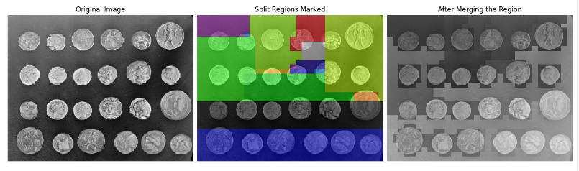
Code for Split and Merging Segmentation
Colab Code link : https://colab.research.google.com/drive/1BA9S25SGj-dUxYVYt_N4hidCNsVt3KTV#scrollTo=CIXHbZfRRFZY
Outputs :

Slide 75
Mathematical Assignment
.
Apply split segmentation and merging segmentation considering the threshold value as <= 2
5 | 6 | 6 | 7 | 6 | 7 | 6 | 6
6 | 7 | 6 | 7 | 5 | 5 | 4 | 7
6 | 6 | 4 | 4 | 2 | 2 | 5 | 6
5 | 5 | 5 | 1 | 2 | 3 | 4 | 6
0 | 1 | 2 | 3 | 3 | 2 | 4 | 7
0 | 0 | 0 | 0 | 2 | 2 | 5 | 6
1 | 1 | 0 | 1 | 0 | 1 | 4 | 4
1 | 0 | 1 | 0 | 2 | 0 | 5 | 4

Slide 76
Edge and Edge detection
Edge : An edge can be defined as a set of connected pixels that formed a boundary between two disjoint regions.
Edge detection : Edge detection is a fundamental technique in image processing that aims to identify boundaries or edges between different objects or regions within an image.

Slide 77

Edge Based Segmentation
Edge Models :
From left to right, models (ideal representations) of a step, a ramp, and a roof edge, and their corresponding intensity profiles.
a
b
c
a. Step Edge: A sudden change in intensity, like the sharp boundary between black and white areas. It looks like a step in a plot of pixel values.
b. Ramp Edge: A gradual change in intensity over a distance, resembling a slope in a plot. It occurs in smooth transitions like shadows.
c. Roof Edge: A peak in intensity, similar to a ridge or hill in a plot. It appears in thin bright lines against a darker background.

Slide 78
Edge Detection
Gradient Based
  Robert cross-gradient operators
  Prewitt operators
  Sobel Operators
Gaussian Based

Slide 79
Gradient Based Edge detection
Gradient Operators
Roberts Operator: Detects step edges by computing the gradient at each pixel using diagonal differences. It's simple but sensitive to noise.
Prewitt Operator: Detects step edges by using horizontal and vertical gradients. It's based on averaging and is more robust to noise than Roberts.
Sobel Operator: Detects step edges similar to Prewitt but includes a smoothing effect. It's effective for reducing noise while detecting edges.

Slide 80
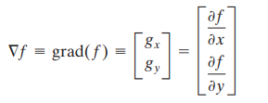

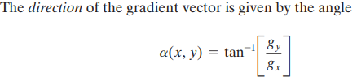
Gradient Based Edge detection Cont.
Gradient is a vector ,

Slide 81
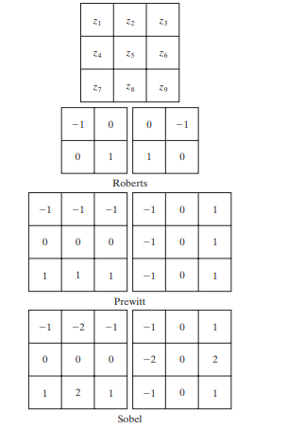
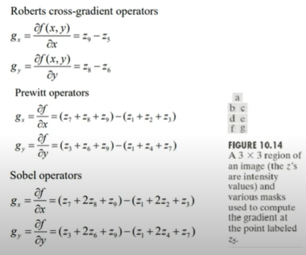
Gradient Based Edge detection Con.
This works on neighborhood concepts that considers differences between them.
Here, gx and gy represent the gradients of the image intensity in the horizontal and vertical directions.
Notes:
Neighborhood : Matrix representation of pixel values

Slide 82
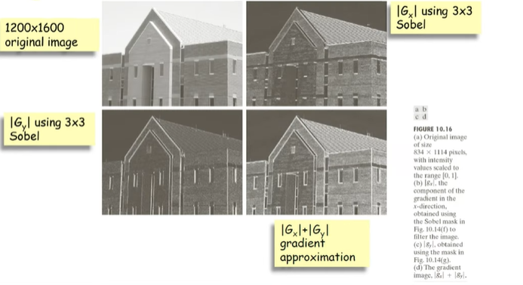
Gradient Based Edge detection Con.
Example of use of Gradient (Sobel operator)

Slide 83
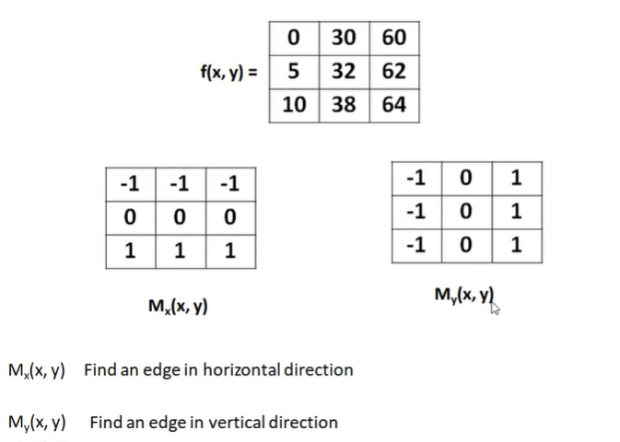
Math Problem on Gradient Edge detection
Detect edge in the following image using strength (magnitude) and direction of gradient. Use Prewitt operator. Consider the pixel (1,1) as the point of interest.
Sln:

Slide 84
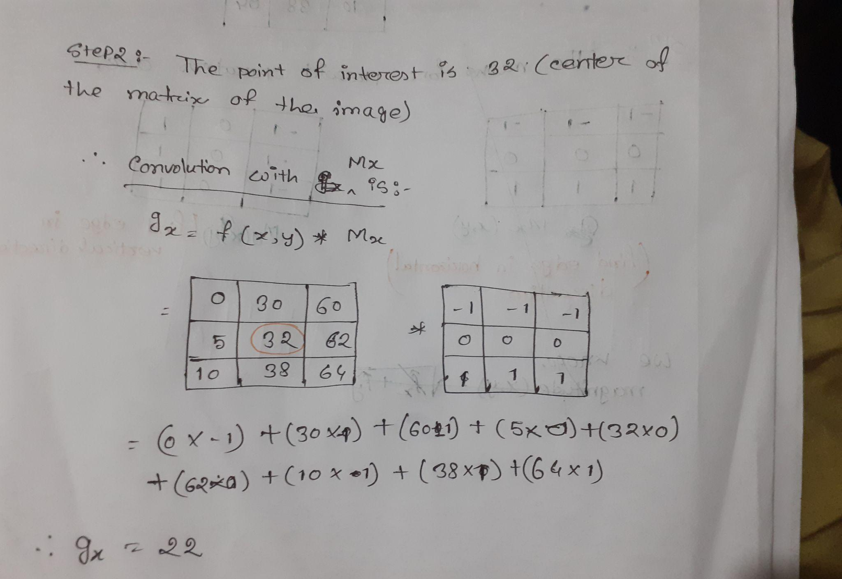
Math Problem on Gradient Edge detection

Slide 85
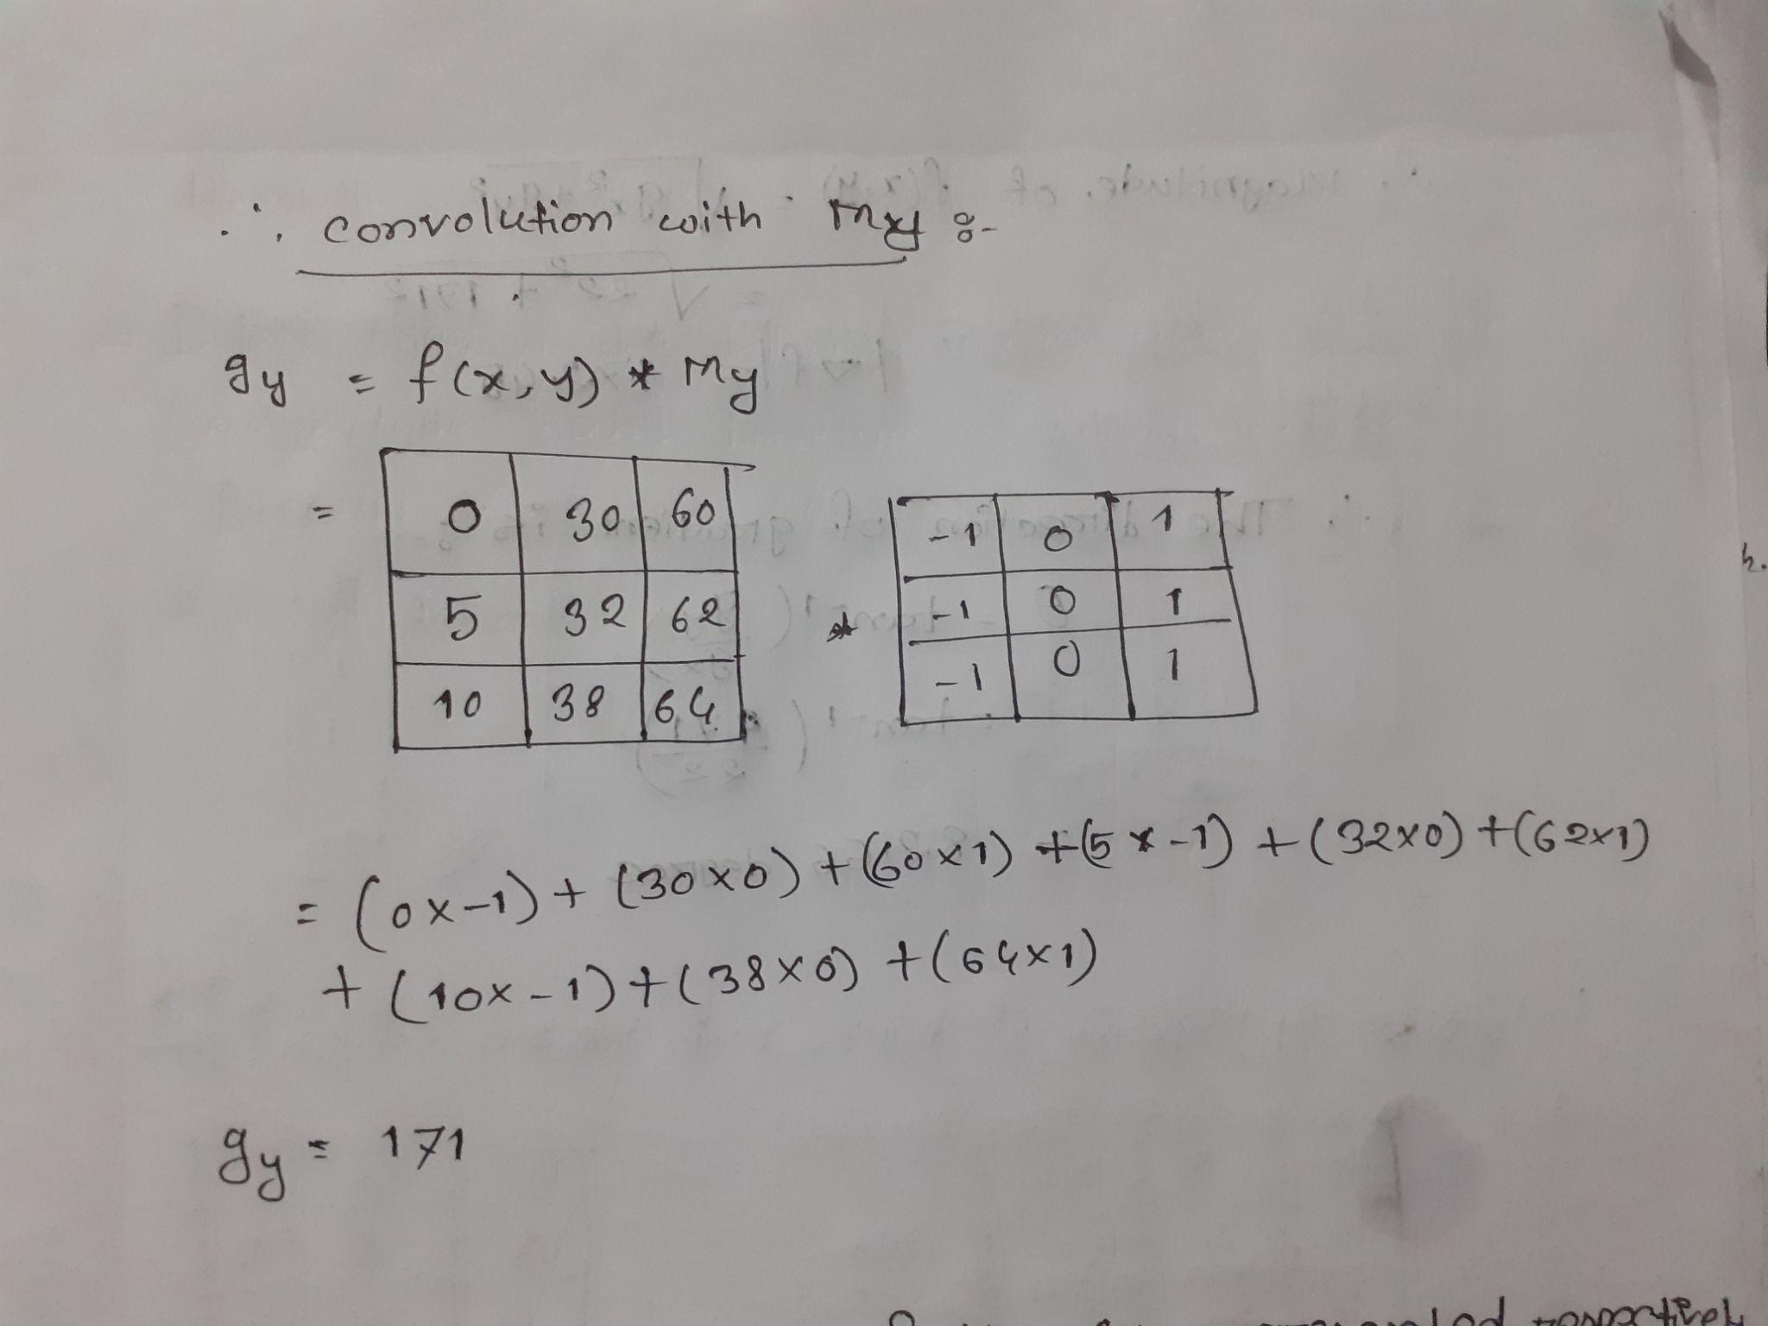
Math Problem on Gradient Edge detection

Slide 86
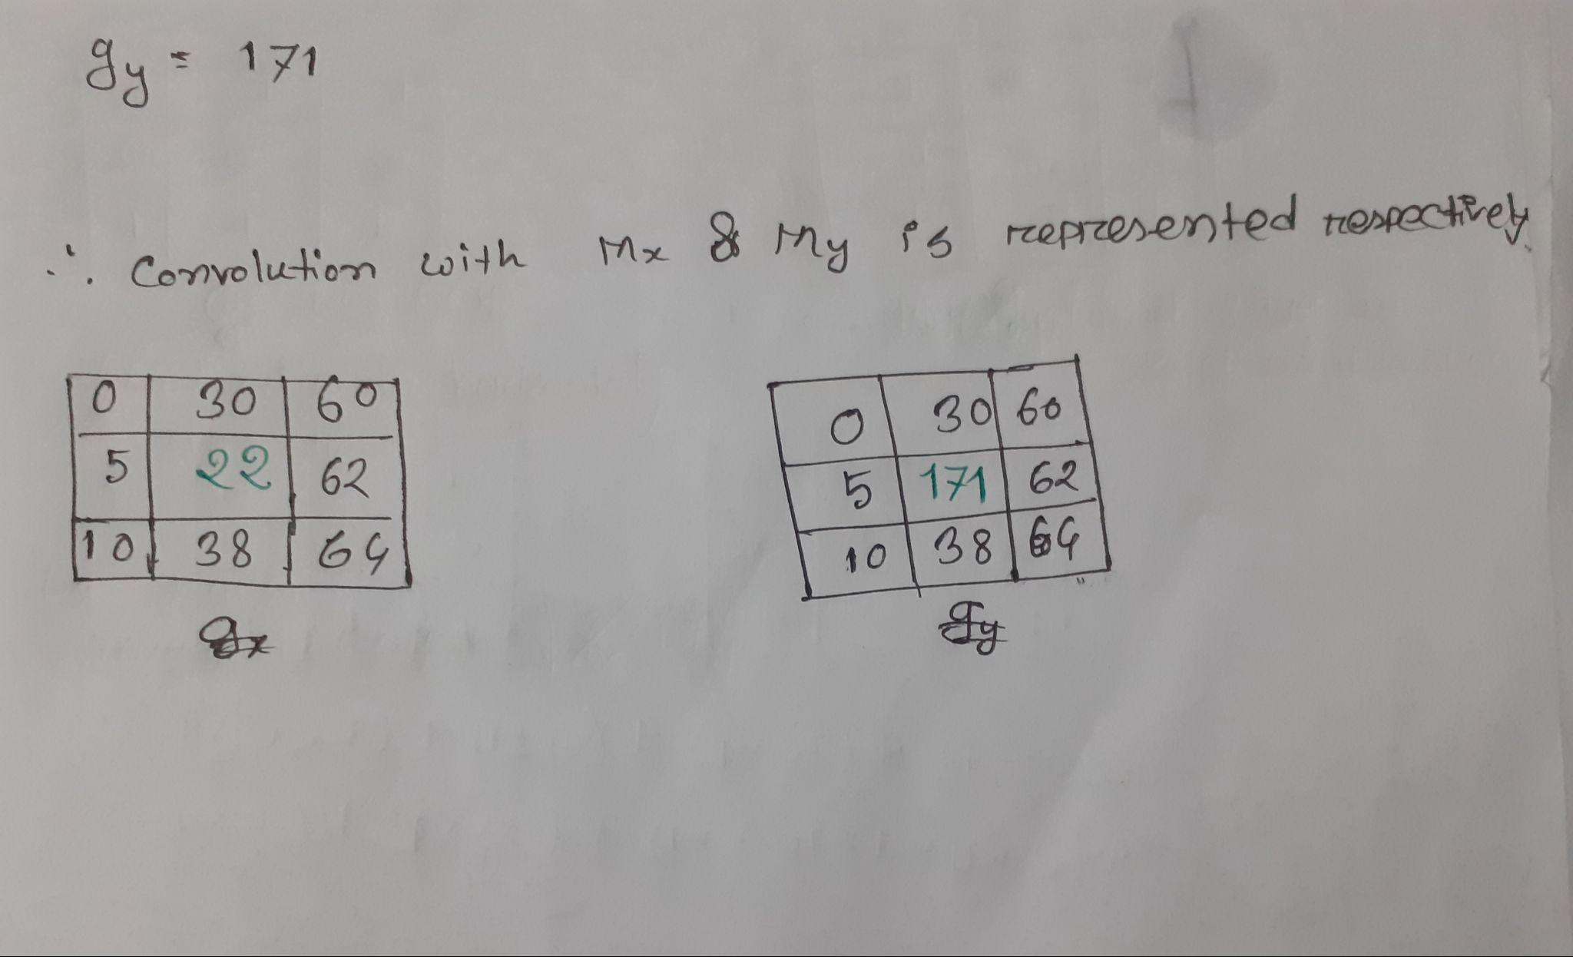
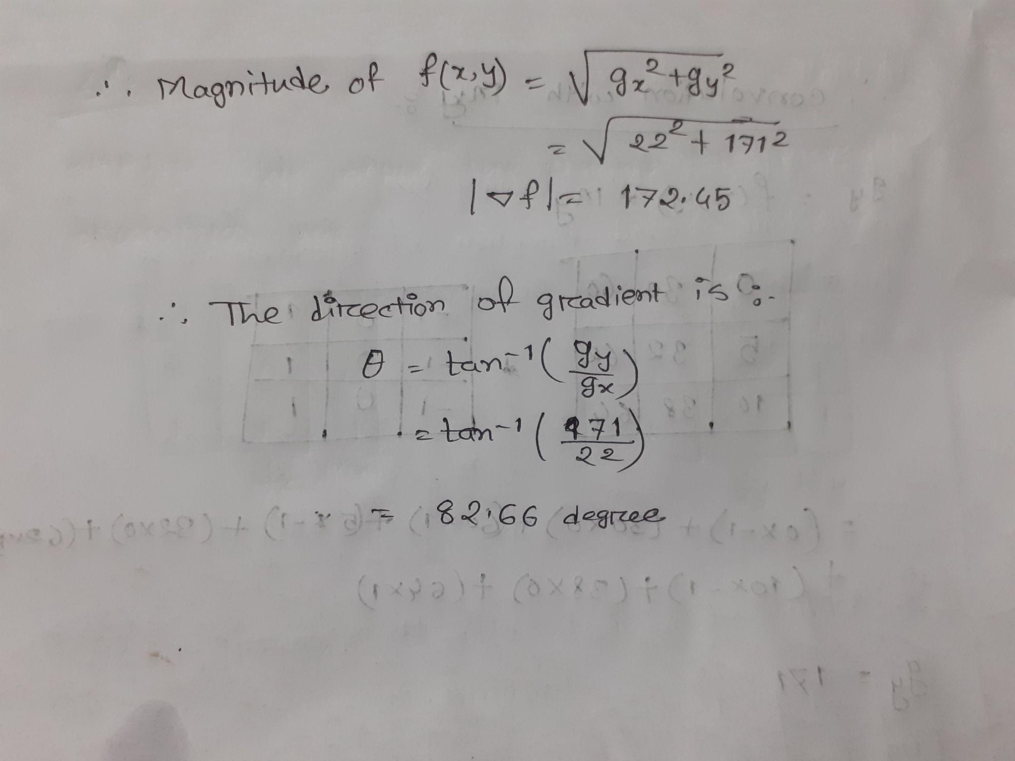
Math Problem on Gradient Edge detection

Slide 87
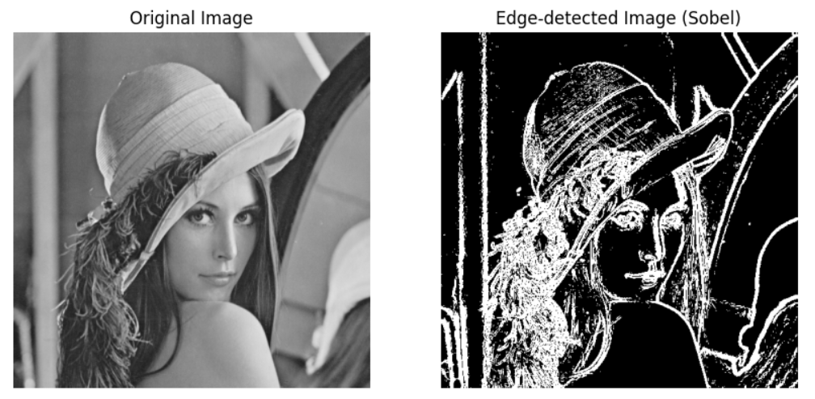
Code for Edge Detection Using Sobel Operator
https://colab.research.google.com/drive/1_g2McBWkIIXB-EaVoB0NJl3K3WsIzJkM#scrollTo=ZSzrO6WAz1YM
Output :

Slide 88
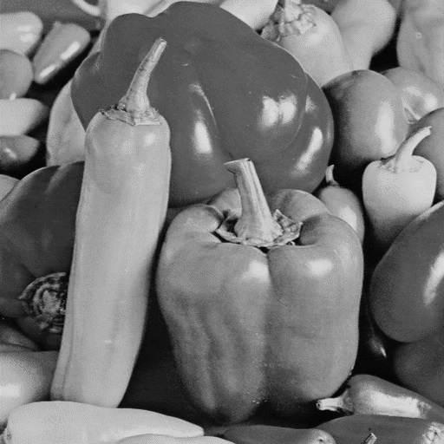
Assignment on Edge detection
Perform Edge detection for the following picture using Prewitt operators

Slide 89
Applications of Image Segmentation
Robotics (Machine Vision)
Medical imaging
Smart Cities
Self Driving Cars

Slide 90
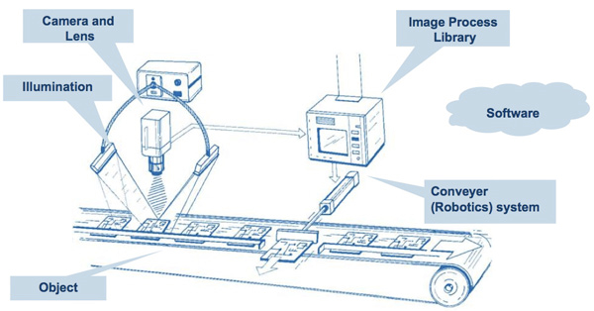
Robotics (Machine Vision)

Slide 91
Medical imaging
X-Ray segmentation
CT scan organ segmentation
Dental instance segmentation
Digital pathology cell segmentation
Surgical video annotation

Slide 92
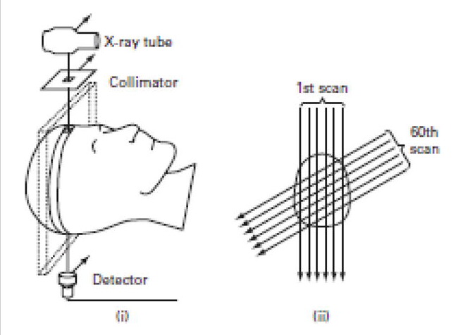
X-Ray segmentation

Slide 93
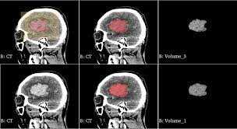
CT scan organ segmentation

Slide 94
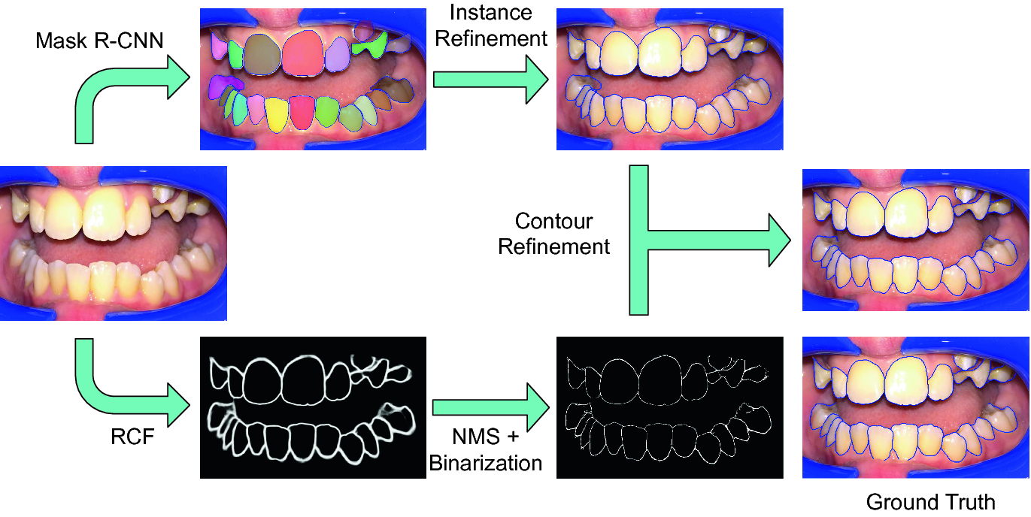
Dental instance segmentation

Slide 95
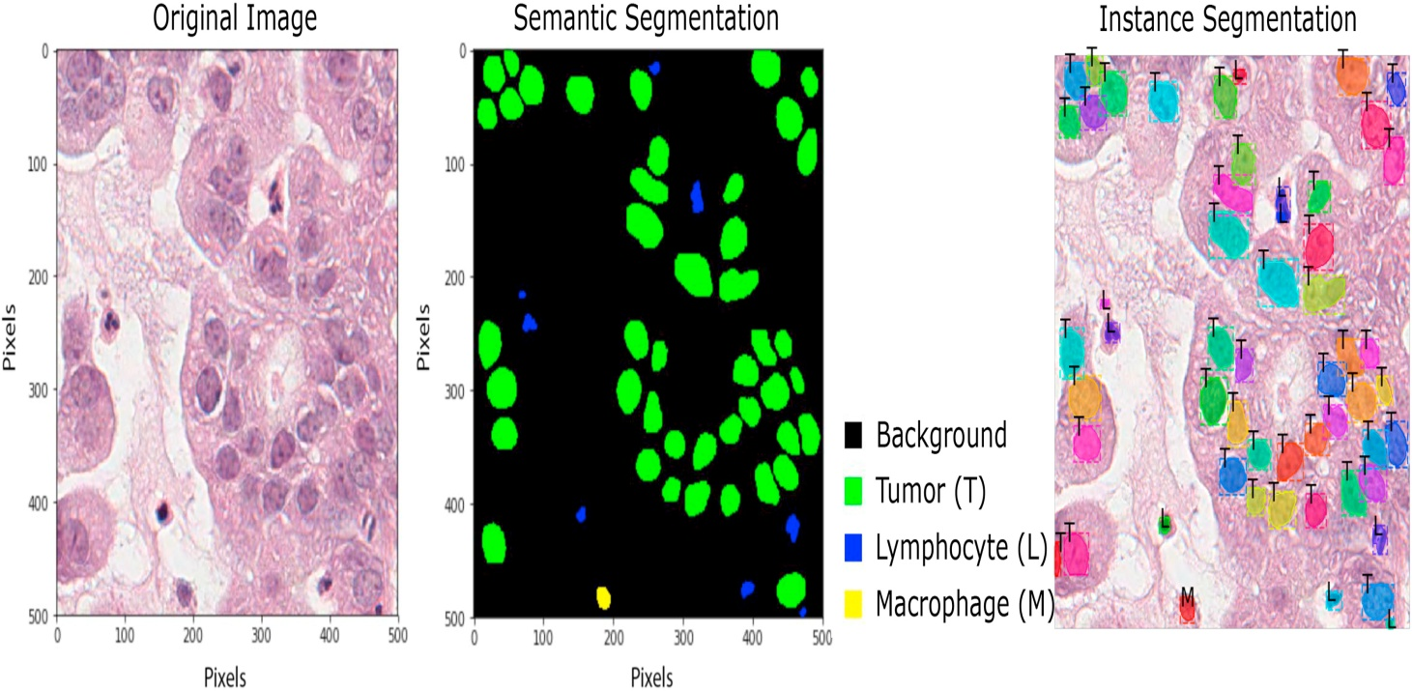
Digital pathology cell segmentation

Slide 96
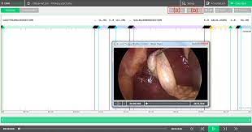
Surgical video annotation

Slide 97
Smart Cities
Pedestrian detection
Traffic analytics
License plate detection
Video Surveillance

Slide 98

Pedestrian detection

Slide 99
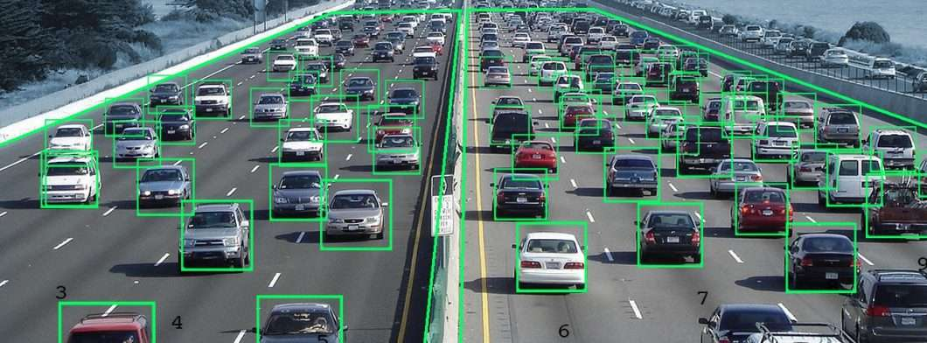
Traffic analytics

Slide 100
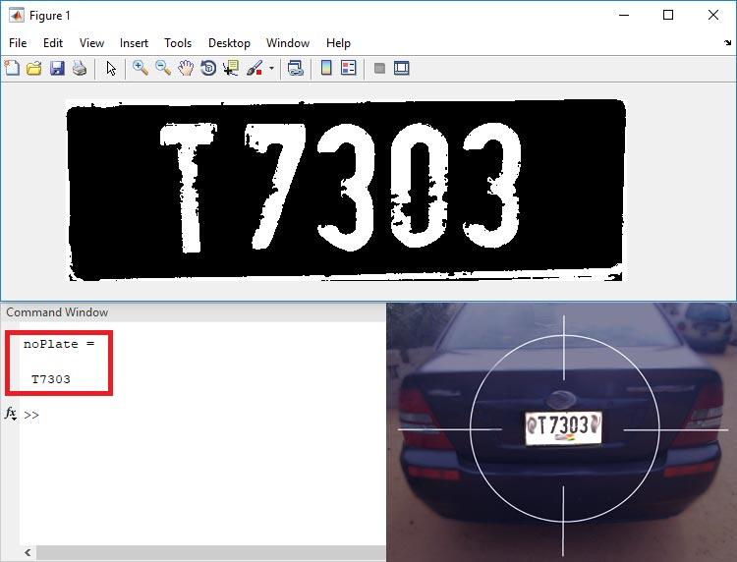
License plate detection

Slide 101
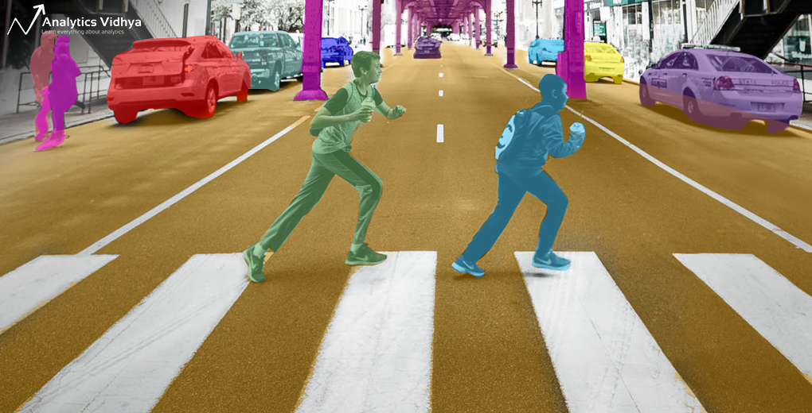
Video Surveillance

Slide 102
Self Driving Cars
Drivable surface semantic segmentation
Car and pedestrian instance segmentation
In-vehicle object detection (stuff left behind by passengers)
Pothole detection and segmentation

Slide 103
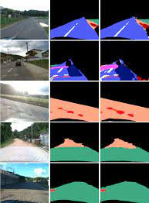
Drivable surface semantic segmentation

Slide 104
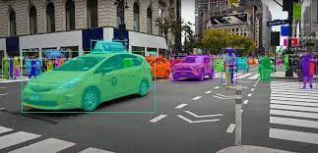
Car and pedestrian instance segmentation

Slide 105
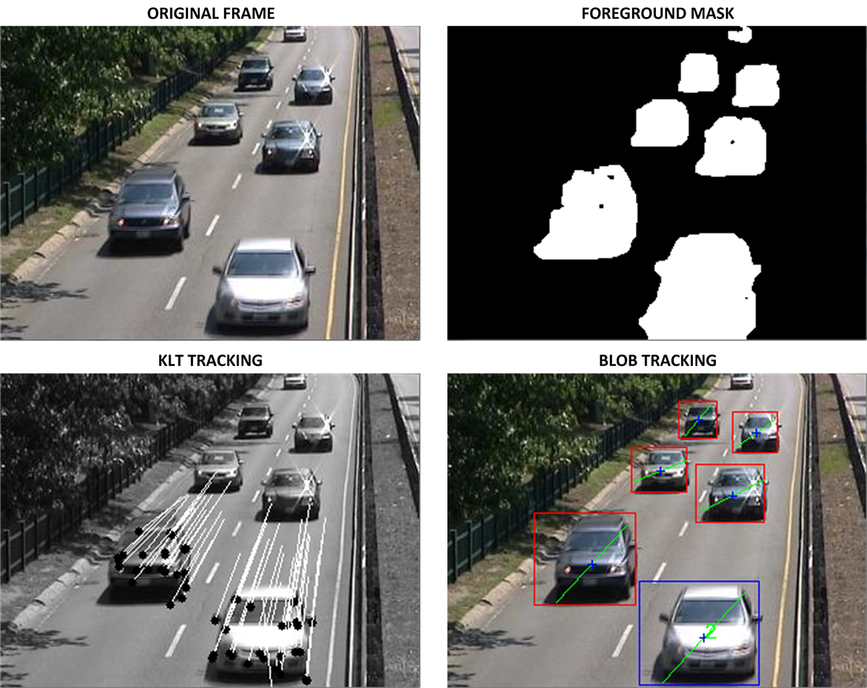
In-vehicle object detection

Slide 106
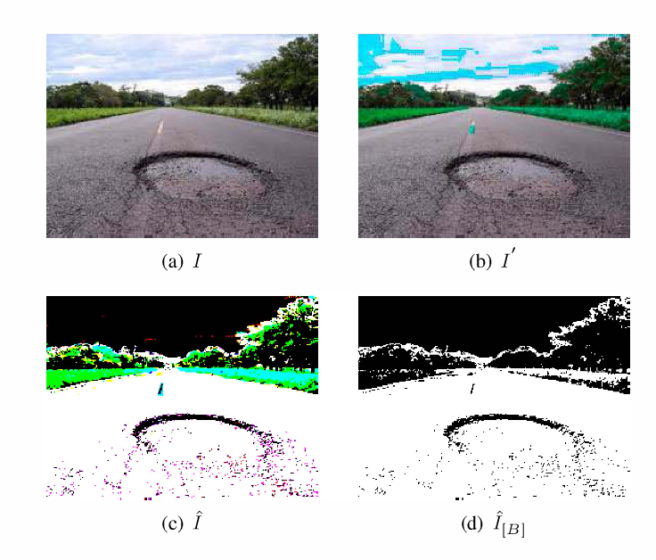
Pothole detection and segmentation

Slide 107
Limitations
Over segmentation and high sensitivity to noise.
Takes more time for processing.
redundant and get overlapped.

Slide 108
Thank you

