Slide 1
Morphological Image Processing
Group-04
Presented By -
1. Sourav Saha (19CSE029)
2. Priyanka Kundu (19CSE012)
3.Md. Moonaz Rahman(19CSE023)
4.Md Masud Rana(19CSE045)
5.Faysal Mia(19CSE038)

Slide 2
Introduction
A tool for extracting image components that are useful in the representation and description of image.
It deals with the shape (or morphology) of objects in an image
The language of mathematical morphology of an image is Set Theory.

Slide 3
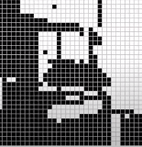
Representation of individual pixels as 0 or 1, convention:
Foreground, object = 1 (white)
Background = 0 (black)

Slide 4
Basic Set Theory
The set space of binary image is Z2
Each element of the set is a 2D vector whose coordinates are the (x,y) of a black (or white, depending on the convention) pixel in the image
The set space of gray level image is Z3
Each element of the set is a 3D vector: (x,y,z)

Slide 5


Basic Set Theory
On the concepts of sets in Z2, where each element denotes the coordinates of an object pixel.
If a=(a1, a2), we write if a is an element in A.
if a is not an element in A.
The null or empty set is denoted by .
We use braces, {·}, to specify the content of a set. For example, C={w|w=-d, for }.

Slide 6
Basic Set Theory
Subset: if every element of A is also an element of another set B, the A is said to be a subset of B.
Union: The set of all elements belonging either to A, B or both.
Intersection: The set of all elements belonging to both Aand B

Slide 7
Basic Set Theory
Disjoint : Two sets A and B are said to be disjoint or mutually exclusive if they have no common element.
Complement: The set of elements not contained in A
Difference : Difference of two sets A and B, denoted by A-B, is defined as

Slide 8
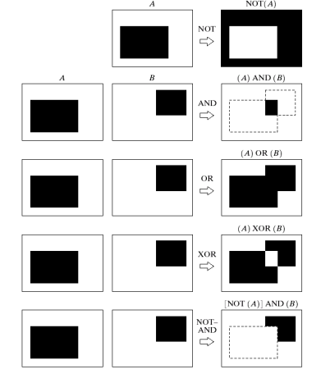
Example Of some Logic Operations

Slide 9
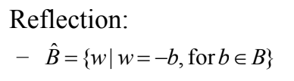
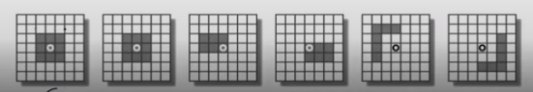
Extra

Slide 10

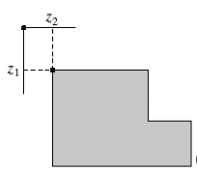
Extra

Slide 11
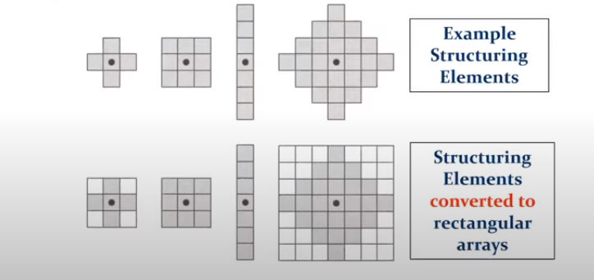
Structuring Element
A small image/template that helps to produce new image from the old one i.e. a small binary array.

Slide 12
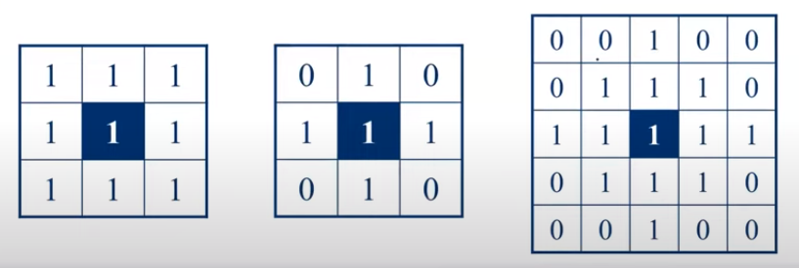
Structuring Element
For simplicity we will use rectangular structuring elements with their origin at the middle pixel

Slide 13
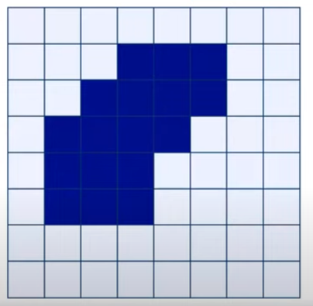

Structuring Element: Hits & Fits
Fit: All "1" pixels in the structuring element cover "1" pixels in the image
Hit: Any "1" pixel in the structuring element covers an "1" pixel in the image

Slide 14
Morphological operations
–Erosion: To shrink an object into a smaller size.
–Dilation: To enlarge an object along its boundary.

Slide 15
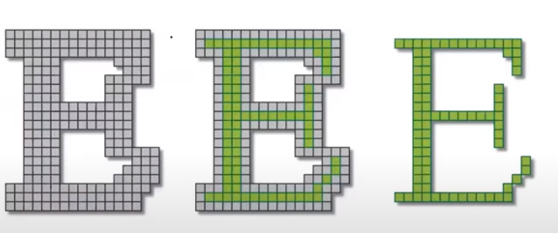
Erosion

Slide 16
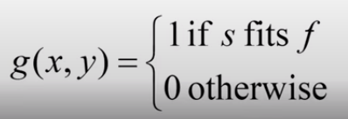
Definition
Erosion of image f by structuring element s is given by f Ꮎ s
The structuring elements is positioned with its origin at (x, y) and the new pixel value is determined using the rule:

Slide 17

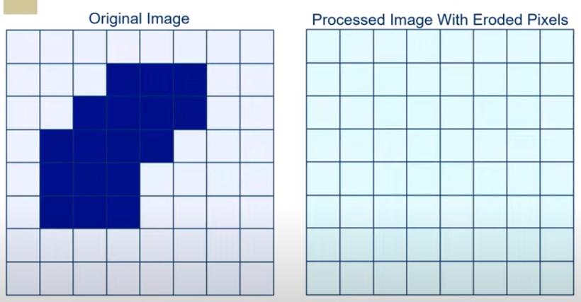
Example Of 2D Erosion

Slide 18
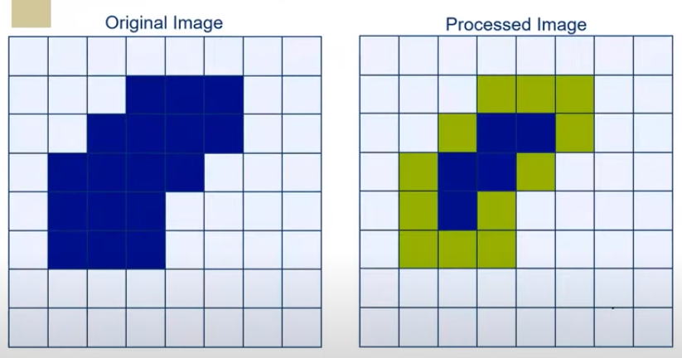
Solution

Slide 19
Implementation
Co-lab Link:
https://colab.research.google.com/drive/1jngt_GsTr2PdkC3fnn73yhWLc0xXLtnk#scrollTo=KVpECbPWKSqo

Slide 20
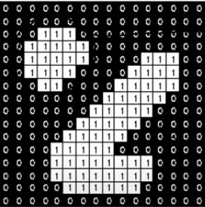
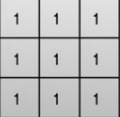
Assignment-1

Slide 21

Dilation

Slide 22
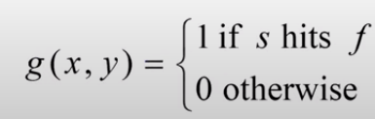
Definition
Dilation of image f by structuring element s is given by f s
The structuring elements is positioned with its origin at (x, y) and the new pixel value is determined using the rule:

Slide 23
Example Of 2D Dilation

Slide 24
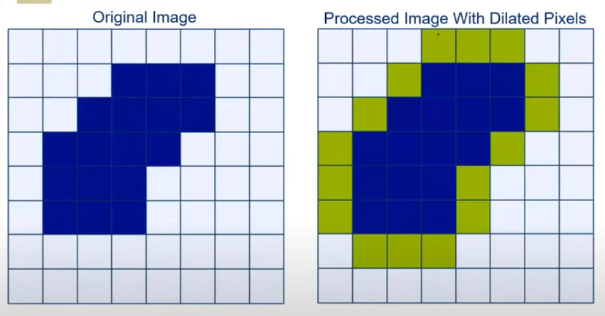
Solution

Slide 25
Implementation
Co-lab Link:
https://colab.research.google.com/drive/1oOcCZtQlkiQO78d1BcxW07OyE8OqqrLu

Slide 26
Assignment-2

Slide 27
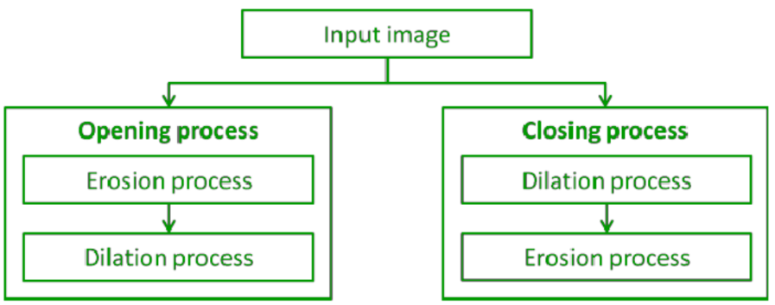
Opening and Closing
The combination of Opening and Closing is generally used to clean up artifacts in the segmented image before using the image for digital analysis.

Slide 28

Opening
Opening is an operation that removes small objects from the foreground of an image (usually considered as white pixels) while preserving the shape and size of larger objects. It is achieved by applying erosion followed by dilation using a structuring element.
The morphological opening is an erosion followed by a dilation.
An example of the opening operation is shown in the diagram in next slide.

Slide 29
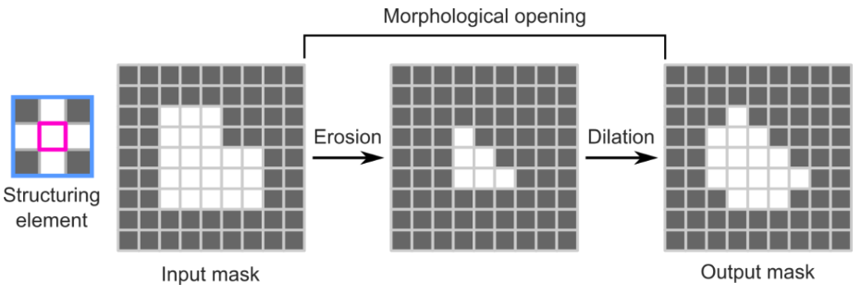
Opening

Slide 30
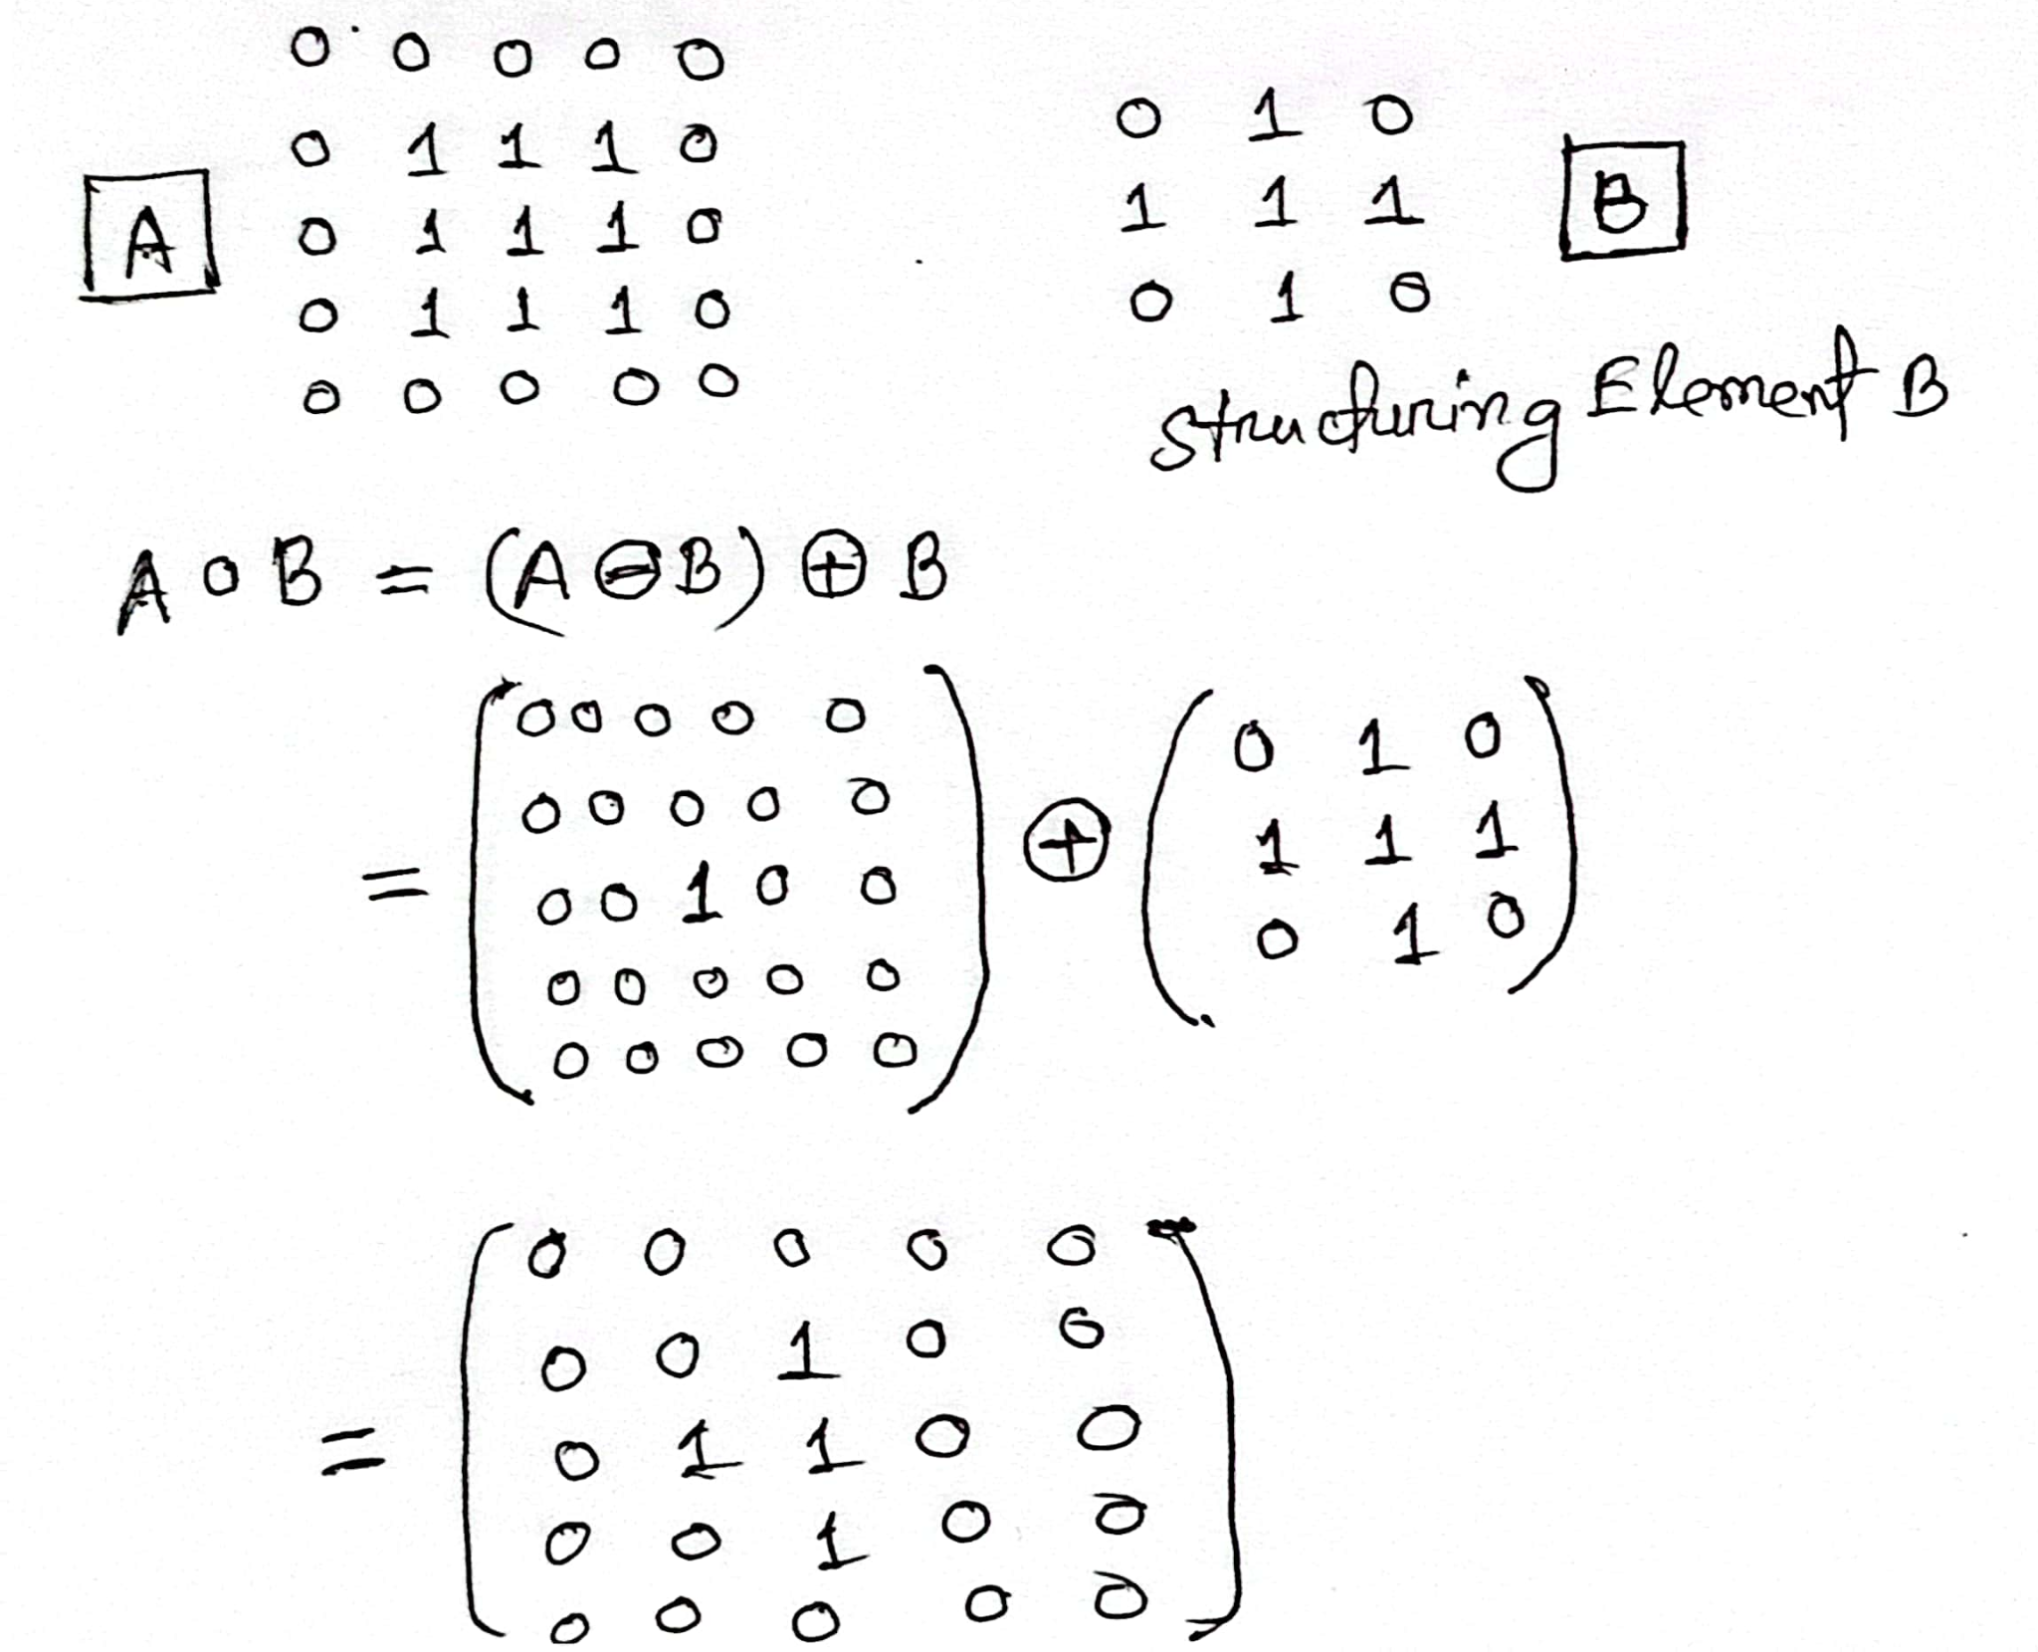
An Example for Better Understanding

Slide 31

Closing
Closing is an operation that fills small holes and gaps in the foreground of an image while preserving the shape and size of objects. It is achieved by applying dilation followed by erosion using a structuring element
Closing tends to close gaps in the image.
An example of the closing operation is shown in the diagram in next slide.

Slide 32
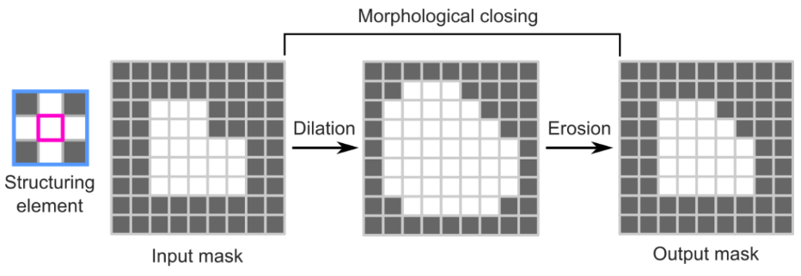
Closing

Slide 33
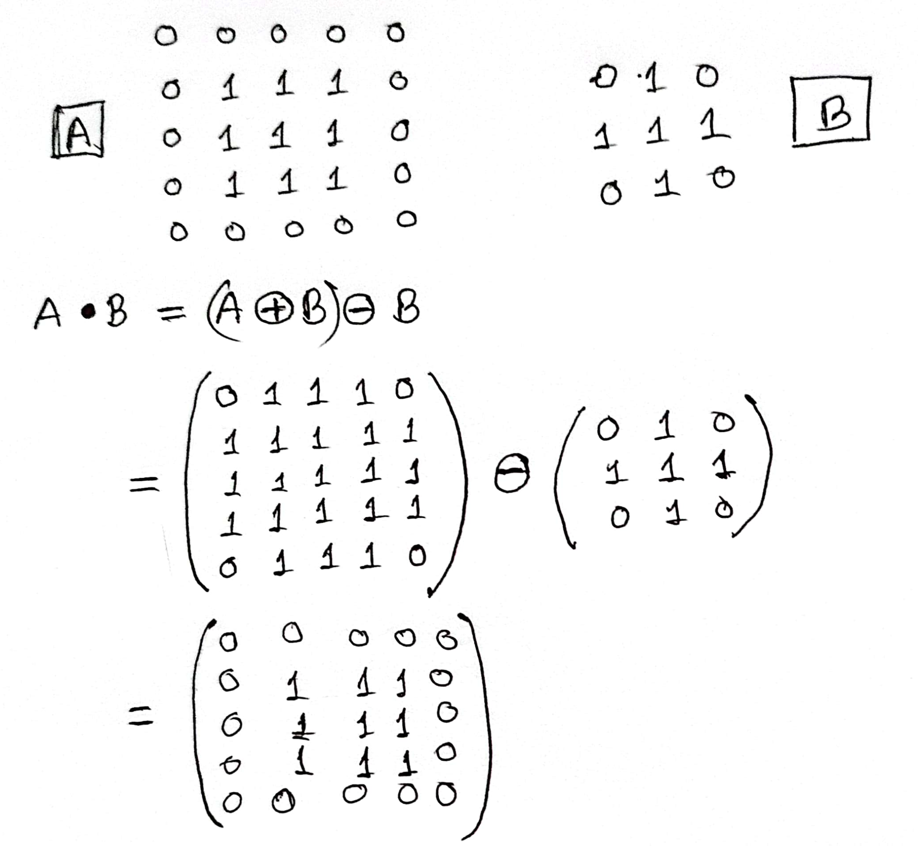
An Example for Better Understanding

Slide 34

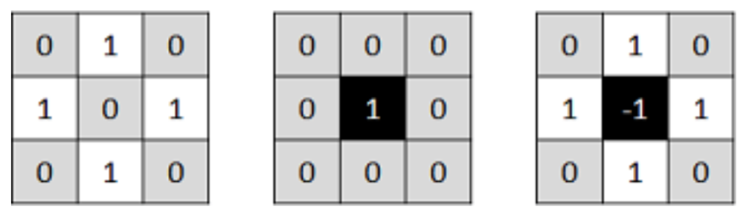
Hit-or-Miss transformation
The hit-or-miss transform is a morphological operation that uses a structuring element to identify specific configurations of pixels in a binary image. It is a combination of erosion operations that separately match the foreground (object) and the background.
Let's see an example:
Structuring elements (kernels). Left: kernel to 'hit'. Middle: kernel to 'miss'. Right: final combined kernel

Slide 35
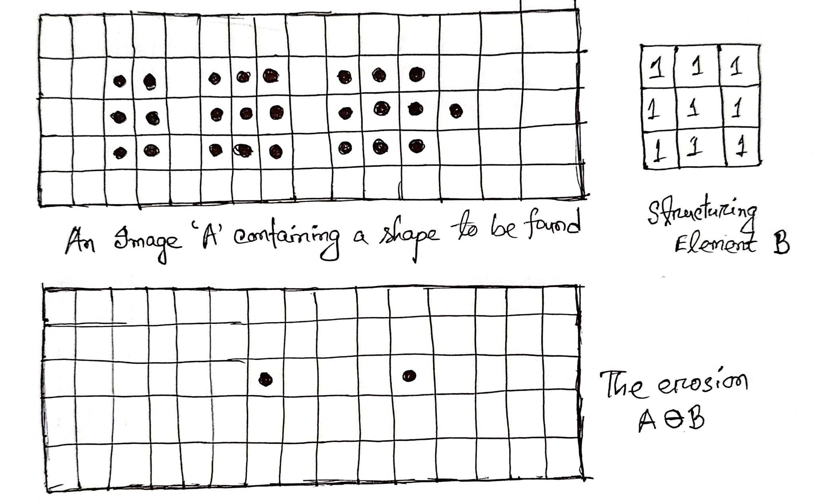
An Example for Better Understanding

Slide 36
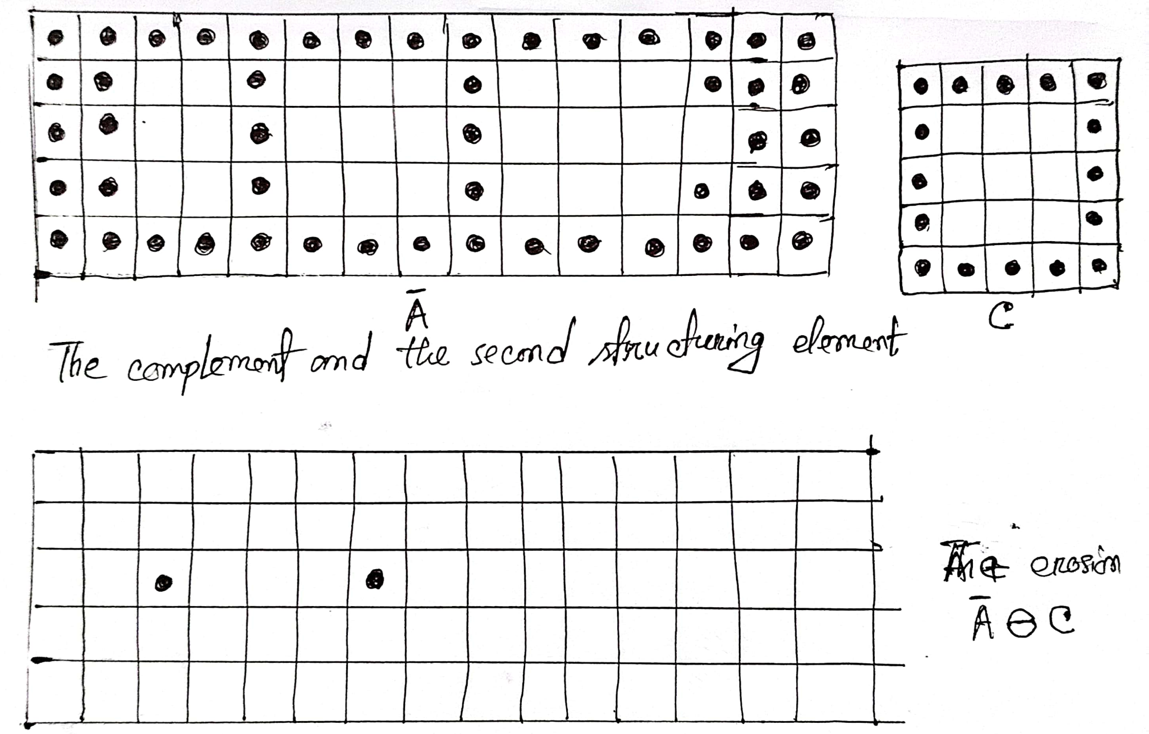

Slide 37
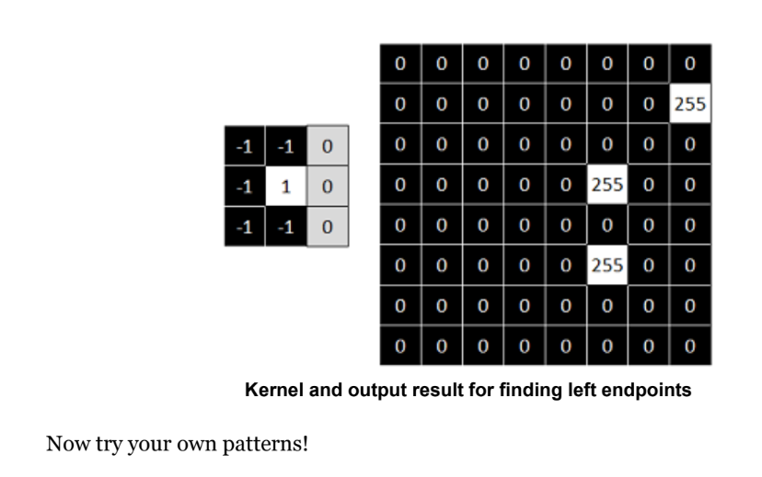
Assignment of Hit or Miss Transformation

Slide 38
Moonaz
BASIC MORPHOLOGICAL ALGORITHMS

Slide 39
BOUNDARY EXTRACTION
Process of identifying the edges or outlines of objects within an image.
Highlight object contours for further analysis, such as shape recognition or object segmentation

Slide 40
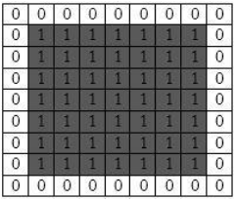

BOUNDARY EXTRACTION
Boundary (A) = A - (A Ɵ B).
B
(Structuring element)
A

Slide 41
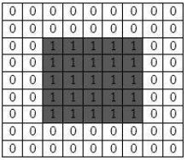
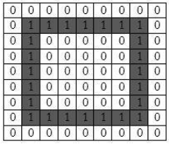
BOUNDARY EXTRACTION
Boundary (A) = A - (A Ɵ B).
B
A
A Ɵ B
B (A) = A - (A Ɵ B).

Slide 42
BOUNDARY EXTRACTION
Applications:
Object Detection and Recognition
Image Segmentation
Medical Image Analysis
Robotics and Autonomous Systems

Slide 43
BOUNDARY EXTRACTION
Which of the following statements is true about boundary extraction?
A. It is used to smooth the edges of objects in an image.
B. It identifies the lines or curves where there is a significant change in intensity.
C. It enhances the brightness of the image.
D. It blurs the image to reduce noise

Slide 44
REGION FILLING | HOLE FILLING
Process of filling the interior regions (holes) of binary objects in an image.
Enhance object representation, improve morphological operations, and prepare for further image analysis.

Slide 45
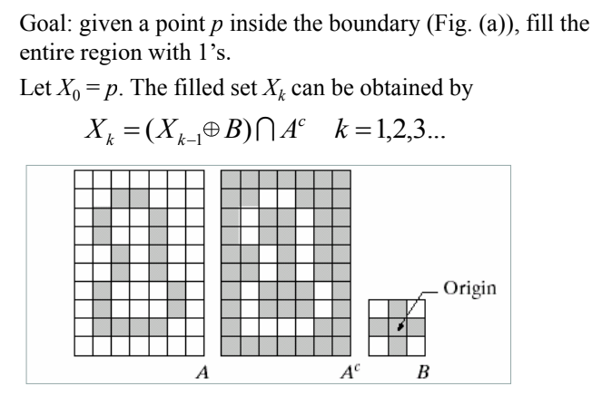
REGION FILLING | HOLE FILLING

Slide 46
REGION FILLING | HOLE FILLING
The algorithm terminates at iteration step k if Xk=Xk-1
The result is obtained from the union of Xk and the boundary in A

Slide 47
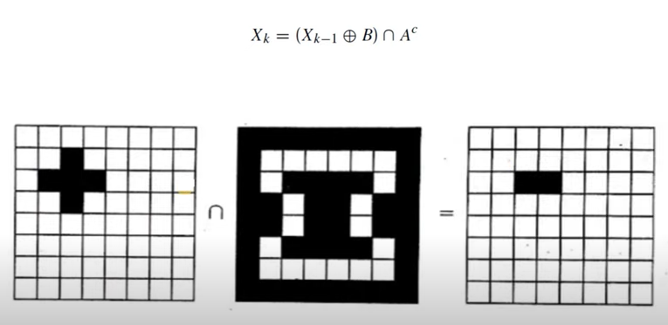
REGION FILLING | HOLE FILLING

Slide 48
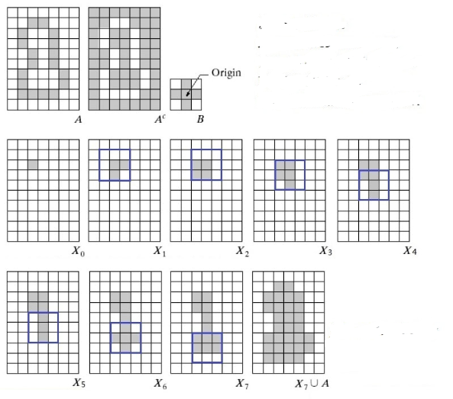
REGION FILLING | HOLE FILLING

Slide 49
REGION FILLING | HOLE FILLING
Applications:
Image Preprocessing
Object Recognition
Texture Synthesis
3D Printing

Slide 50
REGION FILLING | HOLE FILLING
In the context of region filling, what does the term "seed point" refer to?
A. A point used to start the region filling process
B. A point used to end the region filling process
C. A point used to measure image intensity
D. A point used to smooth the image

Slide 51
EXTRACTION OF CONNECTED COMPONENT
Connected component extraction involves identifying and labeling connected regions (components) in a binary image.
Separate distinct objects for analysis, counting, and measurement.

Slide 52

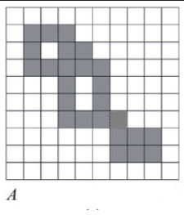

EXTRACTION OF CONNECTED COMPONENT

Slide 53
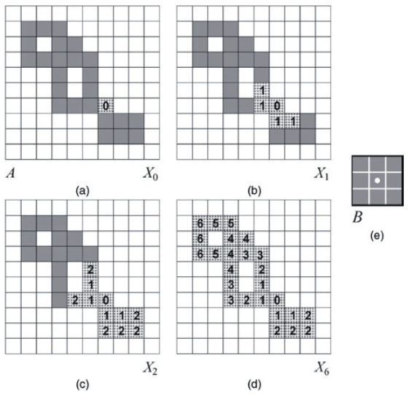
EXTRACTION OF CONNECTED COMPONENT

Slide 54
EXTRACTION OF CONNECTED COMPONENT
Applications:
Object Counting
Image Segmentation
Character Recognition (OCR)
Medical Image Analysis
Shape Analysis

Slide 55
EXTRACTION OF CONNECTED COMPONENT
What is the primary goal of extracting connected components in image processing?
A. To enhance image contrast
B. To detect edges and contours
C. To identify and label distinct regions
D. To reduce image noise

Slide 56
CONVEX HULL
Convex hull is the smallest convex polygon that can contain all the points of an object in an image.
Simplify shape analysis, remove concavities, and provide a tight-fitting boundary around objects.

Slide 57
CONVEX HULL
Let a binary image A.
Let Bi, i = 1,2,3,4 represent the four structuring elements in Fig. (a)
Implementing the equation:

Slide 58
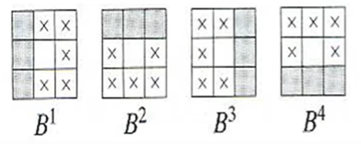
CONVEX HULL
Structuring elements

Slide 59
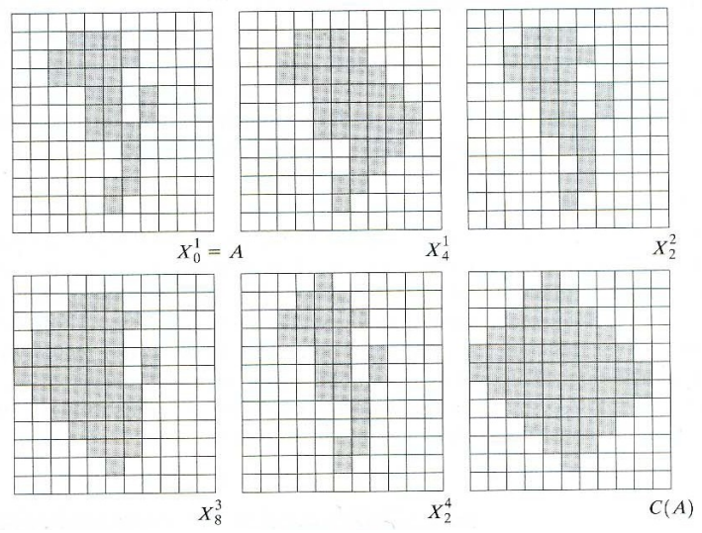
Convex Hull

Slide 60
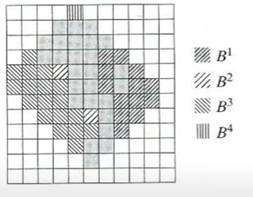
CONVEX HULL

Slide 61
IMPROVING CONVEX HULL ALGORITHM
The algorithm can be improved by limiting the growth of the algorithm beyond the maximum dimensions of the original set.

Slide 62
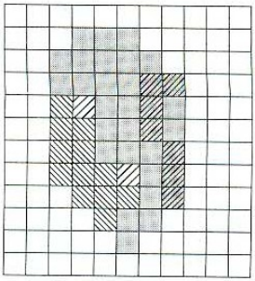
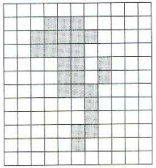
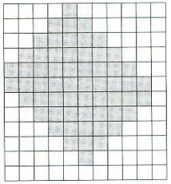
IMPROVING CONVEX HULL ALGORITHM
A
Output
Improved

Slide 63
IMPROVING CONVEX HULL ALGORITHM
Applications:
Computer Graphics: Simplifying shapes and collision detection.
Pattern Recognition: Shape analysis and pattern matching.
Robotics: Path planning and obstacle avoidance.
Geometric: Basis for many computational geometry algorithms.
Data Mining: Identifying the boundary of data points in clustering.
Computer Vision: Object detection and image segmentation.

Slide 64
CONVEX HULL
What is the convex hull of a set of points in a plane?
A. The smallest circle that encloses all the points
B. The largest circle that encloses all the points
C. The smallest convex polygon that encloses all the points
D. The largest convex polygon that encloses all the points

Slide 65
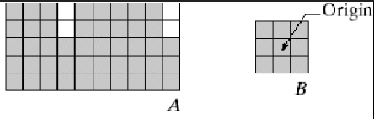
ASSIGNMENT
Extract the boundary from image A.

Slide 66
IMPLEMENTATIONS
LINK: https://colab.research.google.com/drive/1WaeX59inH4426gwl9om2fXPH8JyVLimV?authuser=0#scrollTo=k6mUwSndIP5h

Slide 67
Thinning
1. Used to remove selected foreground pixels from binary images
2. After edge detection, lines are often thicker than one pixel.
3. Thinning can be used to thin those line to one pixel width.

Slide 68
Definition of Thinning
1.The thinning of a set A by a structuring element B:
=> A⊗B=A - (A⊛ B) = A ∩ (A⊛ B)^{c}
2.Symmetric thinning: sequence of structuring elements
{B} = {B1, B2, B3‚...‚ ,B^{n}}, where B is a rotated version of B^{i-1}
.If foreground and background fit the structuring element exactly, then the pixel at the origin of the SE is set to 0

Slide 69
Symmetric Thinning
sequence of structuring elements
{B} = {B1, B2, B3‚...‚ ,B^{n}}, where B is a rotated version of B^{i-1}. Clockwise Rotated . Total Sequence=Number Of Neighbor.
B¹= B²= B³= B⁴=
B⁵= B⁶= B⁷= B⁸=
0 | 0 | 0
1 | 1 | 1
0 | 1 | 0
1 | 0 | 0
0 | 1 | 0
1 | 0 | 1
0 | 1 | 0
0 | 1 | 0
0 | 1 | 0
1 | 0 | 1
0 | 1 | 0
1 | 0 | 0
0 | 1 | 0
1 | 1 | 1
0 | 0 | 0
1 | 0 | 1
0 | 1 | 0
0 | 0 | 1
0 | 1 | 0
0 | 1 | 1
0 | 1 | 0
0 | 0 | 1
0 | 1 | 0
1 | 0 | 1

Slide 70
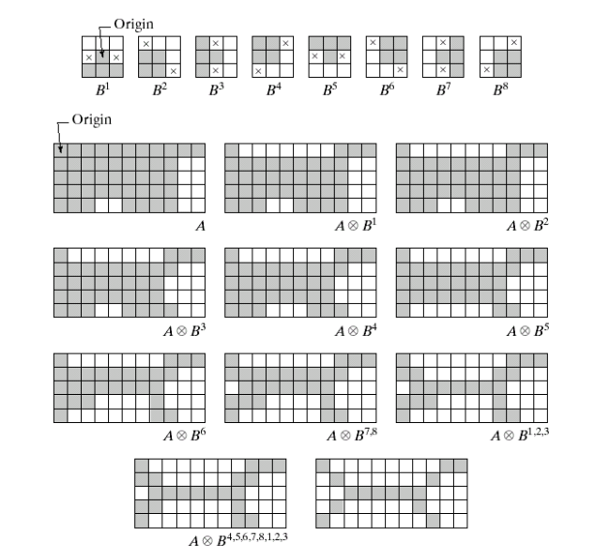
Thinning Illustration
.

Slide 71
Applications of Thinning
1.Fingerprint Analysis: Enhances fingerprint features by reducing ridge patterns to a skeletal form, making it easier to extract and match minutiae points.
2.Medical Imaging: Extracts and analyzes the structure of biological tissues, such as blood vessels or neural pathways, by reducing them to their skeletal forms.
3.Shape Analysis: Helps in the recognition and classification of shapes by reducing objects to a form that retains essential geometric properties.

Slide 72
Thickening
Used to grow selected regions of foreground pixels

Slide 73
Definition Thickening
﻿1.Thickening is the morphological dual of thinning and is defined by => A⊙B=A∪(A⊛ B)
where B is a structuring element Similar to thinning...
{B} = {B1, B2, B3‚...‚ ,B^{n}}, where B is a rotated version of B^{i-1}
2. If foreground and background match exactly the SE, then set the pixel at its origin to 1!

Slide 74
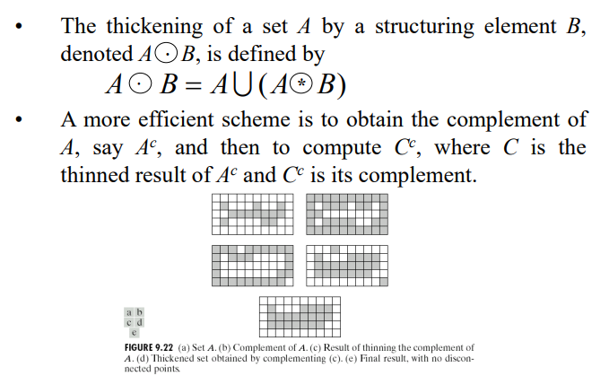
Thickening Process
.

Slide 75
Applications of Thickening
Text Enhancement: Improves the visibility of characters in degraded or low-resolution images by thickening the strokes.
Example: Enhancing text in scanned historical documents for better readability.
2. Medical Imaging: Enhances the visibility of certain structures, such as bones or tumors, making them more prominent for diagnosis.
Example: Thickening the edges of bone structures in X-ray images for fracture detection.

Slide 76
Assignments
Perform Thinning and Thickening process.
Structure elements B1=
Original Image , A =
0 | 0 | 0
x | 1 | x
1 | 1 | 1
1 | 1 | 1 | 1 | 1 | 1 | 1 | 1 | 1 | 1 | 1
1 | 1 | 1 | 1 | 1 | 1 | 1 | 1 | 1 | 0 | 0
1 | 1 | 1 | 1 | 1 | 1 | 1 | 1 | 1 | 0 | 0
1 | 1 | 1 | 1 | 1 | 1 | 1 | 1 | 1 | 0 | 0
1 | 1 | 1 | 0 | 0 | 1 | 1 | 1 | 1 | 0 | 0

Slide 77
Code
Implementation Code Here:https://github.com/Schukuratsu/Python-cv2-fast-thinning-algorithm

Slide 78
Morphological Reconstruction
Extract and reconstruct specific features or structures from an image based on morphological operations
Focuses on selectively highlighting certain parts of an image while suppressing others
Required Elements for Morphological Reconstruction:
Marker Image: An initial image or subset that serves as the seed for reconstruction. It can be created based on specific criteria or thresholds applied to the original image.
Mask Image: The original image or a processed version of the original image that guides and constrains the reconstruction process.
Structuring Element: The neighborhood used for dilation or erosion. Common structuring elements include simple shapes like squares, disks, or more complex configurations.

Slide 79
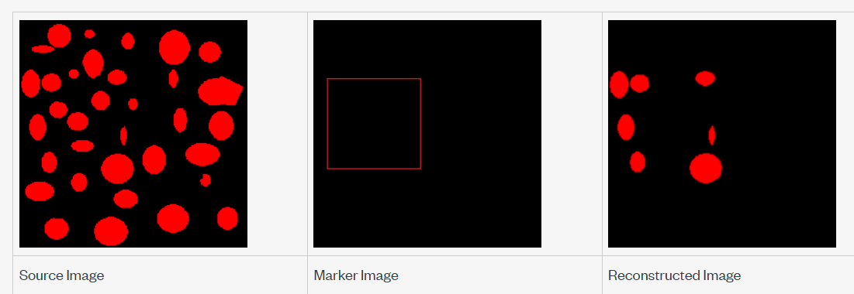
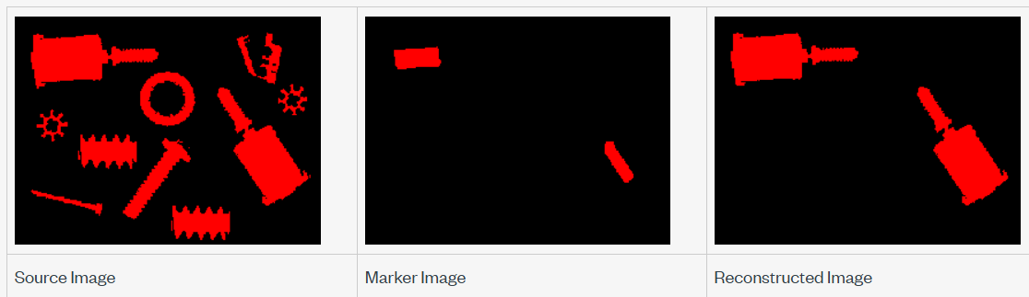
[Extracts the particles connected to a rectangle boundary]
[Extracts the particles based on morphological properties]

Slide 80
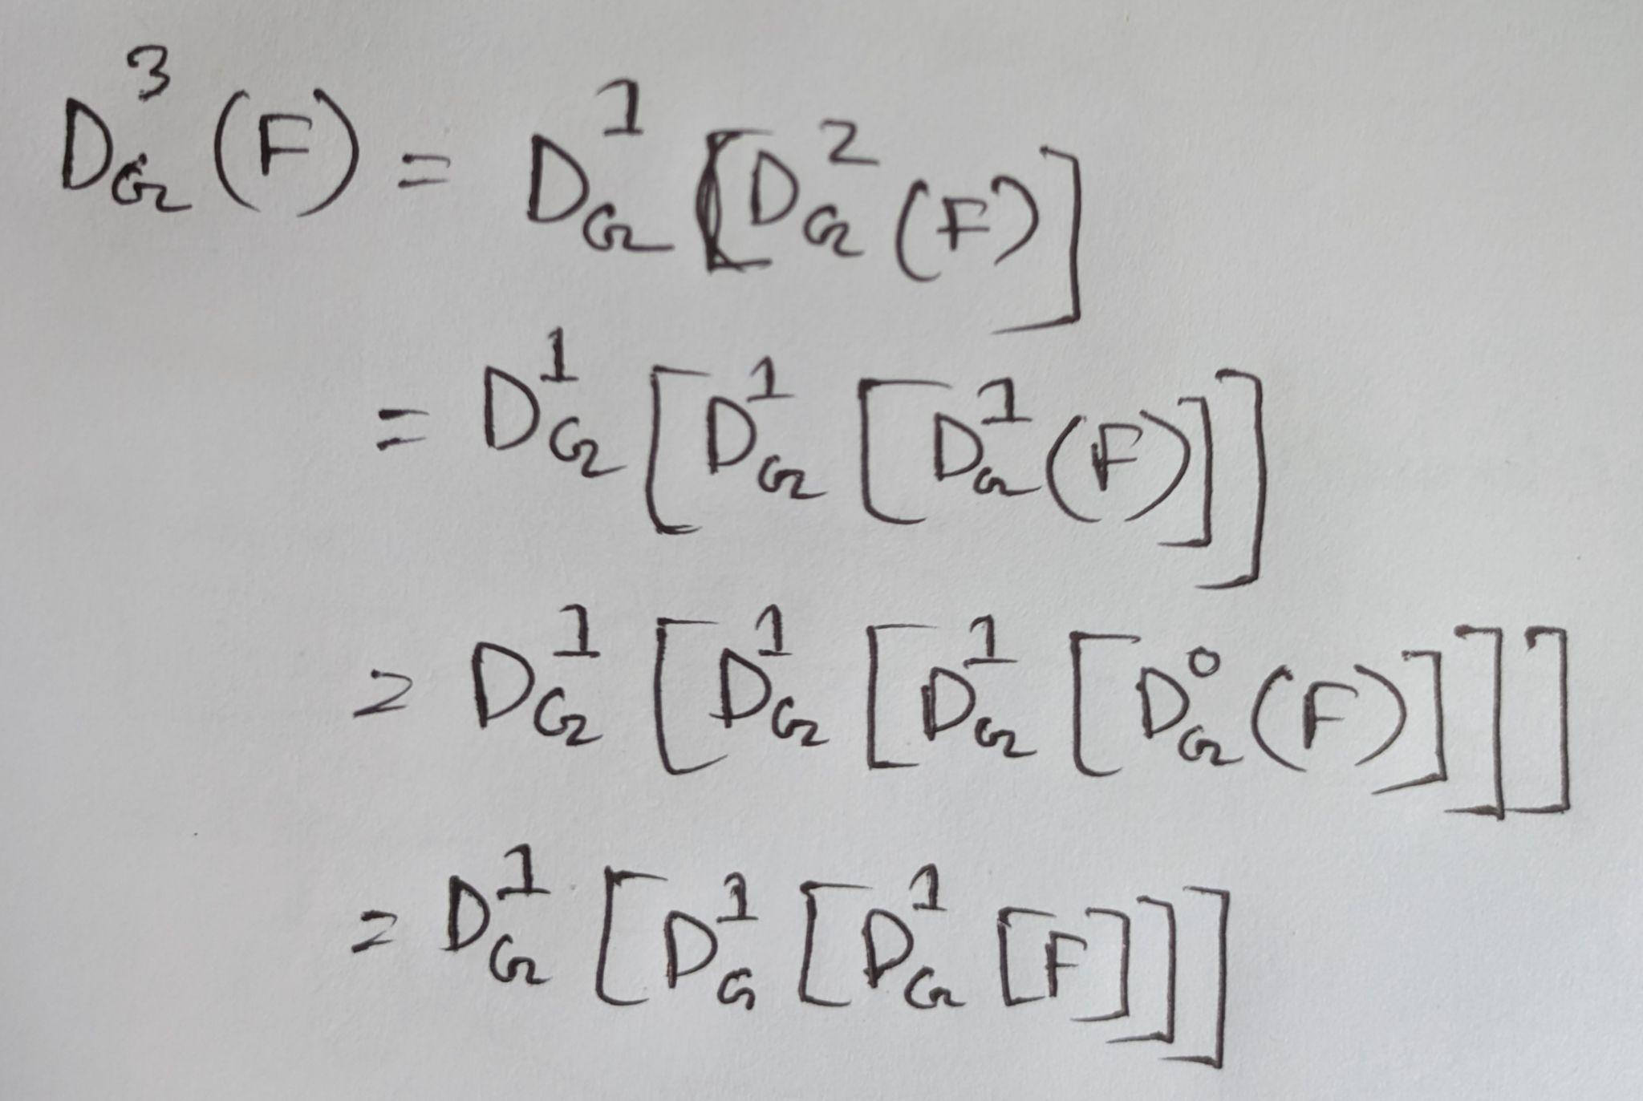
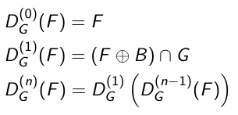
Geodesic Dilation
The geodesic dilation is an iterative morphological transformation requiring:
F = Marker image
G = Mask image
B = Structuring element
n = Number of time of geodesic dilation

Slide 81
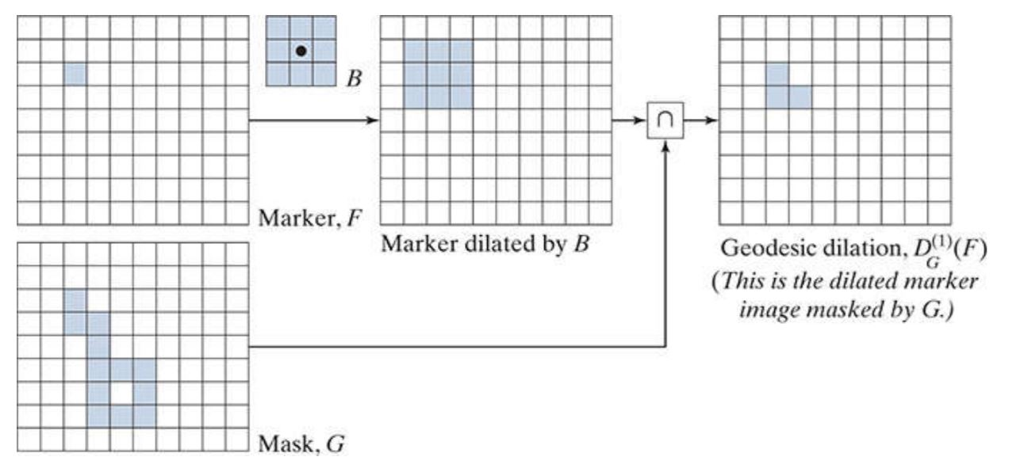
Geodesic Dilation graphical illustration

Slide 82

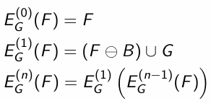
Geodesic Erosion
The geodesic erosion is an iterative morphological transformation which is restricted by mask image
: Geodesic erosion of size n of F with respect to G

Slide 83
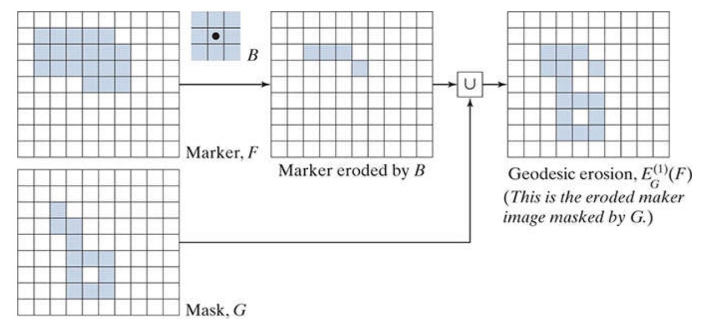
Geodesic Erosion graphical illustration

Slide 84
Quiz
In which scenario would geodesic erosion be particularly useful in image processing
A) To sharpen the edges of objects in a grayscale image.
B) To iteratively erode an image until all the pixels are removed.
C) To control the erosion process using a reference image, ensuring that erosion does not go beyond certain boundaries.
D) To perform edge detection by computing the gradient of the image intensity.

Slide 85




Morphological reconstruction by Dilation & Erosion
The reconstruction through the geodesic operations are defined as the result of such operation at the stability:
Morphological reconstruction by dilation:
Morphological reconstruction by erosion:
with k such
with k such

Slide 86
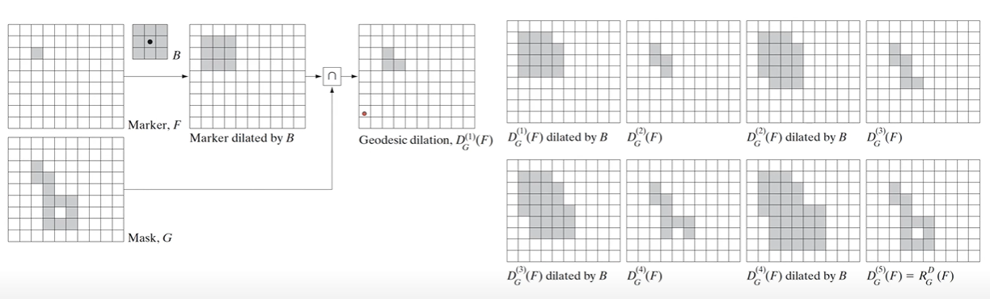
How morphological reconstruction by dilation works

Slide 87

Sample application of morphological reconstruction
Opening by reconstruction:
Opening Through Reconstruction Of Size n:
Erosion for eliminating the details (n times)
Reconstruction through the geodesic dilation

Slide 88

Opening by reconstruction

Slide 89
from skimage import morphology as morph
# Load image & process
im = load_spots()
bw_low = im > im.mean() + im.std()
bw_high = im > im.mean() + 3 * im.std()
bw_hist = morph.reconstruction(bw_high, bw_low)
# Show original concatenated with the filtered images
fig = create_figure(figsize=(8, 8))
show_image(im, clip_percentile=0.5, title="(A) Grayscale image", pos=221)
show_image(bw_low, title="(B) Mask image (low threshold)", pos=222)
show_image(bw_high, title=f"(C) Marker image (high threshold)", pos=223)
show_image(bw_hist, title=f"(D) Reconstruction result (hysteresis threshold)", pos=224)
plt.tight_layout()
glue_fig('fig_hysteresis_threshold_spots', fig)

Slide 90


Slide 91

Filling holes

Slide 92


Filling holes
(a)Text image (b)Compliment of (a) for use as a mask image (c)Marker image (d) Result of hole filling

Slide 93
THANK YOU

