Slide 1
1. Rupa Samodder (19CSE011)
2. Sumaiya Akter (19CSE015)
3. E.H. Farhan Sakib (19CSE033)
4. Mahfuzur Rahman (19CSE022)
5. Shahade Parvaze Siam (19CSE028)
Image Restoration
Presented by: Group 3
Group Members:

Slide 2
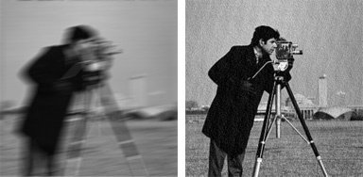
What is image Restoration?
Image restoration attempts to restore/reconstruct/ recover images that have been degraded.﻿
- It identifies the degradation process and attempt to
reverse it

Slide 3
Definition
﻿Restoration attempts to reconstruct or recover an image that has been degraded by using a priori or estimated knowledge of the degradation phenomenon.
Restoration process involves:
modeling the degradation.
applying the inverse process in order to recover the original image.

Slide 4
How a image degraded?
Noise
Blur
Compression Artifacts
Scaling Issues
Aging
Physical Damage

Slide 5
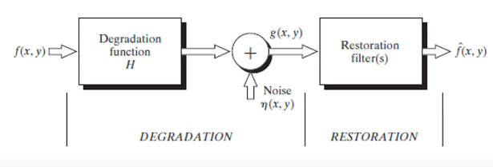
A Model of the image Restoration process

Slide 6
To find the degraded image
The degraded image in the spatial domain is given
As: g(x, y) = h(x,y) ⋆ f(x, y) +n(x, y)
g(x,y) represents the degraded image.
h(x,y) is the degradation caused by the system or process.
f(x,y) is the original image.
n(x,y) represents additive noise.

Slide 7
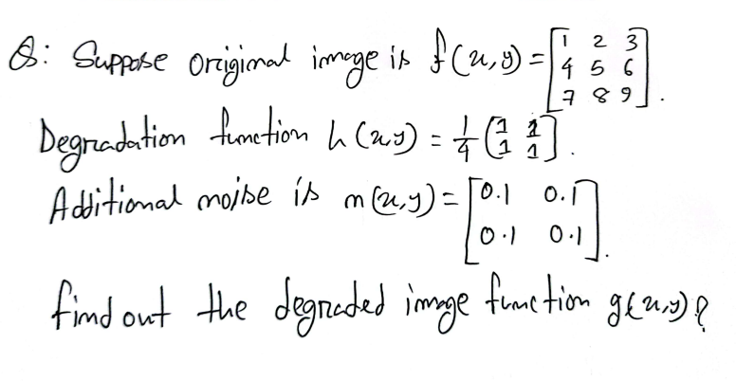

Slide 8
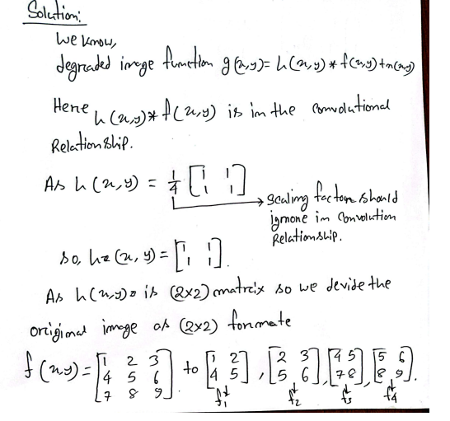

Slide 9
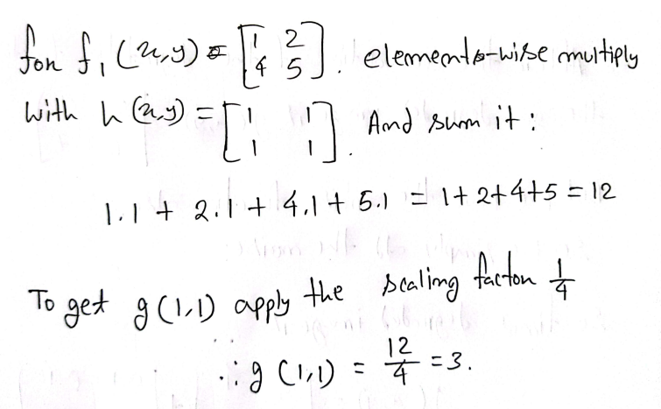

Slide 10
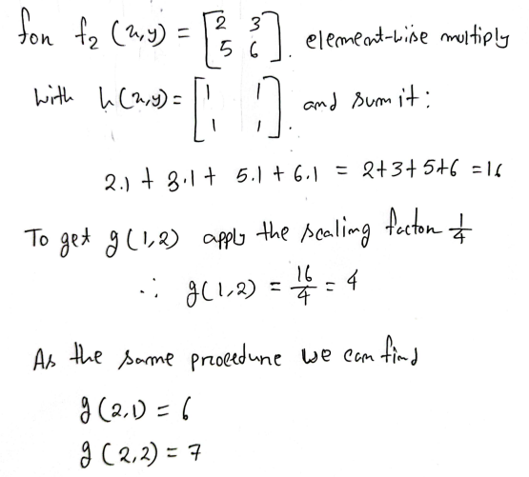

Slide 11
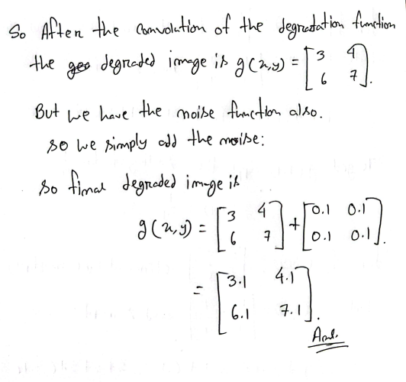

Slide 12



Assignment
Explain how the phenomenon of image degradation is addressed in the context of digital image processing.
Suppose the original image is f(x,y)=
Degradation Function is h(x.y) =
Additional noise is n(x,y) =
Find Out the degraded image function g(x,y) ?

Slide 13
Noise Model
Noise is an unwanted signal which distorts the original pixel intensity values, degrading the quality of image.
Noise is arise in Digital image during acquisition(digitization) and transmission
- The performance of image sensor is affected by variety of factor such as environment condition
-Due interference in the channel used for transmission of an image

Slide 14
Noise cont.
To understand the restoration process,it is important to understand the noise function n(x,y).
Noise cannot be predicted but can be approximately described in statistical way using probability density function(PDF).
Noise Model Assumption
-Independent of spatial coordinate
-Un-correlated with the image (no relation between the pixel values and noise components)

Slide 15
Noise types
There are many different models for the image term n(x,y)
1.Uniform noise model
2 Rayleigh noise model
3. Gaussian noise model
4 Erlang(Gamma) noise model
5. Exponential model
6 Impulse (Salt pepper noise)

Slide 16
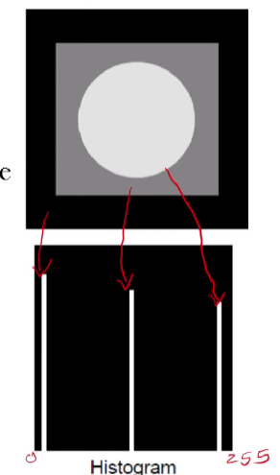
Noise Exampe
Here show a test image and its distribution.
The following slides will show the result of adding
Noise based on various models to this noise.

Slide 17
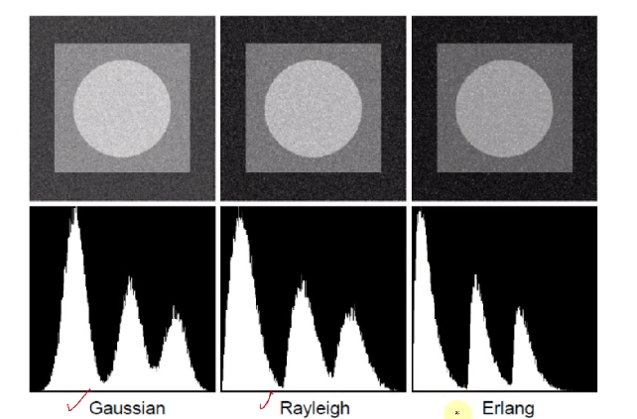
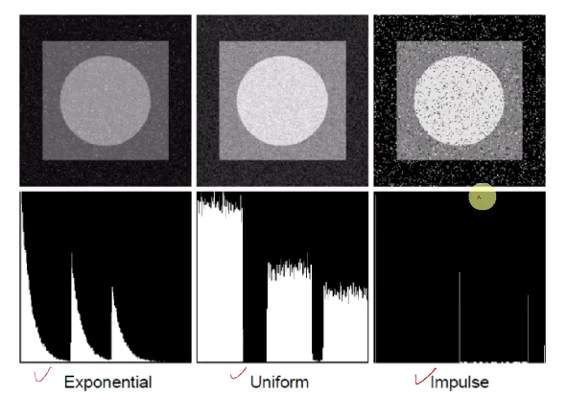
Noise example cont.

Slide 18
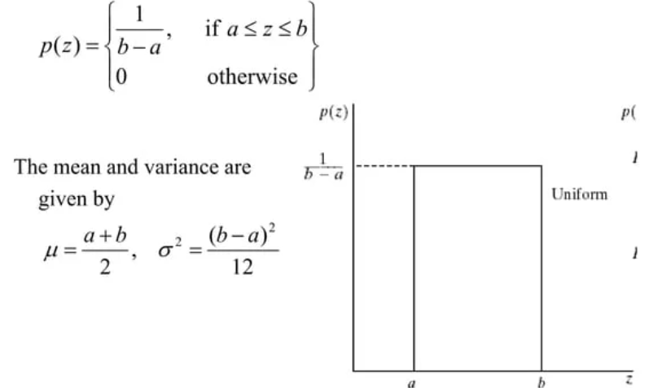
Noise Models: Uniform noise
Uniform noise occurs due to various factors such as electronic interference, sensor limitations, or imperfections in the data acquisition process.

Slide 19
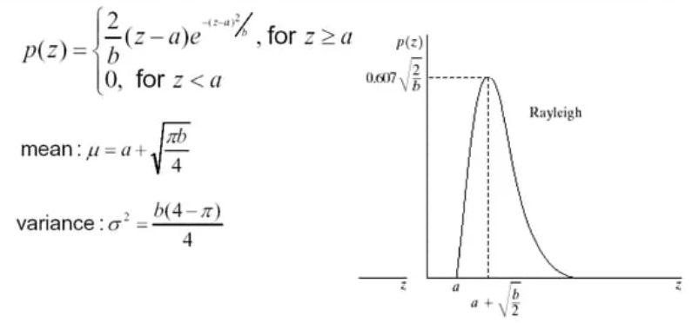
Noise Models: Rayleigh noise
Rayleigh noise often arises from physical phenomena such as thermal noise in electronic devices, atmospheric disturbances, or background radiation.

Slide 20
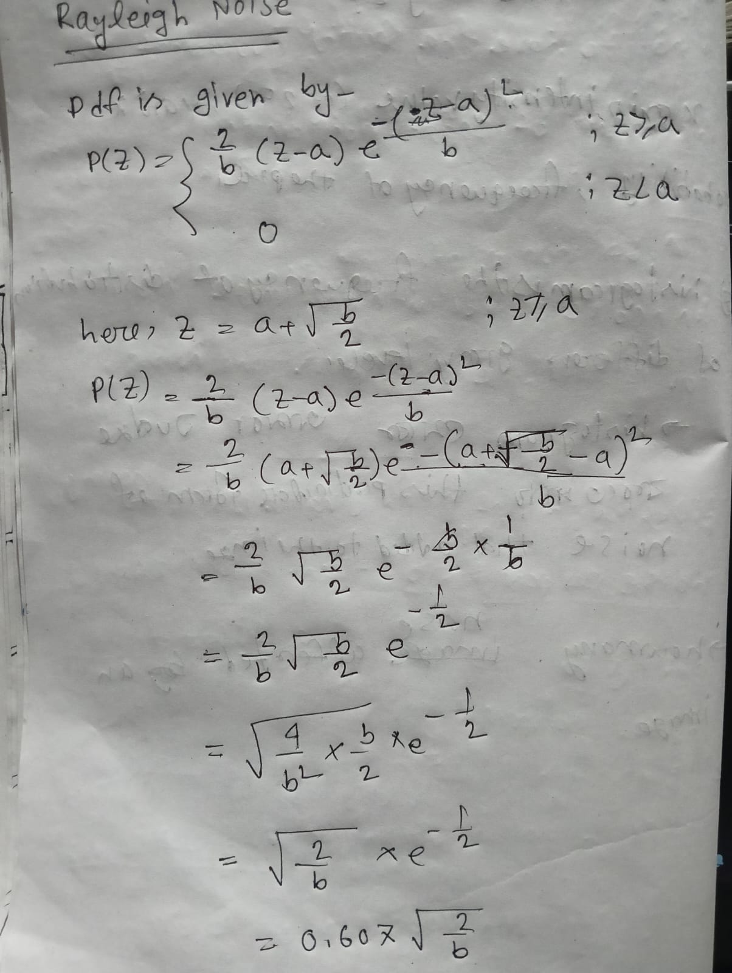
Noise Models: Rayleigh noise cont.
\

Slide 21
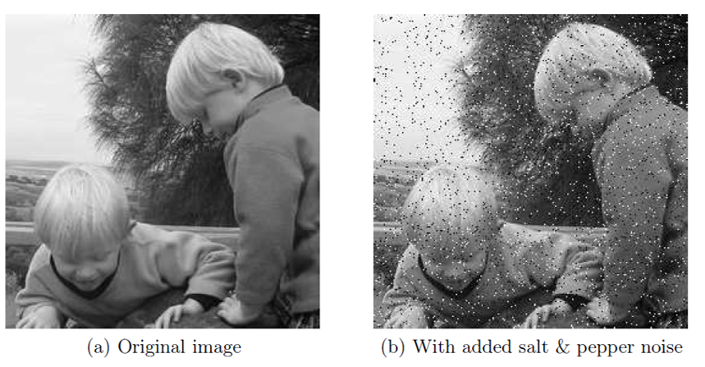
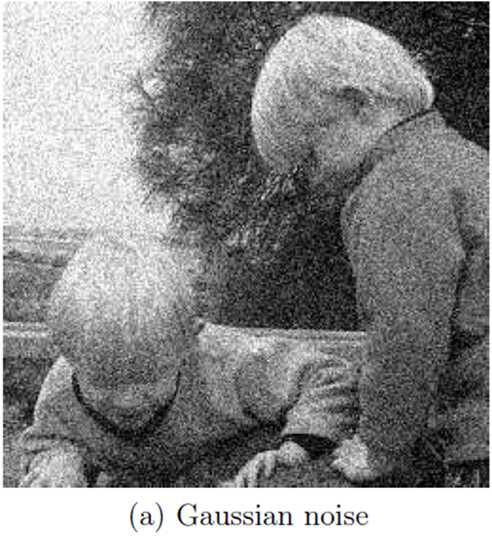
Noise Models: Gaussian Noise

Slide 22
Noise Models: Gaussian Noise or Normal Distribution
Most common noise model (Good approximation of other models)
Gaussian Noise effects both dark and light areas of image (obscuring fine details and edges in the image)
Reduce clarity in color or tone.
Idealized by white noise.
Why Gaussian Noise occurs?
Photon Noise: Pictures in low light conditions
Thermal Noise: Generated by the random motion of electrons in conductive materials, affecting electronic circuits and sensors.
Electronic Sensor Noise: Electronic imperfections within the camera arising from thermal fluctuations and imperfections in electronic sensors
Images acquired by Scanners exhibit this phenomenon.

Slide 23
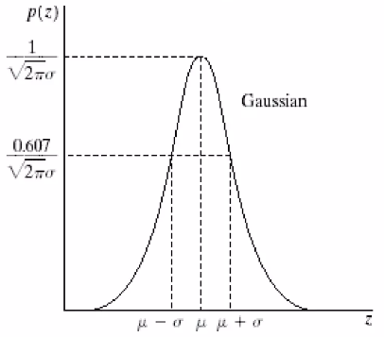
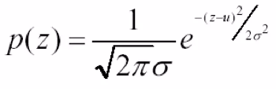
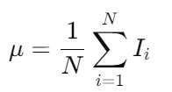

Noise Models: Gaussian Noise
The (Probability Density Function) PDF of a Gaussian random variable, z, is given by:
Where:
z : Gray level
µ : Mean of Average values of z
σ : Standard Deviation
PDF tells how much each Z value occurs.

Slide 24
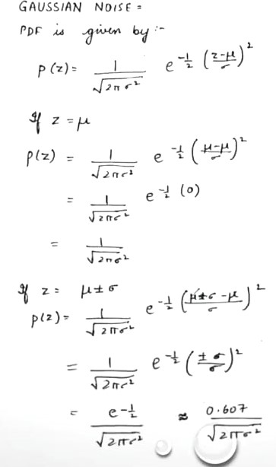
Noise Models: Gaussian Noise

Slide 25
Noise Models: Impulse Noise

Slide 26
Noise Models: Impulse Noise
It is also known as Salt and Pepper Noise, and Binary Noise
It is the only type of noise that can be distinguished from others visually (spikes of the intensity range 0 and 255)
Image having Impulse Noise can be identified:
Random Outliers: Randomly scattered white and black pixels throughout the image
Why Salt and Pepper Noise occurs?
It occurs mostly because of sensor, dust in camera, during transmission and memory problem because of which pixels are assigned incorrect maximum values
Example: Whatsapp sharing Image, Multiple image sharing.

Slide 27
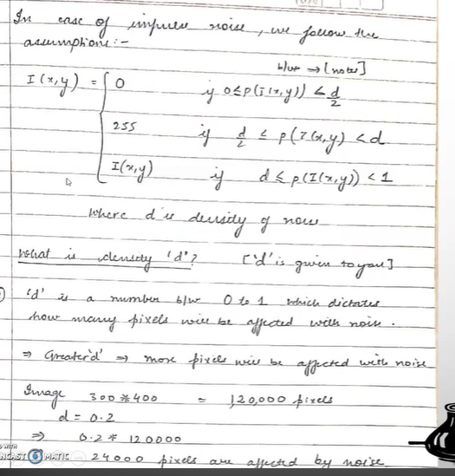
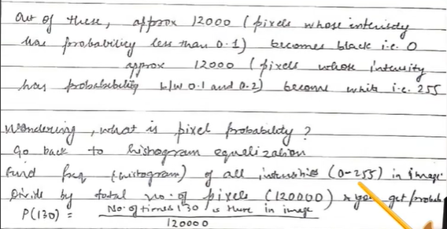
Noise Models: Impulse Noise

Slide 28
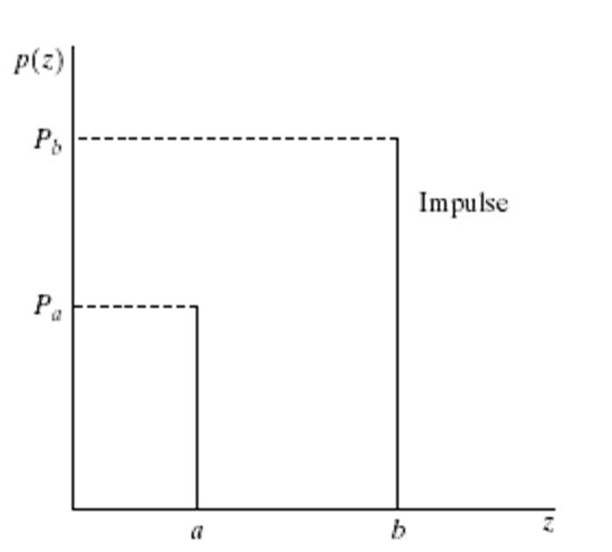
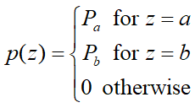
Noise Models: Impulse Noise
The PDF of Impulse noise is given as:
In Bipolar Impulse noise,
Normally, a=0 (black) , b = 255(white)
If either Pa or Pb is zero,
the impulse noise is called unipolar
If neither probability is zero, and especially when they are approximately equal, impulse noise values will randomly distributed over the image .

Slide 29
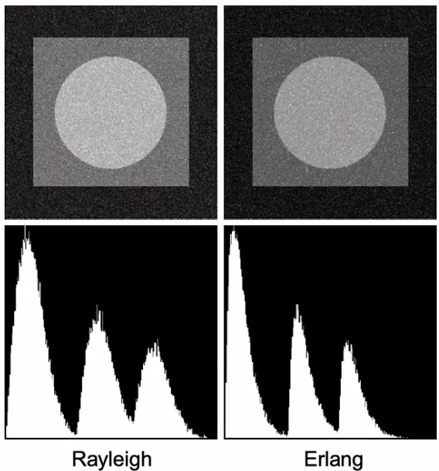
Noise Models: Erlang noise
This type of noise is mostly present in range images
Range images are mostly used in remote sensing applications
Erlang Noise is similar to Rayleigh Noise.
Not used often
The mathematical expression is complex

Slide 30
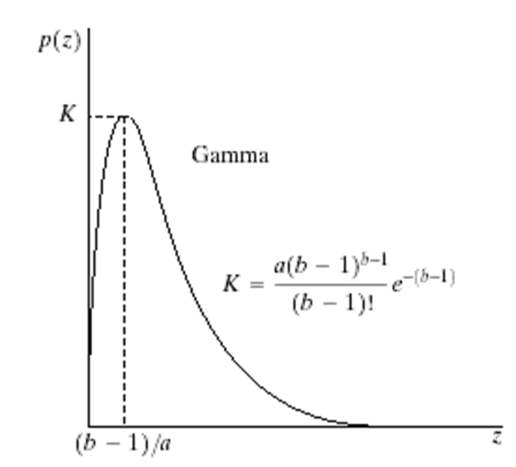
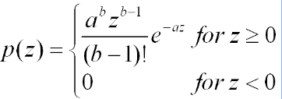

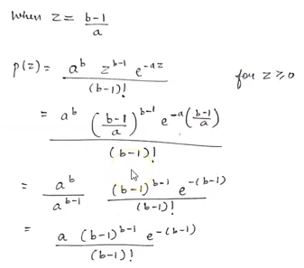
Noise Models: Erlang (Gamma) noise
The PDF of Erlang noise is given as:
The mean and variance of this density are given by:
Where, a= min gray value
b= max gray value

Slide 31
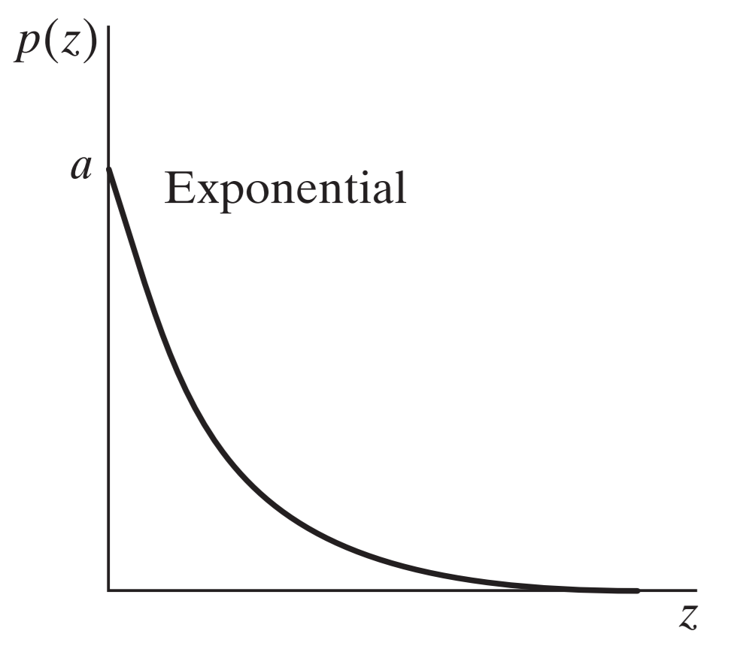


Noise Models: Exponential Noise (b=1) in Erlang noise
This type of noise occurs mostly due to the illumination problems
It is present in laser imaging or mars image
The PDF of Exponential noise is given as:
The mean and variance of this density:
a =rate parameter
Here, a is the initial value of the probability density function p(z) at z=0. It dictates how quickly the exponential curve declines as z increases.

Slide 32
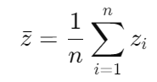



Noise Models: Exponential Noise
Calculate the Sample Mean:
Calculate the Rate parameter:
If z=[2,1,4,3,5]

Slide 33
Noise Models: Impulse Noise & Quiz
Homework:
If there is an image having 760 pixel in height and 360 pixel in width, then what will be the number of affected pixels by noise if density value is 0.4?
https://forms.gle/1GrJGd2V7AQDYj6h6

Slide 34
Noise Removal Restoration Model
Mean filters
Arithmetic mean filter
Geometric mean filter
Harmonic mean filter
Order statistics filters
Median filter
Max and min filters
Midpoint filter
Adaptive filter
Adaptive Mean filter

Slide 35
Mean Filter
A spatial domain filter that smooths an image by averaging pixel values within a neighborhood.
Replaces each pixel value with the average of its surrounding pixels.
Reduces random noise
Effect: Smooths the image but can blur edges

Slide 36
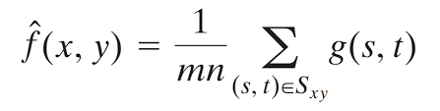
Types of Mean Filters
1. Arithmetic Mean Filter
Computed the average value of the corrupted image g(x,y) in the area defined by Sxy.
Let Sxy represent the set of coordinates in a rectangular neighborhood of size m x n, centered at the point (x,y).
Effect: The Mean filter simply smoothes the image. Noise is reduced as a result of blurring

Slide 37
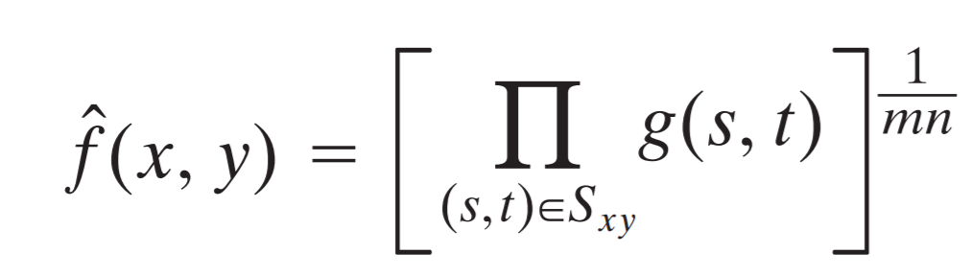
2. Geometric mean Filter
A variation of the arithmetic mean filter.
Comparable to the arithmetic mean filter →
achieve smoothing;
lose less image detail in the process
g(s, t) represents the location of each pixel value inside the window located at coordinates s and t.

Slide 38
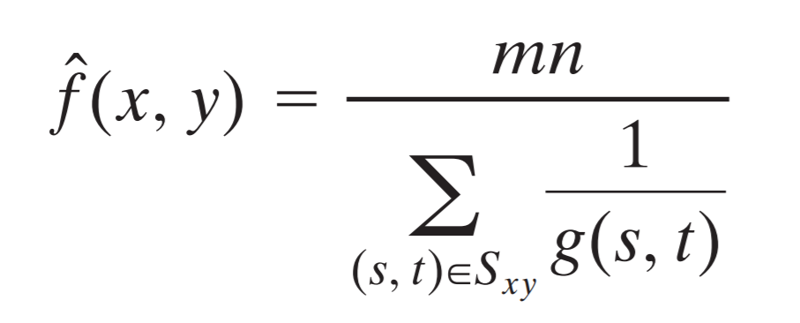
3. Harmonic mean Filter
Uses the harmonic mean of pixel values within a neighborhood.
Another variation of the arithmetic mean filter
Useful for images with salt noise but can fail with pepper noise

Slide 39
Order statistics Filters
Order Statistics filters are filters whose response is based on ordering the pixel contained in the image area encompassed by the filter.
Median Filter
Min and Max Filter
Midpoint Filter

Slide 40
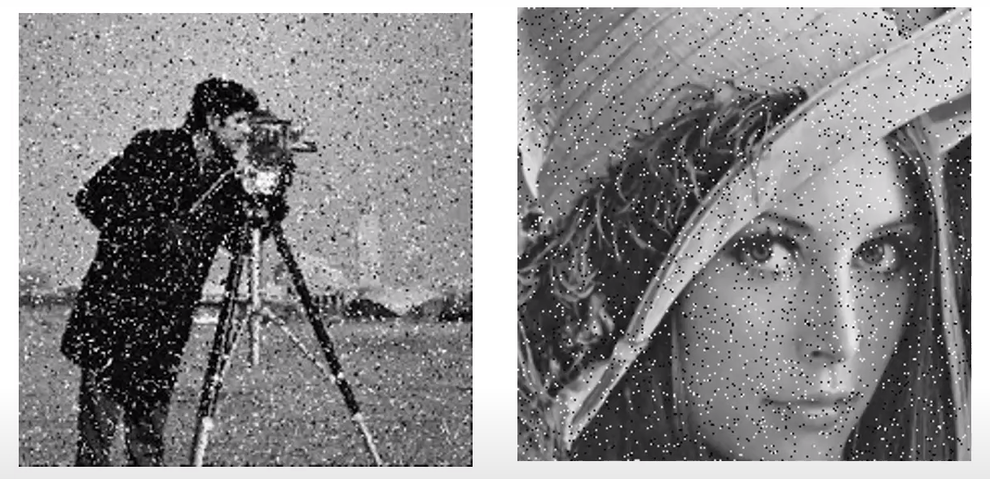
Median Filter

Slide 41

Median Filter
Formula of Median filter is:

Slide 42
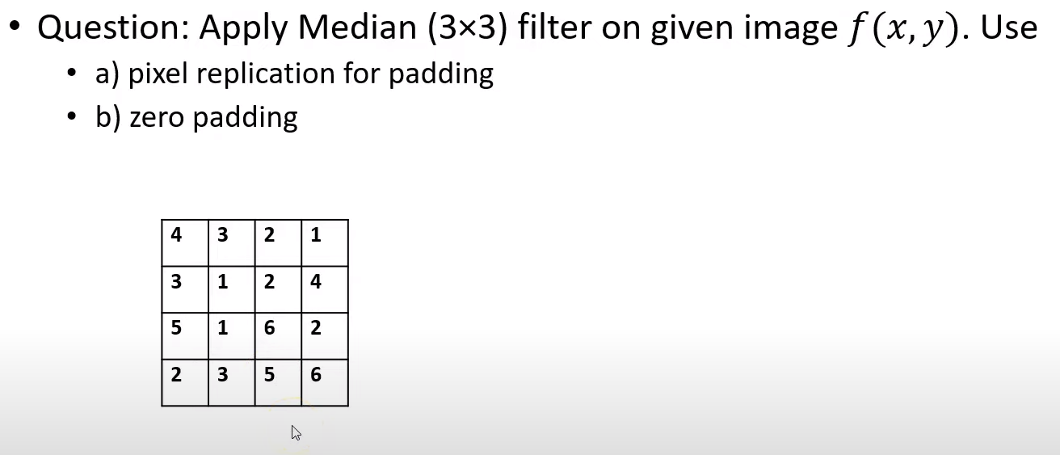
Median Filter

Slide 43
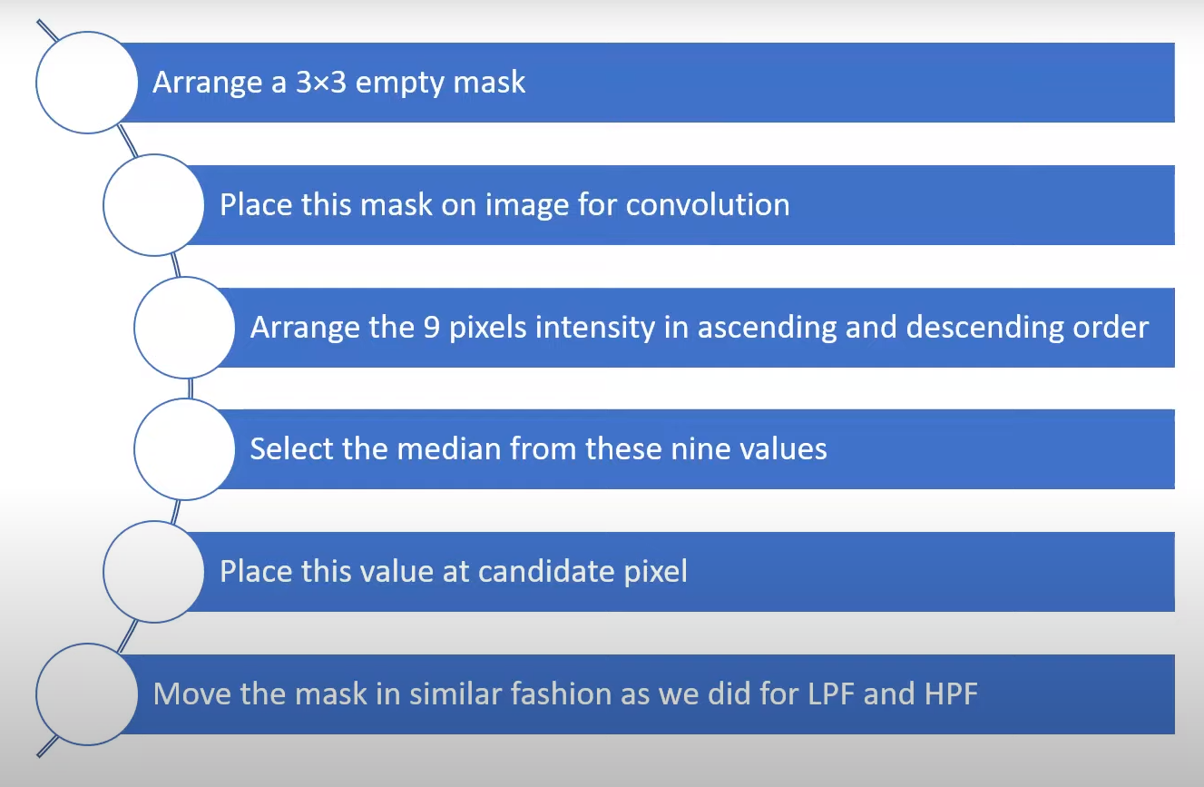
Median Filter

Slide 44
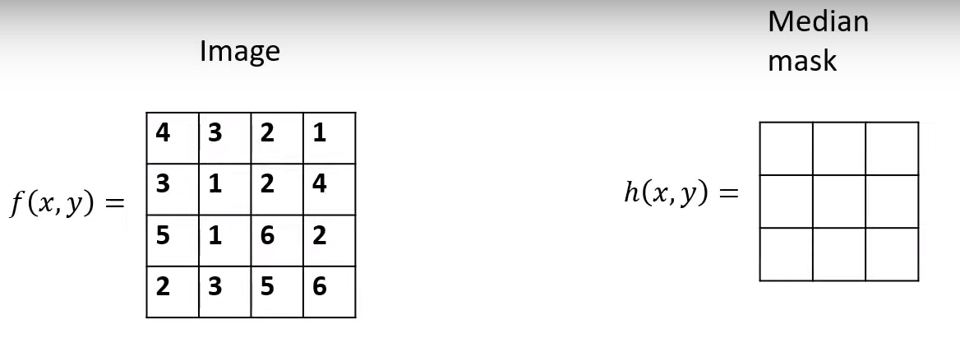
Median Filter

Slide 45
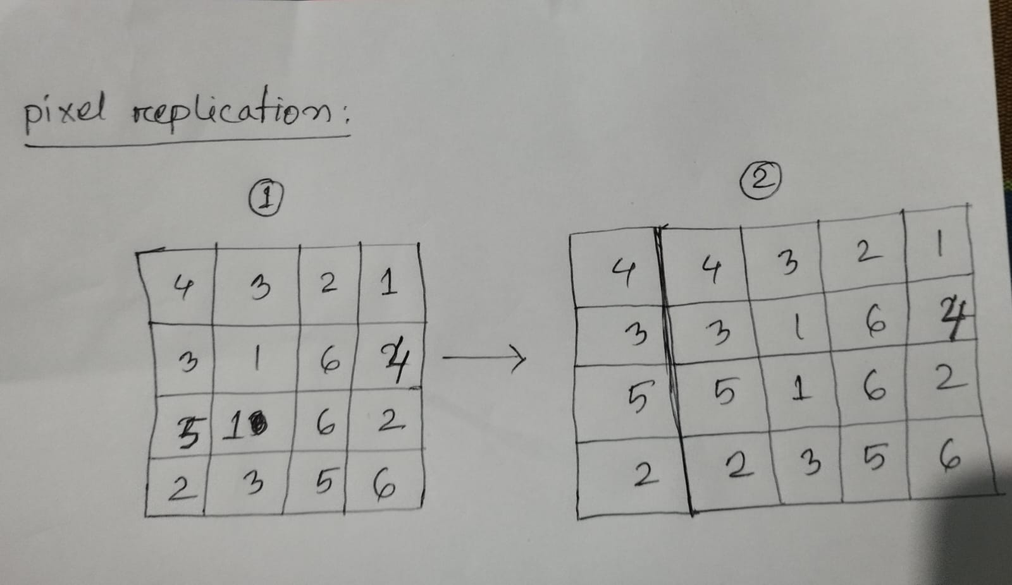
Median Filter

Slide 46
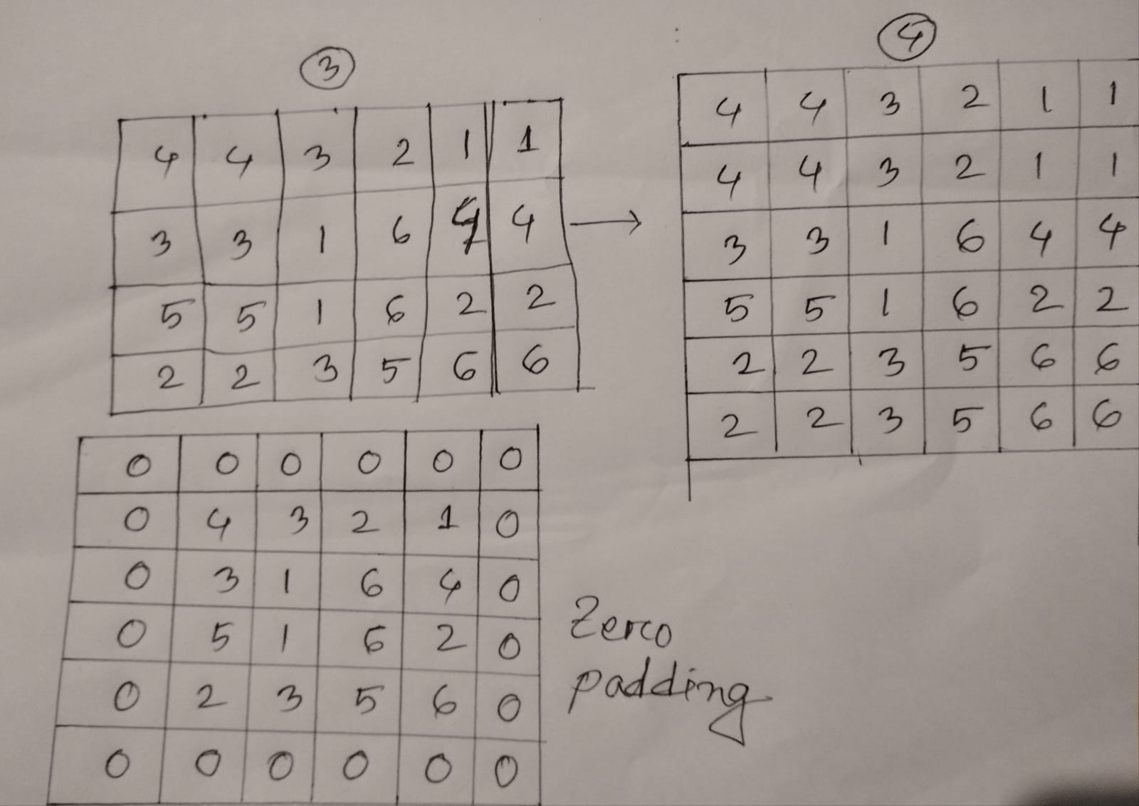
Median Filter

Slide 47
Median Filter
4 | 4 | 3 | 2 | 1 | 1
4 | 4 | 3 | 2 | 1 | 1
3 | 3 | 1 | 2 | 4 | 4
5 | 5 | 1 | 6 | 2 | 2
2 | 2 | 3 | 5 | 6 | 6
2 | 2 | 3 | 5 | 6 | 6
Order: 443443331
descending order: 444433331

Slide 48
Median Filter
4 | 4 | 3 | 2 | 1 | 1
4 | 3 | 3 | 2 | 1 | 1
3 | 3 | 1 | 2 | 4 | 4
5 | 5 | 1 | 6 | 2 | 2
2 | 2 | 3 | 5 | 6 | 6
2 | 2 | 3 | 5 | 6 | 6
So the middle value of the mask will be 3.

Slide 49
Median Filter
4 | 4 | 3 | 2 | 1 | 1
4 | 4 | 3 | 2 | 1 | 1
3 | 3 | 1 | 2 | 4 | 4
5 | 5 | 1 | 6 | 2 | 2
2 | 2 | 3 | 5 | 6 | 6
2 | 2 | 3 | 5 | 6 | 6
Order: 432432312
descending order: 443332221

Slide 50
Median Filter
4 | 4 | 3 | 2 | 1 | 1
4 | 3 | 3 | 2 | 1 | 1
3 | 3 | 1 | 2 | 4 | 4
5 | 5 | 1 | 6 | 2 | 2
2 | 2 | 3 | 5 | 6 | 6
2 | 2 | 3 | 5 | 6 | 6
So the middle value of the mask will be 3.

Slide 51
Median Filter
4 | 4 | 3 | 2 | 1 | 1
4 | 4 | 3 | 2 | 1 | 1
3 | 3 | 1 | 2 | 4 | 4
5 | 5 | 1 | 6 | 2 | 2
2 | 2 | 3 | 5 | 6 | 6
2 | 2 | 3 | 5 | 6 | 6
Order: 321321124
descending order: 433222111

Slide 52
Median Filter
4 | 4 | 3 | 2 | 1 | 1
4 | 3 | 3 | 2 | 1 | 1
3 | 3 | 1 | 2 | 4 | 4
5 | 5 | 1 | 6 | 2 | 2
2 | 2 | 3 | 5 | 6 | 6
2 | 2 | 3 | 5 | 6 | 6
So the middle value of the mask will be 2.

Slide 53
Median Filter
4 | 4 | 3 | 2 | 1 | 1
4 | 4 | 3 | 2 | 1 | 1
3 | 3 | 1 | 2 | 4 | 4
5 | 5 | 1 | 6 | 2 | 2
2 | 2 | 3 | 5 | 6 | 6
2 | 2 | 3 | 5 | 6 | 6
Order: 211211244
descending order: 442221111

Slide 54
Median Filter
4 | 4 | 3 | 2 | 1 | 1
4 | 3 | 3 | 2 | 2 | 1
3 | 3 | 1 | 2 | 4 | 4
5 | 5 | 1 | 6 | 2 | 2
2 | 2 | 3 | 5 | 6 | 6
2 | 2 | 3 | 5 | 6 | 6
So the middle value of the mask will be 2.

Slide 55
Median Filter
4 | 4 | 3 | 2 | 1 | 1
4 | 4 | 3 | 2 | 1 | 1
3 | 3 | 1 | 2 | 4 | 4
5 | 5 | 1 | 6 | 2 | 2
2 | 2 | 3 | 5 | 6 | 6
2 | 2 | 3 | 5 | 6 | 6
Order: 443331551
descending order: 554433311

Slide 56
Median Filter
4 | 4 | 3 | 2 | 1 | 1
4 | 3 | 3 | 2 | 2 | 1
3 | 3 | 1 | 2 | 4 | 4
5 | 5 | 1 | 6 | 2 | 2
2 | 2 | 3 | 5 | 6 | 6
2 | 2 | 3 | 5 | 6 | 6
So the middle value of the mask will be 3.

Slide 57
Median Filter
If you continue to do this then we will get
4 | 4 | 3 | 2 | 1 | 1
4 | 3 | 3 | 2 | 2 | 1
3 | 3 | 3 | 2 | 2 | 4
5 | 3 | 3 | 3 | 4 | 2
2 | 2 | 3 | 5 | 6 | 6
2 | 2 | 3 | 5 | 6 | 6

Slide 58
Median Filter
Using Zero padding we can do the same. The result will be like this
0 | 0 | 0 | 0 | 0 | 0
0 | 0 | 2 | 1 | 0 | 0
0 | 1 | 3 | 2 | 2 | 0
0 | 1 | 3 | 3 | 2 | 0
0 | 0 | 2 | 2 | 0 | 0
0 | 0 | 0 | 0 | 0 | 0

Slide 59
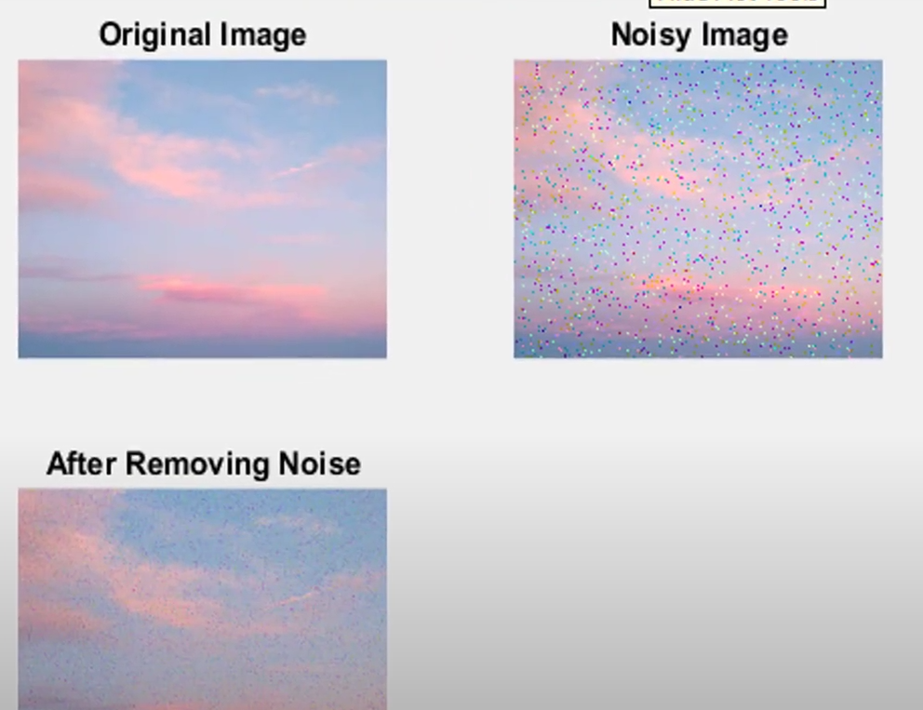
Median Filter

Slide 60
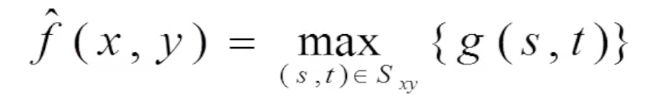
Max and Min Filter
4 | 4 | 3 | 2 | 1 | 1
4 | 4 | 3 | 2 | 1 | 1
3 | 3 | 1 | 2 | 4 | 4
5 | 5 | 1 | 6 | 2 | 2
2 | 2 | 3 | 5 | 6 | 6
2 | 2 | 3 | 5 | 6 | 6

Slide 61
Max and Min Filter
4 | 4 | 3 | 2 | 1 | 1
4 | 4 | 4 | 3 | 4 | 1
3 | 4 | 6 | 6 | 6 | 4
5 | 5 | 6 | 6 | 6 | 2
2 | 5 | 6 | 6 | 6 | 6
2 | 2 | 3 | 5 | 6 | 6

Slide 62
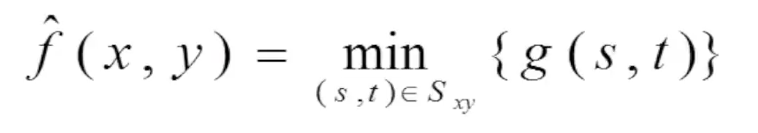
Max and Min Filter
4 | 4 | 3 | 2 | 1 | 1
4 | 4 | 3 | 2 | 1 | 1
3 | 3 | 1 | 2 | 4 | 4
5 | 5 | 1 | 6 | 2 | 2
2 | 2 | 3 | 5 | 6 | 6
2 | 2 | 3 | 5 | 6 | 6

Slide 63
Max and Min Filter
4 | 4 | 3 | 2 | 1 | 1
4 | 1 | 1 | 1 | 1 | 1
3 | 1 | 1 | 1 | 1 | 4
5 | 1 | 1 | 1 | 2 | 2
2 | 1 | 1 | 1 | 2 | 6
2 | 2 | 3 | 5 | 6 | 6

Slide 64
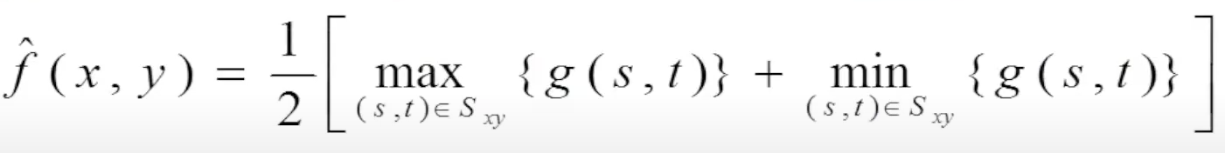
Mid-Point Filter
4 | 4 | 3 | 2 | 1 | 1
4 | 4 | 3 | 2 | 1 | 1
3 | 3 | 1 | 2 | 4 | 4
5 | 5 | 1 | 6 | 2 | 2
2 | 2 | 3 | 5 | 6 | 6
2 | 2 | 3 | 5 | 6 | 6

Slide 65
Mid-Point Filter
4 | 4 | 3 | 2 | 1 | 1
4 | 2.5 | 2.5 | 2 | 2.5 | 1
3 | 2.5 | 3.5 | 3.5 | 3.5 | 4
5 | 3 | 3.5 | 3.5 | 4 | 2
2 | 3 | 3.5 | 3.5 | 4 | 6
2 | 2 | 3 | 5 | 6 | 6

Slide 66
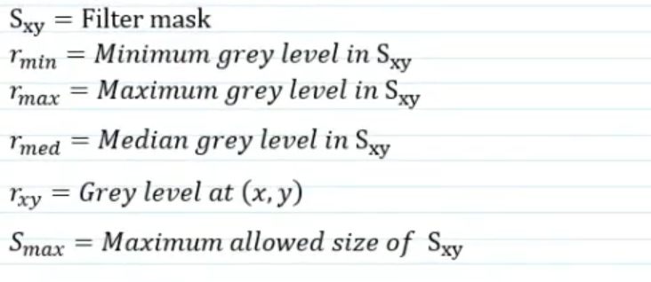
Adaptive Mean Filter

Slide 67
Adaptive Mean Filter
rxy
rmin
0 | 2 | 2
3 | 4 | 5
6 | 7 | 8
Let the Smax = 9*9
Filter mask = 3*3
rmed
rmax

Slide 68
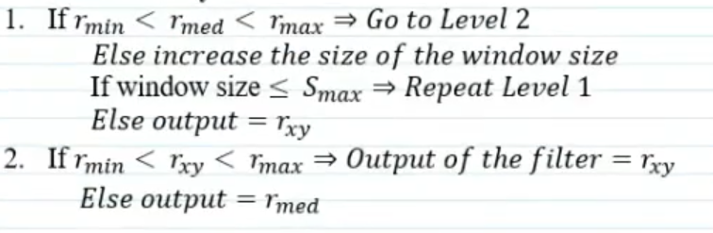
Adaptive Mean Filter

Slide 69
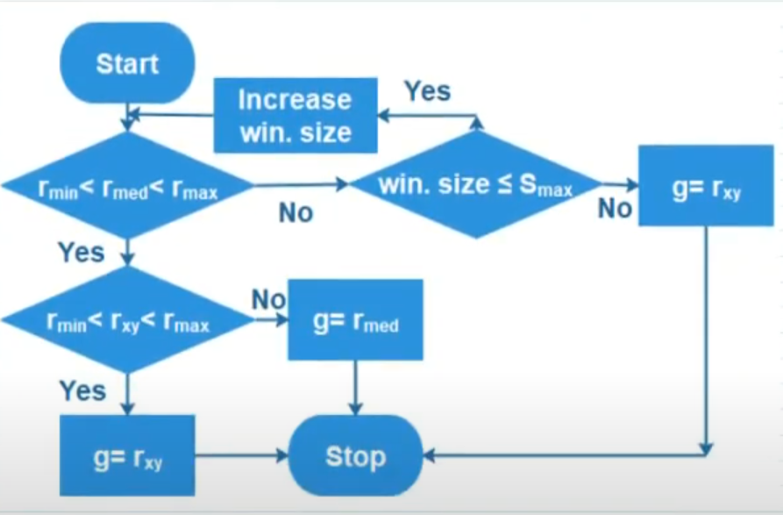
Adaptive Mean Filter

Slide 70
Thank You!

