Slide 1
Department of Geology, University of Dhaka
GHT 402: ENVIRONMENTAL GEOLOGY
(Fourth Year: 2 Credit Hours)
Introduction, Scope and Concepts of Environmental Geology
Hazardous Earth Processes and Their Characteristics: Flood, Landslide, Earthquake, Volcanism, Coastal Hazards
Hazard Mitigation and Management
Human Interaction with the Environment: Pollution, Waste Disposal, Geological aspects of environmental Health
Exploitation of Natural Resources and their environmental Impacts
Landuse and Planning, Environmental Laws, Environmental Conservation

Slide 2



Hazardous Earth Processes and Their Characteristics:
FLOOD
The Hydrologic Cycle
Streams and Their Features
Flooding
Hydro-meteorological Monitoring Network in Bangladesh
Consequences of Development in Floodplains
Strategies for Reducing Flood Hazards
Flood in Bangladesh and Non-structural Measures
Anwar Zahid, Ph.D.
(Hydro and Environmental Geologist)
Part-time Teacher, Department of Geology, University of Dhaka
Deputy Director, Bangladesh Water Development Board
E-mail: anwarzahidb@gmail.com
Notes:
2

Slide 3
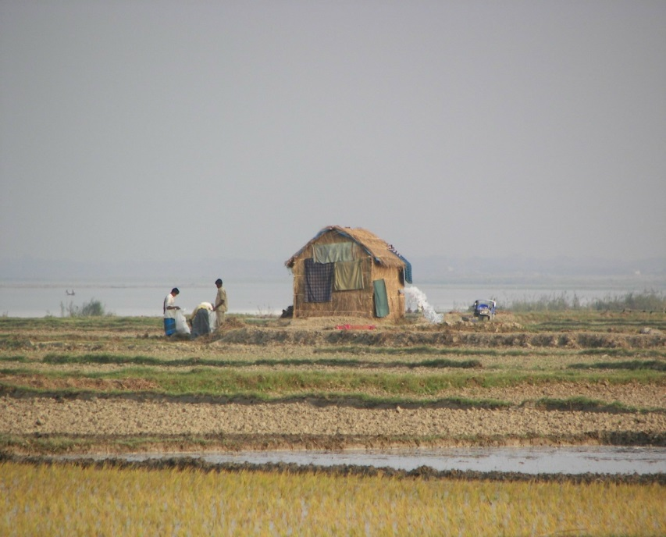
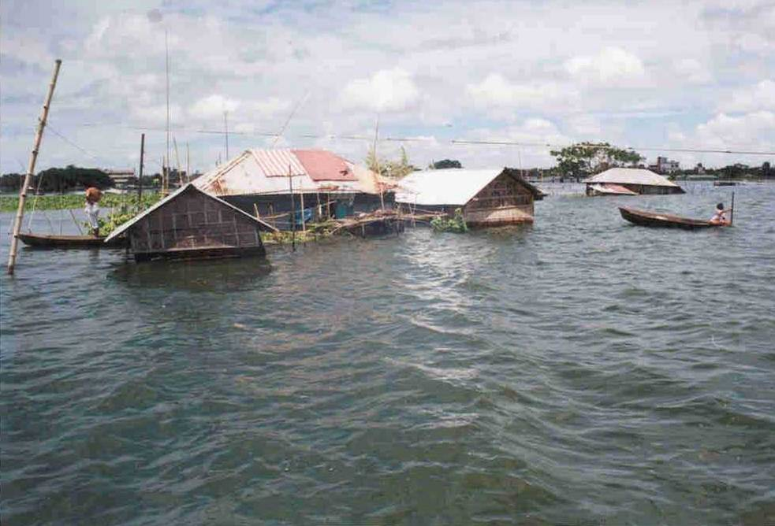
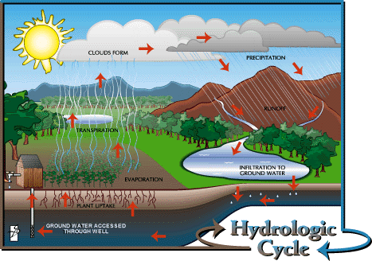
Flooding
anwarzahidb@gmail.com
Notes:
3

Slide 4
Flooding
The size of an unmodified stream channel is directly related to the quantity of water that it usually carries. That is, the volume of the channel is approximately sufficient to accommodate the average maximum discharge reached each year.
Much of the year, the surface of the water is well below the level of the stream banks. In times of higher discharge, the stream may overflow its banks, or flood.
This may happen, to a limited extent, as frequently as every two to three years with streams in humid regions. More severe floods occur correspondingly less often.
The vast majority of stream floods are linked to precipitation (rain or snow). When rain falls or snow melts, some of the water infiltrates, or sinks into the ground.
It may then percolate through soil and rock at greater depths. Some evaporates directly into the atmosphere. The rest of the water becomes surface runoff, flowing downhill over the surface under the influence of gravity into a puddle, lake, ocean, or stream.
Many factors together determine whether a flood will occur.
anwarzahidb@gmail.com

Slide 5
Factors Governing Flood Severity:
Precipitation and Snowmelt
Worldwide, the most intense rainfall events occur in Southeast Asia including Bangladesh, where storms have drenched the region with up to 200 centimeters (80 inches) of rain in less than three days.
In the United States, several regions are especially prone to heavy rainfall events: the southern states, vulnerable to storms from the Gulf of Mexico; the western coastal states, subject to prolonged storms from the Pacific Ocean; and the midcontinent states, where hot, moist air from the Gulf of Mexico can collide with cold air sweeping down from Canada.
Streams that drain the Rocky Mountains are likely to flood during snowmelt, especially when rapid spring thawing follows a winter of unusually heavy snow.
During a flood, the water level of a stream is higher than usual, and its velocity and discharge also increase as the greater mass of water is pulled downstream by gravity. The higher volume (mass) and velocity together produce the increased force that gives floodwaters their destructive power.
Local flood hazard may vary seasonally or as a result of meteorologic fluctuations.

Slide 6
Factors Governing Flood Severity:
Soil/Rock Type and Topography
The rate of surface runoff is influenced by the extent of infiltration, which, in turn, is controlled by the soil type and how much soil is exposed. Soils, like rocks, vary in porosity and permeability.
A very porous and permeable soil allows a great deal of water to sink in relatively fast. If the soil is less permeable or is covered by artificial structures, the proportion of water that runs off over the surface increases.
Once even permeable soil is saturated with water, moreover, any additional moisture is necessarily forced to become part of the surface runoff.
Topography also influences the extent or rate of surface runoff: The steeper the terrain, the more readily water runs off over the surface and the less it tends to sink into the soil.
Water that infiltrates the soil, like surface runoff, tends to flow down-gradient, and may, in time, also reach the stream. However, the subsurface runoff water, flowing through soil or rock, generally moves much more slowly than the surface runoff.
anwarzahidb@gmail.com

Slide 7
Factors Reducing Flood Severity
The more gradually the water reaches the stream, the better the chances that the stream discharge will be adequate to carry the water away without flooding.
Therefore, the relative amounts of surface and subsurface (groundwater) runoff, which are strongly influenced by the near-surface geology of the drainage basin, are fundamental factors affecting the severity of stream flooding.
Vegetation may reduce flood hazards in several ways. The plants may simply provide a physical barrier to surface runoff, decreasing its velocity, and thus slowing the rate at which water reaches a stream.
Also, plant roots working into the soil loosen it, which tends to maintain or increase the soil's permeability, and hence infiltration, thus reducing the proportion of surface runoff.
Plants also absorb water, using some of it to grow and releasing some slowly by evapotranspiration. All of these factors reduce the volume of water introduced directly into a stream system.

Slide 8
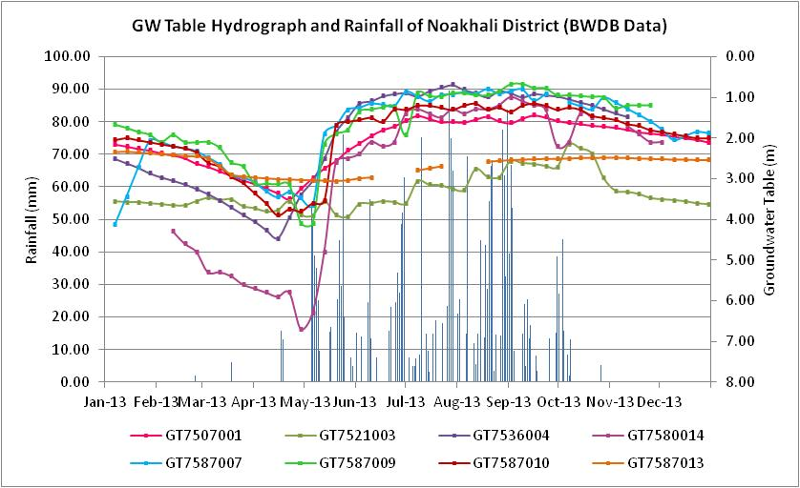
Hydrographs (BWDB data)
Groundwater Table

Slide 9
Flood Characteristics
The elevation of the water surface at any point is termed the stage of the stream. A stream is at flood stage when stream stage exceeds bank height. The magnitude of a flood can be described by either the maximum discharge or maximum stage reached.
The stream is said to crest when the maximum stage is reached. This may occur within minutes of the influx of water, as with flooding just below a failed dam. However, in places far downstream from the water input, or where surface runoff has been slowed, the stream may not crest for several days after the flood episode begins.
Floods that affect only small, localized areas (or streams draining small basins) are sometimes called upstream floods. These are most often caused by sudden, locally intense rainstorms and by events like dam failure.
Floods that affect large stream systems and large drainage basins are called downstream floods. These floods more often result from prolonged heavy rains over a broad area or from extensive regional snowmelt. Downstream floods usually last longer than upstream floods because the whole stream system is choked with excess water.

Slide 10
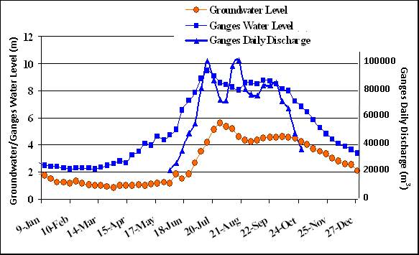
Hydrographs (BWDB data)
Crest
River Stage

Slide 11
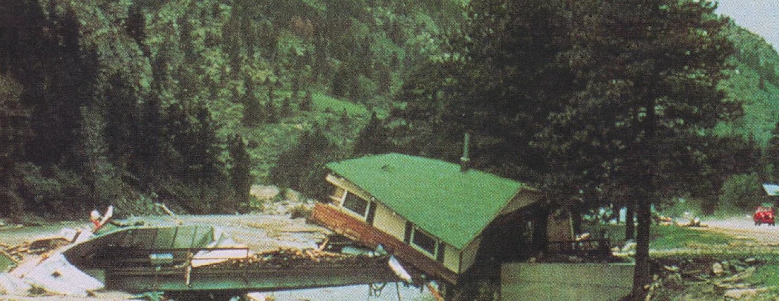
Rise of Stream Stage can be Pronounced and Rapid in Narrow Canyon
anwarzahidb@gmail.com

Slide 12
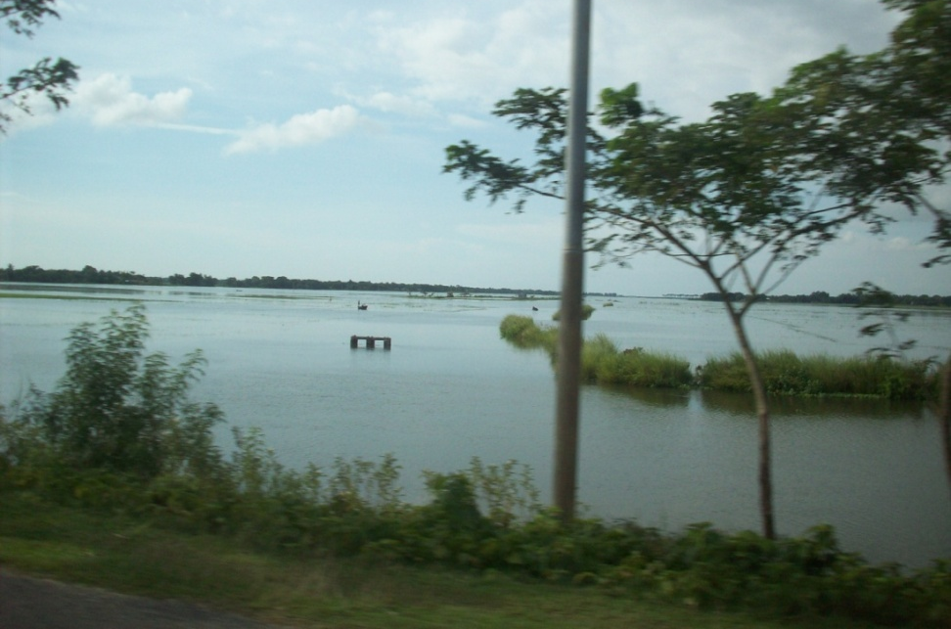
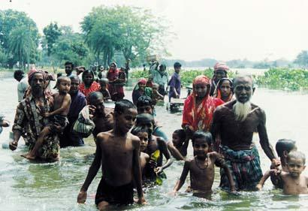
Flood in Bangladesh
anwarzahidb@gmail.com

Slide 13
Stream Hydrographs
Fluctuations in stream stage or discharge over time can be plotted on a hydrograph. Hydrographs spanning long periods of time are very useful in constructing a picture of the "normal" behavior of a stream and of that stream's response to flood-causing events.
Logically enough, a flood shows up as a peak on the hydrograph. The height and width of that peak and its position in time relative to the water-input event(s) depend, in part, on where the measurements are taken relative to where the excess water is entering the system.
Upstream, where the drainage basin is smaller and the water need not travel so far to reach the stream, the peak is likely to be sharper-with a higher crest and more rapid rise and fall of the level and to occur sooner after the influx of water.
By the time that water pulse has moved downstream to a lower point in the drainage basin, it will have dispersed somewhat, so that the arrival of the water spans a longer time.
The peak will be spread out, so that the hydrograph shows both a later and a broader, gentler peak. A short event like a severe cloudburst will tend to produce a sharper peak than a more prolonged event like several days of steady rain or snowmelt, even if the same amount of water is involved.

Slide 14
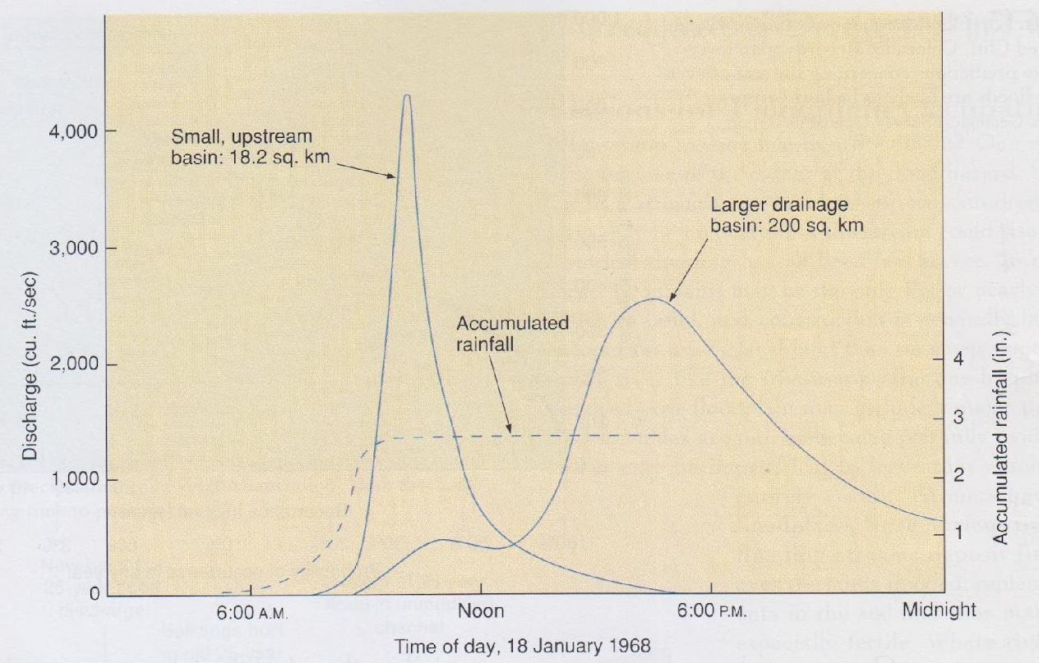
Flood Hydrograph (Texas): In the Upstream Part of the Basin Flooding Quickly Follows the Rain While Larger Stream Lower in the Basin Responds More Sluggishly
anwarzahidb@gmail.com

Slide 15
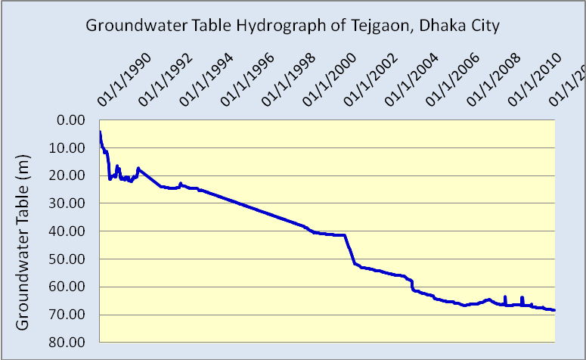
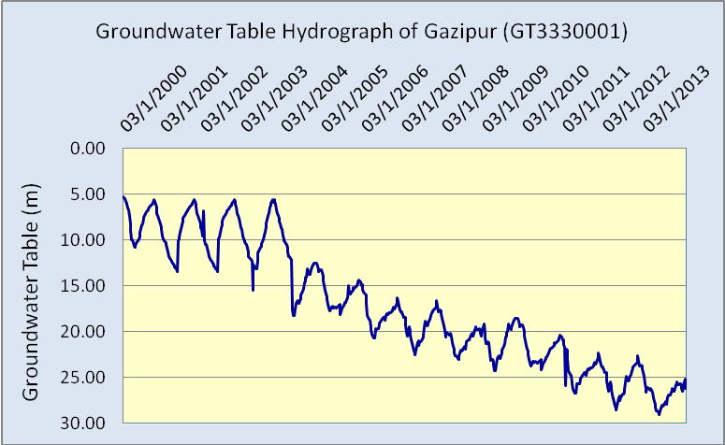
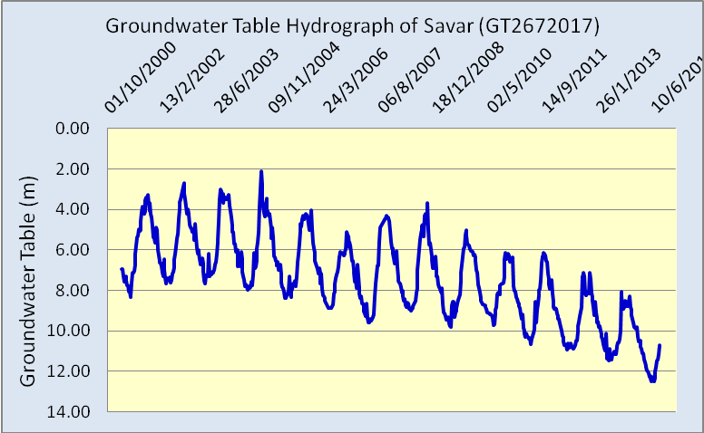
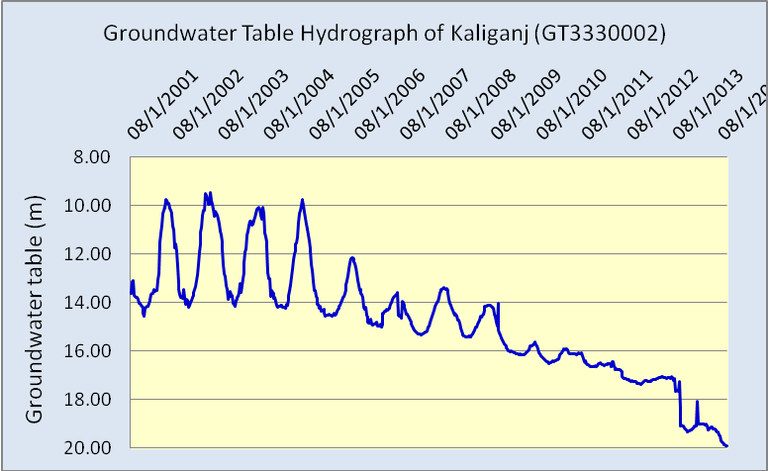
Long-term Groundwater Table/Level Hydrographs
in and around Dhaka City (Upper Aquifer)

Slide 16
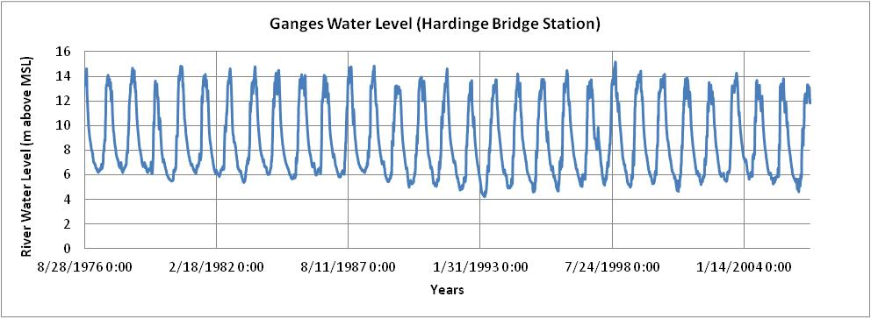
Ganges Water Level Hydrograph
anwarzahidb@gmail.com

Slide 17
Flood-Frequency Curves
Another way of looking at flooding is in terms of the frequency of flood events of differing severity. Long-term records make it possible to construct a curve showing discharge as a function of recurrence interval for a particular stream or section of one.
A flood event can then be described by its recurrence interval: how frequently a flood of that severity occurs, on average, for that stream.
Alternatively, one can refer to the probability that a flood of given size will occur in any one year; this probability is the inverse of the recurrence interval.
Flood-frequency (or flood-probability) curves can be extremely useful in assessing regional flood hazards. If the severity of the one-hundred- or two-hundred-year flood can be estimated in terms of discharge, then, scientists and planners can, with the aid of topographic maps, project how much of the region would be flooded in such events.
Such information is useful in preparing flood-hazard maps, an exercise that is also aided by use of aerial or satellite photography. Such maps, in turn, are helpful in setting new construction projects to minimize the risk of flood damage.

Slide 18
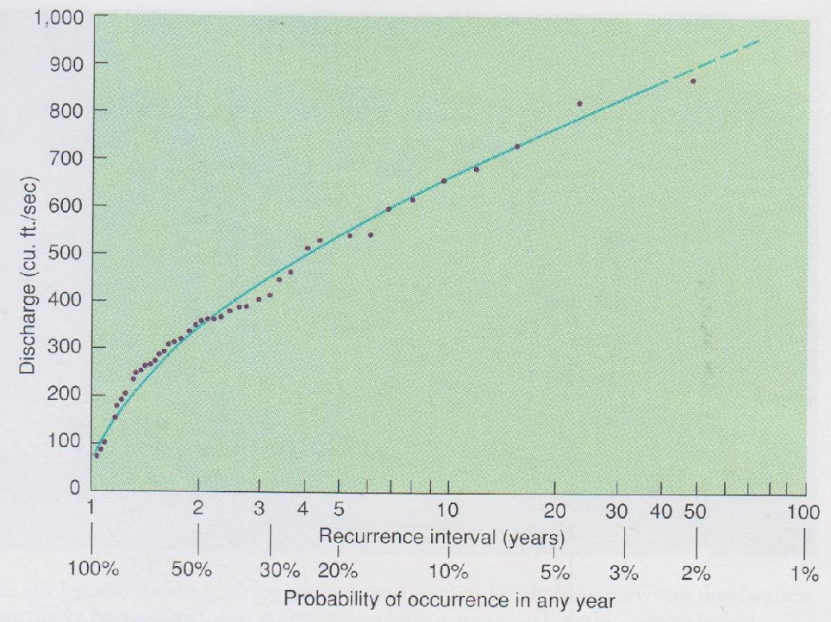
Example: Flood Frequency Curve for Eagle River at Red Cliff, Colorado
The flood frequency curve indicates that for this stream, on average, an event producing a discharge of 675 cubic feet/second occurs once every ten years, an event with discharge of 350 cubic feet/second occurs once every two years, and so on.
A flood with a discharge of 675 cubic feet/second is called a "ten-year flood," meaning that a flood of that size occurs about once every ten years, or has a l0% probability of occurrence in any year; a discharge of 900 cubic feet/second is called a "forty-year flood" and has a 2.5% probability of occurrence in any year, and so on.

Slide 19
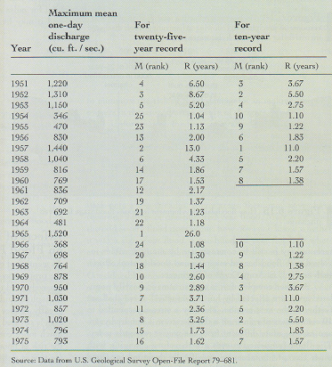
Calculation of Flood Recurrence Intervals
(Example: Big Thompson River, Colorado
The recurrence interval (R) of a given annual maximum discharge (Plummer et al. 2003):
R= (N+1)/M
Where,
N= Records of maximum discharge (or stage) reached by a particular stream each year for total number of years.
M= Rank of each years maximum discharge (or stage) based on it’s severity from N years data (1 to N, 1 being the largest and N the smallest).
Example: Considering 1971 maximum discharge i.e. 1030 Cusec of Big Thompson River, which is 7th largest amongst 25 years (N) data,
R= (N+1)/M= (25+1)/7=3.71 years
anwarzahidb@gmail.com

Slide 20

Ganges Water Discharge Data since 1958

Slide 21
Flood-Frequency Curves: Limitations
Unfortunately, the best-constrained part of the curve is, by definition, that for the lower-discharge, more frequent, higher-probability, less-serious floods.
Often, considerable guesswork is involved in projecting the shape of the curve at the high-discharge end.
Reliable records of stream stages, discharges, and the extent of past floods typically extend back only a few decades.
The high-discharge events are rare, and even when they happen, their recurrence interval can only be estimated.
It is important to remember that the recurrence intervals or probabilities assigned to floods are averages. The recurrence interval terminology may be misleading in this regard.
Over many centuries, a fifty-year flood should occur an average of once every fifty years; or, in other words, there is a 2 percent chance that that discharge will be exceeded in any one year. However, that does not mean that two fifty year floods could not occur in successive years, or even in the same year.

Slide 22
Hydro-meteorological Monitoring Network in Bangladesh
anwarzahidb@gmail.com
Notes:
22

Slide 23
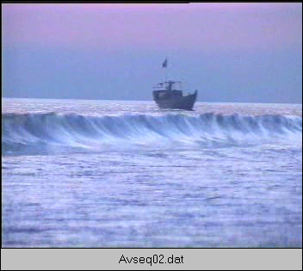
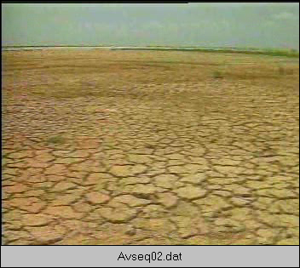
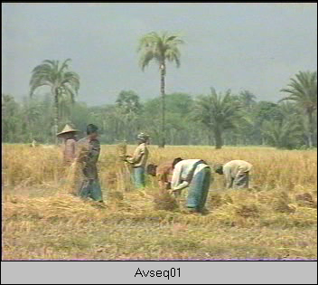
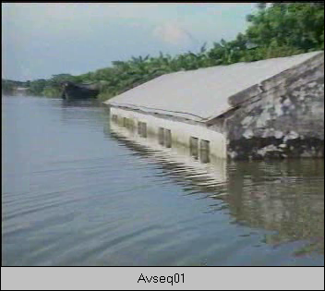
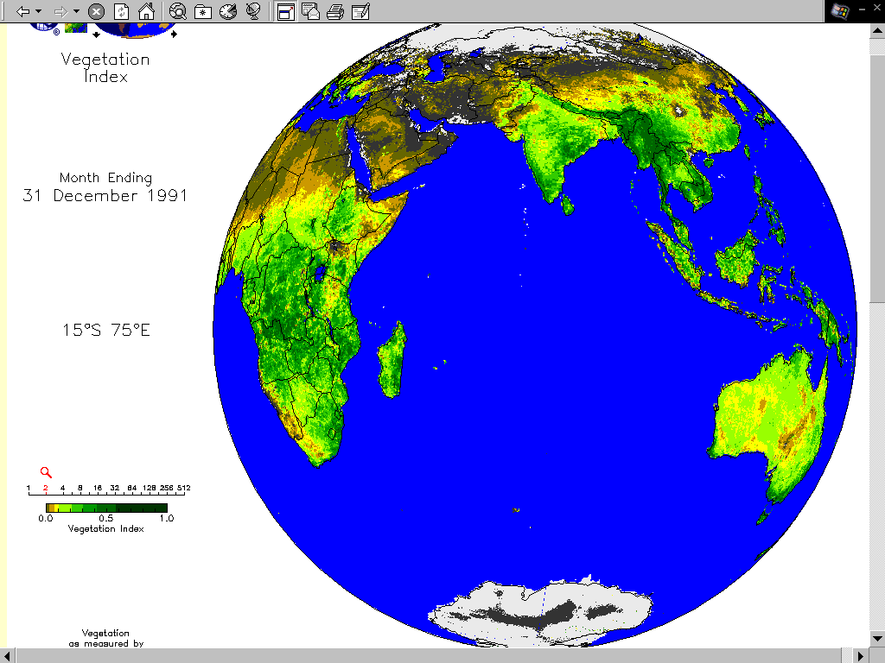
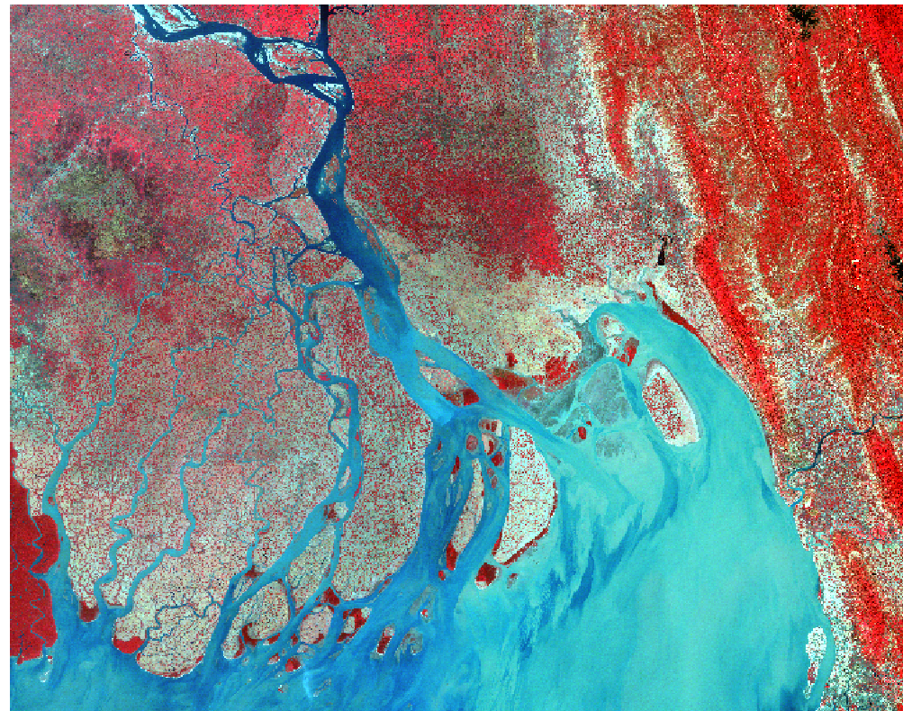
Water Resources Management Vulnerabilities
Sea Level Rise: Increase in salinity intrusion
Increase in snow melt in the Himalayas
Drought
Increase in evaporation
Decrease in precipitation in dry season
Increase in precipitation in monsoon
Prolonged monsoon
Impact on agriculture & fisheries
Increase in flooding intensity
Submergence of coastal areas

Slide 24
Hydro-meteorological Monitoring Network
under Bangladesh Water Development Board
Collect, Process, publish and make availability of data relating to floods, surface and groundwater, river morphology, salinity, sedimentation, water quality and soil characteristics.
Hydrological research, benchmark surveys and evaluation and other studies required by the country.
Monitoring changes in morphological behavior in priority areas and its impact on erosion and bank stabilization.
Groundwater investigation, monitoring and management for agriculture irrigation, domestic and industrial water supply.
Provision of necessary support to WARPO for the development and maintenance of the National Water Resources Data Base (NWRD).
Manage real time data collection for flood forecasting purpose and timely dissemination of flood warning to different Ministries/ Organizations/News media and NGO’s through bulletin.
Publish Monthly Flood Report during the monsoon and Annual Flood Report after the monsoon. Publish monthly groundwater forecasting report.

Slide 25
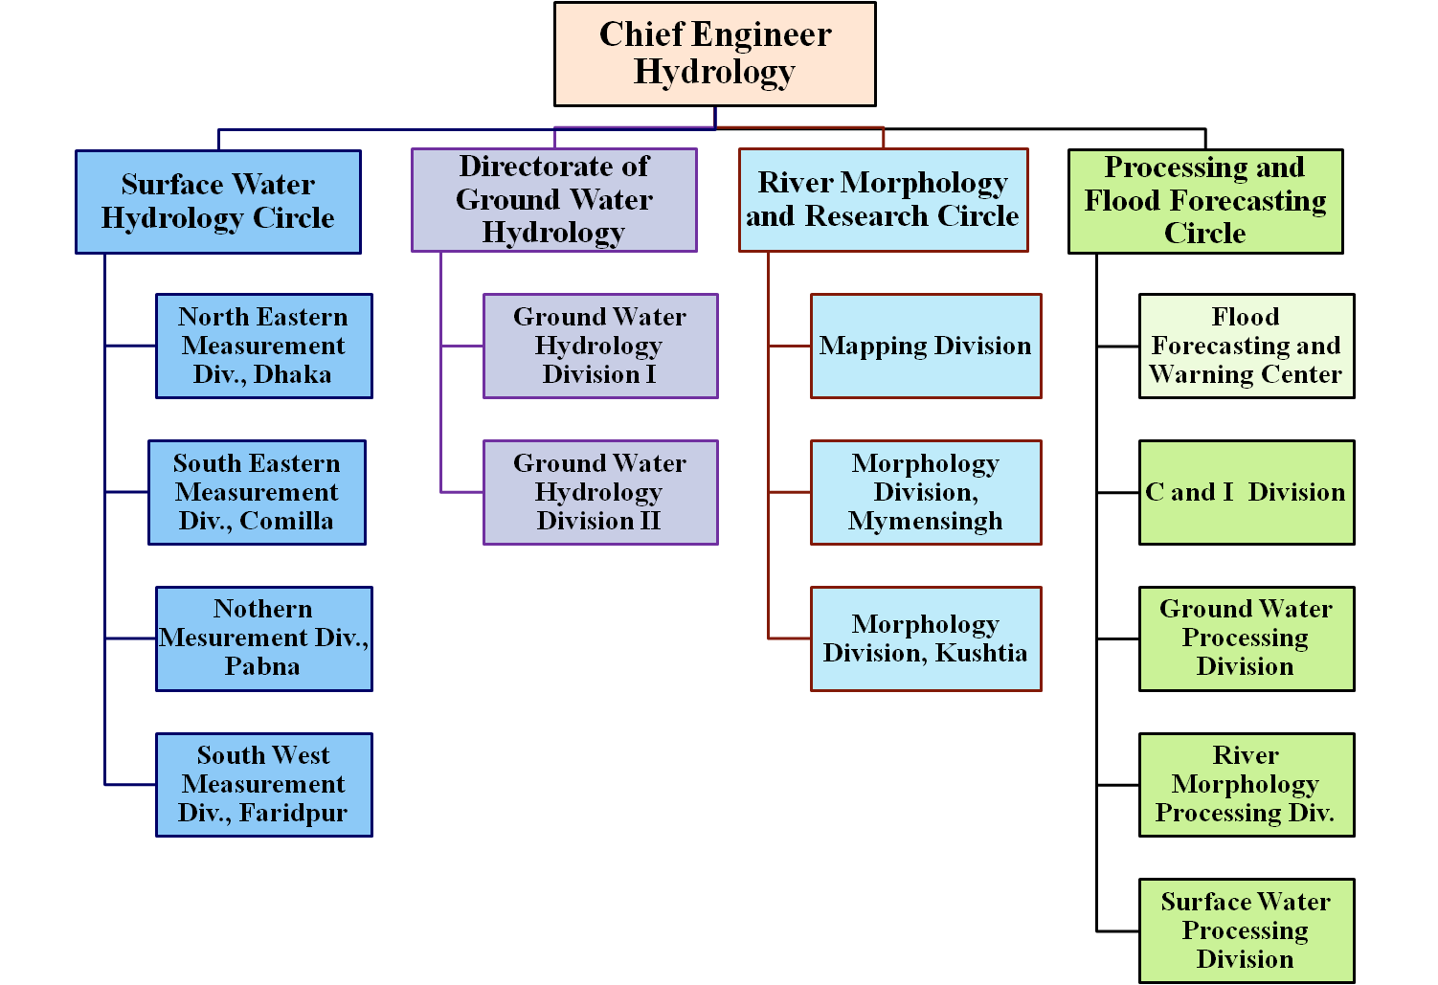

Slide 26
SURFACE WATER HYDROLOGY CIRCLE
Provide supervision and technical guidance to all field surface water hydrological data collection network and ensure quality control of hydrological and climatological data .
Supervise standardization and improvement in the collection of surface water hydrological data (river stage, discharge, rainfall, sediment discharge, salinity, evaporation, wind velocity, temperature, sun shine hour).
Timely transmission of flood related data to the flood forecasting Cell.
Co-ordinate with other BWDB offices and outside agencies on hydrological and climatological study, research, data management or any other related business.
Preparation of survey reports of un-serviceable/condemned materials, equipment etc. and their disposal. Provide comments on related reports.

Slide 27
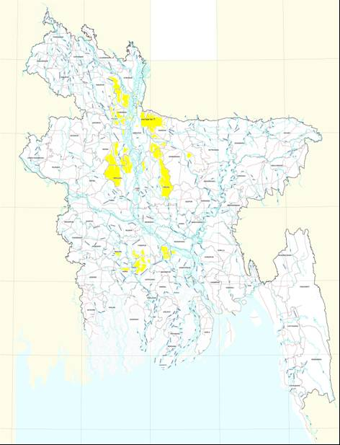
RIVER NETWORK OF BANGLADESH
Hydrographic System of Bangladesh
Hydrographic System in Bangladesh is characterized by the Himalayan to the north, Bay of Bengal to the south, Flood plains of the Ganga-Meghna-Brahmaputra System, Garo Hills, Tripura Hills and Lusai Hills to the east and southeast.
The three major river systems:
1. The Ganga-Padma
2. The Brahmaputra-Jamuna
3. The Surma-Meghna
together draining a total of 1,660,000 km² lying in China, Nepal, Bhutan and India
Fifty seven trans-boundary river (includes the three major rivers and their tributaries and distributaries) system
Seven independent rivers draining Chittagong and Chittagong Hill Tracts directly into the Bay of Bengal.
Inland water bodies of haor, baors and beels.
A coastline of over 700 km and 10 large estuarine waters in the coastal districts
In addition to these there are xxx number of rivers in BWDB Hydrology database on which periodic measurements are made.

Slide 28
Surface Water Hydrology Network
Serial
Type Code
Data Type Name
Count Of Station ID
SW Hydrology
01
NTWL
Non-Tidal Water Level
215
02
TDWL
Tidal Water Level
128
03
NTQ
Non-tidal Discharge
110
04
TDQ
Tidal Discharge
7
05
SWQ
Surface Water Quality
18
06
SA
Salinity
100
07
SED
Sediment
26
Climatology
08
RF
Rainfall
269
09
CL
Climatology
3
10
EV
Evaporation
39

Slide 29
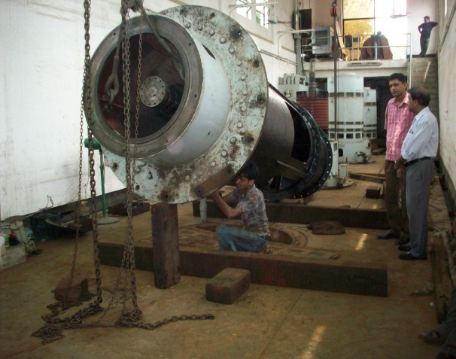

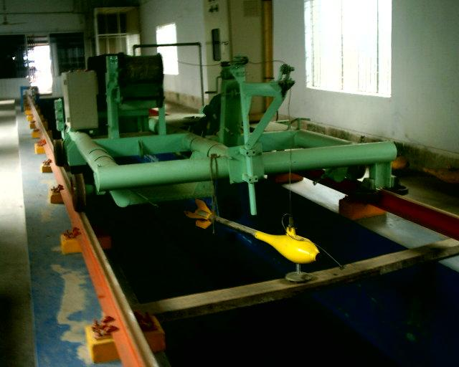
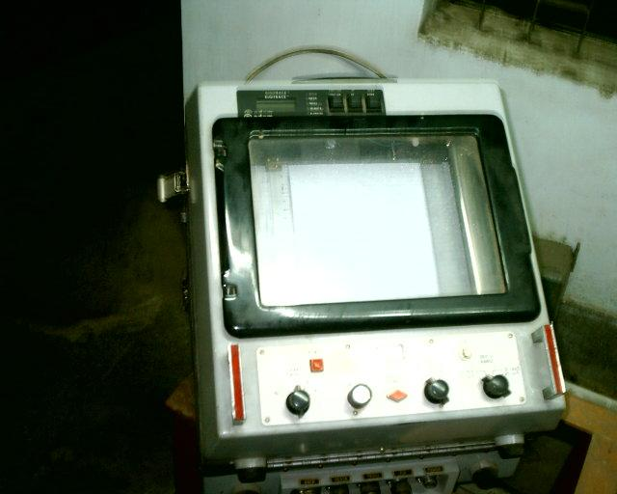
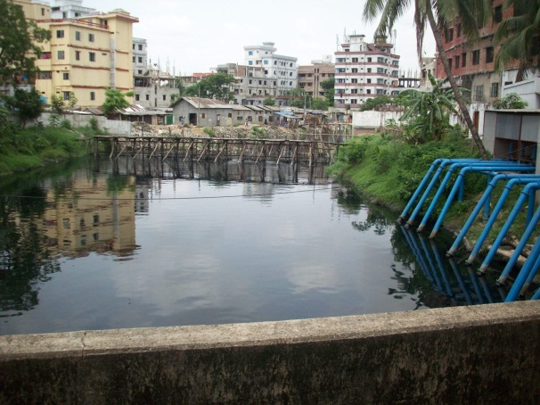
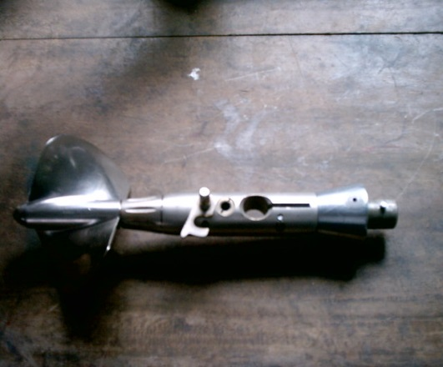
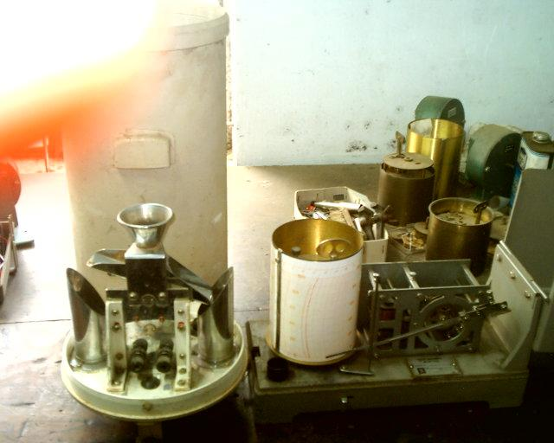
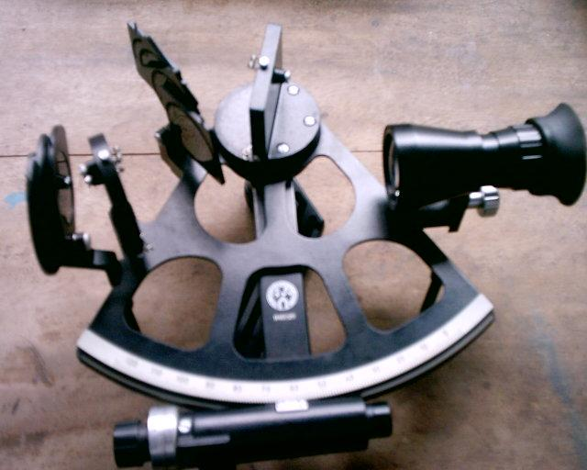
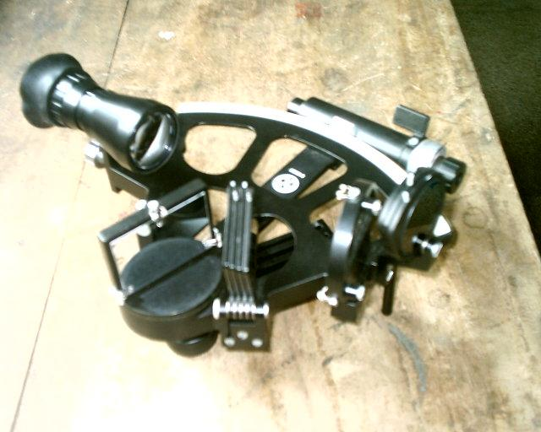
Surface Water Monitoring Equipment

Slide 30
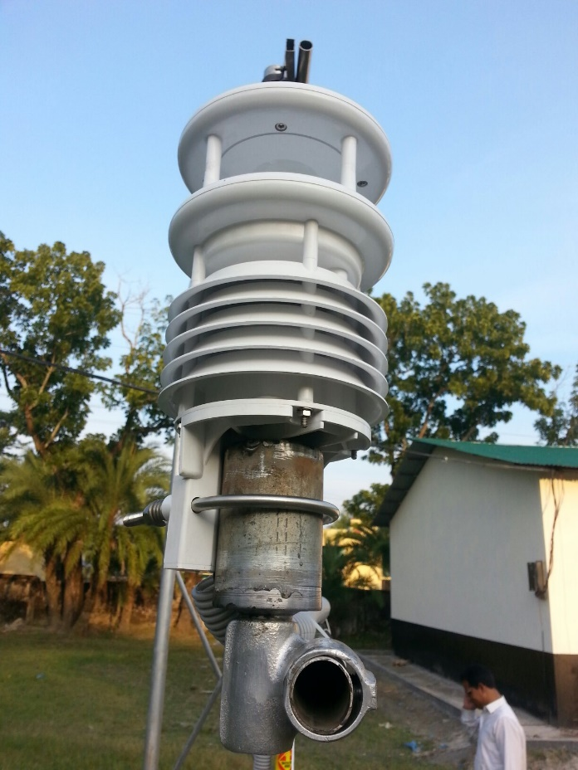
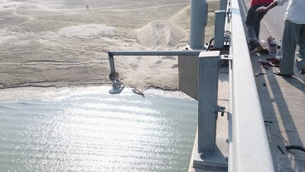
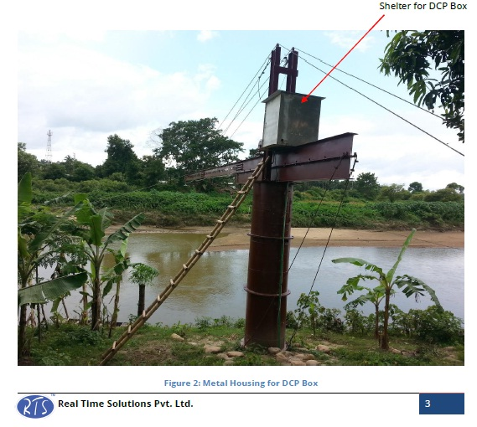
Automation of Monitoring Equipment
anwarzahidb@gmail.com

Slide 31
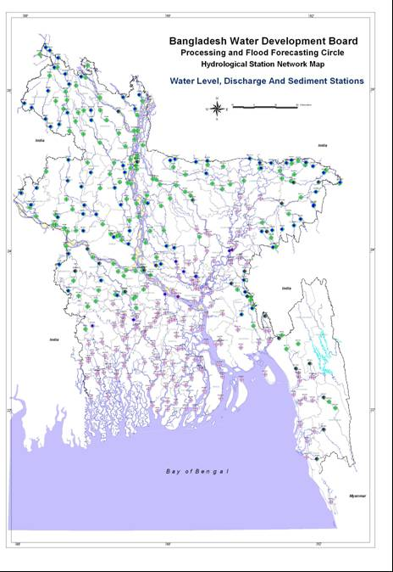
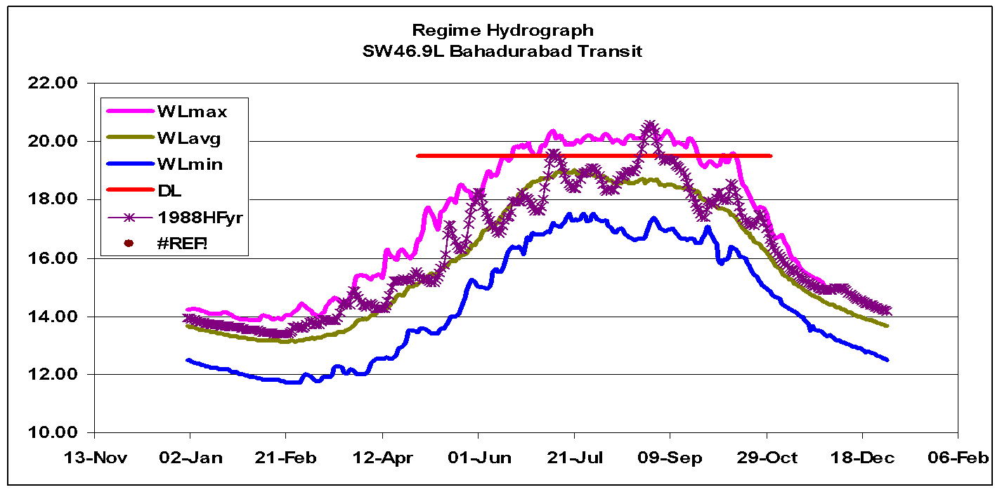
RIVER WATER MONITORING NETWORK
River: 22 Brahmaputra-Jamuna Station: SW46.9L Bahadurabad
The station is located in Islampur UZ in Jamalpur district. Water Level, Discharge and sediment measurements are made at this station.
Availability of WL :from 1949 to 2007 – 58 years
Recorded Highest WL : 20.61 m-PWD on 30/08/1988
Recorded Lowest WL :11.70 m-PWD on 25/02/1952
Danger Level : 19.50 m-PWD
Availability of Discharge : from 1956 to 2006 – 51 years
Recorded Highest Discharge :1,03,129 m³/s on 08/09/1998
Recorded Lowest Discharge : 2,702 m³/s on 01/04/2001
Annual average Discharge; : 20,915 m³/s
Availability Sediment :from 1966 to 1995
Recorded Highest Sediment Discharge: 1,04,39,544 Tons/day on 30/08/1988
Recorded Min. Sediment Discharge: 69,932 Tons/day on 18/02/1995
SW46.9L

Slide 32
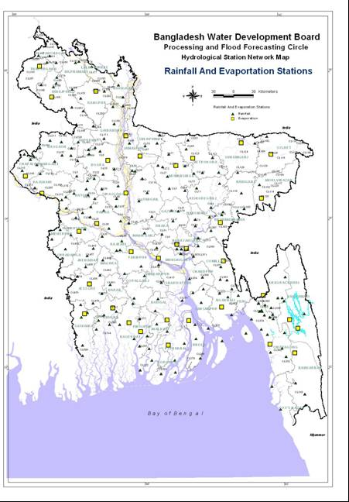
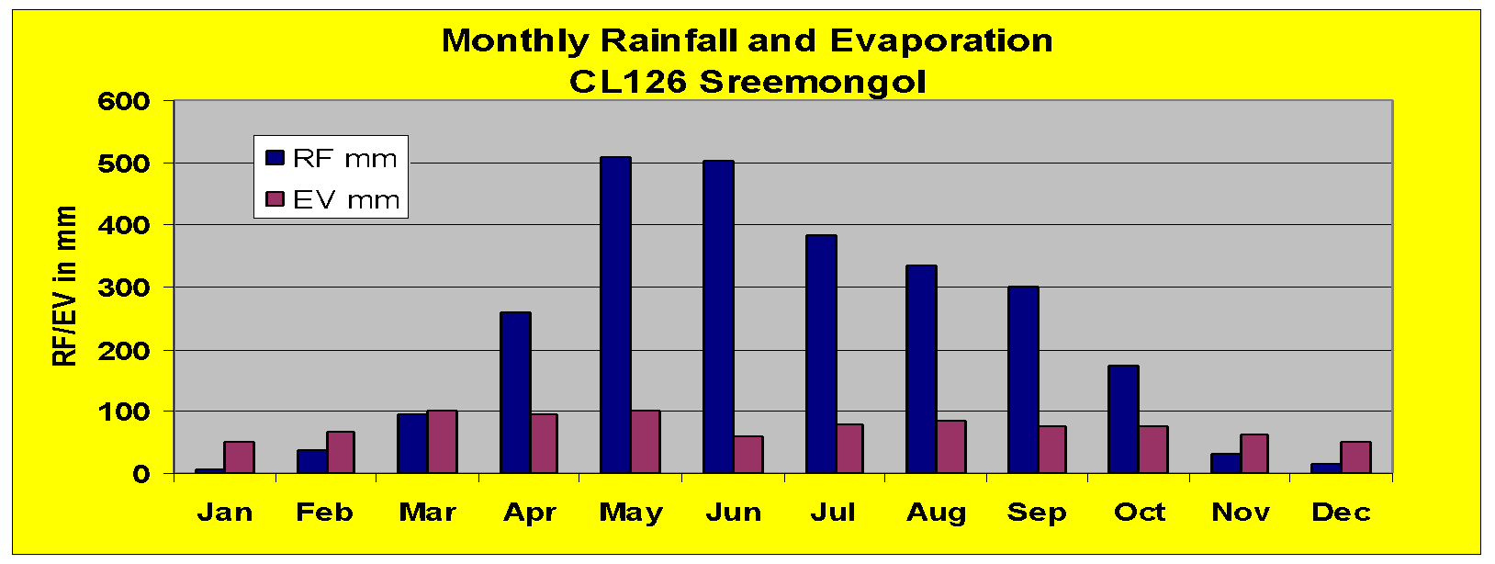
CLIMATE MONITORING STATIONS
Rainfall Station :CL126 Sreemongol
District : Moulvi bazar
Upazila : Sreemongol
Availability of RF :from 1961 to 2007 – 47 years
Recorded Highest Annual RF : 3655 mm 1991
Recorded Lowest Annual RF : 1430 mm 1971
1 day maximum RF : 532 mm on 15/05/1984
Normal Seasonal Rainfall(1975-05)
Season | Rain mm | R Days | EV mm
Summer (Mar-May) | 865 | 33 | 295
Monsoon (Jun-Sep) | 1518 | 76 | 299
PostMonsoon (Oct-Nov) | 204 | 12 | 137
Winter (Dec-Feb) | 56 | 56 | 56
Annual | 2648 | 129 | 898
Normal Monthly Rainfall and Evaporation
Month | RF mm | Rainy Days | EV mm
Jan | 6 | 2 | 50
Feb | 38 | 4 | 67
Mar | 96 | 5 | 100
Apr | 260 | 12 | 95
May | 508 | 17 | 101
Jun | 501 | 20 | 59
Jul | 381 | 20 | 80
Aug | 336 | 20 | 86
Sep | 301 | 17 | 74
Oct | 173 | 9 | 75
Nov | 31 | 3 | 62
Dec | 16 | 2 | 50
CL 126

Slide 33
DIRECTORATE OF GROUND WATER HYDROLOGY
Conduct ground water survey and sub soil investigation of different projects of BWDB.
Conduct qualitative study for the optimum utilization of ground water resources and collection of sediment sample for arsenic source detection for mitigation studies.
Maintain hydro-geological data (ground water table, aquifer test, ground water quality etc) collection network.
Co-ordinate the activities of different agencies and organizations involved in ground water studies and render advise to ground water planners and end users.
Maintain equipments such as drilling rigs, mud pumps, air compressor and other related equipments.
Review comments on different paper clipping on drought conditions and technical reports on ground water resource utilization suggesting probable remedial measure.

Slide 34
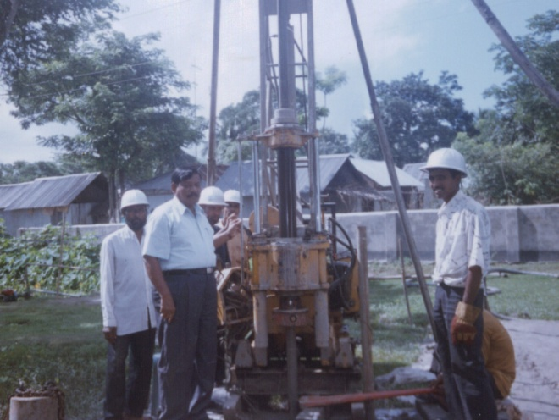
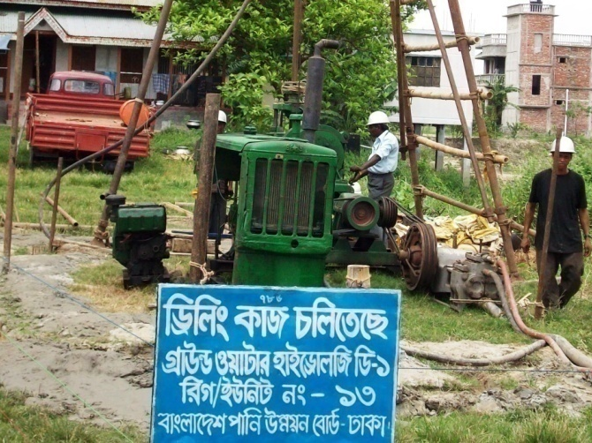
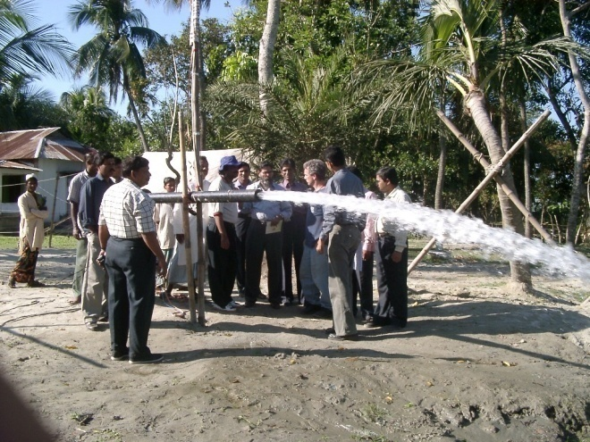
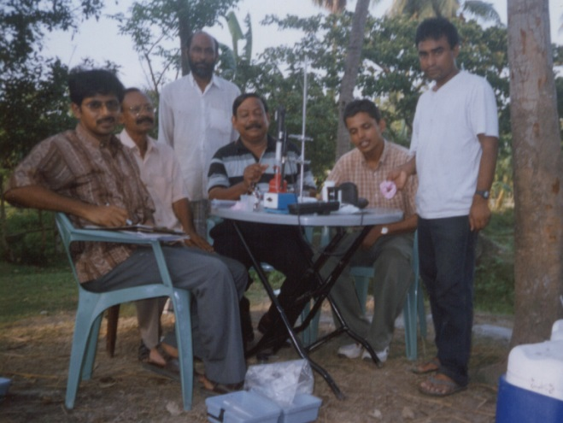
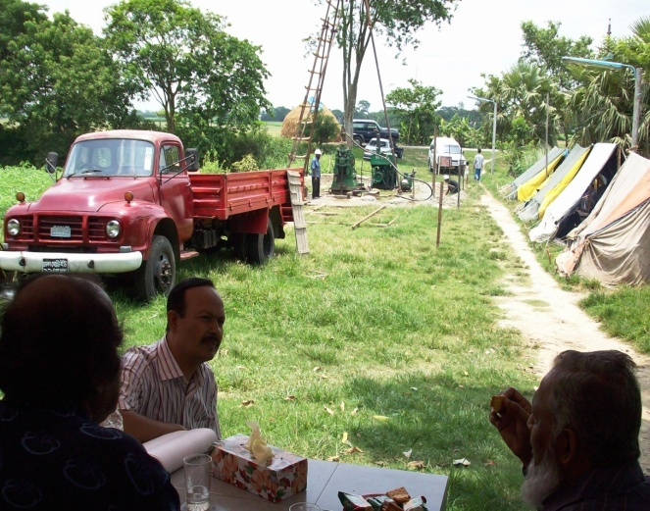
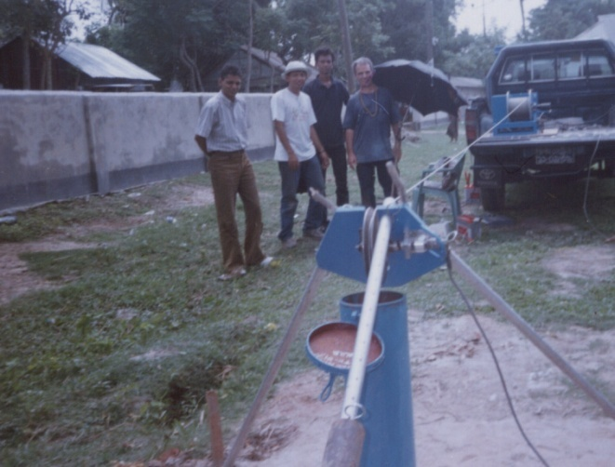
FIELD ACTIVITIES OF GROUND WATER HYDROLOGY

Slide 35
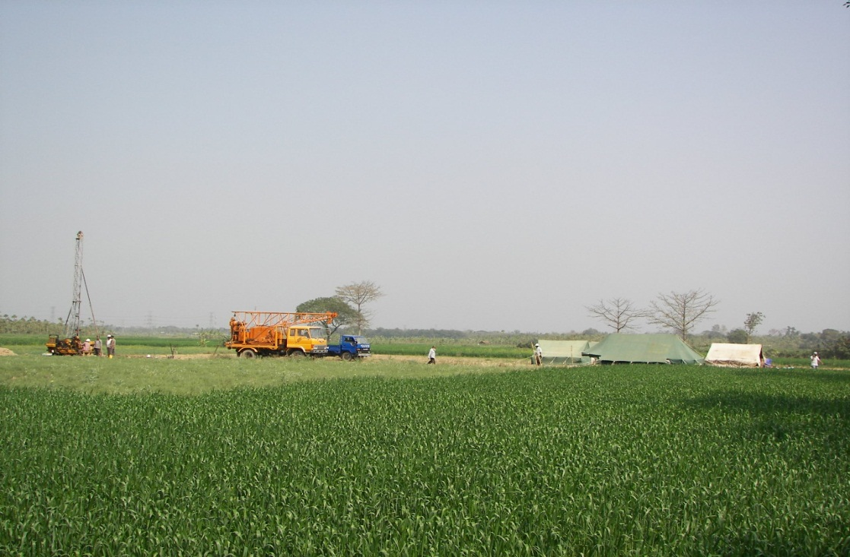
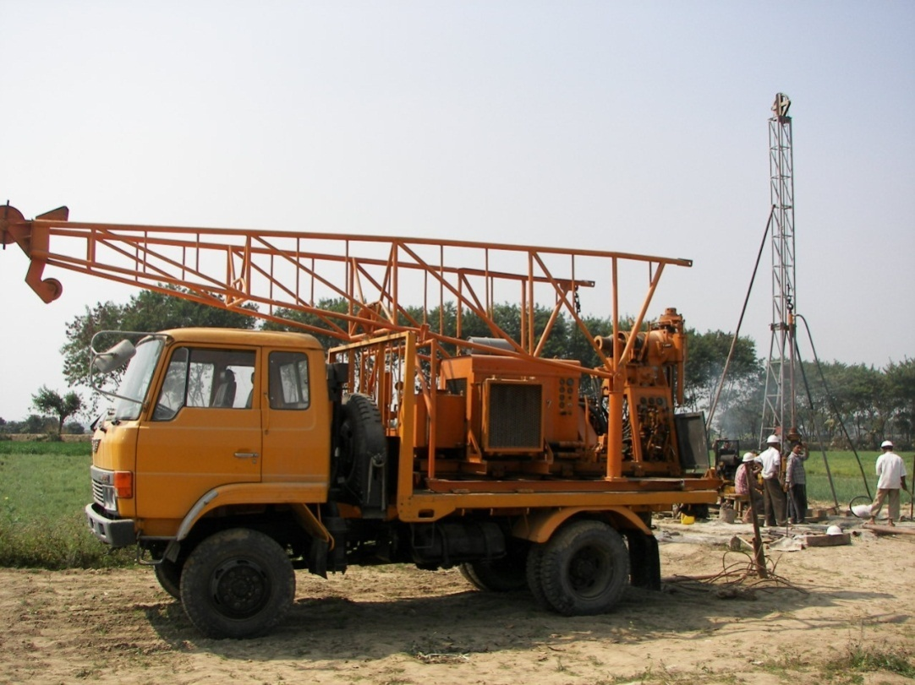
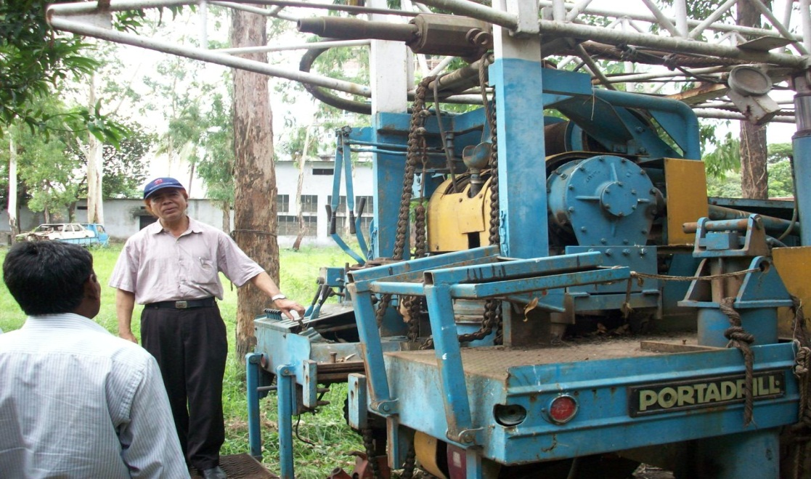
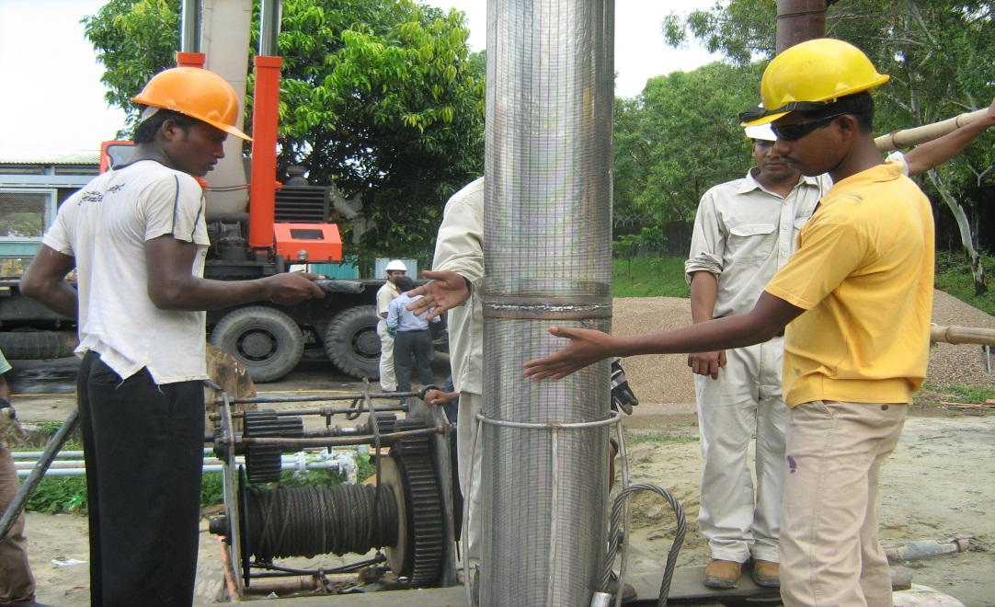
FIELD ACTIVITIES OF GROUND WATER HYDROLOGY

Slide 36
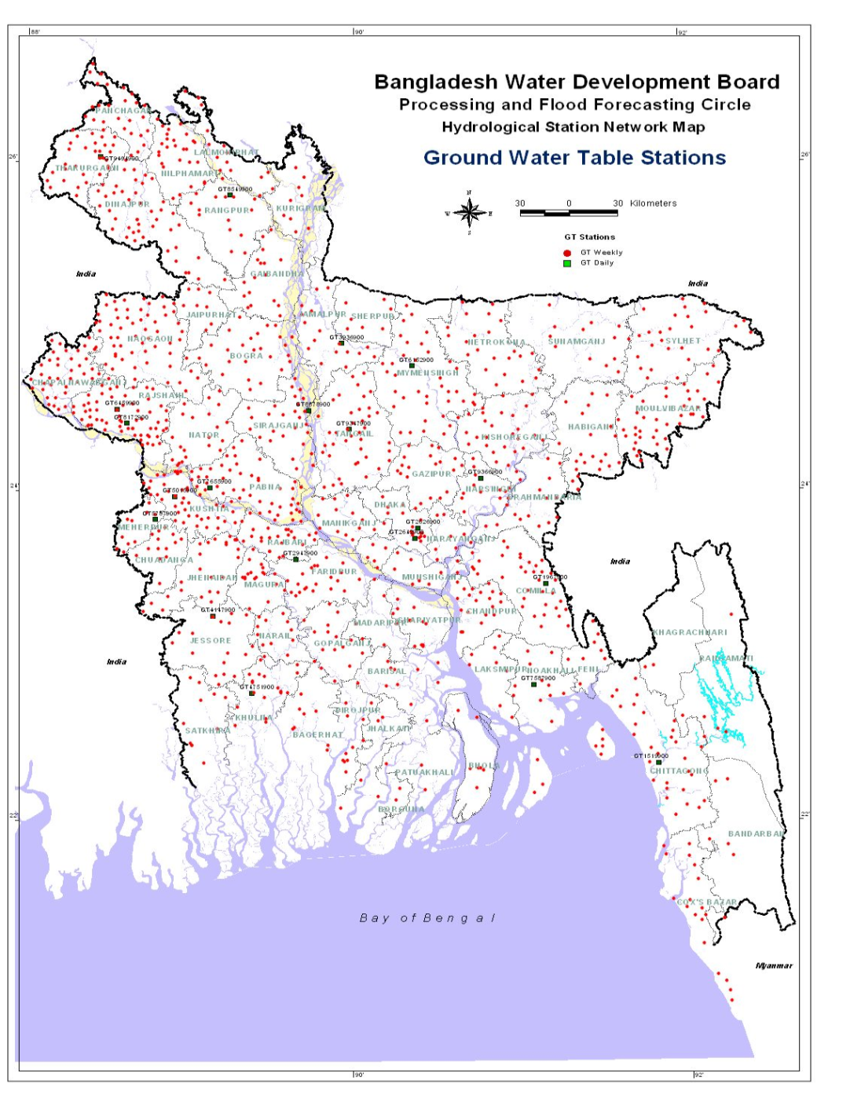

GROUNDWATER LEVEL MONITORING STATIONS
Ground Water Table Well GT2642900
Lalbag District Dhaka
Record Starts: 1996
Record Ends: 2007
No of Years of records: 12
WellID | Year | Depth To GWT(m)
GT2642900 | 1996 | 26.10
GT2642900 | 1997 | 27.18
GT2642900 | 1998 | 28.52
GT2642900 | 1999 | 30.26
GT2642900 | 2000 | 32.38
GT2642900 | 2001 | 35.98
GT2642900 | 2002 | 38.73
GT2642900 | 2003 | 40.48
GT2642900 | 2004 | 42.55
GT2642900 | 2005 | 44.48
GT2642900 | 2006 | 44.45
GT2642900 | 2007 | 47.73
GT2642900

Slide 37




LOCATION OF BWDB TEST HOLE SITES AND LITHOLOGIC CROSS-SECTIONS

Slide 38





LOCATION OF PUMP TEST SITES

Slide 39


LOCATION OF BWDB GROUNDWATER TABLE MONITORING WELLS

Slide 40








Depth-wise Groundwater Level Contour Maps
Monsoon/Wet Season
Pre-monsoon/Dry Season

Slide 41


LOCATION OF BWDB GROUNDWATER QUALITY MONITORING WELLS

Slide 42






Groundwater Salinity
in Coastal Aquifers
Monsoon/Wet Season
Pre-monsoon/Dry Season

Slide 43


Location of Groundwater Monitoring Well Network in Coastal Districts

Slide 44
RIVER MORPHOLOGY AND RESEARCH CIRCLE
Supervise the X-section and the Bathymetric survey of major rivers in Bangladesh.
Monitor morphological changes in the river system of Bangladesh.
Co-ordinate with other BWDB offices and outside agencies on morphological studies, research, data management and other related business.
Supervise the activity of the Mapping work and maintenance of instruments therein.
preparation of survey reports of unserviceable/condemned materials, equipment etc. and their disposal and prepare comments on related reports.

Slide 45
River Cross Section Survey Works
Types of River | Nos.of River | Periods | Cross Sections
Major Rivers | 5 | Every Year | 114 Nos
Major Medium | 10 | 2 Yearly | 232 Nos
Medium Rivers | 18 | 3 Yearly | 243 Nos
Medium Minor | 20 | 4 Yearly | 245 Nos
Minor Rivers | 22 | 5 Yearly | 245 Nos

Slide 46


RIVER MORPHOLOGY SURVEY NETWORK
Surma-Meghna (Lower Meghna)
Section RMML12
This is the most downstream Section Surveyed in the river under River Morphology Directorate. The section is 68 km downstream of Chandpur. The left bank is in Ramgati UZ of Lakshmipur district and the right bank is in Daulatkhan UZ in Bhola district. The list of sections and availability of surveys for all the sections of the river are available.
StationID | Year | IPRL | EPRL | AvgBank RL | PP Width | RLavg | RLmin
RMML12 | 1994 | 3.78 | 2.97 | 3.37 | 18256 | -0.44 | -12.22
RMML12 | 2000 | 3.27 | 2.97 | 3.12 | 18256 | -1.00 | -12.75
RMML12 | 2002 | 3.27 | 2.97 | 3.12 | 18256 | -0.93 | -13.13
RMML12 | 2003 | 2.80 | 3.61 | 3.20 | 17641 | -0.94 | -14.79
RMML12 | 2004 | 3.27 | 3.61 | 3.44 | 17641 | -1.31 | -16.57
RMML12 | 2005 | 3.27 | 3.61 | 3.44 | 17641 | -1.61 | -12.32
RMML12 | 2006 | 3.27 | 3.80 | 3.53 | 17606 | -1.44 | -12.40
RMLL12
IPRL | RL of the intial point (IP) on the left bank
EPRL | RL of the end point of the section on the other bank
AvgBankRL | Average RL of the two high banks
PPWidth | Pillar to pillar width
AvgBedRL | Average RL of bed (includes all points including the banks
RLmin | RL of thalweg

Slide 47
PROCESSING AND FLOOD FORECASTING CIRCLE
Analyze the hydrological and hydro-meteorological data, quality control and processing.
Manage real time data collection for flood forecasting purpose and timely dissemination of flood warning to different Ministries/Organisations/News media and NGO’s through bulletin.
Maintain liaison with MOWR, Cabinet Division, Relief Ministry and the Office of the Prime Minister for briefing them on flood situation in the country.
Publish Monthly Flood Report during the monsoon and Annual Flood Report after the monsoon. Publish monthly groundwater forecasting report.
Co-ordinate with BWDB and other outside agencies on hydrological and hydro-meteorological studies, research, data management and other related business.

Slide 48
PROCESSING AND FLOOD FORECASTING CIRCLE
Design and carry out special studies on arsenic contamination.
Develop and disseminate appropriate technologies for conjunctive use of rainwater, groundwater and surface water.
Prepare district and country wide hydro-geological maps.
Maintain and update ground water models and programmes for monitoring and forecasting the ground water hydrological conditions.
Prepare survey report of unserviceable/condemned materials, equipment, vessels etc. and take necessary steps for their disposal.
Maintain equipment, survey vessels, telemetering and wireless system, calibrating tank and field installations.

Slide 49

Data Entry and Retrieval System (Examples)

Slide 50

Data Entry Sheet

Slide 51

Data Retrieval and Distribution

Slide 52

Transfer Data in Excel Sheet for Distribution

Slide 53
End of Lecture 2
anwarzahidb@gmail.com
Notes:
53

